Slide 1
Working Group on Calibration & Validation (WGCV)
Philippe Goryl, ESA
Agenda Item 3.2
38th CEOS Plenary
Montreal, Canada
23rd - 24th October, 2024

Slide 2
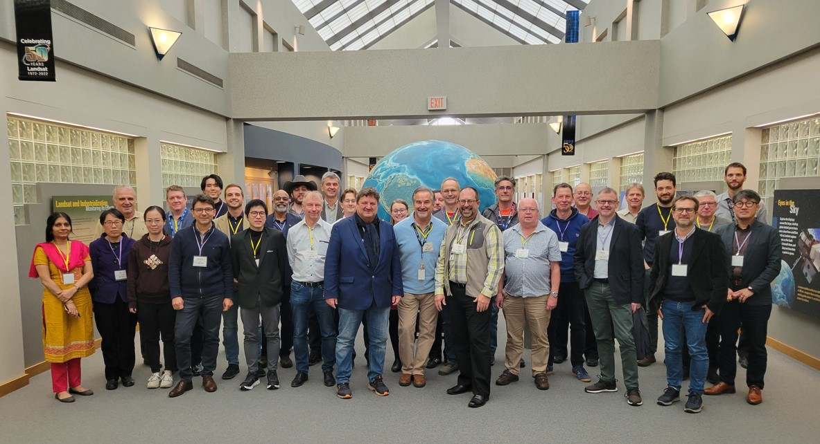
WGCV-54
USGS Visit, 40 years Landsat
Held from 15-18 October 2024 at USGS EROS, Sioux Falls, South Dakota, USA Joint meeting with WGISS
Outcomes:
Uncertainty expression
ARD / interoperability
Maturity Matrix
CalVal Matchup Database, coordination SEO, Newspace
Coordination with WMO-GSICS, Preflight Calibration Workshop, SITSat Task team
WGISS & WGCV to create a joint deliverable for the 2025-2027 CEOS Work Plan regarding the development of the CEOS/KCEO Glossary. Both working groups should ensure enough people are engaged, including from other CEOS groups, as well as from the external community. WGCV & WGISS 🡪 solicit support to brand the glossary as the ‘CEOS/KCEO Glossary’.
* KCEO = Knowledge Centre on Earth Observation (EU)

Slide 3
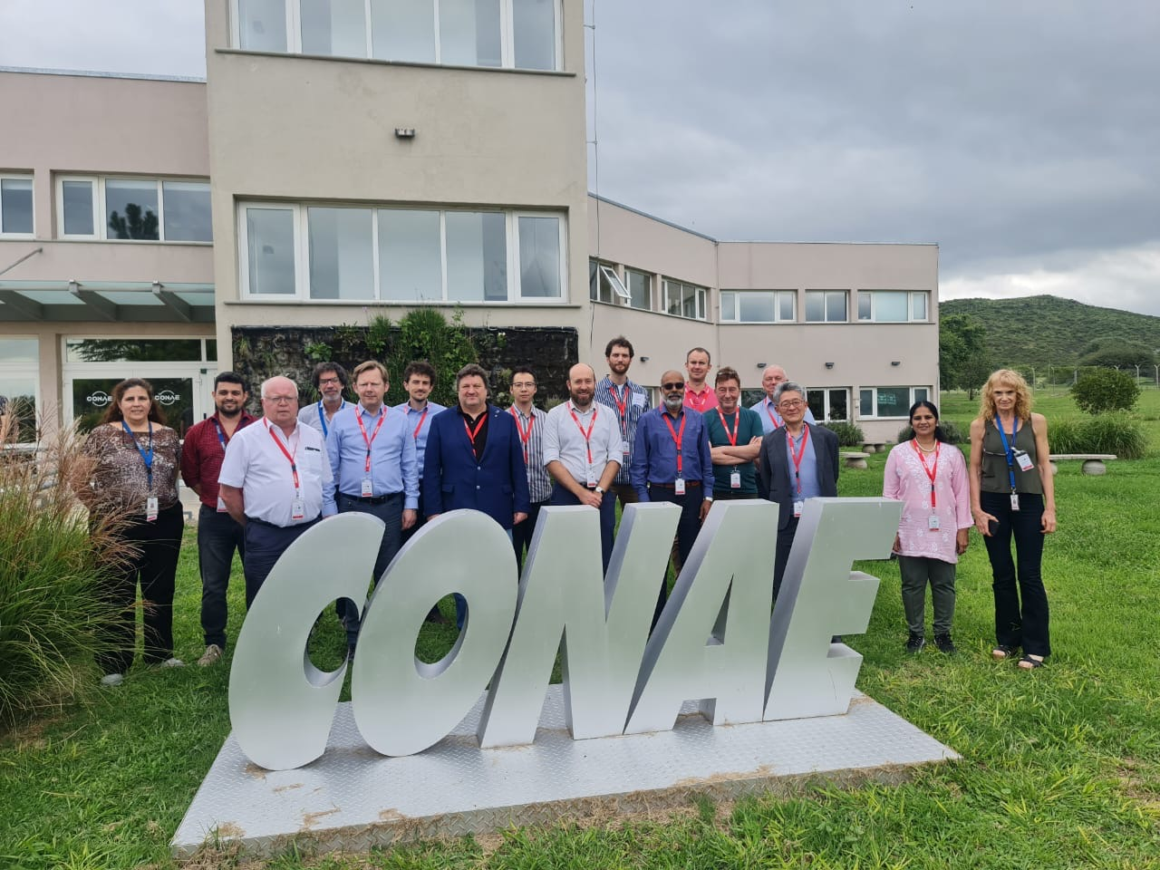
WGCV-53
Held from 5-7 March 2024 at CONAE, Córdoba, Argentina
Outcomes:
Radiometric Matchup Database and GCP Database 🡪 support to Newspace
Support to groups/initiatives biodiversity/climate-gcos/GHG 🡪 Toward Fiducial Reference Measurements
FRM Assessment
Coordination with WMO-GSICS, Preflight Calibration Workshop, SITSat Task team
CONAE Visit
SABIA-MAR – satellite for ocean and coastal water monitoring 🡪 2026

Slide 4
WGCV Subgroup Updates
Infrared and Visible Optical Sensors (IVOS) Subgroup
Held 36th annual meeting (IVOS-36) at AIST, Tokyo, Japan
RadCalNet has more than 1000 registered users of which more than half are active (downloading data) and we have 4 new member sites under development.
Its Sister TIRCALNet for thermal infrared is progressing well with protocols and methods currently being pioneered at the La Crau site by CNES but indicating the real prospect of achieving the target uncertainty, 0.5 K brightness temperature at ToA.
To support new space and interoperability in general, IVOS has identified a consolidated subset of testsites for radiometry and geometry to serve as a common CEOS reference against which sensor performance can be demonstrated in a consistent manner. This is complemented by a tool to facilitate feedback to the satellite operators and the user community. (see recommendation)
The team continues to explore and consider how best to assess and report uncertainty on satellite data and in particular is looking at defining the minimum needed, including sensor characterisation information, with a view of encouraging the ‘new space’ community to provide more consistent and comprehensive information particularly for potential science users.
The endorsement of the recommendation on the new CEOS solar irradiance spectrum has started to lead to reprocessing of data and a move towards widespread adoption amongst space agencies for new missions.
Terrain Mapping Subgroup (TMSG)
Jeanlam further DEMIX results published: Guth et al. Ranking of 10 Global One-Arc-Second DEMs Reveals Limitations in Terrain Morphology Representation. Remote Sens. 2024, https://doi.org/10.3390/rs16173273
meetings: virtual plenary Oct 11, VH-RODA 2-6 Dec, in-person DEMIX, GCPIX workshops and plenary planned at Geomorphometry25, Perugia, Italy June 9-13 https://www.geomorphometry.org/2025/
Call for nominations for the role of TMSG Co-chair Proposition for Tom Maiersperger (USGS) as TMSG co-chair

Slide 5
TMSG: DEM Continuity
WGCV-53-ACT-04 | TMSG Chair, Dirk Geudtner, and WGCV Chair to coordinate an input for the 2024 CEOS Plenary regarding the importance of CEOS Agencies funding missions like TanDEM-X for the provision of Digital Elevation Models (DEMs). Recommendations from this group in view of TanDEM-X mission will eventually cease operations, in view of securing future DEM updates and also DEMs for bare surface in particular (another frequency band in addition to X)
TanDEM-X Global DEM covers the entire land mass to 99,9% (only 0.107% voids).
All heights represent the reflective surface at X-band, i.e., the global DEM is a surface model.
The Copernicus DEM is an edited version of the TanDEM-X Global DEM
The DEM Intercomparison eXercise (DEMIX) clearly demonstrated the technical and qualitative advantage of the Copernicus DEM within its product class (Bielski et al, Guth et al, 2024) making it a de-facto reference
Since 2017 we are in the so-called “4D Mission Phase” concentrating on the observation of topographic changes.
These changes are provided as TanDEM-X DEM Changes Maps (see https://geoservice.dlr.de)
With more than 17 and 14 years in orbit, both satellites have considerably exceeded their design lifetime (initially 5.5 years)
Redundant systems are in place at various points, but both satellites are fully operational and continue to provide data of excellent quality
Hydrazine is currently projected to last until 2028 for TDX and until 2031 for TSX
Battery degradation is main concern, reducing imaging capacity (shorter individual data takes and longer recharge gaps)
Continuity of open, reference quality, global DEM products is at risk and needs the attention of CEOS agencies

Slide 6
WGCV Subgroup Updates
Microwave Sensors Subgroup (MSSG)
CV-23-05: Retrieval and validation of high winds with combined active-passive microwave measurements
High winds calibration for multi satellite sensors, and methodologies used for error characterization, including a template data set.
An improved emissivity model for microwave radiometer BT at high and extreme wind conditions.
CV-23-06: Retrieval and validation of sea surface atmospheric pressure with microwave remote sensing
An improved retrieval algorithm is developed to retrieve surface pressure using joint passive observations at 50-60 GHz and 118 GHz.
Comparisons of all-weather retrievals with collocated reanalysis data and in situ measurement data are completed.
Dec. 2024: Finalize the comparisons of respective and joint retrieval results from 50-60 GHz and 118 GHz radiometers
Retrieval and validation of Global Navigation Satellite System (GNSS) radio occultation (RO) atmospheric products New validation algorithms are developed to assess the GNSS RO data: A numerical weather prediction (NWP) ocean calibration method has been developed to improve data calibration, reducing the errors from calibrations of transmitting power and receiver antenna pattern.
Calibration and validation of GNSS-R data for ocean surface wind retrieval: calibration of multi satellite wind data, including: HY-2 satellite scatterometers, MetOp ASCATs, SSMIS onboard DMSP satellites;
Synthetic Aperture Radar (SAR) Subgroup
Preparation of upcoming SAR Cal & Val workshop to be held from November 12 to 15, Ahmedabad, India: Hosted by the Space Application Centre, ISRO. 31st SAR WGCV Workshop since 1989. More than 70 abstracts submitted. Expected attendance of around 150 participants
SARCalNet: Established SARCalNet website, database and submission templates; Reaching out to members to encourage submission of information about their Corner Reflector sites; Internal review of documentation issued by the SARCalNet initiative.
Altimetry representation in WGCV
Topic of “InSAR Altimetry Calibration and Validation” was included for presentations and discussions at the upcoming SAR Subgroup workshop at ISRO

Slide 7
WGCV Subgroup Updates
Atmospheric Composition Subgroup (ACSG)
Satellite harmonization and validation contributions to Tropospheric Ozone Assessment Report (TOAR-II) on track (VC-20-01)
Aerosol, Cloud and Precipitation Profiles Validation Protocol in final review (CV-22-01)
FRM4GHG and FRM4DOAS papers published, incl. demonstration of CEOS-FRM Maturity Assessment Framework (CV-23-01)
3rd Cabauw INtercomparison of DOAS-like Instruments (CINDI-3) held successfully in May-June 2024 (CV-24-01)
Cal/Val contributions to WGClimate/GHG-TT GHG Roadmap update and draft Facility Scale Methane Best Practices
Land Product Validation (LPV) Subgroup
The Land Product Validation subgroup is in the process of expanding to include:
Evapotranspiration and GPP/NPP as land product focus areas. Co-leads have been identified and developing the web presence and background materials for each is ongoing.
Other land product including Vegetation Indices, Land Cover, and Phenology.

Slide 8
SI-Traceable Satellite (SITSat) Task Team
Group to promote dialogue and coordination of issues and opportunities of SITSats among missions, technologies, and activities.
Jointly between CEOS WGCV and GSICS
SITSat Content
SITSat webpage on the Cal/Val Portal
SITSats for GSICS page
Meetings
WGCV-54 SITSat Task Team side meeting - 18 October 2024, Sioux Falls, USA
Actions taken to develop content for a new SITSat website, which will visualise and explain SITSat missions (e.g. TRUTHS and CLARREO-PF) and what they offer.
TRUTHS for Climate Workshop - 27-28 June, 2024, Harwell, UK
Planned SITSat missions
SITSat Task Team updates
Co-leads: Nigel Fox (UKSA) and Yolanda Shea (NASA)
Held regular online meetings throughout 2024
21 Members

Slide 9
Pre-flight Calibration Workshop
https://atpi.eventsair.com/pre-flight-calibration-workshop/
Workshop on Pre-flight Calibration and Characterisation of Optical Satellite Instruments for Earth Observation
Organised jointly by CEOS WGCV and CGMS GSICS
19-22 November 2024, at ESA-ESTEC Noordwijk, Netherlands
Oral and Poster presentations selected
Presentations grouped among six themes:
Principles of Calibration
Radiometric Gain
Spectral Response Function
Stray Light
Future Calibration Requirements
Thermal Infrared
Organising Committee – CEOS/GSICS
Scientific committee – 29 scientists well distributed internationally
More than 160 registrations (in person)

Slide 10
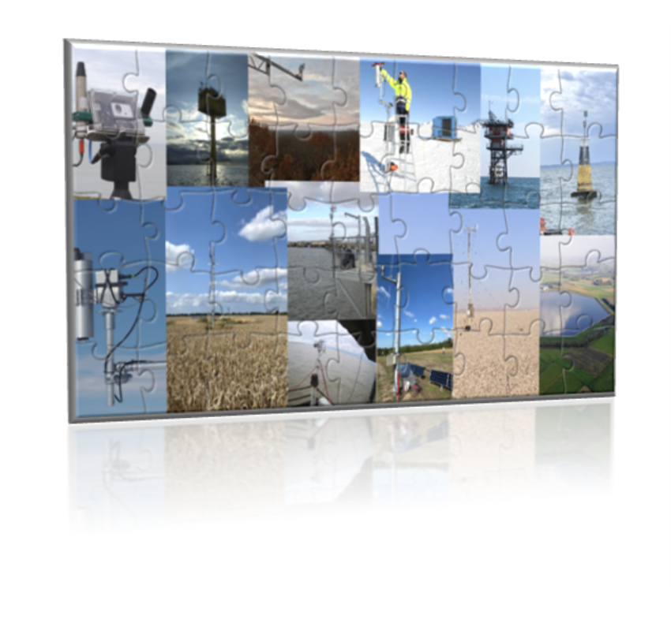
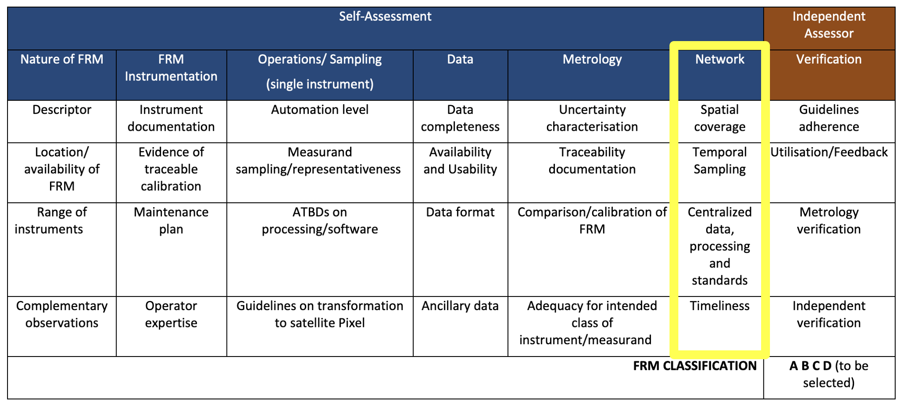
CEOS FRM Assessment framework
Roadmap towards an Assessment Framework for Fiducial Reference Measurements (FRM)- including Guidelines V1: https://calvalportal.ceos.org/web/guest/frms-assessment-framework
Reference Paper 2023: Goryl, P.; Fox, N.; Donlon, C.; Castracane, P. Fiducial Reference Measurements (FRMs): What Are They? Remote Sens. 2023, 15, 5017. https://doi.org/10.3390/rs15205017.
Guidelines Updates: Network Category including aspects: “Spatial coverage”, “Temporal Sampling” “Centralized data, processing and standards” and “Timeliness”. (to be consolidated)
Maturity Matrix tool Updates (according to WGCV-53-ACT-13) (in progress)
New exercise reports: Brewer for NO2 (Henri Dièmoz ARPA, BAQUNIN), FRM4GHG (EM27/SUN) measurements* – Martine De Maziere (BIRA) – (self-assessment for the FTIR data and tools that we are developing in the Topical Centre for reactive trace gas remote sensing (CREGARS) in ACTRIS – (in progress)
Objective to open as service in Q3/Q4 2025.
*Sha, M.K.; De Mazière, M.; Notholt, J.; Blumenstock, T.; Bogaert, P.; Cardoen, P.; Chen, H.; Desmet, F.; García, O.; Griffith, D.W.T.; et al. Fiducial Reference Measurement for Greenhouse Gases (FRM4GHG). Remote Sens. 2024, 16, 3525. https://doi.org/10.3390/rs16183525

Slide 11
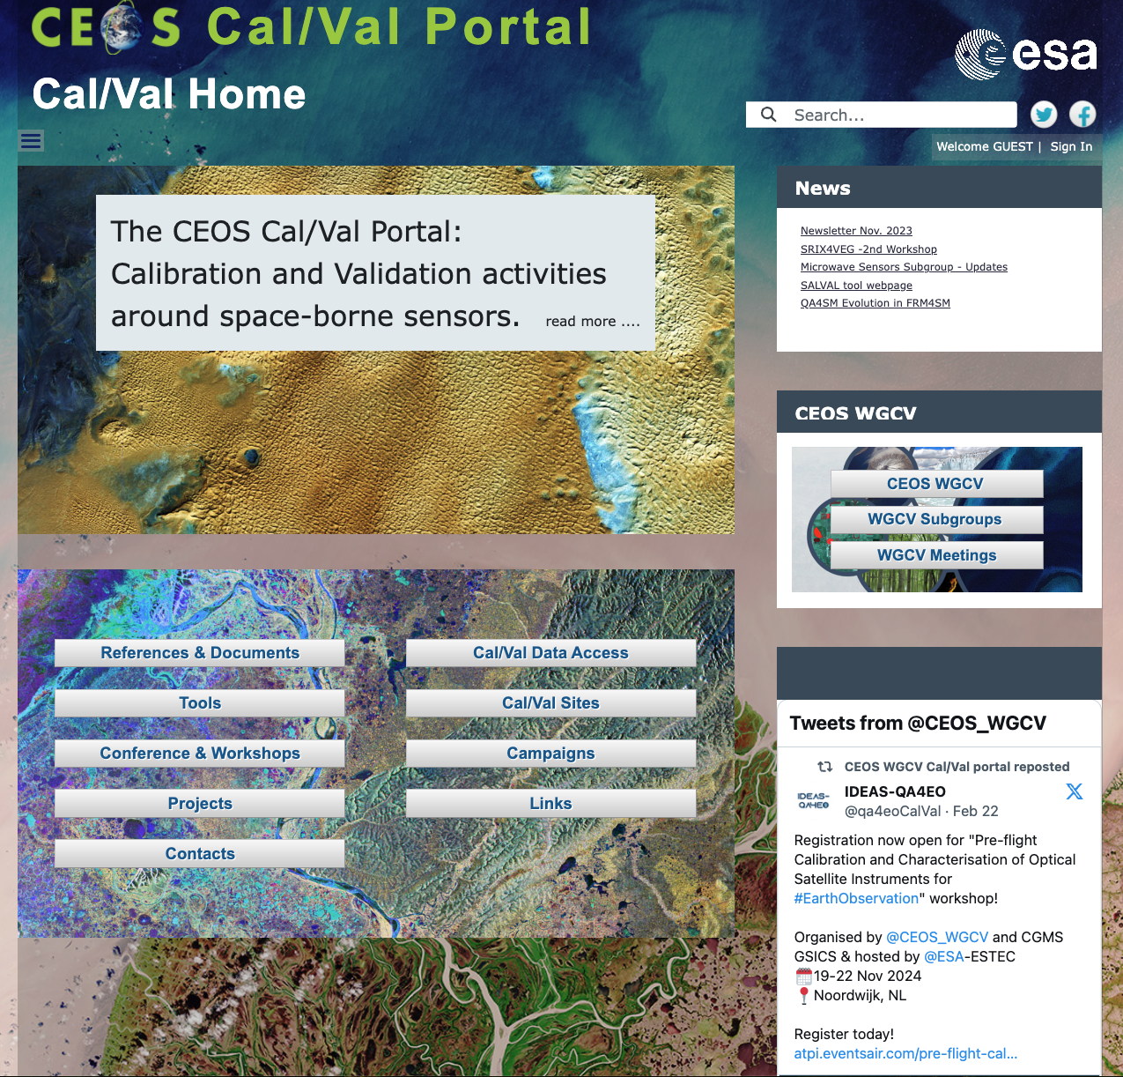
CEOS Cal/Val Portal Updates
SITSat Task Team web-page
The WGCV's contribution to the GCOS IP web-page
Updates for subgroup’s page
IVOS Repository and Forum
SAR Cal/Val Workshop 2024
Update SNOW Cal/Val (in progress):
FMI Webcam and Validation portals
Outreach:
Posts on X by : @CEOS_WGCV
Newsletter
https://calvalportal.ceos.org

Slide 12
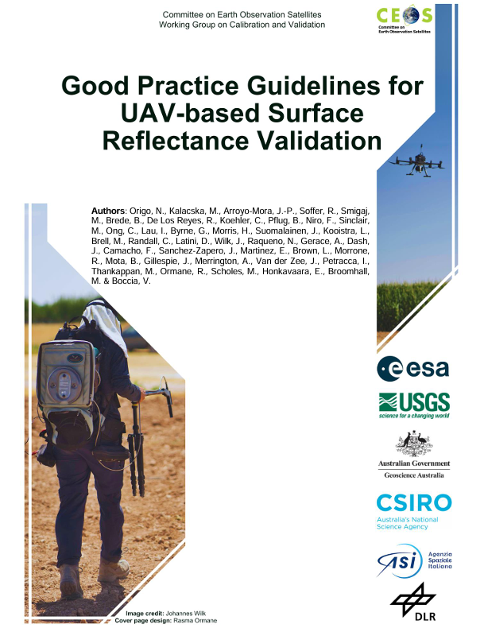
Best Practice Surface Reflectance Intercomparison Exercise for Vegetation (SRIX4Veg)
Best Practices protocol for validating satellite surface reflectance products using UAV spectroradiometers.
Originated from SRIX4Veg intercomparison campaign in July 2022 in Barrax, Spain and March 2024 in Calperum, Australia.
Aimed at users of UAV-mounted instruments capable of validating surface reflectance products.
Finalised November 2024
Endorsed at WGCV-54 subject to WGCV feedback implementations

Slide 13
Best Practice Protocol For The Validation Of Aerosol, Cloud, And Precipitation Profiles
Endorsed at WGCV-54
Action item CV-22-01
Evaluates the need for common practice capturing lessons learned from profiler missions.
Optimisation of Cal/Val techniques in terms of instrumentation, validation, sampling strategies and scenarios, and intercomparison methodologies.

Slide 14
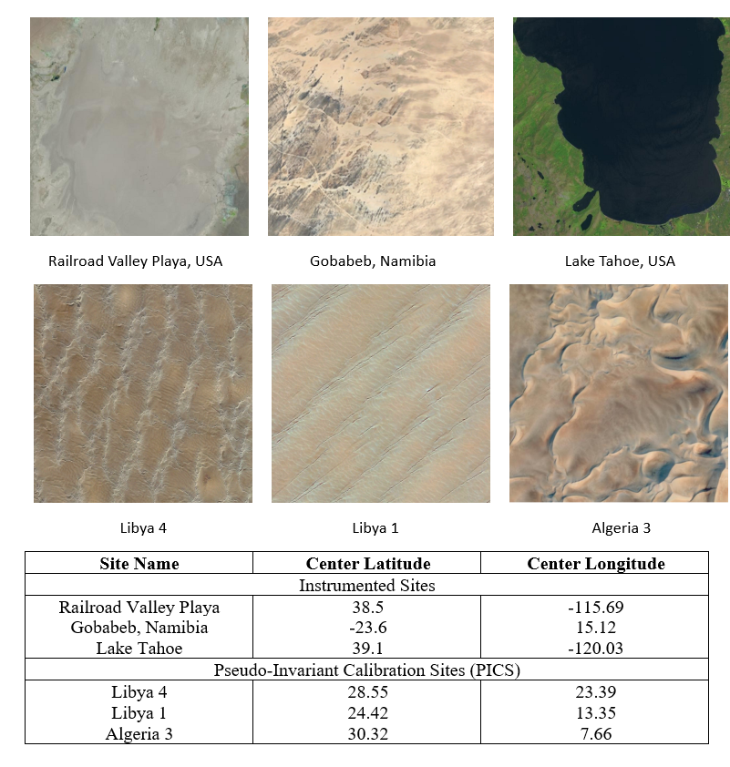
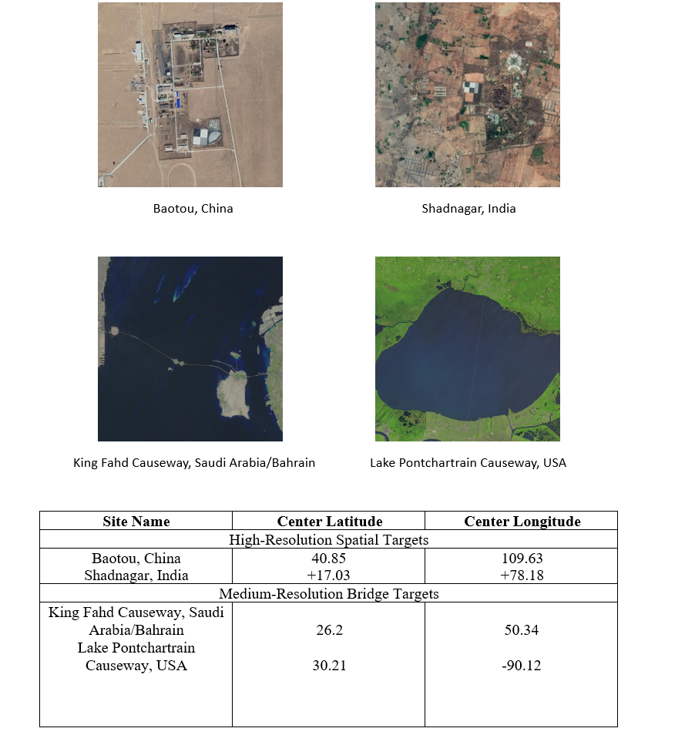
Recommendation
CEOS WGCV Recommendation: Facilitating interoperable global satellite imagery: agency & newspace
To
To facilitate a consistent understanding of the relative radiometric and spatial performance characteristics of passive optical satellite Level 1 imagery CEOS recommends that member agencies regularly collect and provide free access to imagery and associated metadata against a common ‘CEOS reference’ from their own missions as well as encourage/request any commercial data provider they can influence to do the same. The imagery can be made available for collection by API or deposited to a dedicated CEOS archive held in the UK Earth Observation Data Hub (EODH). CEOS will provide feedback on relative performance for QA purposes for both satellite operators and data users via a tool/web app developed by NPL (UKSA).
The CEOS reference has been chosen to be derived from a minimal set of locations together with the minimal required metadata. The reference in practice consists of a few sites for radiometric and spatial evaluation for solar reflective and thermal emissive missions.

Slide 15
Conclusion : Vision for WGCV (1)
The mission of the CEOS Working Group on Calibration & Validation (WGCV) is to ensure long-term confidence in the accuracy and quality of Earth Observation data and products and to provide a forum for the exchange of information about calibration and validation, including the coordination of cooperative activities.
QUALITY OF EARTH OBSERVATION DATA AND PRODUCT
Follow Metrology Principles 🡪 Knowledge and quality of measurements and their uncertainties
Toward Fiducial Reference Measurements (FRM)
- Reference Site / Network : RADCalNet, SARCARLNET, TIRCALNET….
- Support international network TTCON, COCCON, NDACC, PANDORA GLOBAL NETWORK, ICOS…..
- Toward FRM from Space (CLARREO-PF, TRUTHS, LIBRA)……
Provide Methods and Protocols:
- Cal/Val Protocols (SRIX4VEG, ACCP, BIOMASS, ALBEDO, SM, LST…etc..).
- Provide Intercomparison Framework (ACIX, CMIX, BRIX, DEMIX, GCPIX, FRM4STS, FRM4GHG, FRM4VEG…etc….)
🡪 Share information and tools: CEOS Cal/Val Portal

Slide 16
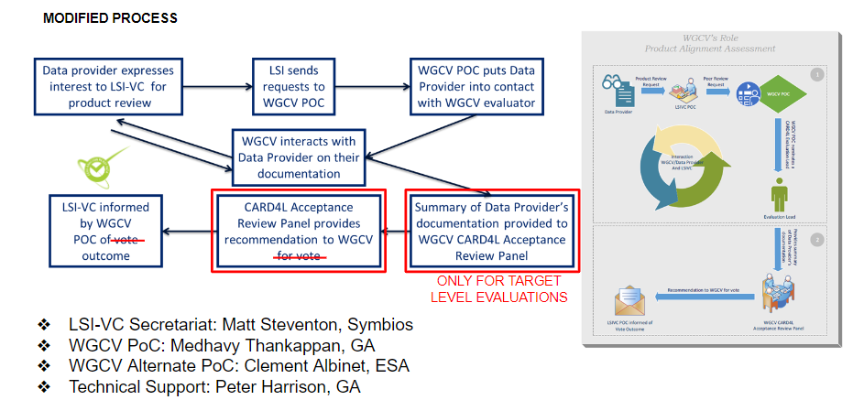
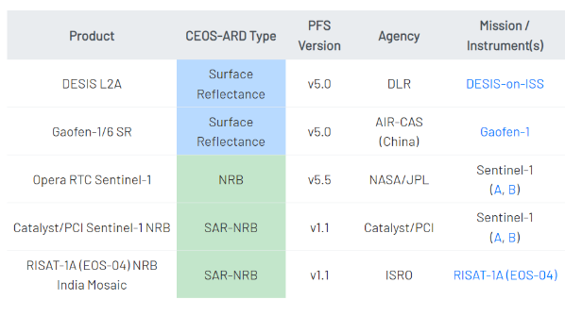
Conclusion : Vision for WGCV (2)
WGCV Support Groups/Initiatives/Applications
ARD ASSESSMENT
CEOS WGCV provide assessment on CEOS ARD compliancy
Interact with Data Provider
WGCV lead : Medhavy Thankappan
CEOS ARD assessment in progress
Action taken at WGCV-54 to evaluate the potential for a WGCV ad hoc group to collaborate on the Surface Reflectance Quality and Consistency project (GA LSI), between WGCV subgroups (IVOS & LPV) and LSI-VC.

Slide 17
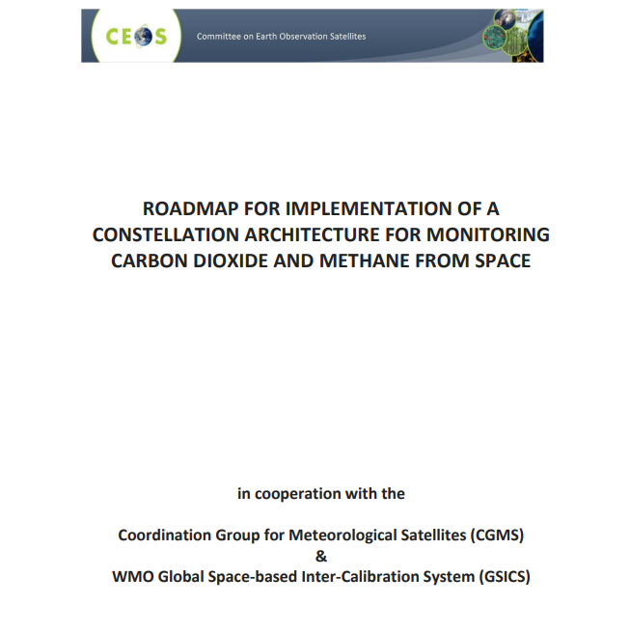
Conclusion : Vision for WGCV (3)
WGCV Support Groups/Initiatives/Applications
Climate – GCOS IP:
- Better align the satellite FRM program to the reference tier of tiered networks and enhance/expand FRM to fill gaps in satellite cal/val.
- B5.1 Increase the number of in situ river level observations that are exchanged internationally and can be used to calibration satellite observations of water levels.
- D4. Create a facility to access co-located in situ cal/val observations and satellite data for quality assurance of satellite products.
- B 1. 5. Establish a long-term space-based reference calibration system to enhance the quality and traceability of earth observations 🡪 SITSat
GHG Tasks:
Contribution to the “ROADMAP FOR A COORDINATED IMPLEMENTATION OF CARBON DIOXIDE AND METHANE MONITORING FROM SPACE”
Participation and contribution to WMO 1st CIPM STG-CENV CIPM Sectorial Task Group on Climate Change
and Environment (CIPM-STG-CENV). 29 actions where WGCV contributes
(uncertainties tool, FRM assessment, support to network, SITSat…)
Coordination with WMO GSICS
Dialog/Cooperation with CEOS groups – WGISS, Interoperability….
Newspace support – Quality Standards, matchup radiometric database, GCP database

Slide 18
Conclusion : Vision for WGCV (4)
WGCV Support Groups/Initiatives/Applications
Support Biodiversity task: initial discussion. Collaboration with WGCV on EBVs.
Discussion on FRM for Land Cover. To be Followed….
From WGCV53
Support the development of RS-enabled EBVs best practice workflows. (including multi sensor approaches)
For EBVs essentially on ecosystem traits (ecosystem function and structure)
Starting from the variables already addressed by WGCV (e.g., Biomass, fAPAR, LAI)
Development of data quality standards for EBV retrieval algorithms.
Development of scientifically sound validation frameworks (including EBV validation protocols, possibly algorithm intercomparisons)
Support to EBV Cal/Val with sharing/provision of in-situ measurements (fiducial reference measurements)
Support the integration of future CEOS missions in the EBV workflows (e.g. CHIME, SBG)
Initial Discussion
Individual elements are put place
Protocols for LAI, BIOMASS, fAPAR, Land Cover
Link with Network: ICOS, TERN, NEON 🡪 toward FRM
FRM4LC
Intercomparison fAPAR, GPP/NPP/ET
Need to continue and reinforce coordination

Slide 19
Conclusion : Vision for WGCV (5)
There are a growing number of public and commercial providers of Earth Observation data. Key to using data from these new sources is a good understanding of their characteristics, how they are calibrated, and their quality and technical capabilities.
Interoperability between satellites/products will allow to extend dramatically the opportunities for global applications (agriculture, water use, forest and vegetation monitoring, pollution monitoring…etc…but also for climate applications).
The data can be used together only if we can trust its accuracy and characterisation. Therefore harmonisation in Calibration and Validation approaches are fundamental.
Global Earth Observation System of System can work if Quality Standard and Reference are put in place
CEOS provides a coherent and comprehensive system for data quality
Metrology principles: Increasing the reliability of data 🡪 Quality Reference
Facilitating Sensor to sensor interoperability by establishing Cal/Val reference (FRM)

Slide 20
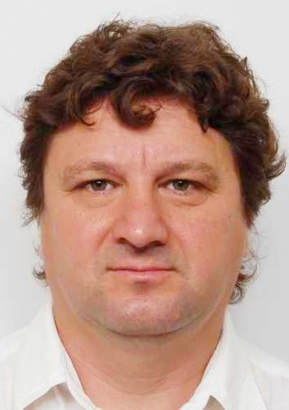
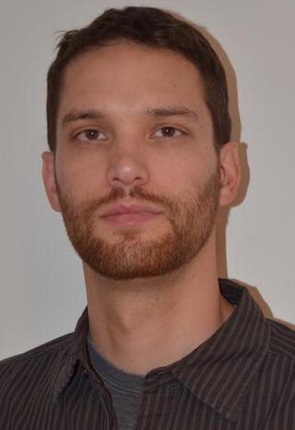
WGCV
Philippe Goryl (ESA) will step down as WGCV Chair after two years in the role
Cody Anderson (USGS) will transition from WGCV Vice Chair to WGCV Chair at CEOS Plenary
A nomination has been received from Geoscience Australia for Medhavy Thankappan to take on the role of Vice-Chair for 2025-2026, and subsequently Chair for 2027-2028.
Medhavy has been an active member of WGCV for many years and contributes to numerous areas of WGCV activity, such as RadCalNet, CEOS-ARD assessments, the SITSat Task Team, and many more
References: Nomination letter, Presentation, CV
Philippe Goryl (ESA, outgoing WGCV Chair)
Cody Anderson (USGS, incoming WGCV Chair)
Medhavy Thankappan (GA)

