Slide 1
Canadian Ecosystem Extent Demonstrator: Hudson Bay Lowlands - Report on Outcomes and Future Developments
Jason Duffe, ECCC
Agenda Item 2.2
38th CEOS Plenary
Montreal, Canada
23rd - 24th October, 2024

Slide 2
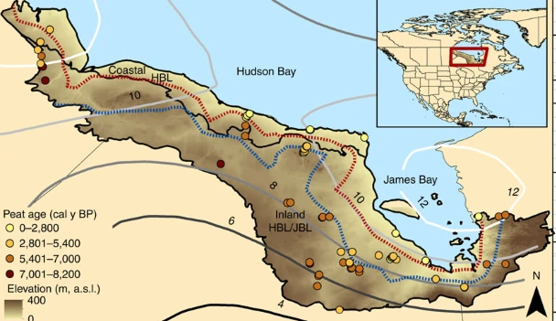
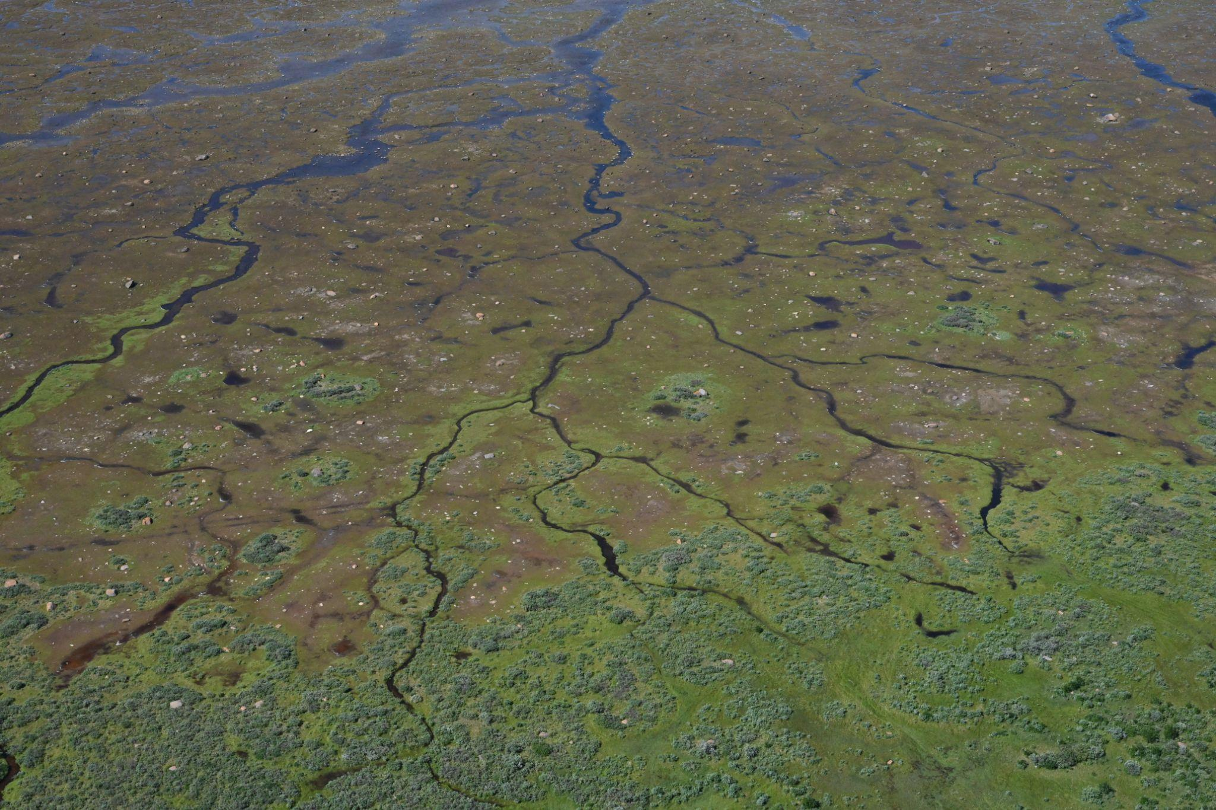
Ecosystems & Biodiversity
Ecosystem Extent
Nature-based Climate Solutions
Condition and Function of ecosystems
Connectivity - Habitats
GBF Headline indicator
Natural ecosystem & Red list of Ecosystems
Hudson Bay Lowlands
A quarter of the globe’s wetlands, the HBL represents the third largest wetland in the world – 370,000 sq km (4%)
2nd largest peat complex - accumulated over 3+m in certain habitats
Undergoing isostatic rebound: 1 to 1.3 meter per 100 years
Subarctic ecoregion with a strong temperature and precipitation gradient – Permafrost in northern areas
Photos: Leduc, August 2024

Slide 3
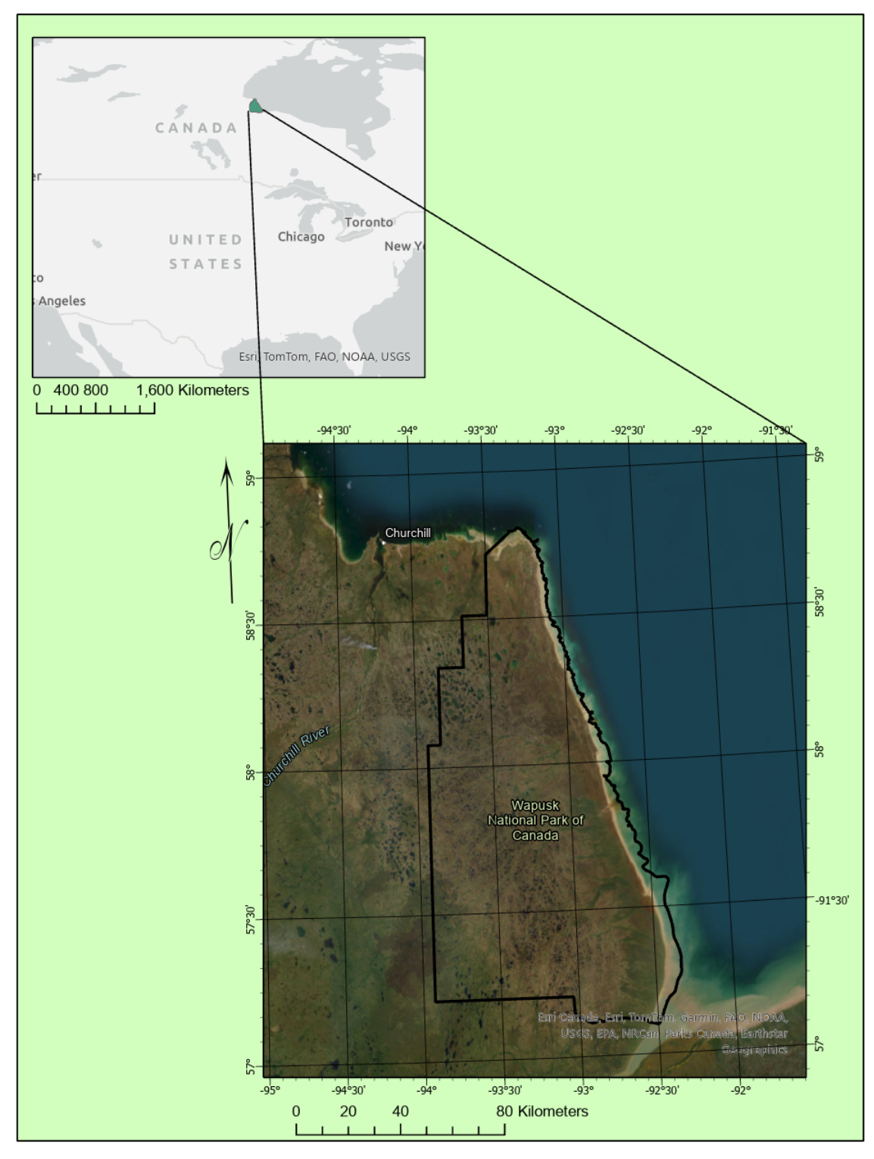
HBL Demonstrator Objectives
Hudson Bay Lowlands Ecozone
Develop standardized mapping approach with machine learning, AI, cloud computing & EO to map ecosystems across HBL
Establish ecotypes consistent with IUCN 2.0 Typology, a comprehensive hierarchical classification framework for global ecosystems.
Wapusk National Park (HBL Demonstrator Site):
Determine what CEOS sensors contribute most to the discrimination of ecotypes.
Assess current limitations for utilizing datasets in an operational capacity.
Wapusk National Park, MB, Canada

Slide 4
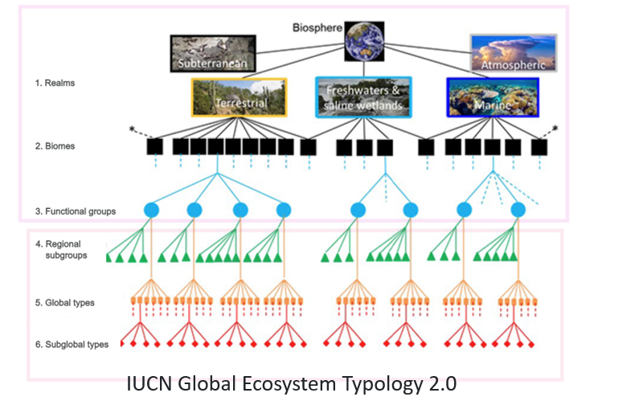
Cross-walking Local Ecotypes to National Ecosystems to Global Ecosystem Typologies

Slide 5
Data sets & testing scenarios
EO data has been received and/or accessed & processed throughout 2024 with the latest data sets coming Summer 2024.
Datasets: | ESA Sentinel 1 & Sentinel 2 | CSA RCM | JAXA ALOS2-PalSAR2 | DLR ENMAP | DLR TanDEM-X
Classification Methods: RandomForest (RF), UNET, & Convolutional Neural Network (CNN) | S1 EW - HH, HV intensity (2022, 2023, 2024 85 Images; S1 IW – VV VH intensity 2021 20 images (Total S1 105)) S2 Multi-Year Composites & Individual images | 30m Compact Pol – RV RH Intensity, mChi Decomp, Stokes Vectors, Polarimetric Parameters (2023 & 2024 – 51 Images) | Dual Polarimetric Dual pol HH, HV intensity processed (2023 & 2024 28 images) Fully polarimetric (partial coverage – 33 images) | 2 Strips (7 and 4 images – July 2024) Surface Reflectance 238 bands | 12 m X-band DEM – 16 images Elevation, Slope, Aspect, Dissection
CEOS Data Cube | Sentinel 2 - Spring, Summer, Fall Composite Bands + NDVI & EVI

Slide 6
AI for Ecosystem Mapping of the Hudson Bay Lowlands
Employing various machine learning/deep learning algorithms for the purpose of ecosystem classification.
‘The primary difference between machine learning & deep learning is how each algorithm learns and how much data each type of algorithm uses.’
We have successfully implemented RandomForest (RF), Convolutional Neural Networks (CNN) and the U-Net architecture for classification
Additionally, we deployed machine learning algorithms to perform similar classifications on cloud platforms within the CEOS Analytical Laboratory (CAL).
U-NET Architecture:

Slide 7
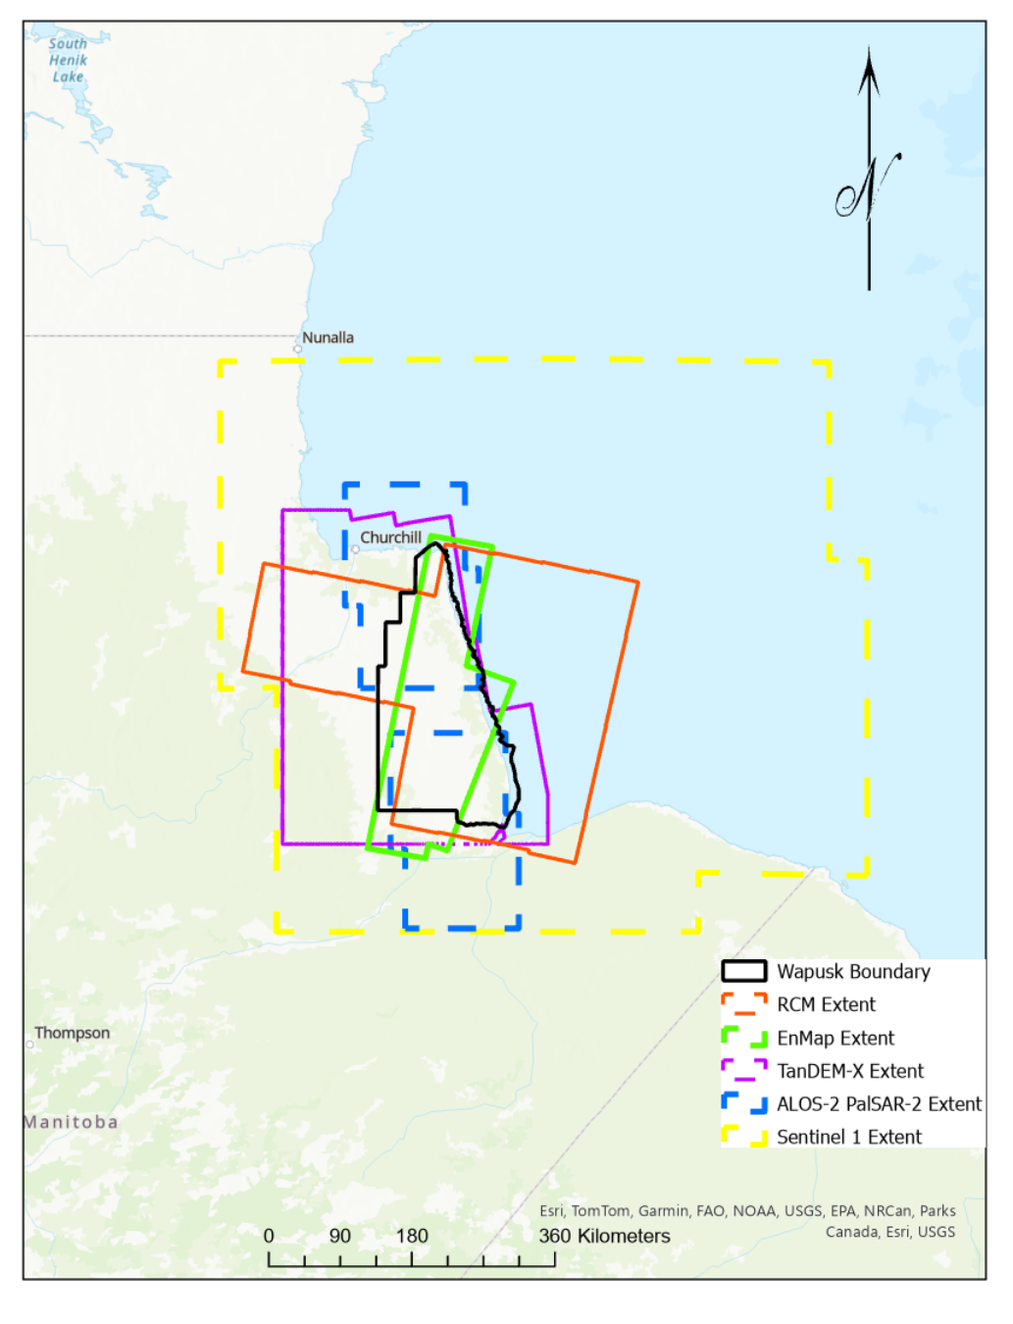
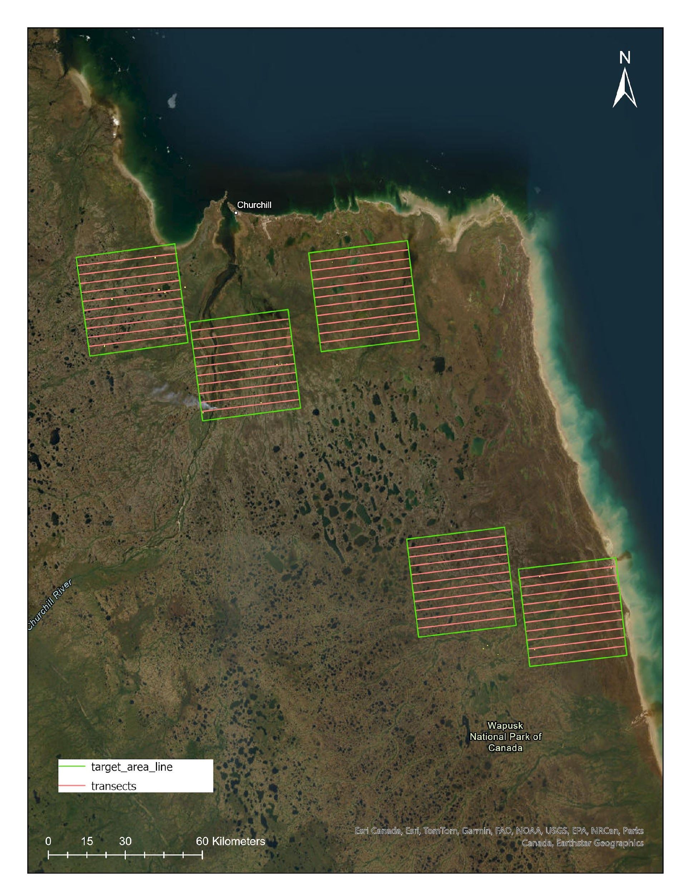
EO extents & field surveying
Sentinel 1 (yellow) had the largest spatial and temporal coverage (105 dates of images due to orbit overlap)
EnMAP (green) has the smallest spatial coverage and least temporal coverage (2 concurrent July dates)
RCM (red) & ALOS-2 PalSAR-2 (blue) had different acquisitions temporally and spatially but full coverage of Wapusk was obtained several times throughout the growing season by both systems
EO Data Extents
Field campaigns completed 2024 in Hudson Bay Lowlands using helicopter transects, air calls & ground plot sampling to supplement older field data.

Slide 8
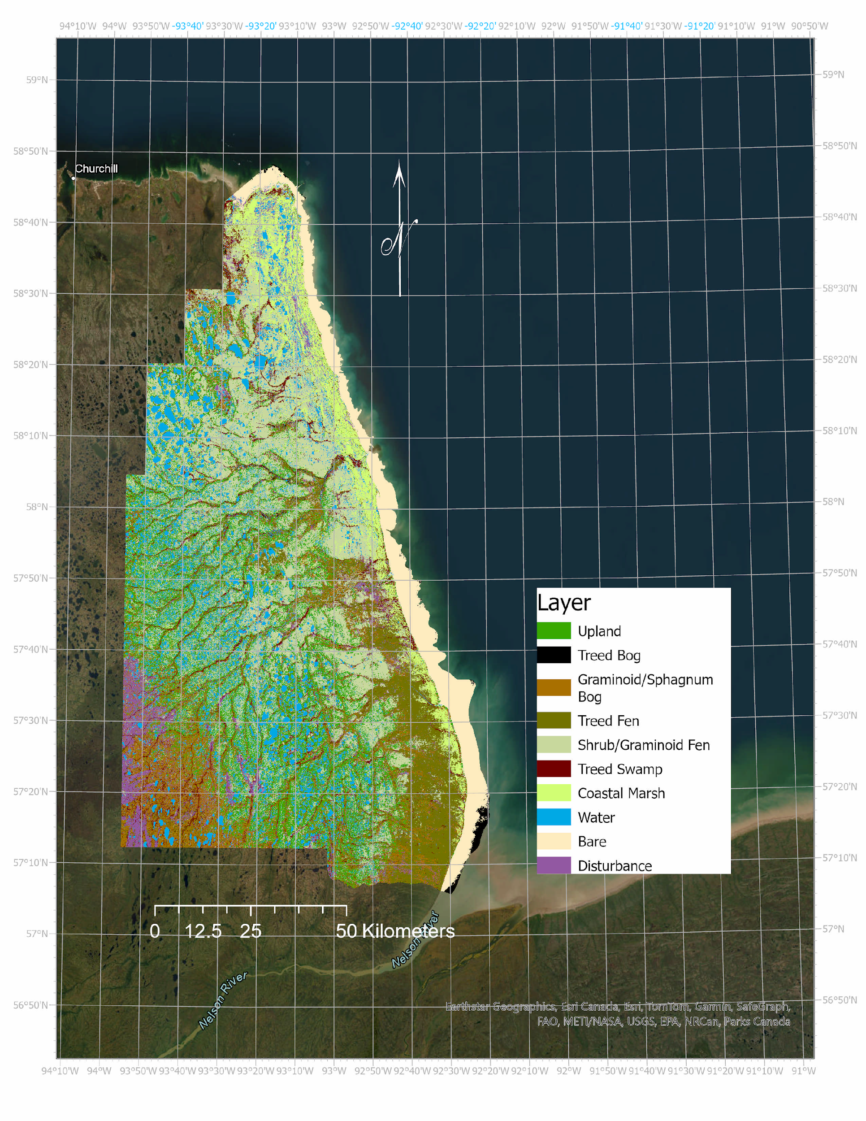
Outcomes Combined EO datasets: Overall Accuracies
Combining data types (e.g. optical and SAR or different SAR frequencies) improved overall class accuracies
EO Combinations | Overall Accuracies | Best Ecosystem Classes | Worst Ecosystem Class
S1, S2, RCM, ALOS, EnMAP, TanDEM-X, RCM - (‘Kitchen Sink’) | 81% | Bare, water, coastal marshes, upland | Treed bog
S1, RCM, ALOS-2 PalSAR-2 (SAR Only) | 76% | Bare, water, treed bog | Swamp (treed/shrub)
S2, RCM, ALOS-2 PalSAR-2 (SAR & Optical minimized – CEOS cube) | 80% | Bare, water, treed fen, upland | Treed bog
For individual EO type data stacks - overall classification accuracies range 54-72%.
Wapusk NP 2024 Ecotype Classification

Slide 9
Outcomes Combined EO: EO Feature contributions
Rank | Feature
1 | TanDEM-X 12 m Elevation
2 | ALOS-2 PalSAR-2 July 5, 2024 HH Intensity
3 | S2 Coastal Blue 60 m Summer Composite
4 | ALOS-2 PalSAR-2 July 5, 2024 HV Intensity
5 | S1 August 8, 2022 HH Intensity
6 | S1 August 27, 2022 HH Intensity
7 | S2 NIR 10 m Spring Composite
8 | S2 RED 10 m Spring Composite
9 | S1 October 14, 2022 HH Intensity
10 | S2 NIR 20 m Summer Composite
11 | RCM 30m CP August 15, 2023 RV
12 | S2 Red Edge 1 20 m Summer Composite
13 | S2 NIR 20 m Spring Composite
14 | ENMAP July 23, 2024 2437 nm
15 | ENMAP July 23, 2024 616 nm
16 | S2 Red Edge 1 20 m Spring Composite
17 | S1 September 15, 2023 HV
18 | RCM 30m CP August 6, 2024 Stokes 3
19 | RCM 30m CP May 22, 2023 Stokes 1
20 | S1 August 4, 2024 HH
21 | ENMAP July 23, 2024 647 nm
22 | S2 Blue 10 m Spring Composite
23 | ENMAP July 23, 2024 482 nm
24 | ENMAP July 23, 2024 622 nm
25 | S1 August 27, 2023 HV Intensity
Feature importance testing using ‘Conditional Permutation Importance’ ranking
For optical imagery (Sentinel-2 & EnMAP) the blue, red, red edge, and NIR bands were the highest contributing features from spring and summer imagery
For SAR imagery (ALOS-2 PalSAR-2, RCM & Sentinel 1) HH intensity consistently was the highest contributing feature no matter the frequency (C-band or L-band) and typically were from spring and late summer/ fall imagery

Slide 10
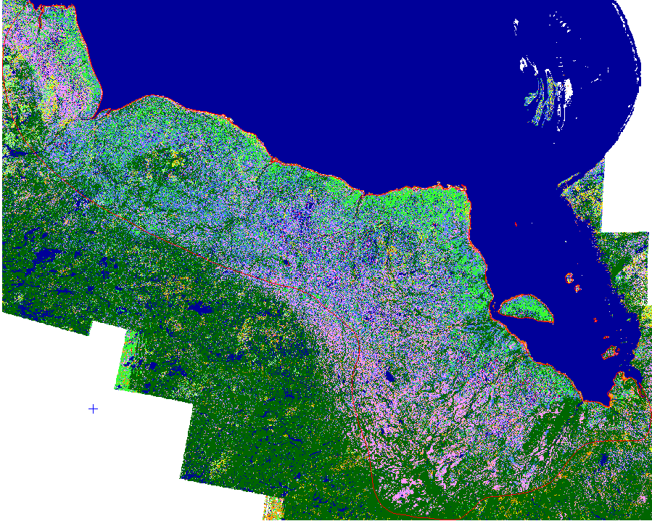
Ongoing challenges and future efforts
Data quality & processing issues:
ENMAP: Images had north-south reflectance gradient
Data lack consistent coverage (spatially & temporally)
makes direct comparison of all sensors challenging
Seasonal data is optimal
In situ training and validation data
High quality & resolution needed
Limited availability
IUCN Typology

Slide 11
Recommendations from HBL Demonstrator
EO Ecosystem Mapping (Extent, Condition, Function) is by vegetation proxy
Ecosystems driven by climate, site factors, hydrology, nutrients/substrate,
High Resolution Bare Earth Model is required for ecosystem mapping & change analysis
SAR derived surface models are limiting
Processing to remove artifacts needed – AI/ML algorithms
Signal to noise ratio is important
Calibration
Compositing
Noise floor
Fully polarimetric (quad-pol or pseudo QP) is as good a multi-spectral optical
Consistent acquisitions are required for optimal biodiversity results
Truly BIG DATA – Compute power becomes limiting
Hyperspectral is important – but more work needed to implement research into at-scale products

