Slide 1
CEOS Plenary 2024
CEOS Executive Officer (CEO) Report
CEO Team
Agenda Item 1.3
38th CEOS Plenary
Montreal, Canada
23rd - 24th October 2024

Slide 2
2024-2026 CEOS Work Plan
2024-2026 CEOS Work Plan overview and progress
Level of representation and activity of each CEOS entity (Ref: Action SIT-39-01): Final findings and reflections
Submissions from CEOS Agencies to the GEO Work Programme for 2025-2027 (For Information)
Decision: Endorsement of the minor revisions to the CEOS Strategic Guidance Document
(Reference document: Updated CEOS Strategic Guidance Document)

Slide 3
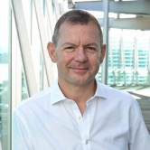
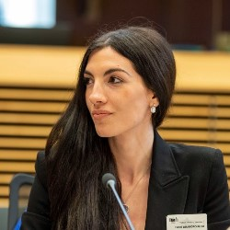
CEO Team
Support ongoing CEOS Work Plan development with Working Groups, Virtual Constellations and other stakeholders to ensure timely contributions and track deliverables
Work with the CEOS Chair and Strategic Implementation Team (SIT) Chair, including representing CEOS at meetings upon their request
Routinely liaise with the CEOS Systems Engineering Office (SEO)
Consult and coordinate with the GEO Programme Board, the GEO Executive Committee and the GEO Secretariat, contributing to the GEO Work Programme activities on behalf of CEOS
Provide input to CEOS leadership on prospects for continued/expanded internal and external cooperation
Track and report on upcoming internal and external meetings and events where CEOS representation/participation is required/invited; report on the status of CEOS representation at relevant meetings during monthly CEOS Secretariat teleconferences
Review and manage the CEOS mailing and contact lists and consult with the SEO in updating the CEOS mailing list servers
Monthly work package report delivered to EUMETSAT, CEOS Chair and CEOS SIT Chair
Additional tasks in the framework of activities listed above
Steven Ramage
CEOS Executive Officer (CEO)
Founder & CEO, Réseau Consulting
Lefteris Mamais
Strategic support to the CEO team
Co-Founder & CEO, Evenflow
Irena Drakopoulou
Operational support to the CEO team
Programme Manager, Evenflow

Slide 4
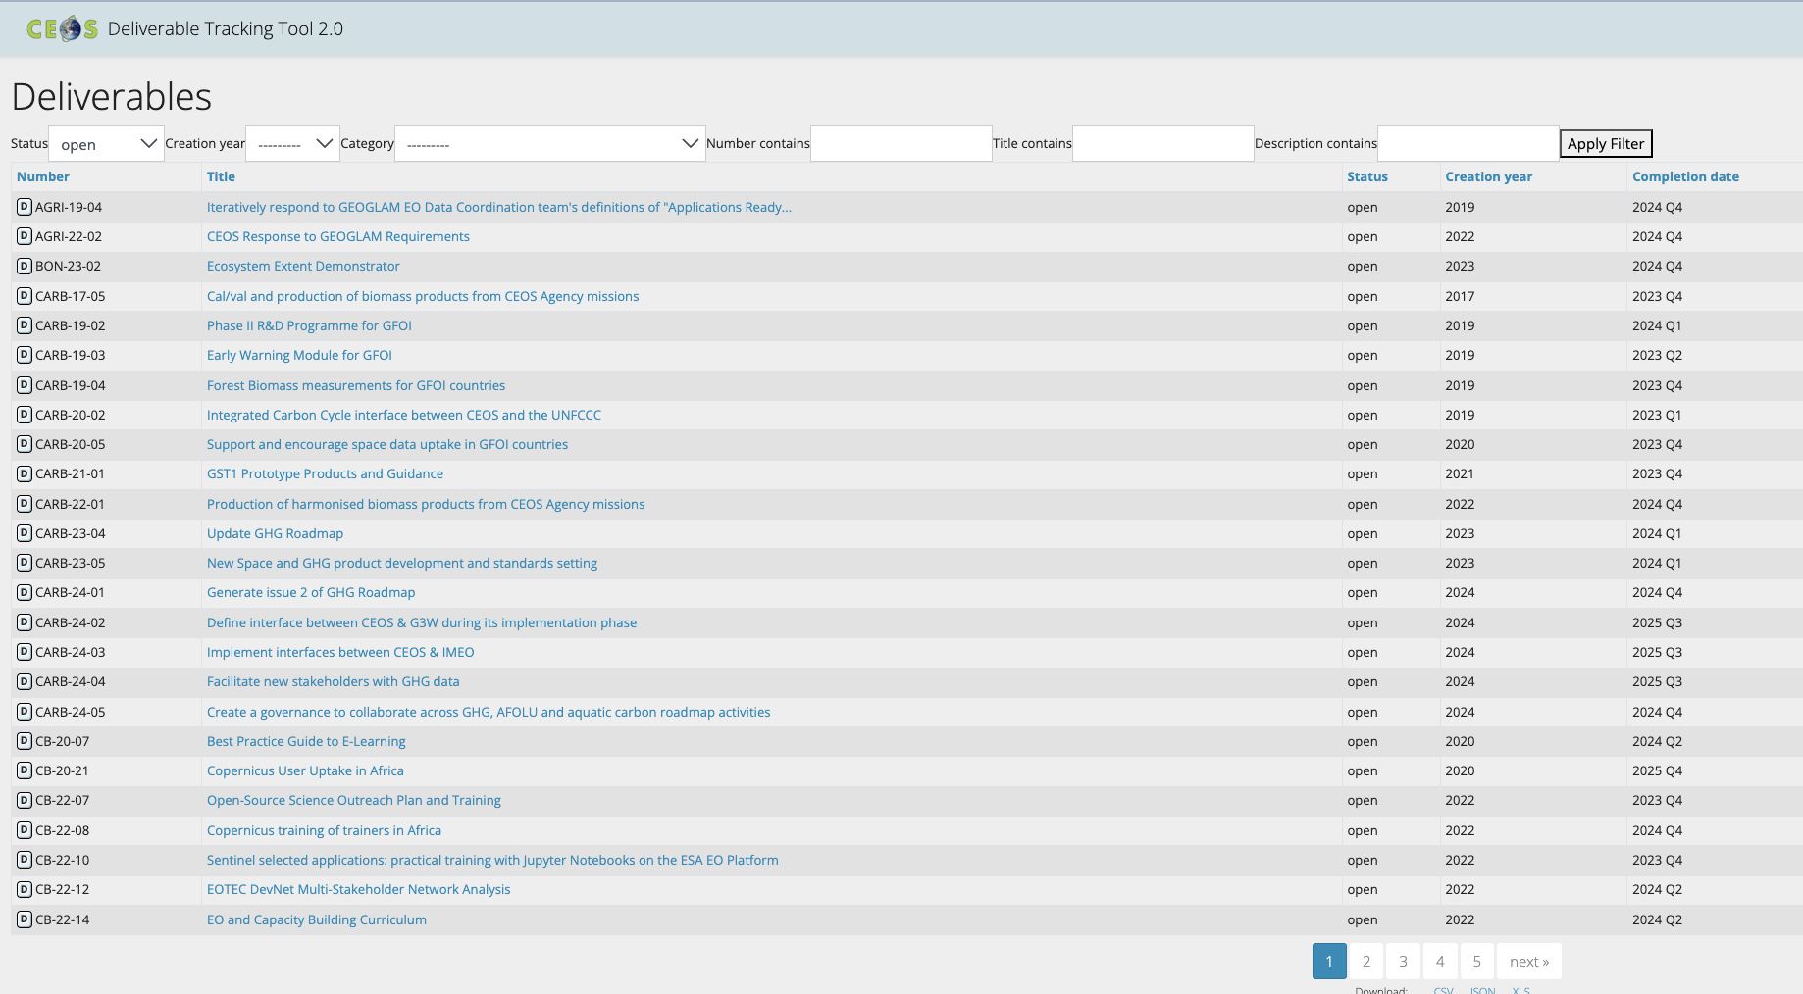
2024-2026 CEOS Work Plan
Overview and Progress
Regular and up-to-date management of the CEOS deliverable tracking tool
Regular communication with the responsible persons for each deliverable
Total current number of overall open deliverables: 117

Slide 5
Action SIT-39-01 Scope and Rationale
Scope
“CEOS Executive Officer team to undertake an assessment of the level of activity of all CEOS constituent groups. Consideration should be given to their representation in the CEOS Work Plan and activity more generally, as well as their interactions with other CEOS entities. The CEO will report findings to the 2024 SIT Technical Workshop and facilitate a discussion.”
.
Rationale
“CEOS should reflect on all existing elements of the CEOS structure and consider whether they are essential elements if they are not appropriately reflected in the CEOS Work Plan with clear deliverables or tasks.”

Slide 6
Action SIT-39-01 - Methodology
The CEO team, in alignment with the CEOS and SIT Chairs, has developed a robust approach to tackle this action
Meetings held
Desk Research to complete as much of the assessment as possible
Member participation
Consultations with CEOS reps for insights and validation
How dynamic?
Representation of CEOS in int’l fora
Level of Activity
Presentation at SIT TW for feedback
How much output?
Deliverables
How much synergy?
Collaboration with other CEOS entities
Solicitation of feedback from all CEOS entity leads
Development of Grid with Indicators
Final findings at CEOS Plenary
Supporting mission of CEOS members
Impact
How impactful for CEOS members?
Contributing to CEOS communications
Presentation at SIT TW to reflect on whether this should be tackled and how
How impactful for broader community?
Citations of work
Contribution to SDGs
…

Slide 7
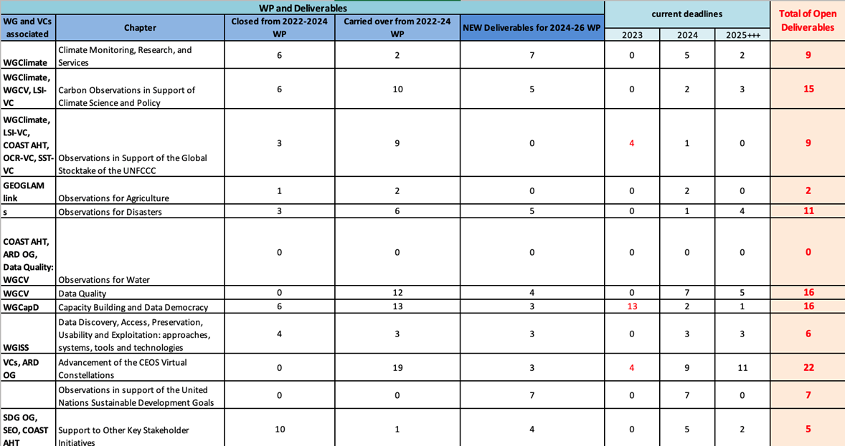
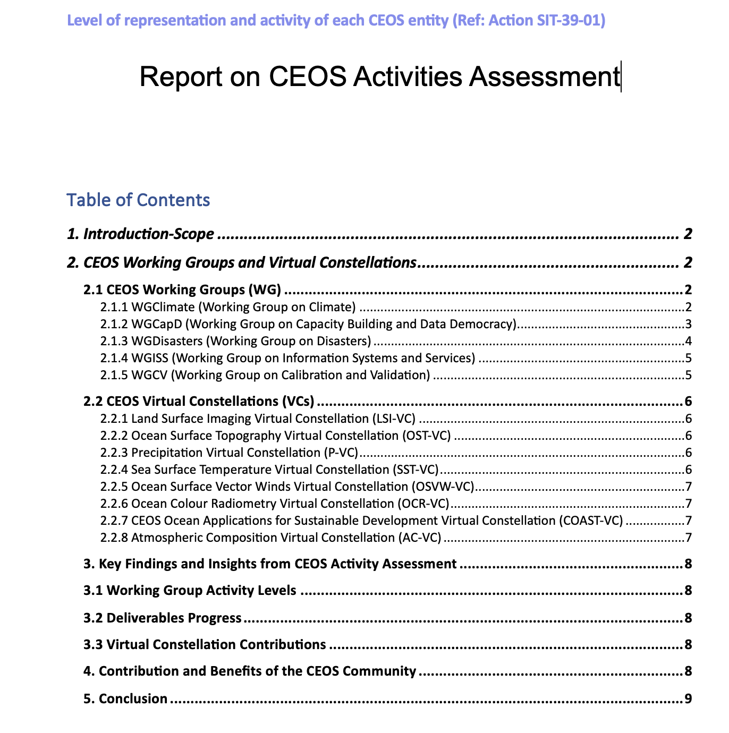
Action SIT-39-01 – Level of activity – Final findings
Analysis of deliverables
Analysis of meetings
Analysis of synergy
Information Sharing
CEOS enhances access to mission-related information across agencies, ensuring that all members stay informed about future missions, data, and technological advancements.
Exchange of Good Practices
CEOS facilitates the exchange of good practice, allowing agencies to learn from each other and adopt proven approaches for managing Earth observation missions.
Expert Mobilization
One of the key strengths of CEOS is its ability to bring together specific experts to address critical issues, whether related to climate monitoring, disaster management, or biodiversity tracking. This expert mobilization contributes to solving technical and scientific challenges more effectively.

Slide 8
Action SIT-39-01 – Level of activity – Final findings
Identified barriers and resource constraints
Expansion of Activities
Personnel or Funding constraints
Travel Restrictions
Need for Increased Coordination
Communication Gaps
To fully capture the CEOS scope of activity and impact, a more comprehensive assessment would be meaningful, involving detailed evaluations from all CEOS associates, including a thorough analysis of CEOS influence outside the immediate community, especially in the areas of policy making, capacity building in developing regions, and international collaboration on environmental challenges.

Slide 9
Submissions from CEOS Agencies to the GEO Work Programme for 2025-2027
CEOS involved in GEO technical activities, namely the GEO Work Programme and governance through the GEO Programme Board and the GEO Executive Committee.
The open call for proposals for the Post-2025 GEO Work Programme was shared with the CEOS community highlighting the deadline for complete proposal submissions by 30th October 2024. Online proposal writing workshops were held in the first half of October.
Earth Intelligence is key https://earthobservations.org/storage/app/media/documents/Events/GEO-Week-2023/GEO%20Post%202025%20Strategy%20Summary.pdf Also R20 and Conveners.
Six thematic areas and two cross-cutting areas for Post-2025 GEO Work Programme.
CEOS contributes to activities, such as current GEO flagship initiatives – GEO BON (EETT and CEOS Chair theme), GEOGLAM (LSI VC), GFOI (LSI F&B), GEO LDN (SEO), as well as GEO Blue Planet (COAST) and EO4SDG (SDG CG) [this will change to address broader sustainable development approach].
Notes:
1. Agriculture and Food Security, 2. Land and Water Sustainability, 3. Ecosystems, Biodiversity and Carbon Management, 4. Weather, Hazard and Disaster Resilience, 5. Climate, Energy, and Urbanization 6. One Health – Cross cutting: 1. Equity and Inclusion, 2. Open Data, Open Knowledge, and Infrastructure

Slide 10
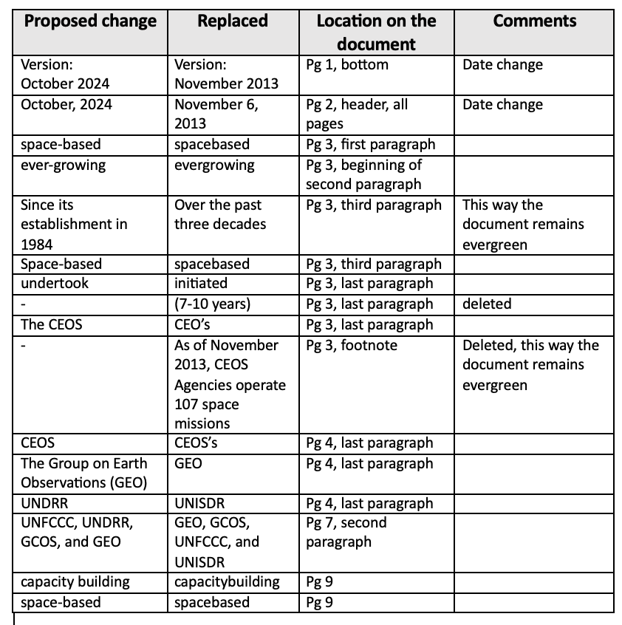
Endorsement of revision to the CEOS Strategic Guidance Document
A total of 16 minor changes were proposed and endorsed.
UPDATED

Slide 11
executive_officer@lists.ceos.org ceos_exec_support@evenflowconsulting.com Thank you
CEO Team
Agenda Item 1.3
38th CEOS Plenary
Montreal, Canada
23rd - 24th October, 2024

