Slide 1
37th CEOS Plenary
Interoperability Framework

Slide 2
CEOS Interoperability Overview
At the 2022 CEOS Plenary, CEOS Principals confirmed that coordination of interoperability related work remains within the WGISS perimeter. WGISS was invited to propose an interoperability roadmap at SIT-38, considering the CEOS Interoperability Framework concept developed and presented by LSI-VC. (Decision 36-09).
WGISS has coordinated across CEOS groups (ARD OG, LSI-VC, SEO, WGISS, WGCV, etc.) to develop a framework and mapping of CEOS activities / groups / people to each interoperability factor.
WGISS requests endorsement of the proposed Interoperability Framework and initial Roadmap.

Slide 3
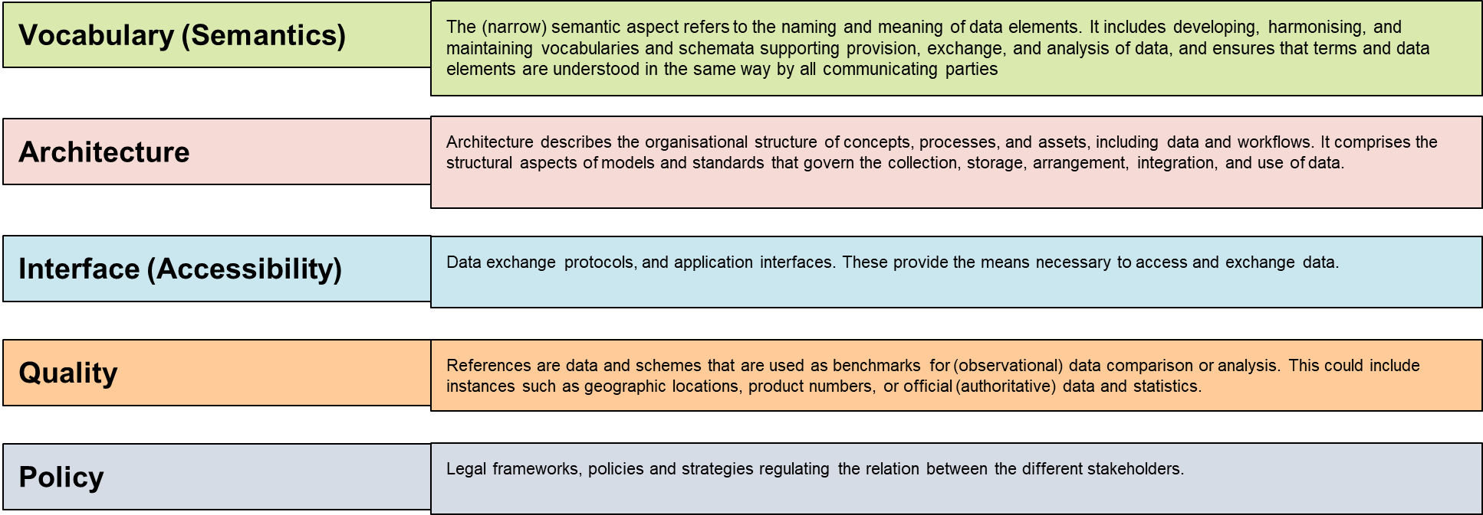
Proposed Interoperability Framework

Slide 4
Framework Roadmap

Slide 5
Interoperability Roadmap Activities

