Slide 1
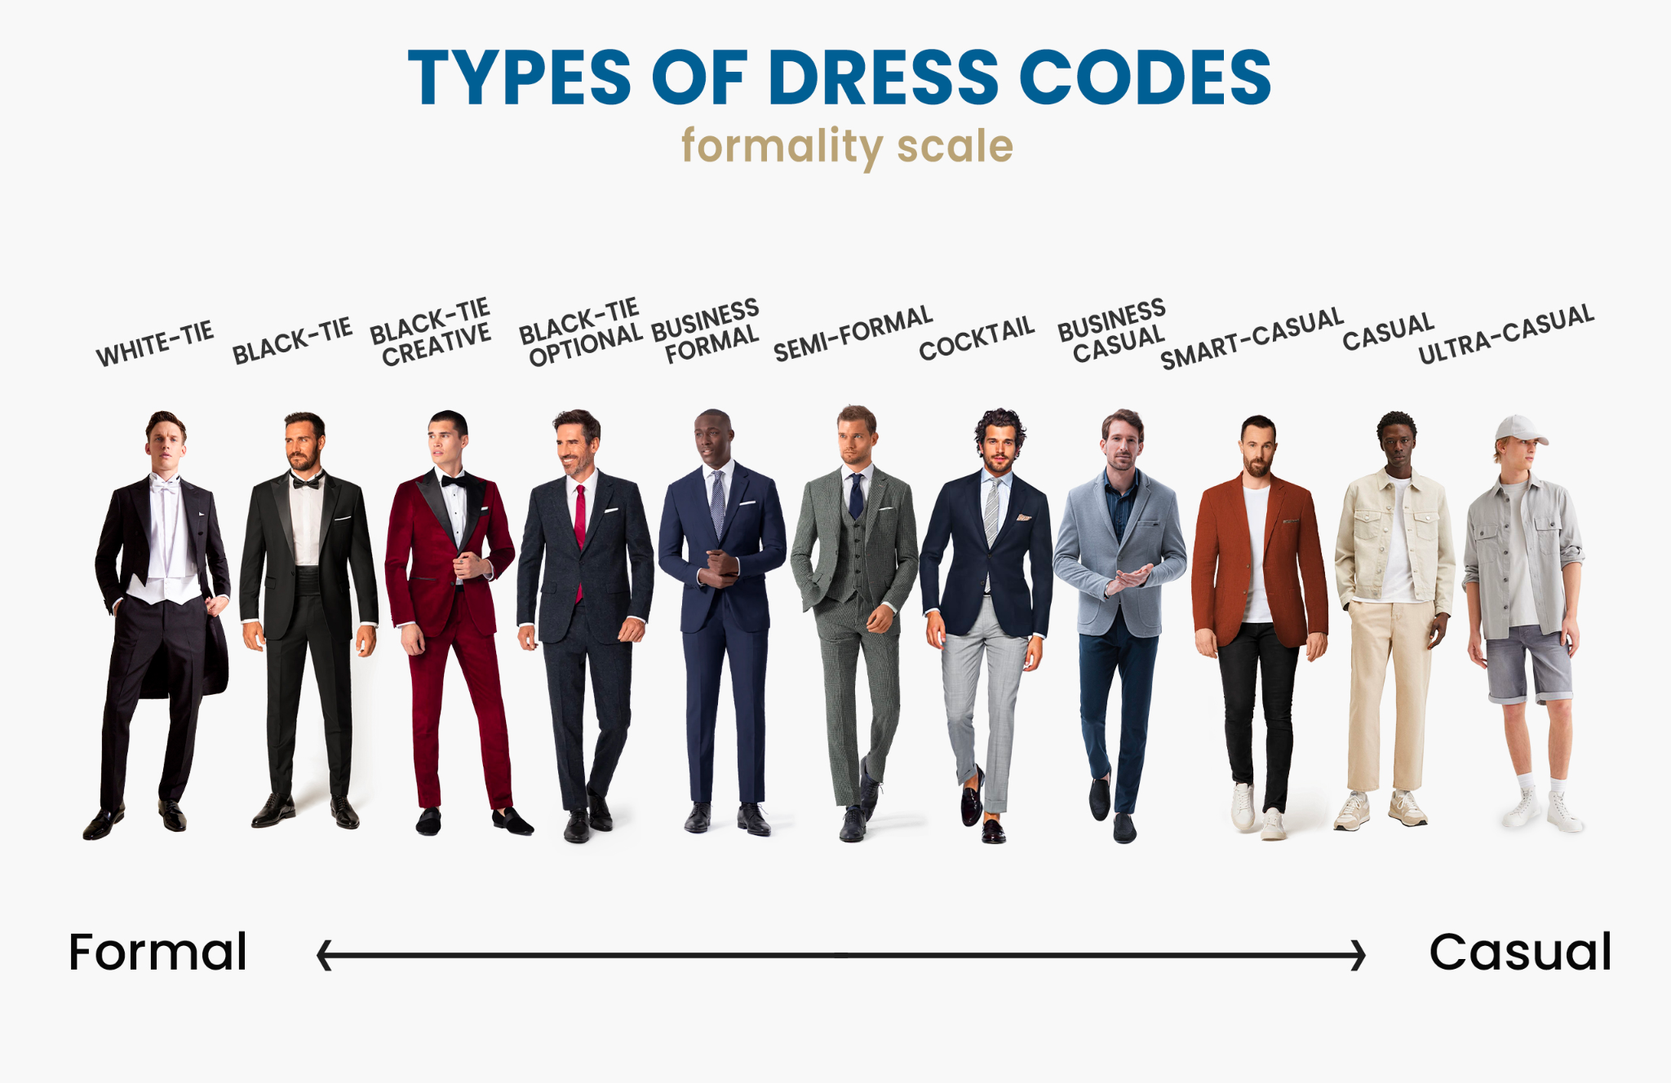
Dinner Reception 16 Nov
Dress code: semi-formal
Light coloured shirt *optional*
Preferably no shorts
Time:
Shuttle bus at 4:00 from lobby
For CEOS SEC - bus will depart at 4:15

Slide 2
17 Nov
Bus leaves at 8am
Will come back to city at about 4pm
Back at hotel by about 6pm

