Slide 1
Ecosystem Extent Task Team: White Paper & Recommendations
Gary Geller
NASA Jet Propulsion Laboratory
California Institute of Technology
Shaun Levick, CSIRO
Sandra Luque, CNES/INRAE
Roger Sayre, USGS
Agenda item 9.1
CEOS Plenary
15-16 November 2023
Chiang Rai, Thailand
(c) 2023 California Institute of Technology. Government sponsorship acknowledged.

Slide 2
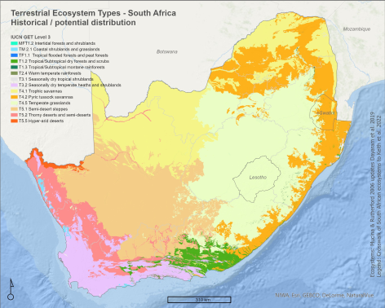
Ecosystem Extent
Essential Biodiversity Variable
Important CBD Indicator
Ecosystem Account in UN SEEA
EO is the primary input
Andrew Skowno, SANBI

Slide 3
Task Team History
2012: Biodiversity Activity
2021/SIT-36: one slide intro
2021/Plenary: “Discussion Group” initiated
2022/Tech Workshop: Ecosystem Extent TT proposed
2022/Plenary: Ecosystem Extent TT approved
Overarching goal: Sustainable CEOS engagement with biodiversity

Slide 4
EETT: From the ToR…
Purpose: To assess the utility for mapping Ecosystem Extent using current and forthcoming space-based observations
Key Objectives:
Develop a white paper that will provide an integrated international perspective on how space-based Earth observations can be used to support ecosystem mapping and monitoring with a focus on ecosystem extent.
Explore and propose an initiative to demonstrate the use of EO for ecosystem extent mapping and monitoring.

Slide 5
White Paper

Slide 6
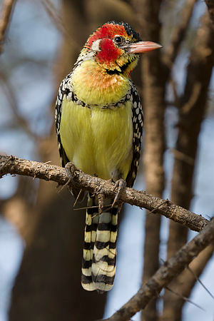
Details
25 pages or less
Primary audience
CEOS agencies and their Principals
Biodiversity community
CBD and Parties
UN SEEA
Authorship
Journal paper follow-on
Wikimedia Commons

Slide 7
Outline
Executive Summary
1 Introduction
1.1 Biodiversity Policy Anchors and Users
2 Mapping Ecosystems
2.1 Land Cover as a Proxy for Ecosystems
2.2 Mapping Ecosystems from Imagery
2.3 Ecosystem Characteristics Useful for Mapping
2.4 Ecosystem Mapping Typologies
3 Space-based EO for Mapping and Monitoring Ecosystem Extent
3.1 Types of Sensors
3.2 Sensor Complementarity
3.3 Opportunities
3.4 Challenges
4 Conclusions and Recommendations

Slide 8
White Paper:
Four Key Outcomes

Slide 9
1) Sensor Complementarity
Sensor type | Key Ecosystem Characteristics
Optical - Multispectral | Composition (coarsely) Functional traits (coarsely)
Optical - Hyperspectral | Composition Functional traits
Radar (SAR) | Physical structure Height, biomass
Lidar | Physical structure Vertical profile
“Composition, Function, Structure”

Slide 10
2) Opportunities
Combining data from different types of sensors
Use of hyperspectral data
Artificial intelligence and machine learning
Time series analysis
Data cubes

Slide 11
3) Challenges
Combining data from different types of sensors
Time series analysis
Limited availability of value-added products
EO data usability & technical capacity of users
Ecosystem condition

Slide 12
Recommendations

Slide 13
Recommendation Area 1
Thematic Recommendation
Specific Recommendations
1. User Engagement
Increase biodiversity community engagement with EO and CEOS through workshop(s) and other activities to improve ecosystem extent mapping.
Key organizations:
Convention on Biological Diversity
UN System of Environmental Economic Accounting
GEO Global Ecosystems Atlas initiative
Ramsar Convention on Wetlands
1a. Identify specific user requirements to guide EOs & identify products needed for ecosystem extent.
1b. Establish a sustainable communication channel between CEOS and user communities for continued interaction.
1c. Improve CEOS understanding of technological, socio-political, and cultural constraints for the biodiversity community to use EO data.

Slide 14
Recommendation Area 2
Thematic Recommendation
Specific Recommendations
2. Technical advances
Support development of technical advances to improve utilization of EO for ecosystem mapping.
2a. For each ecosystem, identify the key EOs and processing methods needed for its delineation.
2b. Facilitate combining data from different types of sensors to take advantage of their complementarity.
2c. Facilitate time series analysis and its application to ecosystem extent mapping.
2d. Explore ways to utilize EO to characterize ecosystem condition and its relationship to ecosystem extent.

Slide 15
Recommendation Area 3
Thematic Recommendation
Specific Recommendations
3. Capacity
Work to increase capacity of biodiversity users to utilize EO for ecosystem mapping and monitoring.
3. Identify opportunities for capacity development resources, e.g., a training or a Massive Open Online Course (MOOC) focused on the use of EO for ecosystem mapping and monitoring.

Slide 17
Ecosystem Extent Task Team: Demonstrator
Gary Geller
NASA Jet Propulsion Laboratory
California Institute of Technology
Shaun Levick, CSIRO
Sandra Luque, CNES/INRAE
Roger Sayre, USGS
Agenda item 9.2
CEOS Plenary
15-16 November 2023
Chiang Rai, Thailand
(c) 2023 California Institute of Technology. Government sponsorship acknowledged.

Slide 18
Demonstrator
Objective: To demonstrate…
Use of EO for ecosystem extent mapping & monitoring
Importance and value of EO
Biodiversity community
CEOS agencies and Principals
Delivery: Plenary 2024
Approach
Leverage partner initiatives
Three opportunities identified

Slide 19
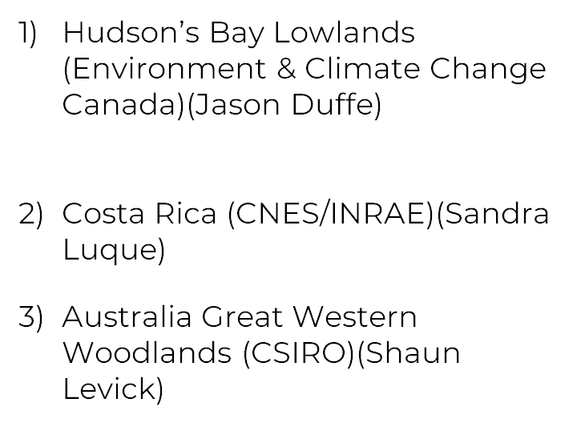
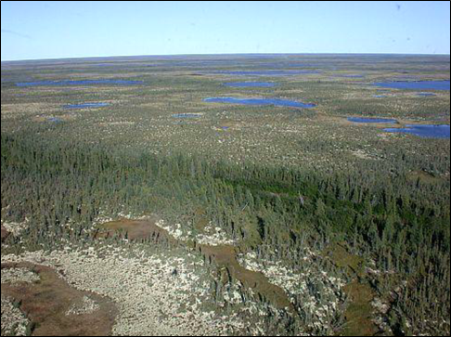
Opportunities
Ponomarenko & Quirouette, 2014

Slide 20
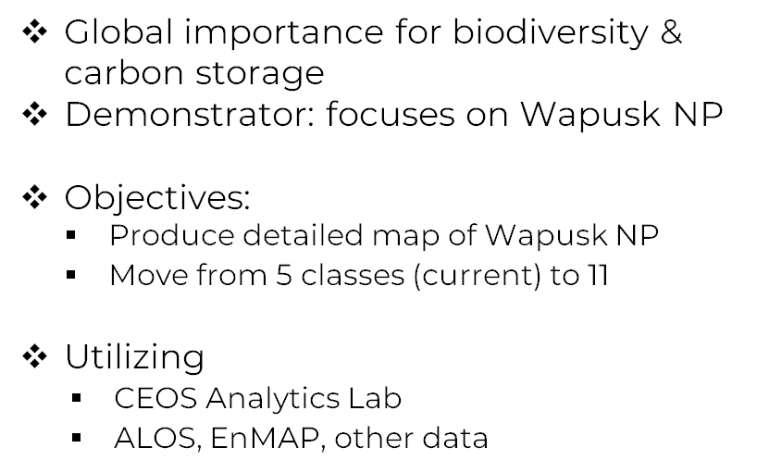
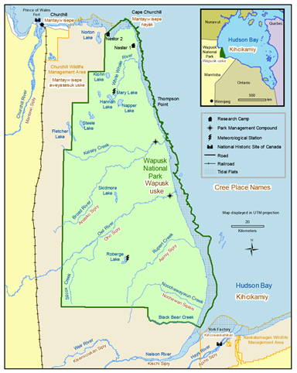
Hudson’s Bay Lowlands

Slide 21
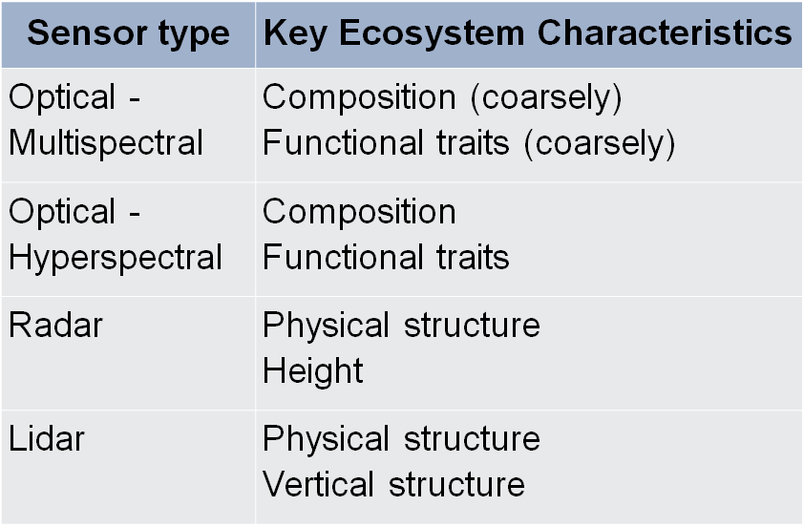
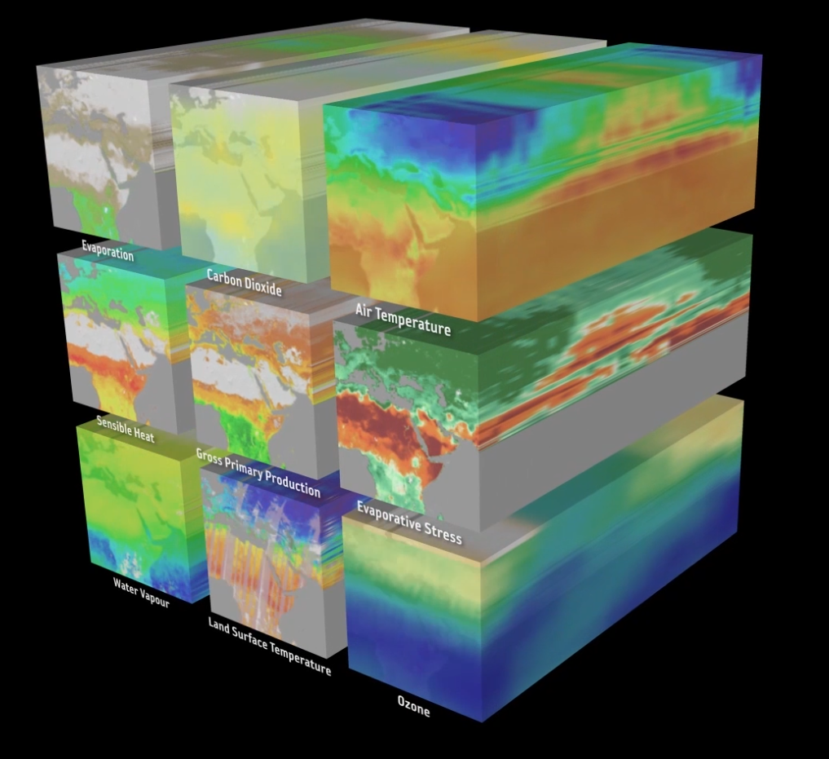
Demonstrator Notes
All three demonstrators
Designed around data cubes
Combine data from different sensors
Are cutting edge activities
Potentially—”running start”

Slide 22
Thank You

Slide 23
Backup

Slide 24
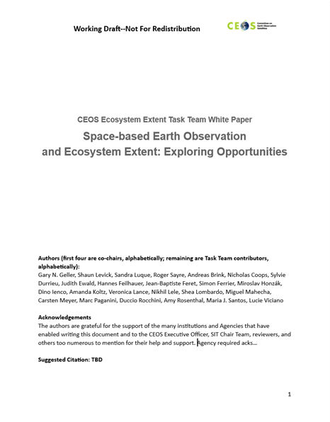
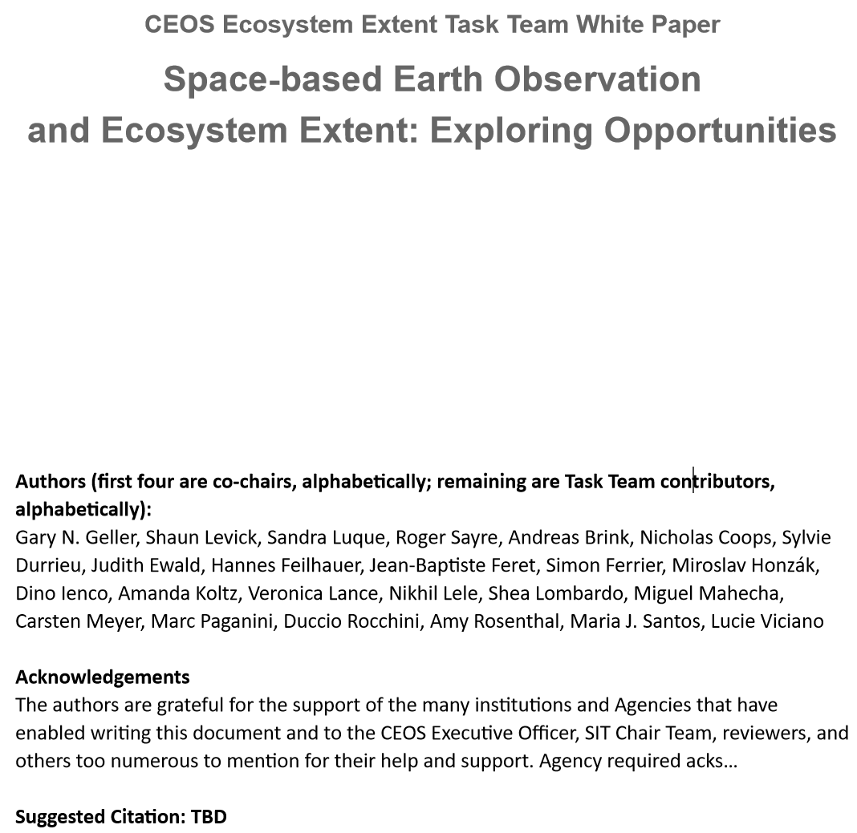
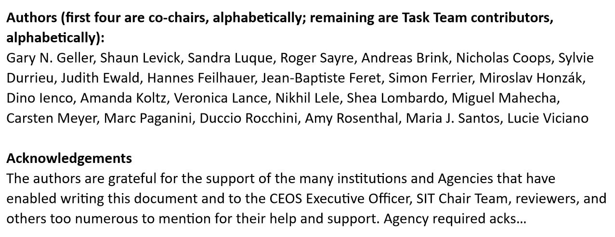
White Paper

Slide 25
Development Process
Form Task Team
Dec ‘22-Feb ‘23
Co-leads draft outline, refine with full TT
TT members (“authors”) contribute text
Co-leads consolidate contributions
Comments provided
Co-leads incorporate comments, prepare V0.9
V0.9
(TW)
Jan-Mar 2023
March-June
June-July
Mid-August
August-September
October
Journal Paper
Concept
Many iterative steps not shown

