Slide 1
WG Capacity Building and Data Democracy (WGCapD)
Jorge Del Rio Vera, WGCapD
Agenda Item 6.3
37th CEOS Plenary
15 - 16 November 2023
Chiang Rai, Thailand
Hosted by GISTDA

Slide 2
Why are Capacity-Building and Data Democracy Important?
Many reasons, but to name a few…
User Uptake
Development of EO applications and services
Insight-driven decision-making
Return on Investment

Slide 3
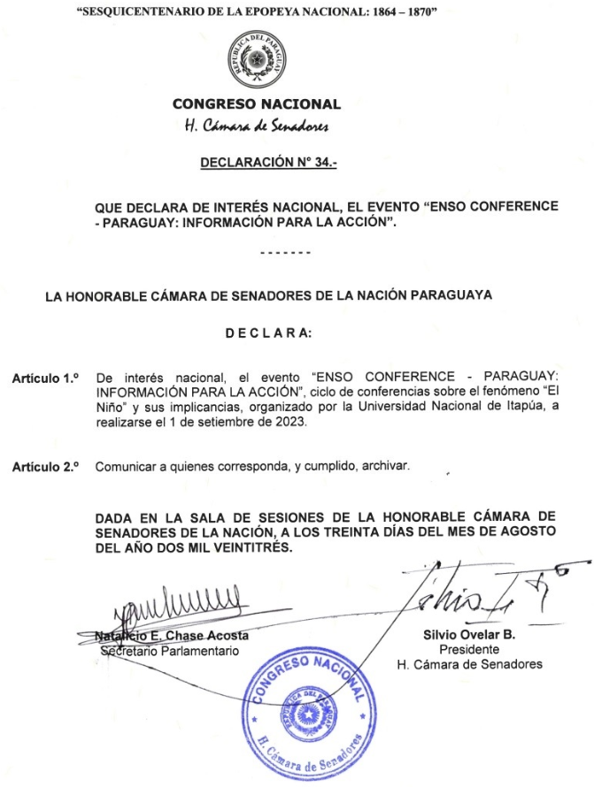
Example of Paraguay
Congress declared an ENSO training of national interest
AEP attending and participating in CEOS WGCapD Meetings Regularly
Need of increasing workforce
Want to know what can be useful and capacity-building activities are extremely helpful

Slide 4
WGCapD Deliverables

Slide 5
WGCapD Deliverables
Overall there are traditional partnerships which consistently deliver
New partnerships are also formed and start to provide recurrent deliverables
WGCapD also helps in understanding which other capacity-building activities related to EO are carried out by the members

Slide 6
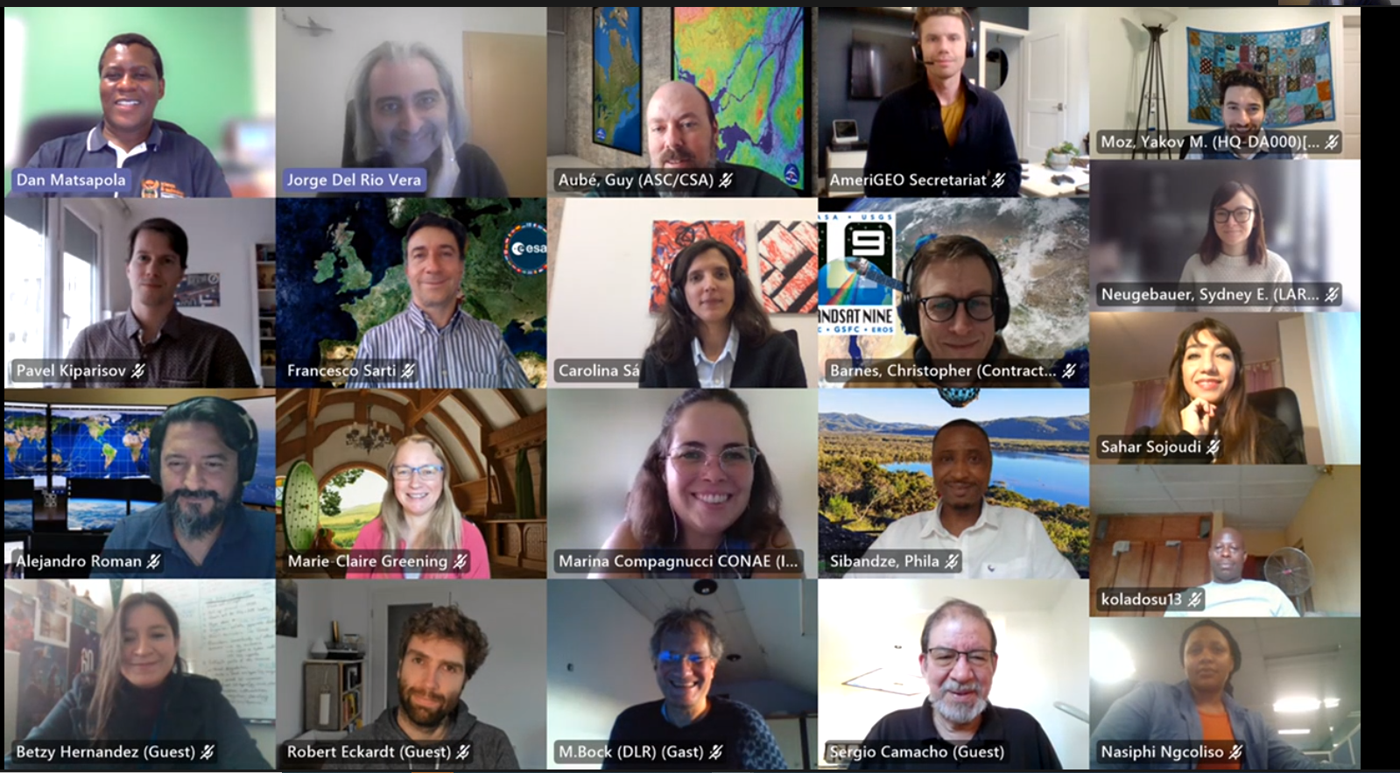
WGCapD-11

Slide 7
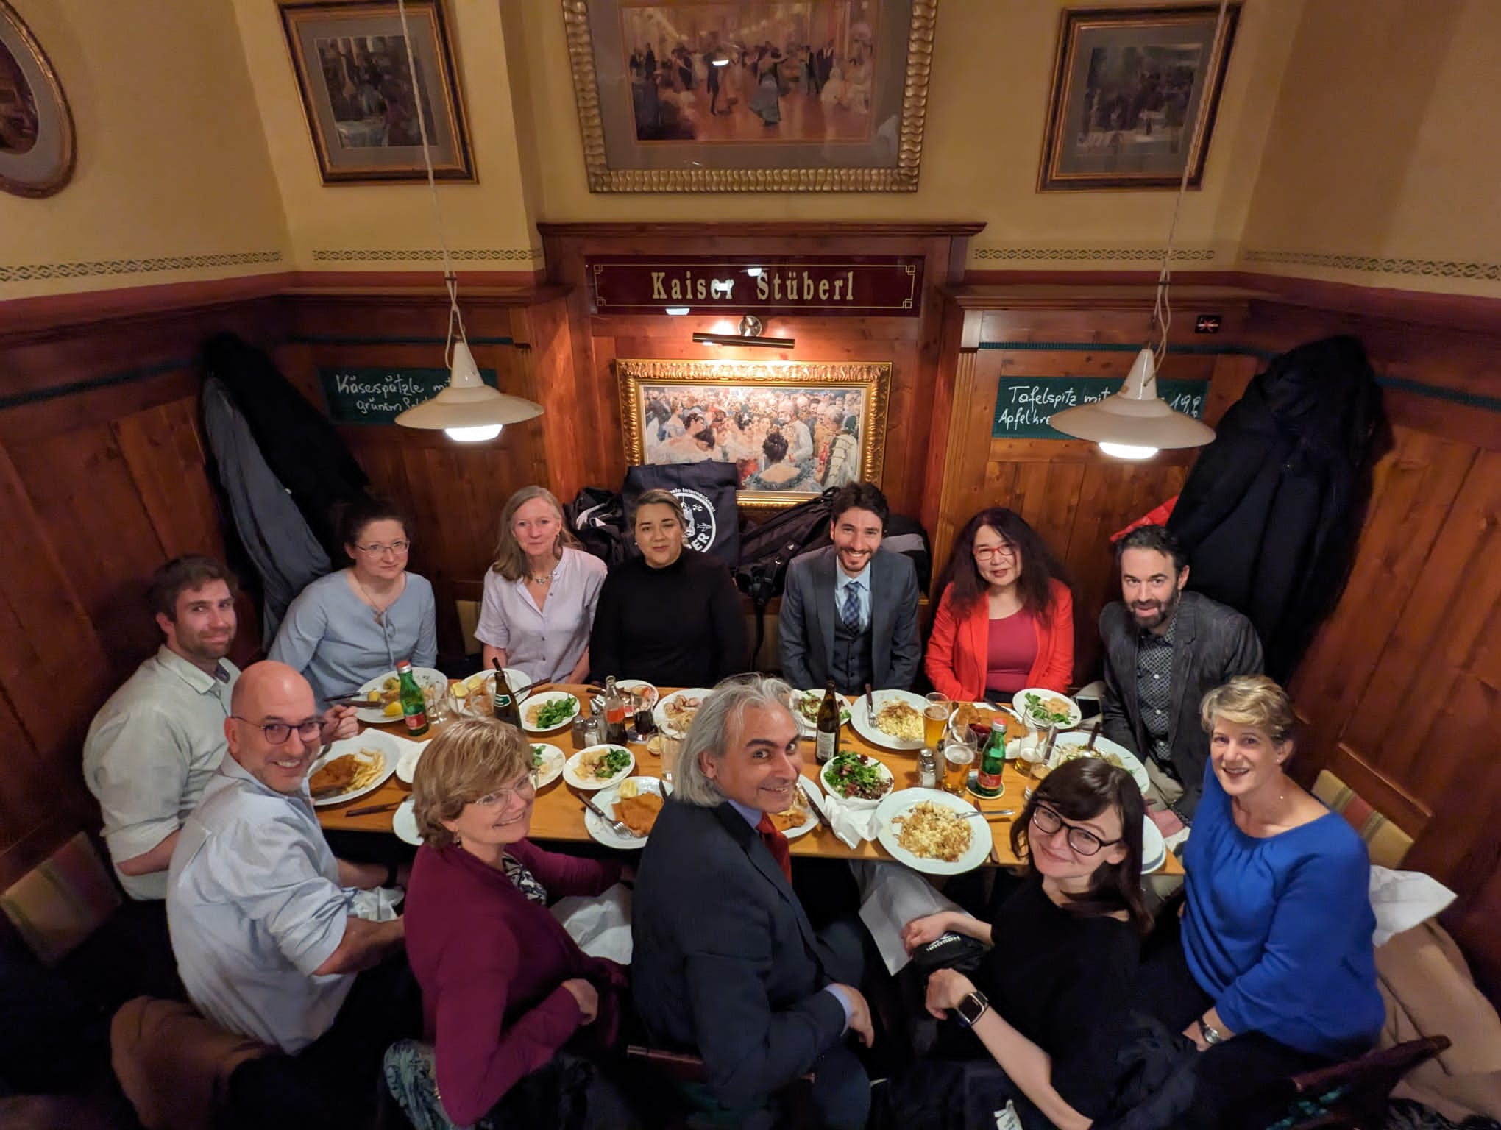
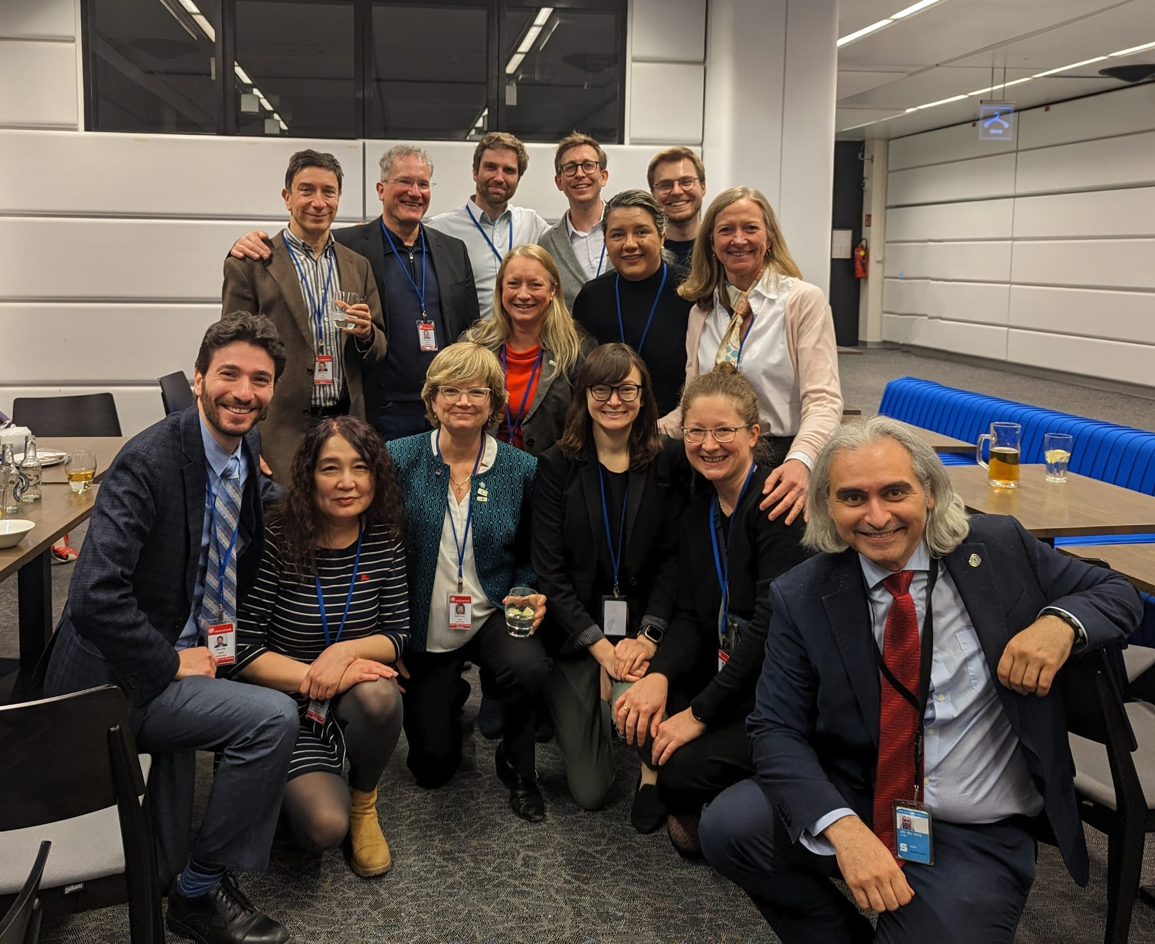
WGCapD-12

Slide 8
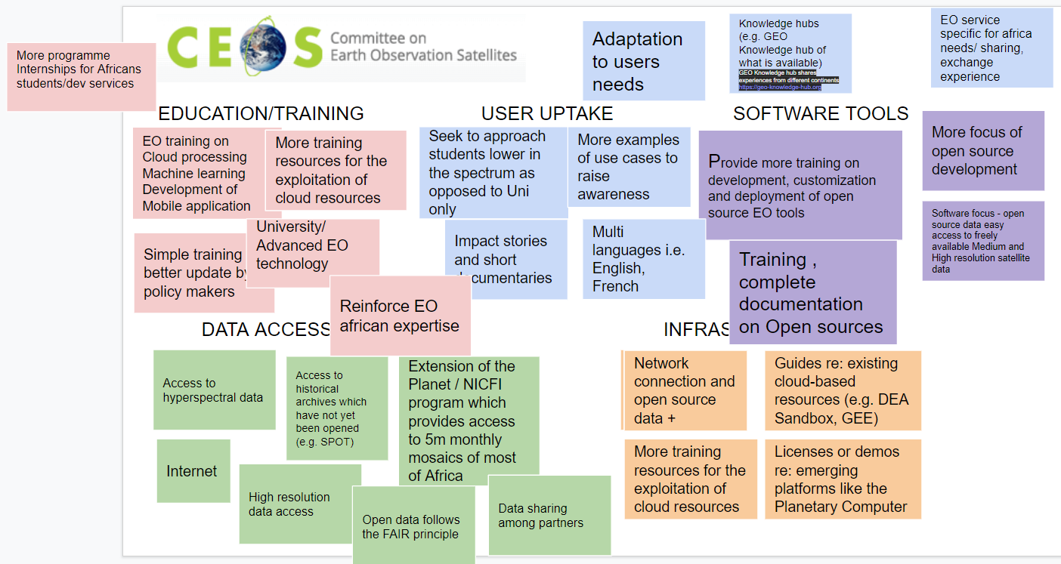
WGCapD Identified Needs:Africa

Slide 9
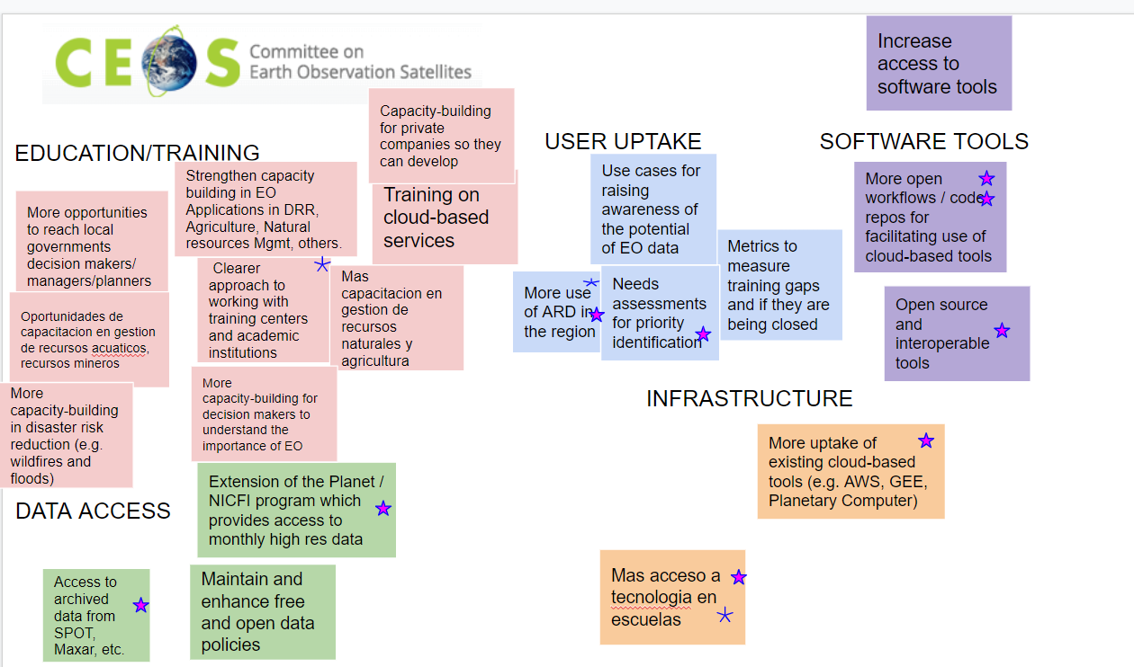
WGCapD Identified Needs: Americas

Slide 10
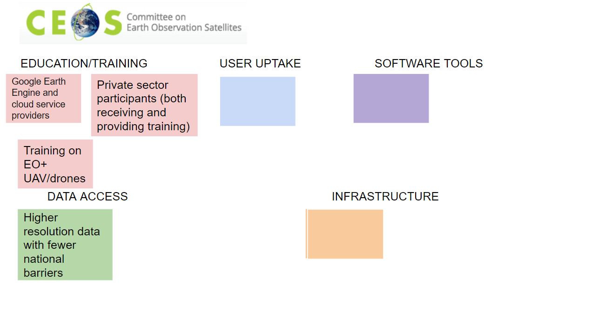
WGCapD Identified Needs: Asia

Slide 11
WGCapD Identified Needs: Europe

Slide 12
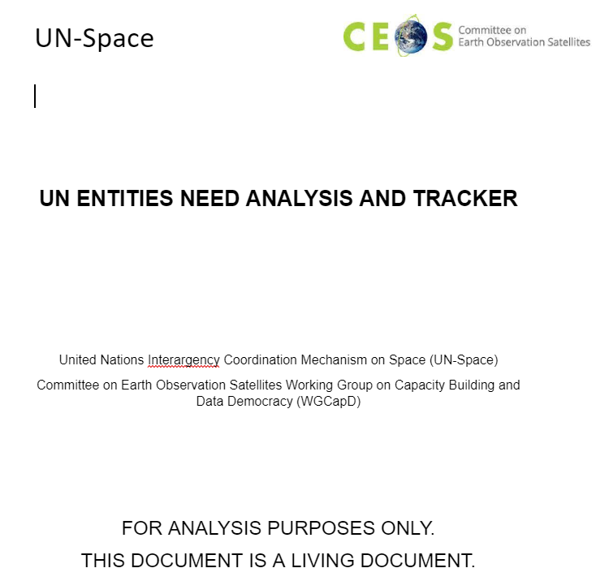
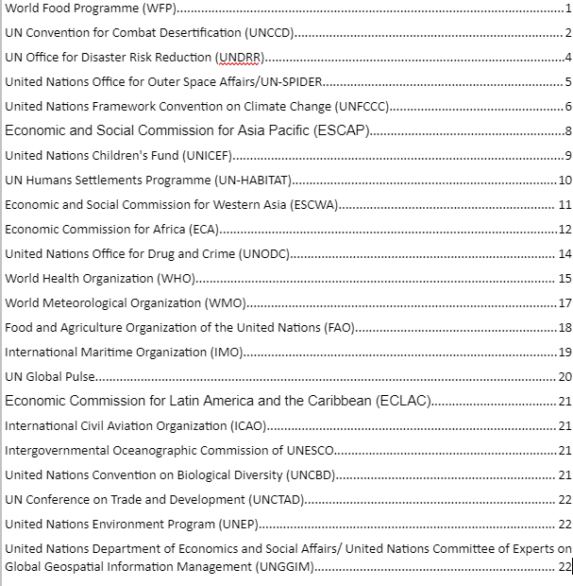
WGCapD Identified Needs: U.N.

Slide 13
What has been the role of WGCapD in the last 2 years?
Link to other WGs
Need for more integration
Link to the UN System – UN-SPACE
Effectiveness
Gateway for new and emerging space agencies
Entry gate for those interested in acquiring capabilities

Slide 14
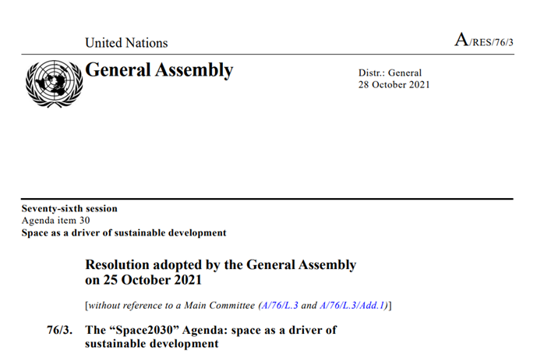
What has been the role of WGCapD in the last 2 years?
Link to policy-making
X-Band Frequency Issue
“Space2030” Agenda
EOTEC DevNet
Networks of Networks for Capacity-Building

Slide 15
The Earth Observation Training, Education, and Capacity Development Network at a Glance
Network of networks
Effort launched in 2021, communities of practice formed in 2022
700+ people are engaged
Aims:
Improve collaboration among EO-capacity building providers
Foster exchange of capacity building resources
Reduce duplication of effort
Thematic focus:
Disaster risk reduction
Climate adaptation and mitigation
Founding partners and leadership team
eotecdev.net @EOTEC DevNet #EOTECDevNet
‹#›

Slide 16
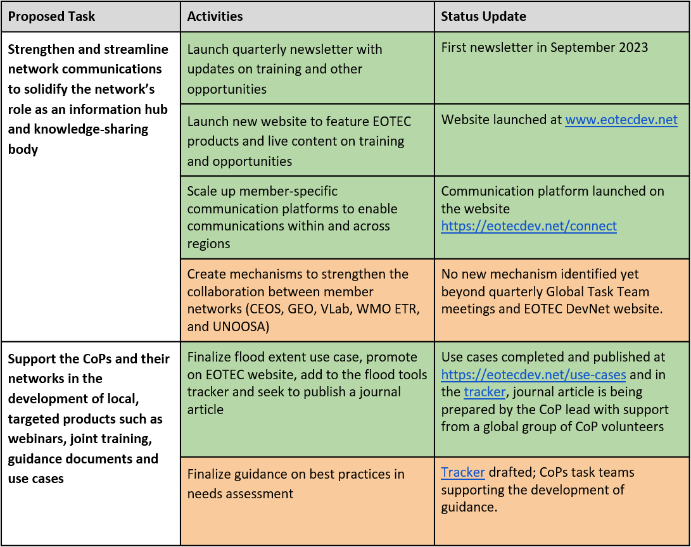
Implementation of 2023-2025 Strategic Plan on track
Status as of September 2023:
11 tasks completed
8 tasks in process
4 tasks not yet started
Detailed status report
Based on 2023-25 tasks listed in report to CEOS on pilot phase and future strategy (March 2023)
‹#›
‹#›

Slide 17
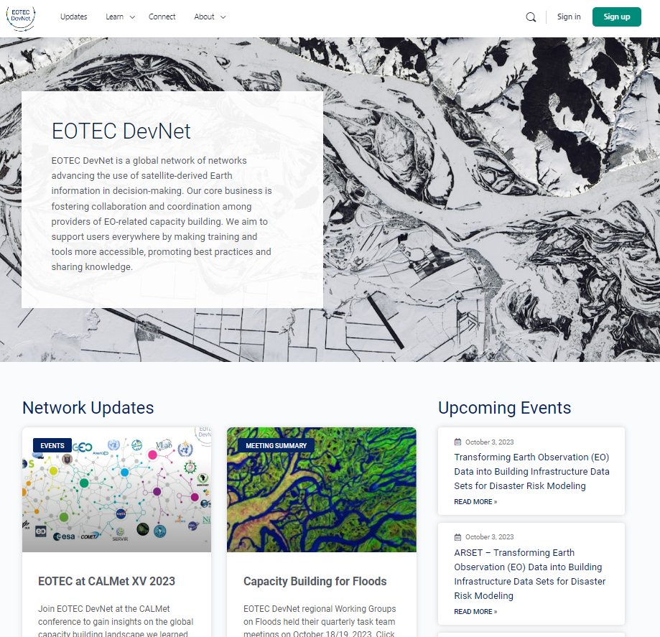
Portal at www.EOTECDev.net
Key features
Upcoming events
Member spotlights and webinar recordings
Tools and use cases
Training events calendar integrated with CEOS Training Calendar
Communications platform with 120+ registered members to engage between meetings
‹#›
‹#›

Slide 18
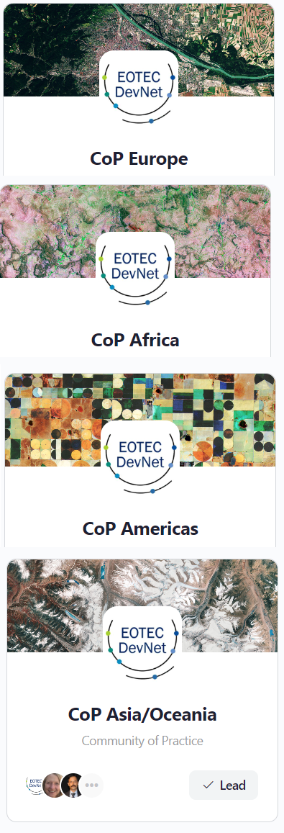
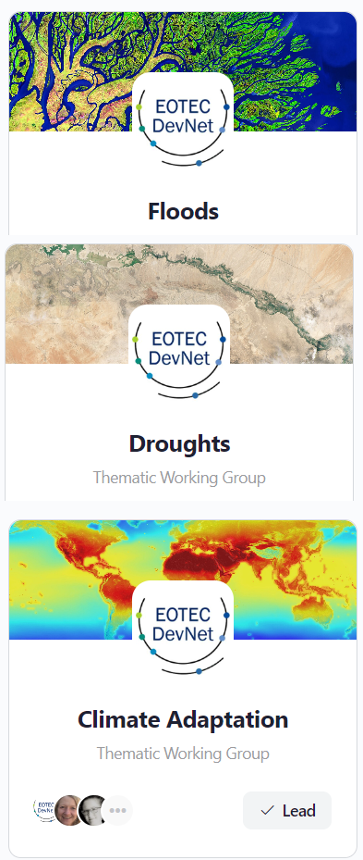
Supporting Growth
Sustainability
NASA and EO College (University of Jena) are supporting the Secretariat
New grant secured from Germany for support through 2026
Will seek further funding and collaborations to support growth
CEOS Ask:
Overall endorsement of the approach
CEOS SEO support for trackers and calendar integration
Encouraging members to participate in Communities of Practice and Thematic Working Groups
‹#›

Slide 19
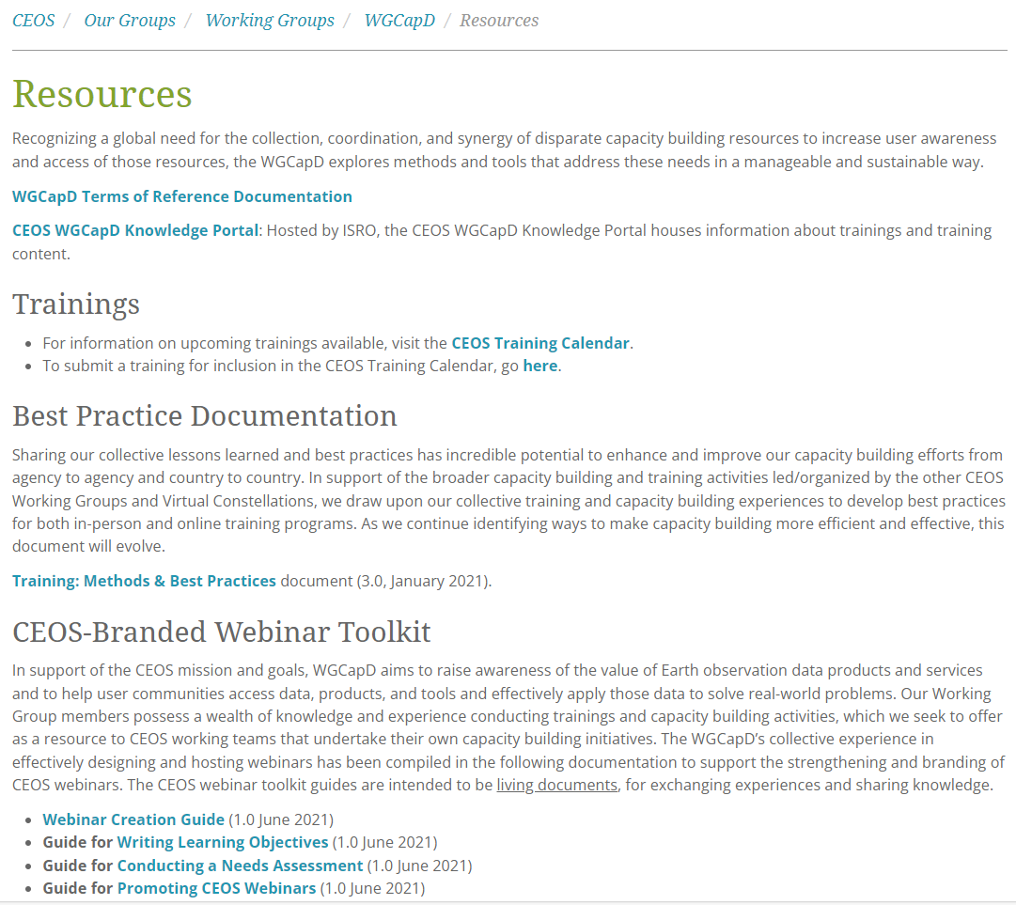
Reflection – where are the strengths?
Needs assessment
Toolkits
Calendar
Reusability of CB resources
Use of new tools
Reach
But more importantly…
You

Slide 20
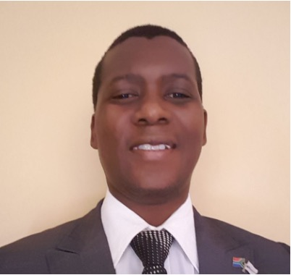
What is next for CEOS WGCapD?
Dan Matsapola (SANSA) Julio Castillo (AEM)
Chair Vice-Chair (for endorsement)

Slide 21
Thank You
Jorge Del Rio Vera, WGCapD
Agenda Item 6.3
37th CEOS Plenary
15 - 16 November 2023
Chiang Rai, Thailand
Hosted by GISTDA

