Slide 1
37th CEOS Plenary
WGISS Reports, - Endorsement: Interoperability Framework - AI/ML White Paper Initiative - Endorsement: Vice Chair Nomination
Makoto NATSUISAKA, WGISS Chair/JAXA
Tom SOHRE, WGISS Vice Chair/USGS
Agenda Item 6.2
37th CEOS Plenary
15 - 16 November 2023
Chiang Rai, Thailand
Hosted by GISTDA

Slide 2
Interoperability Framework
Interoperability Framework

Slide 3
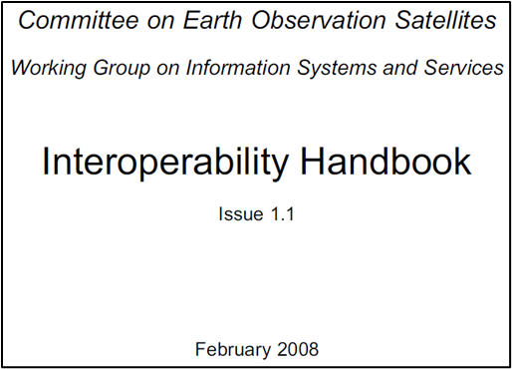
Background
Interoperability challenge discussed at 2022 CEOS Plenary
Development of a CEOS Interoperability Framework and Roadmap needed
Goal to consider Data and Service Interoperability
Assigned to WGISS w/ goal of building upon WGISS expertise and prior work
Reference Interoperability Definition(s):
Interoperability is the “ability of two or more systems or components to exchange information and to use the information that has been exchanged.”
ISO 25964 Thesauri and Interoperability with other Vocabularies (ISO 25964-2:2013)
F.A.I.R. Interoperability: Data is interoperable when it can be integrated with other data and systems to leverage open standards and specifications.
The FAIR Guiding Principles for scientific data management and stewardship | Scientific Data (nature.com)

Slide 4
Framework Collaboration
WGISS Re-initiated the
Data Interoperability and Use Interest Group
CEOS WGISS
CEOS SEO
CEOS ARD OG
CEOS WGCV
Other WG/VC
The WGISS Interoperability Group has
participation from approximately 45 CEOS members

Slide 5
Framework Development Activity
Discussed Interoperability Goals and Challenges
Reviewed Interoperability History within CEOS
Reviewed reference Interoperability Frameworks
Iterated on potential Framework components … agreed on (5) “Factors”:
Developed a Roadmap aligning CEOS Work Plan with Framework Factors
Peer reviewed Framework WGISS WG (April), WGCV WG (June), CGMS (June), LSI-VC (Oct), SIT-TW (Oct)
Agenda item at WGISS-56 (Oct) with Presentations from SEO, NASA, USGS, DLR, and GA/SANSA
Vocabulary (Semantics)
Architecture
Interface (Accessibility)
Quality
Policy

Slide 6
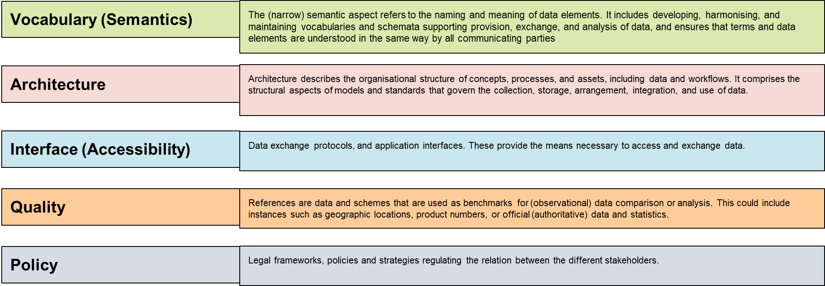
Interoperability Framework

Slide 7
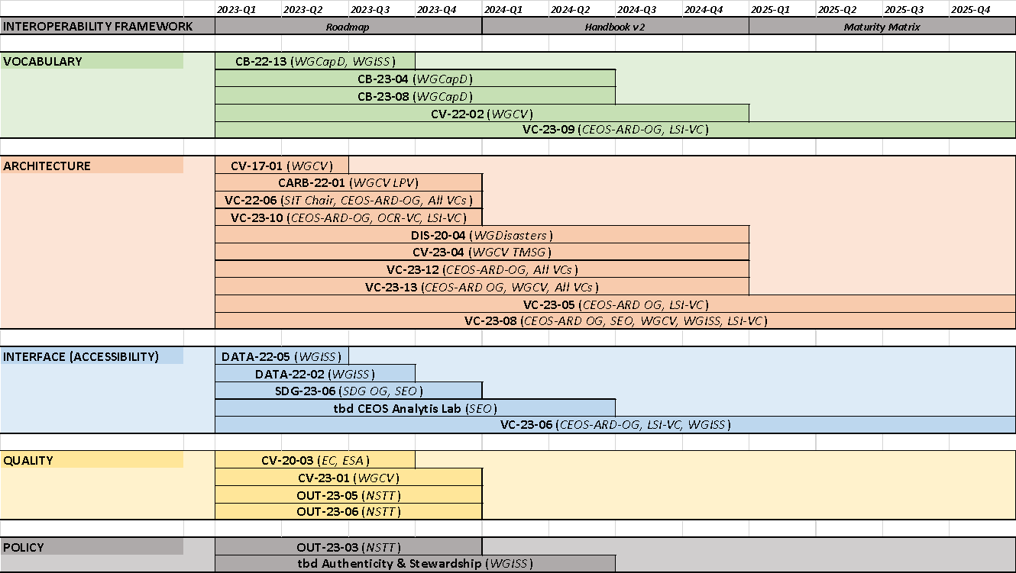
Framework Roadmap

Slide 8
Framework/Roadmap Next Steps
Framework will benefit from Factor “champions” to guide implementation
Continue cross-CEOS Data and Interoperability Interest Group, led out of WGISS
Develop CEOS Interoperability Handbook 2.0
Activities may (likely) support more than one Factor
Develop matrix of activities to Factor(s)
Activities benefit from the Factors as well as contribute to improving the overall Framework maturity
Identify Use Cases (Demonstrators) for Framework
Develop a Maturity Matrix (measure improvement & communicate ongoing maturity)
Initial Roadmap identifies existing activities, but this will be an ongoing effort
Identify gaps and propose new supporting efforts

Slide 9
CEOS Interoperability Summary
At the 2022 CEOS Plenary, CEOS Principals confirmed that coordination of interoperability related work remains within the WGISS perimeter. WGISS was invited to propose an interoperability roadmap at SIT-38, considering the CEOS Interoperability Framework concept developed and presented by LSI-VC. (Decision 36-09).
WGISS has coordinated across CEOS groups (ARD OG, LSI-VC, SEO, WGISS, WGCV, etc.) to develop a framework and mapping of CEOS activities / groups / people to each interoperability factor.
WGISS requests endorsement of the proposed Interoperability Framework and initial Roadmap.
Thanks for support of this effort!

Slide 10
AI/ML White Paper Initiative
AI/ML White Paper Initiative

Slide 11
Background and Scope
The Technology Exploration interest group explores innovative and state of art technologies (e.g. Cloud Computing, Machine Learning), which can improve the impact and exploitation of EO satellite data.

Slide 12
Background and Scope
Challenges for AI (Artificial Intelligence) and ML (Machine Learning) by CEOS members have been shared in the Technology Exploration Group.
Meeting | Title | Presentor
WGISS-46 (2018) | Artificial Intelligence and Machine Learning: Possible Applications in the EO Domain | Sveinung Loekken (ESA)
WGISS-47 (2019) AI & ML session | Workshop on Leveraging AI in the Exploitation of Satellite EO and Numerical Weather Prediction | Sid Boukabara (NOAA)
 | AI for EO and EO for AI | Sveinung Loekken (ESA)
 | Machine Intelligence Towards Tomorrow’s Earth Science Data Systems | Manil Maskey (NASA)
 | A New Large-Scale Sentinel-2 Benchmark Archive to Drive Deep Learning Studies in Remote Sensing | Begum Demir (TU Berlin)
 | Multi-task Deep Learning from Sentinel-1 SAR: Ship Detection, Classification and Length Estimation | Clement Dechesne (UMR CNRS)
 | CNES Initiatives on AI | Pierre Lassalle (CNES)
WGISS-50 (2020) | Artificial Intelligence at the service of Geospatial Information | Pierre-Marie Brunet (CNES)
WGISS-52 (2021) | NEODAAS AI Service or PML with AI and Machine Learning | Katie Awty-Carroll (PML/UKSA)

Slide 13
Background and Scope
AI/ML Task Team, which was organized after WGISS-52, has been discussing the activities in the team and the idea about AI/ML white paper was proposed at WGISS-55 (2023).
Meeting | Title | Presentor
WGISS-54 (2022) | NOAA Center for Artificial Intelligence | Robert Redmon (NOAA)
 | Enhancing Earth Observation Applications Using AI/ML Techniques | Nitant Dube (ISRO)
 | Machine Learning and Graph | Doug Newman (NASA)
 | USGS AI/ML Use Cases | Tom Sohre (USGS)
 | New AI/ML Keywords Being Introduced to GCMD | Valerie Dixon (NASA)
WGISS-55 (2023) | Proposal for AI/ML Survey in WGISS | Yosuke Ikehata (JAXA)
The initiative is included in the CEOS work plan 2023-2025. The deliverable is expected to be the AI/ML white paper to be issued in 2024 Q4. (DATA-23-01)

Slide 14
AI/ML Task Team
Lead: Yosuke Ikehata (JAXA)
Alan Cantin | NRCAN | Douglas Rao | NOAA | Mark de Jong | NRCAN
Andrew Eddy | Athena Global | Esther Conway | UKSA | Mirko Albani | ESA
Andrew Mitchell | NASA | Guoqing Li | RSGS | Nitant Dube | ISRO
Cristian Rossi | UK | Iolanda Maggio | ESA | Oyoshi Kei | JAXA
Dana Ostrenga | NASA | Ishihama Naoki | JAXA | Richard Moreno | CNES
David Borges | NASA | Keishiro Nakamoto | JAXA | Rob Redmon | NOAA
David Moffat | PML | Ken Casey | NOAA | Rustem Albayrak | NASA
Diane Davies | NASA | Kristi Kline | USGS | Tom Sohre | USGS
Diane Knappett | UK | Makoto Natsuisaka | JAXA | Tyler Stevens | NASA
Doug Newman | NASA | Maral Bayaraa | UK | Valerie Dixon | NASA

Slide 15
Motivations
AI/ML technologies are getting to be used to the Earth observations. In the CEOS community, some members have already employed those to their applications, but the knowledge (What can those do? How can we use? To whom can we ask? Where can we find references?) is scattered.
To summarize those knowledge would be productive for AI/ML beginners by reducing associating learning costs.

Slide 16
Concepts
The white paper should focus on “AI/ML use cases in the Earth observations” and doesn’t involve detailed information about theories nor algorithms, since there has already been a lot of lecture books, review papers, etc.
Main target of the white paper are expected to be application developers who try to develop AI/ML applications for the Earth observations but have never tried those.
Simple descriptions and reference lists (reverse lookup?).
Easy to update (Wiki, Git, etc.., TBD)
Contribution for the capacity buildings

Slide 17
Draft Table of Contents (Version 0.4 )
(Under Discussions)
1. Purpose of this document
2. Expected readers
3. Project members
4. Background
5. Standards
5.1. ISO
5.2. OGC
6. Initiatives and Programs
6.1. NASA (ESDIS, IMPACT)
6.2. NOAA/NCAI
7. Usage methods of machine learning and AI for Earth observation
8. Use cases of machine learning and AI for WGISS
8.1. Agriculture
8.2. Marine monitoring
8.3. Climate

Slide 18
Milestone
Proposal
Reorganize
Draft Version
Published
WGISS-55
WGISS-56
WGISS-57
WGISS-58
2023 Apr
2023 Oct
2024 Mar
2024 Oct
AI/ML TT Monthly Meetings
Solicitation of Contributors
Discussions on Table of Content
AI/ML TT Monthly Meetings
Discussions
Text Each Section
AI/ML TT Monthly Meetings
Draft Version Review in the TT
Request Comments from CEOS
Report to SIT-TW 2024

Slide 19
Future Vision
The AI/ML white paper will continue to be updated, since the AI/ML technologies and services are progressing day by day. The format of the document might be changed into Wiki or Git style to make the update easier.
The initiative will contribute to the capacity buildings with and/or through EOTEC DevNET etc..

Slide 20
Presentation Summary
WGISS has initiated AI/ML white paper initiative since 2023. The initiative explores AI/ML use cases for the Earth observations and will summarize those into the AI/ML white paper by 2024 Q4 (DATA-23-01).
Main target of the white paper are expected to be application developers who try to develop AI/ML applications for the Earth observations but don’t have the experience.
The initiative will contribute to the capacity buildings with and/or through EOTEC DevNET etc.. in future.

Slide 21
WGISS Vice Chair Nomination
WGISS Vice Chair Nomination

Slide 22
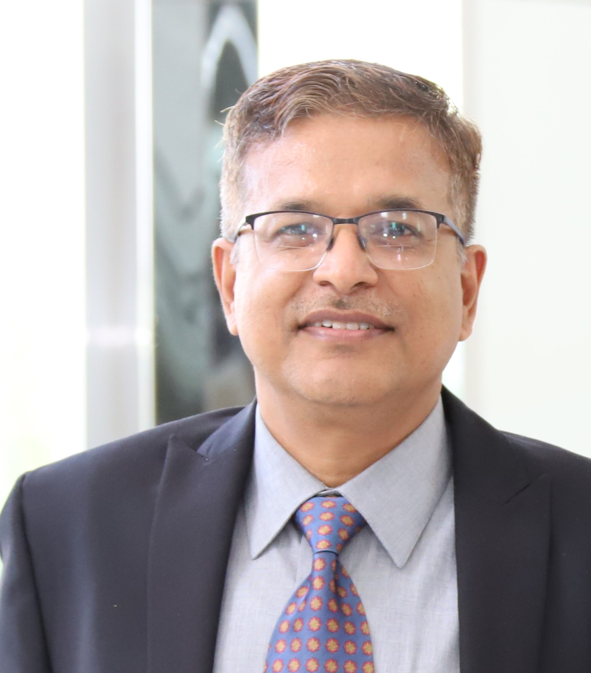
WGISS Vice Chair Nomination
ISRO proposed to nominate Dr. Nitant Dube, who is the group director of MOSDAC Research Group at Space Applications Center of ISRO (SAC-ISRO)
30 years career at SAC-ISRO in design development and operationalization of Earth observation data processing systems, development of geospatial applications and Earth observation data life cycle management
Long term contributions for WGISS since 2012
WGISS requests endorsement of the proposed nomination.

