Slide 1
Working Group on Calibration & Validation (WGCV)
Philippe Goryl,
Cody Anderson
Agenda Item 6.1
37th CEOS Plenary
15 - 16 November 2023
Chiang Rai, Thailand
Hosted by GISTDA

Slide 2
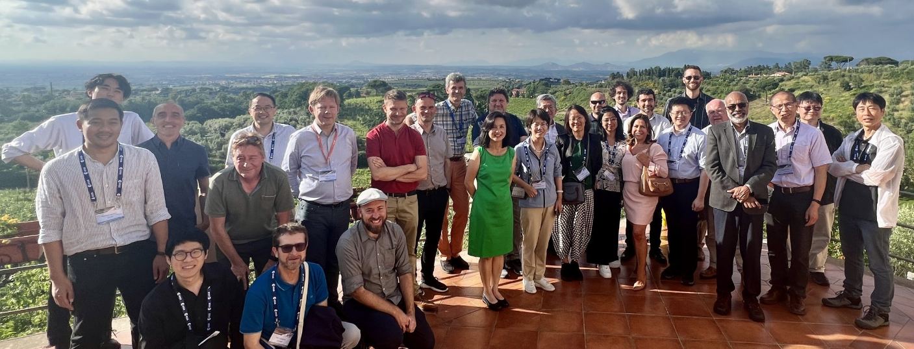
WGCV-52 in Frascati, Italy
Held from 5-9 June 2023, in ESA/ESRIN, Frascati Italy

Slide 3
WGCV Subgroup Updates
TMSG:
Held first in-person meeting since re-activation in Iasi, Romania, on occasion of the Geomorphometry 2023 conference
DEMIX close to finalisation, peer-reviewed publication submitted and final report expected by end 2023
Active and fruitful cooperation with International Society for Geomorphometry (ISG) developing and implementing new benchmarking method ('wine contest')
New initiative attempting intercomparison of Ground Control Points (GCP) for global harmonisation of orthorectification proposed: Seeking agencies support!
SAR:
SAR subgroup met at DLR in October 2023, meeting held in conjunction with TerraSARx/Tandem-X science team meeting.
Space agencies are actively working on sharing of cal/val resources, RFI mitigation, CEOS ARD;
SAR subgroup announced a new Chair Dirk Geudtner, ESA, and Vice-Chair: Stephane Cote, CSA.

Slide 4
WGCV Subgroup Updates Contd.
LPV :
LPV is busy with protocol development in the following Focus Areas: Burned Area, Phenology, Vegetation Index, Land Cover, and Global Downward Radiation Product. Also, Soil Moisture has been promoted to Validation Stage 4.
CEOS-LPV and GEOGLAM organised 3 days workshop with aim to develop good practices for validation of crop and crop type maps and related crop area estimation. A peer-reviewed paper on definition of community good practices for accuracy assessment of cropland and crop type maps is in preparation to be published in end of 2023. Summary of the paper will be also included in the CEOS-LPV good practices protocol for Land Cover,currently in preparation. The first version of this protocol is expected to be released in Q4 2023 for internal review within CEOS.
IVOS :
Meeting held in September 2023, in Germany.
Discussion on solar irradiance spectrum, identified radiometric, geometric and spatial sites for developing New Space match up database.

Slide 5
WGCV Subgroup Updates Contd.
MSSG:
Progressing CV-23-05: Retrieval and validation with high winds with combined active-passive microwave measurements and CV-23-06: Retrieval and validation of sea surface atmospheric pressure with microwave remote sensing.
ACSG:
Progressing CV-20-01: Validation Protocols for Atmospheric Aerosol and Cloud Profiles
Cal/Val contributions to VC-20-01 (tropospheric ozone) and VC-20-02/03/04 (coordination of Air Quality Constellation validation)
Recommendations for sustainability of GHG column Cal/Val networks (NDACC, TCCON, COCCON): Seeking agencies support!
Joint meeting with AC-VC held in October 2023, in Belgium. Discussed on needs, synergies and way forward for the Cal/Val of the GHG, Air Quality and Ozone constellations.
Agreement to work on an Atmospheric Composition Cal/Val Resources document similar to the Hyperspectral document.

Slide 6
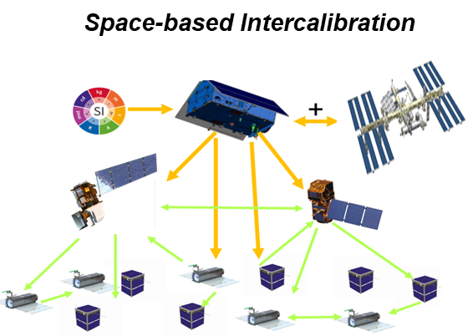
SI-Traceable Satellite (SITSat) Task Team
International activities around SI-Traceable data for Climate Monitoring from Space, including plans to launch SITSats
Task Team to consider the coordination strategy for SITSats proposed at WGCV-51 (October 2022) and endorsed by CEOS Plenary 2022
Initial tasks:
Develop ToR, Objectives, Membership, Lead(s), Work Plan, Outputs / Deliverables
Agree on clear definition of criteria that constitute a SITSat
Use ‘well-defined’ examples in Solar reflective domain as a starting point
SITSat Task Team Terms of Reference endorsed at WGCV-52. Consensus in
WGCV for Task Group to be a joint initiative with GSICS
Deliverables:
Establish a clear definition of what constitutes a SITSat and minimal requirements needed to evidence this status
Develop a roadmap (whitepaper) of what a SITSat enabled observing system looks like
Data sharing based on a systems approach
Communications strategy for awareness raising / key messages / utility for observing system / integrated multi-SITSat observing system

Slide 7
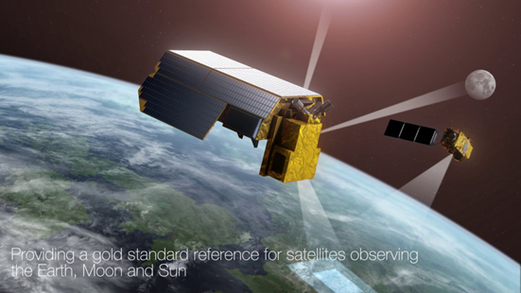
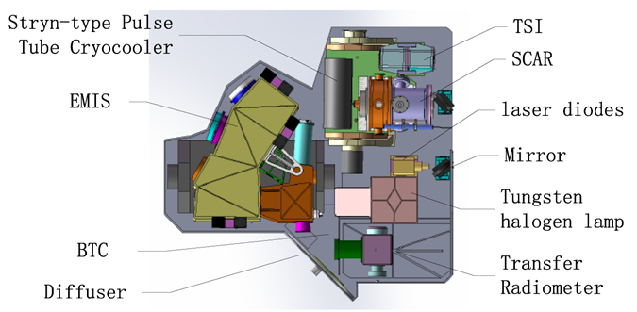
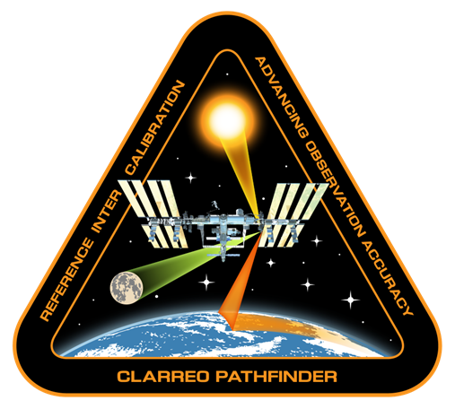
SITSats in Development
CLARREO PATHFINDER-NASA TRUTHS-ESA LIBRA-CMA
Task Team Updates:
Kickoff meeting held in 23 October 2023
Co-leads: Nigel Fox (UKSA) and Yolanda Shea (NASA)
Total Members: 19

Slide 8
CV-14-03: Pre-Flight Calibration Workshop
Discuss and promote best practices on pre-flight and onboard calibration of sensors; concentrate on passive optical instruments
Ongoing monthly meeting to discuss progress on workshop organisation
Workshop Dates:
November 19-21, 2024 at ESA ESTEC, Noordwijk, the Netherlands
November 22, 2024 for TIR satellite imagers being planned
Save the date announcement shared
Website for the meeting is being developed
More information will be made available at: https://ceos.org/meetings/workshop-on-optical-space-sensor-pre-flight-calibration-and-characterisation/

Slide 9
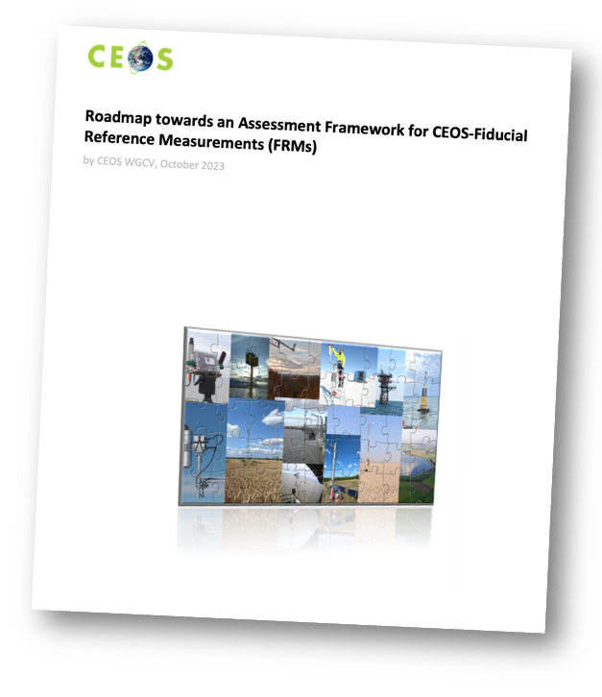
CV-23-01: Fiducial Reference Measurement
Assess maturity and compliance of a ‘Cal/Val reference measurement’ based on community-agreed CEOS-FRM quality criteria.
Document outlines a roadmap for endorsing specific measurements as FRMs and is accessible on the CEOS Cal/Val portal
WGCV members will conduct pilot projects to assess suitability
Possible examples: RADCalNet, ICOS, Baqunin, FRM4DOAS, Hypernets, Gobabeb, etc.
Results expected to be presented at WGCV-53
Welcome pilots from interested agencies
Goryl, P.; Fox, N.; Donlon, C.; Castracane, P. Fiducial Reference Measurements (FRMs): What Are They? Remote Sens. 2023, 15, 5017. https://doi.org/10.3390/rs15205017).

Slide 10
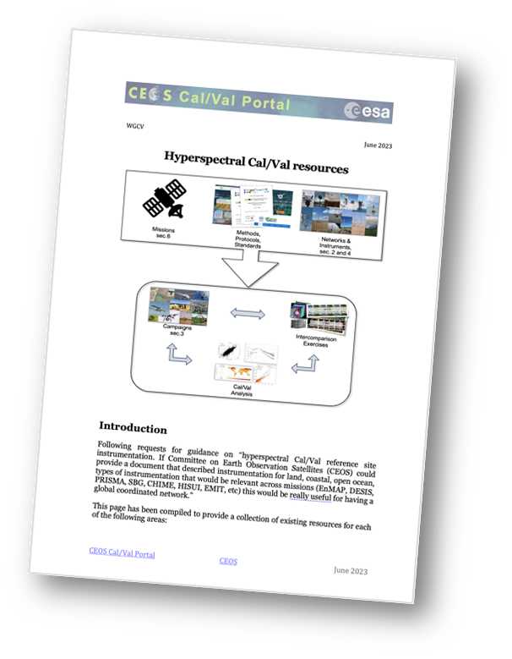
Cal/Val Portal Updates 2023
Software update Liferay® Updates
Info: Liferay Community Edition Portal 7.4.3.14 CE GA14 (Cavanaugh / Build 7403 / March 4, 2022)
Document on Hyperspectral Cal/Val Resources is available at: https://calvalportal.ceos.org/web/guest/hyperspectral-calval-resources
CEOS endorsed reference Solar irradiance spectrum: https://calvalportal.ceos.org/web/guest/solar-irrad-spectrum
Outreach : Introductory video for the CEOS Cal/Val portal. The first of a series of videos that will describe the platform's features and capabilities. https://youtu.be/SpDvqV-4qhs
thanks to Libby Rose (Symbios)!

Slide 11
Content Updates
SAR Subgroup Workshop.
CEOS SAR Cal/Val 2023 Workshop Announcement and website - New dedicated website for SARCalNet is in development phase.
ACSG provided input for Cal/Val sites. Plan for new website.
SALVAL (Surface Albedo VALidation) tool.
LPV DIRECT 2.1 database
New MSSG website pages – hosted in the Cal/Val Portal: Space-borne scatterometers and wind retrieval, more to come
Plan for a new Website, including DEMIX material
Dedicated page for Solar Irradiance Spectrum. WGCV actions, more to come
‹#›

Slide 12
Contribution to New Space
Provide references for calibration, validation, and data quality
Provide methods and protocols for cal/val, access to tools and expertise
Assessing the development of a “Match Up Database for New Space”
Comprising coincident satellite data together with Fiducial Reference Measurements (FRM) for radiometry, typically over RADCalNet sites

Slide 13
Intercomparison Exercises
ACIX: Atmospheric Correction scheme intercomparison
ACIX-I, ACIX-II completed results available in the cal/val portal. ACIX-III evolving towards hyperspectral using PRISMA and EnMap data.
CMIX: Cloud Masking scheme intercomparison
CMIX-1 results available. Initiated development of SkyCam - Ground based sky camera network for validation on satellite derived cloud masks.
DEMIX: DEM intercomparison and impact on orthorectification process
Close to finalisation, peer-reviewed publication submitted and final report expected by end 2023
BRIX: Intercomparison of Biomass algorithm retrieval
BRIX-2 was closed with two team providing preliminary results
SRIX4VEG: Intercomparison of Surface reflectance for vegetation
Result of SRIX4Veg I will be presented at 2023 November Workshop. SRIX4VEG II campaign being held in Australia in March 2024
CINDI-3 (Cabauw Intercomparison of Nitrogen Dioxide Measuring Instruments, May-June 2024): community-wide field intercomparison of MAX-DOAS, Mobile-DOAS (variability and tomography), airborne (TBC) + PGN/Pandora + suite of aerosol instruments + other trace gases
Notes:
This comparison framework facilitates the understanding and knowledge of the various products from New Space and space agencies allowing better harmonisation between missions.

Slide 14
Calibration Networks
Calibration Networks | Description | Current Status | Next Steps
RADCalNet | Provides SI-traceable TOA reflectances for post-launch radiometric cal/val of optical sensors. | Current sites: La-Crau (France), Railroad Valley (USA), two sites in Baotou (China), Gobabeb (Namibia) plus new sites expected to join the network. | Continuous collaborative efforts to maintain instrumentation in operation, process and quality control data and communicate with users. Growing user base and data uptake.
SARCalNet | Network of selected curated sites for SAR cal/val. | Dedicated website to collect databases of reference targets, demo data from different missions and relevant documentation is progressing well and will go live early next year. | Form working group for SARCalNet under SAR Subgroup Invite community to submit calibration sites
TIRCalNet | Dedicated to TIR optical sensors cal/val. | CNES in collaboration with NASA/JPL have deployed a JPL field radiometer at La Crau site. | Identify other candidate sites Discuss with partnering agencies on how to collaborate and set up and operate networks (funding for instrumentation, site operation, data analysis, supporting studies, etc.)

Slide 15
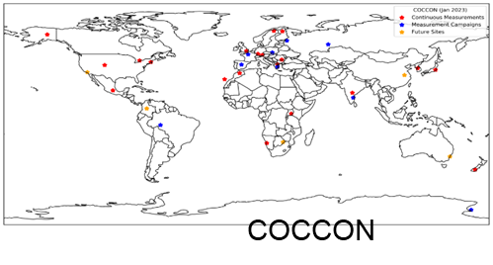
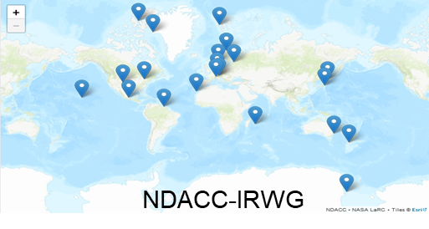
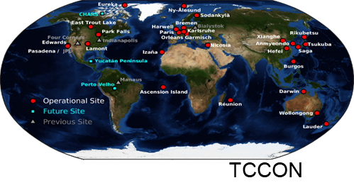
GHG Cal/Val Networks
NDACC-IRWG,TCCON and COCCON data increasingly recognised for satellite and model validation in various programmes: ESA ATM-MPC, EUM AC-SAF, CO2M validation, OCO-2/3, GOSAT series,TANSAT, Copernicus services (CAMS, C3S), ESA CCI (ozone, GHG, ozone & aerosol precursors)
Jean-Christopher Lambert (WGCV ACSG Subgroup Lead) proposed actions for network sustainability on behalf of the Networks team
Ahihiko Kuze from WGCV is GHG Task Team Cal/Val lead
Discussions between ACSG, WGClimate and GHG Task Team
Decided to incorporate the recommended actions into Annex C of the GHG Roadmap document
GHG recommendations were also presented at the AC-VC/ACSG joint meeting in Brussels.

Slide 16
WGCV Contribution to Interoperability Framework
VOCABULARY | CV-22-02: CEOS Terms and Definitions Wiki
ARCHITECTURE | CV-17-01 : L1 top-of-atmosphere interoperability, CV-23-04: Launch of a GCP Intercomparison Exercise, VC-23-13 : CEOS-ARD Product Assessments VC-23-08: CEOS Representation to the Open Geospatial Consortium (OGC) Analysis Ready Data (ARD) Standards Working Group (SWG) CARB-22-01: Production of harmonised biomass products from CEOS Agency missions
QUALITY | CV-20-03: DEMIX CV-23-01 : Develop an FRM Assessment Framework

Slide 17
Upcoming WGCV Plenary Meetings
WGCV-53
Córdoba, Argentina | March 5-8, 2024
Hosted by CONAE
WGCV-54
Sioux Falls, USA | Fall 2024 will be a joint meeting with WGISS
Hosted by USGS
Thanks to CONAE and USGS for offering to host!

Slide 18
Thank You!

Slide 19
WGCV Members’ Contributions to Cal/Val Standards
TBC – WGCV Team to add details, for awareness

