Slide 1
37th CEOS Plenary
Environment and Climate Change Canada Presentation for Associate Membership to the Committee on Earth Observation Satellites (CEOS)
David Harper
Director General
Monitoring and Data Services
Meteorological Service of Canada
Environment and Climate Change Canada
Agenda Item 5.1
37th CEOS Plenary
15 - 16 November 2023
Chiang Rai, Thailand
Hosted by GISTDA

Slide 2
Presentation Outline
Value of Satellite Earth Observation (SEO) for ECCC
Canada’s National Satellite Earth Observation Strategy
Canada’s recent investments in Satellite Earth Observation
International Satellite Earth Observation Governance
ECCC associate membership in CEOS
Funded missions and near-term priorities for ECCC

Slide 3
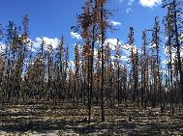
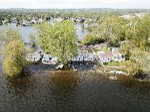
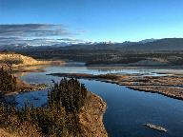
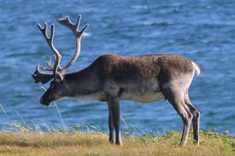
ECCC is the Largest Civilian Government User of Satellite Earth Observation (SEO) in Canada
ECCC data needs focus on:
Real-time data provision for operational applications
Large volume, time series for change detection
High latitude coverage over Canada’s vast landmass
Free and open access
More mature,
fully operational applications
Environmental forecasts, warnings, and information services (weather, ocean/waves, ice, air quality, UV, volcanic ash, etc.)
Enforcement (marine winds, ice, and oil pollution)
Climate and air quality monitoring and modelling
Emergency preparedness and response
Wildlife habitat assessment and analysis
Inland and coastal water quality monitoring
Ecosystem mapping for conservation
Emission estimation
Weather and Climate
Environmental Modelling
Emergency Response
Ecosystem Monitoring
Wildlife Habitat Assessment
Less mature,
emerging applications
Images subject to copyright.

Slide 4
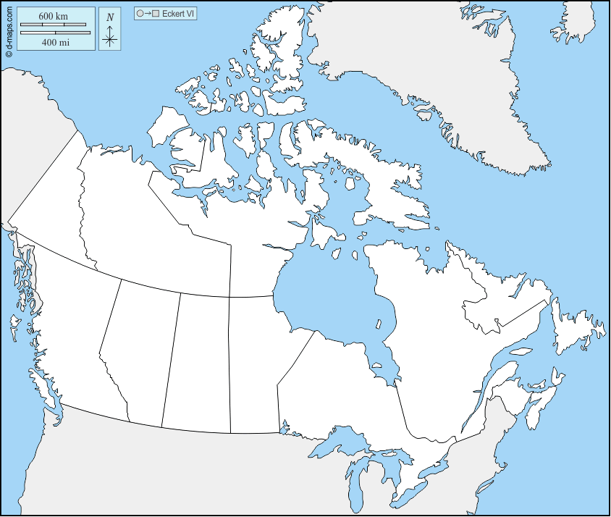
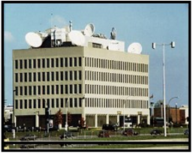
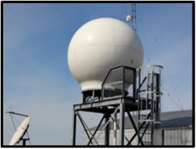
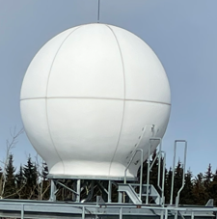
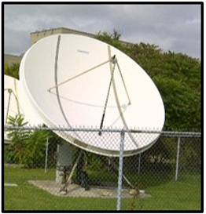
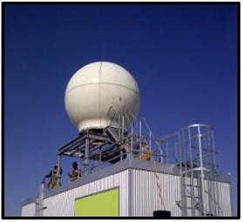
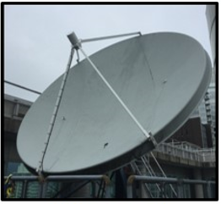
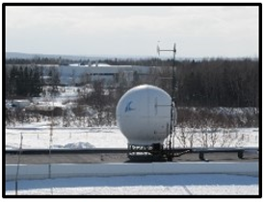
ECCC’s Satellite Reception Networks
GEOSTATIONARY
POLAR-ORBITING
Resolute (NU)
POES
RESOLUTE
CMC-DORVAL
Inuvik (NT)
POES New Site
Iqaluit (NU)
POES New Site
STONY PLAIN
Gander (NL)
POES Re-install
DOWNSVIEW
Stony Plain (AB)
POES Re-install
EDMONTON
Edmonton (AB)
POES
Dorval (QC)
GOES-R East & West
Vancouver (BC)
GOES-R West
Downsview (ON)
GOES-R East
VANCOUVER
GANDER

Slide 5
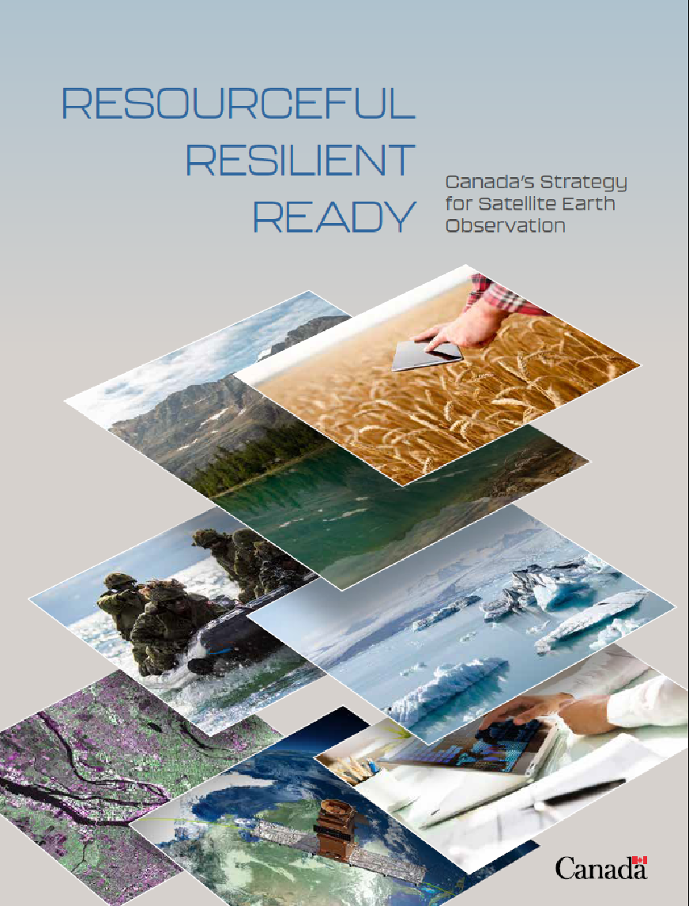
Resourceful, Resilient, Ready: Canada’s Strategy for Satellite Earth Observation (EO)
OBJECTIVE #1
OBJECTIVE #2
Ensure the benefits of satellite EO are maximized
Harness satellite EO to tackle climate change and issues that matter to Canadians
OBJECTIVE #3
OBJECTIVE #4
Strengthen delivery of critical services to keep Canadians healthy, safe, and informed
Inspire satellite EO skills and capacity development for the next generation
Images subject to copyright.

Slide 6
Resourceful, Resilient, Ready: Canada’s Strategy for Satellite Earth Observation
Maximize the benefits of satellite EO Enhance access to open data Thriving SEO sector Domestic and International partnerships | Tackle climate change and other key issues Climate change mitigation and adaptation solutions Key environmental and health indicators | Strengthen critical services Continuity of critical services Modernize critical ground infrastructure | Satellite EO skills and capacity development Promote SEO literacy Partner with indigenous communities
Review of the Remote Sensing Space Systems Act Negotiation of a Canada-Copernicus Data Sharing Arrangement MOU with EUMETSAT Development of Digital Earth Canada Surface Water Ocean Topography (SWOT) mission -launched in 2022 | GHGSat, Inc investment ($20M, November 2021) WildFireSat investment ($170M, B2022) High-altitude Aerosols, Water vapour and Clouds (HAWC) investment ($200M, 2022) Arctic Observing Mission pre-formulation ($6M) RADARSAT+ ($1B, October 2023) National Imagery Subscription Service pilot Exploring Terrestrial Snow Mass Mission | Investment in updating critical infrastructure to receive satellite data ($80M B2021) Earth Observation Service Continuity (RCM follow-on; $9.9M B2021) Considering development of a Status and Trends Program | SmartEarth ($8M announcement, Jan 2022) Satellite EO coordination office established (CSA, NRCan, ECCC). Formal MOU under review Earth System Data and Analysis Grants Investigation of capacity development options
Continued scanning for opportunities to align with other strategies, funding, and efforts across the federal government

Slide 7
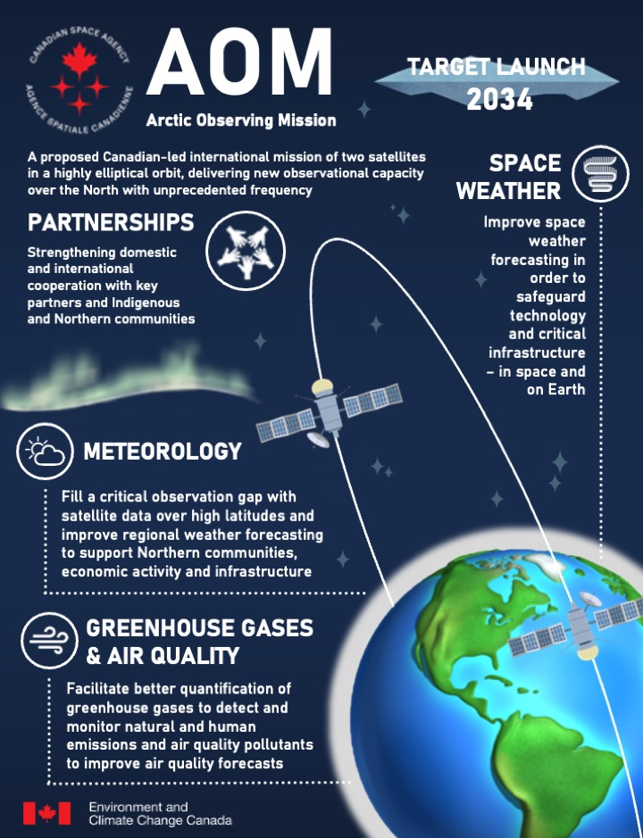
Near-term Priorities: Arctic Observing Mission (AOM)
A proposed mission of two satellites in a highly elliptical orbit, delivering new observational capacity on weather, greenhouse gases, air quality and space weather over the North with unprecedented frequency
AOM started a 2.5-year pre-formulation study in 2022 that will refine the options for the mission architecture and inform what is required for the design, implementation and operational phases of the mission
AOM International Expert Team includes members from NOAA, NASA and EUMETSAT, with ESA as an observer
The pre-formulation study is scheduled for completion in October 2024 with the outputs to be incorporated into AOM’s business case, to inform future budget ask for end-to-end mission funding
Images subject to copyright.

Slide 8
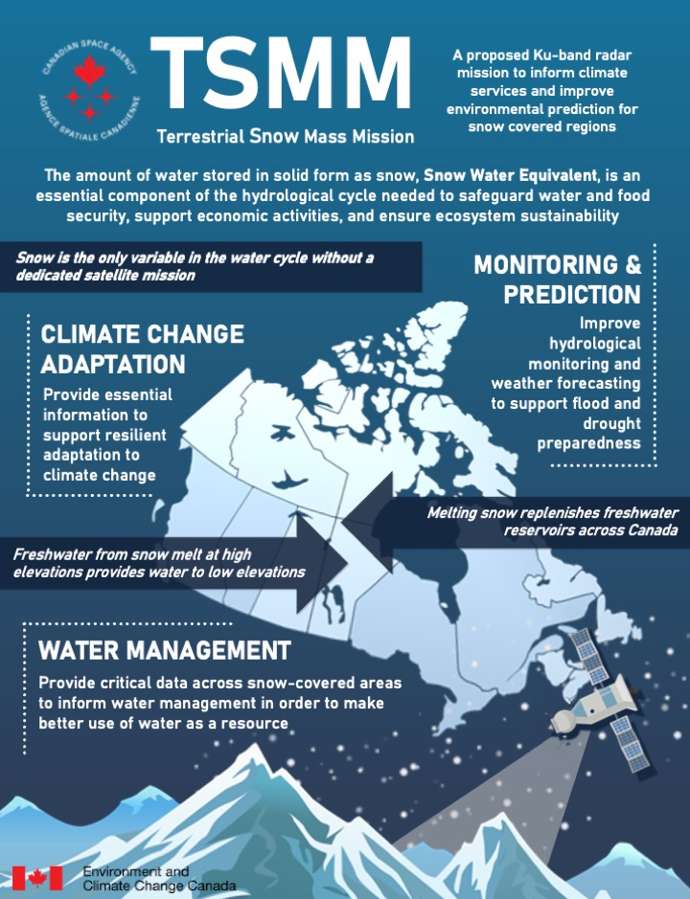
Near-term Priorities: Terrestrial Snow Mass Mission (TSMM)
TSMM will address a fundamental observational gap and enhance snow mass information required to safeguard water and food security, support economic activities, ensure ecosystem sustainability, and protect Canadians from flood and drought risks
Complete coverage of the Northern Hemisphere, which could be leveraged for Southern Hemisphere observations during the Arctic Summer
ECCC are mission leads in partnership with the CSA with strong international collaborations with NASA, EUMETSAT and the Finnish Meteorological Institute
Mission is in its pre-formulation phase and preparing for a funding request in fall 2023 for inclusion in Budget 2024-25
Images subject to copyright.

Slide 9
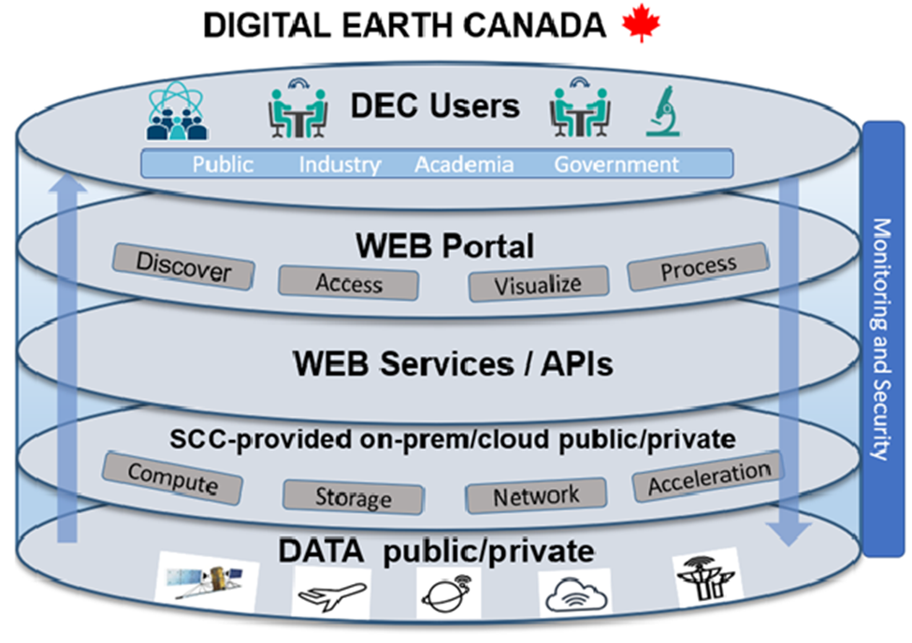
Near-term Priorities: Digital Earth Canada (DEC)
DEC is a cloud-based analytic environment to federate, process and analyze satellite EO data to support decision-making and spur science and innovation industry and academia
DEC is led by CSA, with ECCC, as a key collaborator working towards a DEC prototype, currently under development
DEC users will be able to exploit the full value of the data:
Easy and efficient access to data worldwide and a virtual and secure work environment
Toolbox of APIs and software to discover, access, visualize data and Earth System Models directly on the platform
Develop/publish/share workflows, products and results
Open-source technology and open standards that can be deployed and used in various environments (commercial cloud, on-premises, etc.)
Flexible and adaptable resources to quickly respond to shifting priorities
Scalable computational capacities for peak-demand and ML/AI-based workflows

Slide 10
ECCC’s Participation in SEO International Governance
GEO
Group on Earth Observations
CEOS
Committee on Earth Observation Satellites
EUMETSAT
European Organisation for the Exploitation of Meteorological Satellites
CGMS
Coordination Group for Meteorological Satellites
WMO
World Meteorological Organization
COPERNICUS
GEO Principal for Canada is from ECCC
GEO is an intergovernmental partnership that improves the availability, access and use of Earth observations for a sustainable planet
ECCC currently seeking Associate Member status
CEOS is the primary forum for international coordination of space-based Earth observations
CSA primary member for Canada
MOU re-signed in 2021 facilitates coop- eration between ECCC and EUMETSAT on meteorological satellites, climate and environmental monitoring from space and space weather
EUMETSAT is the European operational satellite agency for weather, climate and environment monitoring from space
ECCC is head of delegation for Canada’s Observer status in CGMS
CGMS is responsible for protection of in- orbit assets, improvement of quality data, support to users, facilitation of shared data access and development of satellite products in key applications
ECCC participates at all levels in various WMO groups
WMO, a UN agency is dedicated to international cooperation on the state and behavior of the Earth’s atmosphere, its interactions with the land and oceans, and the weather and climate it produces
Canada and the European Commission signed the Copernicus Cooperation Agreement in 2022
Copernicus is the EO component of the European Union’s space programme, offering information services on the Earth and its environment drawn from satellite EO and in-situ data
Influence international directions, gain knowledge, leverage relationships

Slide 11
Canada and CEOS: Activities and Contributions
Collaborative EO projects
International agreements
EO training
Technical information
CEOS Working Groups
Global initiatives
Access to Canadian experts for international partners
Representation of CEOS at the GEO post-2025 working group
Data exchange and coordination
Capacity building
Overall governance, including co-lead of the CEOS Ecosystem Extent Task Team (EETT)
Data and information on Canadian existing and planned missions
Scientific research and applications
Data policies and standards
Expertise and services for collaborations on cross-mission cal val activities
Information on Canadian existing and planned missions

Slide 12
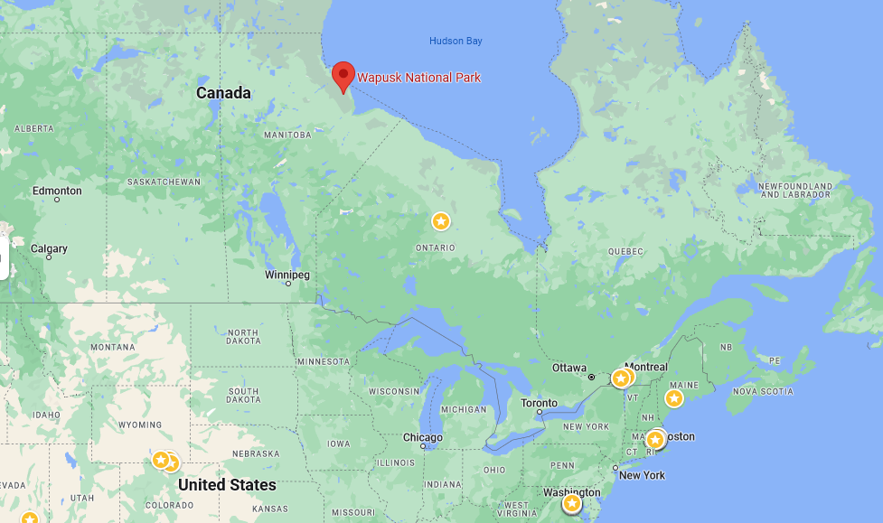
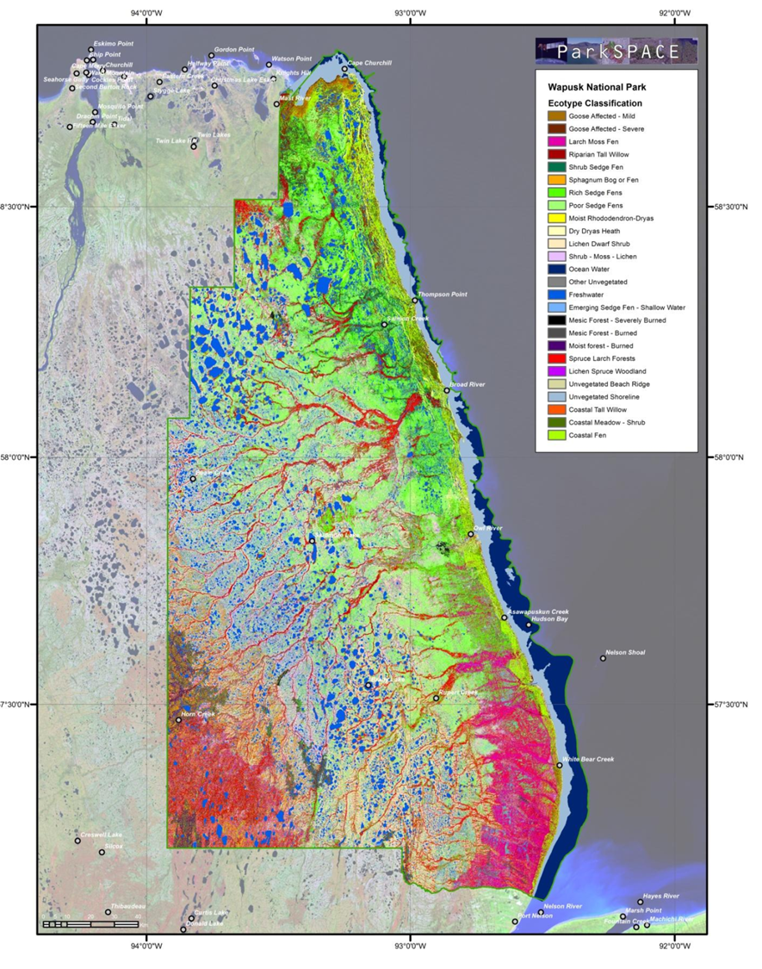
Canada is Active on Several CEOS Working Groups and Teams
Benefits of participation on CEOS working groups:
Maintain knowledge of activities from other national space agencies and organizations
Integrate Canadian data with other global partner datasets to maximize inter-operability
Increase Canada’s international impact, through coordination with federal departments & the EO industry in support of CEOS activities
Compare methodologies and techniques and share of information with international experts
Hudson’s Bay Lowlands CEOS EETT Demonstrator led by ECCC
Estimates ecosystem extent for each class and ecotype and produce detailed map of Wapusk National Park
Combines data from several EO sensors, in situ data and other sources, uses advanced classifiers and AI/ML methods
Uses the CEOS Analytics Laboratory
November 2024: demonstration and delivery at CEOS Plenary
Images subject to copyright.

Slide 13
ECCC Recognizes the Value of CEOS Associate Membership to:
Exchange scientific knowledge between international leaders and sharing of ECCC expertise on environmental monitoring practices using EO with the CEOS community
Complement current Canadian participation in CEOS working groups and expert teams
Ensure synergies realized between ECCC’s role on GEO, CGMS, CEOS and the WMO
Support CSA’s CEOS chairmanship role and the priorities of exploring a Post-2024 Strategy for CEOS, biodiversity and increasing policy linkages with the biodiversity community
Welcome further collaborations with foreign national space agencies and organizations as Canada’s planned SEO missions advance

Slide 14
Thank you for your attention and consideration of ECCC’s nomination for CEOS Associate Membership
David Harper
Director General
Monitoring and Data Services
Meteorological Service of Canada
Environment and Climate change Canada
David.Harper@ec.gc.ca

Slide 15
ANNEX SLIDES

Slide 16
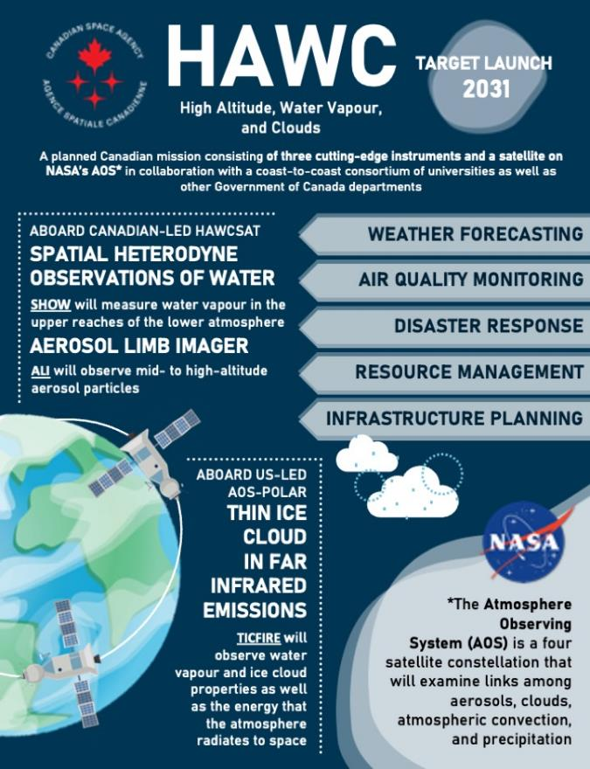
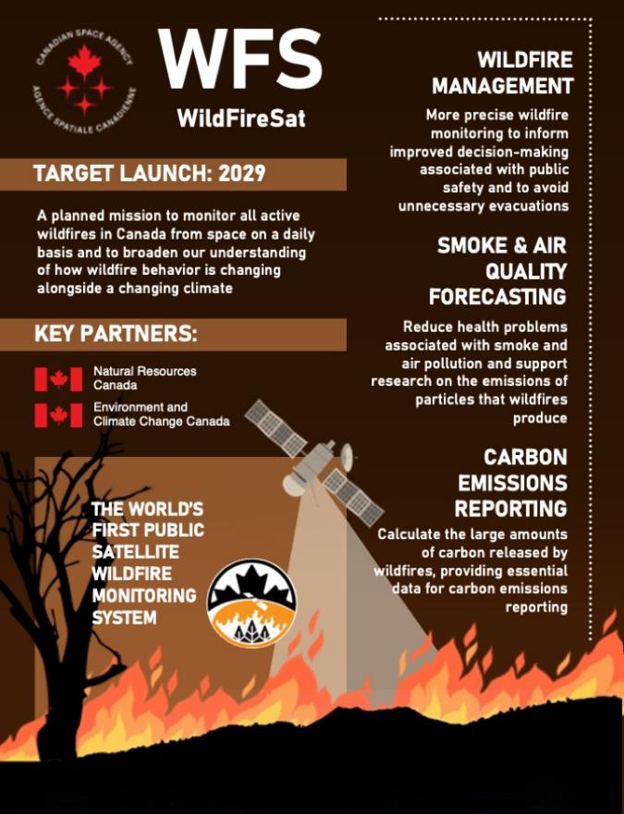
Funded Missions: HAWC & WFS
HAWC: ECCC are key collaborators on the mission and ECCC’s Meteorological Service of Canada will benefit from improvements to the prediction of near-term weather events, long-term climatic conditions and air quality
WFS: Funding to ECCC for R&D and operationalization of WildFireSat data to improve the accuracy of the daily forecasts of the Air Quality Health Index
Images subject to copyright.

Slide 17
Funded Missions: RADARSAT+
A Government of Canada-wide mission that will address the continuity and expansion of government services and programs derived from Synthetic Aperture Radar data, particularly from the RADARSAT Constellation Mission (RCM)
ECCC has numerous, pre-operational, operational and emerging user needs that require continued access to SAR data to deliver on our core responsibilities
In October 2023, the Canadian Space Agency announced a 15-year investment to design, build and launch a replenishment satellite for the RCM, and a project to initiate the definition of a fourth-generation national sovereign satellite system that will succeed the RCM
Construction and use of government-owned sensors and satellites: Next-generation satellite mission to succeed the RADARSAT Constellation Mission
Collaboration with international partners: New and expanded bartering arrangements
Access to free and open data
Purchase of commercial data

