Slide 1
Toward a CEOS Aquatic Carbon Roadmap Seeking Plenary Endorsement
Rio Marie-Helene (ESA), Laura Lorenzoni (NASA) and Hiroshi Murakami (JAXA)
With the support of Jamie Shutler (University of Exeter, UK), Cecile Rousseau (GFSC/NASA, US), Robert Brewin (University of Exeter, UK), Hubert Loisel (ULCO, FR), Shubha Sathyendranath (PML, UK), Ewa Kwiatkowska (Eumetsat)
Agenda Item 4.6
CEOS Plenary 2023
14th - 16th November 2023, Chiang Rai

Slide 2
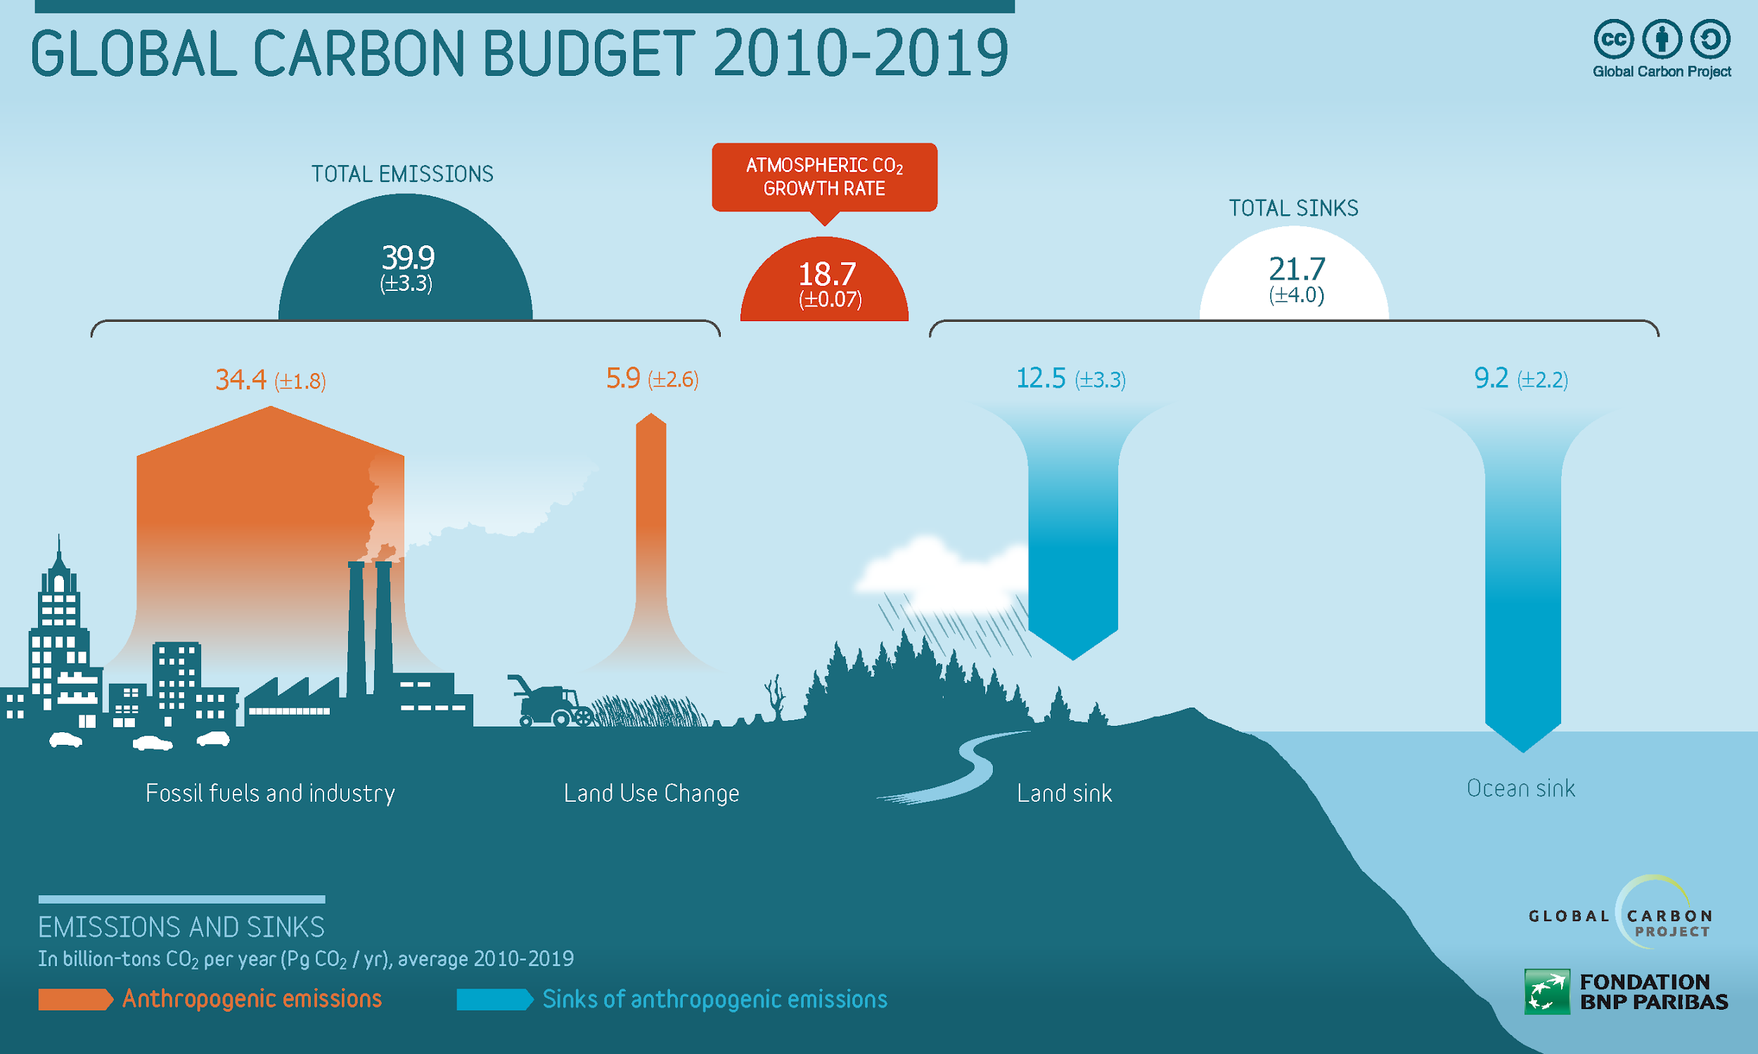
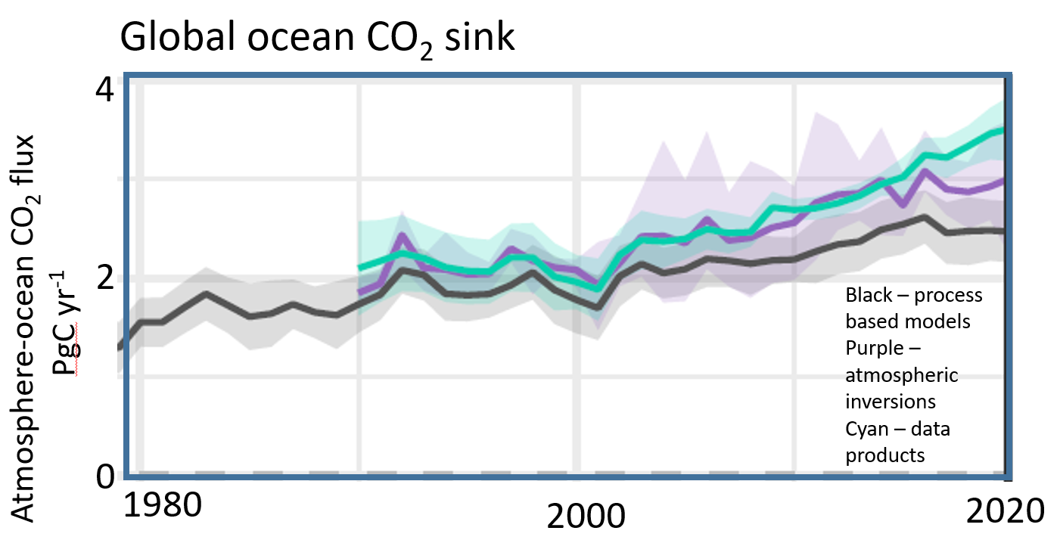
Ocean carbon: a key constraint to the Global Carbon Budget
Oceans play a major role in the Global Earth Carbon Cycle
They have absorbed over 25% of all anthropogenic CO2 released in the atmosphere.
The global land sink is currently impossible to observe, so its modelled estimate relies upon ocean & atmosphere data.
Ocean and atmosphere are the two observational constraints on global carbon budgets.
Improving ocean carbon estimates will improve the land carbon budget and global carbon assessment!
Despite the GCB ocean component now has a greater reliance on observations than models, discrepancies exist between observations and model
good estimates
poor estimates
good observations
Modelled or calculated using all other components
measured
Friedlingstein et al, 2022

Slide 3
Ocean carbon: a changing component of the global system
Not only ocean carbon is a key constraint to the global carbon budget, but its monitoring is also essential as increasing anthropogenic CO2 emission are reducing the pH of oceans (ocean acidification)
Global ocean pH stripe, determined using satellite data and illustrating how global carbon emissions are making the oceans more acidic. Data: Gregor & Gruber, (2021).
With direct impact on
Phytoplankton
CaCO₃ and O₂ cycles
biodiversity
Higher trophic levels
So far, the ocean sink has increased with emissions. But its future response is not known (can the sink continue to increase, or how will biology change and influence it?)
Including a reduction of the oceans capacity to continue to provide this service

Slide 4
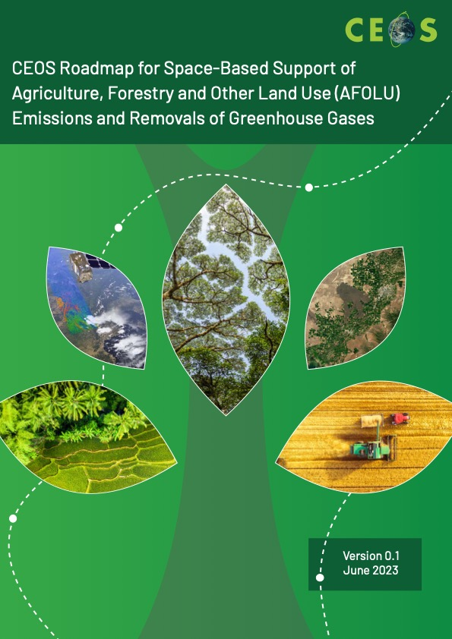
Toward an Aquatic Carbon Roadmap
CEOS Global Stocktake strategy paper
-> demonstrate the value of Earth Observation satellite datasets to support the Global Stocktake process
CEOS Aquatic Carbon Roadmap?

Slide 5
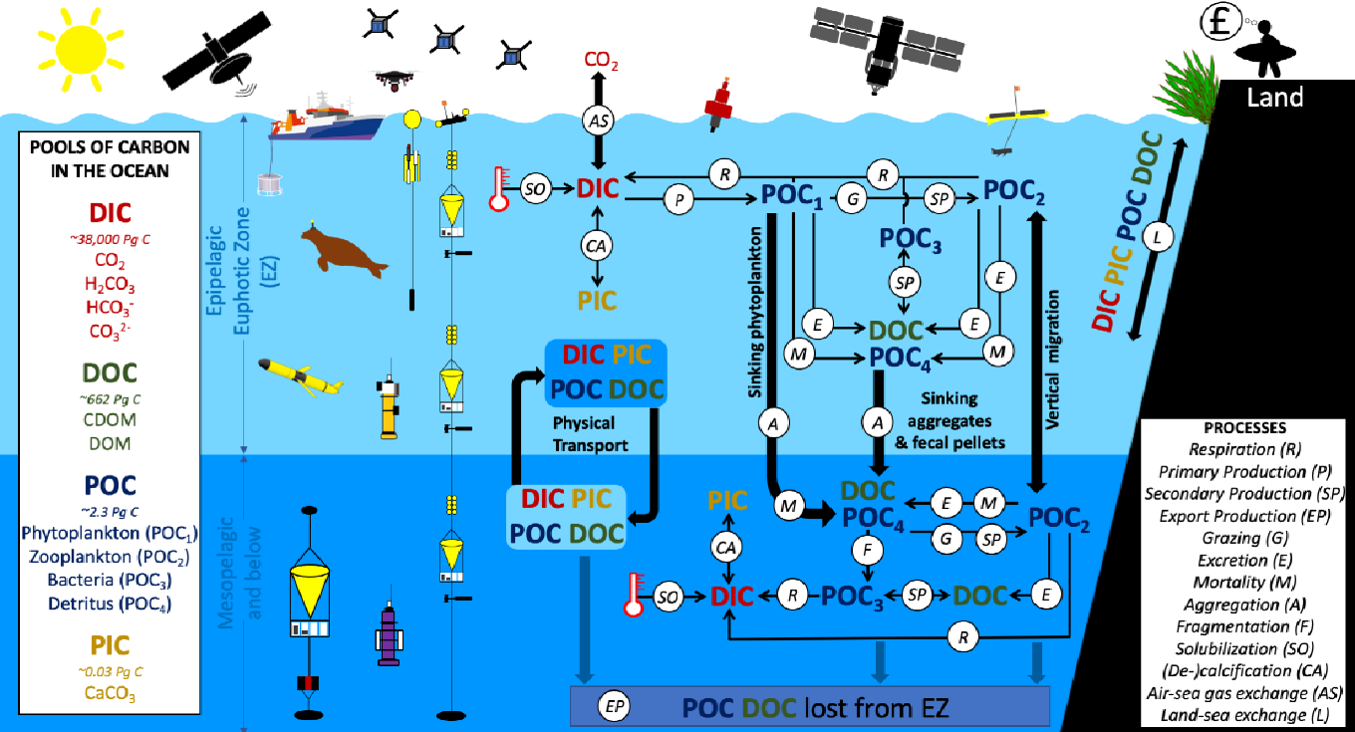
Aquatic Carbon Roadmap Focus
Deliverable VC-23-01
Pools and processes of the ocean biological and solubility carbon pumps
Both the GHG and AFOLU roadmap have a strong focus on the major milestones of GST1 (2023) and subsequently for GST2 (2028) and how remote sensing data can effectively support these by providing means to monitor carbon emissions and removals, based either on a top-down approach (GHG roadmap) or a bottom-up approach (AFOLU roadmap).
In order to address the objectives of the Aquatic Carbon roadmap, and effectively contribute to supporting the GST process, the Aquatic carbon roadmap not only will cover the specific topic of ocean carbon sink (air-sea CO2 exchange) monitoring, but will:
Brewin et al, 2001:Sensing the ocean biological carbon pump from space: A review of capabilities, concepts, research gaps and future developments, Earth-Science Reviews 217 (2021) 103604.
address more largely the different components of the ocean carbon cycle including the biological pump, the solubility pump and their interaction,
cover all horizontal (from lakes to coastal and open oceans) and vertical dimensions (from exchange of CO2 with atmosphere, through the land to ocean aquatic continuum, up to the vertical transport of carbon to the deep ocean until overturned)

Slide 6
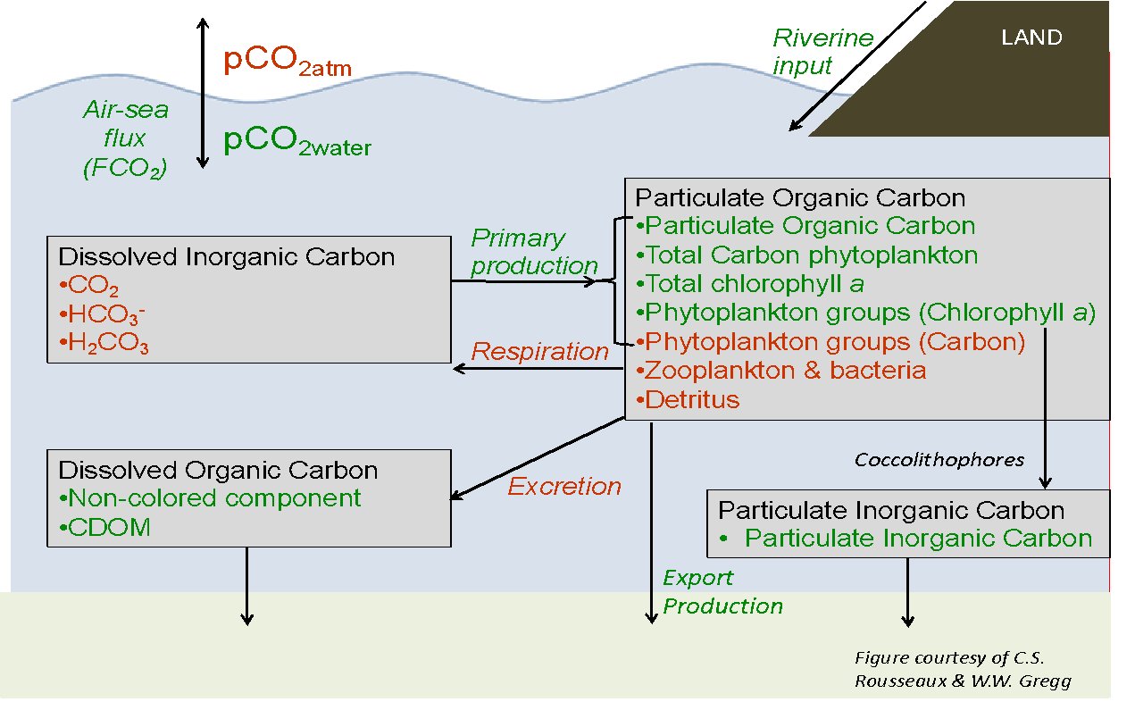
Aquatic Carbon Roadmap Focus
Deliverable VC-23-01
CEOS Carbon Strategy Report 2014
Pools and processes of the ocean biological and solubility carbon pumps
Some additional pools have become amenable to remote sensing:
Phytoplankton groups
Detritus (a first approximation)
We have today a budget for most of the pools and fluxes of carbon in the mixed layer, BUT many gaps and challenges subsist…
Global assessments are using satellite data in inconsistent and non-optimal ways.
Large uncertainties exist in our understanding of trends in fundamental biological carbon fluxes in the ocean, notably primary production and export production.
Knowledge gap in freshwater production and land-ocean fluxes is even greater.
We have little knowledge on blue carbon and its changes.
Brewin et al, 2001:Sensing the ocean biological carbon pump from space: A review of capabilities, concepts, research gaps and future developments, Earth-Science Reviews 217 (2021) 103604.
Magnitude and regional distribution of biologically-mediated carbon fluxes come from a variety of climate-related modifications to the marine environment (ocean acidification, storminess over the oceans, vertical stratification, changing temperature, increasing sea level, disappearing sea ice, and their combined impacts), which still need to be better understood and assessed and will likely impact inorganic carbon pools (e.g. ocean sink)

Slide 7
Aquatic Carbon Roadmap Objectives
Deliverable VC-23-01
To provide a framework and serve as a guiding vision for long term (~ 15+ years) coordination of CEOS agency observing programmes in support of the science and policy needs for Aquatic carbon related information in the context of the CEOS carbon strategy.
To contribute to support the needs and ambition cycle of the Global Stocktake of the Paris Climate Agreement, by
driving the inclusion of inorganic and organic carbon in the ocean within global and regional carbon assessments constraining the global carbon budget
supporting countries reporting on their NDC by improving the estimation and monitoring the changes in CO2 fluxes from/to the Oceans at country level (within each country’s exclusive economic zone (EEZ))
improving the monitoring of major Blue Carbon coastal ecosystem’s extent and carbon stock around the world.
To characterize the needs, gaps and challenges, regarding the required data and products to support science, services and applications and the observing systems that can support their developments, including the needs to plan for ground and space segments. This includes addressing basic observation continuity and the necessary agency coordination to achieve it.
To clarify the importance and elevate the profile and complexity of remote sensing and satellite Earth observation that are already routinely used within carbon assessments, highlighting how Earth observation has much more to offer beyond its current use and serve as an effective means for communicating our intentions to society, UNFCCC, national inventory community.

Slide 8
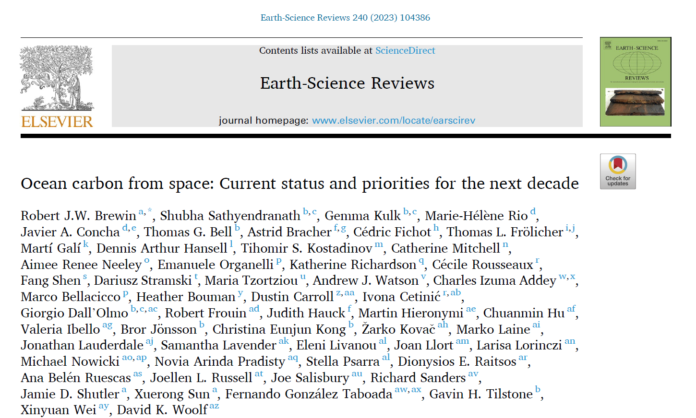
OCR-VC contribution to the CEOS Workplan
2020-2023
2023-2025

Slide 9
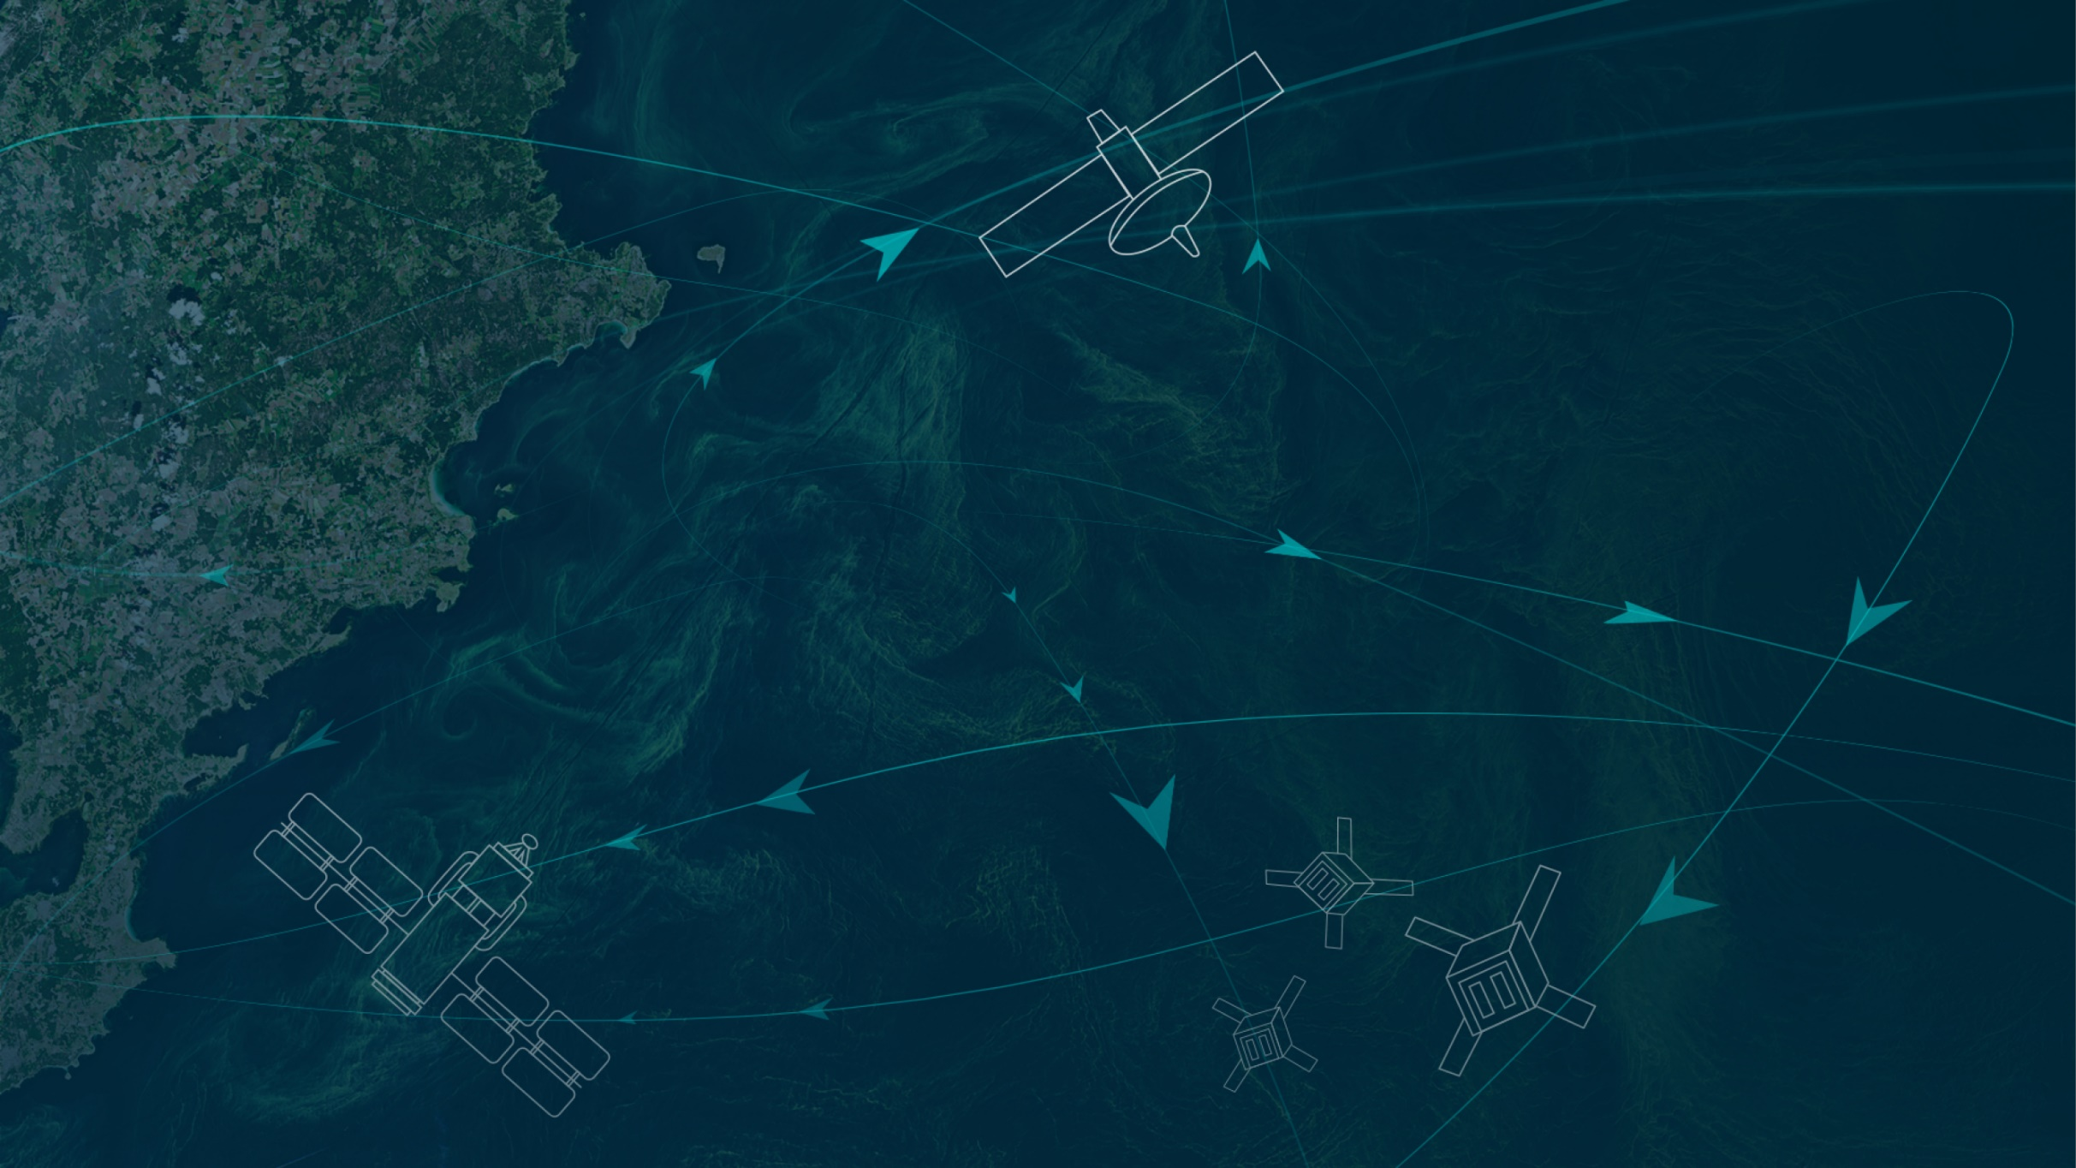
https://oceancarbonfromspace2022.esa.int/

Slide 11
The Workshop in Numbers
Gender Distribution
Prepared by: Javier Alonso Concha and Sabrina Lodadio

Slide 12
Community white paper
55 co-authors
1- Introduction
2- Workshop details and approach to capture collective view of the status of the field
3- Session-specific theme outcomes
In the following sections, we begin by providing a brief description of each session-specific themes, briefly highlight the current state of the art, then focus on a number of priorities for which scientific challenges, gaps and opportunities are identified, to be targeted over the next decade.
3.1 Particulate Organic Carbon (POC)
3.2 Phytoplankton Carbon (C-phyto)
3.3 Phytoplankton and Primary Production
3.4 Dissolved Organic Carbon (DOC)
3.5 Dissolved Inorganic Carbon (DIC)
3.6 Particulate Inorganic Carbon (PIC)
3.7 Fluxes at the Ocean Interface
3.8 Cross-cutting activities: Blue Carbon
3.9 Cross-cutting activities: Extreme Events
3.10 Cross-cutting activities: Carbon Budget Closure
4- Common outcomes
5- Emerging concerns and broader thoughts
6- Summary
Reference paper for the Aquatic Carbon Roadmap

Slide 13
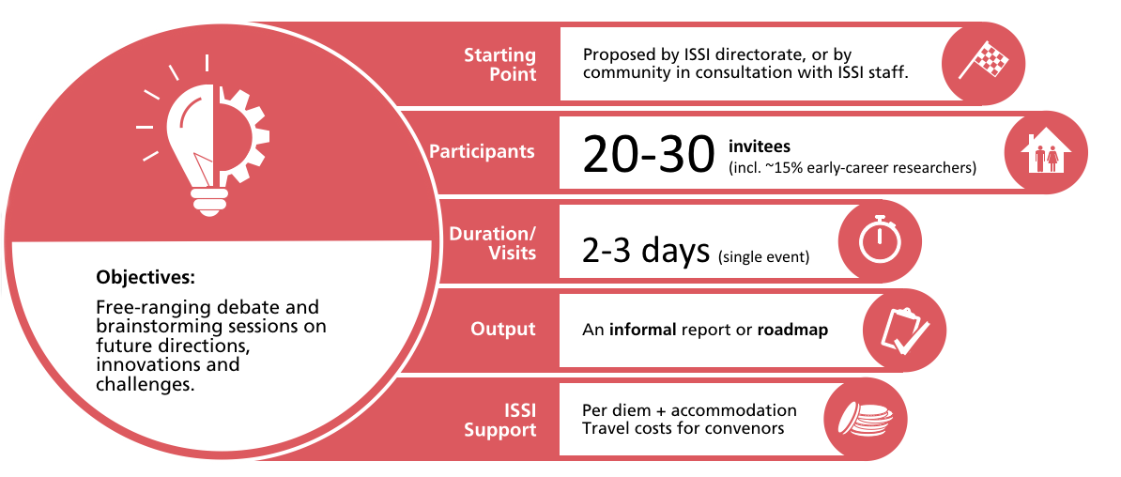
The ISSI Blue Carbon From Space Forum Deliverable VC-23-02
When? 14-17 May 2024
Where? ISSI (International Space Science Institute), Bern, Switzerland
Main topics:
Session 1- Observing system : EO capabilities to map BC ecosystems extent/carbon stock/change: status, gaps, observing system requirements to fill gaps – including in-situ/airborne observations gaps
Session 2 - Impact of external drivers : Further understanding and predicting the impact of external drivers on BC ecosystems (climate change, hurricane, aquaculture, agriculture, mangrove forest exploitation, terrestrial and marine sources of pollution and industrial and urban coastal development )
Session 3- Coastal Blue Carbon restoration and preservation as a Nature-Based climate change Mitigation : To what extent Blue Carbon ecosystem represents a nature-based solution for mitigating the impact of climate change ? What is the impact of ecosystems restoration and preservation actions on mitigation and how EO can support its quantification?
Session 4- Economic value of blue carbon ecosystems / Carbon Credits / MRV
Session 5 - Tools/Products/Indicators to support policy needs with a main focus on the needs and ambition cycle of the Global Stocktake of the Paris Climate Agreement -> what is needed to support the Global Stocktake 2028.
Each topic will be covered during dedicated sessions and recommendations will be collected with the final objective to draft a white paper as an outcome of the Forum.
-> Direct inputs to the Aquatic Carbon Roadmap

Slide 14
Toward an Aquatic Carbon Roadmap – Resources for completion
The development of an Aquatic Carbon roadmap is a very timely, needed, but at the same time very ambitious commitment
The contribution and coordination from IOCCG/CEOS OCR-VC agencies will be essential to work towards actual deliverables. Most of these agencies have carbon related activities on which the roadmap will build.
ESA is currently launching three aquatic carbon projects that will run over the next two years (one on estimation the Ocean Carbon cycle from satellite data, one on Coastal Blue Carbon, and one on developing Ocean Carbon related ECVs and climate data records
NASA has provided continued support for a number of activities under the Ocean Biology and Biogeochemistry program, the Carbon Monitoring Program, and the Carbon Cycle Science program.
EUMETSAT plans to develop operational carbon products from S3 starting end 2024/beginning 2025. Our goal will be to coordinate the product development across the agencies and use Aquatic Carbon Roadmap recommendations that will be available by that time
Consequently, significant contribution to the Aquatic Carbon Roadmap is expected from the scientific community through the different activities being supported by the CEOS member agencies.
Relevant activities are also ongoing within the International Ocean Colour Coordination Group: an IOCCG Aquatic Carbon from Space Task Force is being initiated (led by Jamie Shutler, University of Exeter, UK and Cecile Rousseaux, NASA GSFC, US) and a Working Group on Primary Production (chaired by Robert Brewin, University of Exeter, UK).
Both activities will be running in parallel to the roadmap development and will strongly contribute to it.

Slide 15
Toward an Aquatic Carbon Roadmap – Resources for completion
The development of an Aquatic Carbon roadmap will strongly benefit from interactions/coordination with other CEOS activities
The Aquatic Carbon Roadmap will likely require a degree of coordination and collaboration with AFOLU Roadmap and the GHG Roadmap, in particular for what regards Blue Carbon ecosystems (Wetland/mangroves are part of the AFOLU roadmap)
Other contribution might come from other OCR-VC agencies (e.g. NOAA) and other CEOS VC and WG (e.g. SST-VC, OST-VC, OSVW-VC, COAST, and WGClimate).
=> CEOS support needed to coordinate between the three roadmaps and between OCR-VC and other relevant CEOS entities

Slide 16
Toward an Aquatic Carbon Roadmap – Resources for completion
Coordinators
Laura Lorenzoni (NASA, agreed but still to be confirmed by CEOS Principals at Plenary)
Marie-Helene Rio (ESA, agreed but still to be confirmed by CEOS Principals at Plenary)
Hiroshi Murakami (JAXA, agreed but still to be confirmed by CEOS Principals at Plenary)
Scientific leaders
Jamie Shutler (University of Exeter, agreed)
Bob Brewin (University of Exeter, agreed)
Cecile Rousseaux (GSFC-NASA, agreed)
Kelsey Bisson (NASA, agreed)
And many contributors from the CEOS OCR-VC / IOCCG space agencies and the scientific community

Slide 17
Toward an Aquatic Carbon Roadmap – Outline
1. Introduction (overview, purpose and scope)
- the role of aquatic systems in carbon uptake and cycling
- the ocean observational constraint on global carbon
- Evaluate the role of remote sensing to inform IPCC Guidelines and 2035+ vision
2. The critical need and opportunity (from Brewin et al., 2020;2023, Shutler et al., 2020; in-revision and other contributions from the Aquatic Carbon From Space Special Issue).
3. Overview of remote sensing and Earth observation capabilities (brief overview from Brewin et al., 2020;2023, Shutler et al., 2020; in-revision), including the necessary synergy with in-situ measurements and models.
4. Deployment of capabilities
- use existing capabilities to demonstrate strength of the ocean constraint on global carbon (from Shutler et al., in-revision)
- expand visibility of satellite derived data within international data and products portals (e.g. Copernicus)
5. Roadmap and perspective
6. Complementarities and linkages to other CEOS roadmaps (GHG and AFOLU))
7. Capacity building
- CEOS data portal
- Private or commercial (e.g., Planet).
- agencies or programmes (e.g., Copernicus).
8. Forward looking actions
- future satellite missions (from Brewin et al., 2023)
- demonstrations (how to use roadmap, or identify importance – from Shutler et al., in-revision)
- links to other carbon-based cycles (e.g. methane).
- future global stocktakes and updates
9. Summary and next steps
10. Recommendations coming out of this roadmap.

Slide 18
Decisions sought at Plenary
We ask the principals to decide at plenary whether they are willing to provide representation and resources going forward to support the development of a full CEOS Aquatic carbon Roadmap. This will support the global carbon assessments (e.g., annual global carbon assessments, future global carbon stocktakes), current and future ocean health assessments and mitigation (e.g., UN decade of ocean research) and will be used to guide the Intergovernmental Panel on Climate Change (IPCC) Guidelines and 2035+ vision.

