Slide 1
Greenhouse Gas Roadmap & TT within joint CEOS/CGMS WG Climate
Wenying Su, NASA
Y.Meijer, ESA
J. Worden, JPL
GHG Task Team
Agenda Item 3.5
CEOS Plenary 2023
15-16 November 2023, Chiang Rai

Slide 2
Context
GHG Observations of crucial importance to Paris Agreement & Global Stocktake
CEOS efforts directed by the GHG Roadmap
CEOS actively engaging with WMO’s emerging Global Greenhouse Gas Watch initiative
CEOS actively engaging with International Methane Emissions Observatory (of UNEP)
Increasing commercial & NGO activity on CH4 (and possibly CO₂) observations from space
Increasing interest on GHG Observation across CEOS agencies and their governments
Coordination of GHG Observation from space is one of the incoming SIT Chair (JAXA) priorities

Slide 3
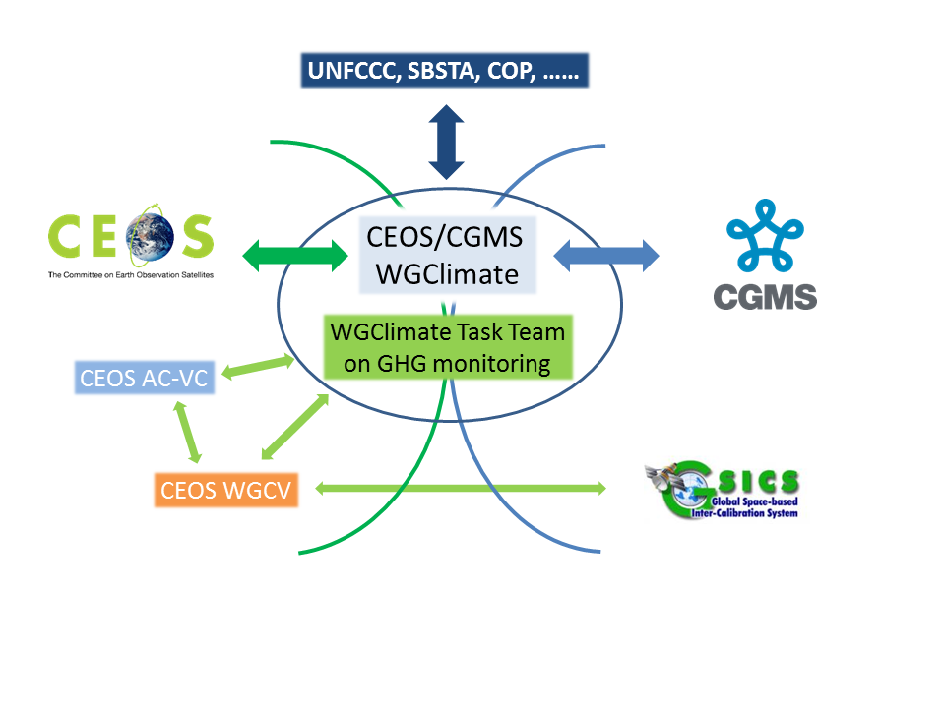
GHG Task Team Role
Responsible for maintaining and implementing the GHG Roadmap
Interfaces with, stimulates and monitors GHG related activities across various (CGMS &) CEOS WGs: WG-Climate, WG-CalVal, AC-VC, WG-CapD, NewSpace Task Team, etc
Actively ensure representation of CEOS and CGMS bodies by identifying Points of Contact (PoCs) for tasks to be executed by these bodies
GHG Task Team webpage is now available on CEOS webpage under WGClimate: https://ceos.org/ourwork/workinggroups/climate/ghg-tt/

Slide 4
GHG Task organisation
Area leads (plus deputies) have been appointed using the thematic areas of Annex C (actions) in the GHG Roadmap:
Stakeholder Engagement - Mark (John, Wenying)
System Development Facilitation – Richard (John, Kevin)
Operational Preparation and Training – TT discuss
Sensor Development – John (AC-VC) (Yasjka)
L1 & L2 GHG Product Development – Ruediger & Dave
Flux Inv. Model Development – Kevin (Frederic)
Calibration & Validation – Hiroshi (Kuze)

Slide 5
Meetings in 2023
General Meetings
02 FEB: GHG Task Team meeting #2, at WMO, Geneva
12 SEP: Leads discussion (telecon)
17 OCT : GHG Task Team meeting #3, at ESRIN
Contributions to various CEOS and CGMS (WG) meetings
Topical meetings
7-8 JUN (Joint CEOS/IMEO) International Coordination Workshop on Detection of Anthropogenic Methane Emissions from High-Resolution Satellites, Harvard Univ., USA
03 JUL Emission Uncertainties Workshop, Paris, France

Slide 6
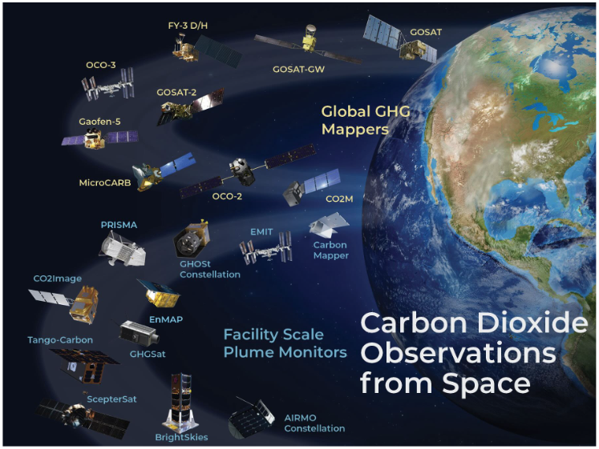
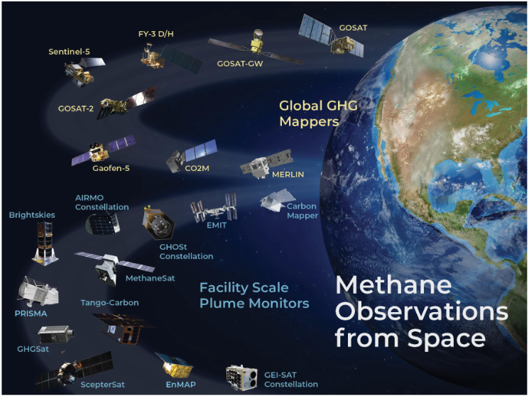
Recent Achievements – 1/2
GHG Roadmap Update
Only soft update through Annex C of the GHG Roadmap
Action list has been updated through a thorough review by Area Leads (add more milestones & specific (SMART) actions)
Engagement with WG-CV on sustainability of GHG Cal/Val network
CEOS GHG Mission Portal
Provides centralized overview of GHG Missions with updated mission timeline charts (https://database.eohandbook.com/ghg/)
Missions are split between CO2 and CH4
Missions are split along various scales (point/area vs national/regional)
International Engagement
WMO Global GHG Watch (G3W)
IMEO (members participating in WGs)

Slide 7
Recent Achievements – 2/2
Contribute to the Space Agency Response to the GCOS IP 2022
Improve diurnal sampling of observations and coverage of GHGs, precursor aerosols, and SIF
Proof of concept for new technologies and new methods to measure GHG at high latitudes, particular in winter
Design a constellation of operational satellites to provide near-real time global coverage of CO2 and CH4 obs
Improve and coordinate measurements of relevant ECVs at anthropogenic emission hotspots to support emission monitoring
New Space
Rapid increase in New Space contributions to facility-scale GHG measurement (10 out of 15 new missions shown in mission timeline portal are from New Space)
Need to understand how to use New Space data for science policy and finance given intellectual property concerns
IMEO seeks CEOS support to coordinate facility scale and wide area observations for emission attribution.
Notes:
Response quite well covered by current or planned GHG TT activities
Main activity gap is for observations in difficult areas and challenging circumstances, e.g. Polar regions (esp. winter)

Slide 8
CEOS Work Plan
GHG Task Team actions in CEOS Work Plan
CARB-23-01: Lessons learned from pilot CO₂ and CH₄ products (delivered for GST-1) closed
CARB-23-02: Standards for uncertainty monitoring of flux estimates closed*
CARB-23-03: GCOS IP response for GHG-related activities closed
CARB-23-04: Update GHG Roadmap (focus on Action List) (almost) closed
CARB-23-05: New Space and GHG product development and standards setting
- Initial evaluation of New Space GHG observations, based on CEOS meetings and joint EDAP ESA/NASA evaluation teams, raised concerns about the role of intellectual property on the traceability of reported measurements (finished)
- Consider waiting until EDAP and other evaluation team efforts are concluded this year before making a formal recommendation.
* This will evolve further as normal work in GHG TT
Notes:
EDAP: Earthnet data assessment project

Slide 9
Challenges
Stakeholder/User engagement:
UNFCCC (GST)
CO₂: policymakers at smaller spatial & temporal scales (covenant of mayors, finance)
CH₄: (policymakers) on non-O&G related emissions, e.g. landfills, wetlands
Mission delays or no follow-ups
False notion that New Space could do it all
Convey the message that measuring CO₂ & CH₄ do not directly result in emission estimates
Assess monitor requirements for the carbon cycle in a changing climate

Slide 10
Plans
Next steps of GHG Task Team:
Coordinate GHG TT activities with the AFOLU Roadmap, and evaluate ways to contribute to the Aquatic Carbon Roadmap
Coordinate GHG new space activities following the New Space TT recommendations
Engage with and ensure CEOS expertise is utilized in WMO’s G3W and UNEP’s IMEO
Update and Improve CO2/CH4 fluxes and user engagement based on lessons-learned from the 1st GST

