Slide 1
WMO Global Greenhouse Gas Watch
Natalia Donoho for
Lars Peter Riishojgaard, Oksana Tarasova
WMO
Agenda Item #3.2
37th CEOS Plenary
15 - 16 November 2023
Chiang Rai, Thailand
Hosted by GISTDA

Slide 2
Global Greenhouse Gas Watch
WMO and partners are developing a Global Greenhouse Gas Watch, building on the Global Atmosphere Watch and World Weather Watch
Key elements
Integrated global greenhouse gas observing system (surface- and space-based) operating under WMO Res. 1, with near-real time international exchange of all observations;
24/7 operational GHG modeling/assimilation (multiple systems), providing top-down flux estimates;
Routine internationally coordinated intercomparison and verification of model output;
In order to provide authoritative data to UNFCCC Parties and other users, GGGW estimation will be conducted
Openly - with participation from all interested Parties;
Transparently – with free and unrestricted access to all input and output data as well as verification results;
Using documented (preferably published) methodologies and algorithms.
Users of GGMI output
Parties to the Paris Agreement (e.g input to GST and for support review of BTRs under ETF);
Regional and local users, e.g. via IG3IS;
Carbon markets, e.g verification of offsetting;
Science community working on GHG budgets;
IPCC, for emission pathways, future scenarios;
 | ‹#›

Slide 3
Global Greenhouse Gas Watch: outputs
• Monthly CO₂ net fluxes between the Earth surface and the atmosphere with 1x1 degree horizontal resolution delivered with a maximum delay of one month
• Monthly CH₄ net fluxes between the Earth surface and the atmosphere with 1x1 degree horizontal resolution delivered with a maximum delay of one month
• 3D fields of atmospheric CO₂ and CH₄ abundance with hourly resolution and the latency to be defined through user requirements and further consultation (tentatively on the order of a few days).
• N₂O abundances and net fluxes with resolution and latency still to be defined.
 | ‹#›

Slide 4
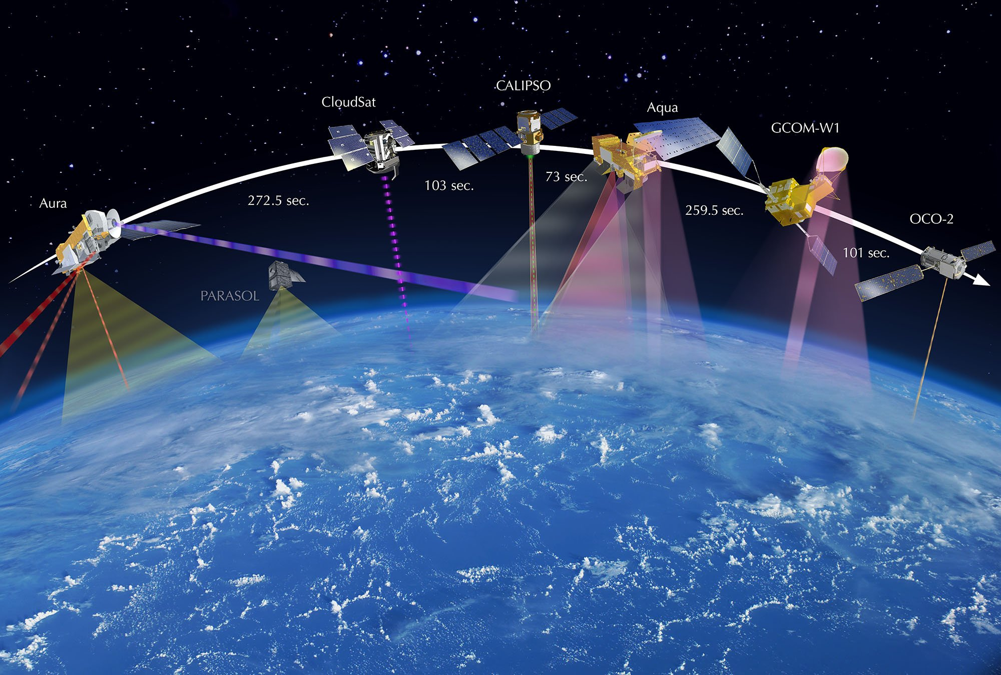
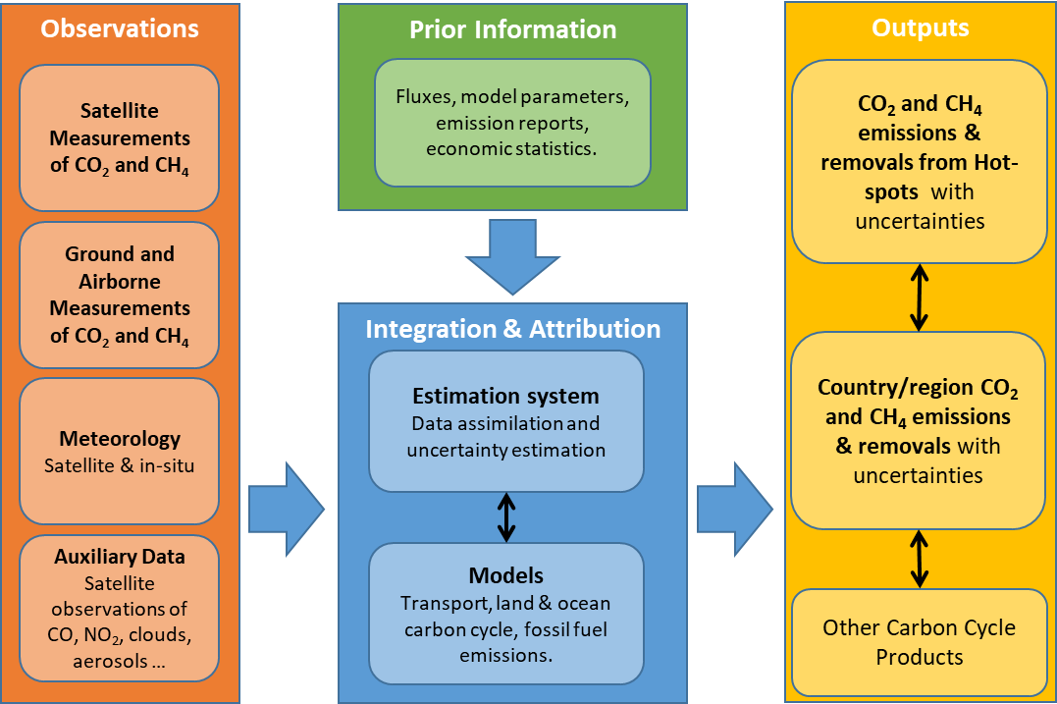
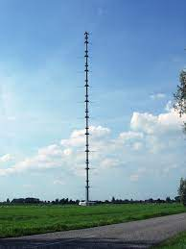
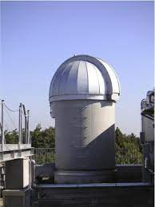
General principles of the observations- based emission estimates
GGGW will be supported by several global modelling centers
Policy and decision relevant information
Conceptual architecture of the system (implemented by the European Commission)
 | ‹#›

Slide 5
Potential uses and downstream applications
modelled global GHG concentration fields at 1x1° resolution, and modelled monthly surface fluxes at 1x1° resolution
IG³IS can play a role here
Harmonized and standardized user-tailored products on a decision-relevant scale
The data delivered by the GGGW can directly be used in support of the global stocktake, while specific user tailored applications are outside of the scope of GGGW
 | ‹#›

Slide 6
Cg-19 Resolution: call for the development of the implementation plan
“(1) Emphasis on WMO’s unique role in establishing best practices for measurement, data, and reporting standards, validation and intercomparison of information products, and other best practices needed to support global greenhouse gas monitoring infrastructure and actionable information services;”
“(4) Integration of the components of the Global Greenhouse Gas Watch within appropriate WMO-coordinated systems, the WMO Integrated Global Observing System (WIGOS), the WMO Information System (WIS), and the WMO Integrated Processing and Prediction System (WIPPS);”
“(7) A detailed analysis of the expected cost of implementation of the various elements of the Global Greenhouse Gas Watch, distinguishing between costs to the WMO Secretariat, costs to Members, and an estimate of expected extra-budgetary resources, including sources;”
Implementation plan should describe HOW the Concept of GGGW proposed to Congress will be implemented
 | ‹#›

Slide 7
Implementation plan: content
1. Introduction, background.
2. Existing components and gap analysis
3. Observing system
4. Modelling system
5. Prior information (emissions…)
6. Data management
7. R&D needs
8. User engagement and uptake of GGGW
9. Capacity development
10. Cost estimates, funding sources
11. Resource mobilization
To collect inputs 2 technical workshops were conducted:
Modelling within GGGW (by invitation), 19-22 September, Bonn
Observations within GGGW, 3-5 October, Geneva
 | ‹#›

Slide 8
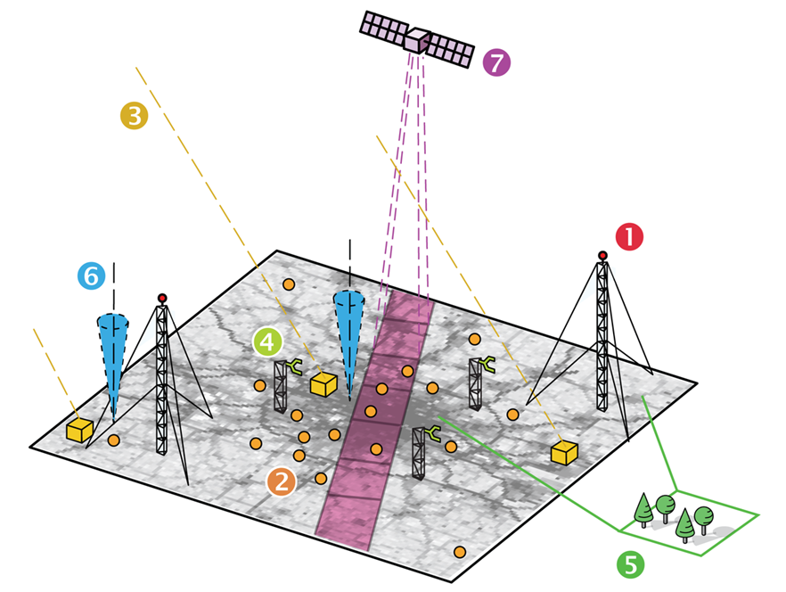
Observations in GGGW concept
The list of observable parameters required for the realization of the GGGW is extensive, but clear priorities can be identified. Here the priorities are listed within five categories, from A (highest) to E (lowest):
A. Ground-based measurements of GHGs
B. Remote-sensing and vertically resolved observations of GHGs
C. Ocean carbon cycle observations
D. Direct GHG flux observations
E. Higher tier observations
The minimum GGGW system should have adequate observations from at least categories A, B and C. An adequate number of stations should provide observations of the lowest tier (category E), based on the overall network design
Tall towers (1), street level mid-cost sensors (2), roof level stations (3), eddy covariance flux stations (4), ecosystem parameters (5), total column GHG and meteorology (6) and satellite (7) observations, in many parts including co-emitted species (from: ICOS Cities)
 | ‹#›

Slide 9
Workshop recommendations: Status of observations and gaps
Satellite agencies can help in:
addressing spatial and temporal gaps
ensuring sustainability of the satellite observations
assisting with the training of personal
communication regarding use of integrated observing system in support of the decision-making products generation
Spatiotemporal data gaps: over the Tropics, in Africa, over the open oceans, Arctic ecosystems, lack of vertically resolved measurements
Validation gap: Ground-based remote sensing even more sparse than in situ, satellite cross-validation
Operational concerns: No exhaustive inventory of available measurements, not timely for satellite validation, lack of definition of “good enough” measurements, planning of missions
Financial gap: no money for maintenance, research-based funding
Manpower gap: not enough trained staff to support measurements
Communication gap: unclear use of observations

Slide 10
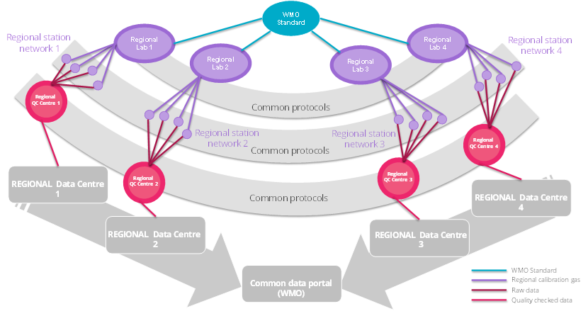
Workshop recommendations: Integration and standardization
A tiered observing network, that includes a ‘reference’ quality component throughout the world can help provide a framework for integrated observing systems
Key aspect of integration is the integration of remote-sensing and in situ information for the same variables
Integrated system needs an “all domains approach” which somehow retains the specific requirements of each individual domain (land, ocean, atmosphere).
Multi-purpose measurements programme: inclusion of additional variables to constrain better priors (inundation datasets, higher frequency burned area, anything that improves the temporal profile of priors, vegetation type)
Calibration is important, needs to be globally available (distributed calibration facilities)
Existing standards need to be used as much as possible
Metadata standards and metadata reporting needs to be consisted across and within domains

Slide 11
Workshop recommendations: Data systems and data utilization
Data exchange is important for GGGW implementation;
Data management needs to be funded as an integral part of GGGW;
Guiding principle: FAIR and Open: leverage the existing WMO standards(WIS2 and WIGOS); maintenance of standards, sensitive to user communities, cloud friendly
Metadata/data reporting practice for uncertainty reporting and provenance are needed
Data access can be federated, but sufficiently centralized
Timeliness can be improved; will be easier if different data streams can be accommodated: (i) quick turn-around “NRT” data, as is, within days of measurement time; (ii) Final, quality-controlled data within months of measurement time;
Sustainability (also of data management systems) is important
Satellite agencies can provide free and unrestricted access to as much relevant data as possible with the latency of 3 days
Communication of the value of integrated system (both in situ and satellite) is critical for user support

Slide 12
Next steps
15 Oct: recommendations of the workshops are summarized
By 30 Oct: high level action items are formulated for each section
By 20 Dec: sections cross check by the Study Group
By 28 Feb: finalization and submission to Infrastructure Commission
June: presentation to the Executive Council
20 Oct: Section leads are established
By 30 Nov: details of the short-terms actions are drafted
By 20 Jan: community review
April: recommendations of the Infrastructure Commission
Active promotion of the initiative at diverse events, including COP28 and resource mobilization

Slide 13
Of particular relevance to the satellite community:
After much discussion about run-time schedules and data latency, both workshops more or less independently converged on a latency requirement of 72 hours;
Two main drivers:
Overall requirement for monthly fluxes soon after the end of the past month;
Secondary but important use of operational data assimilation as key quality control tool for both space-based and surface-based observing systems;
SG-GHG is seeking engagement from CEOS in helping to draft chapter on observations (Yasjka Meijer invited);
Access to space-based GHG data will be critical to the success of GGGW; could be discussed in the context of WMO Resolution 1, either at the Workshop on Core Satellite Data (December 2023) or at CM-15 (February 2024)

