Slide 1
The CEOS AFOLU Roadmap Seeking Plenary Endorsement
Ben Poulter, NASA
Osamu Ochiai, JAXA
Frank-Martin Seifert (ESA)
LSI-VC Forests & Biomass Team
Agenda Item 4.1
CEOS Plenary 2023
14th - 16th November 2023, Chiang Rai

Slide 2
A team effort across/beyond CEOS
Ben Poulter (NASA Goddard Space Flight Center), Osamu Ochiai (JAXA), Frank-Martin Siefert (ESA), Clement Albergel (ESA), Stephen Briggs (ESA), Mark Dowell (EC-JRC), Laura Duncanson (University of Maryland), Sven Gilliams (VITO), Nancy Harris (WRI), Martin Herold (GFZ), Neha Hunka (University of Maryland), Heather Friendship-Kay (Aberystwyth University), Ian Jarvis (GeoGlam), Richard Lucas (Aberystwyth University), Yasjka Meijer (ESA), Joana Melo (EC-JRC), Shaun Quegan (University of Sheffield), Ake Rosenquist (JAXA), Frank-Martin Seifert (ESA), Lindsey Sloat (WRI), Terry Sohl (USGS), Daniela Requena Suarez (GFZ/WUR/GFOI), Stephen Ward (JAXA), Alyssa Whitcraft (University of Maryland), Sylvia Wilson (USGS)

Slide 3
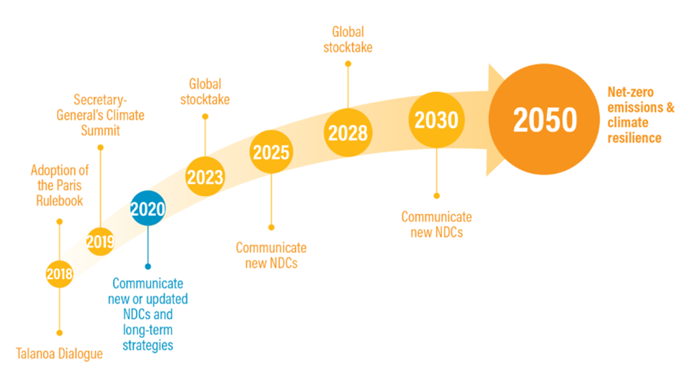
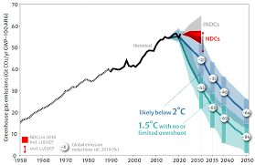
The Global Stocktake of the Paris Agreement
https://www.climate-chance.org/en/comprehend/blog-observatory-global-africa/cop28-first-global-stocktake-what-to-expect-paris-agreement/

Slide 4
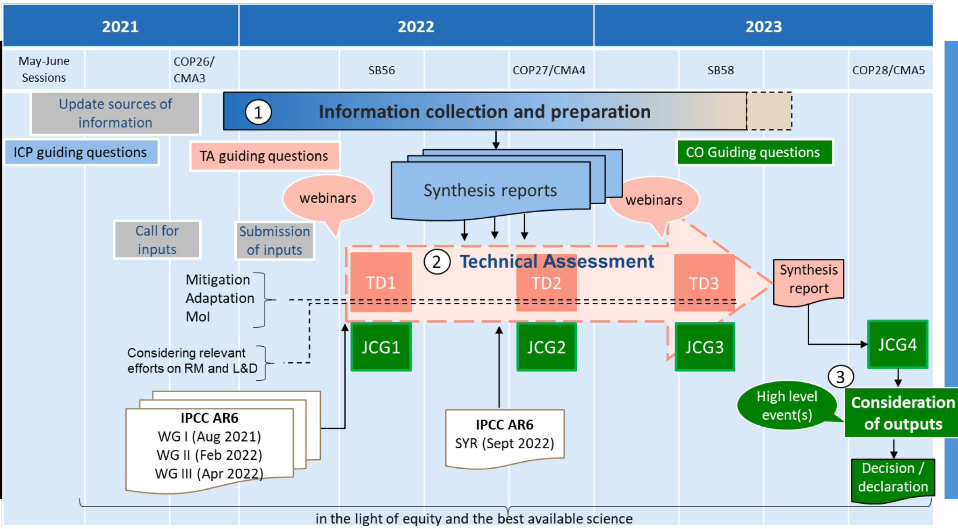
The Global Stocktake of the Paris Agreement

Slide 5
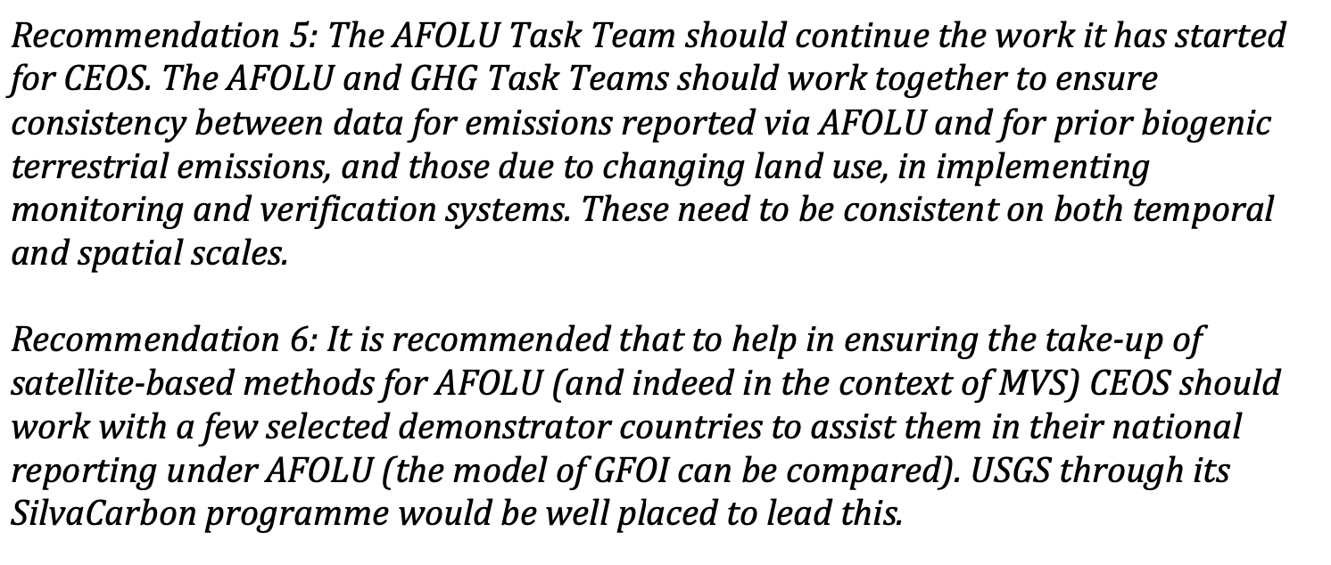
The Global Stocktake of the Paris Agreement
The 2021 CEOS Strategy document to support the Global Stocktake was approved to:

Slide 6
Milestones and key accomplishments
Distribution 1st draft, CEOS review, May 2023
Presentation of AFOLU Roadmap WRI Land Carbon Lab. Summit & 24th Session of GCOS/WCRP/TOPC, summer 2023
Contribution of AFOLU section to CEOS New Space report
Contribution to GCOS IP updates on biomass
Engagement with CEOS LSI-VC, WGClimate and GHG TT
Key papers
Joana Melo et al 2023 Satellite-based global maps are rarely used in forest reference levels submitted to the UNFCCC. Environ. Res. Lett. 18 034021
Eric L Bullock et al 2023 Estimating aboveground biomass density using hybrid statistical inference with GEDI lidar data and Paraguay's national forest inventory. Environ. Res. Lett. 18 085001
Osamu Ochiai et al 2023 Towards a roadmap for space-based observations of the land sector for the UNFCCC global stocktake, iScience 26 106489
Neha Hunka et al On the NASA GEDI and ESA CCI biomass maps: Aligning for uptake in the UNFCCC Global Stocktake Environ. Res. Lett (in review)
Neha Hunka et al How the map-product estimates compare to the IPCC default tables for Tier 1 estimates (i.e. Tables 4.7 to 4.10 in Chapter 4, IPCC 2019 Refinement Guidelines)? (in prep)

Slide 7
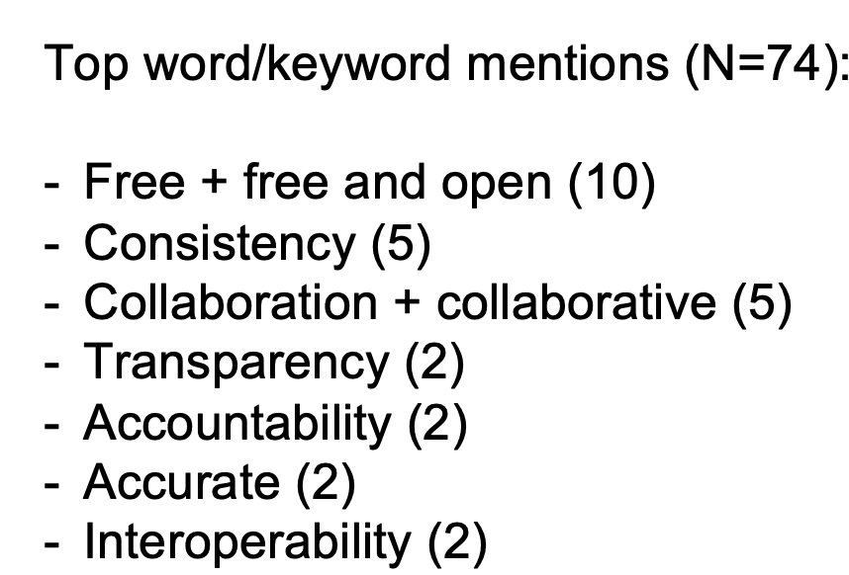
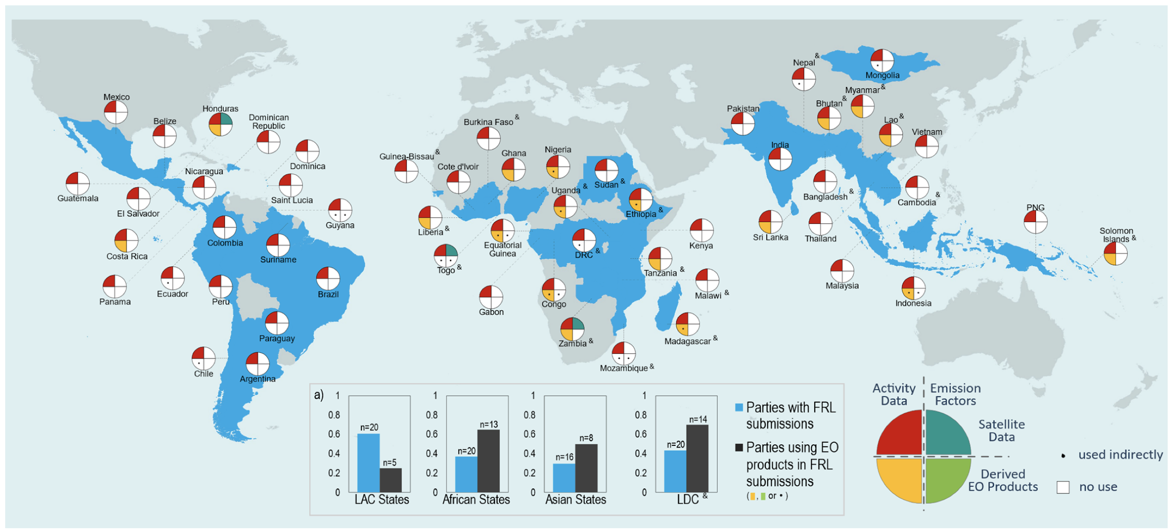
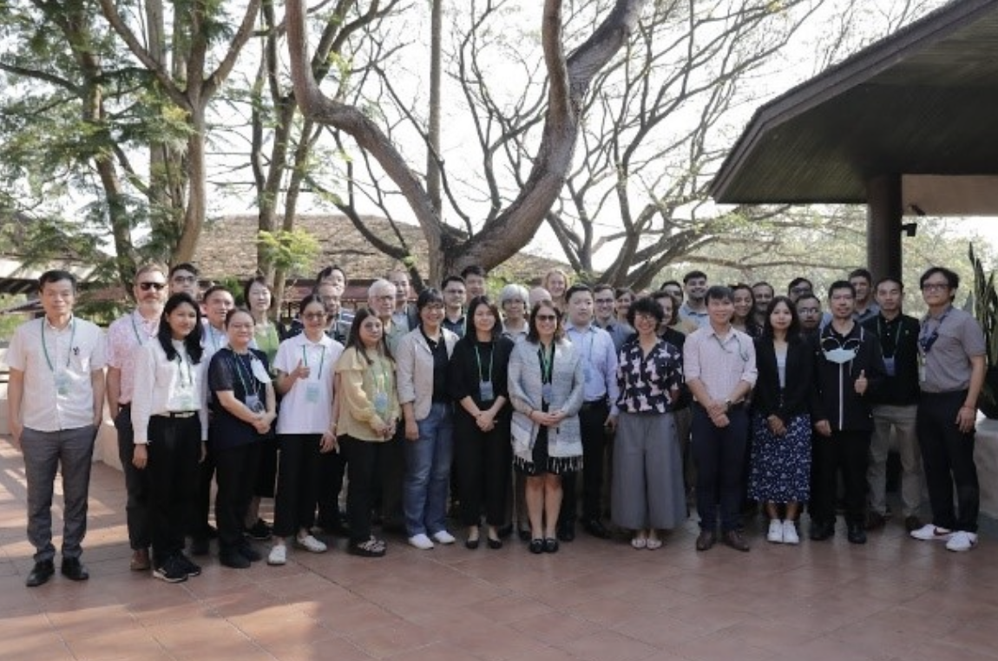
Milestones and key accomplishments
Land Cover Working Group
Biomass Harmonization WG
Melo et al., 2023
Stakeholder WG
GISTDA-SilvaCarbon Workshop 2023

Slide 8
Table of Contents
Overview of IPCC methodologies
Stock change
Gain loss
EO for Activity Data
Land cover change working group
EO for Emissions Factors
Biomass harmonization working group
Capacity Building and Stakeholder Engagement
Integrated Monitoring and Verification System
Recommendations (& actions)

Slide 9
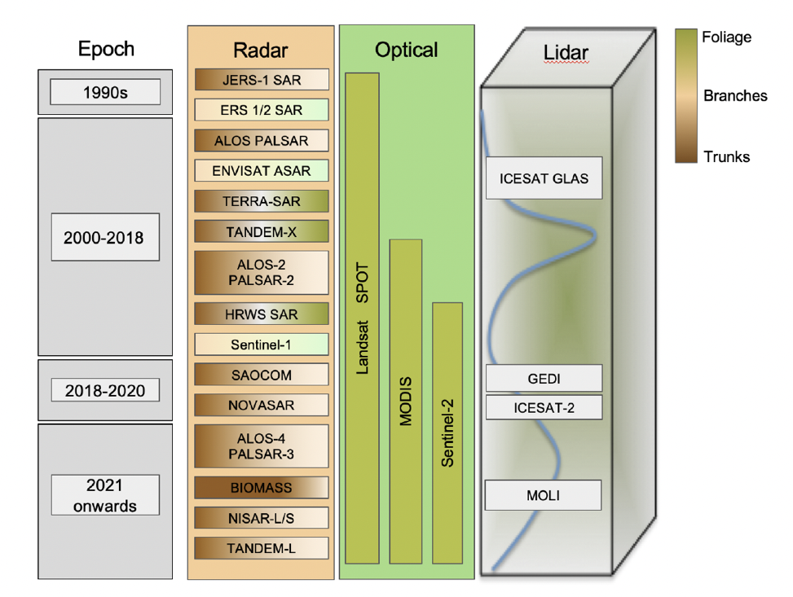
Assessed contributions of radar, optical and lidar missions
Reviewed the use of Earth observations in national GHG inventories
Identified thematic areas where EO data are successfully used, i.e., forests, agriculture, wetlands, or biomass
Identified challenges and opportunities in using EO data in national GHG inventories as basis for Recommendations and actions

Slide 10
Recommendation principles
Ensure continuity and evolution of observations
Support policy relevance & impact of CEOS data
Ensuring that every country has the land satellite data required to report to UNFCCC under IPCC guidance
Engage w national inventories to support uptake
Support top-down and bottom-up comparisons
Guidance for Non-CEOS providers
Coordination w. GHG Roadmap

Slide 11
Recommendation 1
 | Audience | Recommendation
Ensure long-term continuity and backward compatibility for missions providing activity data and emission factors | CEOS Agencies | 1a: Support continuation of remote sensing missions and derived products that provide activity data and biomass change information so that countries can safely embed these data streams into their inventory workflows and guidance documents. 1b: Explore harmonization and integration activities that generate temporal continuity and provide complete and consistent spatial coverage of activity data and biomass estimates. 1c: Evaluate the planned program of record to identify mission gaps and to define future missions, including backward compatibility of next-generation missions, to support activity data and biomass estimates.

Slide 12
Recommendation 2
Thematic Area | Audience | Recommendation
Improve use of Earth observation data in UNFCCC reporting and IPCC Guidelines. | UNFCCC/ IPCC | 2a: Formalize a dialog between CEOS GST activities and the UNFCCC regarding the systematic use of Earth observations to inventory guidelines and reporting. 2b: Develop a protocol or best-practice guidance to use EO-based estimates of AGB in support of national estimation, reporting and climate policy support, including guidance on the use of spatially disaggregated land cover change and biomass estimates in inventories. 2c: Enable international activities such as the establishment of Forest Biomass Reference Measurement in-situ long-term monitoring plots (e.g. Geo-Trees) to ensure space-derived data are of the highest quality, uncertainties are well characterized. 2d: Align terminology and analytical frameworks of uncertainty assessments and the release of AGB estimates consistent with IPCC Guidelines. 2e: Develop traceability and flexibility for different land activity definitions to be consistent with national definitions used in GHG inventories.

Slide 13
Recommendation 3
Thematic Area | Audience | Recommendation
Recognizing that different countries have various requirements to support their system for reporting, enable dialog between inventory practitioners and CEOS community | National Inventories / CEOS Agencies | 3a: Work with national measurement and reporting teams to define, develop and evaluate Earth observation datasets that serve common needs of countries. 3b: Build capacity for national GHG inventory teams to integrate Earth observations data with existing and new inventory guidelines through demonstration projects.

Slide 14
Recommendation 4
Thematic Area | Audience | Recommendation
Support efforts to reconcile bottom-up, top-down, and inventory estimates of GHG emissions and removals | Research community | 4a: Develop guidance and datasets to support the consistent comparison and assessment of bottom-up and top-down methodologies with national GHG inventories.

Slide 15
Recommendation 5
Thematic Area | Audience | Recommendation
Integration of New Space and commercial partnerships in supporting national GHG inventories | CEOS | 5a: Provide guidance for how new forms of activity and biomass data from non-government supported space agencies can be integrated within public-space Earth observation workflows. 5b: Establish protocols for open-source science sharing tools and cloud computing to facilitate data and code development.

Slide 16
Recommendation 6
Thematic Area | Audience | Recommendation
Ensure consistency of CEOS AFOLU and GHG Roadmaps to support a integrated national GHG inventory systems, GHG+. | CEOS | 6a: Coordination with GHG Task Team to integrate bottom-up and top-down measurements in support of national GHG reporting. 6b: Expand the purview of CEOS AFOLU Roadmap to include methane and nitrous-oxide emissions from agriculture. 6c: Work with WMO to facilitate and support the development of a Global Greenhouse Gas Watch (G3W).

Slide 17
Recommendation 7
Thematic Area | Audience | Recommendation
Development of actions to support the CEOS AFOLU recommendations | CEOS AFOLU | Develop series of actions for implementing the CEOS AFOLU Roadmap for CEOS SIT 2024

Slide 18
Next steps
JAXA/ESA/RESTEC/GOFC-GOLD side event on Satellite Observation at COP28
Set of ‘actions’ to implement the Roadmap recommendations defined by SIT-39 (2024)
ESA-led Amazonia field campaign w INPE and NASA contributions (2024+)
AFOLU Roadmap for endorsement by the CEOS Plenary (2023)

Slide 19
The Team Ask of Plenary…
LSI-VC Forests & Biomass team has developed this roadmap over the past 3 years to guide future CEOS efforts in this area
We ask that Principals endorse this Roadmap at the 2023 CEOS Plenary
And agree to the group developing a short-form appendix of actions for tracking and implementation by LSI-VC (for SIT-39, Tokyo)
THANKS to the many and varied contributors over the last 2-3 years!

