Slide 1
JAXA Agency Report
16 November 2023
Takeshi Hirabayashi
Senior Chief Officer of Earth Observation
Missions
Director of Satellite Applications
and Operations Center (SAOC)
Japan Aerospace Exploration Agency

Slide 2
JAXA’s Satellite Development and Operation Schedule
Original Mission Period
Extended Mission Period
JFY |  | 2018 | 2019 | 2020 | 2021 | 2022 | 2023 | 2024 | 2025 | 2026 | 2027 | 2028 | 2029 | 2030 | 2031 | 2032
JAXA Earth Observation
ALOS-2/PALSAR-2
Land Monitoring
ALOS-3 was lost due to the launch failure of H-3 launch vehicle in March 2023. Next optical
satellite system is being studied together with private sector and Japanese government.
ALOS-4 (L-SAR) *
（* Launch schedule: TBD）
Water Cycle
GCOM-W/AMSR-2
GPM/DPR
AMSR-3 (Hosted by GOSAT-GW)
Precipitation
Post DPR mission - PMM
Vegetation
Aerosol
GCOM-C/SGLI
Pre-phase A Study
Phase A
Phase B
Phase C, D
Launch
Forest
Multi-footprint Observation LIDAR and Imager (MOLI) - planned to observe forest 3-D structure and ground height by LIDAR sensor onboard ISS.
Clouds
EarthCARE/CPR
GOSAT/FTS
GHG
GOSAT-2/FTS-2
GOSAT-GW (MEXT＆MOE)

Slide 3
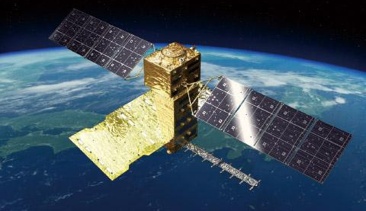
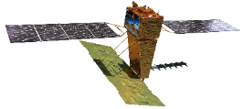
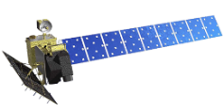
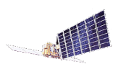
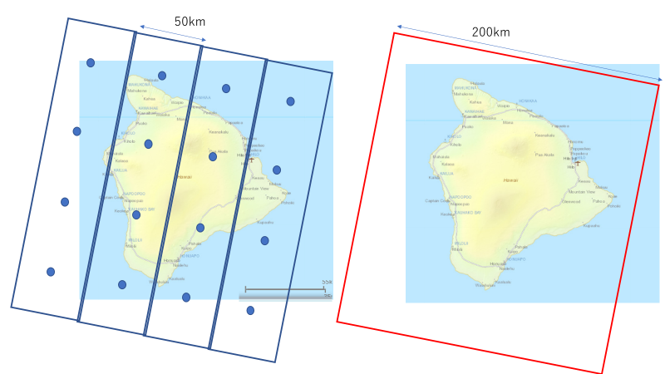
Advanced Land Observing Satellite-4
High-resolution
Resolution
To be launched in JFY2023
(2) Wider observation
3m
▼
ALOS-2
(2014-)
▼
ALOS-4
(JFY2023-)
Maximum L-band SAR resolution
10m
ALOS ▼
(2006-2011)
(1) Higher resolution
16m
JERS-1 ▼
(1992-1998)
High-performance radar technology enables to find early signs of disasters faster than ever.
Monitoring land deformation and subsidence up to a few centimeters by comparing by comparing acquired data in the same area at different times.
Increasing the observation frequency (once in 2 weeks) so that disaster prevention agencies can find abnormal changes in timely manner.
Increasing the swath from 50 km to 200 km while keeping the high resolution which enables to observe a broader area at the same time.
Applications other than disaster:
Forest management.
Monitoring infrastructure displacement.
50km
70km
75km
200km
Swath
Wide-swath
Coverage of 1 repeat cycle (14 days)
3m resolution
50 km swath width
3m resolution
200 km swath width

Slide 4
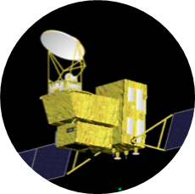
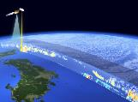
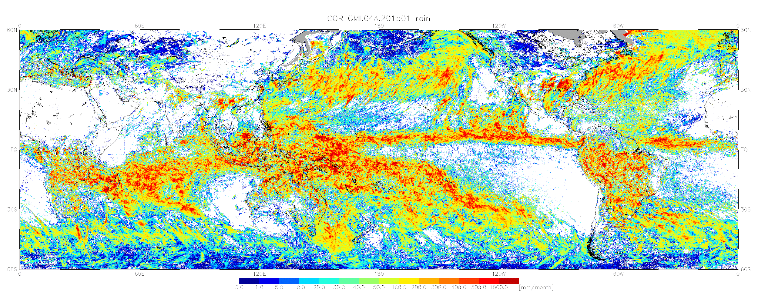
EarthCARE
Global Observing SATellite for Greenhouse gases and Water cycleGOSAT-GW
To be launched in 2024
Europe-Japan joint mission
3 dimensional global distributions of cloud and aerosol to contribute to precise understanding of climate change
JAXA and NICT provides world's first satellite-based cloud vertical motion by the Clod Profiling Radar (CPR) with 94 GHz with Doppler Capability at 0.8 km spatial resolution.
To be launched in JFY2024
Carrying two instruments, AMSR3 and TANSO-3.
AMSR3 (JAXA) will succeed AMSR series observations with adding new high frequency channels (166 & 183 GHz) for snow fall retrievals and water vapor analysis for numerical weather prediction.
TANSO-3 (led by Ministry of Environment in Japan) uses imaging spectrometer technology to measure CO₂, CH₄ and NO₂ globally with medium and locally with high spatial resolution.
Water Cycle
EarthCARE
GOSAT-GW
Cloud/Aerosol
Radiation Budget
Green-house gases
AMSR3 for both snow & rain
Orbit | Sun-synchronous sub-recurrent orbit Altitude: approx. 400km Inclination angle: 97.05° Local Sun Time at Desc.: 14:00 Revisit time: 25 days
Instruments | - Cloud Profiling Radar (CPR) by NICT & JAXA - Atmospheric Lidar (ATLID) by ESA - Multi-Spectral Imager (MSI) by ESA - Broad-Band Radiometer (BBR) by ESA
Mass | Approx. 2.2 tons at launch
Designed lifetime | 3 years
Orbit | Sun-synchronous sub-recurrent orbit Altitude: approx. 666km Inclination angle: 98.06° Local Sun Time at Desc.: 1:30 +/- 15 min Revisit time: 3 days
Instruments | - Advanced Microwave Scanning Radiometer 3 (AMSR3) - Total Anthropogenic and Natural emissions mapping SpectrOmeter-3 (TANSO-3) (for Ministry of Environment in Japan (MOE))
Mass | Approx. 2.6 tons at launch
Designed lifetime | 7 years

Slide 5
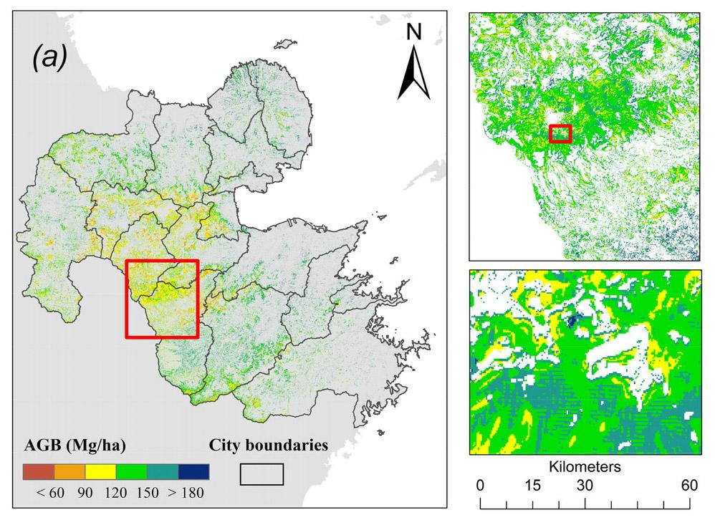
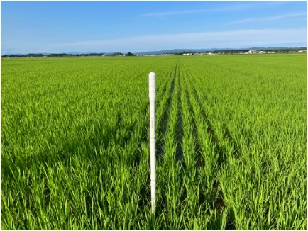
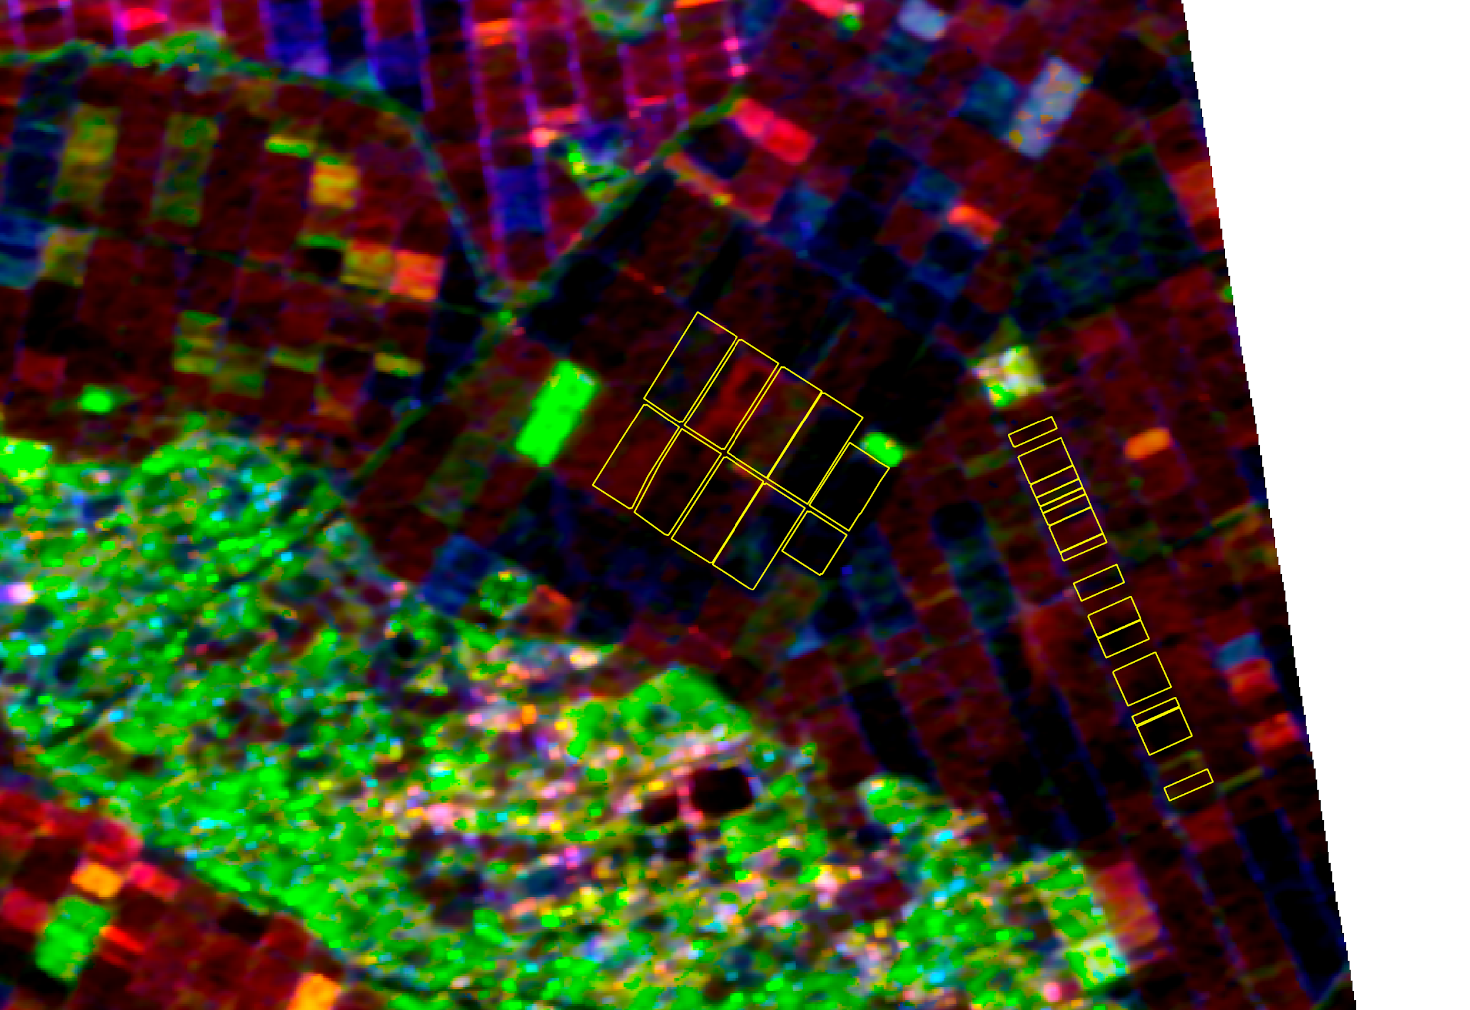
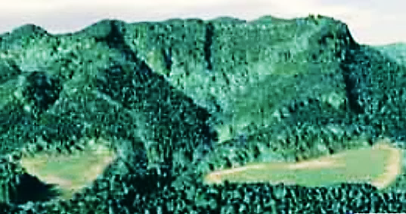
Towards upcoming JAXA SIT initiative:
Biomass Mapping and CH4Rice cooperation in Asian region
Biomass Mapping cooperation
CH4Rice Project
Assessment of Methane Emission from Rice Paddies and Water Management
Detailed Estimation of Forest Biomass Using Full Polarization Data
National/Regional
Global
Detailed and High-Precision
Forest Biomass Amount
AGB map of Oita Pref., Japan
[Li et al., 2022]
Automatic water-level Measurement
PALSAR2 Full-pol Data
Decomposition result
Satellite-based SAR is identified as an available tool to estimate aboveground forest biomass in 2019 IPCC guideline refinement.
→Several global biomass mapping have been developed. (i.e. ESA CCI Biomass, NASA/JPL Biomass, NASA GEDI Biomass)
Challenges in mapping Asian forest biomass – spatial deviation of reference data distribution and errors caused by ground slope.
Aiming to develop accurate satellite-based forest biomass maps and promote their utilization in national policies through cooperation with Asian countries, discussion with potential partners has started.
Japanese Government approved funding as a “Stardust Project”.
CH4Rice Project is implemented by APRSAF SAFE initiative. To contribute to SIT initiative outcome, JAXA SIT will engage with this initiative to carry out case studies to monitor methane from rice field.
Objective of CH4Rice is to contribute to climate change mitigation through methane MRV, efficient irrigation and sustainable agriculture, by estimating methane emission from paddy rice based on assessing water level.
Preparing study sites and in-situ water-level measurements in Asian countries. ALOS-2 PALSAR-2 observation with Full-pol mode for these sites has started.
Potential Partners:
GISTDA (Thailand), MoE DIGS (Department of Geospatial Information Service) (Cambodia), ICIMOD (Nepal)
Project Lead: VNSC (Vietnam)
Participating Agencies: BRIN (Indonesia), GISTDA (Thailand), PUST (Bangladesh), ISRO, JAXA, U-Tokyo with other possible cooperators (e.g. ESA/CESBIO, PhilSA, etc.)

Slide 6
See you in Tokyo
in April 2024.

