Slide 1
37th CEOS Plenary
Agency Report of
ROSCOSMOS
Tamara Ganina, Roscosmos
Agenda Item 13.2
37th CEOS Plenary
15 - 16 November 2023
Chiang Rai, Thailand
Hosted by GISTDA

Slide 2
Main Results of ROSCOSMOS by 2023
1
All ROSCOSMOS’ activities are carried out in accordance with the Russian Federal Space Program for 2016-2025. The new program from 2026-2036 is under development
2
In 2023 ROSCOSMOS successfully launched the followinf satellites: ‘Electro-L’ № 4, ‘Kondor-FKA’ (SAR satellite), ‘Meteor-M’ № 2-3. Until the end of 2023 ROSCOSMOS plans to launch ‘Resurs-PM’, ‘Meteor-MP’ and ‘Ionosphera’ satellites
3
Currently, there are 12 satellites operating as part of Russian remote sensing constellation which includes ‘Kanopus-V’ NN 3 – 5 and ‘Kanopus-V-IK’, ‘Meteor-M’ NN 2-2 – 2-3, ‘Electro-L’ NN 2 – 4, ‘Arctica-M’ № 1 and ‘Kondor-FKA’ № 1
4
More than 70 standards have been developed and approved in order to support Russian space activities,, taking into account the requirements of international standards (ISO, OGS and others)
5
Also ROSCOSMOS’ geoinformation recourses are being actively developing as well, providing consumers with access to remote sensing data and derived products:
ROSCOSMOS Geoportal;
Federal Remote Sensing Data Foundation;
Basic Products Bank;
Thematic Services ‘Digital Earth’
6
Currently ROSCOSMOS is implementing the Russian Federal Project ‘Sphere’, within the framework of which it’s planned to create the constellation of more than 1000 small satellites (including communication, IoT, remote sensing and broad band access satellites) as well as commercial constellation including more than 170 satellites

Slide 3
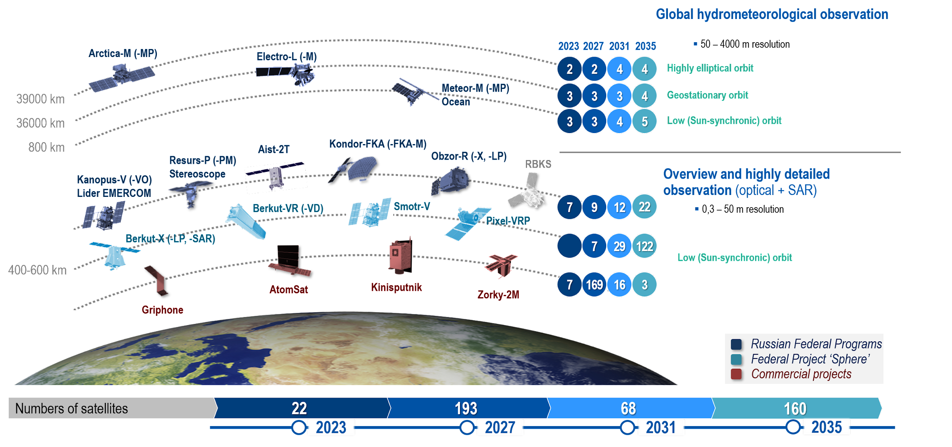
Development Plans for the Earth Remote Sensing Satellite Constellation by 2035

Slide 4
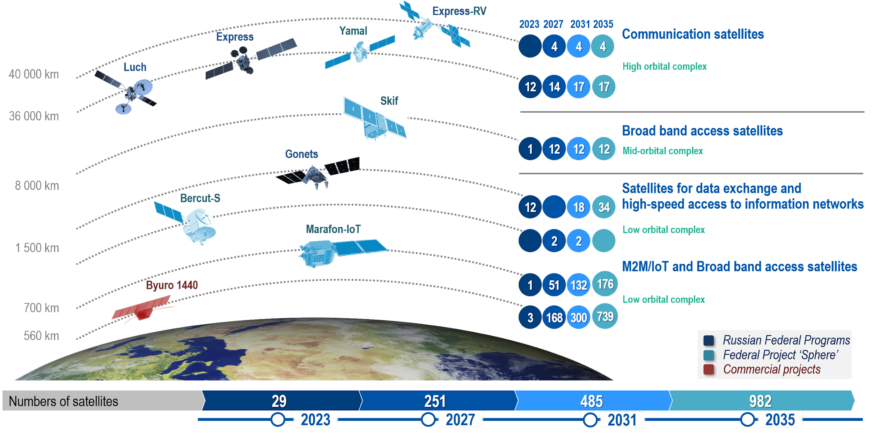
Development Plans for the Communication Satellite Constellation by 2035

Slide 5
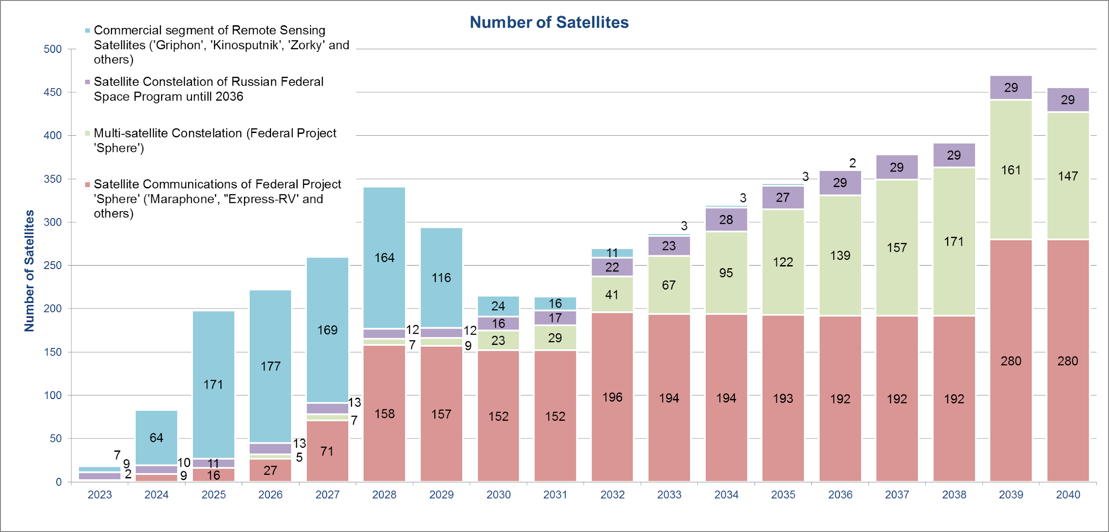
Number of Satellites in Different Types of Satellite Constellations by 2040
470
378
341
345
287
222
214

Slide 6
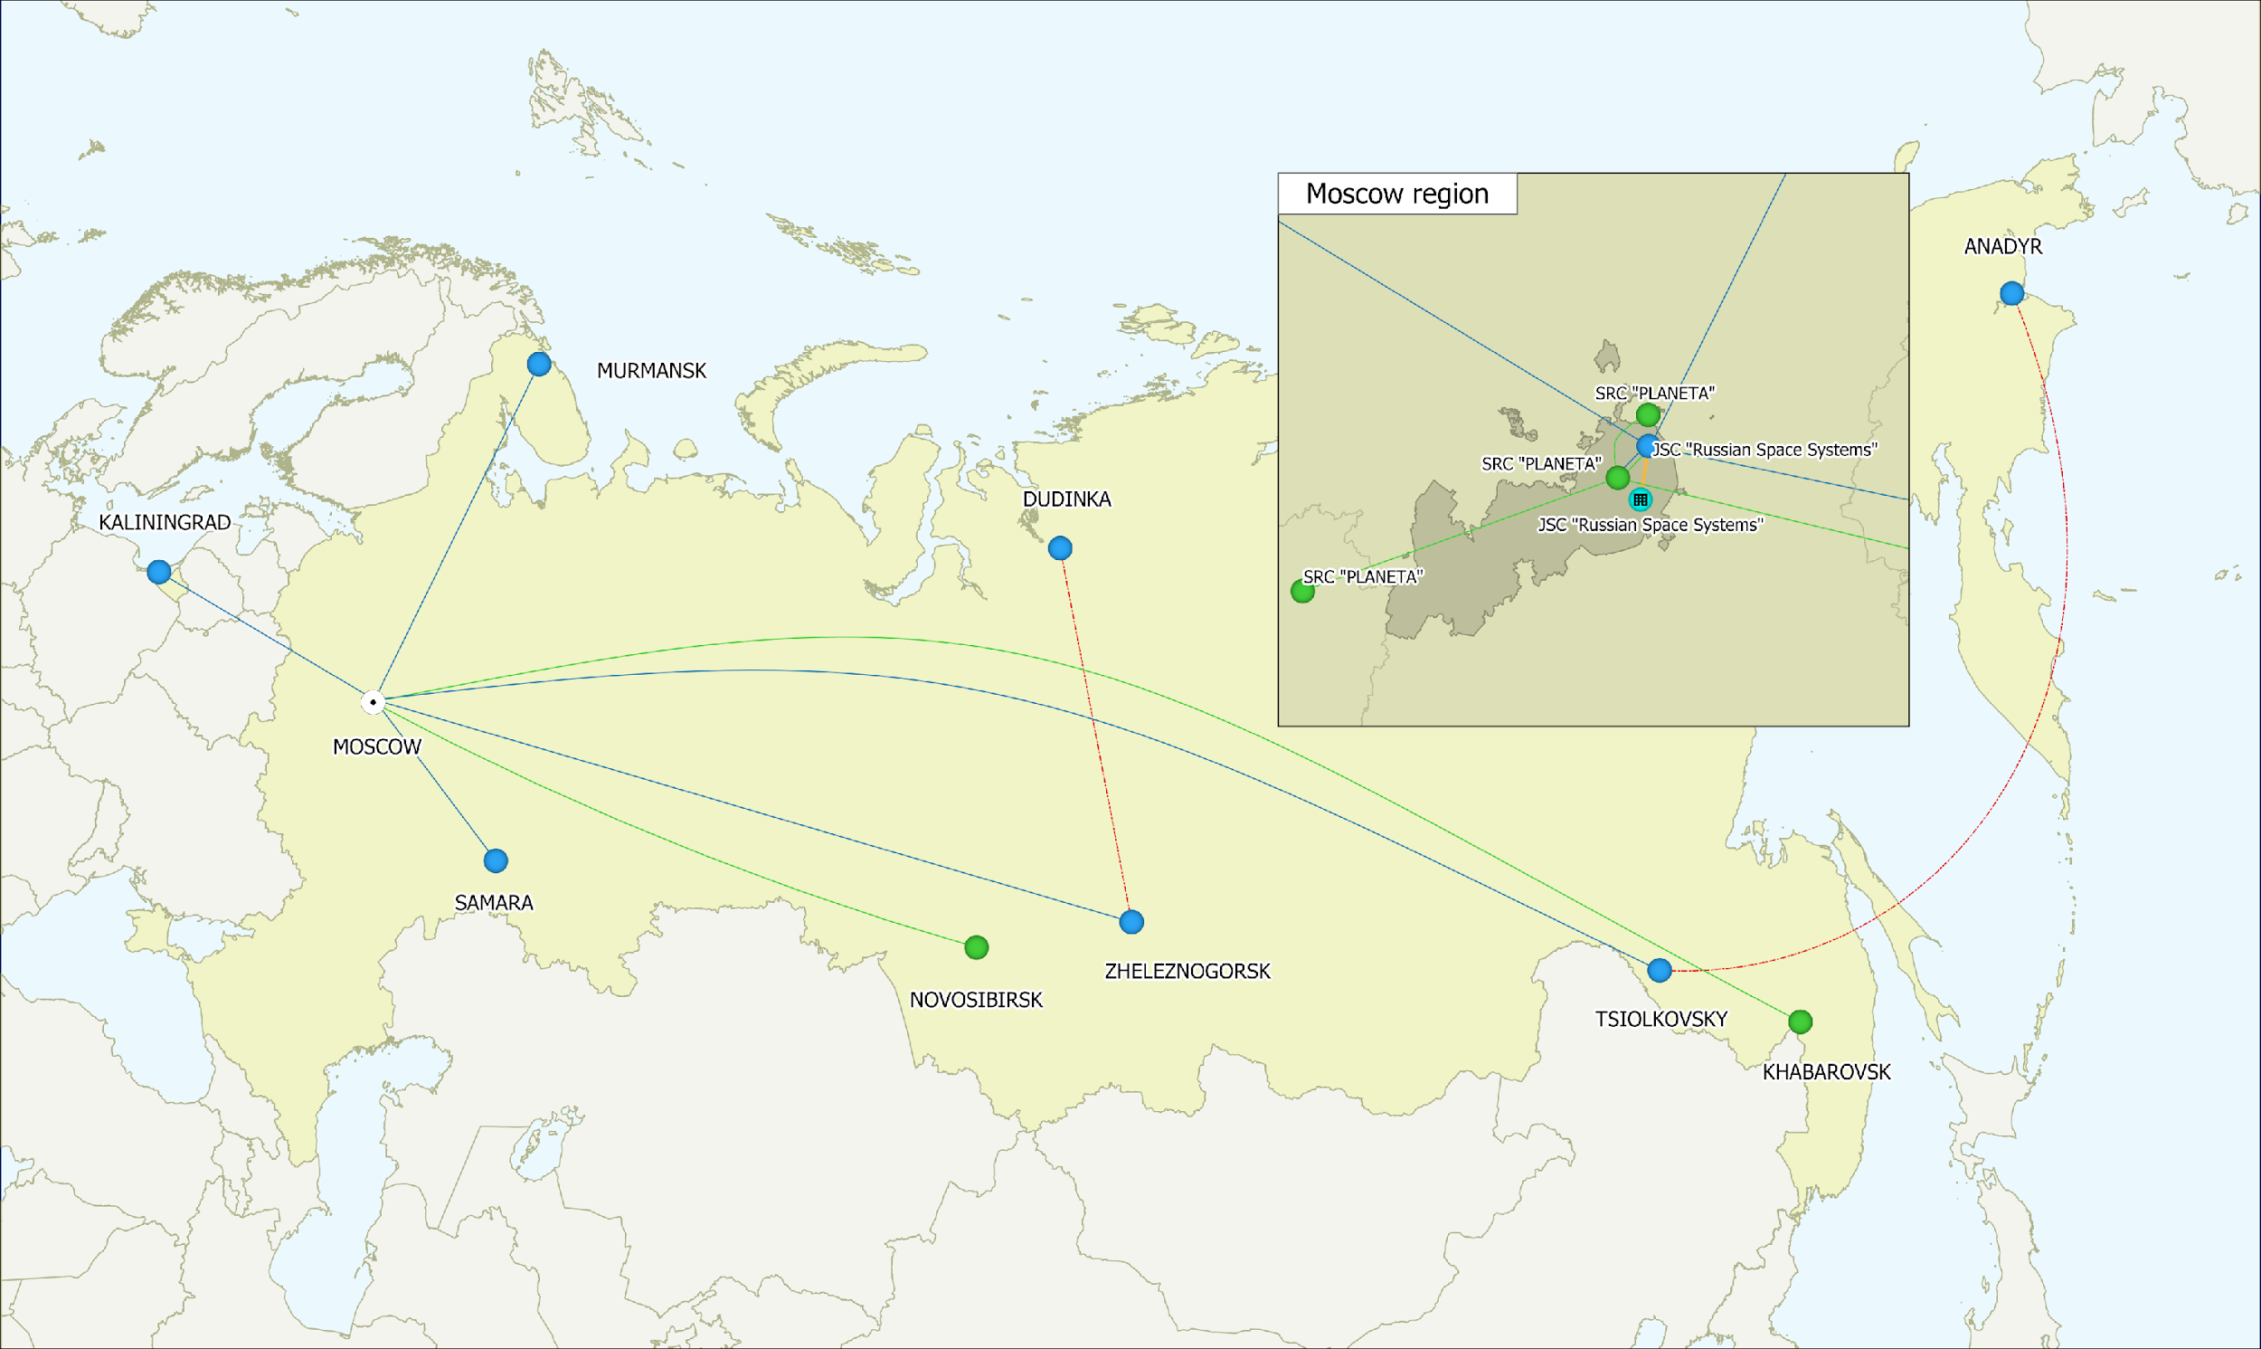
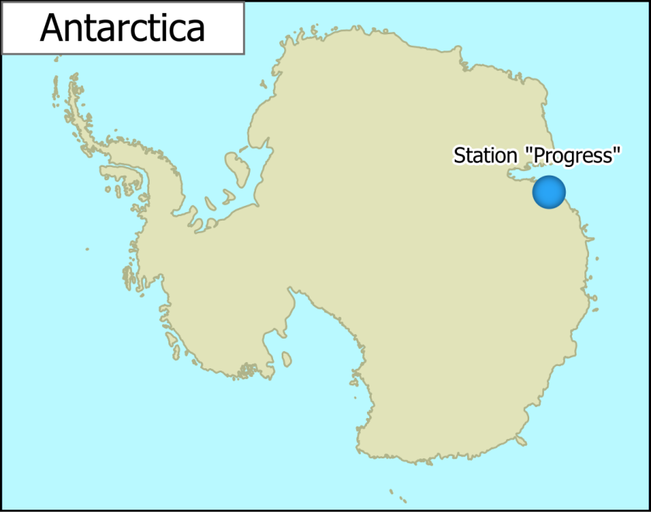
Integrated Geographically Distributed Informational System of Earth Remote Sensing
Ground-based information center | Receiving complexes
 | 2023 | 2030
Murmansk | 2 | 13
Moscow region | 9 | 11
Dudinka | 1 | 13
Zheleznogorsk | 4 | 8
Anadyr | - | 13
Kaliningrad | 2 | 3
Spaceport “Vostochny” | 3 | 3
Station ‘Progress’ (Antarctica) | 1 | 2
Total | 22 | 66

Slide 7
ROSCOSMOS’ Activities in the frame of CEOS and other International Organizations
ROSCOSMOS is a member of WGCV, WGISS and WG of Disasters
ROSCOSMOS also provides the latest information on Russian satellites to update the CEOS MIM Database (the latest update was in 2023)
ROSCOSMOS organized and hosted the following international events:
CEOS meetings:
WGCV-33, Moscow, May 2011
WGISS-38, Moscow, September 2014
Other events:
ASEAN Remote Sensing data training, Moscow, March 2015
13th GEO Plenary and Exhibition, Saint-Petersburg, November 2016, (in partnership with Roshydromet)
36th meeting of the International Charter on Space and Major Disasters, Moscow, October 2016
AOMSUC-8, Vladivostok, October 2017 (in partnership with Roshydromet)
CGMS-47, Sochi, May 2019 (in partnership with Roshydromet)
42d meeting of the International Charter on Space and Major Disasters, Saint-Petersburg, October 2019
ROSCOSMOS also interferes in the activities of the UN Committee on the Peaceful Uses of Outer Space (COPUOS), GEO, CGMS, WMO, International Charter on Space and Major Disasters
and other international communities and groups

Slide 8
Thank you for your attention!
Tamara Ganina,
Deputy Head of R&D Department
JSC ‘’Russian Space Systems’
gtd@ntsomz.ru

