Slide 1
CEOS Agency Reports EUMETSAT Item 3.2.
Phil Evans
Director-General

Slide 2
MTG-I1 First Images from FCI and LI
MTG-I1 commissioning is running smoothly:
First FCI Image released on 4 May
First LI Image released on 3 July
Operational data flow to test users started on 31 October
Satellite planned to be declared fully operational by January 2024
Slide 2

Slide 3
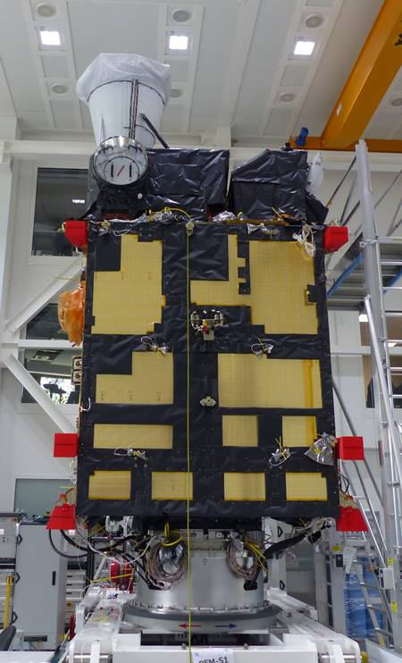
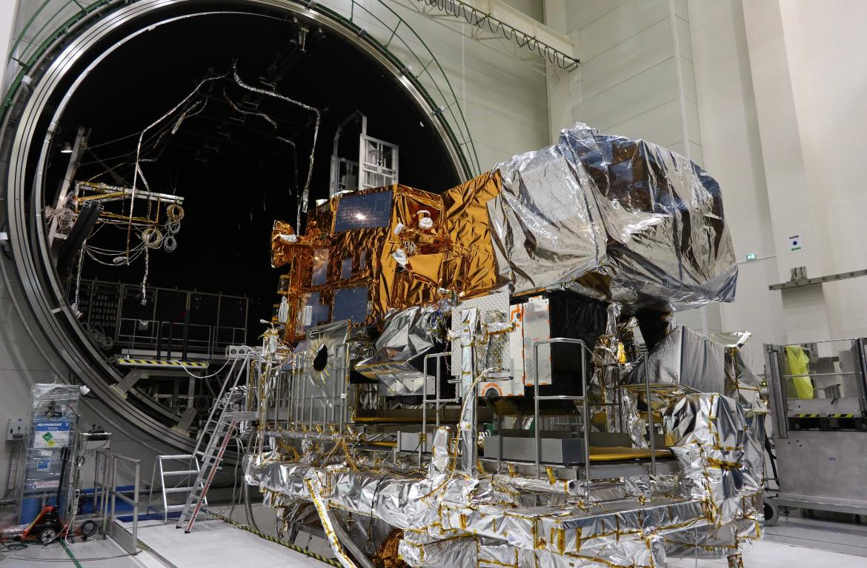
Towards MTG-S1 and Metop-SG
MTG-S1 integrated and ready for launch as of Q3/24
Metop-SGA TVAC completed and will be ready for launch by Q1/25
Metop-SGB starting environmental tests to be ready for launch by Q3/25

Slide 4
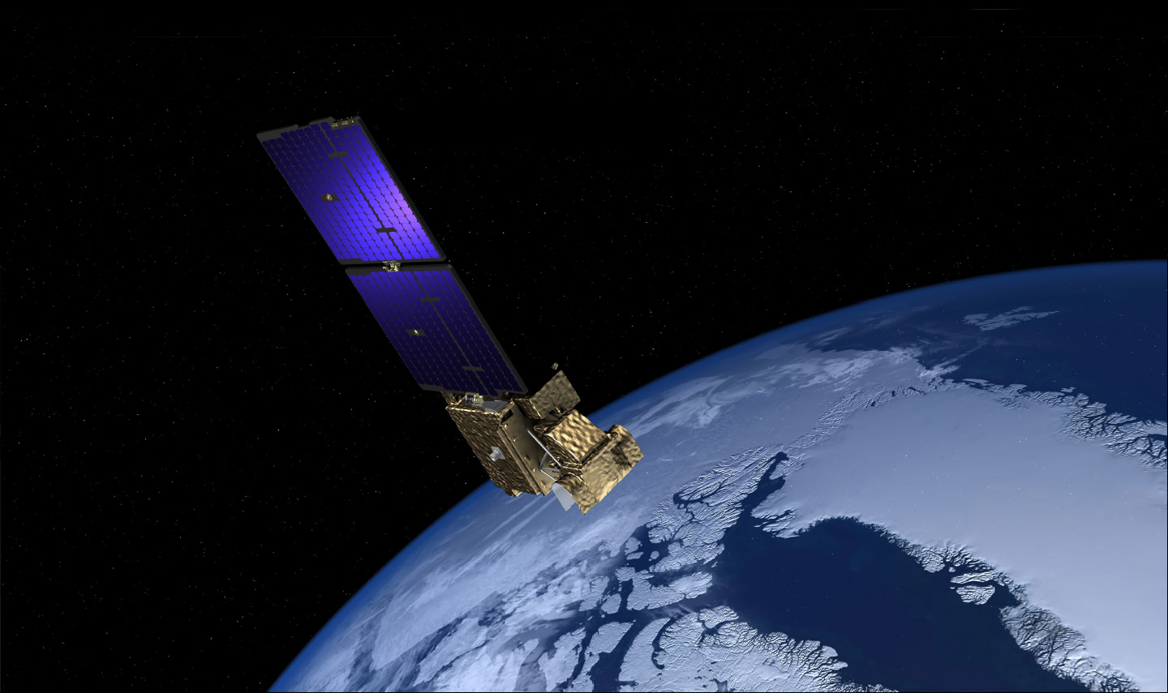
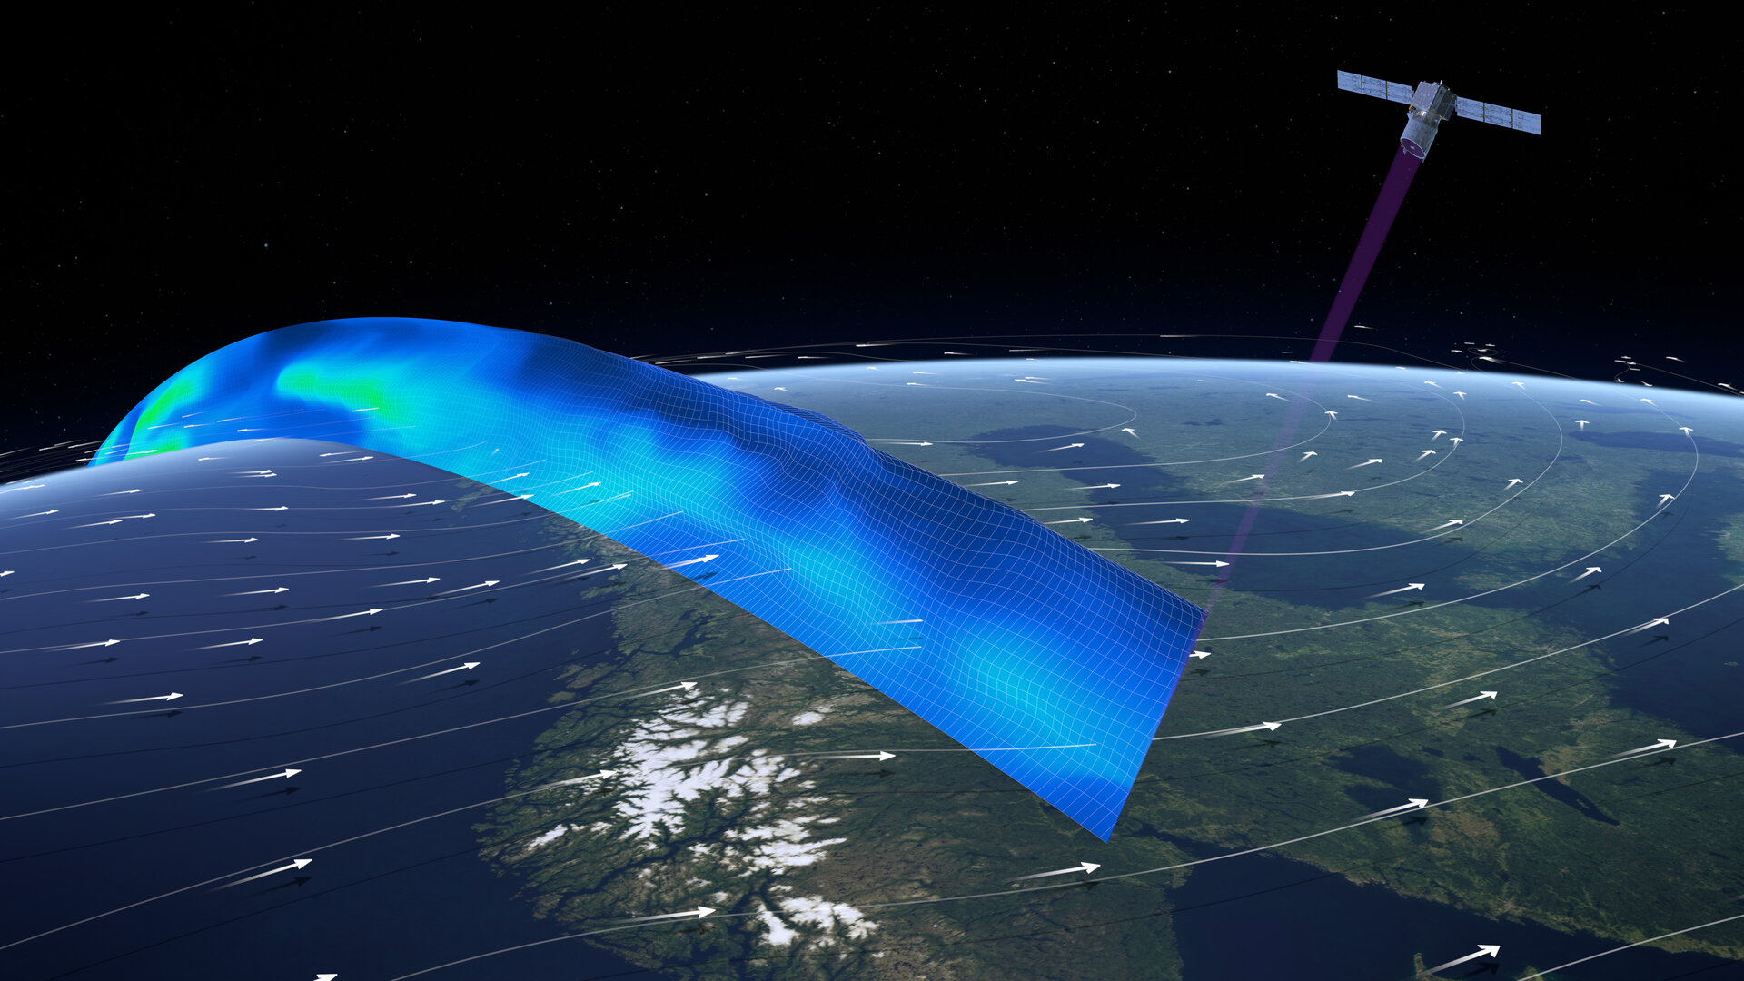
EPS-Aeolus and EPS-Sterna
Phase B on going and presentation of both programmes for approval in June 2024
2023 dedicated to a solid SEB Study for both programmes
EPS-Aeolus impact factor on Day 1 forecast accuracy 3%
EPS-Sterna impact factor on Day 1 forecast accuracy 6%
Global and regional impacts observed, with EPS-Sterna having a specific additional positive impact on Northern regions
Impacts largely independent and additive (93.5%)
Positive combined impact of would exceed that of one Metop satellite
Combined benefit to cost ratio in the range of 30:1
Conservative approach – true impact may well be higher
Images: ESA

Slide 5
Other News from EUMETSAT
European Weather Cloud (Cloud-based data infrastructure for European MET community) went operational on 26 September 2023
EUMETSAT delivered the DestinE data lake on 3 November
Proposal to extend commercial RO date service, based on global redistribution licence until mid-2026
Development of a coordinated AI/ML roadmap by MET community in Europe

Slide 6
EUMETSAT and Copernicus
WEkEO (cloud-based data access platform) new contract started with major development planned
Prepared for launch of Sentinel-6B in 2025 with a GS supporting dual operations S6-A & B
Sentinel-4 will be launched on-board MTG-S1 in 2024/25
Sentinel-5 will be launched on Metop-SGA in 2025
Ground Segment for CO2M constellations in development to support launch in 2026
Microcarb will serve as preparation mission for CO2M
Massive efforts on Fiducial Reference Measurements infrastructures to prepare for these missions – Focus on Ocean Colour, SST and GHG

