Slide 1
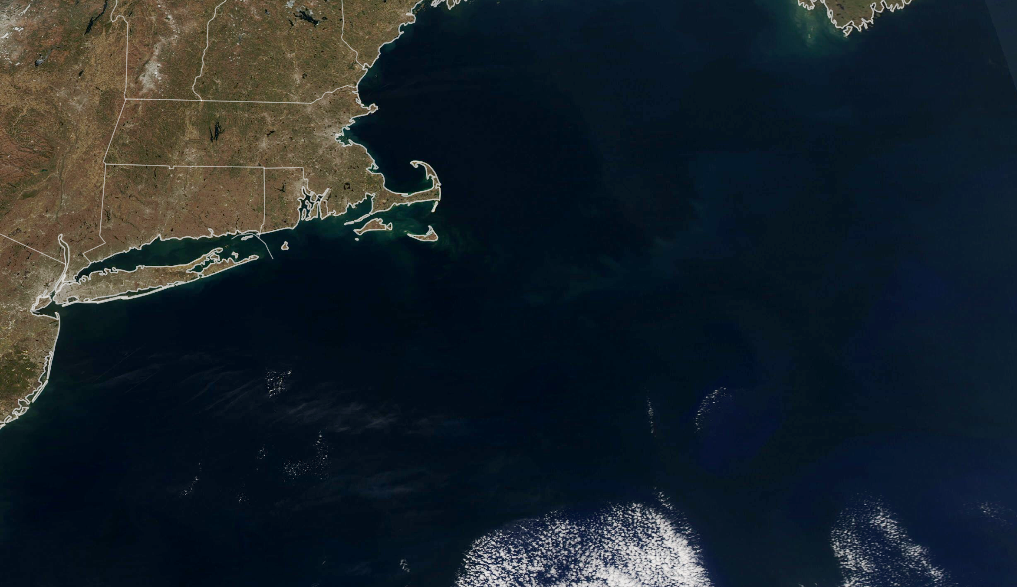
37th CEOS Plenary
Chiang Rai, Thailand
Karen St. Germain, Ph.D.
Director, Earth Science Division
Science Mission Directorate, NASA
Nov. 15, 2023
Notes:
CEOS Plenary, Agency Reports

Slide 2
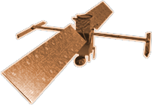
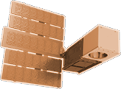
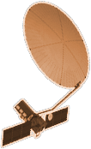
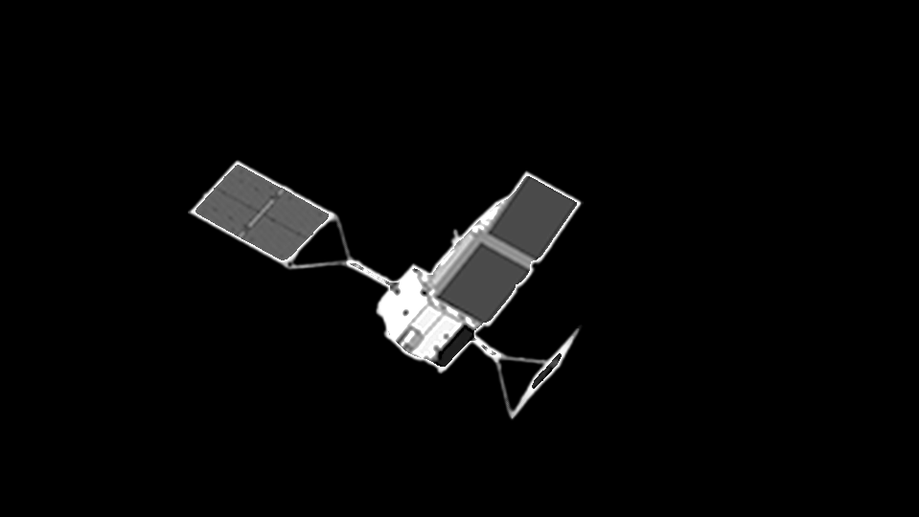
2020
SENTINEL-6
MICHAEL FREILICH
ICESAT-2
GRACE-FO (2)
CYGNSS (8)
LANDSAT-9
2015
LIS
NISTAR, EPIC
SWOT
SAGE III
EARTH FLEET
SMAP
TSIS-1
TEMPO
ECOSTRESS
OCO-2
INVEST/CUBESATS
TROPICS (4)
GEDI
GPM
NACHOS 2022
CTIM 2022
NACHOS-2 2022
MURI-FD 2023
SNOOPI* 2024
HYTI* 2024
ARGOS* 2024
OCO-3
LANDSAT 7
LANDSAT 8
PACE
TERRA
EMIT
AQUA
SUOMI NPP
PREFIRE (2)
AURA
CLOUDSAT
JPSS INSTRUMENTS
CLARREO-PF
2000
NISAR
2010
OMPS-LIMB 2022
LIBERA 2027
OMPS-LIMB 2027
OMPS-LIMB 2032
TSIS-2
2005
MAIA
2025
ISS INSTRUMENTS
KEY
SENTINEL-6B
INTERNATIONAL PARTNERS
U.S. PARTNER
ISS INSTRUMENT
JPSS INSTRUMENT
CUBESAT
LAUNCH DATE TBD
EARTH SYSTEM
OBSERVATORY MISSION
GLIMR*
INCUS*
MISSIONS
CRISTAL*
MISSIONS
POLSIR*
AOS-
STORM + PMM
AOS-SKY*
LANDSAT NEXT*
(PRE) FORMULATION
IMPLEMENTATION
OPERATING
EXTENDED
GRACE-C*
SBG*
11.01.23
2030

Slide 3
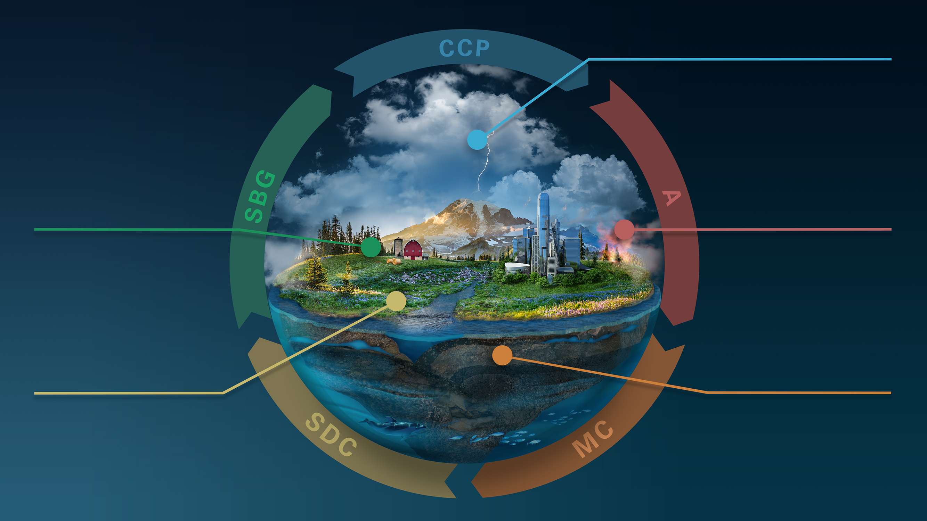
CLOUDS, CONVECTION
AND PRECIPITATION
Water and Energy in the Atmosphere
INTERCONNECTED
CORE MISSIONS
SURFACE BIOLOGY
AND GEOLOGY
AEROSOLS
Particles in the
Atmosphere
Earth Surface & Ecosystems
SURFACE DEFORMATION
AND CHANGE
MASS CHANGE
Large-scale Mass
Redistribution
Earth Surface Dynamics
Notes:
The ESO is the heart of our response to the Decadal Survey.

Slide 4
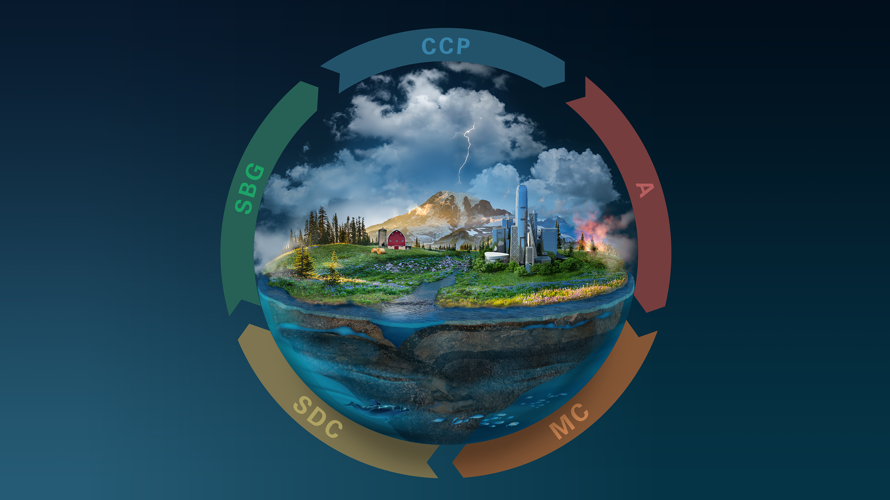
Greenhouse Gases
INNOVATION & COMPETITION
EARTH EXPLORER MISSIONS
Ozone and Trace Gases
Snow Depth and Water Content
Atmospheric Winds
3D Ecosystem
Structure
Ice Elevation
Ocean Surface
Winds and Currents
Notes:
The Decadal recommended Earth System Explorers a new competed mission element in the Earth portfolio.

Slide 5
Earth Science to Action Strategy
Earth Science to Action
Public Understanding & Exchange
Solutions & Societal Value
Earth System Science & Applied Research
Foundational Knowledge, Technology, Missions, & Data
06.27.23
Notes:
Base layer: foundational knowledge, technology, missions & data. Includes building models. (Knowing)
2nd layer: Earth system science and applied research. Includes improving models (Learning)
3rd layer: Solutions & Societal Value Includes using models (Doing)
Top layer: Public understanding & exchange (Teaching)

Slide 6
NASA Transform to Open Science
NASA's Transform to Open Science (TOPS)
a 5-year mission to accelerate adoption of open science
Goals:
Increase understanding and adoption of open science principles and techniques
Broaden participation by historically excluded communities
Accelerate major scientific discoveries
Engagement
Capacity Sharing
Incentives
Coordination
https://nasa.github.io/Transform-to-Open-Science/
Notes:
Community outreach is the fourth, and most critical, component of NASA’s open science activities.
At their core, Open Science principles embrace transparency, collaboration, and participation.
Community participation in Open Science is essential, but how can we make data and science more participatory? NASA is supporting Community Building through Capacity Building & Partnerships via the Transform to Open Science (TOPS) mission.
TOPS Goals:
Increase understanding and adoption of open science principles and techniques
Broaden participation by historically excluded communities
Accelerate major scientific discoveries

Slide 7
SWOT (Surface Water and Ocean Topography)
Data on global sea surface heights
Collected during SWOT’s first full 21-day science orbit, July 26-Aug. 16, 2023
First global sea level from SWOT:
https://youtu.be/obIkUQtSJgk?si=seGlRuWIvz_PihR9

Slide 8
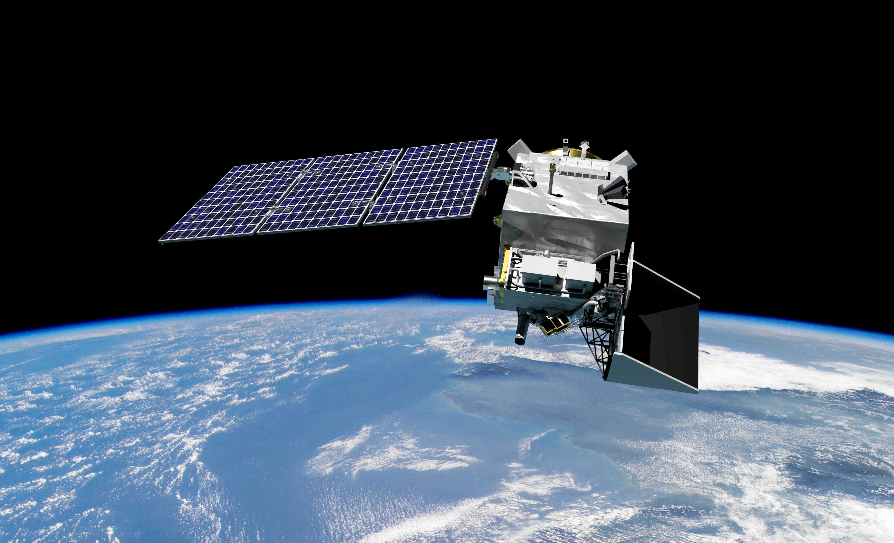
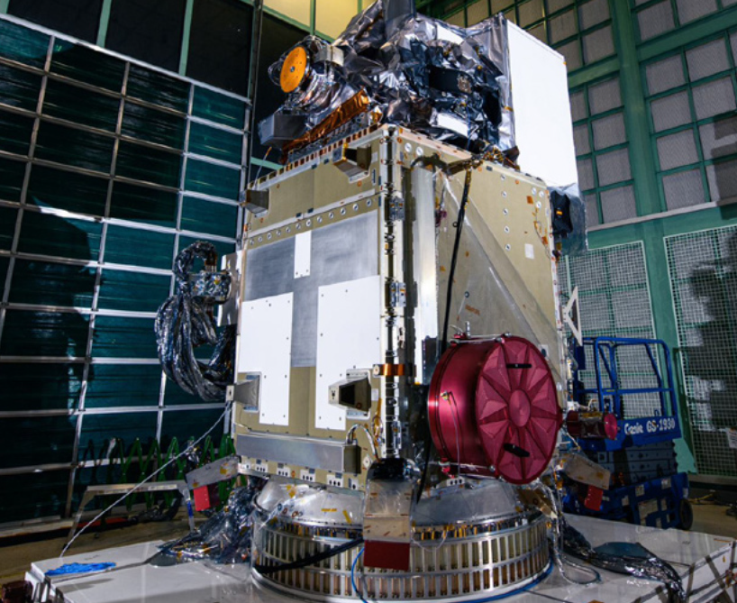
UPCOMING LAUNCH: PACE – Plankton, Aerosol, Cloud, ocean Ecosystem
Left: GSFC rendering of PACE in orbit
Above: PACE’s primary sensor, the Ocean Color Instrument, is an advanced global, hyperspectral imaging radiometer
PACE will extend and improve NASA’s 20+ years of observations of living oceans, atmospheric aerosols, and clouds, initiating an advanced set of climate-relevant data records.
Notes:
PACE will extend and improve upon NASA’s 20+ years of global satellite observations of our living ocean, atmospheric aerosols, and clouds and initiate an advanced set of climate-relevant data records. By determining the distribution of phytoplankton, PACE will help assess ocean health. It will also continue key measurements related to air quality and climate. PACE’s specific science goals include: extending systematic ocean color, atmospheric aerosol, and cloud data records for Earth system and climate studies; and addressing new and emerging science questions by detecting a broader range of color wavelengths that will provide new and unprecedented detail.

Slide 9
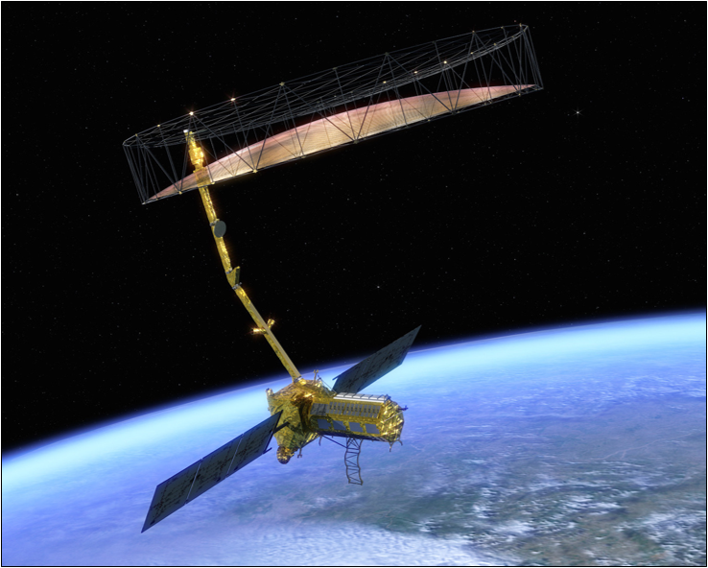
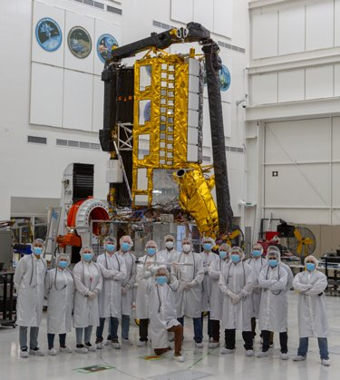
UPCOMING LAUNCH: NISAR – NASA-ISRO Synthetic Aperture Radar Mission
Left: Rendering of NISAR in orbit;
Above: NISAR System Integration and Test Team with Completed Radar Payload
As an ESO pathfinder mission, NISAR data will be free and open, hosted at Alaska Satellite Facility Distributed Active Archive Center (DAAC). Observations from NISAR will inform science and applications in Solid Earth, Ecosystems, and Cryosphere: volcanos, soil moisture, ice sheets, glaciers, coastal processes, subsidence, and more.

Slide 10
Notes:
https://images.nasa.gov/details-iss040e081123

