Slide 1
37th CEOS Plenary
UK Space Agency annual update 2022-23
Beth Greenaway, UKSA
Agenda Item #
37th CEOS Plenary
15 - 16 November 2023
Chiang Rai, Thailand
Hosted by GISTDA

Slide 2
UK Earth Observation
The Department for Science, Innovation & Technology are the lead for the development of the UK’s EO policy and long-term strategy.
The UK’s National Space Strategy was published in 2022 and aims to make the UK one of the world's most innovative and attractive space economies.
The National Space Strategy sets out the UK’s ambition to stay at the forefront of Earth Observation technology and know-how.
Overarching UK EO Policy & Strategy
Supporting public sector use of EO data and services
EO policy & mission delivery, sector support
Key governmental users of EO data & services
Wider UK Government stakeholder Departments and Agencies

Slide 3
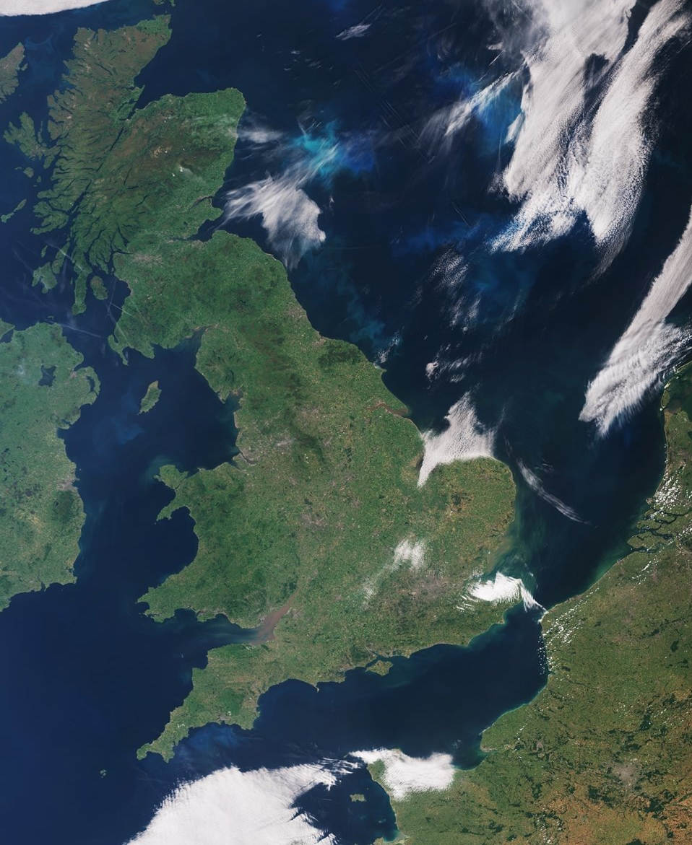
UK Space Agency
The UK Space Agency helps the UK to harness the power of space to benefit our people, planet and shared prosperity, by:
Catalysing Investment
Delivering space capabilities and missions
Championing space
Earth Observation is one of 8 key UK Space Agency priorities.
We work to define the UK’s EO requirements, and design and deliver a portfolio of programmes.

Slide 4
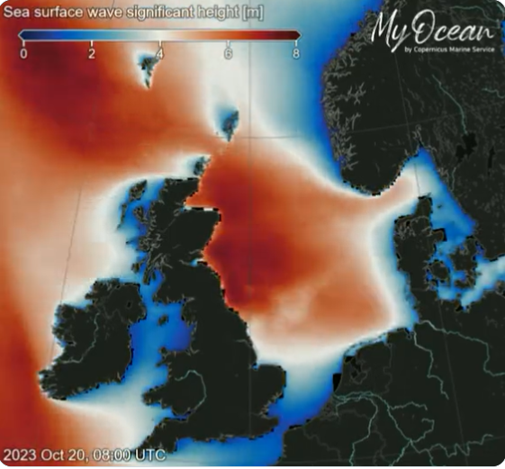
Copernicus
The UK has reached a bespoke agreement with the EU to enable the UK to participate in Copernicus component of the EU Space programme from 1st January 2024.
This comes at a crucial moment as the Copernicus system is vital to global efforts to tackle environmental and climate change related challenges.
The UK will again be eligible to be included in all elements of the programme including building the missions, managing the operations and data and developing services to the end users.
Sea surface wave significant height (metres) around Great Britain and Ireland during Storm Babet, 20th October 2023. Credit: Copernicus Marine Service

Slide 5
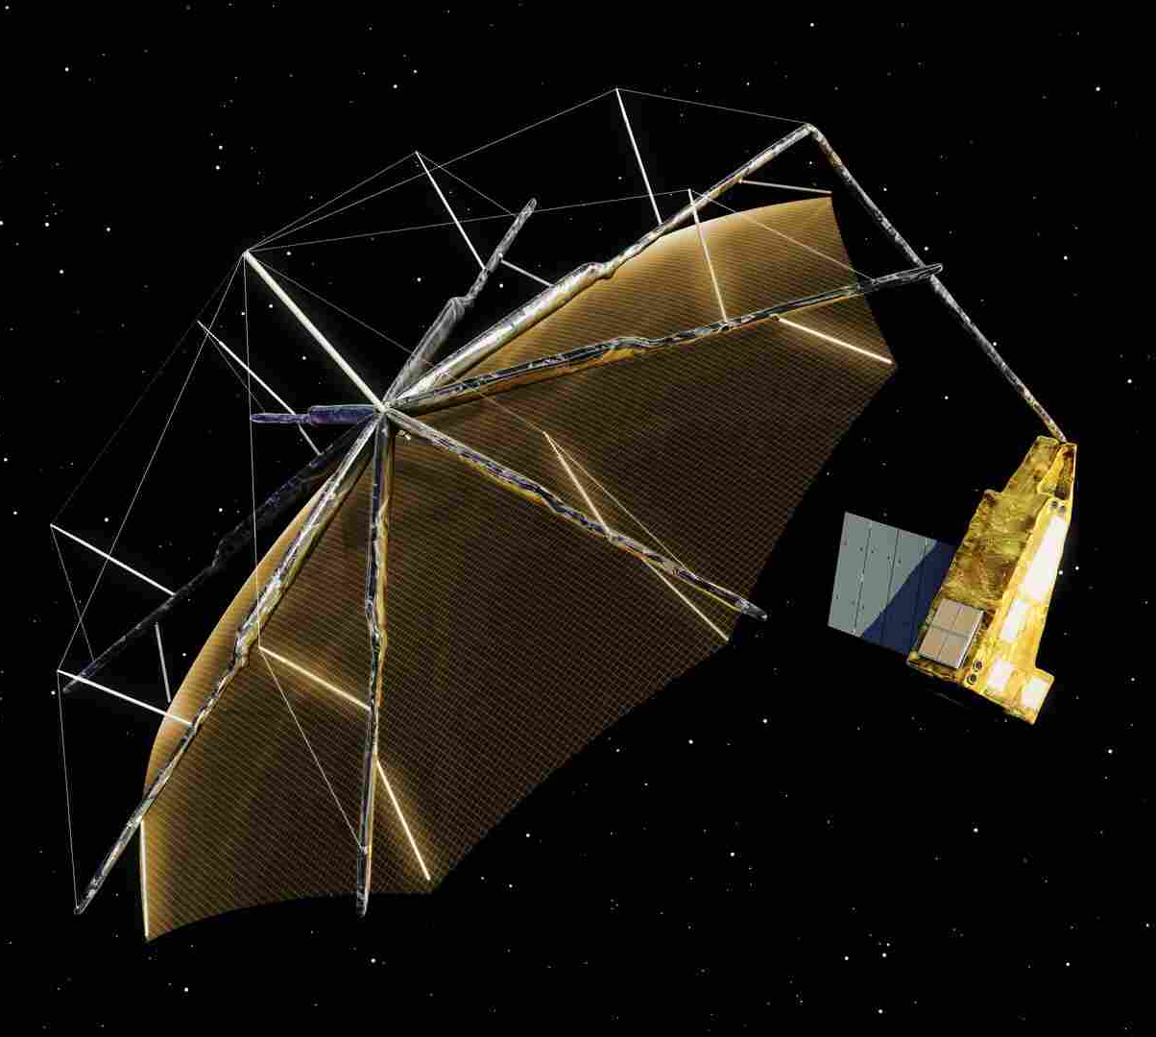
ESA
The UK is a key member of the European Space Agency and plays a strong role in ESA’s Earth Observation Programmes, allowing us to collaborate with other European countries on key EO and meteorological missions as well as R&D, science, technology and data activities.
TRUTHS – a UK-conceived and UK-led mission. TRUTHS will be a calibration lab in space, increasing accuracy of EO data ten-fold. It will provide a benchmark reference of the optical radiation state of the planet. UK Prime in Airbus-UK. Estimated to launch in 2031.
Biomass – the first mission to monitor forests in 3D – for better accuracy of stored Carbon. This is a UK-backed ESA Earth Explorer mission, with strong UK scientific leadership, and a UK Prime in Airbus-UK. Due to launch in 2025.
BIOMASS – Credit: ESA

Slide 6
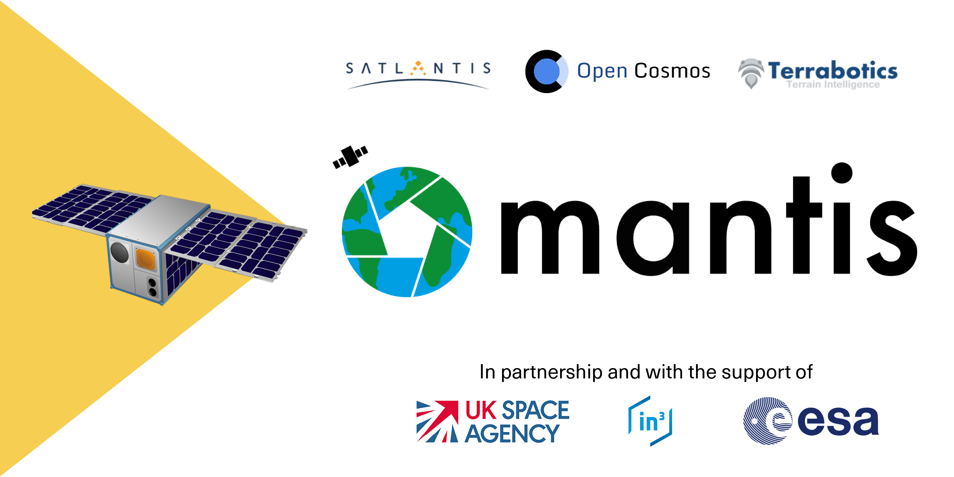
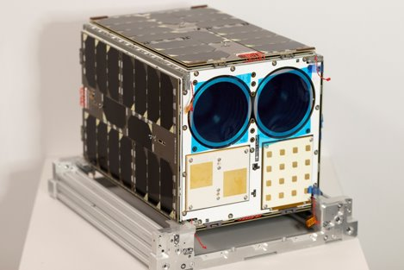
Mantis Launched 11th November!
The first satellite to be launched from ESA’s InCubed programme
UKSA – through ESA - have contributed £2.2m to support the commercial advancement of space-related innovation in the UK
MANTIS is a demo mission consisting of an innovative multispectral high-resolution optical payload for EO, and a processing unit aimed at exploiting AI to derive insights on-board.
MANTIS will be particularly suitable for de-risking energy and mining applications, where 60% of resources can be found in remote and hostile regions.

Slide 7
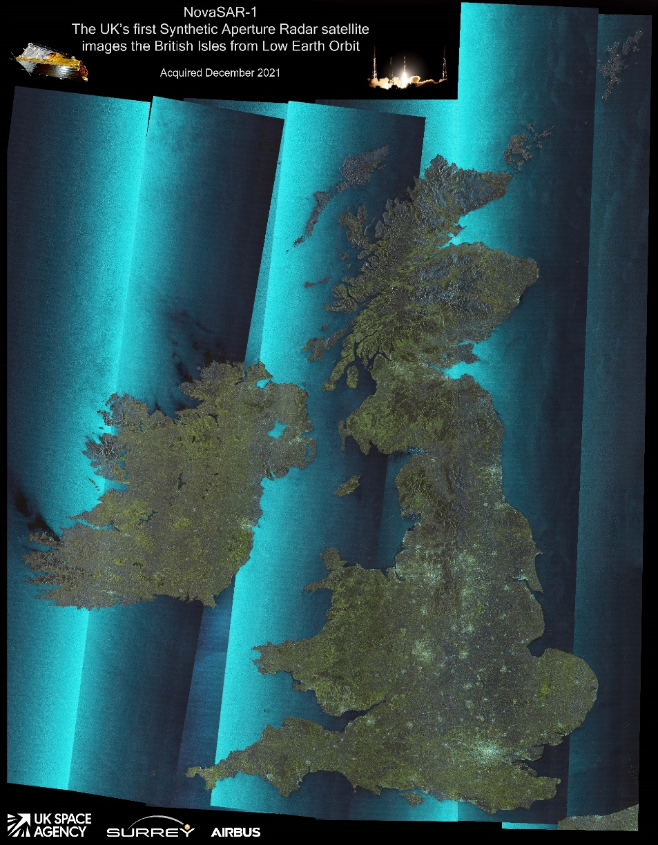
NovaSAR
NovaSAR is a commercially owned and operated (SSTL) satellite, first of its kind to be manufactured in the UK, which is a low-cost SAR demonstration mission combining SAR imagery with simultaneous AIS data.
UKSA provided a grant to SSTL to de-risk development of this novel S-Band SAR mission which was launched in 2018.
NovaSAR has collated a rich suite of images for use in various applications, including crop analysis, flood and forestry mapping, and maritime surveillance.
An agreement has recently been reached ensuring that processing and data flow of the UK Governments share will continue unimpeded until the end of mission lifetime.

Slide 8
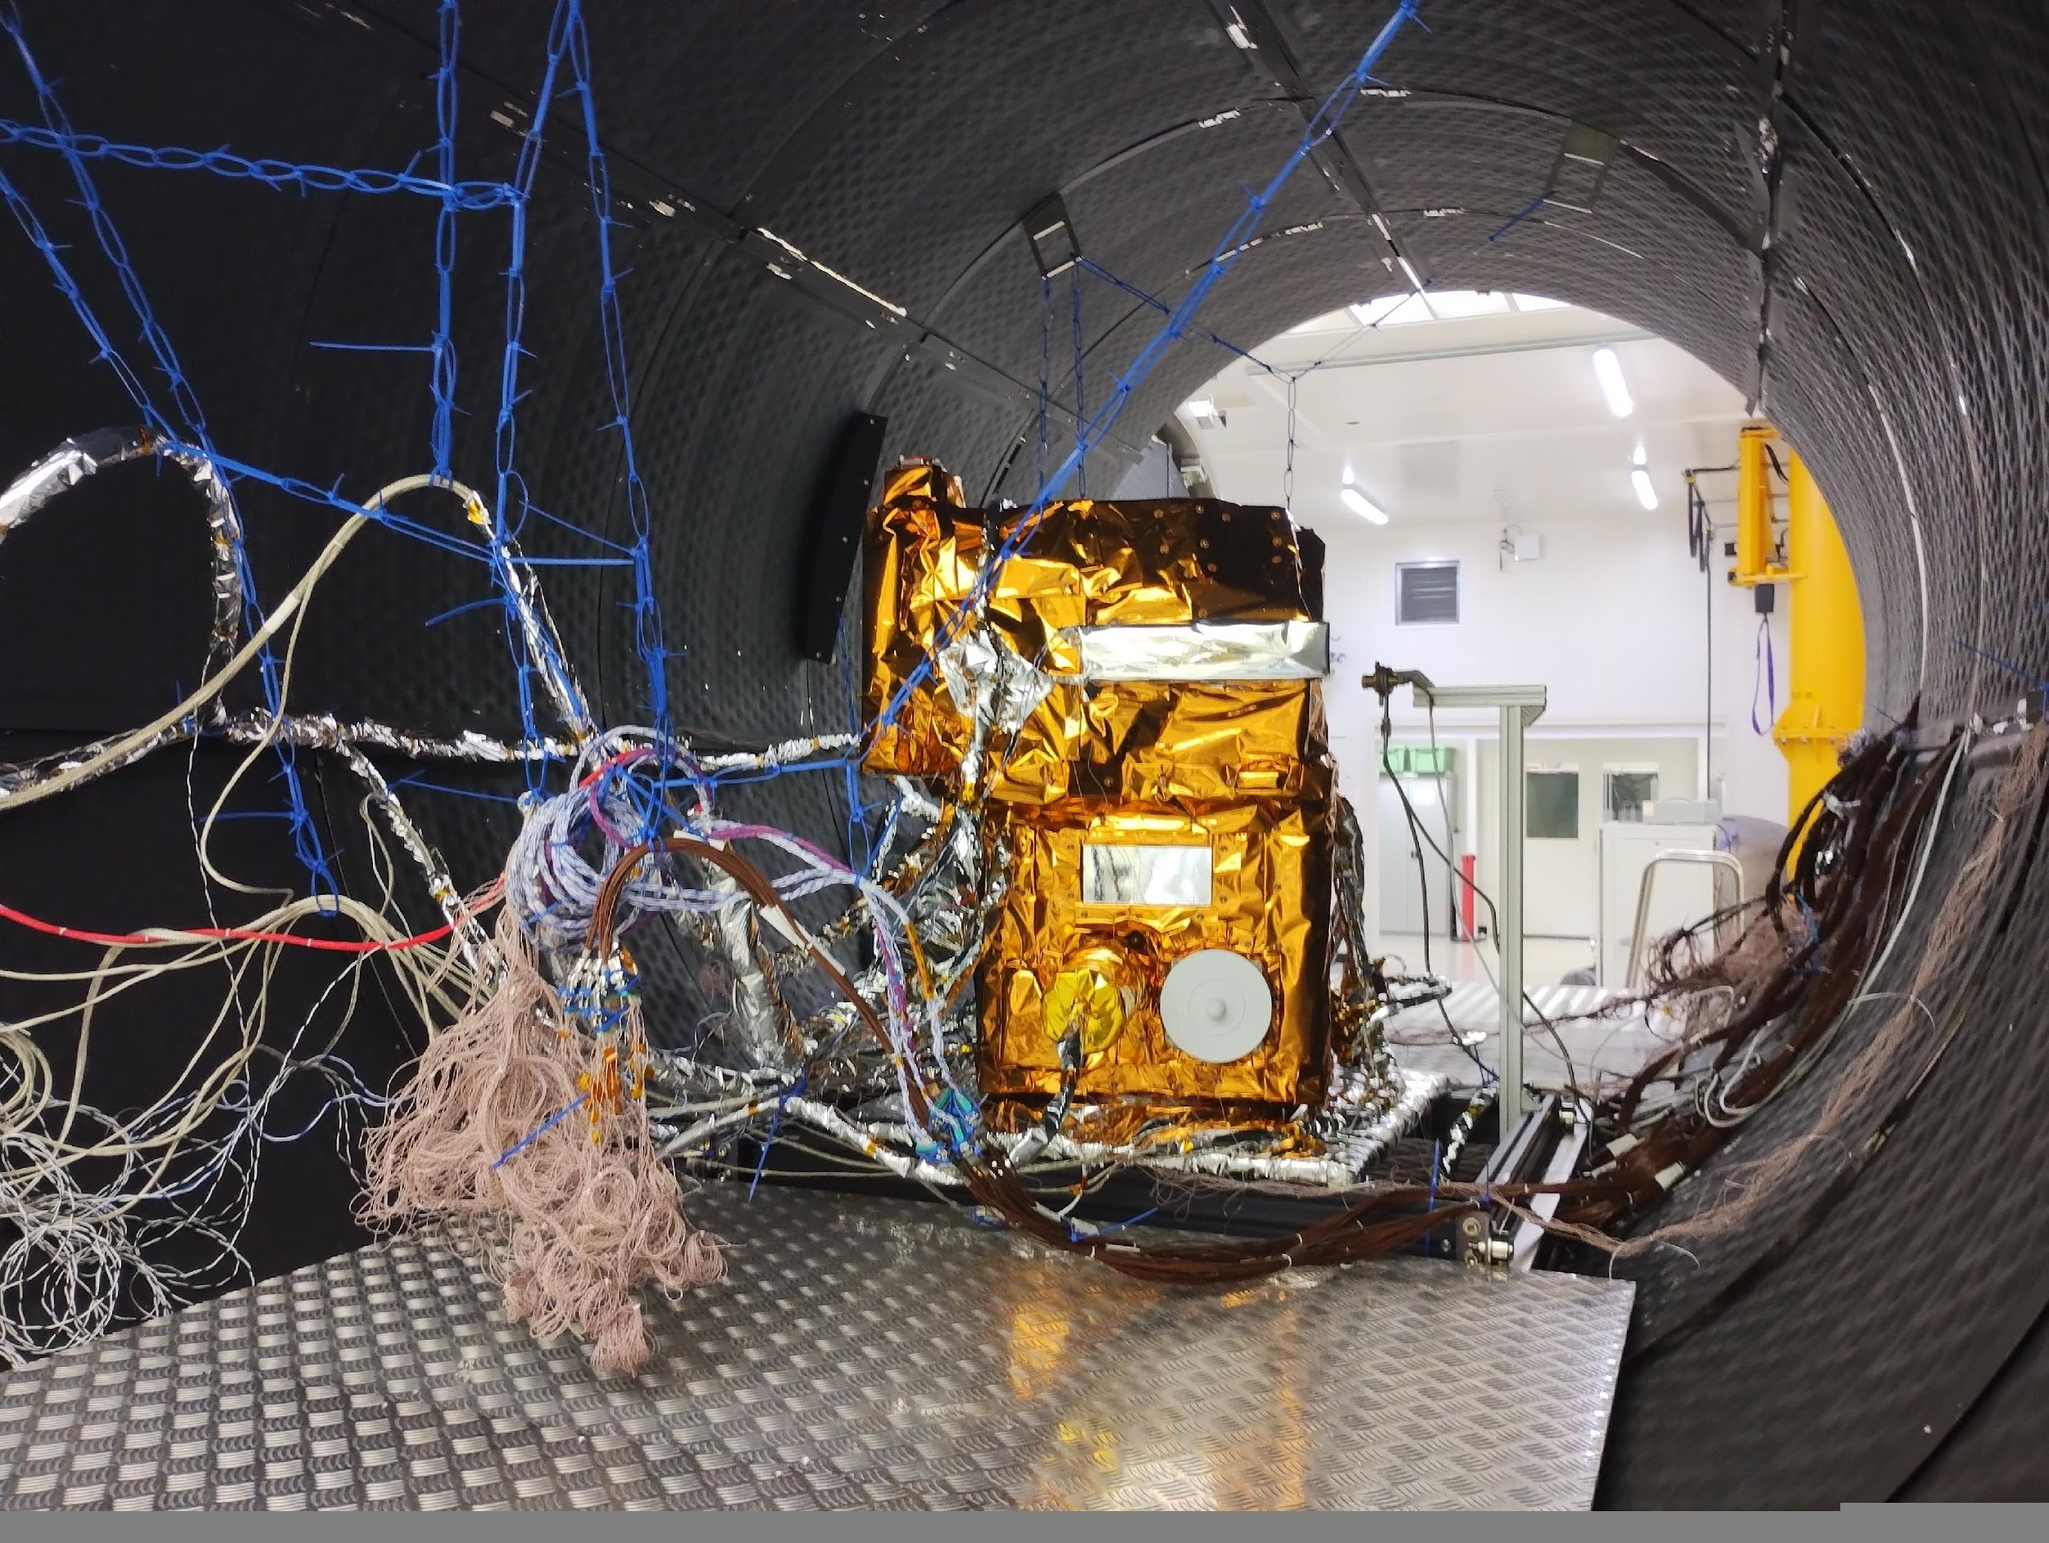
Microcarb – has passed TVAC !
MicroCarb is a joint mission between UKSA and CNES which will characterise GHG fluxes and gauge how much carbon is being absorbed by oceans and forests.
Monitoring the data will allow us to anticipate how the ecosystems will react to global warming and help us to monitor progress in meeting the Paris Agreement climate targets.
The UK is involved with the Assembly, Integration and Testing of satellite, design and build of key parts, data collection, algorithm development and scientific mission preparation.
Will be shipped to France in early 2024 ready for launch as soon as a launcher is available

Slide 9
Centre for EO Instrumentation (CEOI)
UK National EO technology programme - driving force in the UK for the development and delivery of world class instrumentation for national and international EO missions for science, operational and commercial needs
Raises technology readiness level to a stage that allows contribution to many EO missions across the globe
Significant additional investment in the past year with larger projects about the
2023 EO mission capability reviews shows a healthy and diverse community with over 35 missions and instrument ideas across the range of domains and technologies. .
We are looking for ideas to collaborate
Atmosphere - meteorology​ | 9​
Atmosphere - chemistry​ | 5​
Upper atmosphere & magnetosphere​ | 3​
Aerosols​ | 1​
Ocean & Coastal​ | 8​
Inland water​ | 4​
Land use​ | 16​
Cryosphere​ | 6​
Climate​ | 11​
Water cycle​ | 5​
Maritime ops & surveillance​ | 8​
Air Quality​ | 2​
Forestry & Biomass​ | 6​
Soil moisture/inundation ​ | 2​
Urban​ | 7​
Dual Use​ | 8​

Slide 10
Climate
Space4Climate
Space Climate Observatory
An international initiative to coordinate international efforts to support emergence of operational tools for climate monitoring, mitigation and adaptation.
At GLOC in May, UKSA announced the first 3 UK-developed climate services tool projects compliant with SCO criteria
UK Space Agency's primary climate network. Brings together 60 members from government, industry and academia to provide, use or develop space data into trusted climate services.

Slide 11
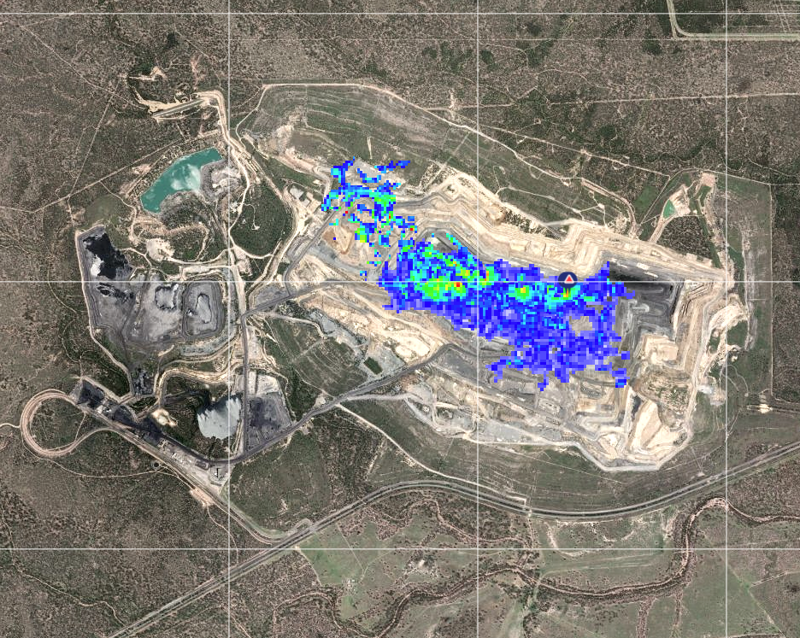
GHGSat Data
Supporting the UK’s commitment to reach net zero emissions by 2050, UKSA has procured methane data from commercial Canadian company GHGSat, to enable accurate monitoring and reporting on methane emissions around the world.
UKSA is using some of this procurement to provision the International Methane Emissions Observatory (IMEO) with bespoke imagery.
IMEO already receives archived GHGSat data through a Canadian Government initiative, and the UK’s provision will complement this with 300 images of satellite tasking to request imagery for specific sites.
Emission plume observed near an open-pit mine. Credit: GHGSat

Slide 12
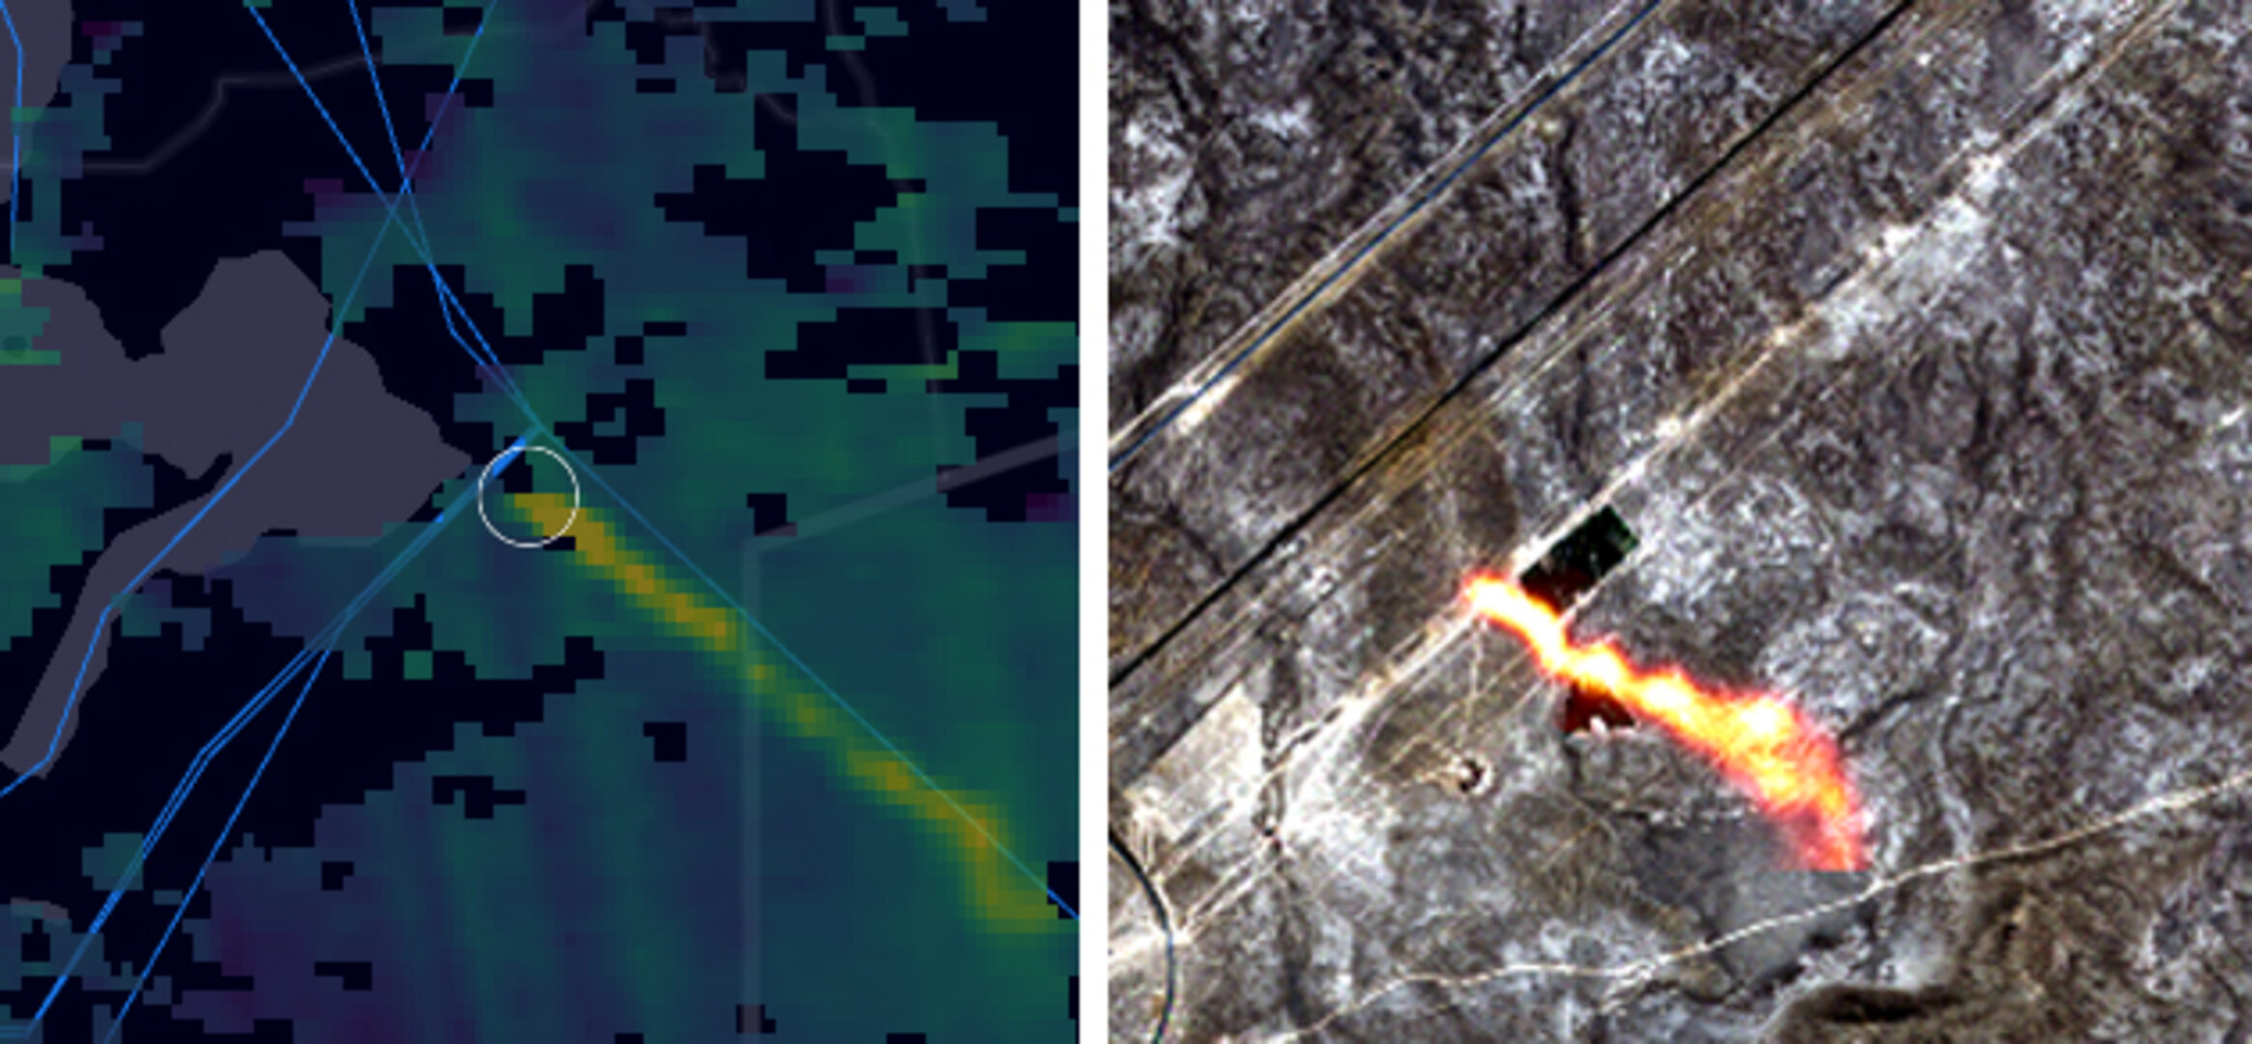
Methane Standards framework
The UK is pursuing the development and adoption of internationally agreed standards for satellite-derived methane data.
With more and more commercial methane satellites set to be launched, it’s vital that interoperable data standards are agreed that are rigorous, but also practical to ensure action can be taken to tackle methane emissions.
At CEOS SIT, the UK offered to host a workshop in 2024 to enable CEOS partners to continue to address this issue across 2024 to collaborate with international partners to tackle this issue.
We look forward to welcoming the international community to the UK to shape this work together and continue to play our part as an EO community in ‘keeping 1.5 alive’.
Methane plumes - combined data from Sentinel 5p and Sentinel 2. Credit: ESA

Slide 13
COP28
UKSA at COP28:
Space4Climate (UK academic/industry/governmental partnership) to showcase at the first ever space pavilion
Influence Blue Zone proceedings – coordinated events across UK Gov.
Earth Information Day
CEOS Statement to SBSTA
UKSA CEO Paul Bate to attend 1st COP Space Summit.
Secure international support for methane standards framework, to assure satellite-derived methane emissions data
Foster skills and enthusiasm for climate action in the next generation.

Slide 14
GEO
Our Dept. for Science, Innovation & Technology have taken on the role of UK GEO Principal.
At GEO Ministerial, Viscount Camrose reiterated the UK continuation of the UK’s ODA funding of $150,000 to the GEO Global Agricultural Monitoring Initiative (GEOGLAM) in 2024, as well as continued support for GEO Trees.
Announced that the UK will be providing funding worth $180,000 towards the GEO-led Global Ecosystems Atlas.
“We are delighted to champion this work as its first sponsor and call on other nations to join us. We recognise the potential of Atlas as not only an exemplar of the post-2025 strategy, but also a tool to successfully implement the Global Biodiversity Framework as we respond to the biodiversity crisis”.

Slide 15
UK contributions to CEOS
LSI VC/WG Climate: AFOLU Roadmap, 3 contributors from UK, and S Quegan contributed to final Recommendations. J. Remedios: contributions to climate data record definitions, CEOS/CGMS Statement to SBSTA.
GHG Task Team and IMEO: support to methane standards discussions.
WG Cal/Val: Chair of one of the subgroups (IVOS) – Nigel Fox – leading the group and associated thematic activities covering all aspects of Infrared, Visible and Optical sensors: pre-, post- launch Cal/Val (primarily Level1), (Radiometric and Geometric), Test-sites (deserts, moon, ocean), interoperability. Playing a major role in initiatives on SITSats and associated task groups
WG Disasters: Disaster Charter Chair https://www.gov.uk/government/news/uk-takes-over-leadership-of-international-charter-space-and-major-disasters ;
WG Disasters: International Volcano Observatory, significant involvement from UK (Bristol and Leeds Universities). Of note: The science community incl USGS and UK are saying they can expand the number of monitored volcanoes. Agencies providing data already (CNES, ASI and DLR).
WGISS: Best practice for Jupyter Notebooks is being developed (Esther Conway) jointly with the Capacity Development WG

Slide 16
Summary
Earth Observation is a priority for the UK
Portfolio of activities covering the whole value chain, national, bilateral and multinational activities.
COP28 important for us.
We hope to be your 2025 CEOS Chair!

