Slide 1
CEOS Agency Report: NOAA
Dr. Stephen Volz
NOAA Assistant Administrator for Satellite and Information Services
November 15, 2023

Slide 2
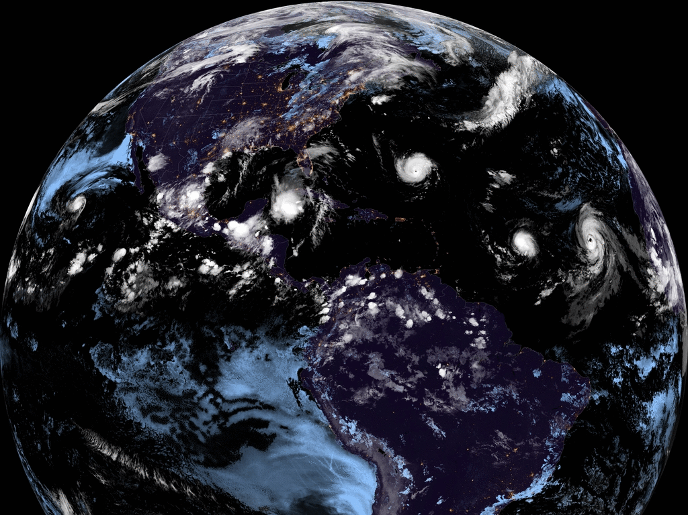
Climate-Ready Nation
2030 Vision Statement
A thriving Nation whose prosperity, health, security, and continued growth benefit from and depend upon a shared understanding of, and collective action to reduce, the impacts of climate change

Slide 3
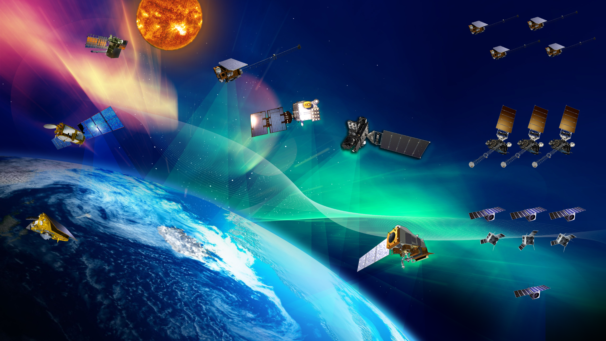
NOAA Has Future
Satellite Missions
SWFO
SWFO-L1 - Launches fiscal year 2025
DSCOVR
Operational July 27, 2016
COSMIC-2
Operational Feb. 25, 2020
SW Next
Jason-3
Operational July 1, 2016
GOES-R Series
GOES-16 - Operational Dec. 18, 2017
GOES-17 - Operational Feb. 12, 2019
GOES-18 - Operational Jan. 4, 2023
GOES-U - Launches fiscal year 2024
GeoXO
Sentinel-6 Michael Freilich
Operational Nov. 22, 2021
NEON
JPSS Series
Suomi-NPP - Operational May 1, 2014
NOAA-20 - Operational May 30, 2018
NOAA-21 - Launched Nov. 10, 2022
JPSS-3 - Launches fiscal year 2033
JPSS-4 - Launches fiscal year 2028
QuickSounder
Launches fiscal year 2026
Notes:
What you can say about this graphic:
NESDIS expects to launch:
GOES-U during the third quarter of fiscal year 2024;
SWFO during the second quarter of fiscal year 2025;
JPSS-3 during the first quarter of fiscal year 2033;
JPSS-4 during the first quarter of fiscal year 2028; and
QuickSounder during the first quarter of fiscal year 2026.
Find more related written content in the “Our Observing Systems / Integration” topic slide in the Master NESDIS Resource. Also, find the meaning of—and proper way to write—related terms in the NESDIS Style Guide for Terms.
Source of graphic: NOAA Environmental Visualization Lab, memo about the change in launch sequence for Joint Polar Satellite System

Slide 4
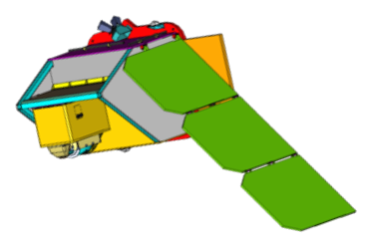
NOAA Next Generation LEO Mission Objectives:
Accelerated development: Authorization to launch in ~3 years
Disaggregated constellation of satellites
Greater risk tolerance in individual mission elements
Leveraging elements of commercial space hardware, including “off the shelf” spacecraft and launch vehicle
2024
2023
Award Phase A studies for next generation microwave and infrared sounder
2022
Award Broad Area Announcements (BAAs) for technology demonstration and capabilities assessment
Hyperspectral microwave sounding
3D winds
Path-find ways to exploit commercial advances in “New Space” with the QuickSounder mission
Refine architecture studies (2022)
Continue User Engagement
QuickSounder Mission Concept:
Demonstrate all of the above, and
Validate program cost and schedule estimates for similar future satellites
Demonstrate small satellites can meet our mission requirements
Establish the LEO Program (2021)
Notes:
First, I will speak about our future low earth orbit, or LEO, plans, which we call the Near-Earth Orbit Network program, or NEON.
The current baseline for NOAA’s LEO satellite system is formulated, developed, and launched by the Joint Polar Satellite System (JPSS) program. The JPSS program follow-on is the Near Earth Orbit Network (NEON) program, which is intended to offer substantial improvement in weather forecasting and prediction of high impact weather events as it replaces previous monitoring and observation capabilities as they approach end-of- life.
The NEON program is complying with both the U.S. Weather Research and Forecasting Innovation Act of 2017 and a NOAA’s Satellite Observing System Architecture (NSOSA) study.
NEON will comprise a portfolio of low earth- orbiting satellites and associated mission-specific ground infrastructure and services, partner missions, and commercial data sources.
The program will formulate multiple projects to provide:
Continuity of the product baseline generated from LEO satellite data as an integral part of the NESDIS architecture.
Global observations of high-value environmental measurements that compliment and enhance persistent measurements obtained by geostationary satellites
A scalable, agile, and evolutionary ground infrastructure capable of supporting a scaleable number of satellites for operations and products
Strive to meet NESDIS aspirational requirements and support new user requirements using partnerships, commercial, or NOAA-developed approaches to provide an integrated understanding of the earth’s environment.

Slide 5
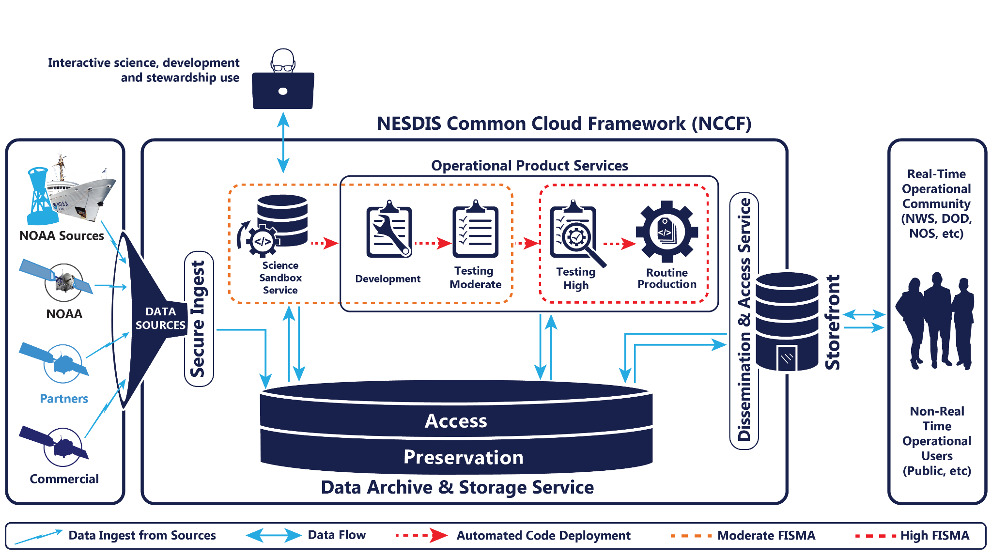
The NESDIS Common Cloud Framework
What is NESDIS Common Cloud Framework (NCCF): A flexible enterprise framework of services that has the potential to support multiple and new missions, science needs, and new products. NCCF is secure, scalable, resilient, fault tolerant, data and applications agnostic solution that is capable of processing and disseminating all types of data flows.
Notes:
Vision is to get to common IT system functions in a single cloud platform, creating more efficient and scalable IT approaches.
All NCCF initial services are delivered and will continue to be developed and optimized as migration accelerates
A common repository for all NESDIS satellite and archive data will enable science innovation and accelerate the development of new AI/ML applications - goal is to bring our collaborators to this treasure trove of environmental data
At the same time, the NCCF will promote data sharing through a common storefront to enhances usability and discoverability of all NESDIS data, for better use from our CEOS partners

Slide 6
Thank you

Slide 7
Additional Slides

Slide 8
NEON Program Initial Scope
Initial program content is focused on:
Exploiting commercial investment, expertise, and innovation in space and space systems technology and leveraging smaller instruments, satellites, and launch vehicles
Pursuing the development of next generation microwave and infrared sounders most critical to NWP
QuickSounder Project: demonstrate operational observations can be obtained with a small, commercial-based satellite on a compressed schedule
Gain experience with new commercial business models, and new acquisition strategies while utilizing elements and best practices of the commercial space industry to meet program level requirements
Launch within approximately three years
Series-1 Project: provide microwave & infrared sounding essential to the performance of the NWP global models.
Develop next generation instruments with improved science performance, agility and resiliency over legacy instrument capabilities
Partnerships: maintain continuity of key partnerships supported by the JPSS Program

Slide 9
Summary
The new Office of LEO Observations is comprised of the the JPSS and NEON Programs
The 1330 JPSS constellation is healthy and on track to support baseline LEO observations through 2038 and beyond
The NEON program will address data continuity beyond JPSS while addressing new observational requirements
Near term NEON activities will focus on the QuickSounder project and instrument development for Series-1
Partnerships with domestic, international and commercial partners will remain a significant LEO focus moving forward

