Slide 1
USGS Agency Report
Tim Stryker / Steve Labahn
Agenda Item 3.2
37th CEOS Plenary
15 - 16 November 2023
Chiang Rai, Thailand
Hosted by GISTDA

Slide 2
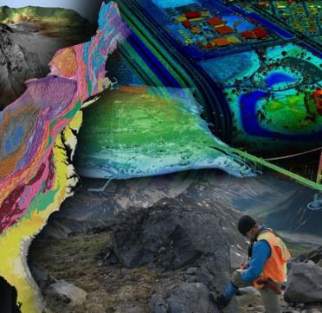
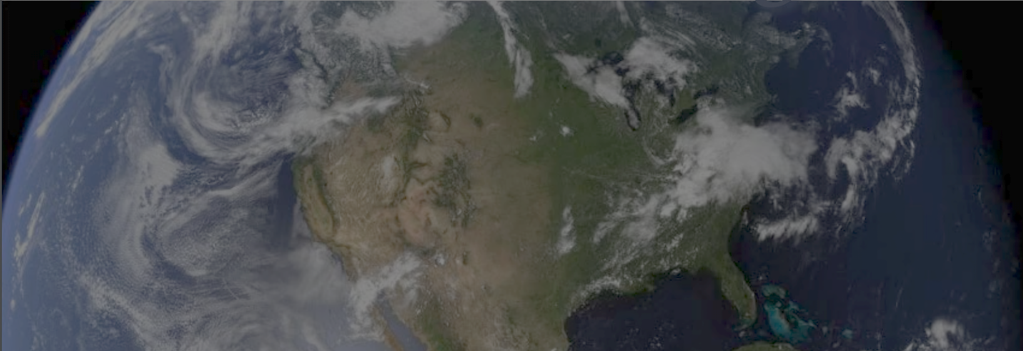
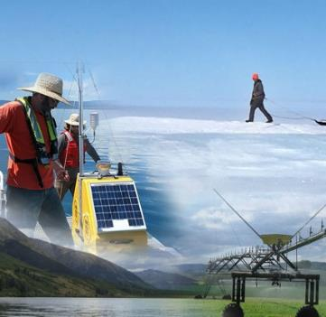
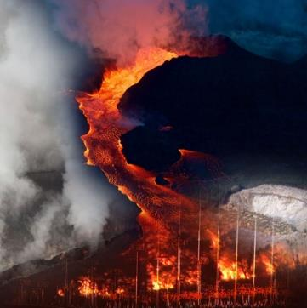
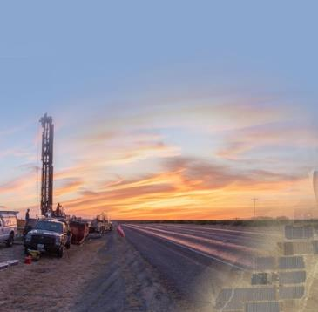
USGS Mission Areas
Water Resources
Natural Hazards
Core Science Systems
Ecosystems
Energy and Minerals
Vision
Lead the Nation in 21st-century integrated research, assessments, and prediction of natural resources and processes to meet society’s needs
Mission
Monitor, analyze and predict current and evolving dynamics of complex human and natural Earth system interactions
Deliver actionable intelligence at scales and timeframes relevant to decision makers

Slide 3
KEY USGS INVOLVEMENT IN CEOS
Land Surface Imaging Virtual Constellation
USGS Co-Chair (S. Labahn)
Working Group on Calibration & Validation
USGS serves as a Vice-Chair (C. Anderson)
Working Group on Information Systems and Services (WGISS)
USGS serves as Chair (T. Sohre)
Working Group on Climate
Members K. Casey (NLI), T. Sohl (EROS), K. Bruno (NLI)
Working Group on Capacity Building and Data Democracy
Member Chris Barnes (EROS/KBR)
Working Group on Disasters
Member Mike Poland (USGS Yellowstone Volcano Observatory)
Notes:
We’re deeply committed to CEOS’s mission
USGS sees great value in our CEOS partnerships – providing our resources and expertise, and leveraging those of our CEOS partners
In addition to our official leadership and membership roles, we are heavily invested in CEOS Analysis-Ready Data, Interoperability, Ecosystems Extent Mapping, GFOI/AFOLU capacity-building, and New Space Task Team activities.
We are also enthused about CSA’s 2024 Biodiversity theme and are committed to support it with our science, user needs, and programmatic capabilities.
African proverb: “If you want to go fast, go alone; if you want to go far, go together.”

Slide 4
USGS National Land Imaging Program: Roles and Responsibilities
As defined by Public Law and National Space Policy,
to carry out the Public Interest of the United States:
Operate and maintain a National Land Imaging Archive to house a Basic Data Set of global data – for historical, scientific, and technical purposes – includes data from U.S. civil, commercial and foreign satellite systems
Operate and maintain the Landsat flight and ground systems
Collect, process, archive and distribute these data as Public Domain holdings of the United States
Determine U.S. civil operational requirements for global land surface data and to conduct a national program of civil-operational land imaging
Conduct science, research and development in the applications of remote sensing in order to enhance the ability of the U.S. to manage and utilize its renewable and nonrenewable resources
Develop civil applications and information tools using known standards and protocols and make them available to the general public; facilitate federal civil agency use of National Security Space system data via the Civil Applications Committee
Fundamental goal: Ensure public availability of a primary data record about the historical condition and current state of the Earth’s land surface and to predict its future condition

Slide 5
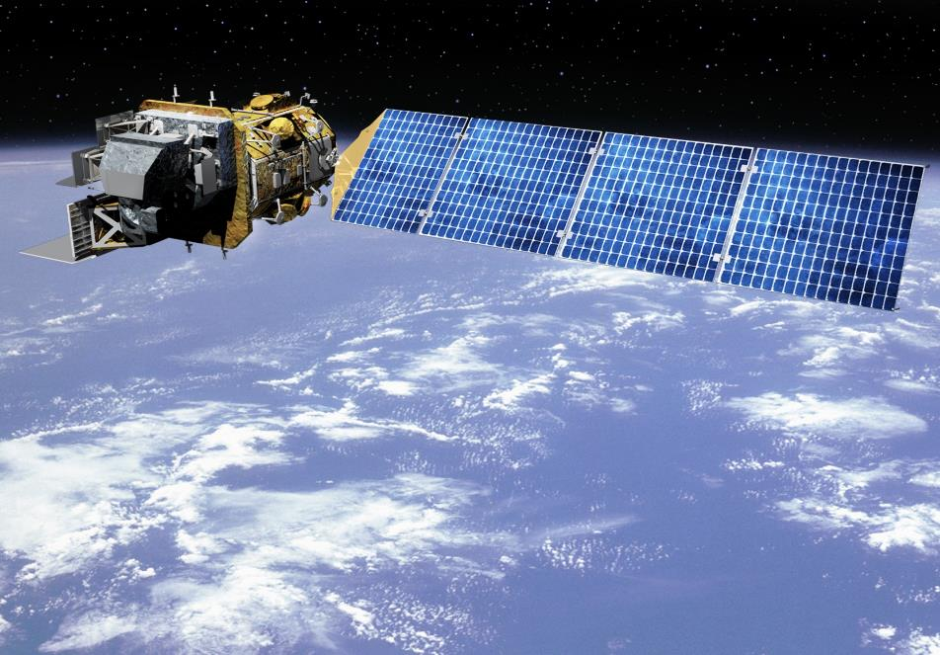
What is Landsat?
The world's longest continuously operated land remote sensing satellite series and most widely used land remote
sensing data set, helping us understand and manage natural and human-induced landscape change via a multitude of
land, water, and natural resource management applications.
Multi-spectral coverage in VNIR-SWIR-TIR**
-> to map surface composition & temperature
15- / 30- / 100- meter spatial resolution
-> to resolve human-scale land dynamics
16-day revisit frequency (8-days with L8 and L9 satellites)
-> global, seasonal coverage
Broad area collection => 12,000+ square miles per image
-> 1400 images/day = 20 million square miles/day
Highly calibrated “science quality” data
-> to resolve long-term trends & retrieve biophysical variables
Free and Open Data policy since 2008
-> 100 million products distributed and 4 billion data accesses
via Commercial Cloud in the last year alone
Common Uses of Landsat data by Federal Agencies, States, and the private sector:
Agriculture and Forestry
Regional Land Use Planning
Land Use/Land Cover
Fire/Disaster Management
Energy and Mineral Mapping
Water Quality and Resources
Global Change Science
Flood Management
National Security
Ecosystem Monitoring
Famine Early Warning
Carbon Assessment
Drought Monitoring
Transportation Planning
Calibration/Validation
**VNIR: Visible Near-Infrared SWIR: Shortwave Infrared TIR: Thermal Infrared
Notes:
Landsat is the world's longest continuously operated land remote sensing satellite series. It is also the most widely used and cited land remote sensing data set, helping us understand and manage natural and human-induced landscape change via a multitude of land, water, and natural resource management applications.
It's often called the "Swiss Army Knife" of space systems, supporting myriad user applications across Federal agencies, states, and the private sector. Landsat spectral coverage beyond human eyesight helps us map surface composition and temperature. It sees change at human-relevant and actionable scales, and at a weekly revisit frequency when both Landsat 8 and 9 are flying and there are no clouds in the imagery.
Best of all, Landsat provides "gold standard" highly-calibrated scientific data that are relied upon by scientists to tease out often subtle change on the land surface and by commercial Earth observation companies to help calibrate their data and improve their products. These data were made freely available by USGS in 2008 and continue to be incredibly popular across an expansive user community.

Slide 6
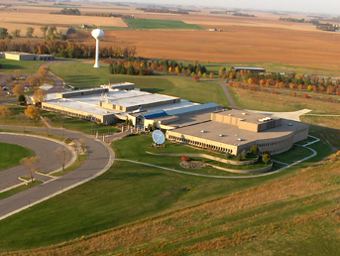
Landsat Operations Status
Landsat 9 (2021 - )
Collecting up to 740 new scenes per day; night and off-nadir imaging of volcano and fire imaging.
Earth Resources Observation
and Science Center (EROS)
Landsat Archive Operations
11+ million unique Landsat scenes available in the over 50-year archive, with well over 100 million downloads since Landsat data become freely available in 2008.
–
“Collection 2” available on the Amazon Cloud.
Landsat 8 (2013 - )
Collecting up to 740 new scenes per day; night and off-nadir imaging of volcano and fire imaging.
Landsat 7 (1999 - 2022)
Recently lowered into non-WRS-2 storage orbit; awaiting OSAM-1 satellite rendezvous and refueling (est. 2026)
Collecting 400 scenes/day to evaluate the value of early morning imaging

Slide 7
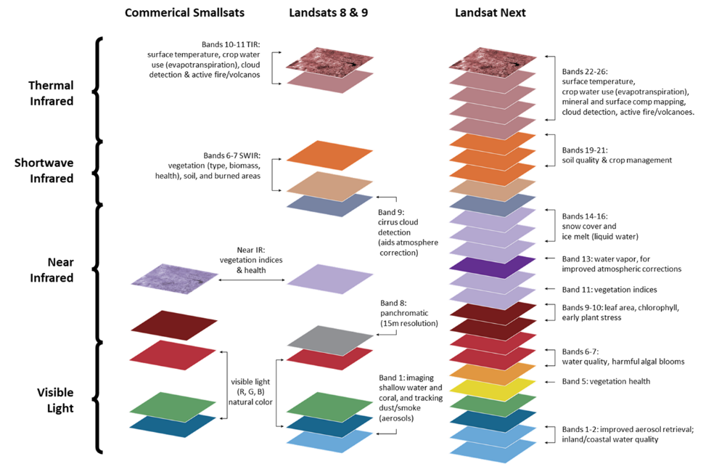
Landsat Next Requirements Meet Emerging Needs
Multi-spectral 🡪 Super-spectral
The USGS spent several years engaging with the user community to develop and validate requirements and set priorities for Landsat Next to meet emerging needs:
Launch Readiness Date: ~November 2030
Improved revisit frequency to support applications which require ~weekly clear views, such as crop health & productivity, water quality, snow/ice state, wildfire
Higher spatial resolution (10-meter data vs 30-meter) to support monitoring of small agricultural fields, forest disturbance, urbanization, and other applications
Additional spectral bands to support emerging applications in water quality, snow hydrology, soil mapping, and other areas
Maintaining radiometric quality established by Landsat 8/9
Landsat Next will provide more than twice as many spectral bands
as Landsat 8/9, with spatial resolution improved by a factor of two,
and significantly improved repeat coverage
Notes:
DOI/USGS is responsible for determining the U.S. civil operational requirements for global land surface data
Our starting point for Landsat mission requirements was a detailed understanding of user needs:
What are their applications for the data?
What information are they trying to extract?
What specific spectral components do they need to retrieve that information?
What is the resolution necessary to ‘see’ the phenomenology?
How often does it occur? How often must you see it to understand it; to react to it?
This chart illustrates the improvements in spectral coverage and the information it brings. Examples of the information needed include
better soil quality and crop management
snow cover estimates
plant stress
water usage and quality
harmful algal blooms
surface temperature.
Each of the 26 bands currently chosen for Landsat Next have been identified and refined through user needs assessments, followed by science community subject matter expert workshops to convert application expert needs into science-quality observation requirements.
The Landsat Next mission concept will provide twice as many spectral bands as Landsat 8/9, with spatial resolution improved by a factor of 2 (from 30 meters to 10 meters for some bands), and with significantly improved repeat coverage (6-days versus today's 8-day revisit).

Slide 8
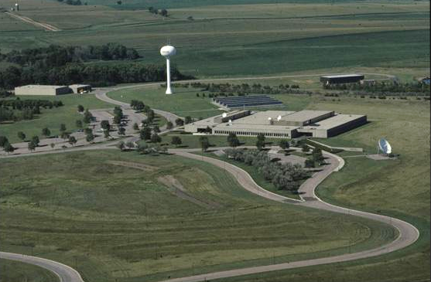
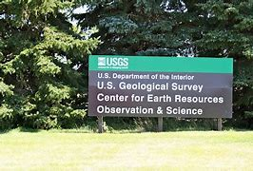
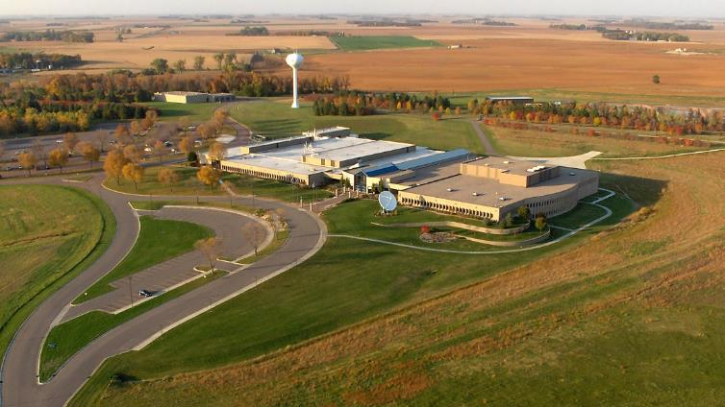
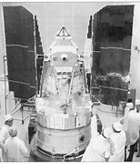
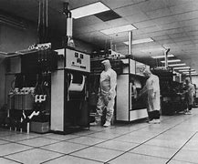
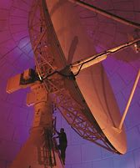
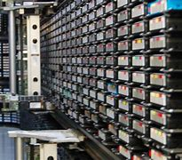
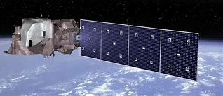

Slide 9
Backup Slides

Slide 10
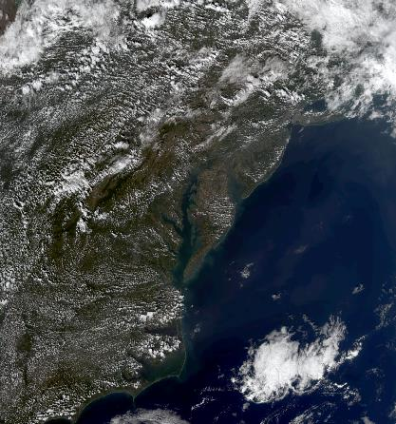
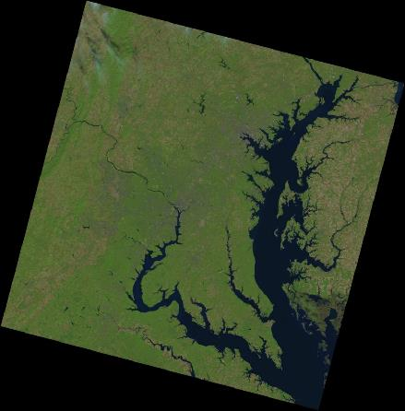
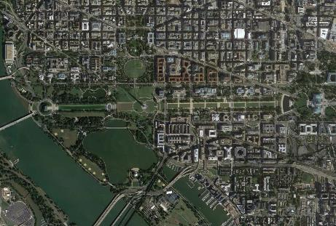
Why is Landsat Unique?
Quality of imagery and global coverage
Cross-calibration of sensor data
Irreplaceable 50-year record of historical change of Earth’s land surfaces
Free and open data policy
Landscape-scale resolution
Simultaneous observations across the spectrum from visible to shortwave to thermal infrared bands
Supports government (civil and military), commercial, non-profit, and education users across the U.S. and worldwide in a broad set of diverse applications
Weather-scale
Landsat
Commercial High-resolution

Slide 11
Sustainable Land Imaging (SLI)
A partnership between DOI/USGS and NASA to ensure sustained access to high-quality, global, land-imaging measurements compatible with the existing 50-year Landsat record for research and operational users
NASA is responsible for developing the space segment, launch, and on-orbit check-out
DOI/USGS is responsible for establishing user needs, developing the ground segment, and flight and ground system operations
Landsat Next
2030 -

Slide 12
Driving Applications for Landsat Next
Societal Benefit Area | Application | Science Benefits from Landsat Next
Agriculture | U.S and global agricultural monitoring | Landsat Next will allow USDA Foreign Agricultural Service (FAS), Farm Service Agency (FSA) and National Agricultural Statistics Service (NASS) more precise observation of crop emergence.
 | Crop residue monitoring/soil conservation | Landsat Next observations in the early growing season can allow USDA Natural Resources Conservation Service to detect cover crop and crop residue for soil conservation at the field-scale.
Forestry | Forest health monitoring | Landsat Next will aid USFS, BIA, BLM, FWS, NPS and USGS in the detection and identification of insect/disease agents for forest health monitoring, since symptoms are often seasonal and transient.
Water Resources | Evapotranspiration and water use | Landsat Next frequent observations of evapotranspiration (ET) are needed for field-scale ET estimates and continuous water use monitoring operationally by BOR, USGS, FAS, NASS and Western States.
Water Quality | HAB detection and monitoring | The new targeted spectral bands for water quality provided by Landsat Next will enable detection of specific organisms that cause harmful blooms.
Cryosphere | Snow/water availability | Higher temporal frequency and new targeted spectral measurement capabilities of Landsat Next will reduce cloud cover contamination while increasing detection.
Public Health | Monitoring urban heat islands | Landsat Next can help capture more frequent, intense, and longer heat waves as climate change indicators.
Wildfire | Pre- and post-fire assessment | Landsat Next higher temporal revisit is needed to capture the onset of more frequent wildfires and provide immediate post-fire response.
Notes:
Agriculture
U.S and global agricultural monitoring
Landsat Next will allow USDA FAS, FSA and NASS more precise observation of crop emergence – a critical growth stage for modeling crop development and monitoring crop condition – enabling capture of key phenological dates to estimate crop yield, such as greening and leaf area amount and health – key indicators for predicting food supply and food shortage, foreign aid and global food security. USDA RMA relies on high frequency Landsat data for continuous monitoring in detection of possible instances of fraud, waste, and abuse.
Crop residue monitoring/soil conservation
Landsat Next observations in the early growing season can allow USDA NRCS to detect cover crop and crop residue for soil conservation at the field-scale. Cost-share programs encourage use of cover crops to achieve conservation objectives, relying on cover crop termination dates to determine incentive payments to farmers. Requires weekly clear observations to determine crop termination dates accurately; timing of crop residue monitoring critical – missing an image means missing the opportunity to see crop residue before cultivation.
Forestry
Forest health monitoring
Landsat Next weekly revisit will aid USFS, BIA, BLM, FWS, NPS and USGS in the detection and identification of insect/disease agents for forest health monitoring, since symptoms are often seasonal and transient. Aids global forest monitoring for carbon sequestration and emissions. Global Forest Watch relies on Landsat to generate deforestation alerts and requires more frequent observation to detect deforestation before agricultural planting and vegetation recovery “hide” the forest loss, capturing onset of deforestation, impact and swift response.
Water Resources
Evapotranspiration and water use
Landsat Next weekly observations of evapotranspiration (ET) are needed for field-scale ET estimates and continuous water use monitoring operationally by BOR, USGS, FAS, NASS and Western States. The improved capabilities will provide more timely and accurate water use information to water managers and other stakeholders.
Water Quality
HAB detection and monitoring
The new targeted spectral bands for water quality provided by Landsat Next will enable detection of specific organisms that cause harmful blooms such as cyanobacteria at higher frequency to allow early detection and timely warning/mitigation, used by EPA, NOAA, USGS, NIH, NASA and other state/local water resources and public health agencies.
Cryosphere
Snow/water availability
Higher temporal frequency and new targeted spectral measurement capabilities of Landsat Next will reduce cloud cover contamination while increasing detection of rapidly evolving snow processes and melt timing and measure the presence of liquid water content and snow grain size for melt state determination, which together improve prediction of water availability and volume.
Public Health
Monitoring urban heat islands
Landsat Next weekly revisit can help capture more frequent, intense, and longer heat waves as climate change indicators, and help define more effective mitigation strategies for NIH, FEMA and local governments for urban heat wave seasons at urban district/residential area scales.
Wildfire
Pre- and post-fire assessment
Landsat Next sub-weekly revisit is needed to capture the onset of more frequent wildfires and provide immediate post-fire response to Federal, state and local land management agencies by assessing burn severity, and mapping and monitoring post-fire landslide hazards, providing timely information for effective post-fire burned area emergency response—BAER teams need Landsat imagery within 7 days of containment.
Burned Area Emergency Response (BAER) relies on Landsat imagery to provide initial evaluation for post-fire assessment and response within 7 days of fire containment, the BAER Imagery Support Program provides satellite images, burn area severity classifications, and other critical data to BAER teams. If an imaging date is missed, it won’t meet the BAER assessment team requirement of within 7 days of containment.
Water quality monitoring requires consistent and constant monitoring and near-real time information delivery. Water quality can change rapidly, and bloom events can happen suddenly. More imaging opportunities can provide valuable time for public health warnings and reducing economic loss.
Crop residue monitoring/soil conservation: Cost-share programs encourage the use of cover crops to achieve conservation objectives. Programs use cover crop termination dates to determine incentive payments to farmers. Require at least once a week clear observation to determine the crop termination dates accurately. Timing of crop residue monitoring is critical in early growing season before the planting season starts, to determine crop tillage practices (till or no-till; tillage fractures the soil, disrupts soil structure, accelerating surface runoff and soil erosion). Missing an image date may miss the opportunity to see ground cover (crop residue) before cultivation starts.
Crop condition monitoring/food security: Crop condition monitoring requires at least once a week clear observation to capture key phenological points/dates to estimate the crop yield, such as when the crops turn green and the amount of leaf area to indicate growth stage and health, as key indicators for predicting food supply and food shortage, foreign aid, and food security worldwide.
Deforestation/Carbon Sequestration: Global deforestation requires near-real time continuous monitoring. Global Forest Watch relies on Landsat to generate deforestation alerts and requires more frequent observation, especially in forestated area that tend to be cloudier. There’s a small window to observe deforestation before agricultural planting and vegetation recovery to “hide” the forest loss. Having more clear observation can capture the onset of deforestation, assess the impacts and act swiftly.
ET/Water use: Farmers can use the evapotranspiration information to have a better idea of whether they’re irrigating enough or overwatering. They could also look at evapotranspiration levels across the field to ensure they are getting uniform coverage from their sprinklers—not underwatering some spots or overwatering others. ET can changes rapidly depending on the environmental conditions. Frequent monitoring of ET fills the biggest gap of water management in the West to deliver needed information straight to the farmers to adjust individual field water consumption.

Slide 13
Temporal Coverage Impacts of Landsat Next on U.S. Federal Agency Needs
 | Climate |  | Landsat Heritage |  | Landsat Next
Science Applications and Agencies for User Needs Satisfaction | Climate Indicators | Critical Measures | L8+L9 |  | Triplets
 |  |  | 8-day Revisit | 16-day Revisit | 6-day Revisit
Agriculture & Forestry (FAS, FSA, NASS, NRCS, RMA, USFS, BIA, BLM, FWS, NPS, USGS, EPA, USAID, NASA, DOE) | ST, LC | CT, CY, LAI, VC
Emergency/Disasters (USGS, OSMRE, BOEM, BSEE, USFS, NOAA, USAID, NIH, FEMA, NASA, DOE) |  | AF, VA, SWE, OSE
Public health/Water Quality (USGS, NPS, EPA, NOAA, NIH, NASA) | ST | UHI, WQWC
Water resources monitoring (BOR, USGS, FAS, NASS, NASA, DOE) | ST | ET, WQWC
Wildfire Response and Assessment (BIA, BLM, FWS, NPS, USGS, USFS, NRCS, NASA) | ST, LC | BABS, VC, LULC
Cryosphere (BOR, USGS, NRCS, NOAA, NASA, DOE) | ST, GLI | GLI, SCE, SGS
Ecosystems/Land Use (USDA, DOI, EPA, NOAA, USAID, FEMA, NASA, DOE) | ST, LC | fPAR, LULC, VC
Key to Agencies
FAS: Foreign Agriculture Service
FSA: Farm Service Agency
NASS: National Agricultural Statistics Service
NRCS: Natural Resources Conservation Service
RMA: Risk Management Agency
USFS: U.S. Forest Service
BIA: Bureau of Indian Affairs
BLM: Bureau of Land Management
FWS: U.S. Fish and Wildlife Service
NPS: National Park Service
USGS: U.S. Geological Survey
EPA: Environmental Protection Agency
USAID: U.S. Agency for International Development
NASA: National Aeronautics & Space Administration
DOE: Department of Energy
OSMRE: Office of Surface Mining Reclamation and Enforcement
BOEM: Bureau of Ocean Energy Management
BSEE: Bureau of Safety and Environmental Enforcement
NOAA: National Oceans and Atmospheric Administration
NIH: National Institutes of Health
FEMA: Federal Emergency Management Agency
BOR: Bureau of Reclamation
USDA: U.S. Department of Agriculture
DOI: Department of the Interior
ST – Surface Temperature
LC – Land Carbon
GLI – Glacier & Ice Sheets
CT – Crop Type
CY – Crop Yield
LAI – Leaf Area Index
VC – Vegetation Condition
BABS – Burned Area/Burn Severity
AF - Active Fires
VA – Volcanic Activity
SWE – Surface Water Extent
OSE – Oil Spill Extent
UHI – Urban Heat Island
WQWC – Water Quality/Water Chemistry
ET – Evapotranspiration
LULC – Land Use/Land Cover
SCE – Snow Cover Extent
SGS – Snow Grain Size
fPAR - Photosynthetically Active Radiation
Reflects varying spatial and spectral capabilities
GREEN = > 2/3 of user revisit needs met
YELLOW = 1/3 – 2/3 met
RED = < 1/3 met
Notes:
This chart shows the increased utility of Landsat Next’s capabilities as they relate to documented U.S. Federal agency user needs.
I’d note that the USGS user needs assessment process (a.k.a. “Requirements, Capabilities, and Assessment” methodology) is useful not only to our and NOAA’s (“NOSIA”) systems engineering activities, but can also be applied in an international context (e.g., LSI GEOGLAM).

