Slide 1
37th CEOS Plenary
Canadian Space Agency Report
Éric Laliberté, CSA
Agenda Item 3.1.4
37th CEOS Plenary
15 - 16 November 2023
Chiang Rai, Thailand
Hosted by GISTDA

Slide 2
RADARSAT Constellation Mission (RCM)

Slide 3
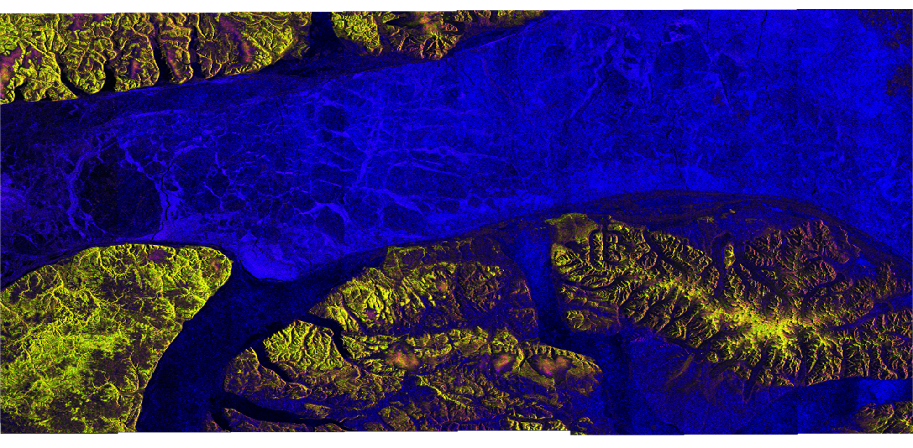
RCM 1 000 000th Image
On March 30 2023, RCM captured its one-million image of Earth, a little more than three years after the start of its operations.

Slide 4
RADARSAT+

Slide 5
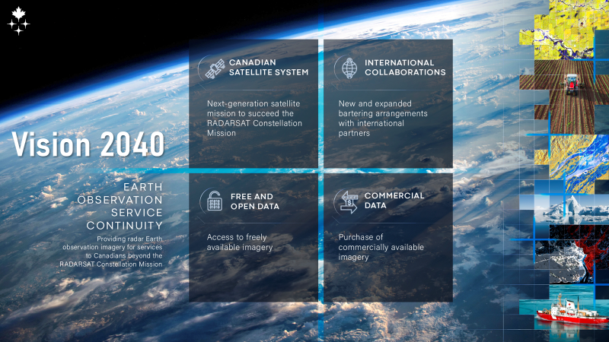
Vision 2040

Slide 6
SCISAT in numbers

Slide 7
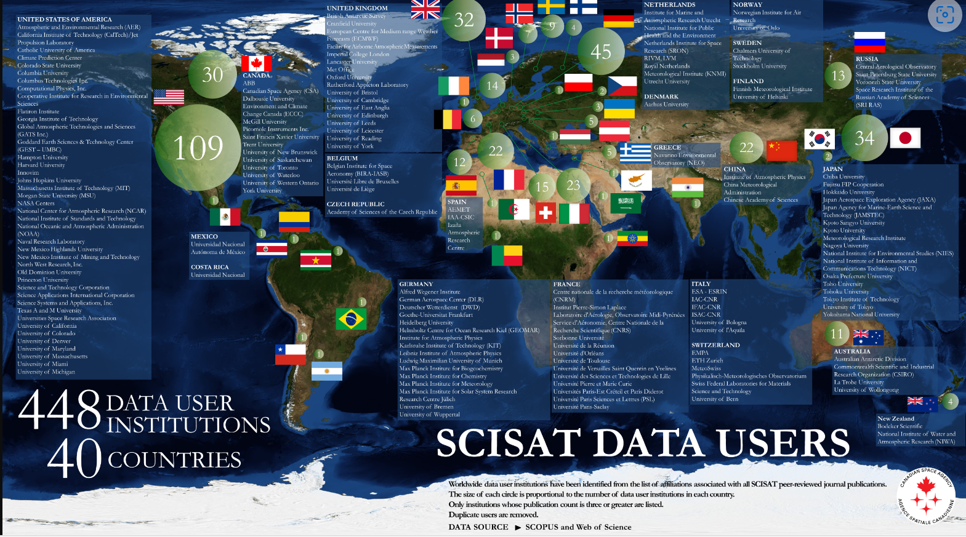
SCISAT - Worldwide data users
‹#›

Slide 8
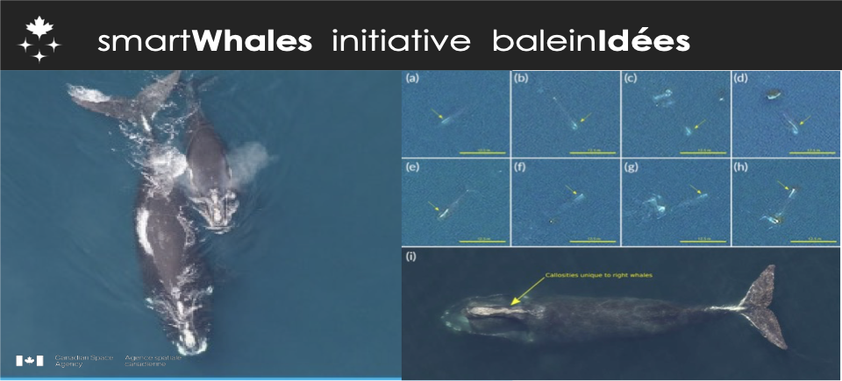
Smart Whales Initiative
Notes:
smartWhales is the first smartEarth Integrator imitative
Between the Canadian Space Agency (CSA), Department of Fisheries and Oceans (DFO), Transport Canada (TC).
With the objective to Explore how Data from space could help protect the endangered North Atlantic right whale
And Develop of Space-Based Solutions for the detection/monitoring and prediction/modelling streams
A 3-years initiative from 2020 to 2024
5 R&D Contracts awarded to 5 consortia: Detection/Monitoring ( Hatfield, FRS, GSTS) and Prediction/Modelling (WSP and ARCTUS)
A community of 90 Highly Qualified Personnel
3rd and last workshop is scheduled January 2024
CSA – DFO-TC present a poster on smatWhales outcomes to date at North Atlantic Right Whale Consortium (24-25 October, Halifax)
Smartwhales outcomes (pick and choose from the list below)
Satellite Earth Observation for Whale detection over large areas
Exploring alternative methods for NARW habitat monitoring
Identifying high risk areas for whale vessel risk collision
Improving snow crab and lobster fishing gear entanglement risk models
Determination of appropriate whale signature parameters on both optical and SAR data
SAR imagery characterization for identification of biogenic slicks associated with prey
AI-based ocean front detection for Chl-a, Color Dissolved Organic Matter and Sea Surface Temperature
A first prototype automated pipeline in the cloud - from upload to detections
More info : Data from space could help protect the endangered North Atlantic right whale - Canada.ca
Images description
-1- Aerial photograph of a North Atlantic right whale (Eubalaena glacialis) mother and calf showing distinguishing characteristics, including the lack of a dorsal fin, stocky black body and a V-shaped blow hole.
(Photo credit: Christin Khan of the National Oceanic and Atmospheric Administration, Northeast Fisheries Science Center)
-2- North Atlantic Right Whales (NARW) identified by size, shape, scars and callosities (irregular patches of keratinized surface skin) as seen on 15cm WorldView-3 super resolution imagery (panels ‘a’ through ‘h’), and compared to a close range aerial image (panel ‘I’).
Image source: Fluvial Systems Research Inc.

