Slide 1
37th CEOS Plenary
GEMS Status 2023
Goo Kim, NIER
Agenda Item 3.1.2
37th CEOS Plenary
15 - 16 November 2023
Chiang Rai, Thailand
Hosted by GISTDA

Slide 2
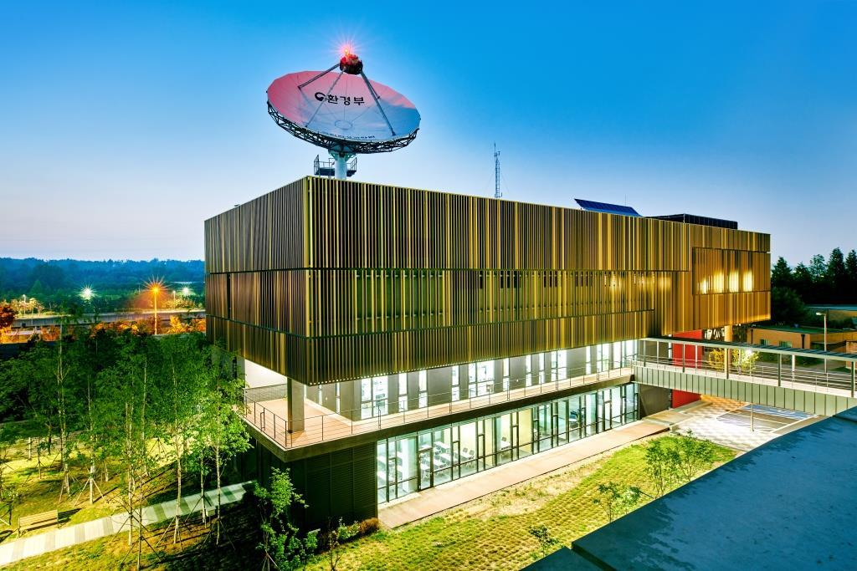
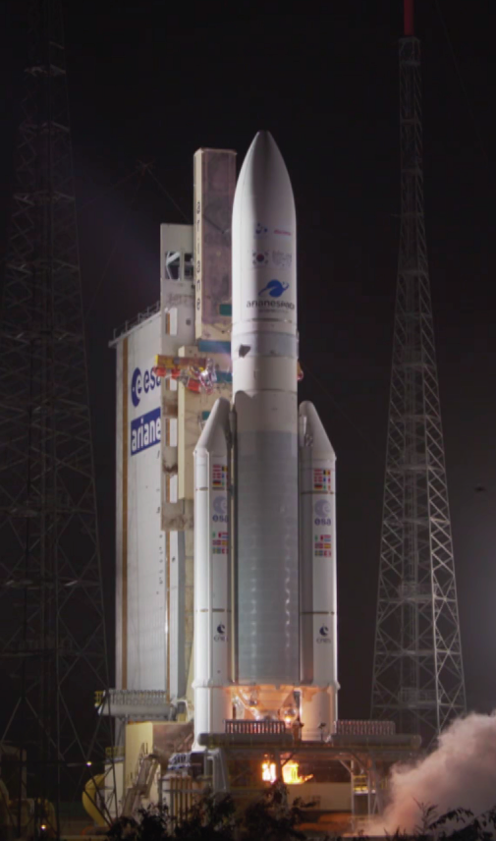
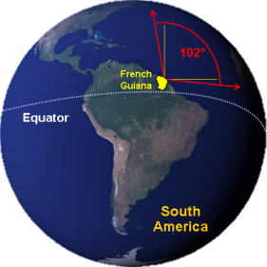
Launch of GEMS and its spec.
Launch on 19 February 2020 (the Guiana Space Center)
GK-2B
GEMS
Environmental Satellite Center
GEMS overview
Main Targets | O₃, SO₂, NO₂, HCHO, Aerosol and so on
Mission Period | 10 years
Scan Area | 5,000km x 5,000km(5°S – 45°N, 75°E – 145°E)
Spatial Resolution | 3.5km x 8km (Ozone Profile & CHOCHO: 14x32km, SO₂: 7x16km)
Time Resolution | 8 times on average (30min scanning, 30min stand-by)
Spectral Resolution | UV-VIS, 300-500nm
Obit/Height/Longitude | Geostationary satellite/36,000km/128°E

Slide 3
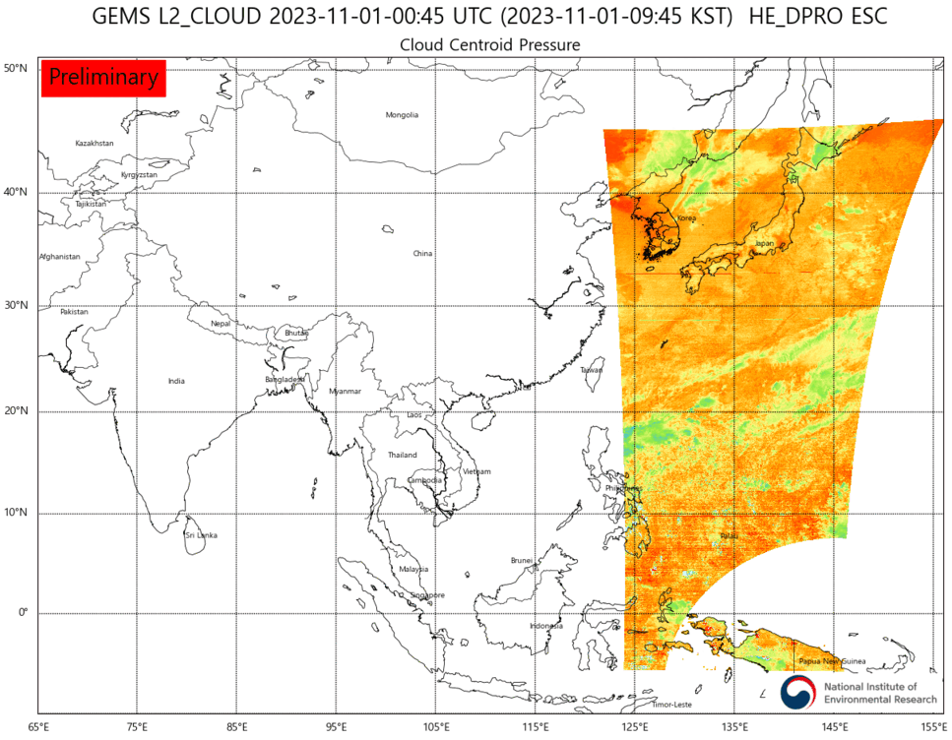
GEMS observation plan
Scan Regions
Countries in GEMS domain (20)
Brunei
Bangladesh
Bhutan
Cambodia
China
India
Indonesia
Japan
Laos
Malaysia
Mongolia
Myanmar
Nepal
Palau
Philippines
Singapore
S. Korea
Sri Lanka
Thailand
Vietnam

Slide 4
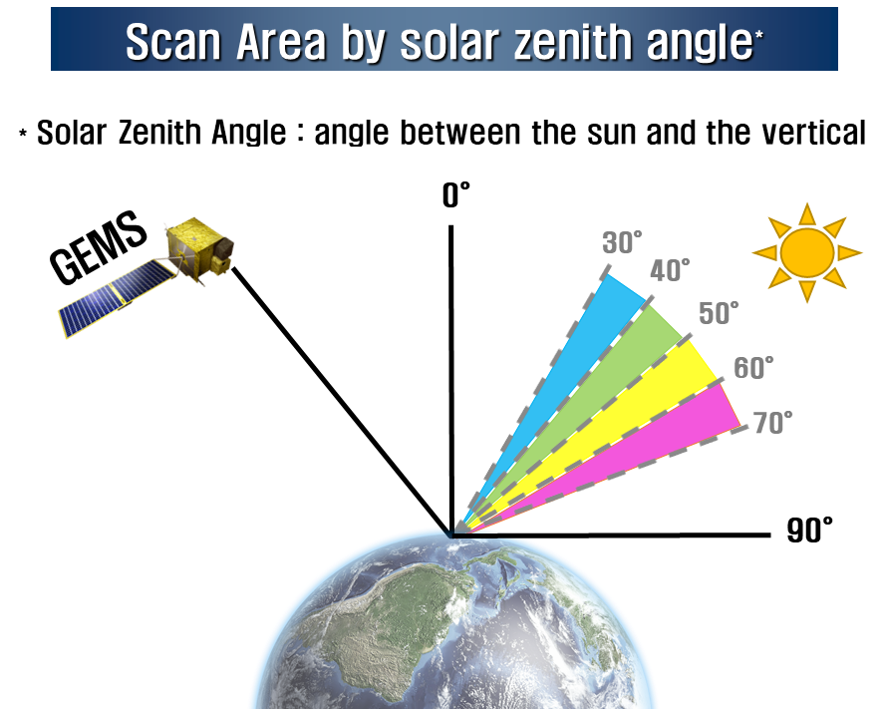
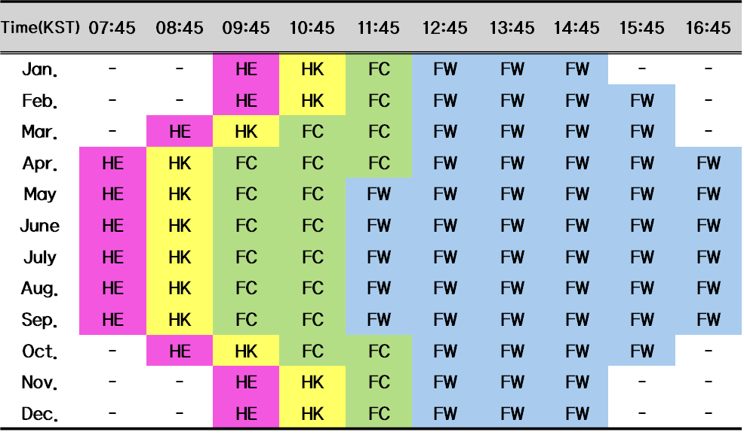
GEMS observation plan
Monthly observation plan

Slide 5
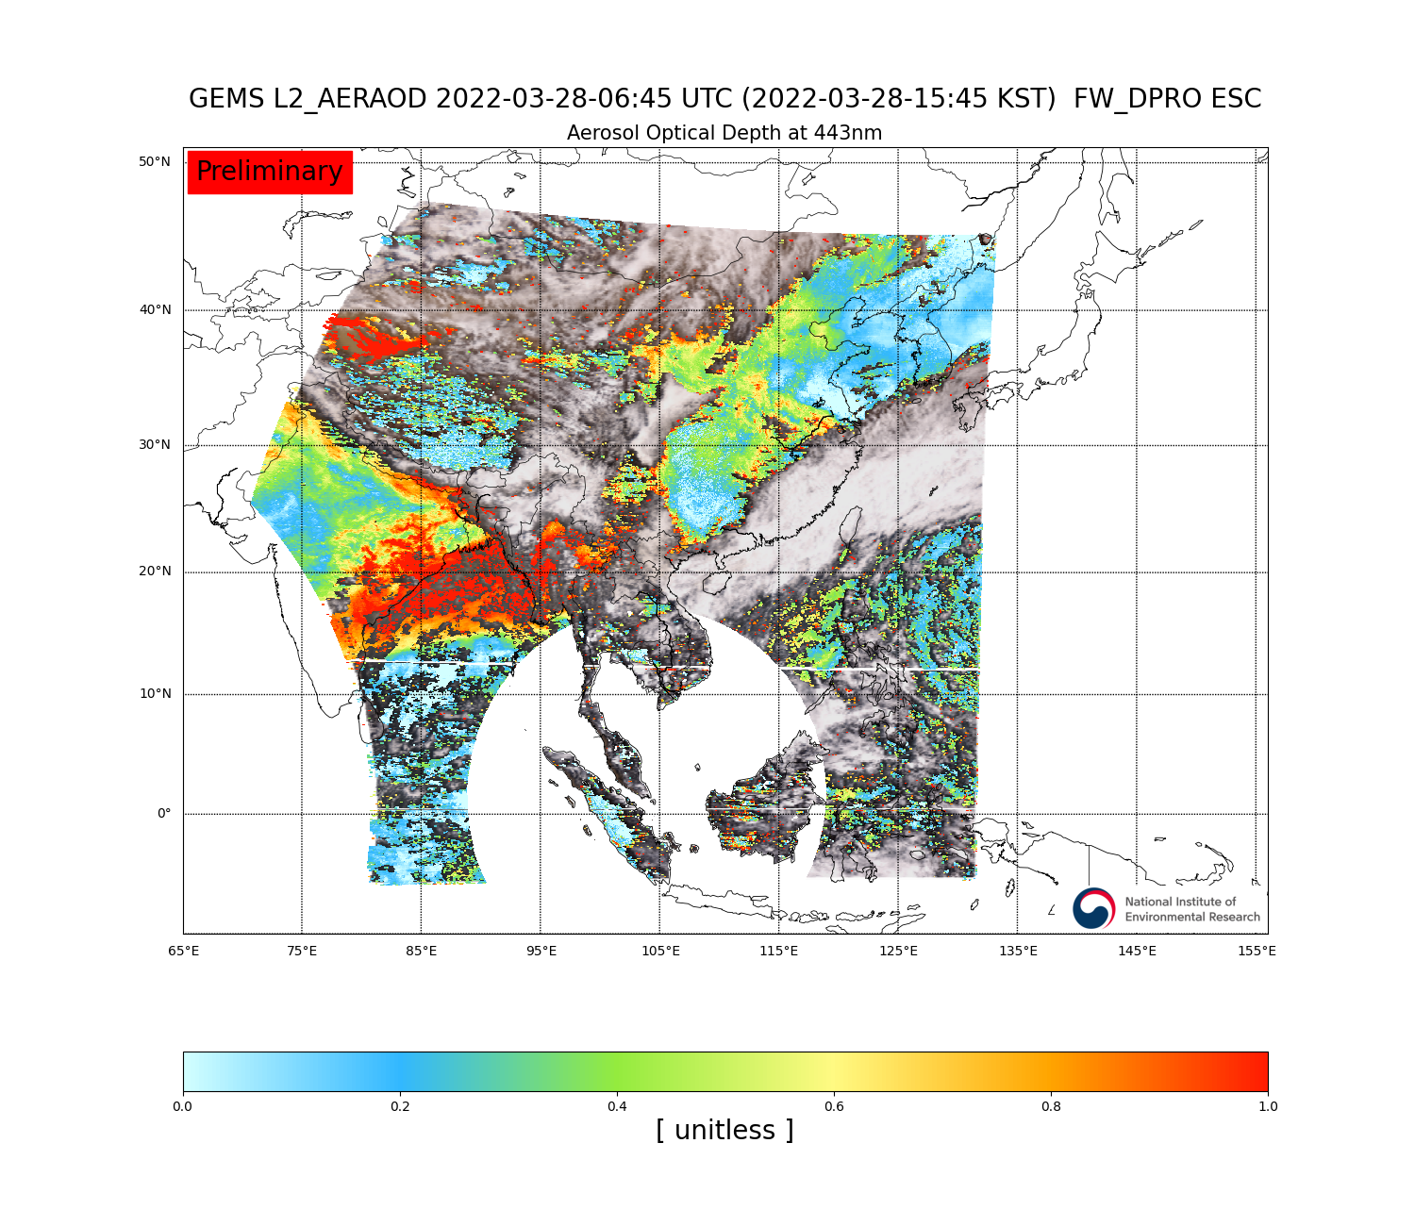
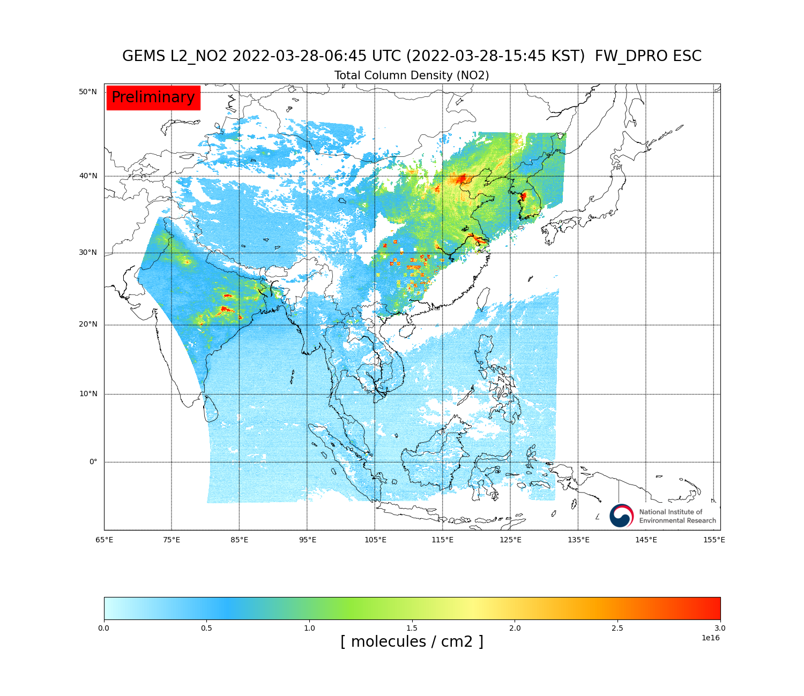
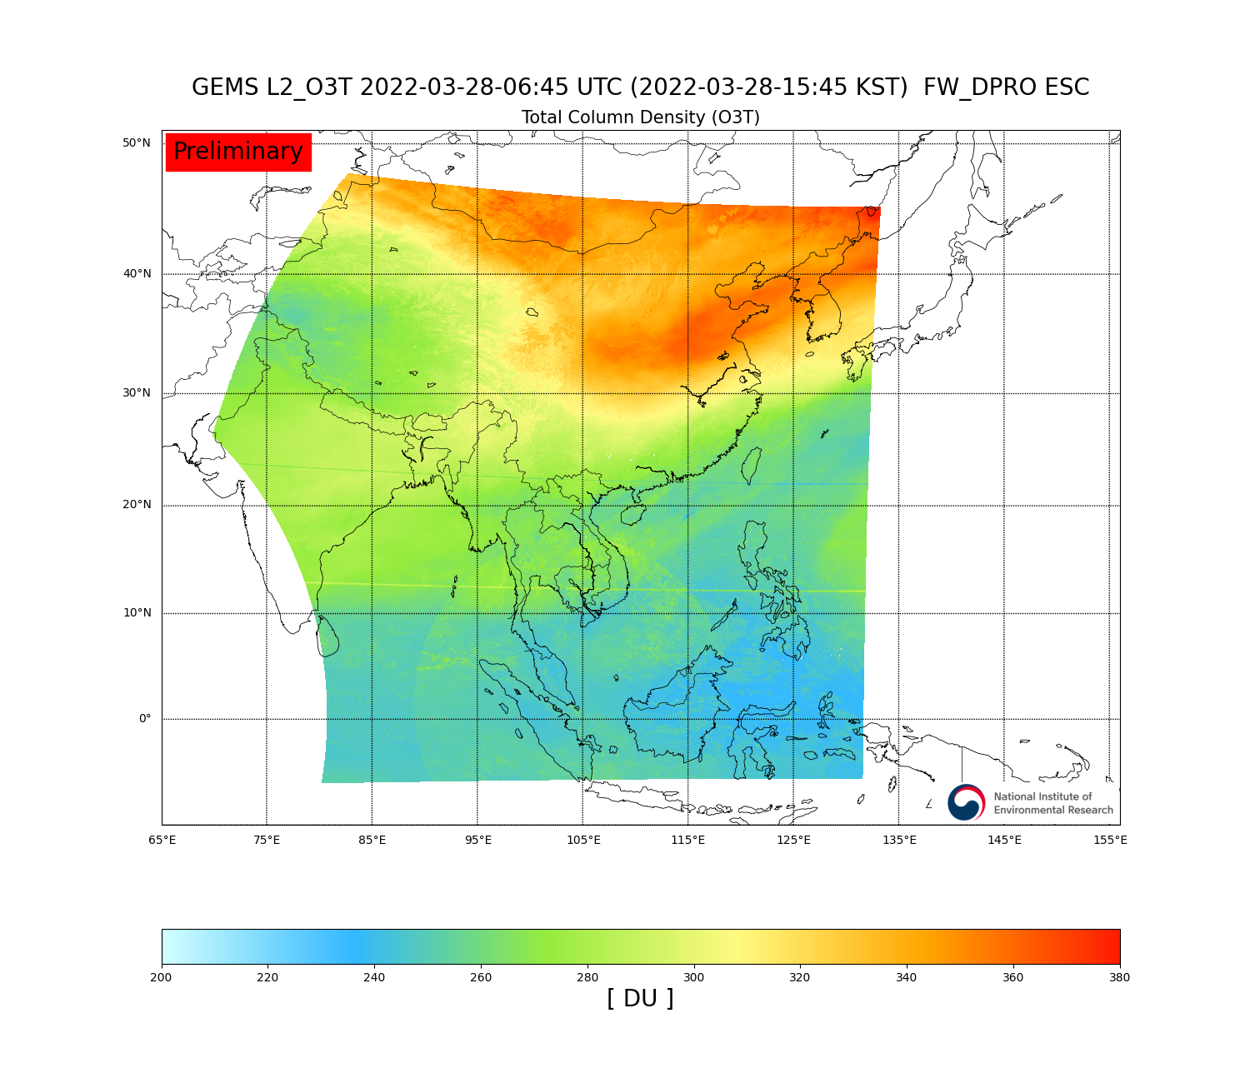
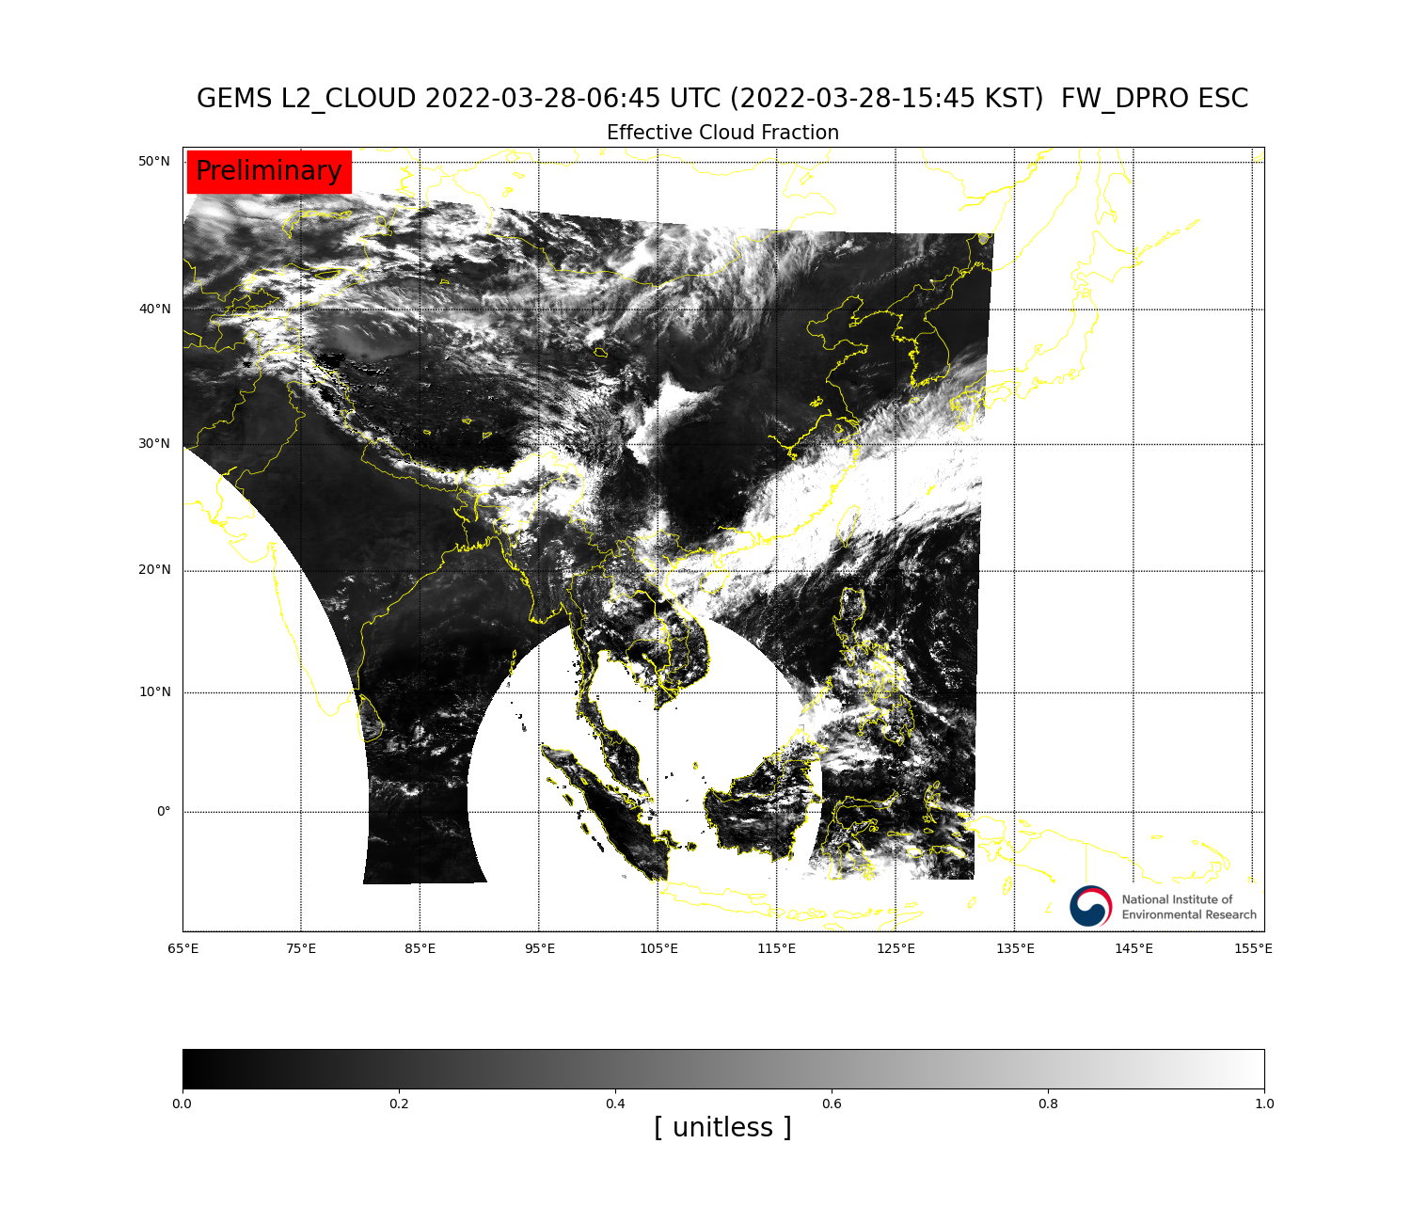
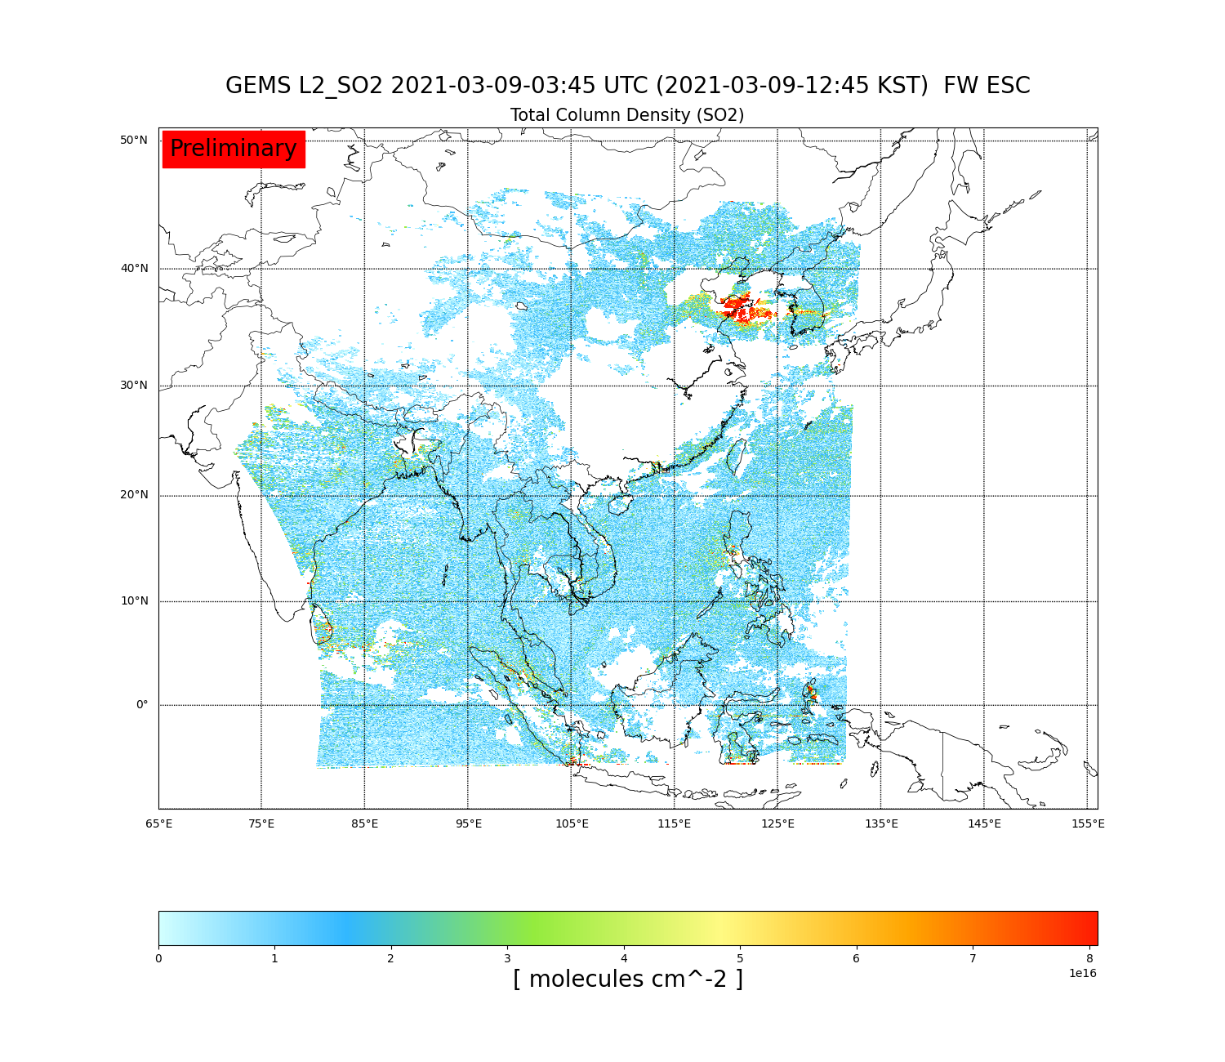
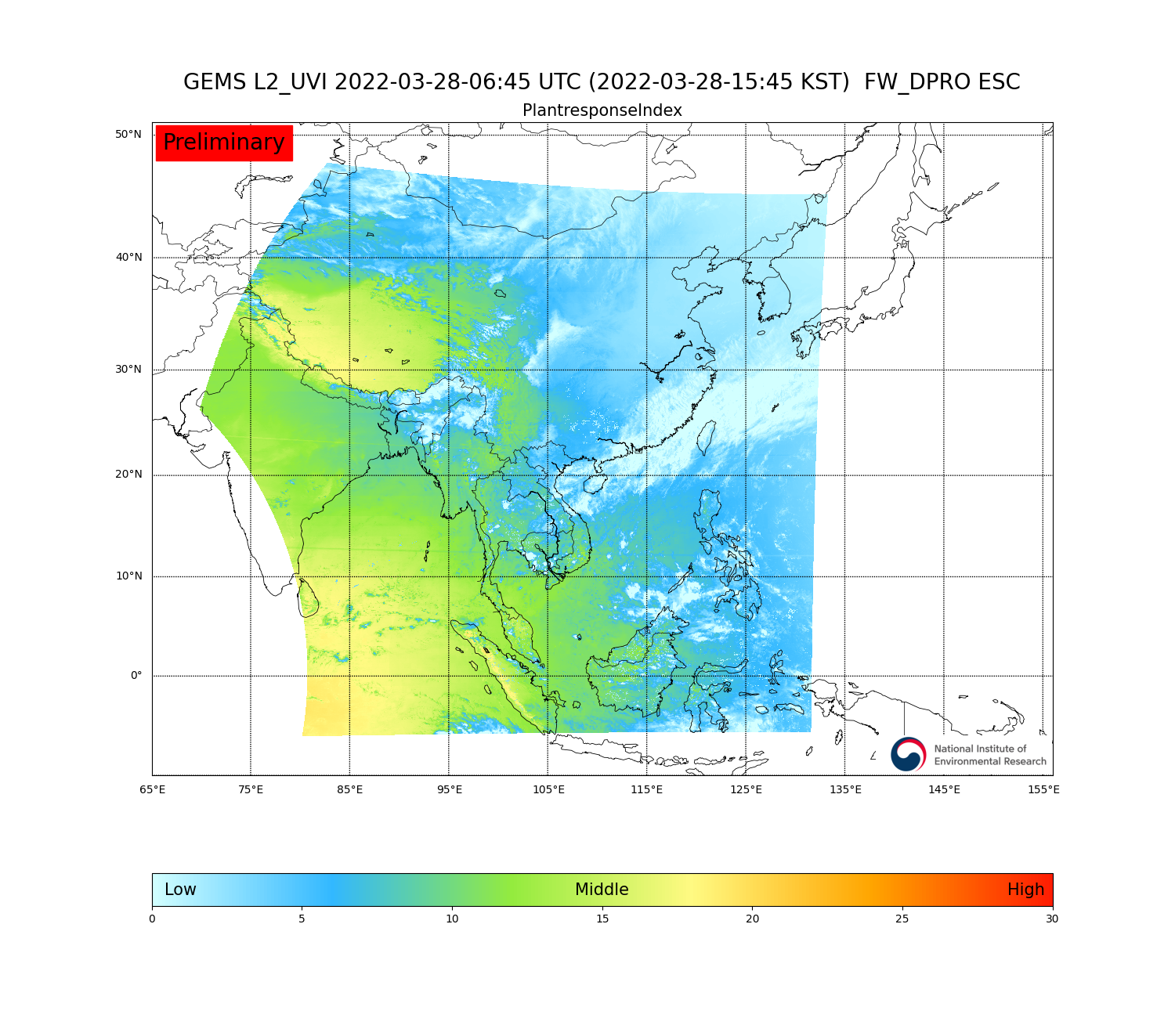
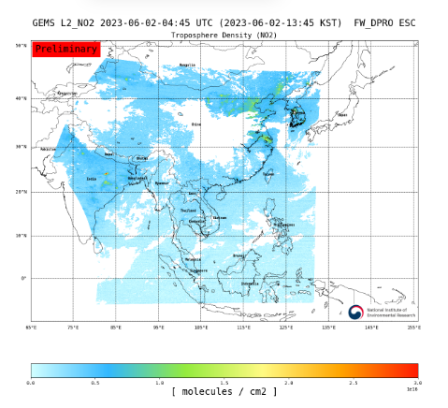
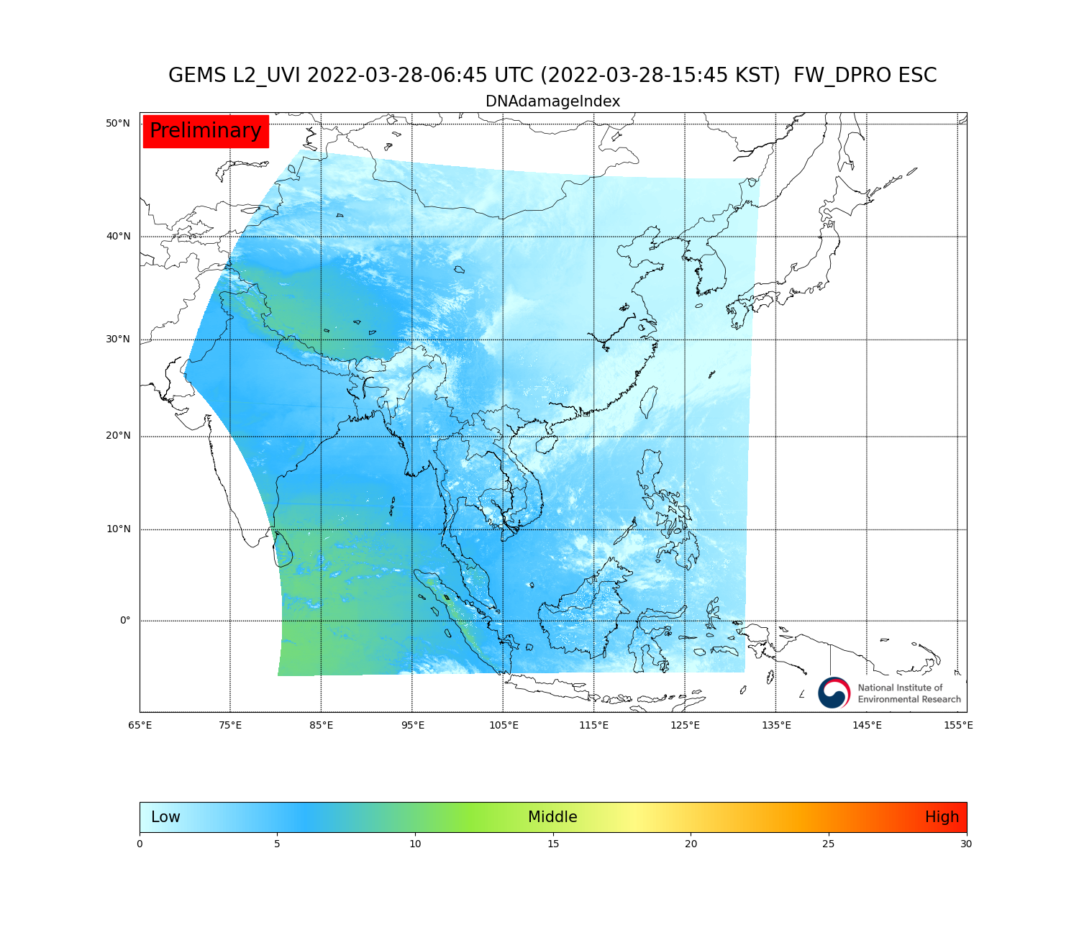
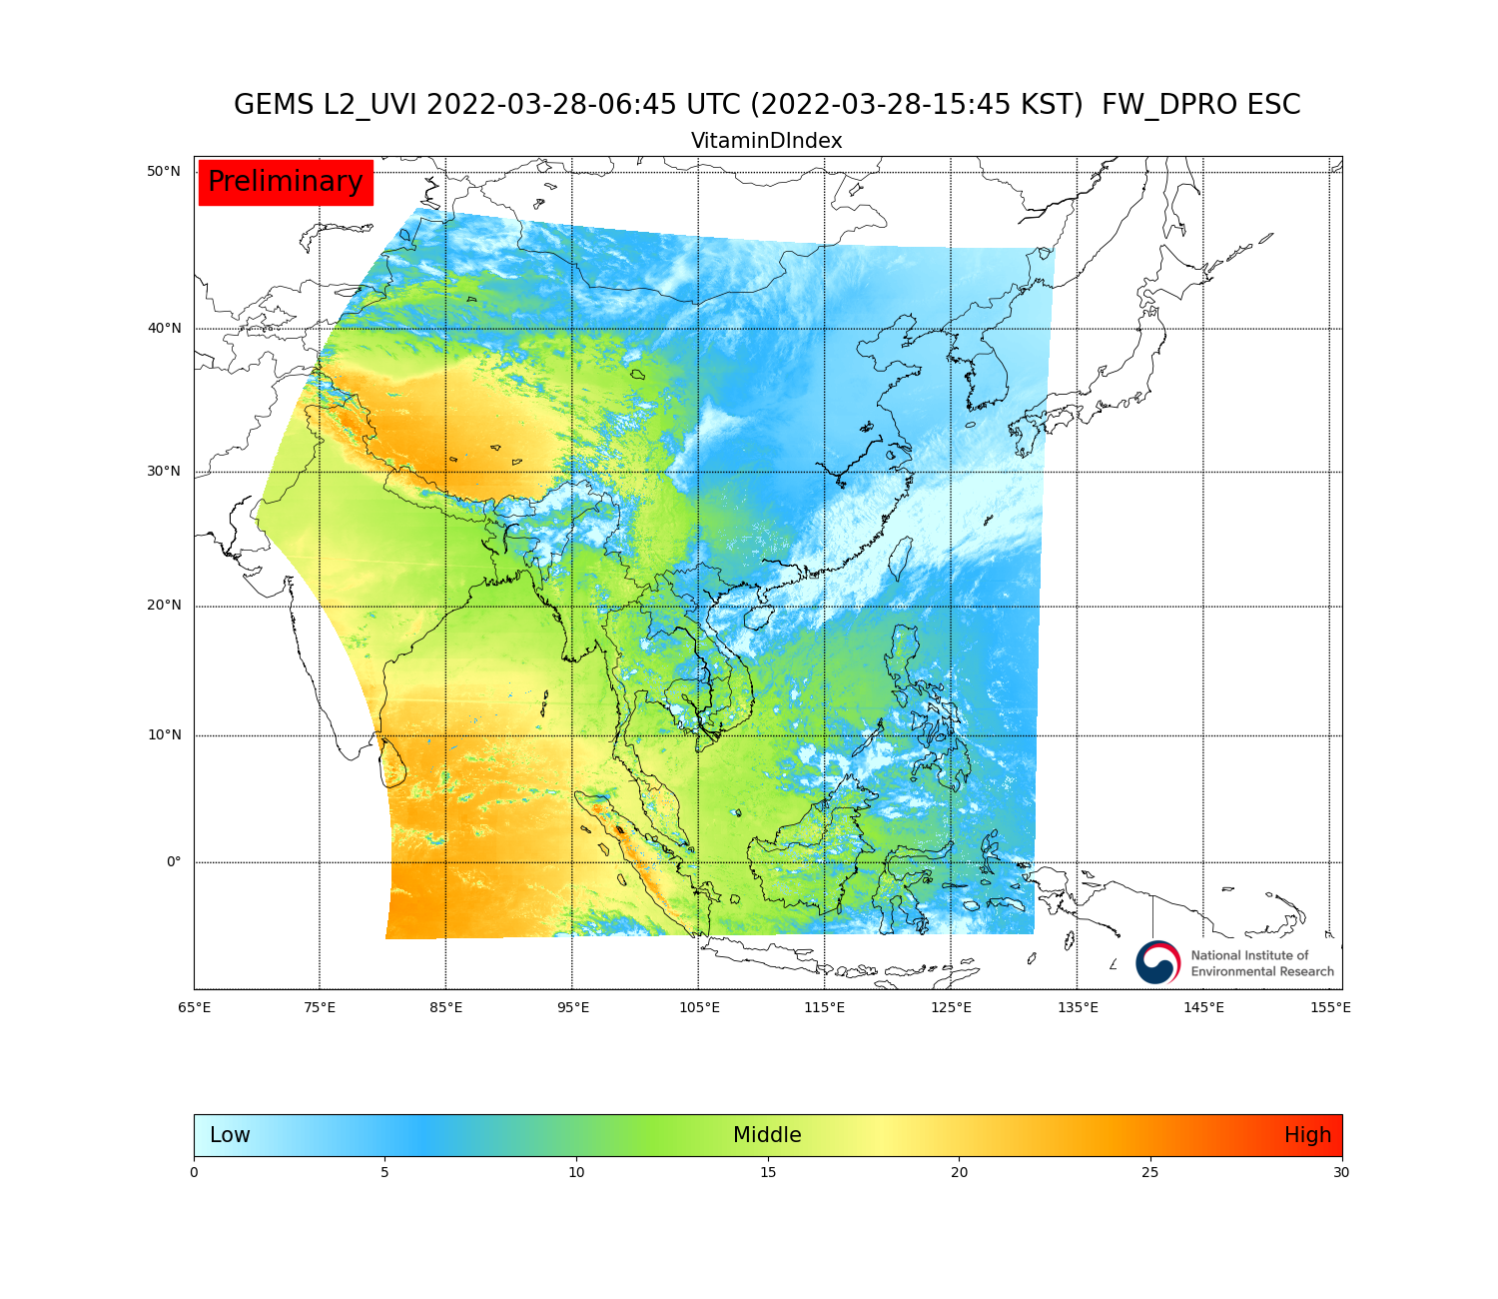
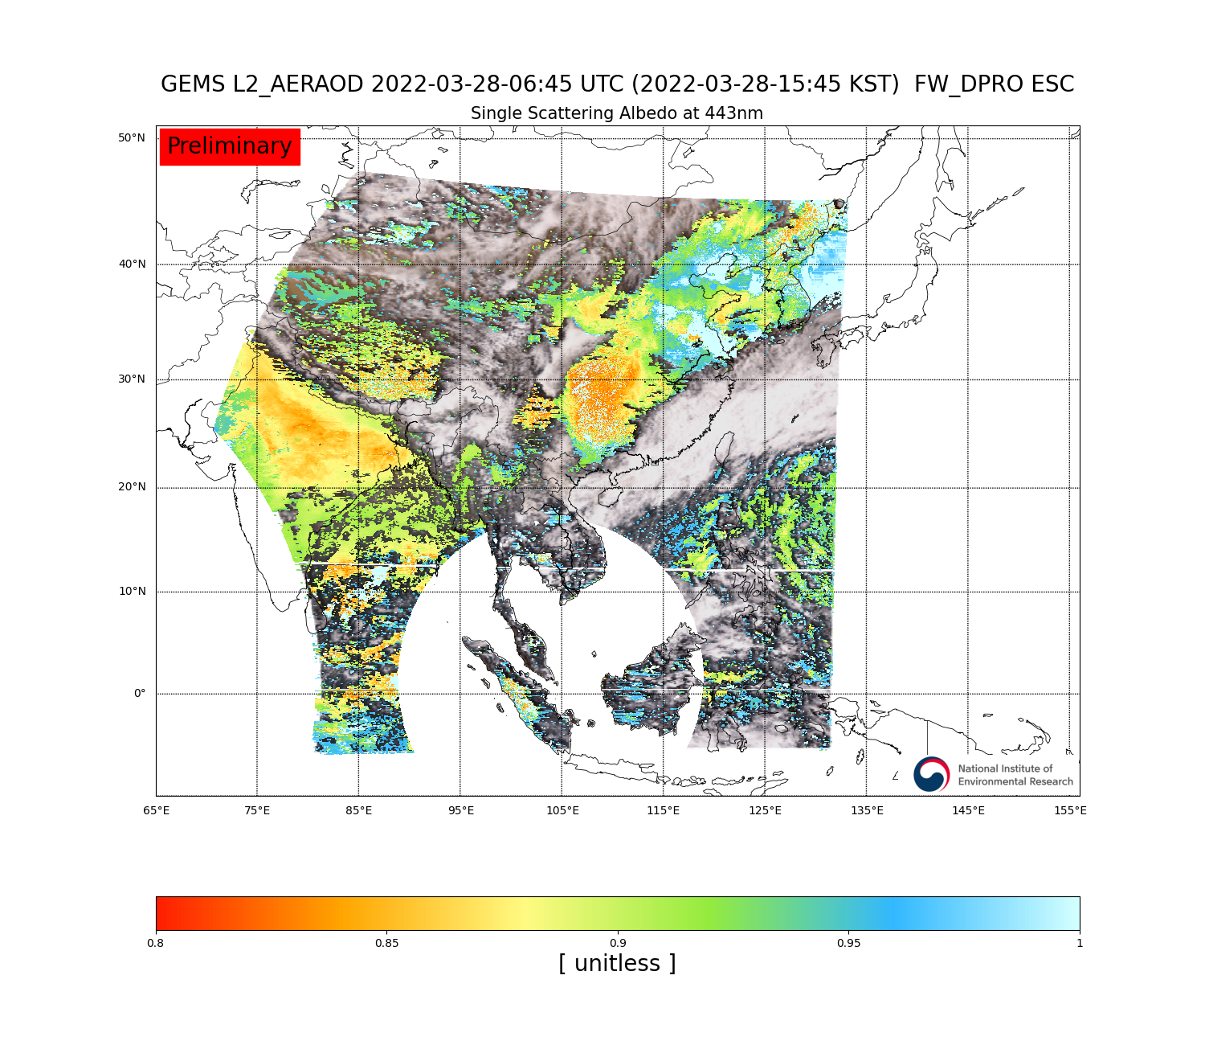
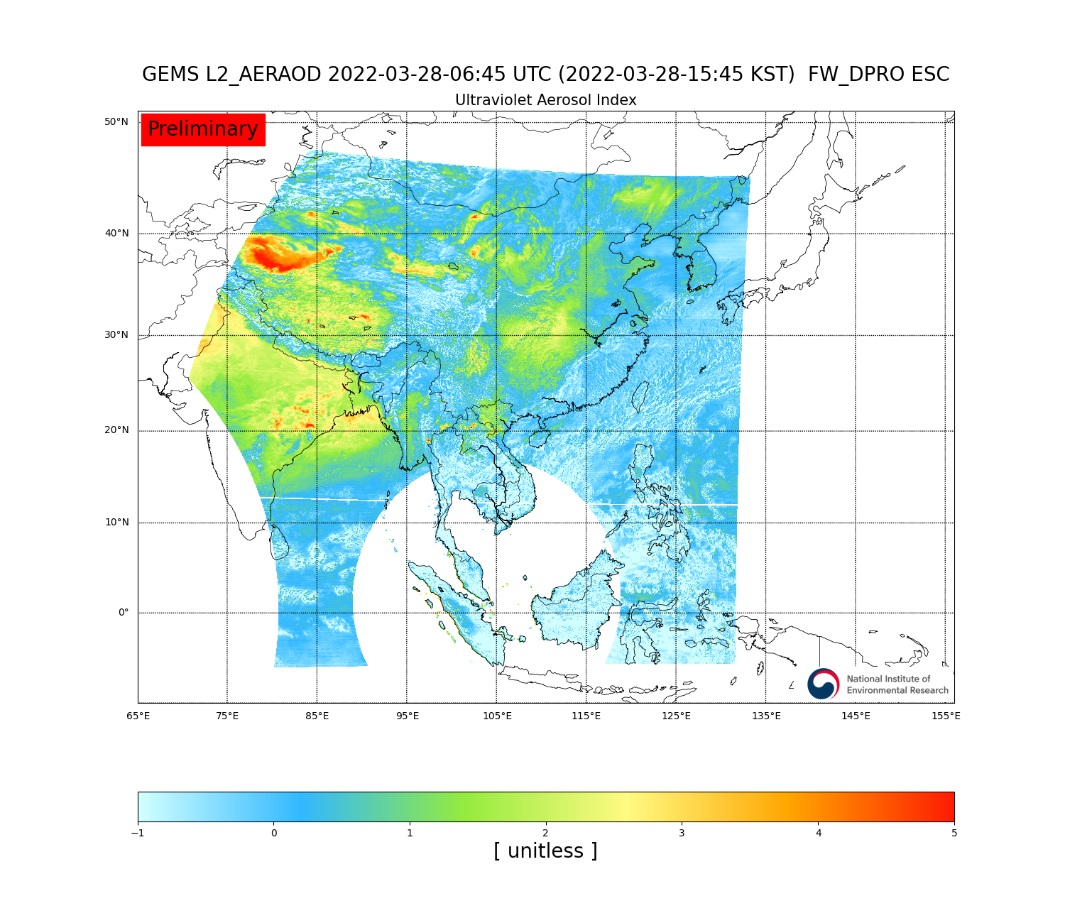
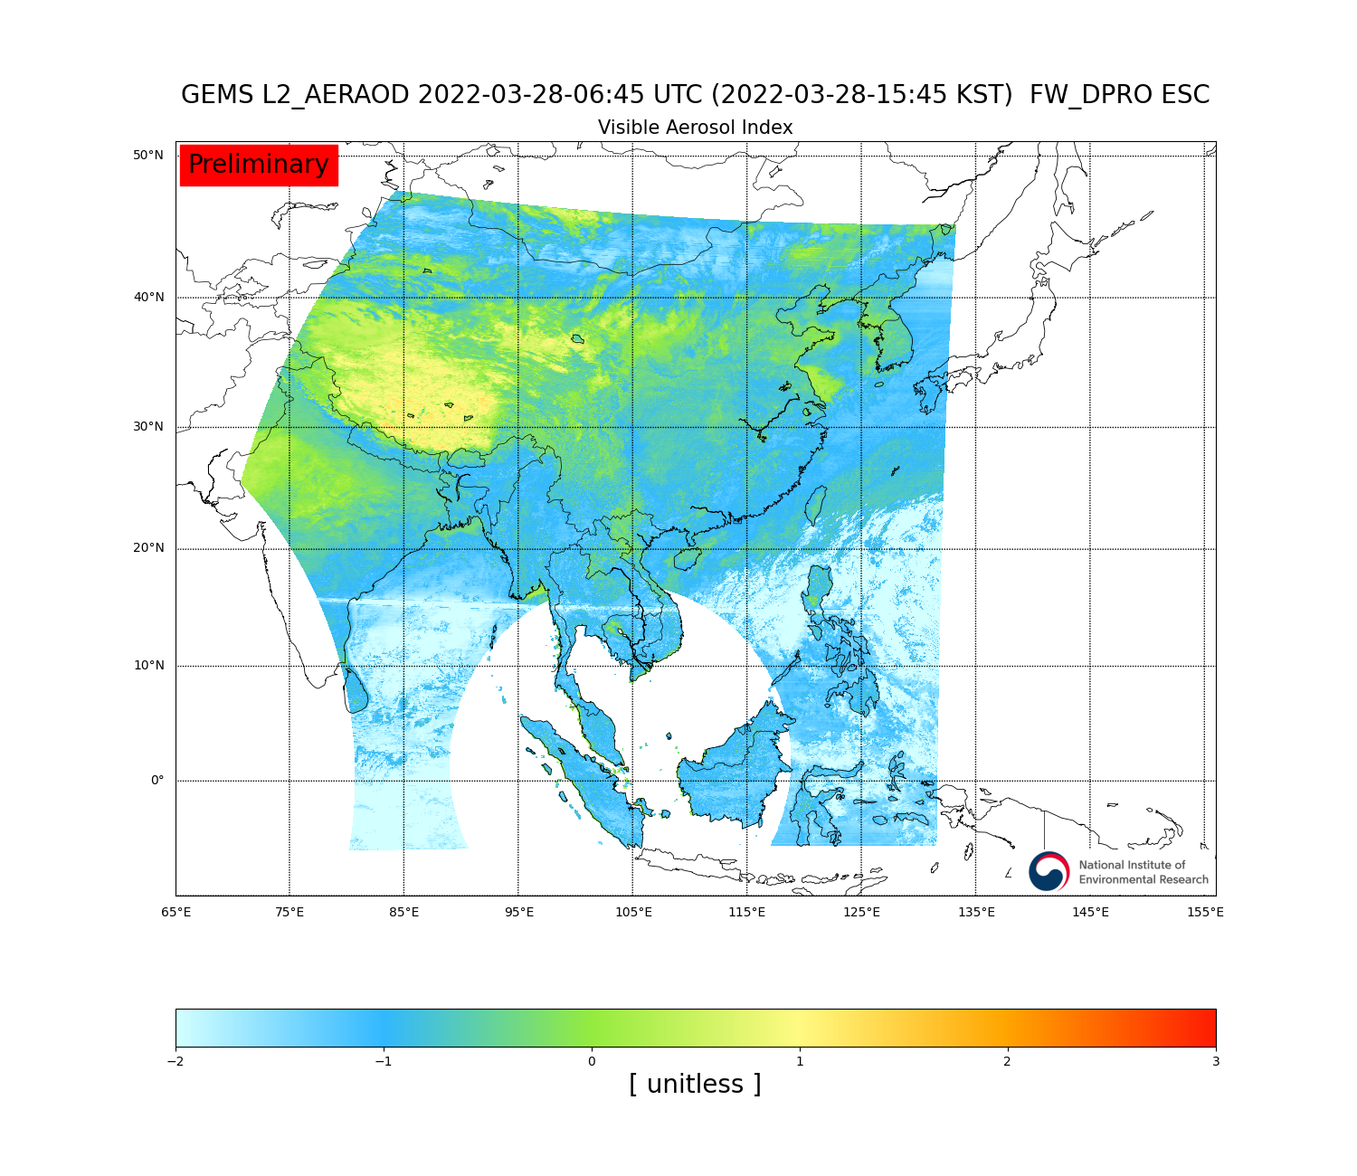
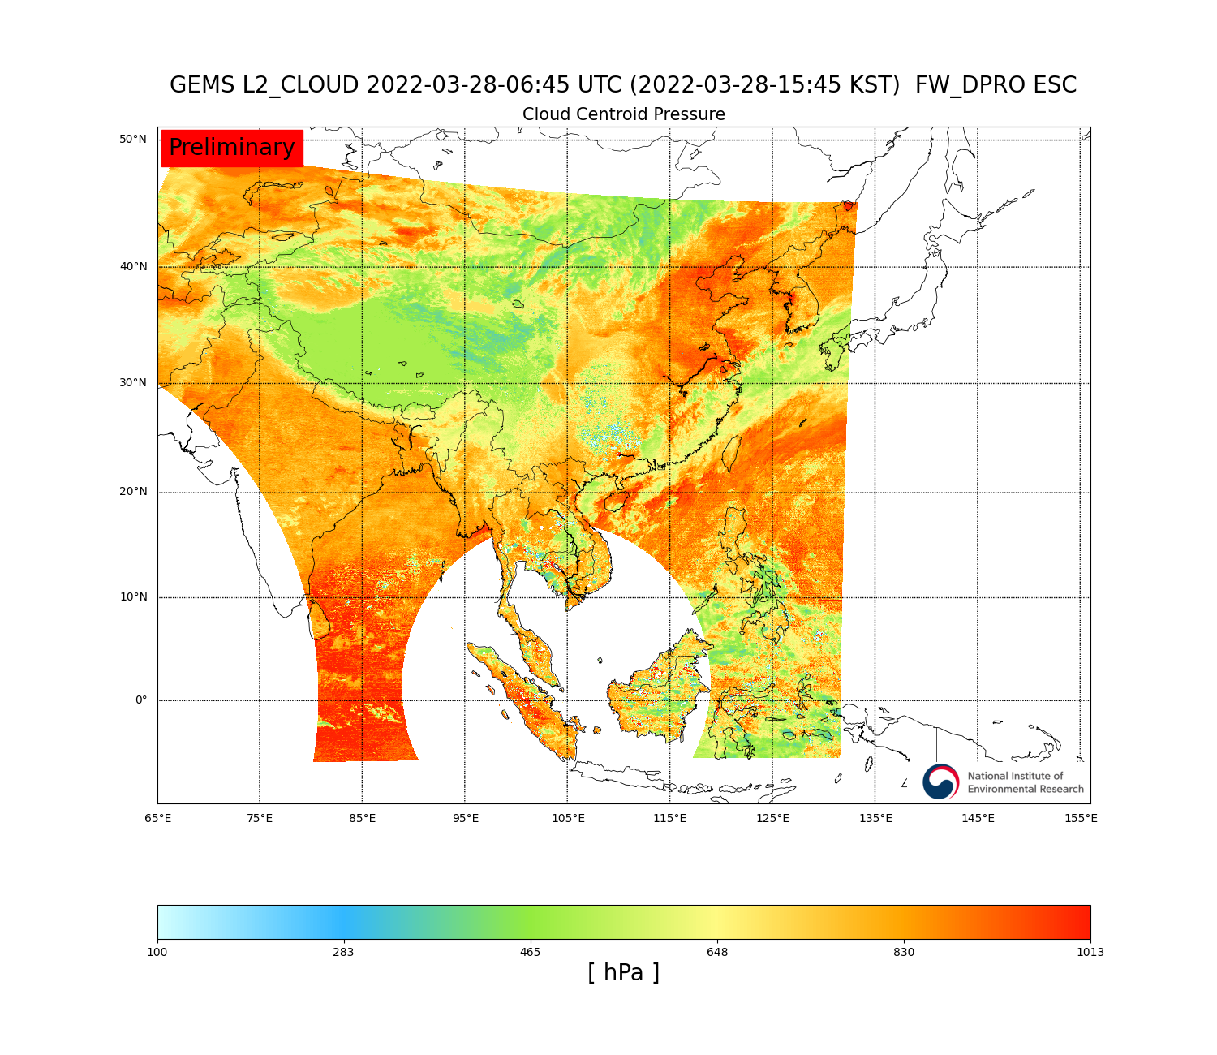
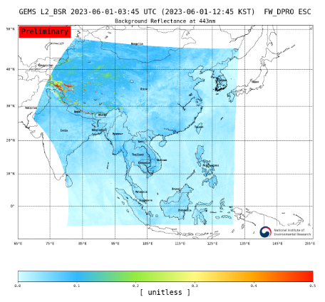
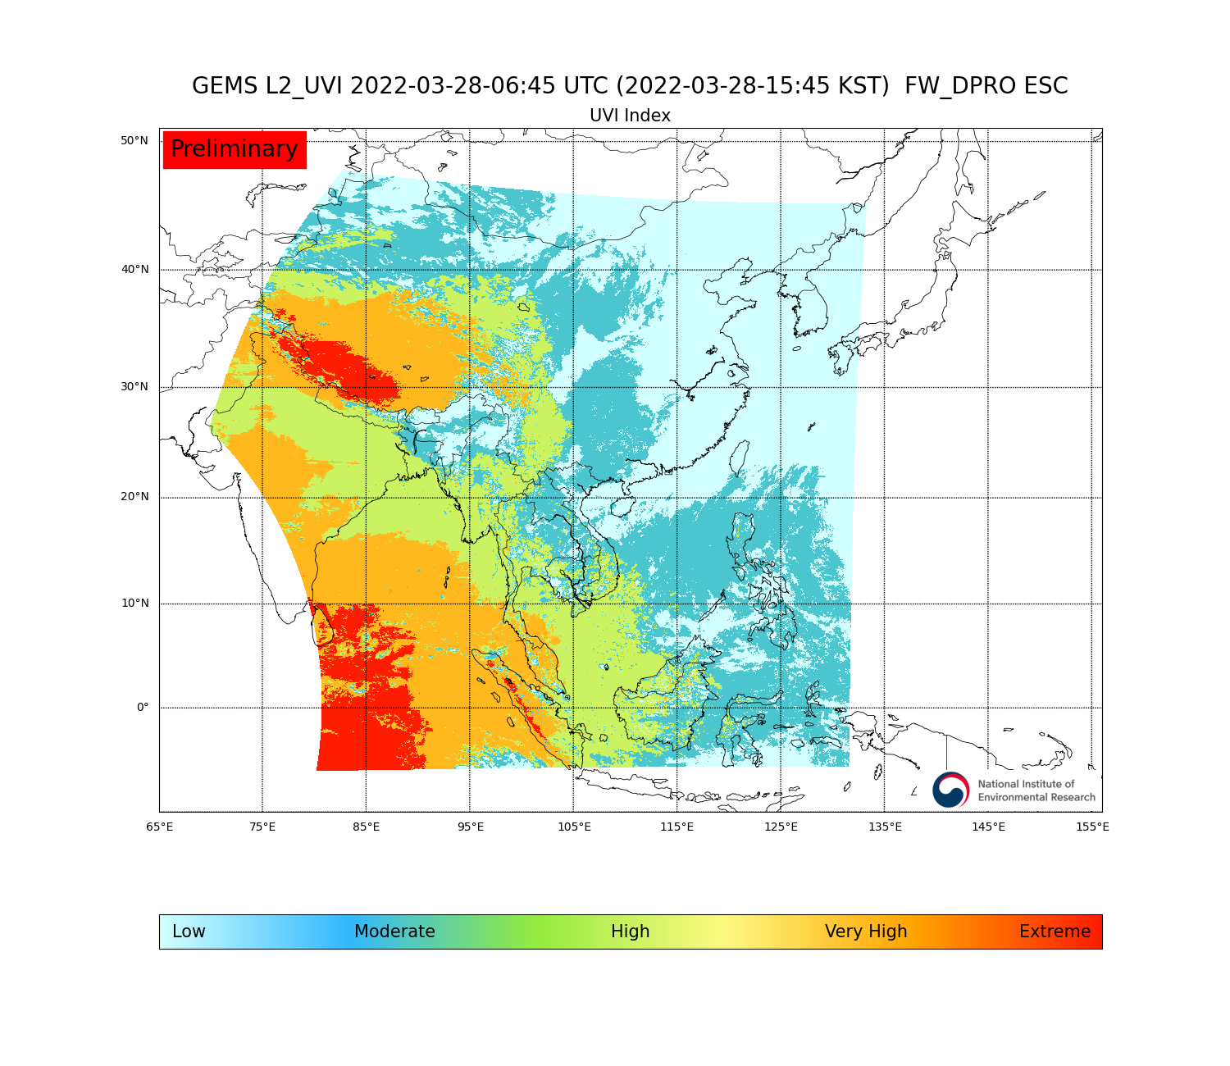
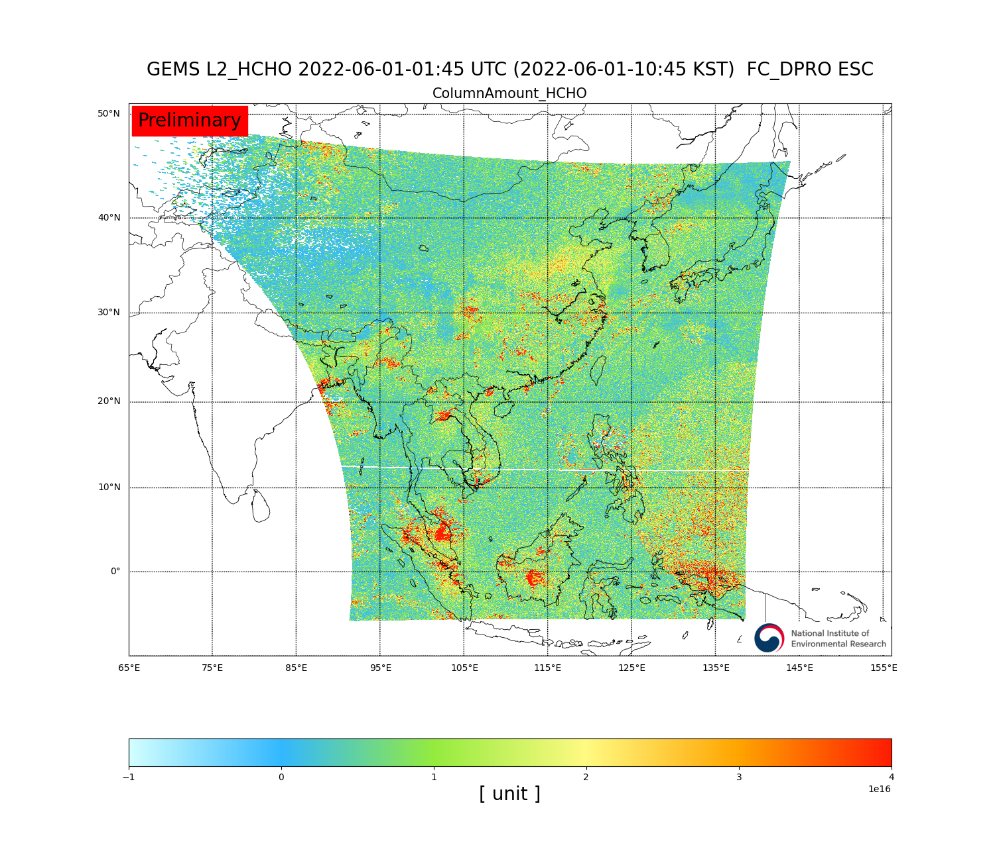
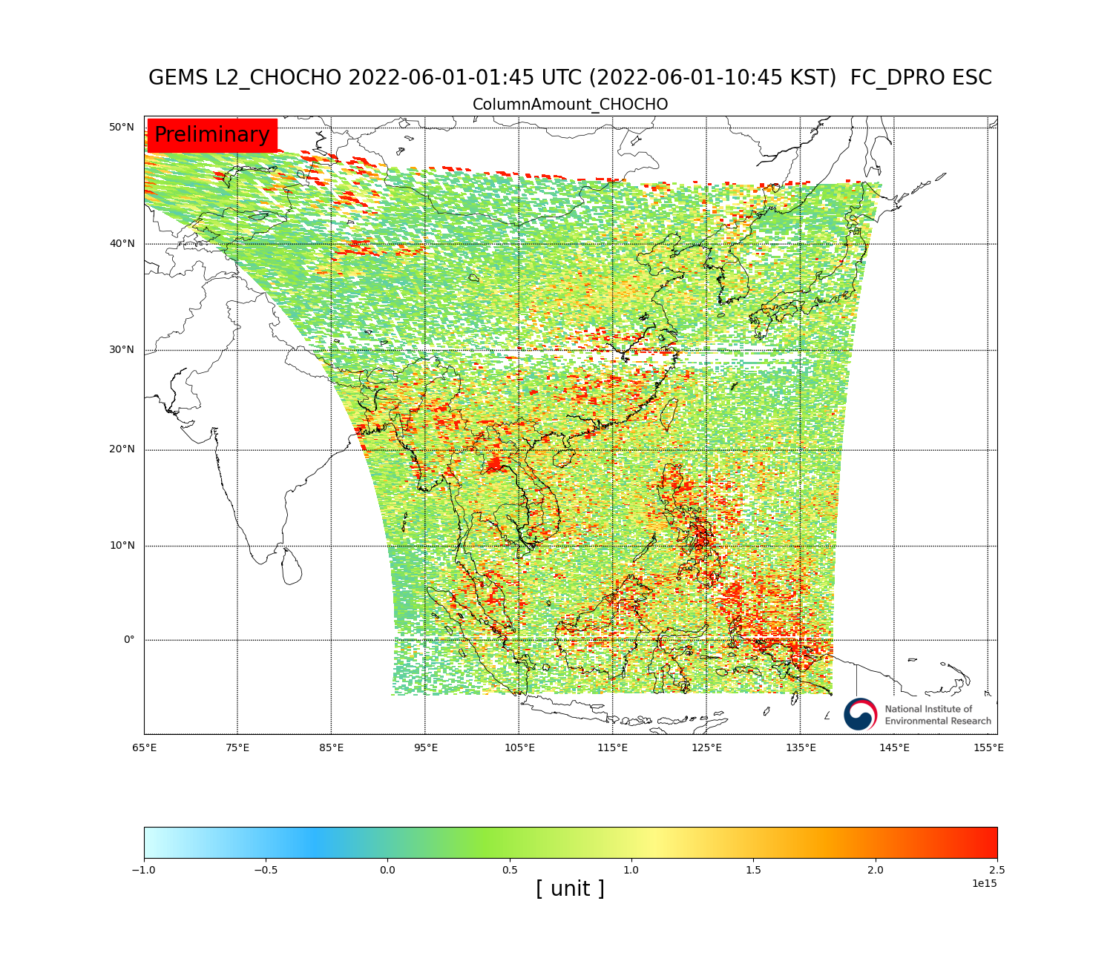
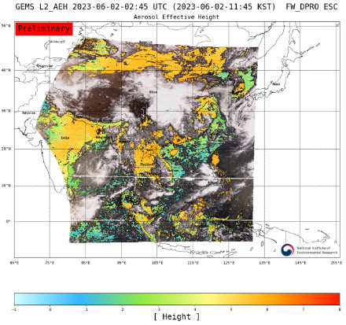
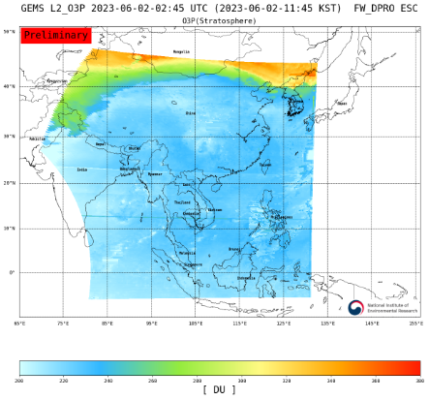
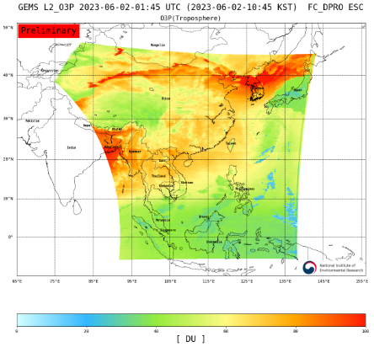
GEMS data release
Normal Products (Level2) Total: 21types
Aerosol optical depth
NO₂
Total ozone
Effective cloud fraction
SO₂
Plant response index
Tropospheric NO₂
DNA damage index
Vitamin D index
Single scattering albedo
UV aerosol index
Visible aerosol index
Cloud pressure
Background Relectance
Cloud radiance fraction
UV index
HCHO
CHOCHO
Aerosol Effective Height
Stratospheric Ozone
Tropospheric Ozone

Slide 6
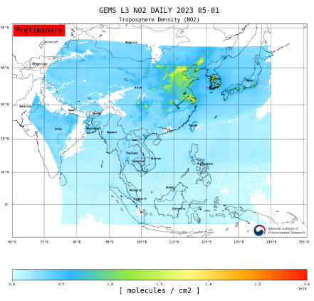
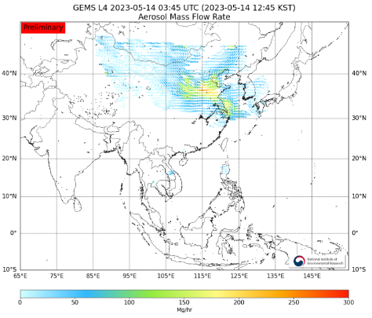
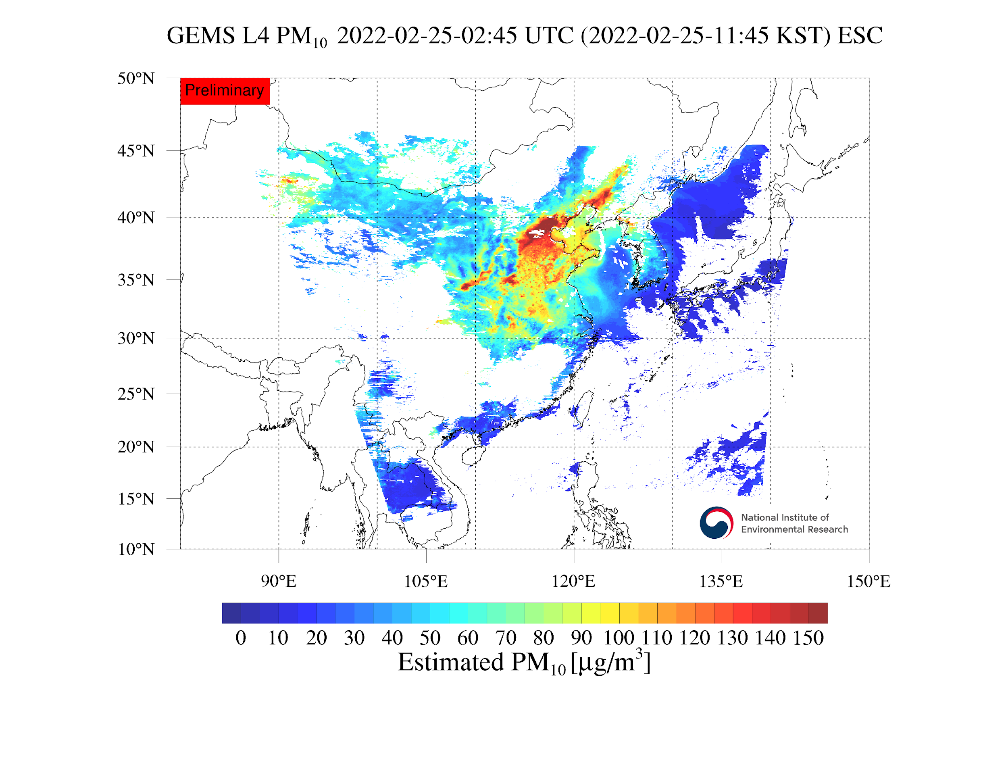
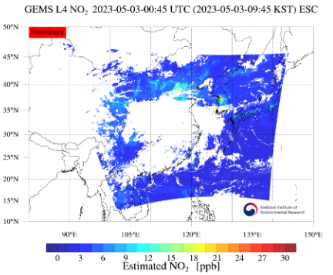
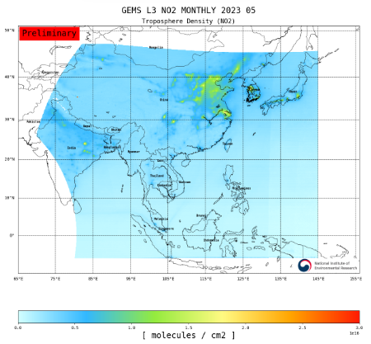
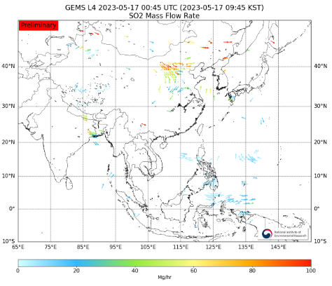
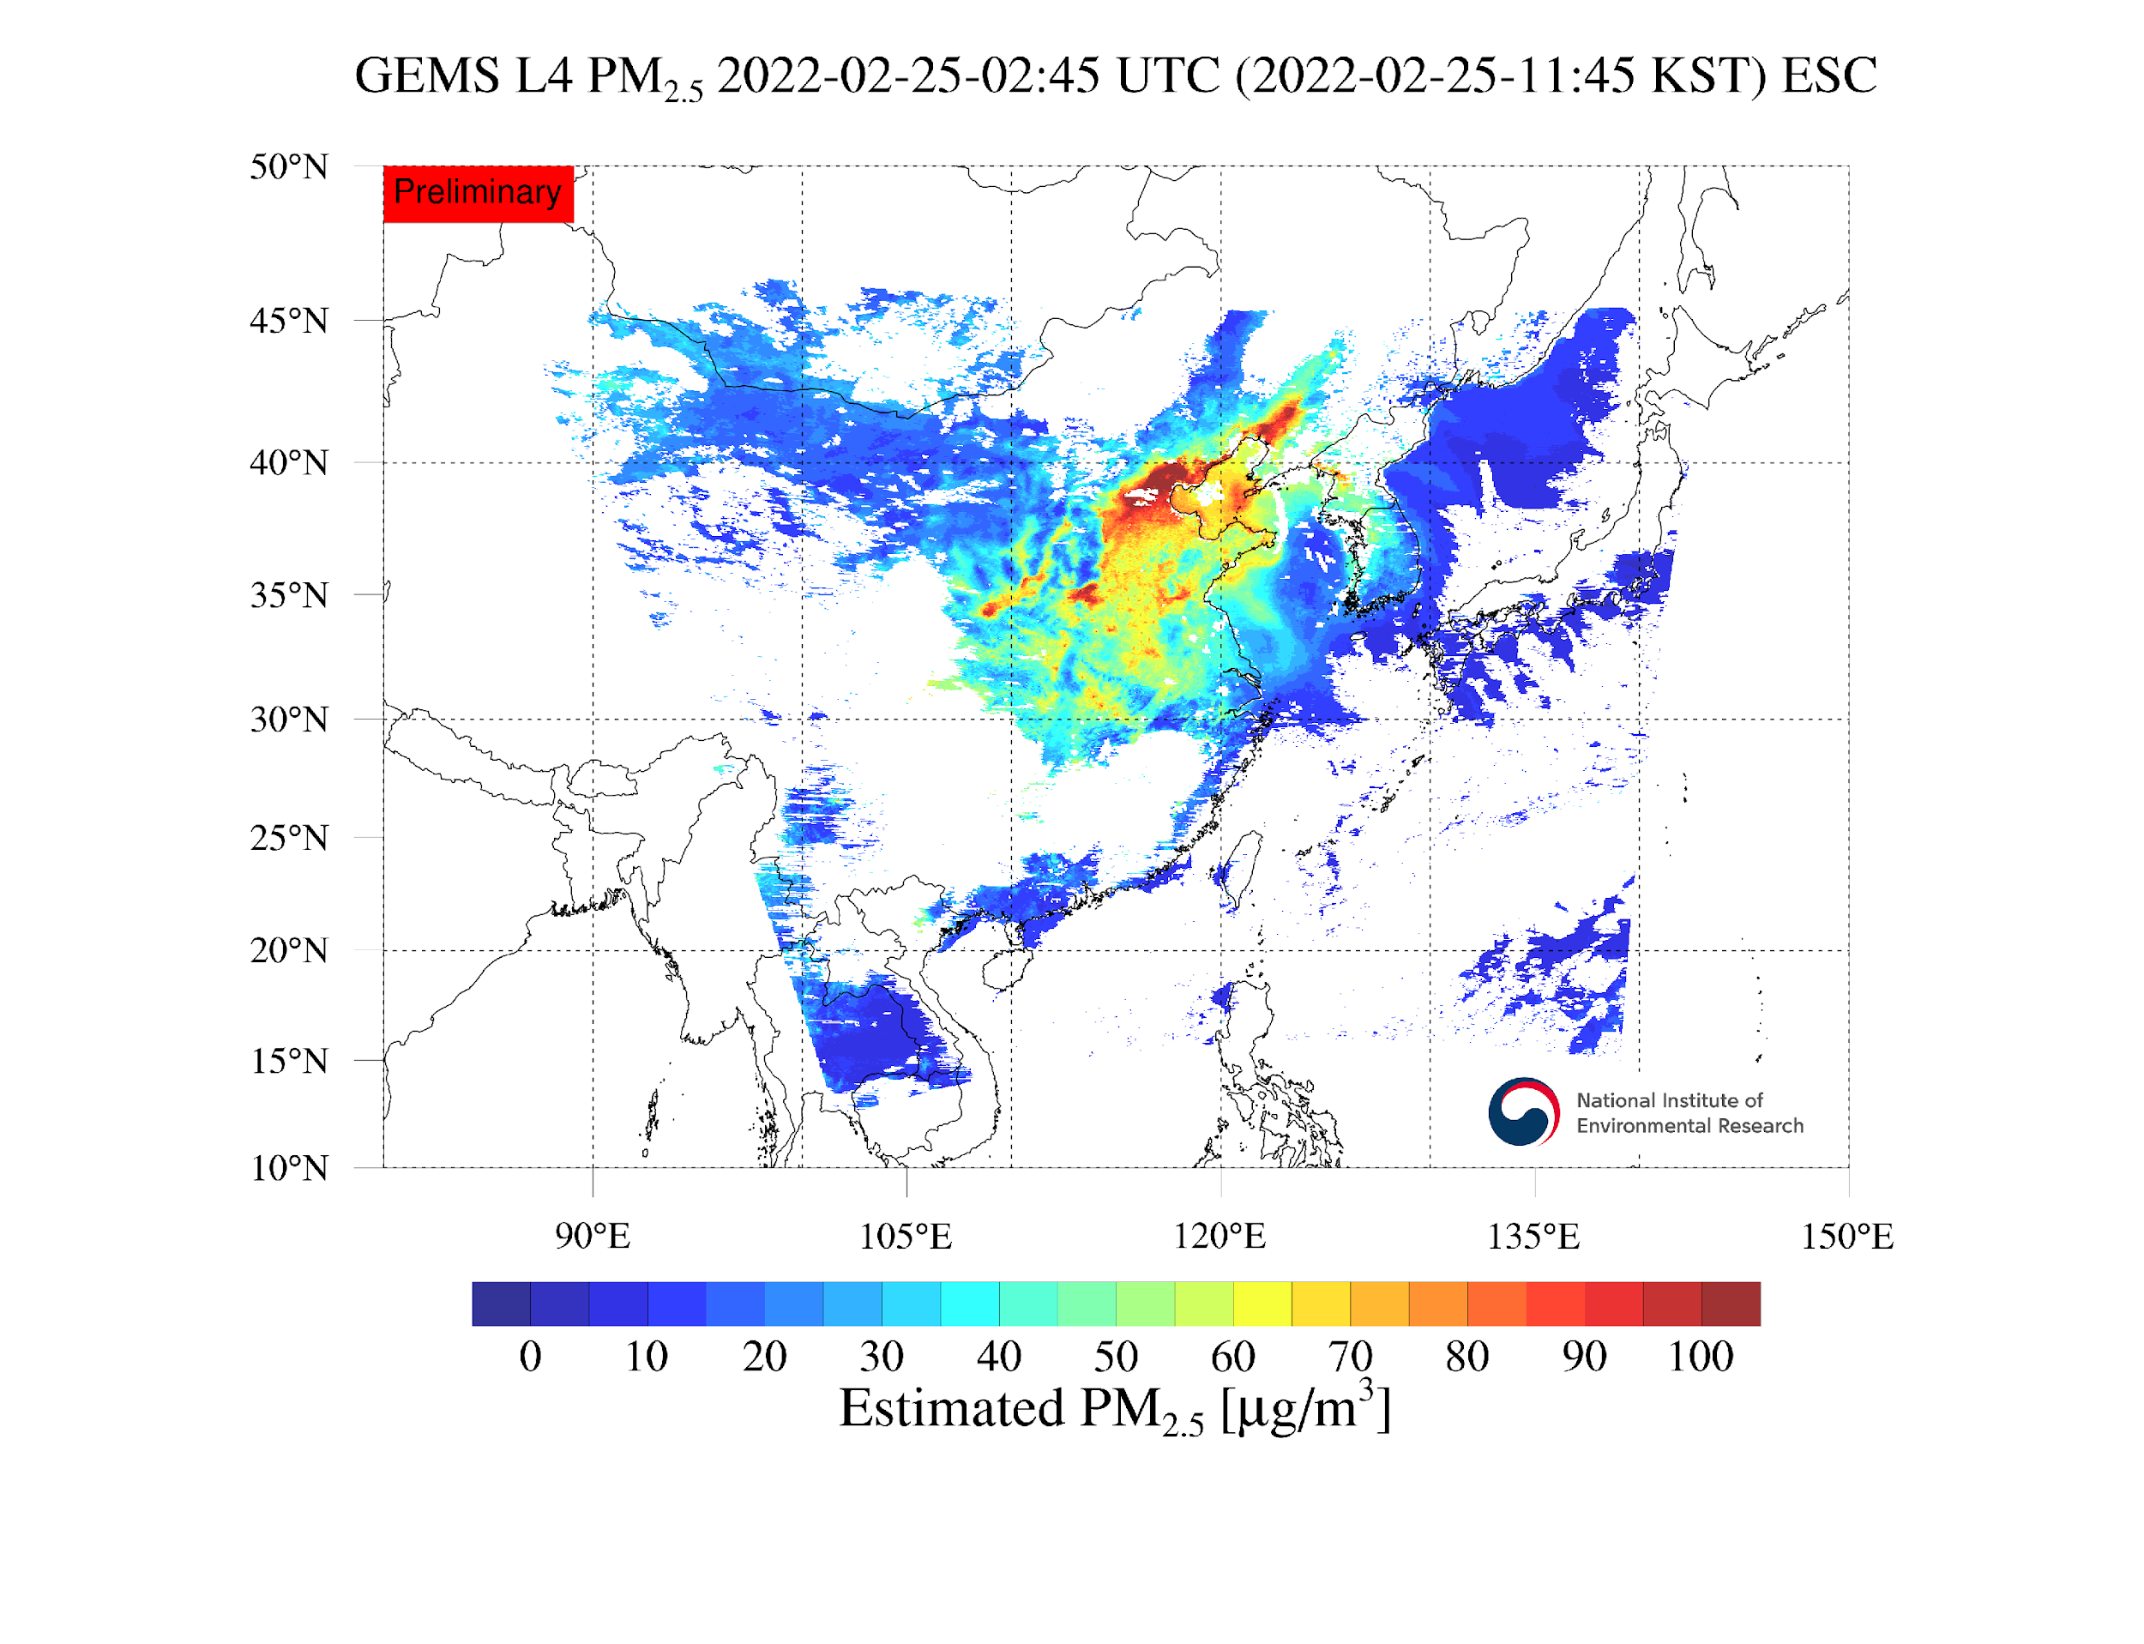
GEMS data release
(Jun.2023~) Average Products (Level3)
Value Added Products (Level4)
New
NO2-Daily-Average(NO2-Trop-daily)
Aerosol mass flow rate
PM₁₀ surface conc.
NO₂ surface conc.
NO2-Monthly-Average(NO2-Trop-daily)
SO₂ mass flow rate
PM_{2.5} surface conc.

Slide 7
GEMS data release
Normal Products (Level2)
Application Products (Level3, 4)
Level | No. | Product Group | Product | Unit
L2 | 1 | Aerosol | Aerosol Optical Depth | -
 | 2 |  | Sing Scattering Albedo | -
 | 3 |  | UV Aerosol Index | -
 | 4 |  | VIS Aerosol Index | -
 | 5 | AEH | Aerosol Effective Height | Km
 | 6 | Cloud | Effective Cloud Fraction | DU
 | 7 |  | Effective Cloud Pressure | DU
 | 8 |  | Cloud Radiance Fraction | DU
 | 9 | BSR | Background Surface Reflectance | -
 | 10 | O3 | Ozone Total | hPa
 | 11 |  | Tropospheric Ozone Profile | -
 | 12 |  | Stratospheric Ozone Profile | -
 | 13 | VOCs | Formaldehyde | molec/cm2
 | 14 |  | Glyoxal | molec/cm2
 | 15 | NO2 | Tropospheric Nitrogen dioxide | molec/cm2
 | 16 |  | Stratospheric Nitrogen dioxide | molec/cm2
 | 17 | SO2 | Sulfur dioxide | molec/cm2
 | 18 | UVI | UV Index | -
 | 19 |  | Plant Response Index | -
 | 20 |  | DNA Damage Index | -
 | 21 |  | VitaminD Synthesis index | -
Level | No. | Product Group | Product | Unit
L3 | 1 | Average | Tropospheric Nitrogen dioxide (daily average) | molec/cm2
 | 2 |  | Tropospheric Nitrogen dioxide (monthly average) | molec/cm2
L4 | 3 | Flow Rate | Aerosol Mass Flow Rate | Mg/hour
 | 4 |  | Sulfur dioxide Mass Flow Rate | Mg/hour
 | 5 | Estimated Surface | PM2.5 Surface | ㎍/㎥
 | 6 |  | PM10 Surface | ㎍/㎥
 | 7 |  | NO2 Surface | ppb
Serviced since 2021
Serviced since 2022
Serviced since 2023
New
☯ Ratio between NO2 and △XCO2 product will open from this year(TBD)
- Only image files will be displayed through gems homepage

Slide 8
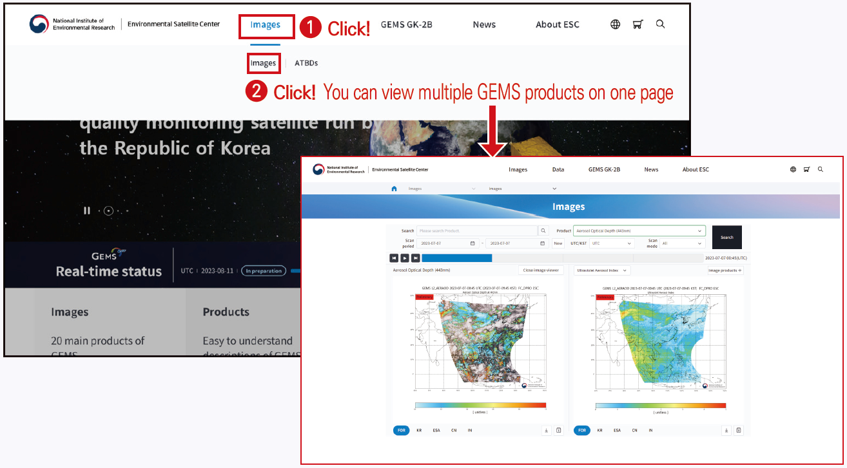
GEMS data release
(May. 2023~) Homepage design updates
☯ GEMS data can be easily accessed through Website
☯ Website Address : https://nesc.nier.go.kr
New

Slide 9
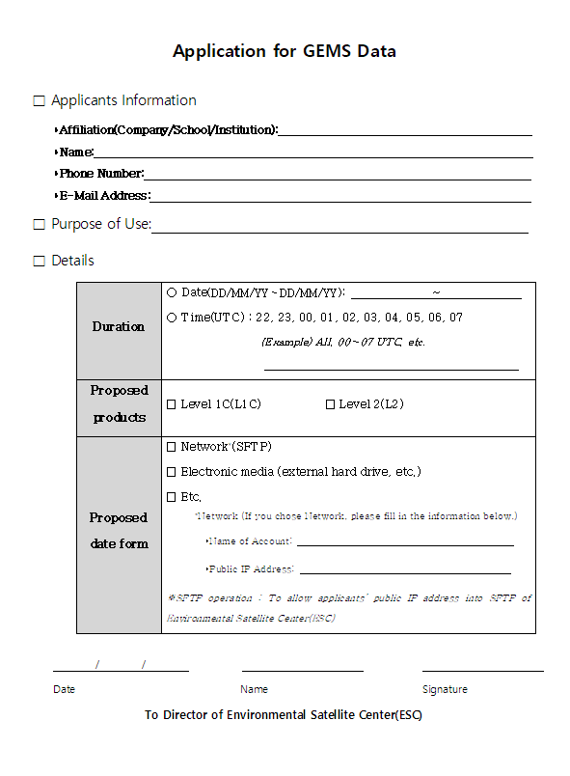
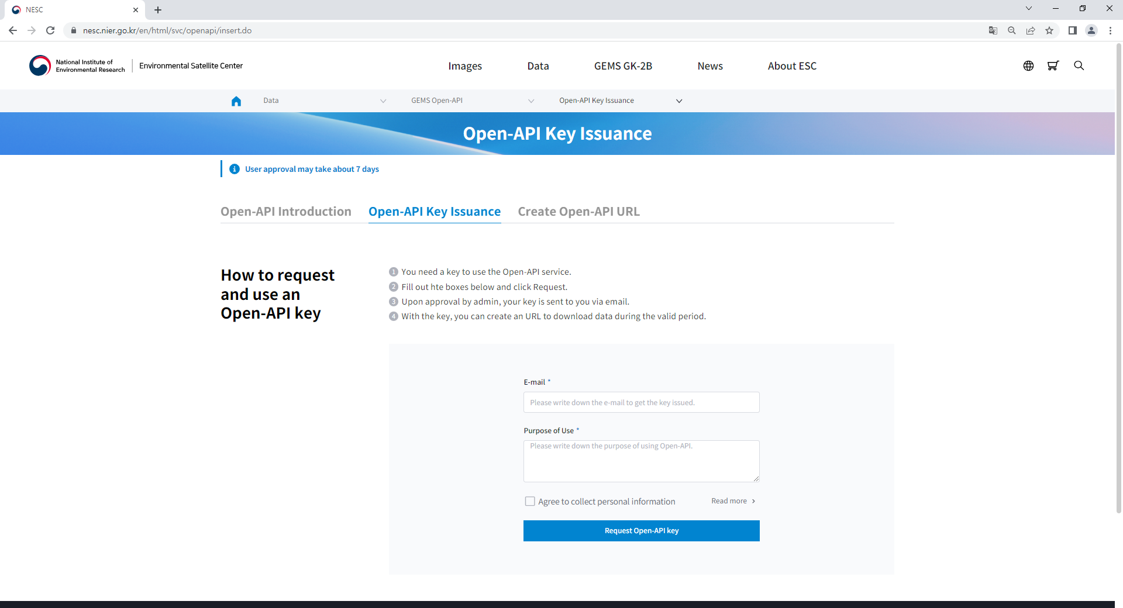
GEMS data release
Data service summary
(1) Request with application form
ESC
User
(2) Approved
1. Download from the ESC website (nesc.nier.go.kr)
- Anyone can download GEMS data without logging in.
- Up to 20 GB and 40 files
2. SFTP service (A written application form required)
- User’s public IP address, which is allowed to pass
through the ESC’s Web Application Firewall (WAF).
- Submit an account(to connect SFTP server and download data)
※please refer to “How to Access GEMS data” page
(https://nesc.nier.go.kr/en/html/cntnts/91/static/page.do)
3. GEMS Open-API (need to request API Key through ESC website)
- GEMS Open-API is an interface that enables users to more easily access
and use GEMS images and data products to serve their own purposes
such as developing web services or mobile applications
※please refer to “Open-API Key Issuance” page
(https://nesc.nier.go.kr/en/html/svc/openapi/insert.do)
Servers
(Application form)
(3) Connect to serves
New

Slide 10
GEMS data release
New
(Jun. 2023~) GEMS Application Tool (GEMSAT)
- GEMSAT is an intuitive software that provides specialized and dedicated functionality of plotting, visualizing, and analyzing
space-based air quality data so that users can easily leverage satellite measurements to meet their specific needs.

