Slide 1
2023 CEOS Chair Priorities – Report on Outcomes
Pakorn Apaphant, GISTDA
Agenda Item 2.1
37th CEOS Plenary
15 - 16 November 2023
Chiang Rai, Thailand
Hosted by GISTDA

Slide 2
GISTDA CEOS Chair Theme 2023
For 2023 GISTDA has prioritised the theme:
“Space Technology for Better Environments,
Economies, and Humanity”

Slide 3
GISTDA CEOS Chair Priorities 2023
1
Supporting CEOS Preparations and Inputs to the Global Stocktake of the UNFCCC Paris Agreement
Workshop
GISTDA - SilvaCarbon 2023 CEOS Workshop on Uptaking Global AFOLU Datasets
CEOS Agency Datasets
Continued expansion of the offering of CEOS Agency datasets available to support the GST and countries’ assessments of their Nationally Determined Contributions (NDCs)
GHG & AFOLU Roadmap
Support the Implementation of both the GHG Roadmap and AFOLU Roadmap
2
Supporting Exploration of New Geometries for Space Agencies and CEOS with New Space
New Space
Task Team
Work with CEOS New Space Task team led by SIT Chair to develop New Space Economy document as a means for knowledge sharing with CEOS Agencies
Promote sharing of information between CEOS members
Collaboration
Opportunities
Define actions within CEOS framework
Workshops/Meetings as inputs to the border CEOS discussion on New Space opportunities.
Facilitate a discussion during CEOS 2023 timeframe

Slide 4
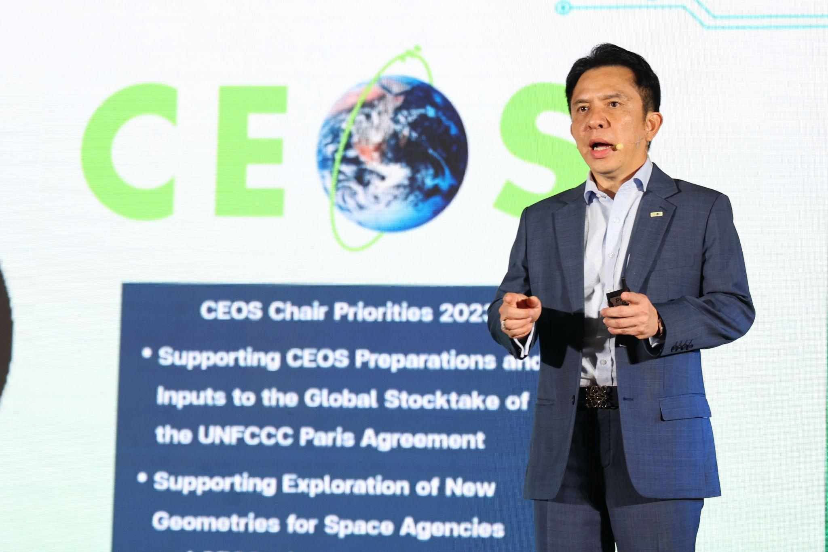
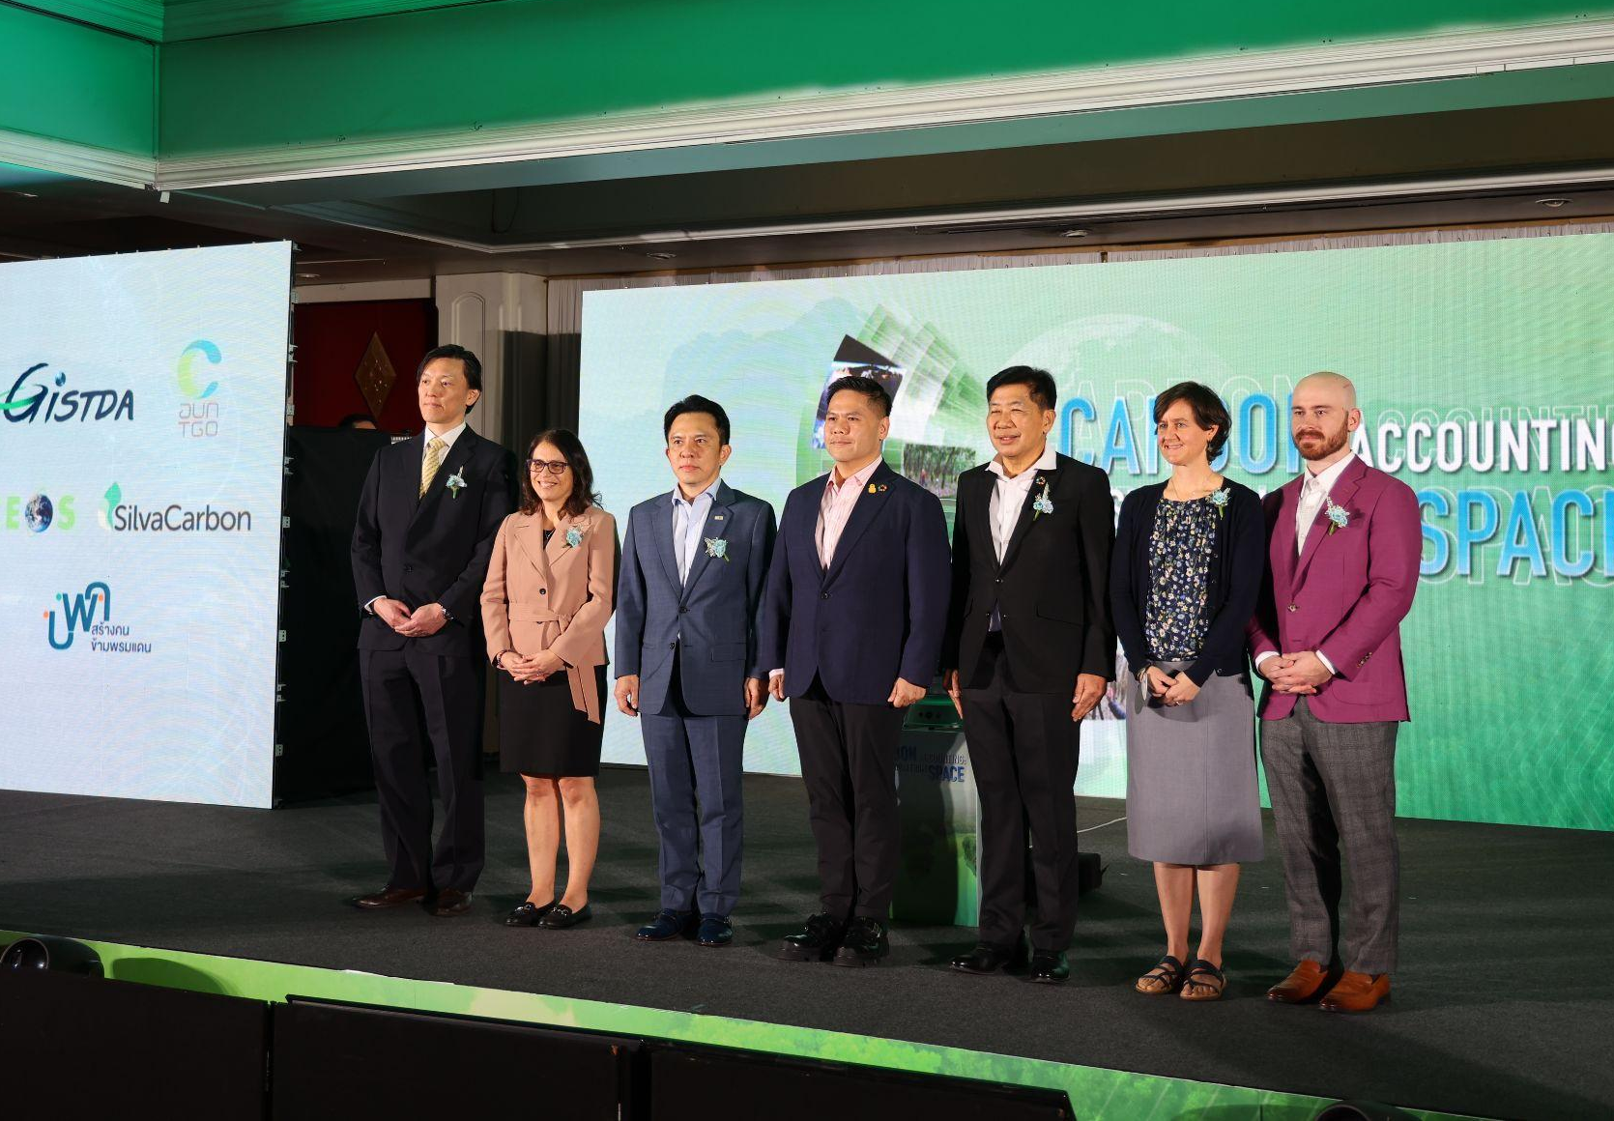
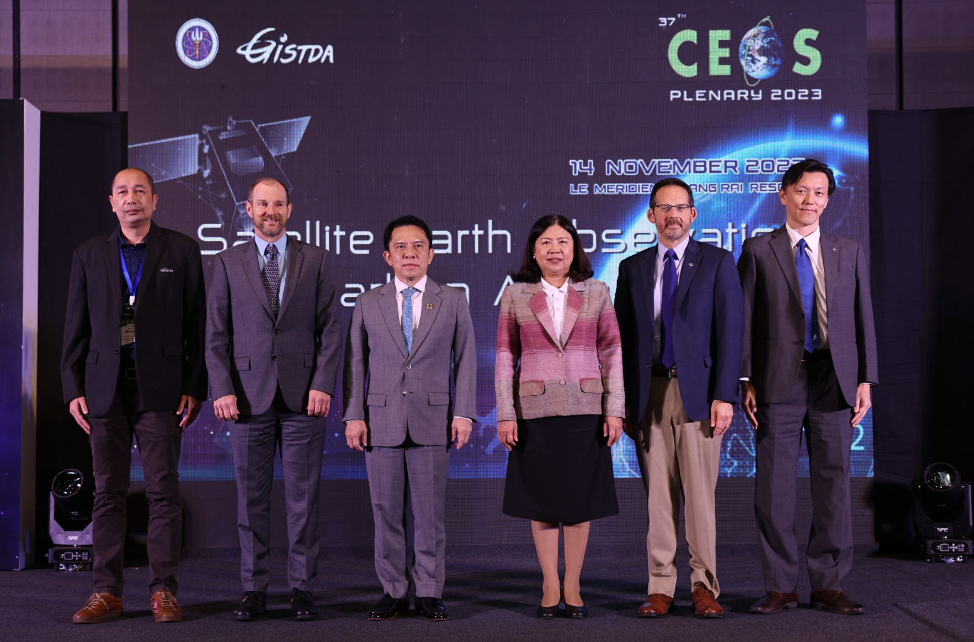
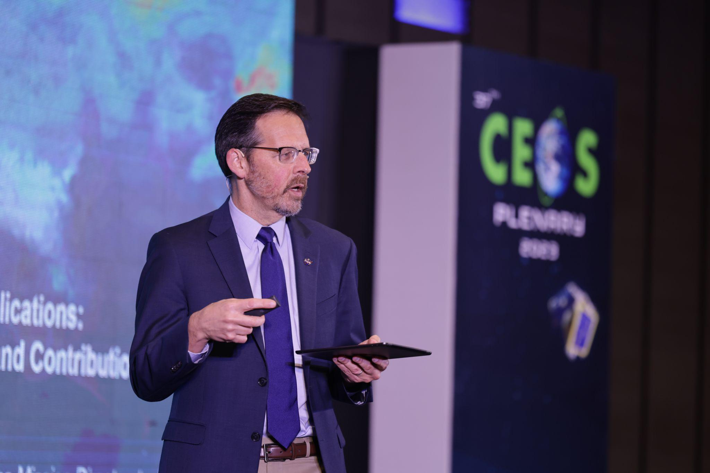
CEOS Chair Activities:
GISTDA SilvaCarbon Workshop 2023
23 February - 3 March 2023, Thailand
Satellite Earth Observation & Carbon Accounting Workshop
14 November 2023, Thailand
Notes:
Bridged the scientific community in all disciplines to be aware of Carbon Accounting with Earth Observation Technology
Organized the forum

Slide 5
CEOS Chair Activities: Global Stocktake
Key outcomes:Key outcomes:
Increase Awareness and Knowledge Sharing for Carbon Accounting from Space
Extensive collaboration and engagement among CEOS Agencies
Available data and methodology for countries’ assessments of their Nationally Determined Contributions (NDCs)
Increase new potential end-users to explore and use EO datasets

Slide 6
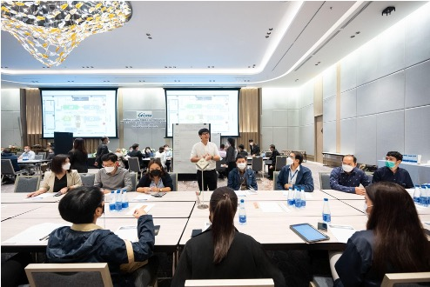
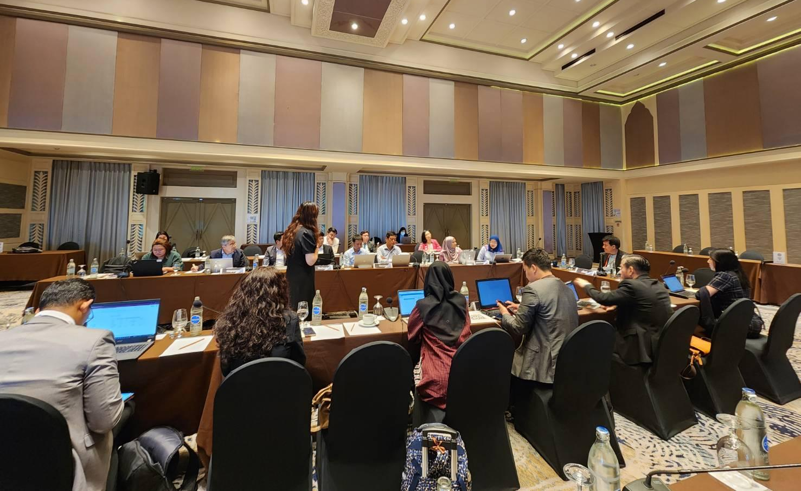
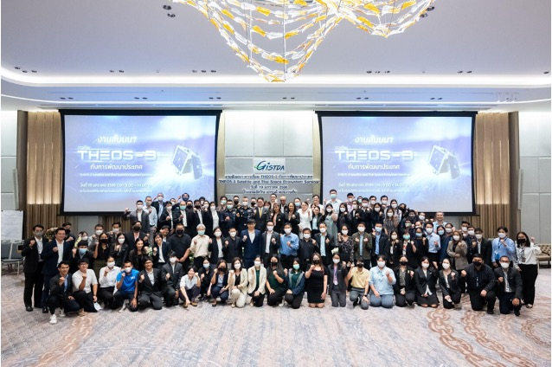
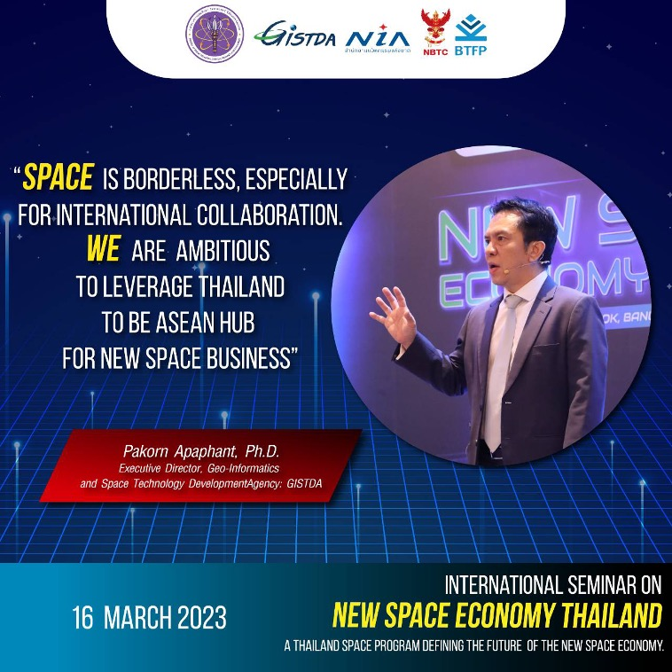
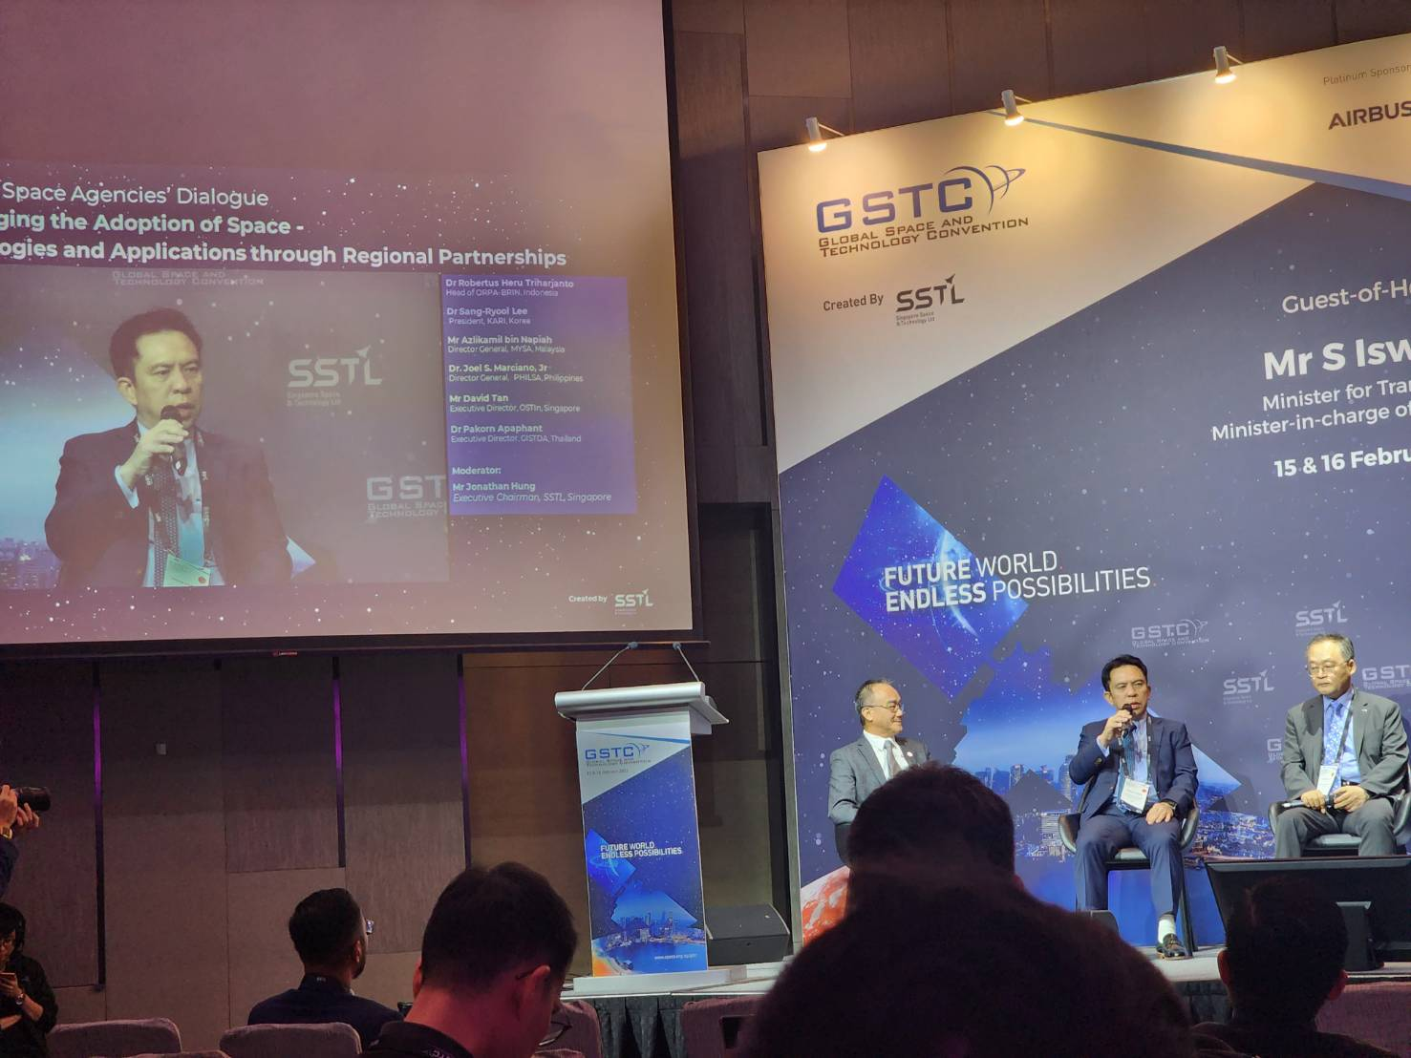
CEOS Chair Activities:
New Space
THEOS-3 Seminar on Thai Space Ecosystem
19 January 2023 in Bangkok, Thailand
Global Space and Technology Convention 2023
15-16 February 2023, Singapore
International Seminar ‘New Space Economy’
16-17 March 2023 in Bangkok, Thailand
ASEAN SCOSA Space Workshop: Observation Gaps
Report
(input for New Space White Paper)
30 May - 1 June 2023 in Thailand
Asia Satellite Business Week
7-9 June 2023 , Singapore
Thailand Space Week
25 - 27 October 2023 in Thailand

Slide 7
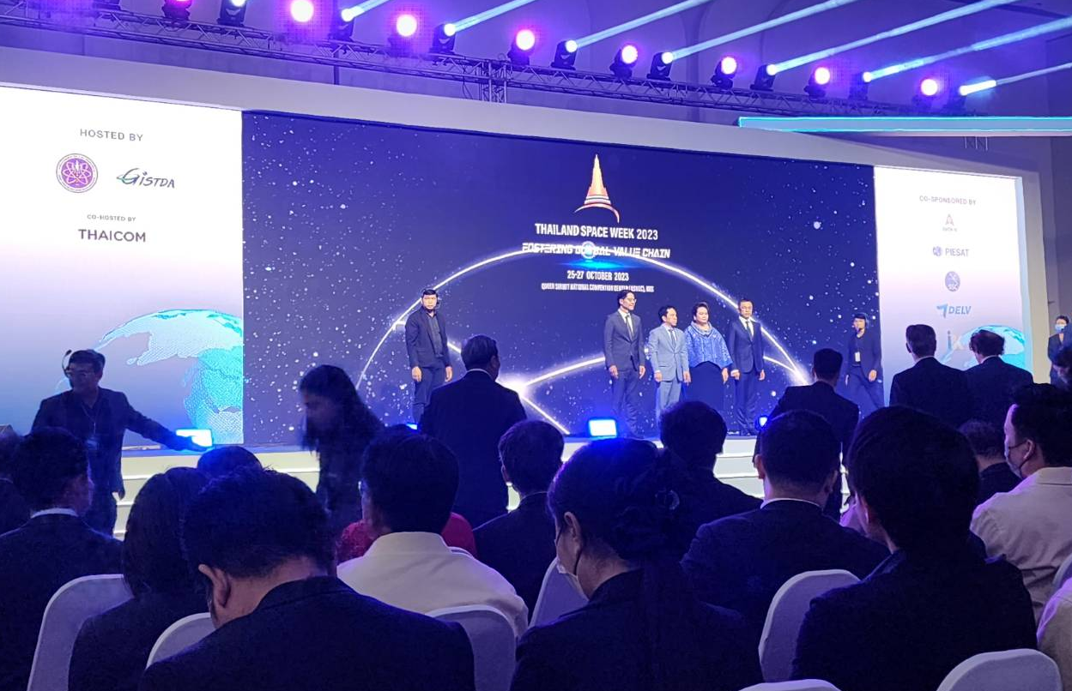
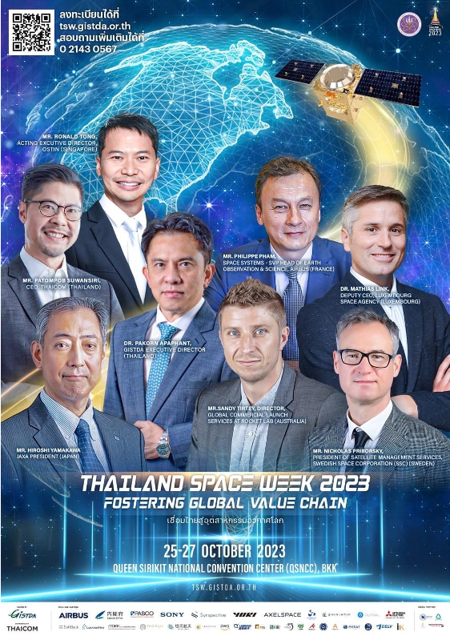
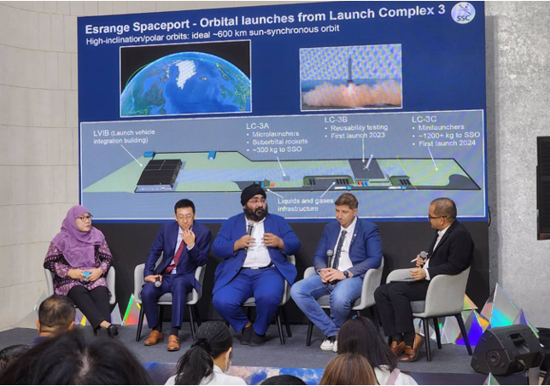
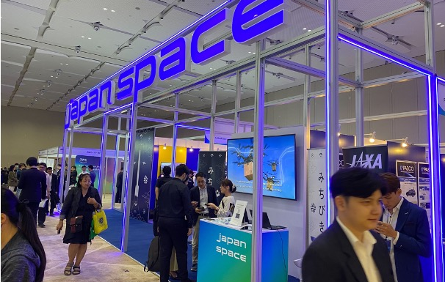
Thailand Space Week
25 - 27 October 2023 in Bangkok
❖ 3,500+ on-site participants
❖ 10,000+ online audience
35 session, 150 speakers from ASEAN and Space Faring nations
❖ New Space support
Business matching and networking opportunities
National space policy and funding
Regional space business showcase
Joint development space project outcome and engagement

Slide 8
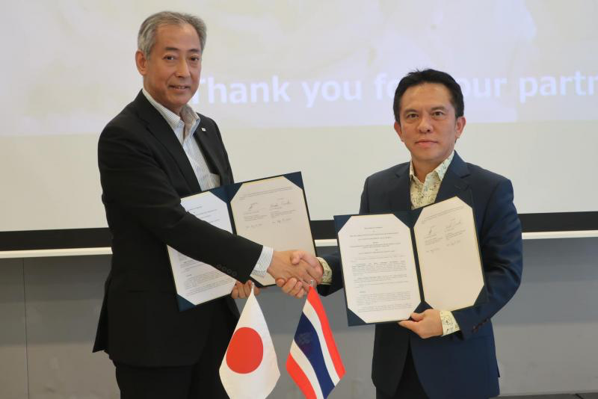
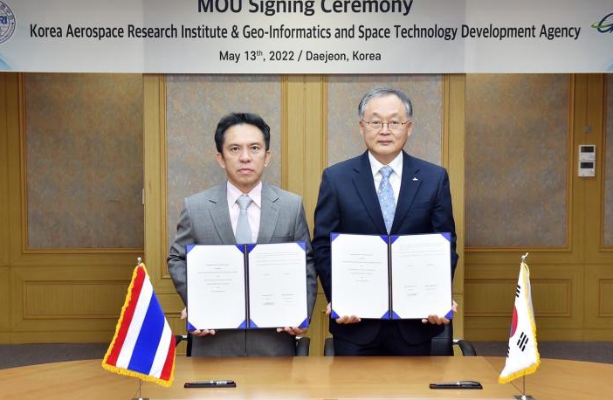
CEOS Chair Activities:
New Space
Key outcomes:
Input for the content of the ‘New Space White Paper’
Collaboration opportunities particularly in the South-East Asia
Increased awareness and understanding of the New Space Economy
Business opportunities from EO data and services
Government and private sectors engagement
Notes:
- support doc / collect info from the region for NEW Space White Paper

Slide 9
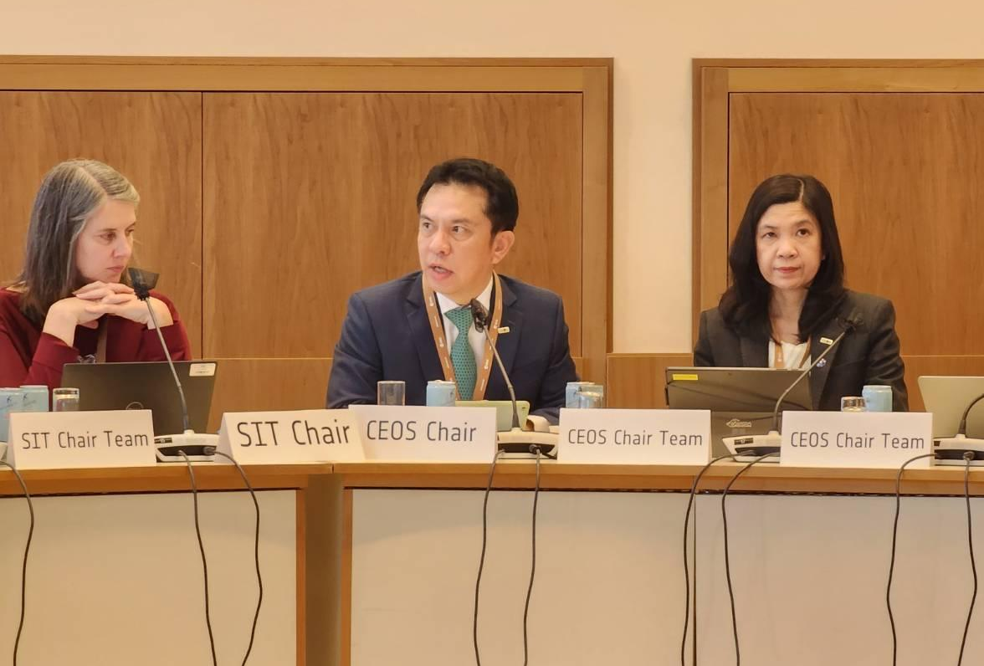
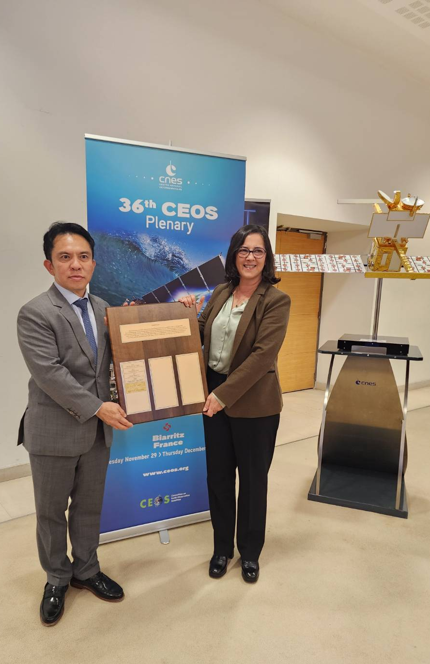
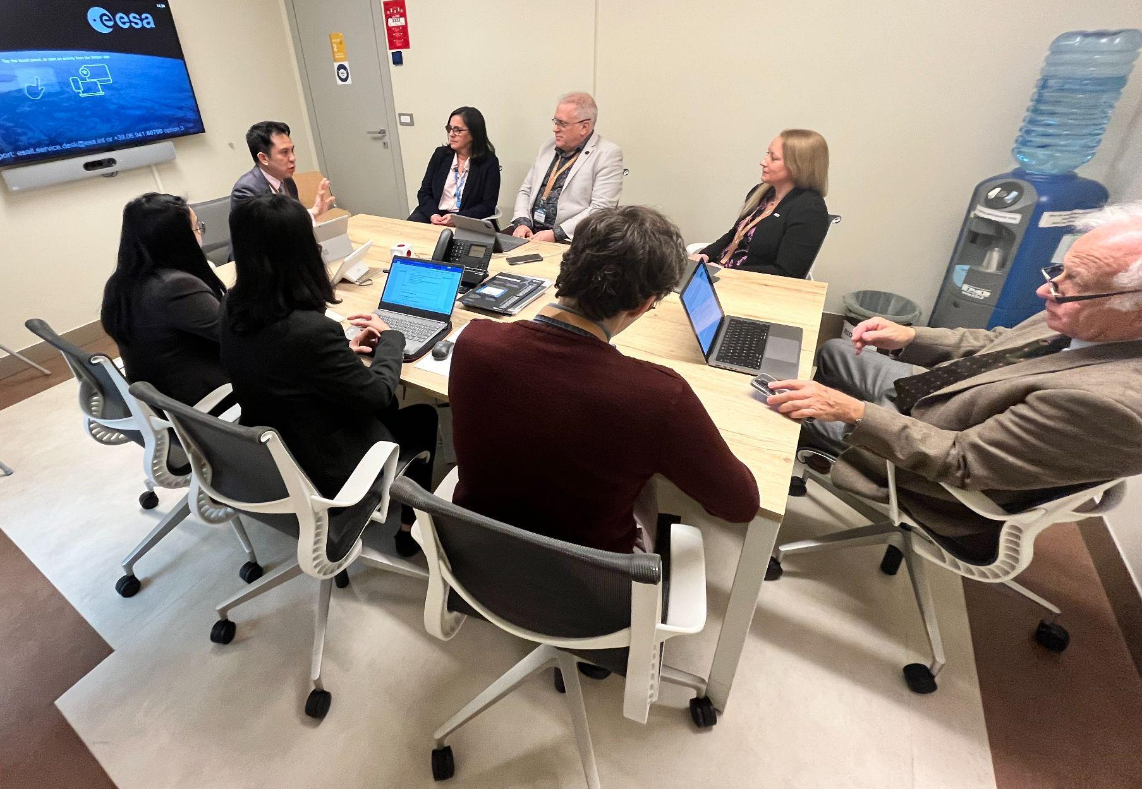
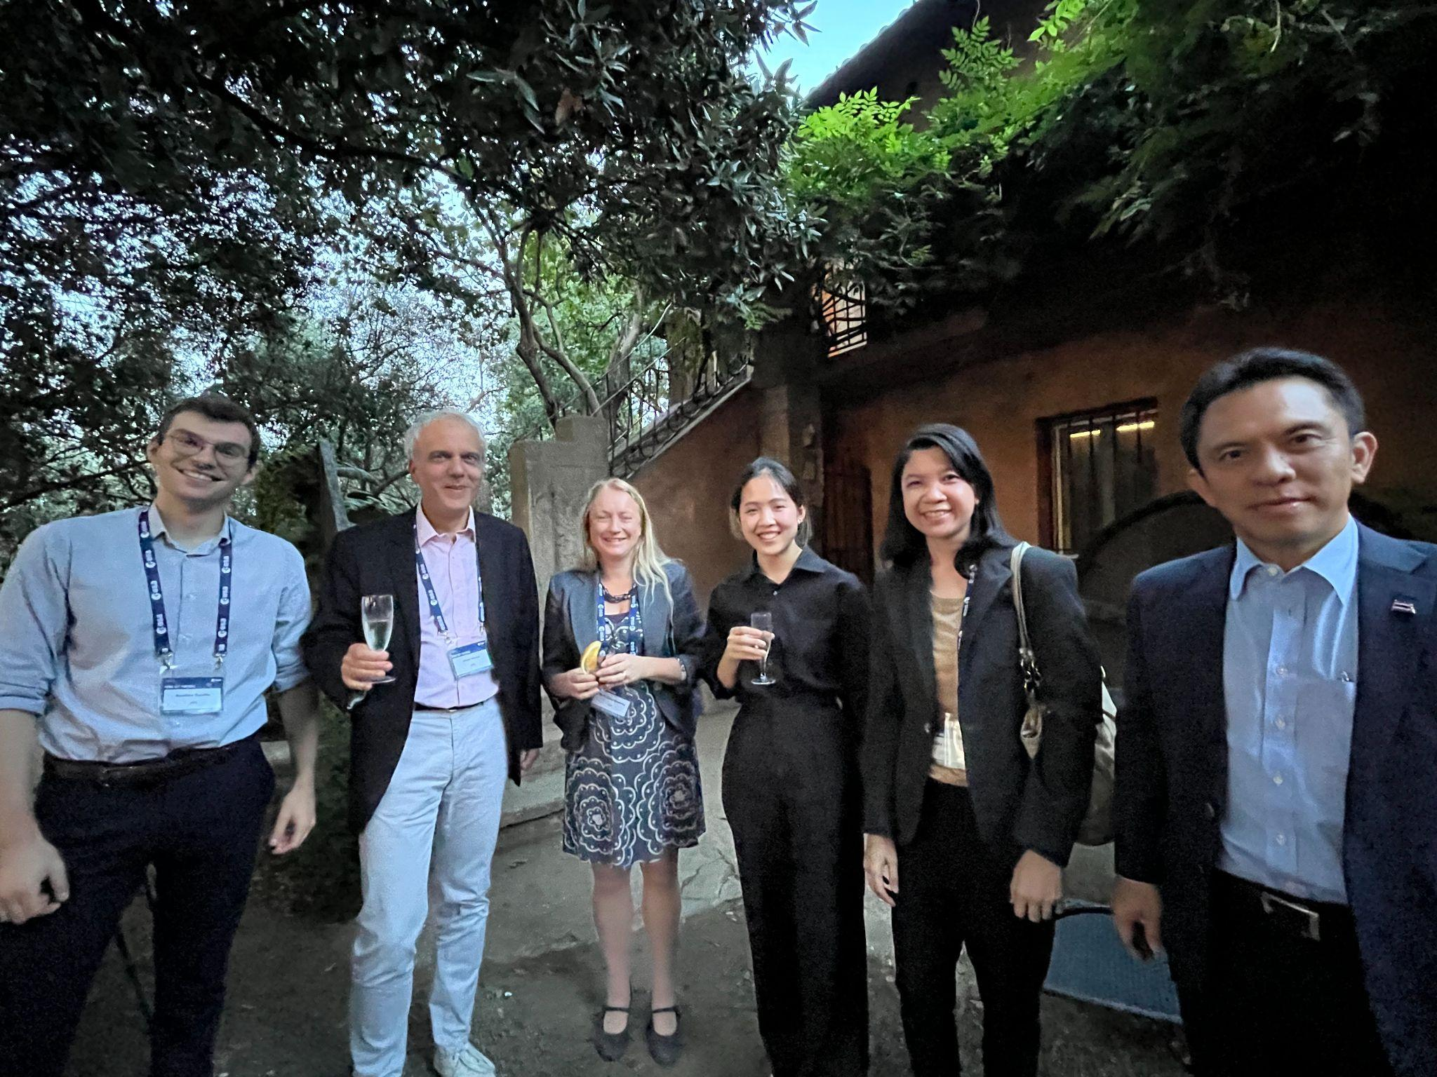
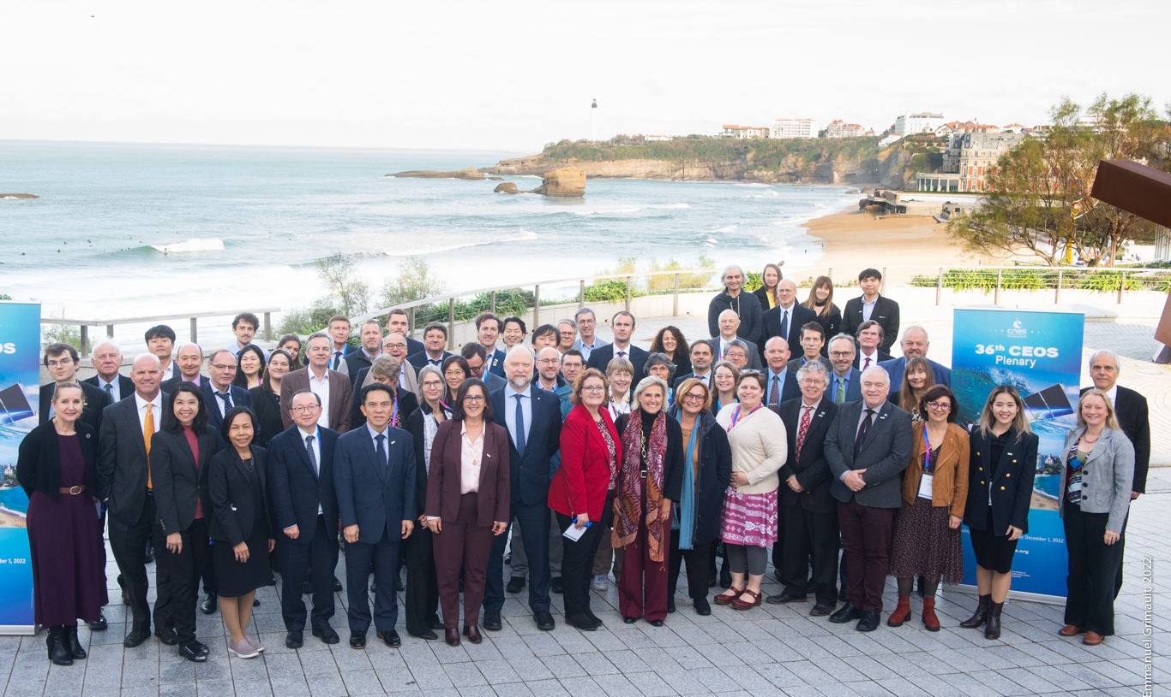
IT HAS BEEN A WONDERFUL YEAR.

Slide 10
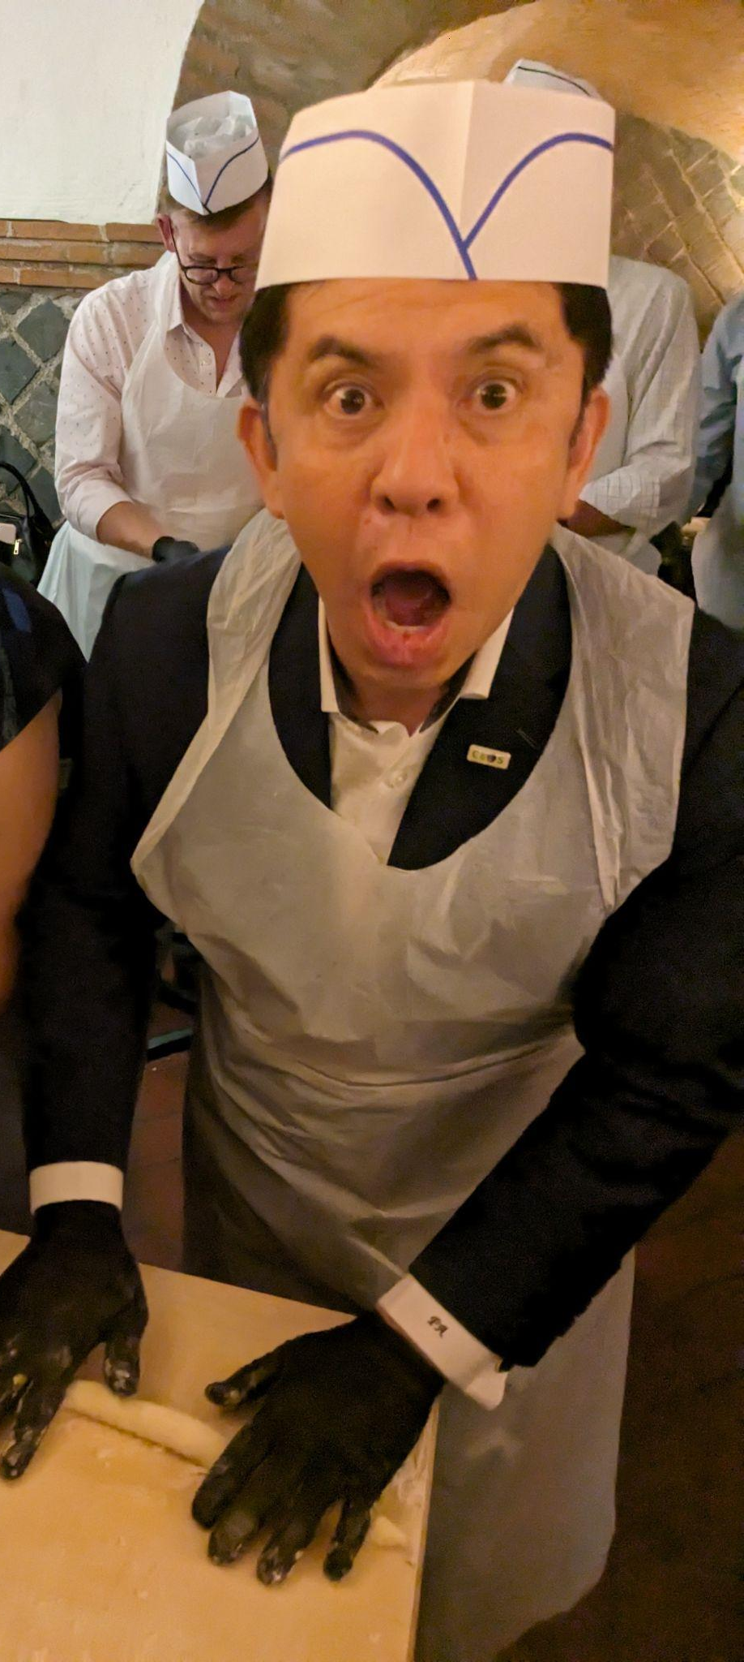
Kawp-Kun-Krub
ขอบคุณครับ

