Slide 1
Canadian Space Agency
2024 CEOS Chair Priorities
Éric Laliberté Canadian Space Agency
Agenda Item #6.2
SIT Technical Workshop 2023
18th - 19th October 2023, ESA/ESRIN

Slide 2
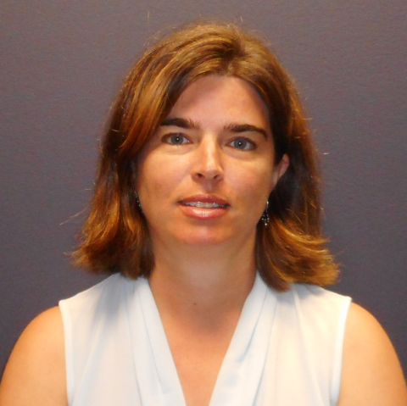
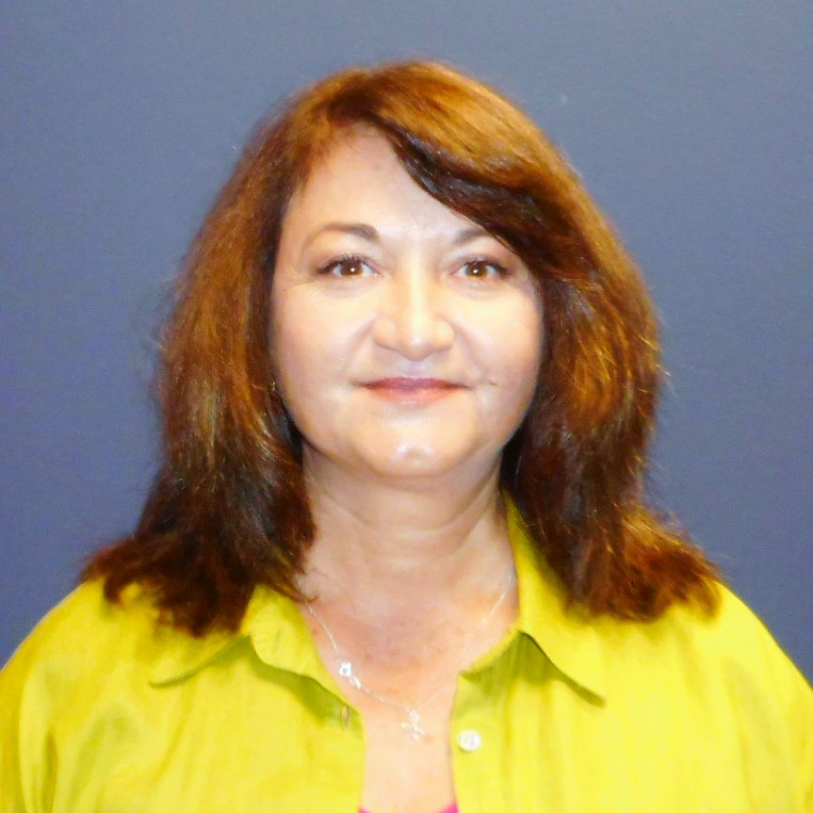
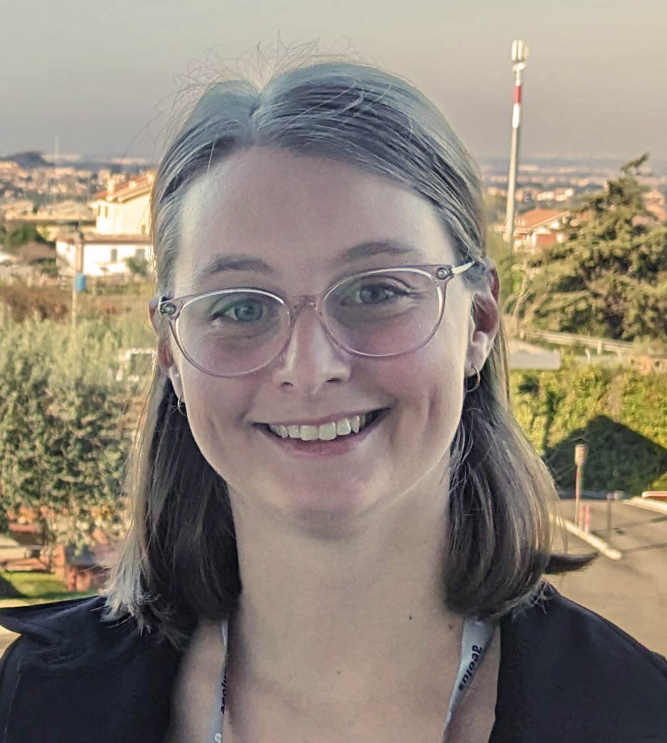
2024 CEOS Chair Team
Éric Laliberté
Frederic Fournier | Lucie Viciano | Carmen Marcu | Matt Steventon | Libby Rose | Stephen Ward

Slide 3
Proposed Theme
CSA will prioritise one headline theme: Biodiversity
“Around 1 million species already face extinction, many within decades, unless action is taken to reduce the intensity of drivers of biodiversity loss.
Without such action, there will be a further acceleration in the global rate of species extinction, which is already at least tens to hundreds of times higher than it has averaged over the past 10 million years”.
– Intergovernmental Science-Policy Platform on Biodiversity and Ecosystem Services (IPBES) Global Assessment Report on Biodiversity and Ecosystem Services

Slide 4
Why Biodiversity?
Biodiversity is a national priority for Canada
Kunming-Montreal Global Biodiversity Framework (GBF) adopted in 2022
In 2022 CEOS established the Ecosystem Extent Task Team (EETT) as a pragmatic and manageable aspect of the biodiversity area for initial focus by CEOS.
Clearly a lot of interest in the CEOS community
CEOS and agencies should be ready to assist with the biodiversity indicators.
Co-location of CSA and UN CBD is an opportunity for closer engagement.
Seek to establish by end of 2024 a concrete plan for the future of CEOS and biodiversity.

Slide 5
A Complex Space
There are numerous biodiversity activities, programmes, organisations…
How does CEOS best engage and how do we connect the dots?
Scoping and leveraging is critical!
Various angles: Ecosystem Extent, Composition and Condition, Ecosystem Accounting, (+ genetics, species)
Targets
EBVs
Indicators
GBiOS

Slide 6
CEOS Agencies are Active!
The CSA team has held many consultation calls with agencies over the past month – thank you all!
Aim was to understand which agencies are active in biodiversity, what they are doing, and how we might make connections
NOAA: Marine focus, Marine BON, potential connection to COAST, Coastwatch Seascapes, Coral Reef Watch, IUU fishing, National Marine Sanctuaries, ecosystem accounting connections,
ESA: History with GEO BON, EBVs, workshops, Copernicus, ESA science goals
SANSA: Strong policy connections in South Africa, South African National Biodiversity Institution, Digital Earth Africa, Forestry, Invasive Species, EO Dashboards goal
JAXA: Providing data for EETT demonstrators, long mangrove / Ramsar / Global Mangrove Watch history
ISRO: Pilots on ecosystems in himalayan alps, mangrove areas, and coral reefs; working towards generation of EBVs for official reporting
NSO: Issuing three open calls for biodiversity projects (Nature, Agriculture, Water,), EO planned for Dutch statistics office, strong demonstrator potential
USGS: Co-leading EETT (Roger Sayre), GEO Ecosystem Atlas activity, Silvacarbon, GFOI
DLR: Supporting German Ministries, Biodiversity MOOC suggestion, EnMAP applications and indicators, EETT support
CSIRO & GA: CSIRO co-leading EETT, Australian (WA) demonstrator; TERN (Terrestrial Ecosystem Research Network) and AusCalVal linkages noted; wildfire recovery interest;

Slide 7
Biodiversity Priorities
Priority #1
(Internal)
Exploring a Post-2024 Strategy for CEOS and Biodiversity
Priority #2
(External)
Increase Policy Footing and Linkages to the Biodiversity Community
Paper available here

Slide 8
Priority #1: Exploring a Post-2024 Strategy for CEOS and Biodiversity
Inward-looking, CEOS organisation focus
Overall aim is to reach CEOS Plenary 2024 for a well-informed discussion on potential CEOS commitment to a broader biodiversity strategy
Work with the EETT on implementation of white paper, recommendations, and support demonstrators
Identify potential future CEOS Work Plan tasks on biodiversity
Achieve a strong understanding of CEOS Agencies’ biodiversity activities, datasets, and investments
Explore the appropriate organisational structure for any continued effort on biodiversity in CEOS
Seek to strengthen the pool of biodiversity expertise available to CEOS
Articulate the fundamental reasons for the topic of biodiversity to figure more prominently in the spectrum of CEOS activities

Slide 9
Priority #2: Increase Policy Footing and Linkages to the Biodiversity Community
Engagement with biodiversity community and key stakeholders
Reflect on past UN CBD communication with CEOS
Seek to establish more formal ties between CEOS and the UN CBD Secretariat, UN System of Environmental-Economic Accounting (SEEA) and the Group on Earth Observations Biodiversity Observation Network (GEO BON), IPBES; Explore the potential of a collaborative biodiversity agenda
Consider how CEOS might connect to the Global Biodiversity Observing System (GBiOS) and Global Ecosystems Atlas activities under GEO
Establish a strong understanding across CEOS of the major policy drivers for biodiversity.
Gather user requirements for this domain to inform how CEOS can most effectively contribute.
Raise the profile of CEOS in the biodiversity community and amongst policymakers
Increase the visibility of EO’s potential contribution to biodiversity and the Global Biodiversity Framework (GBF).

Slide 10
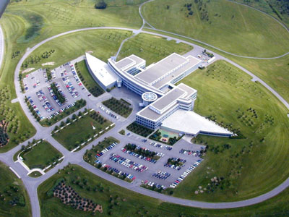
CEOS Plenary 2024
22-24 October 2024
CSA HQ
More info to come…
In the meantime, please save the dates!

Slide 11
Thank you!
Any questions?

