Slide 1
SIT Chair 2022-23
Term Report
Simonetta Cheli, ESA
Agenda Item 14.2
2023 CEOS Plenary
15-16 November 2023, Chiang Rai

Slide 2
SIT Term Priorities - recap
WHAT did we want to do?
Focus on global challenges with strong UN mandates, GEO support, and high relevance for satellite EO
HOW did we want to do it?
Exploration of how CEOS could employ new geometries with industry, new missions, and new data and analysis techniques for maximum impact and continued relevance in a changing sector

Slide 3
Thematic Priorities
Strong UN mandates, GEO support, and high relevance for EO
Climate & Carbon (UNFCCC, Paris Agreement and the GST)
Sustainable Development Goals (2030 Agenda)
Disaster Risk Reduction (Sendai Framework)
Track the emerging (4th) GEO priority
Resilient Cities & Human Settlements (New Urban Agenda 2016, SDG #11)
Ensure support for ongoing CEOS thematic observing strategies including Ocean domain with COVERAGE, COAST and our VCs (e.g. GEO Blue Planet & SDG 14.1 eutrophication)
Outcome-focused term with SIT and TW agendas designed to support the 2-year targets
Success in these thematic priorities aimed to translate into opportunities for engaging new users not familiar with EO from space on the above, and other, themes
Notes:
Potential future users: international, regional and national organisations such as UN agencies (incl. SDG Indicator Custodian Agencies), National Statistical Offices, and the Financial Institutions (e.g. World Bank)

Slide 4
Thematic Priorities
Improve CEOS support to global challenges with 3 lines of action:
New geometries for space agencies and CEOS with New Space companies
New mission needs and users
New data techniques

Slide 5
SIT Chair priorities …

Slide 6
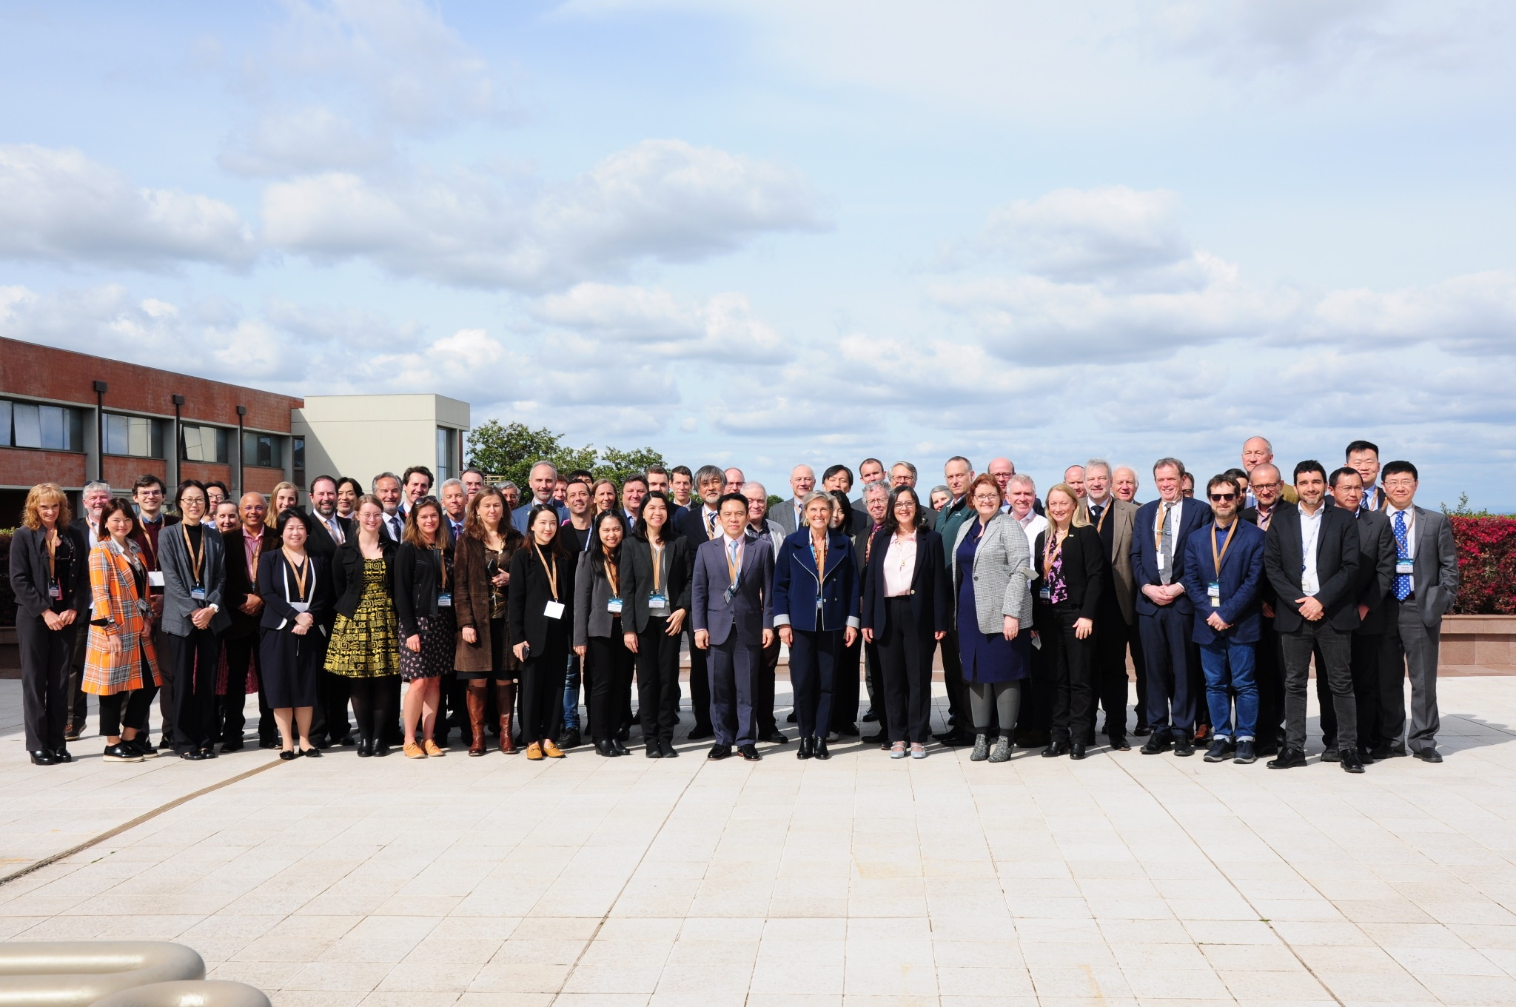
2022-23 meetings
SIT-37, Mar 2022 - virtual (our final pandemic WebEx meeting)
SIT-TW, Sep 2022 - ESRIN (the first face-to-face since 2019!)
SIT-38, Mar 2023 - ESRIN
SIT-TW, Oct 2023 - ESRIN

Slide 7
Significant activities and progress
Climate & Carbon
SIT team supported the JAXA, ESA, NASA leads within LSI-VC for the CEOS AFOLU Roadmap completion
Thanks to NASA/Ben Poulter for taking on lead author role in 2022
AFOLU Roadmap, after 2-3 years effort, is brought to this Plenary for endorsement
Seeks to ensure that every country has the land satellite data required to report to UNFCCC under IPCC guidance
Provides a roadmap for space agencies to keep up with needs
Actions supplement proposed by SIT Chair for ease of tracking
A BIG THANKS to all within LSI-VC who have contributed

Slide 8
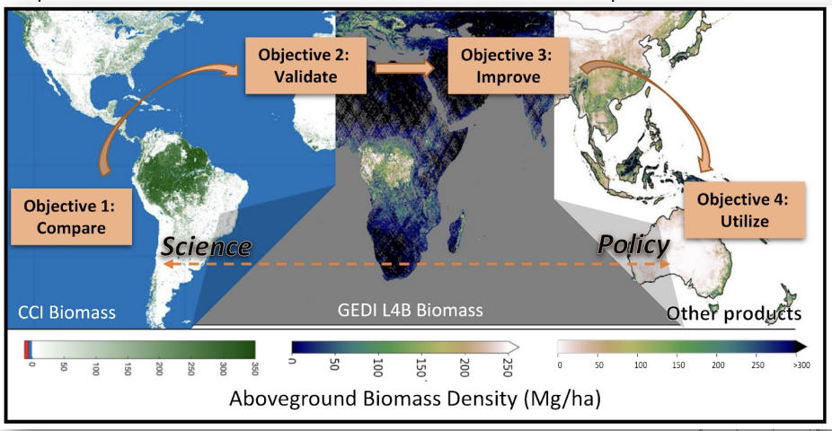
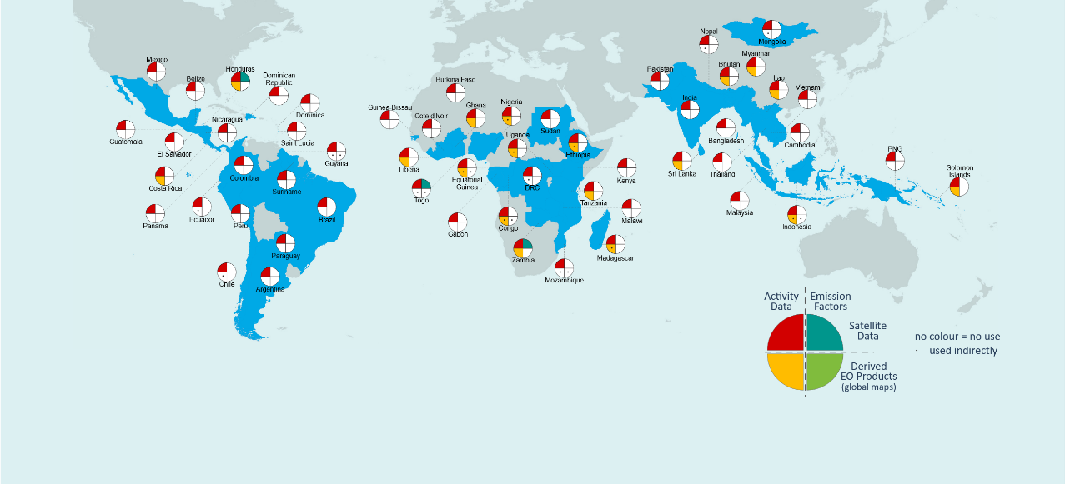
Significant activities and progress
Climate & Carbon
Biomass harmonisation group doing excellent work to address user perspectives and uptake of CEOS data for impact
SIT Chair Team promoted closer integration of in-country work (SilvaCarbon) with our work plan items like AFOLU
Ensured exposure for the important research work (e.g. Melo et al) on changes needed to improve uptake of our datasets
JAXA SIT Chair Team will continue addressing through SE Asia in-country case study
NASA has a 3-year study grant on these issues

Slide 9
Significant activities and progress
Climate & Carbon
UNFCCC SEC active participation in 2022-23 CEOS mtgs
GST Process and Systematic Observations Synthesis Report developed - with extensive CEOS input
OCR-VC supported through process of bringing proposal for Aquatic Carbon Roadmap to Plenary
GEO-TREES supported to secure req’d assistance
SIT Chair stewards the CEOS GST Strategy Actions and these are serving us well
CEOS GST Data Portal updated in 2023 with new and updated datasets
ESA contribution of the EO Handbook 2023 - Space Data for the Global Stocktake

Slide 10
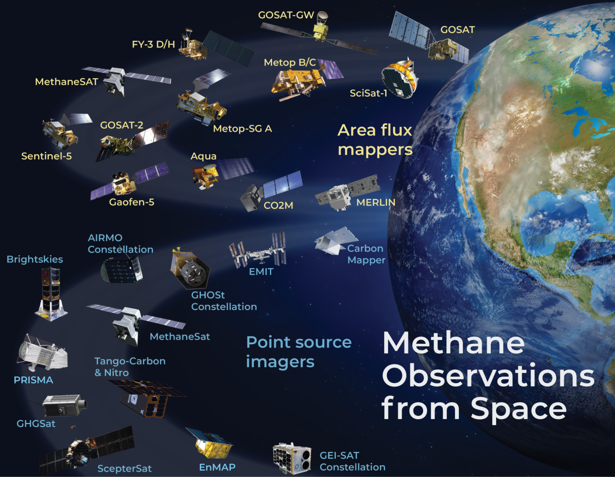
Significant activities and progress
GHG Roadmap and Coordination
ESA volunteered Yasjka Meijer to take over from Mark Dowell (thanks to both!)
SIT team coordinated CEOS participation and engagement in the CEOS-IMEO workshop at Harvard in June
A potential model for public and new space interaction via a neutral 3rd party
IMEO Roadmap & cooperation continues
GHG TT is supporting WMO in developing the Implementation Plan for its intended Global Greenhouse Gas Watch
ESA and JAXA teams jointly supported the new GHG Satellite Mission Portal powered by the CEOS MIM
Includes public, private, NGO missions
ceos.org/ghg
thanks to GHG TT specialists

Slide 11
Significant activities and progress
Sustainable Development Goals
SDG Coordination Group established at 35th Plenary (2021) and led by SIT Chair and SEO for respectively the Strategy and the Implementation.
GEO Work Programme provides CEOS with one efficient way to work on specific SDG Targets / Indicators.
CEOS is represented by SIT Chair and CEO at GEO Programme Board and at GEO Executive Committee.

Slide 12
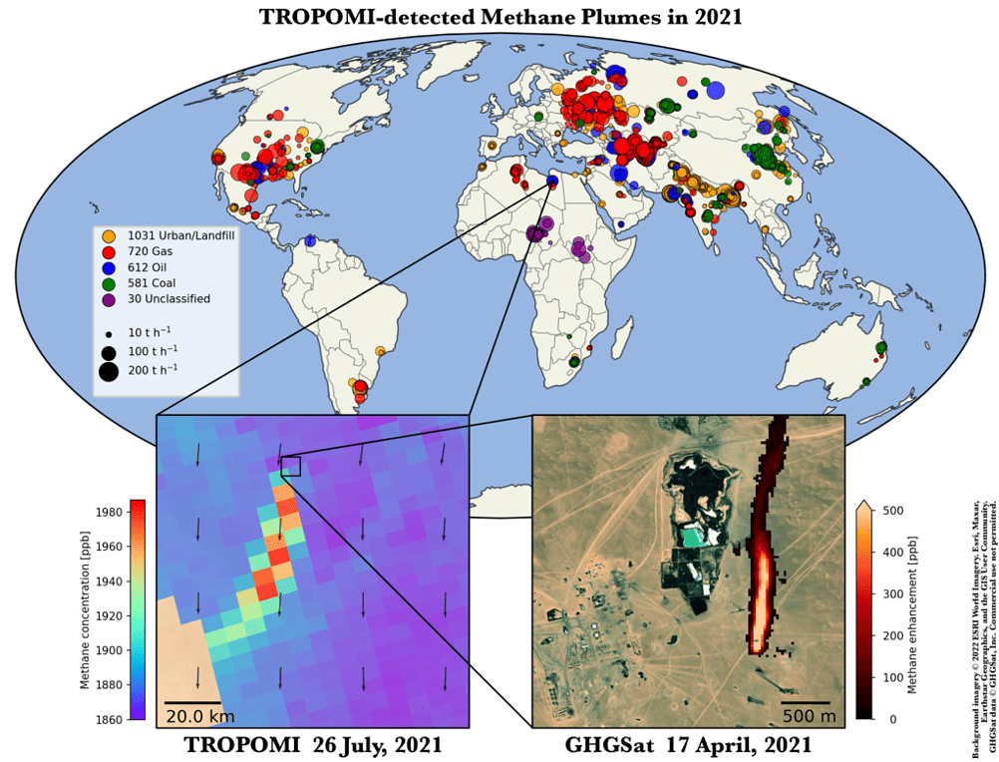
Significant activities and progress
New Space
21 CEOS agencies represented in the New Space Task team led by SIT Chair during the term
Significant exchange of experience and views
White paper and recommendations for Plenary endorsement
Methane Emissions Detection: an example of successful Public-New Space partnership
IMEO-brokered engagement with NS companies a nice model for cooperation
Best practices work within GHG TT as ‘proactive defence’ of public space capabilities and getting more clarity for NS performance claims

Slide 13
Significant activities and progress
Shepherding CEOS-ARD via SIT Chair appointment of CEOS-ARD Oversight Group lead, Ferran Gascon – who will continue in JAXA term.
Ocean Coordination Group: the SIT Chair team lead the Ocean Coordination Group during the whole year 2022.
SIT Chair provided a report at 2022 CEOS Plenary that lead to the one-year extension of the Ocean Coordination Group
After the 2022 plenary, NOAA (Paul DiGiacomo) kindly accepted to take the leadership of the group
Virtual Constellations: during its 2-year term, the SIT Chair Team supervised the activities of the VCs as reported in 8.1

Slide 14
A SIT Chair term of many contributors
The SIT Chair priorities would not to have been successfully achieved without the resources allocated by the CEOS agencies - thank you !
Thanks to all in the ESA team and across CEOS working teams and agencies who contributed to the success and outputs of the term
Our subject champions were instrumental to the achievements - you know who you are!
Excellent cooperation with the CEOS Chairs during our term and very good transition with Australia as former SIT Chair
Good luck to JAXA and thanks for the intensive consultation processes undertaken to ensure continuity and clear purpose

Slide 15
Thank you!

