Slide 1
37th CEOS Plenary
Change of approach in Indian Earth Observations
Rajeev Jaiswal, ISRO
Agenda Item 13#
37th CEOS Plenary
15 - 16 November 2023
Chiang Rai, Thailand
Hosted by GISTDA

Slide 2
Reforms in Indian Space Sector
Union Cabinet approval for Space Sector Reforms: 24th June 2020
Space Activities by Private Industry
Authorization
Handholding
Promotion
Opening up of India’s Space Sector
‘Demand’ based approach by NSIL
NSIL to own operational satellites/launchers
Announcements of Opportunity for Private Industries

Slide 3
User demand aggregation for demand driven satellites
Change of approach from supply based model to demand based model,
Justification for the satellites, associated ground segment, applications and their utilization need to be driven and ensured by the end-users
Assessing advantages of satellite based services, including economic benefits.
Emphasizing on quality and timely delivery of services.
Operationalisation of applications at user end and transfer to industry after maturity

Slide 4
Mechanism for Aggregating Requirements and Funding
Funding through User Ministries/ Departments to ensure commitment towards optimal data utilization
Aggregating User Requirements (ISRO)
Space Commission
Demand from User Dept. (SAMS mechanism)
Funding through User Department
Launching by ISRO
Funding through DOS budget
Data Provided directly to Users (Ownership User Dept.)
Launching by ISRO / NSIL
Providing Data & Services (Ownership DOS)
Paradigm Shift
Supply driven model
Demand driven model

Slide 5
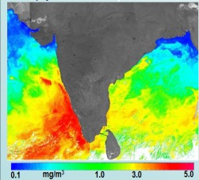
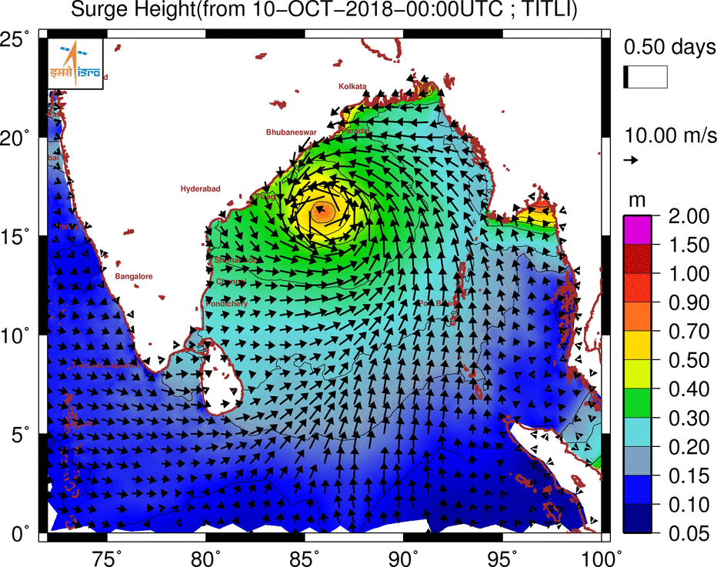
Indian EO : Recent Demand Driven Missions
EOS-6 (Nov 2022)
EOS-04 (Feb 2022)
Frequency | C-band (5.35 GHz) Single, Dual & Circular (Hybrid)
Modes | Strip map, CRS, MRS, Spotlight
Resolution | 3 to 6 m, 25 m, 50 m
Swath | 10 km to 240 km
Incidence Angles | 20° – 49°
Repetivity | 25 days - 240 km swath systematic
Orbit | 536 km ; ECT: 6:00 Hrs
Ocean Color, SST & Winds
Orbit | Sun synchronous
ECT | 12:00 Hrs
Payloads | OCM (13 bands: 407 to 1020 nm) : 360 m Scatterometer-3 (Ku Band - 13.51GHz) SSTM-1 (2 Bands: 11 &12 µm) : 1080 m
Draped DEM
Day/Night/ All weather imaging
Continuity to RISAT-1 Mission

Slide 6
Indian Space Policy 2023: Opening of Indian Space potential
Ease-of-doing business
Utilization of DOS facilities
Single window
Ensure safety and security
Easy access to RS data
NGE is encouraged for :
Building rockets and satellites
Launching owning and operating space assets
Delivering commercial services
Co-own technologies with ISRO
EO data acquisition and dissemination
Arms of the Government of India for enabling
Space research, technology development & enabling industries, Scientific missions
Commercial exploitation of space technology
Regulate, Handhold & Promote Industry

Slide 7
Free and Open access of EO data
Probably first in the world policy - IRS data having 5m and higher spatial resolution are made available on ‘free and open’ basis to all, through Bhoonidhi portal.
Any resolution IRS Data (produced using public funds) - “free of any charges” to Government agencies.
All archived IRS satellite data & satellite derived thematic data shall be made available on ‘free and open basis’.

Slide 8
Commercial EO data dissemination
IN-SPACe will act as single window clearance for all Space Based Applications to Non-Governmental Indian Entities and Government.
Authorisation to Indian Entity for Remote Sensing data dissemination
NSIL to do commercialization of public funded satellite - IRS data sale
Free and transparent price for NGEs and international users of IRS data of <5m resolution
Any other IRS data services of commercial nature, any resolution (value added data)
NGEs
Satellite data provider will be free to decide their data price as per market force.

Slide 9
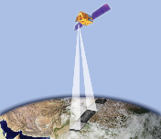
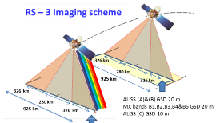
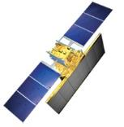
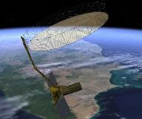
Upcoming Earth Observation Missions
Next Generation Resourcesat
High resolution Stereo
High Res Sat
Constellation
RISAT-1B
Wide Swath imaging with improved spatial resolution
All-weather;
Day & Night Imaging
Daily re-visit of Area of Interest
Concurrent Stereo & MX imaging
L & S Band SAR
High res. TIR & VSNIR
Oceansat-3 Series (constellation)
Met. Observation
All-weather;
Day & Night Imaging
Ocean Color & Wind vector – Continuity + SST
Continuity & Next Generation
Thermal Imaging

Slide 10
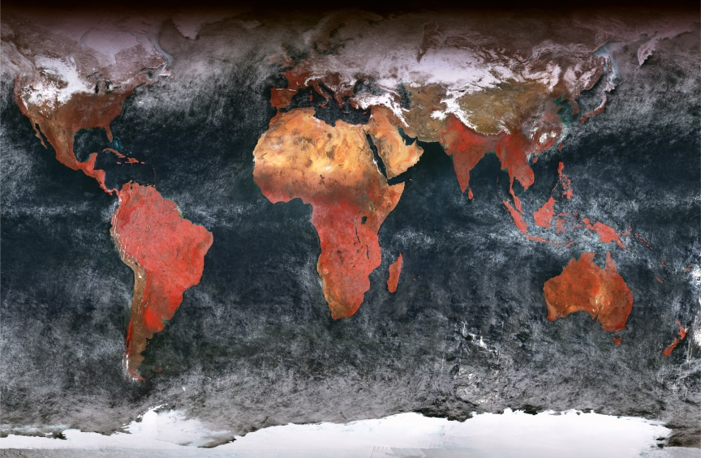
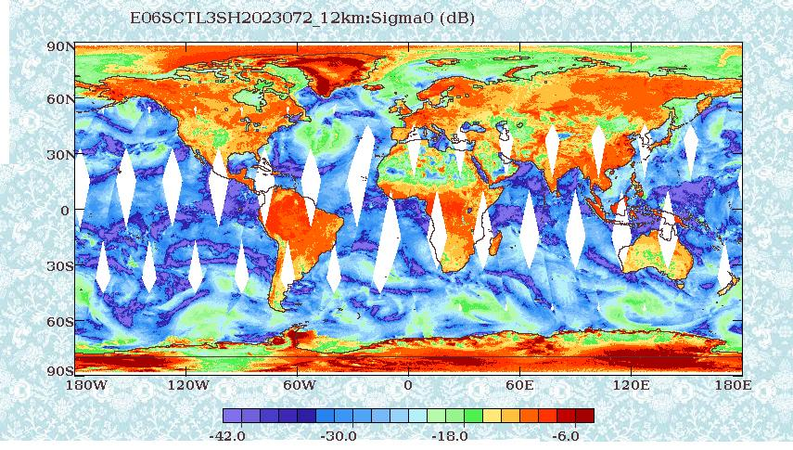
EOS-06 (Oceansat-3)
2 days full Global data at 1 km resolution (systematic coverage)
2 days Local area coverage at 360 m resolution
OCM – Global Area Coverage
SCAT
Data is made available through Bhoonidhi
Data within 180 min for SCATSAT & OCM < 1 hr
Emergency planning within 8-10 hr and products in 1 hr
Scatterometer-3 nominal mode provides 12.5 X 12.5 km grid for wind vector and high resolution mode provides 5 X 5 km grid size (experimental)

Slide 11
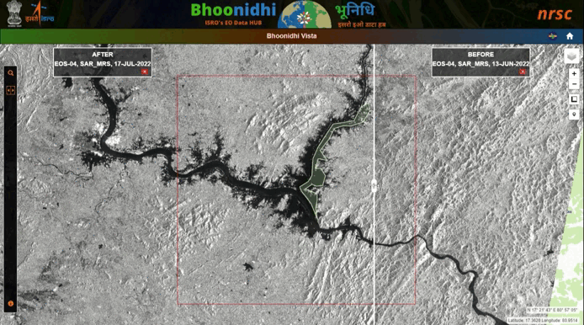
Comparison-Godavari Floods in July 2022 - EOS-04 SAR-MRS
BHOONIDHI – Visualization tool
Indian EO Data Hub
Search, View, Add to Cart, Place work order, Download…
Similar to Sentinel Data Hub/ USGS Earth Explorer...
Data can be visualized through Bhoonidhi – VISTA@ www.nrsc.gov.in

Slide 12
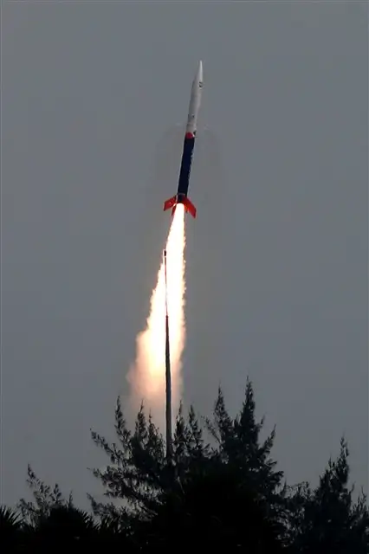
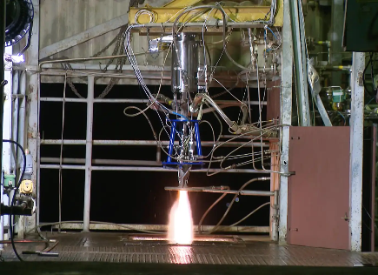
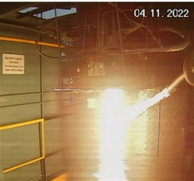
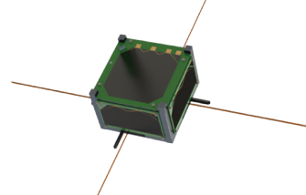
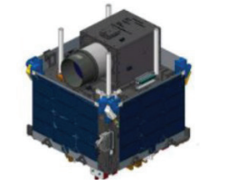
Private Sector in Space Activities
18.11.2022
Launch Vehicles
450+ MSMEs, 50+ Large Enterprises, 100+ Start-ups
Sub-orbital flight
PSLV
LVM3
SSLV
Successful rocket-engine test by Skyroot Aerospace at ISRO facility
Vikram-S
Offloading Production to Industries
Hyperspectral Small Satellites
First launch of launch vehicle built by a private company in India; Skyroot Aerospace
Satellites by Industry
Satellite Bus Technology Transfer
Thybolt
ANAND
Communication payload
Semi-cryo Engine test
Geospatial Decision Support
Agnikul Cosmos
Dhruvaspace
Pixxel
Alpha Design

Slide 13
Thank You
rajeev@isro.gov.in

