Slide 1
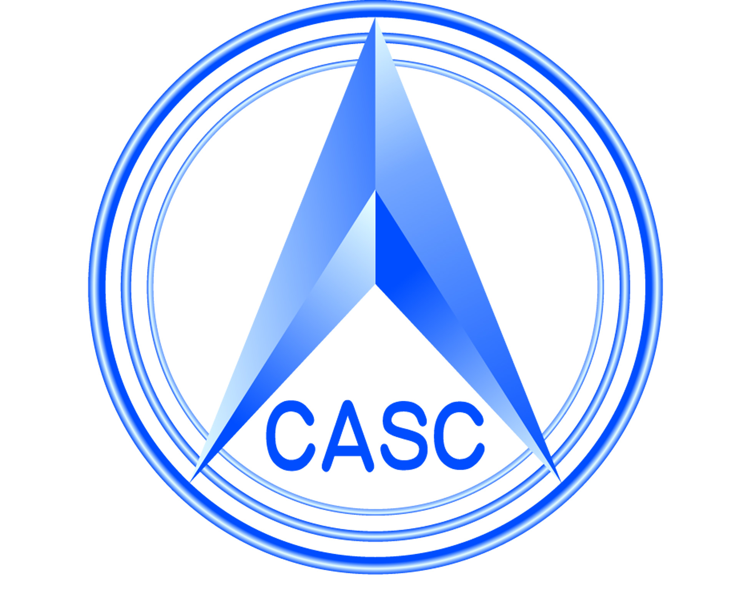
System Design and Application of High Resolution Multimode Imaging Satellite
FAN Lijia, DAI Jun
China Academy of Space Technology（CAST）

Slide 2
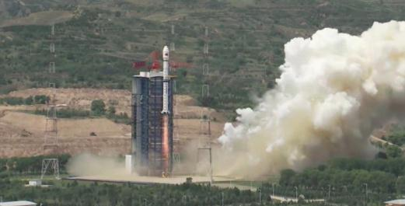
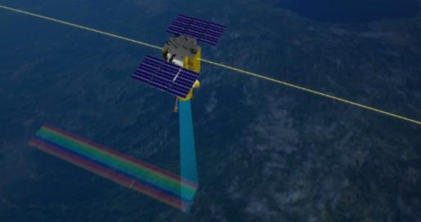
1. Introduction
High Resolution Multi-mode Imaging Satellite（HRMIS）
Developed by CAST.
The overall objective is to meet the growing demand for high-resolution satellite imagery.
Launched on July , 2020 by the Long March 4B (CZ-4B).

Slide 3
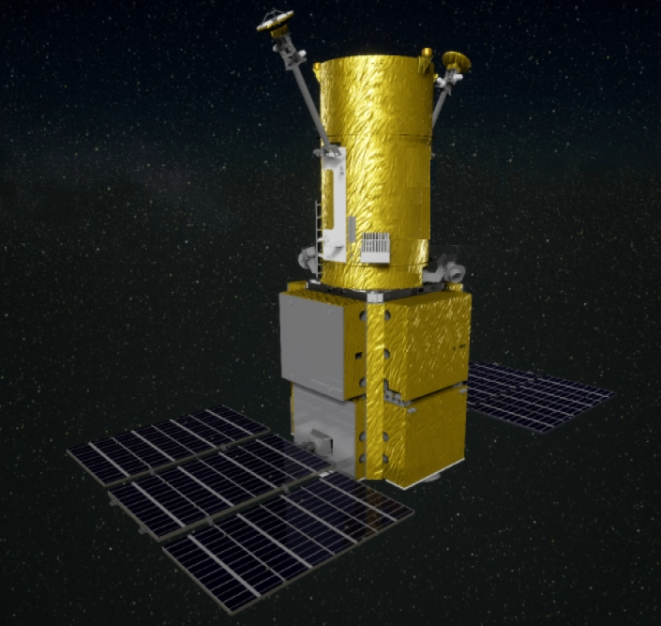
2. System Design of the Satellite
System Schemes
Orbit：SSO，10:30 AM LTDN
Lanunch Mass：2400kg
Payload: High Resolution Camera(HRC)、 Synchronous Monitoring Atmospheric Corrector(SMAC)
Collection Scenarios：Multiple collections 、Strip Mapping over large areas、Stereo and Tristereo Acquisition and Corridor Acquisition over linear targets
Platform：
Attitude ：3-axis stabilized
High agility：CMG assembly for actuation
Data transmission：X band，2×800Mbps
SMAC
HRC
Platform

Slide 4
2. System Design of the Satellite
Payload
High Resolution Camera:
Optical System: Three mirror coaxial optical system
Spatial resolution at nadir: Pan 0.5m, MS 2m
Swath width: 15 km
Band Name
Wavelength(nm)
Synchronous Monitoring Atmospheric Corrector (SMAC)：
Spectral Band
Optical System: Dual lens optical system
Spatial resolution: 8km
Swath width: 16 km
8 Bands (nm) | Polarization | channel | Detection
480~500 | √ | 3 | AOD
540~560 | / | 1 | AOD
660~680 | √ | 3 | AOD
850~890 | √ | 3 | AOD
900~920 | / | 1 | Water vapor concent
1360~1400 | / | 1 | Cirrus
1580~1640 | √ | 3 | Surface refectance
2210~2290 | √ | 3 | Surface refectance

Slide 5
3. Application
Image of the airport observed on 2020，Natural color Image (Pan-sharpened)

Slide 6
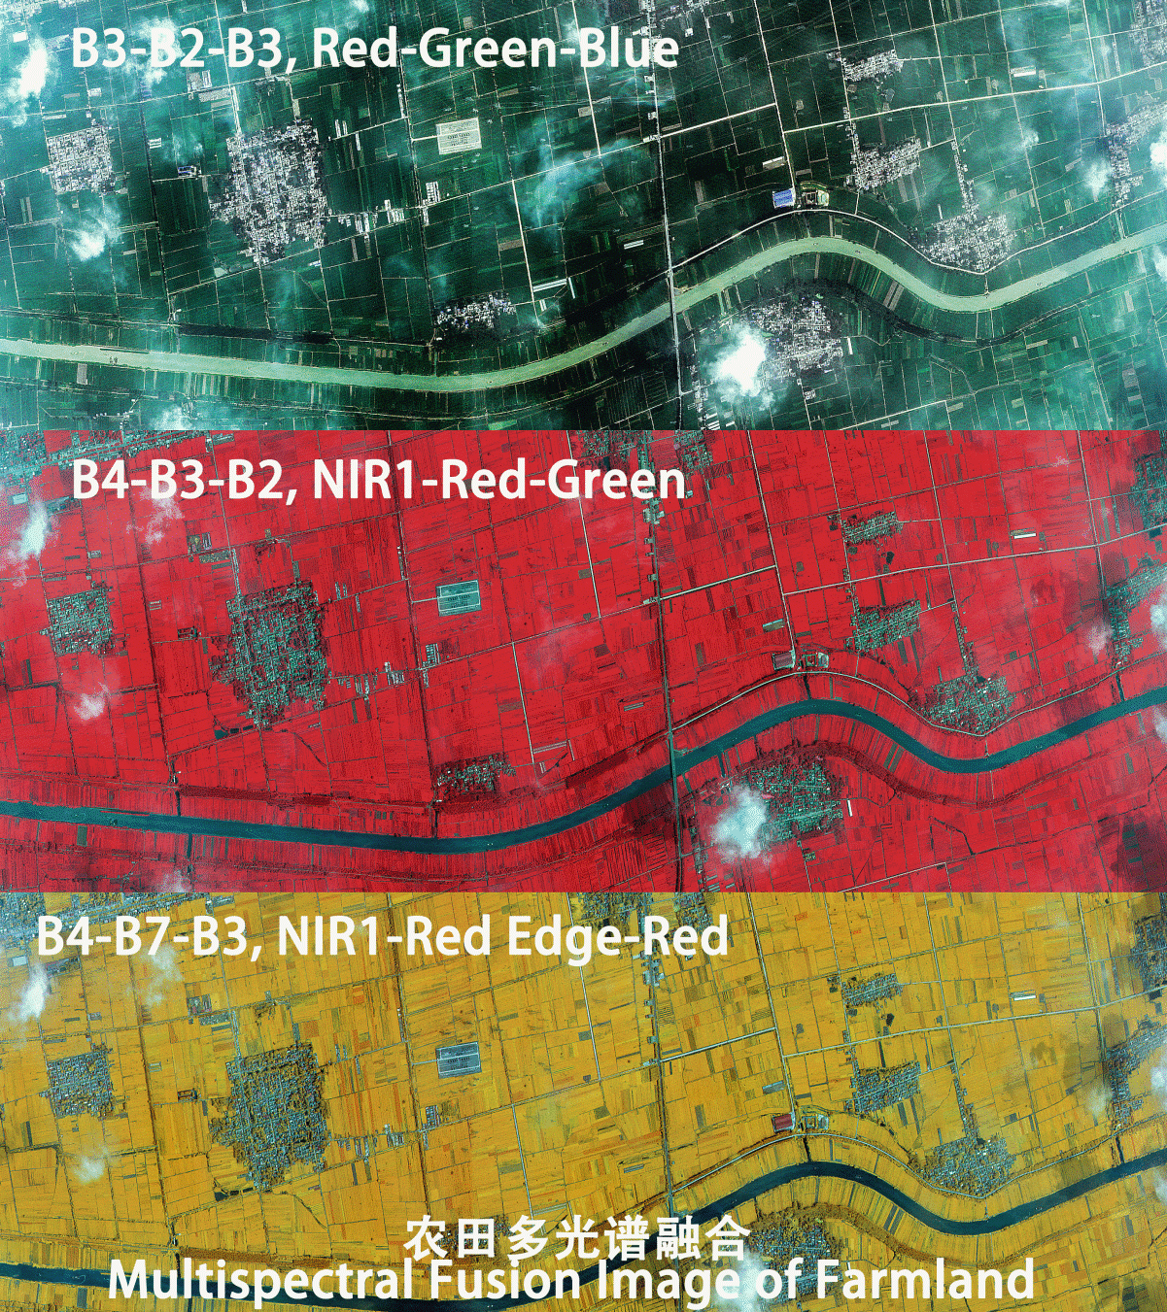
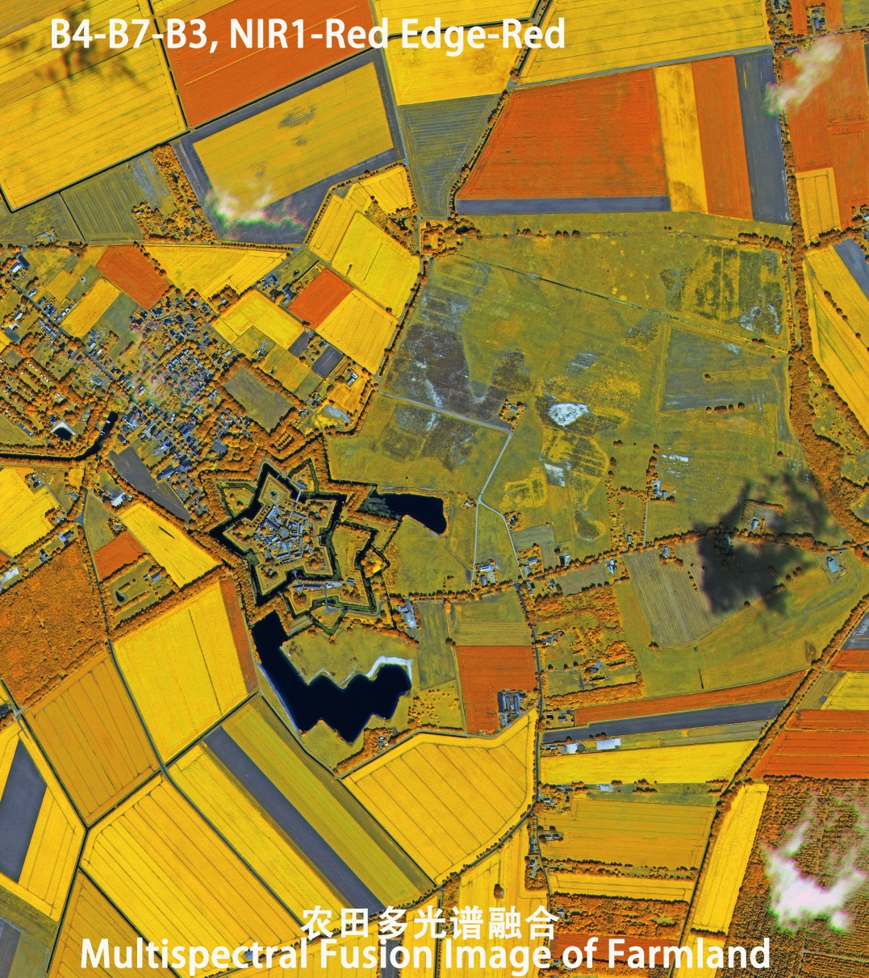
3. Application
MS Image：Benefits of 8 Bands
The accuracy
of
Classification can be improved

Slide 7
3. Application
SMAC(Synchronous Monitoring Atmospheric Corrector )
Clarity- Improved
Clarity -Improved
Remove atmospheric path radiation and cross radiation effects

Slide 8
3. Application
HRMIS has been in stable operation for 3 years，it has been used in Natural Resources，Emergency Management，Agriculture and Rural Affairs，Ecology and Environment，Housing and Urban-Rural Development，Forestry and Grassland，etc.
It accelerates the quantitative application of the remote sensing images, and shows that the application will have tremendous potential.

Slide 9
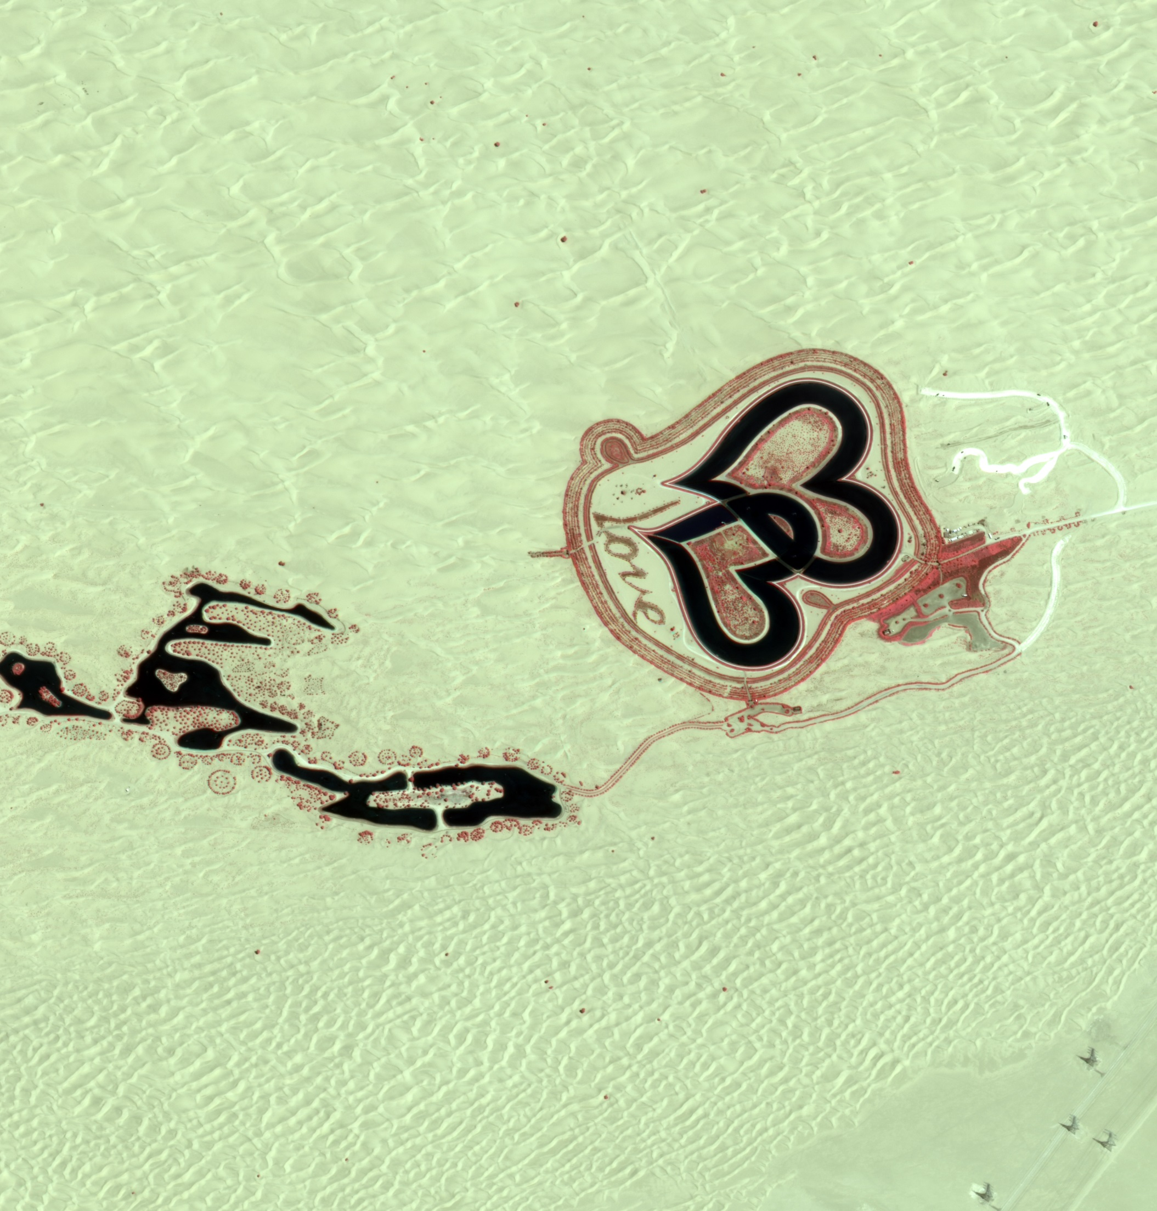
Thanks for
attending!

