Slide 1
37th CEOS Plenary ASI Report
Laura Candela
ASI
15 - 16 November 2023
Chiang Rai, Thailand

Slide 2
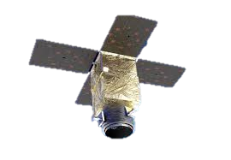
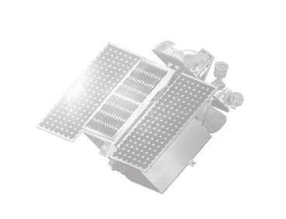
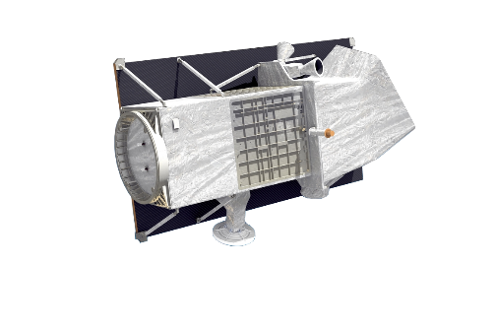
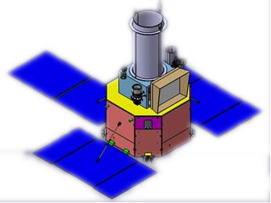
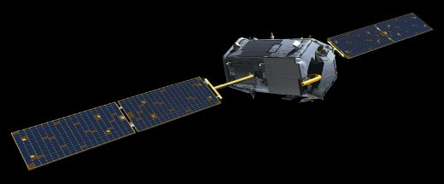
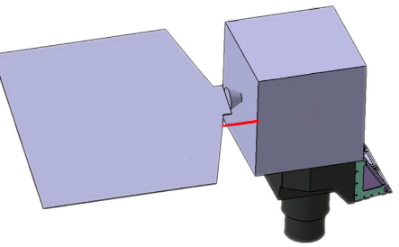
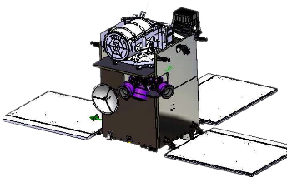
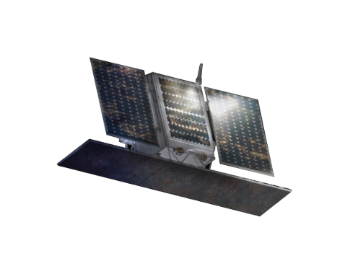
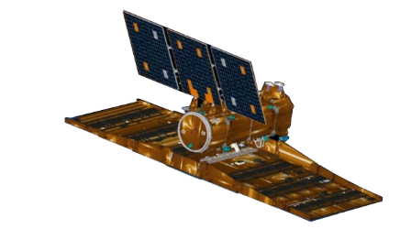
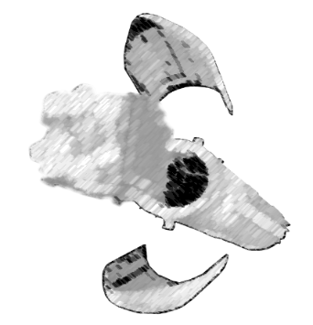
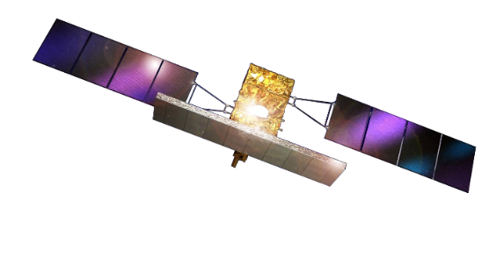
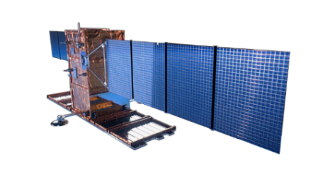
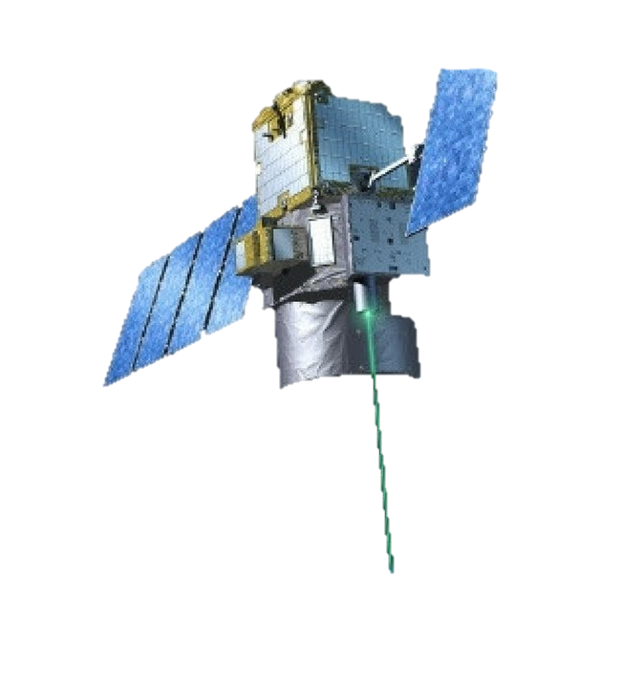
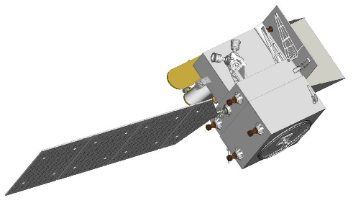
Earth science and applications
Ensure that Earth Observation missions offers the best possible benefits for science and society. Involve EO community in all program phases
Earth Observation at glance:
8 major objectives
V²HR
PLATiNO-3 VHR
PLATiNO-4
MAIA
OCO-Next
PRISMA
PSG
PLATiNO-1 M&B
GEOSAR
COSMO FUTURO
CSG 1 & 2
CSG 3 & 4
CSK
SAOCOM
L-Band M&B
CALIGOLA
SBG -TIR
Pull users towards applications and services
Facilitate access to data, information and processing capabilities.
Pioneer new services
Stimulate downstream industrial and economic growth
In operations
In development
Planned

Slide 3
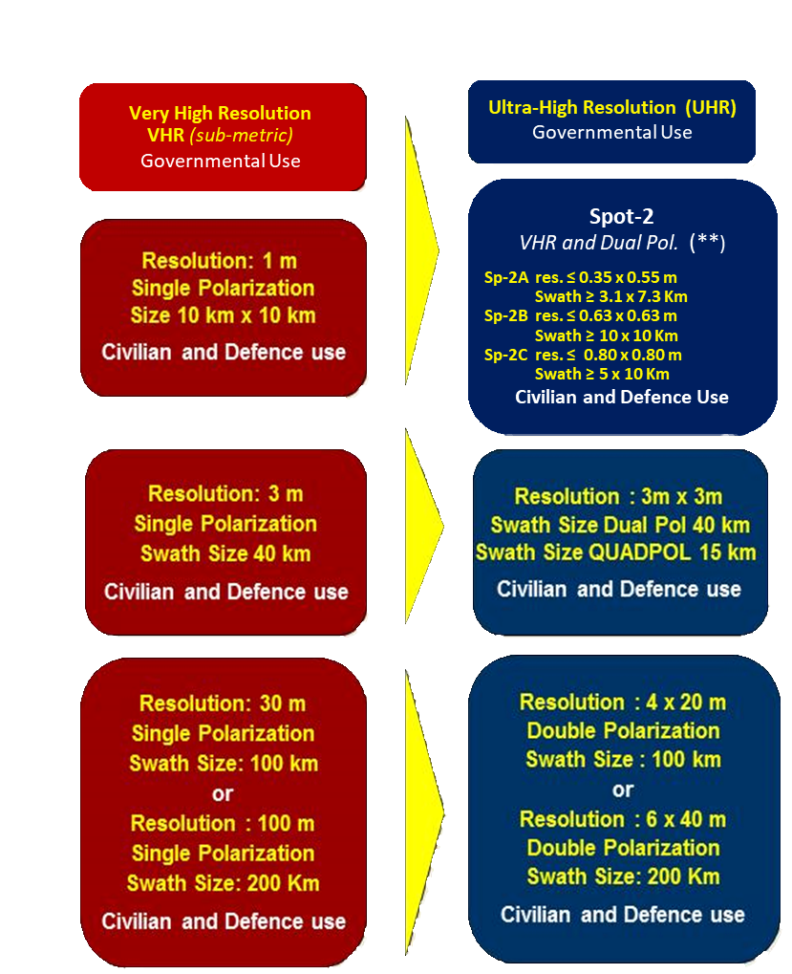
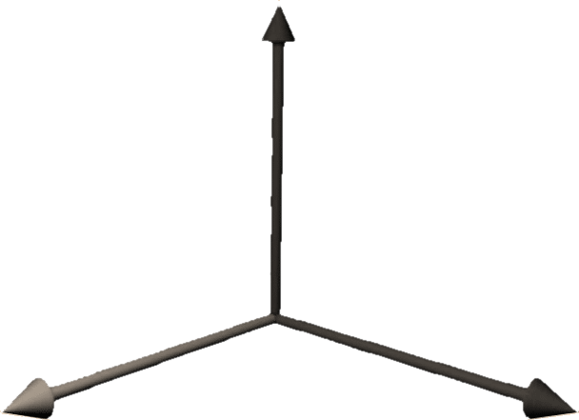
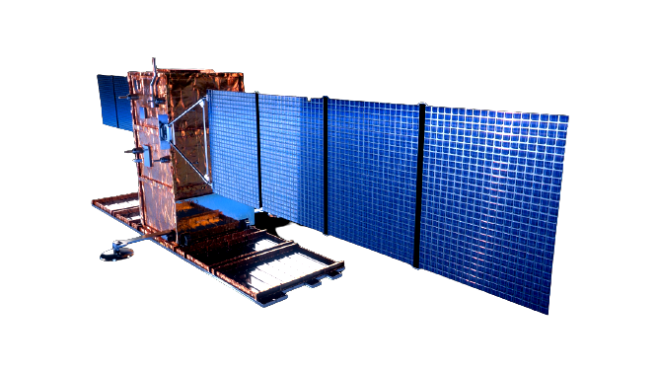
Microwave: COSMO-SkyMed and Beyond
CSK
CSG
The FUTURE
New architectures: a system of systems
GEO and LEO elements
Multi-Sensor capabilities (X and L band SAR)
Multi modes: mono and bi-static SAR
Enhanced performances
Systematic mapping and new on-demand services
SPOTLIGHT
STRIPMAP
SAR Different Bands & Modes
SCANSAR
Development & evolution of Size & Orbits
Devel. and evol. in Time

Slide 5
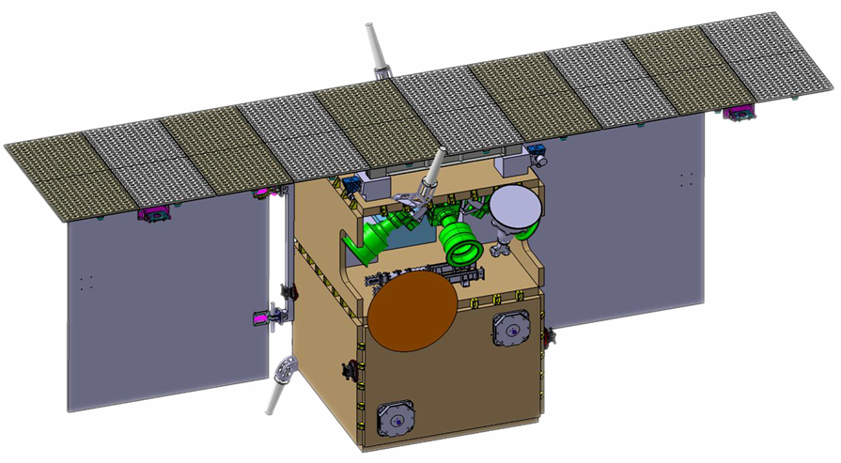
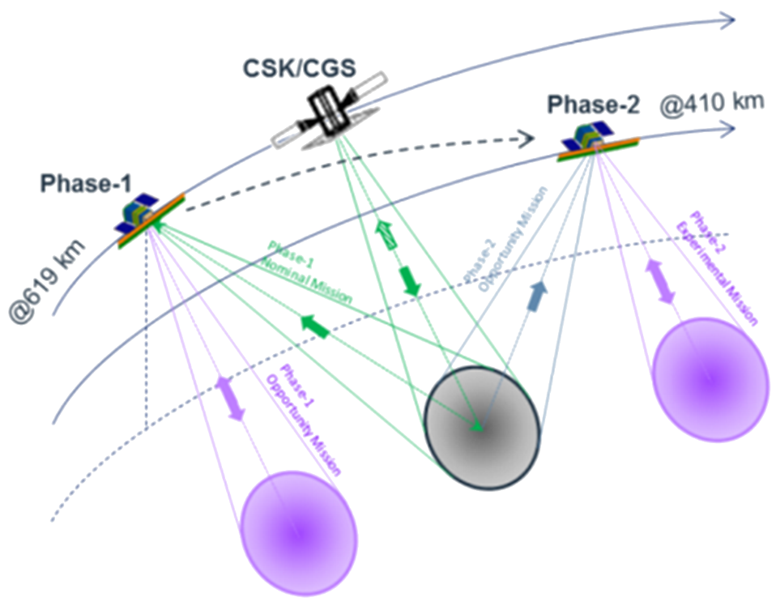
PLATiNO-1 – SAR Mission-X band
Mission timeline:
Commissioning (LEOP and Commissioning) 3 months;
Phase-1 (@619 km, formation flying with CSK/CSG) 1 year;
Re-orbit phase (orbit transfer) 6 months;
Phase-2 (@410 km, monostatic acquisition) 1.5 years;
De-orbiting phase 6 months.
During Phase-1 PLT-1 will mainly work as a receiver acquiring from Earth the signal generated by CSK/CSG
Bistatic performances (Phase-1)
Altitude | 619 km
Swath | 40 km
Stripmap Resolution | 3 m
Spotlight Resolution | 1 m
Continuous stripmap | Up to 1000 km
Monostatic performances (Phase -2)
Altitude | 410 km
Swath | 15 km
Stripmap Resolution | 3 m
Spotlight Resolution | 1 m
Continuous stripmap | Up to 800km
PLT-1 shall be sized to provide the capacity to acquire, downlink and archive images totaling 20000 km2 daily.
Launch date: end of 2024
ASI Earth Observation Division - This document contains proprietary information of ASI, and may not be reproduced, copied, disclosed or utilized in any way, in whole or in part, without the prior written consent of ASI

Slide 6
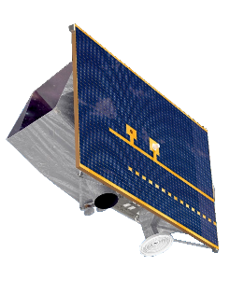
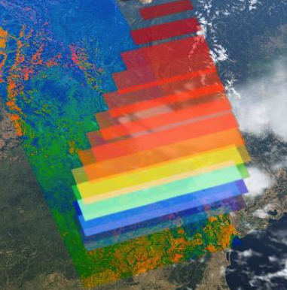
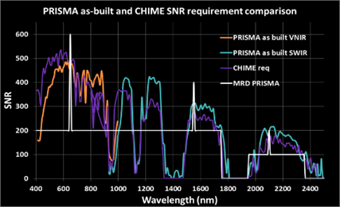
PRISMA - Hyperspectral
Fully funded by the Italian Space Agency (ASI): in-orbit Earth Observation system that simultaneous combines data of a hyperspectral sensor and a panchromatic camera from the same scene.
240 total bands in VNIR (#66, 400–1010 nm) & SWIR (#174, 920–2505 nm) at a spatial resolution of 30 m on a swath of 30 km
Mean spectral resolution of 10 nm in a spectral range of 400-2500 nm
Pan (Panchromatic) imagery is provided at a spatial resolution of 5 m
Simultaneous acquisition of images in the VNIR, SWIR and PAN on the same scene

Slide 7
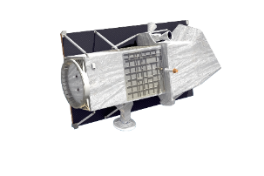
PRISMA 2nd Generation
PRISMA Second Generation is the future Hyperspectral Italian Mission.
Entirely Funded by the Italian Space Agency
High-performance satellite ensuring Hyperspectral data continuity currently available from the PRISMA mission and providing enhanced performances
Launch date: end of 2027
SWATH and SNR: on demand techniques of SWATH enlargement and SNR enhancement on a single pass using the platform agility.
Revisit time (72 h with a maximum off-nadir angle of ± 30°)
Acquisition modes: STRIPMAP and SPOTLIGHT.
STRIPMAP image: VNIR/SWIR GSD ≤ 30 m and PAN GSD ≤5 m, swath ≥30 km and indefinite length with a Daily STRIPMAP Imaging Capacity (acquire, downlink and archive) more than 2.000.000 km2.
SPOTLIGHT image (on-demand): VNIR/SWIR GSD ≤10 m and PAN GSD ≤2,5 m, swath ≥30 km and length up to 210 km with a Daily SPOTLIGHT Imaging Capacity (acquire, downlink and archive) more than 200.000 km2.
ASI Earth Observation Division - This document contains proprietary information of ASI, and may not be reproduced, copied, disclosed or utilized in any way, in whole or in part, without the prior written consent of ASI

Slide 8
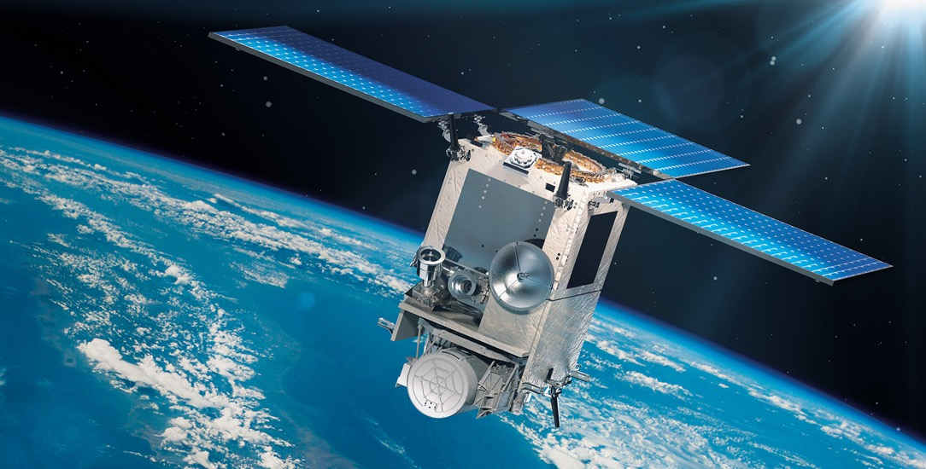
PLATINO-2 MAIA (Multi-Angle Imager for Aerosols)
Joint ASI-NASA/JPL mission, launch expected in 2025
MAIA will explore linkages between exposure to different types of PM and human health.
Products: Daily-averaged total PM₁₀, total PM_{2.5}, and speciated PM_{2.5} mapped in selected areas on a 1-km grid.
Kicked-off a prototype project to assess population risk exposure at urban level, in the Southern Italian area, under a ASI-CNR/IIA Agreement. Planned extension to the other areas. Expected results also to support evaluation of SDG Indicator 16.2.1
Bounding box:
360 km x 480 km
Planned MAIA observation areas over Europe

Slide 9
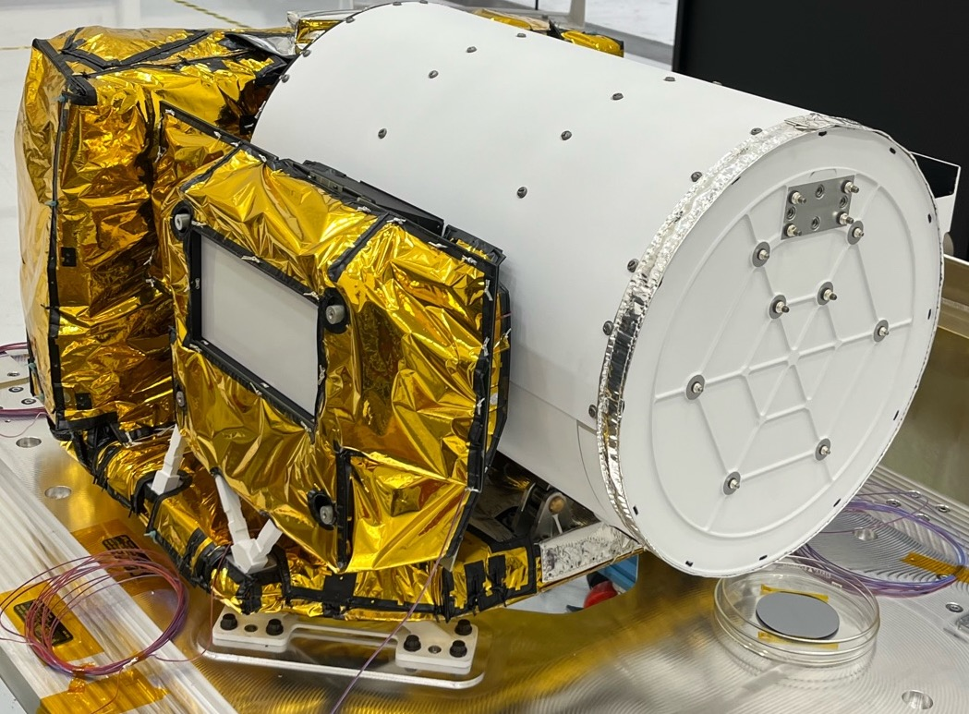
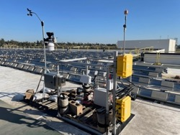
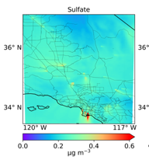
MAIA Mission key components
Satellite instrument | Surface monitors | Chemical transport model | Health records
Public products
Privacy protected
24-hr averaged concentrations of PM₁₀, PM_{2.5}, speciated PM_{2.5}
Epidemiological
studies
Birth, death, and hospitalization data

Slide 10
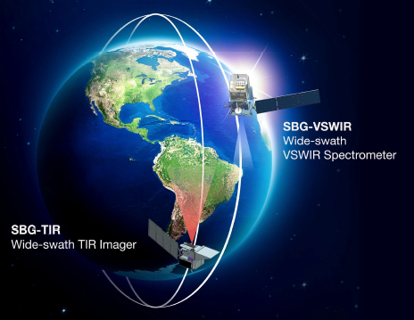
SBG-Surface Biology and Geology
TIR-Multispectral Mission
TIR instrument
VNIR camera
Thermal IR Bands | 8.28 μm / 8.63 μm / 9.07 μm / 11.33 μm / 12.05 μm
mid-IR bands | 3.98 μm / 4.80 μm
short-wave IR | 1.60 μm
NETD | 0.2 °K @ 300 °K
GSD | 60m
Swath width | 935 km
Coverage | Global
Visible Bands center | 655 nm
NIR Bands center | 835 nm
SNR | 100
GSD | <35 m
Swath width | 935 km
Coverage | Global
Launch date: end of 2027

Slide 11
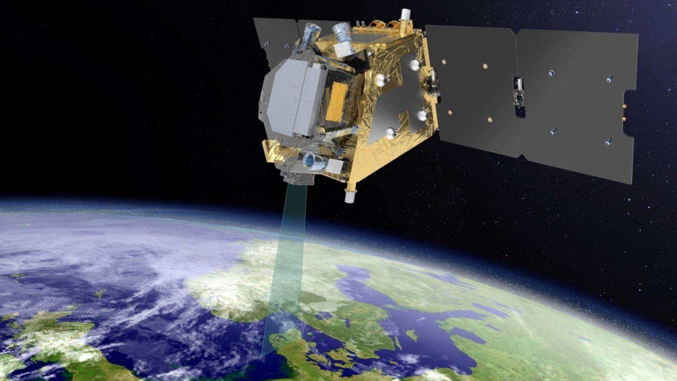
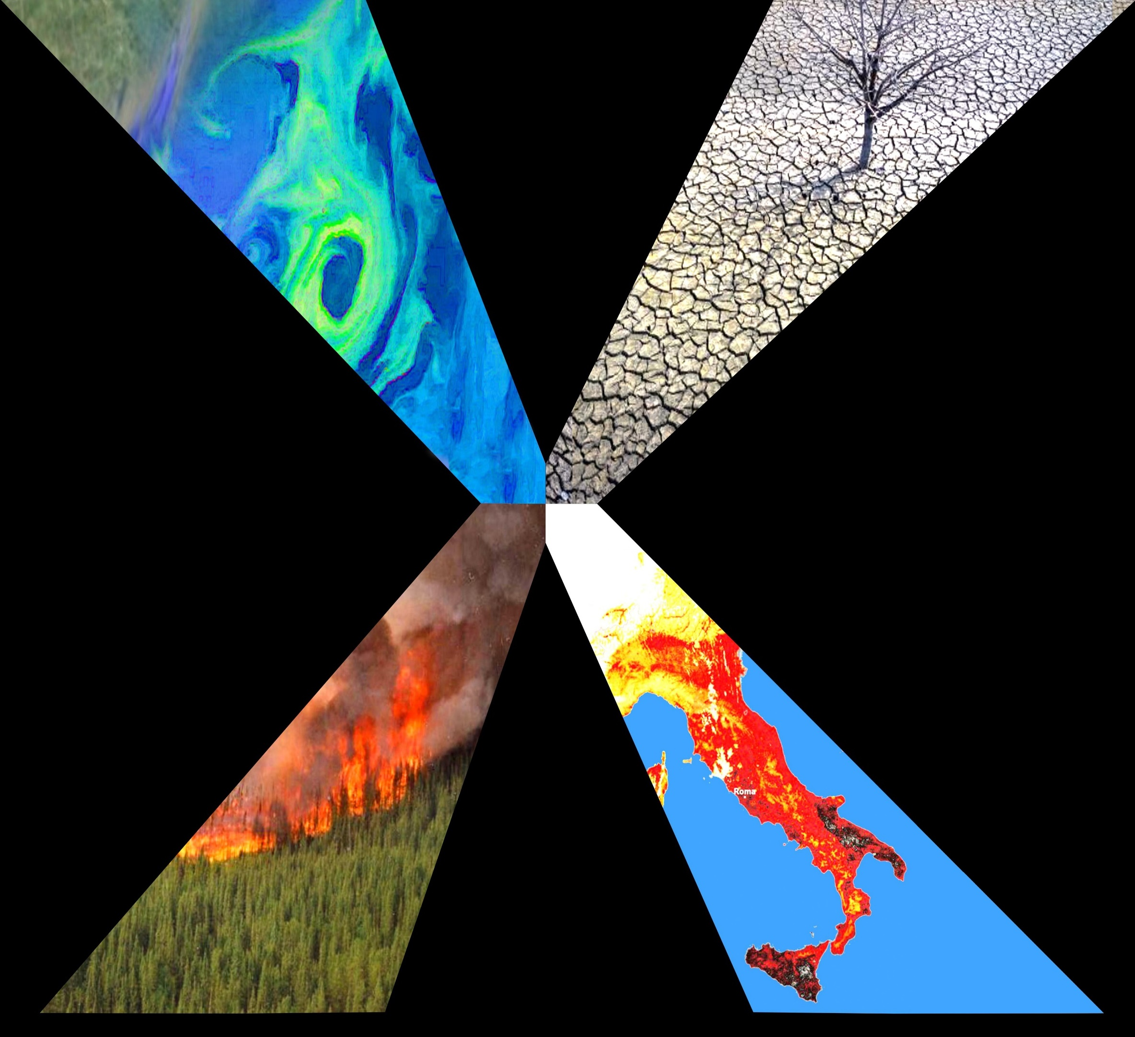
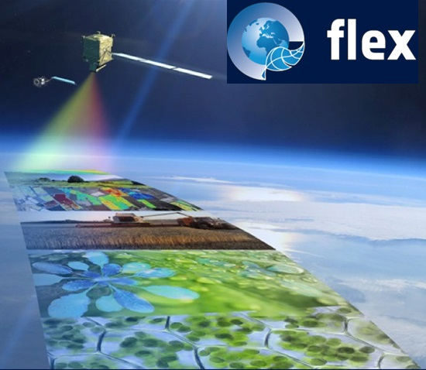
OCO-NEXT Mission
OCO-NEXT (The Next Generation Orbiting Carbon Observatory) a ASI-JPL partnership to provide a key contribution to the understanding of carbon cycle behavior in an hotter world, with increasing number of extreme events
What we expect from OCO-NEXT:
Extending the critical CO2 climate data record with global surface coverage and expanded capabilities compared to OCO-2 and OCO-3;
Global, high-precision column mixing ratios of CO2, CH4, CO, and SIF, and gridded 250 km, monthly fluxes of CO2 and CH4;
150–180 km swath width with single sounding nadir footprint of 2 km × 2 km;
Sun-sync, 833-km LEO orbit crossing at 1330 daily, flying in formation with JPSS-1/JPSS-2, near global coverage with 16-day repeat cycle.
Instrument Complement:
Measure CO2, CH4, CO, and SIF emissions simultaneously:
SIF instrument (ASI-contributed)
Band 1 (677-697 nm): O2 B-band/Red SIF
Band 2: (740-780 nm): O2 A-band/enhanced SIF
GHG instrument (JPL)
Band 3 (1591-1660 nm): weak CO2/CH4
Band 4 ( 2010-2085 nm): strong CO2
Band 5 ( 2302-2370 nm): strong CH4 and CO

Slide 12
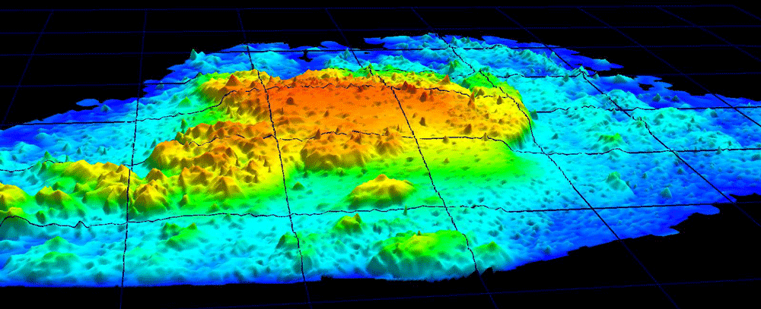
LIDAR mission: CALIGOLA
Cloud Aerosol Lidar for Global Scale Observations of the Ocean-Land-Atmosphere System
Mission Objectives
Atmospheric particles and clouds microphysical and dimensional properties
Aerosol type determination and Aerosol-cloud interaction processes
Atmosphere and marine particles fluorescence measurement
Earth's surface elevation measurements
“Ocean color" products improvement & Characterization of organic matter/aerosols dissolved in the sea
Sub-System Technologies: Laser Transmitter, ultra-stable low-weight space telescopes, transmission/receiving optics,
Launch date: tentative 2030
Source: NASA/USGS, public domain

Slide 13
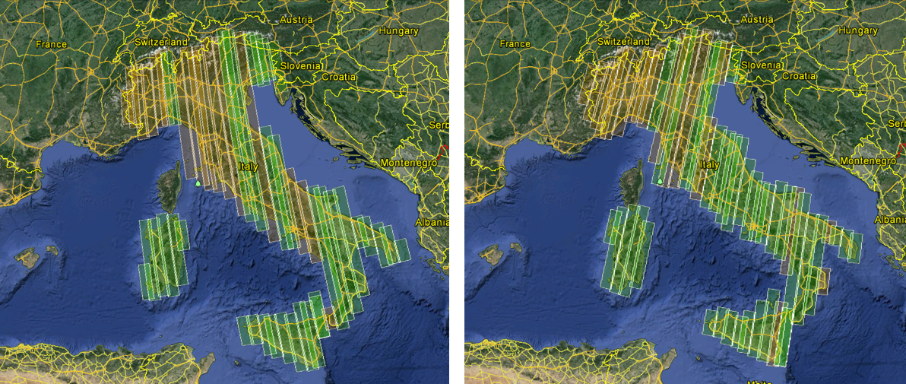
MapItaly: A service for Italian institutional users
Ultimate Objective: Provide a single access point to the SAR observations over Italy for institutional users
Atmospheric particles and clouds microphysical and dimensional properties
Aerosol type determination and Aerosol-cloud interaction processes
Since 2010, COSMO-SkyMed First (CSK) and Second Generation (CSG) are systematically mapping Italian Territory, X-band, stripmap mode, update of interferometric couples every 16 days.
SAOCOM data (L-band) are being added systematically since 2022.
Sentinel 1 data (C-band) will also be added (starting from 2014
Catalog and complete archive maintained online
API for searching and downloading data
Operational by the end of 2023

Slide 14
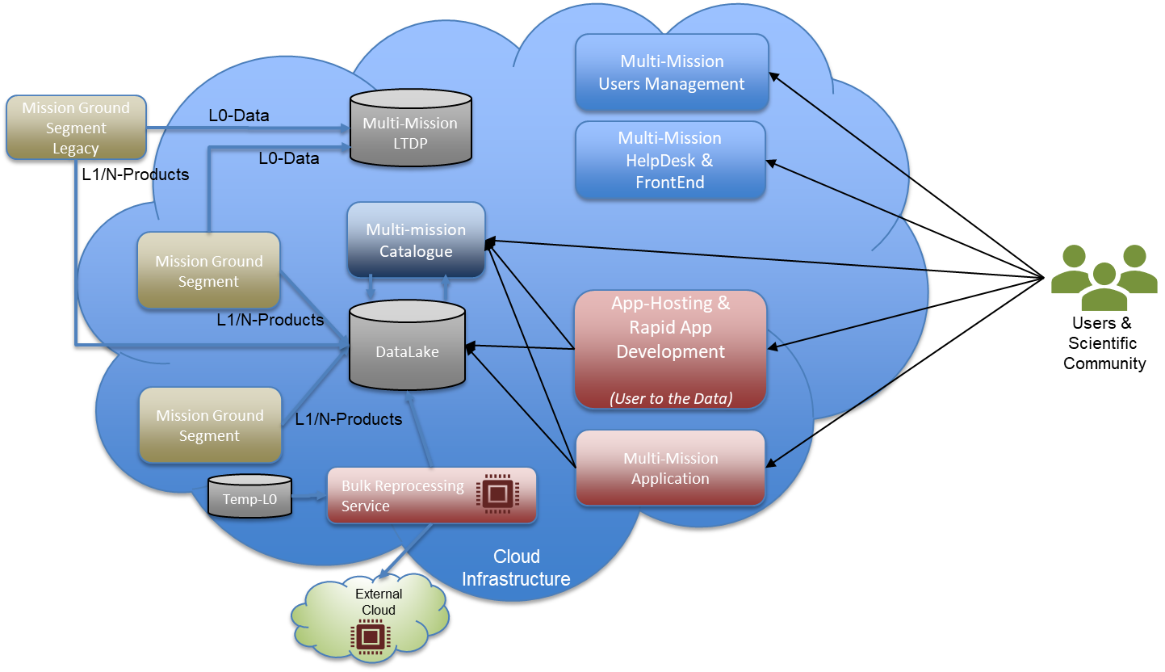
MADS - Multi Mission Data Access Services

Slide 15
National Service Development
ASI Domain
IRIDE Service Domain
Open calls
Mission exploitation
Innovation for Downstream Preparation
Framework agreements
IRIDE Marketplace
CyberItaly
1. Coasts & Coastal Waters
2. Air Quality
3. Ground Motion
Services
4. Land Cover
User in the loop
Partnership
Needs as design drivers
5. IdroMeteoClima
6. Water Management
7. Emergency
8. Security
Local PA Uptake Initiative

Slide 16
THANK YOU FOR YOUR ATTENTION!
ASI Earth Observation Division - This document contains proprietary information of ASI, and may not be reproduced, copied, disclosed or utilized in any way, in whole or in part, without the prior written consent of ASI

