Slide 1
37th CEOS Plenary
South African National Space Agency (SANSA)
Asanda Sangoni
SANSA
Agenda Item 13.1
37th CEOS Plenary
15 - 16 November 2023
Chiang Rai, Thailand
Hosted by GISTDA

Slide 2
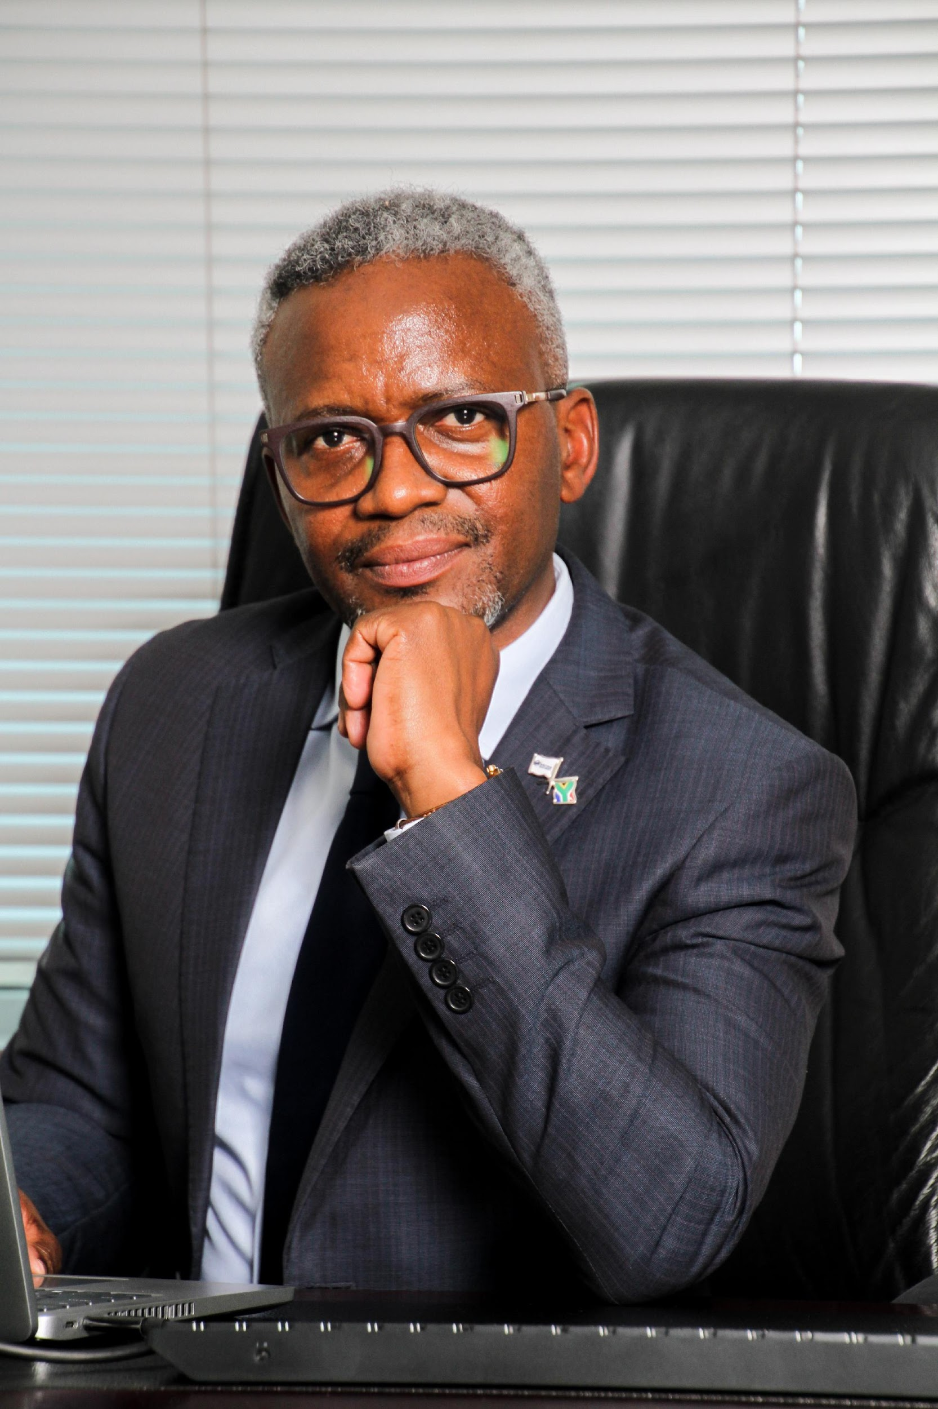
Updates in Leadership
New CEO : Mr Humbulani Mudau
From the Ministry of Science & Innovation
Masters in Satellite Remote Sensing from the University of Paris VI; a B.Sc. Honours in Environmental Management and Geospatial Sciences from University of Johannesburg; a Certificate in Remote Sensing from University of Johannesburg; and a B.Sc. Biological Sciences from University of Venda.
Member of the GEO Ministerial Working Group

Slide 3
SANSA EO Priorities
Access to a variety of sensors
Free & Commercial Arrangements
Climate Change Adaptation
Signatory to SCO
Developing a National Space for Climate Change Agenda
Disaster Risk Reduction
Discussions with UNOOSA thro UNSPIDER to host a Regional Support Office
Predictive models
Sustainable Natural Resources
Developing a National Natural Resource Management System
land degradation, water pollution; food loss (livestock and crop heath) air pollution; wildlife extinction; biodiversity loss and climate change impact (i.e. high frequency of drought, heat waves, floods); protection of marine and coastal environment

Slide 4
Current Investment in EO
Advanced Predictive & Forecasting Tools
Intentional move towards Earth Intelligence
Incorporating AI techniques and smart analytics
Upskilling our EO Capability
Prioritizing cooperation arrangements that drive capacity building and innovation
SA EO Mission
Government support

Slide 5
Proposal
CEOS Hosting 2026

Slide 6
Thank you!

