Slide 1
United Nations Office for Outer Space Affairs
Report to CEOS Plenary 37th
15-16 November, Thailand

Slide 2
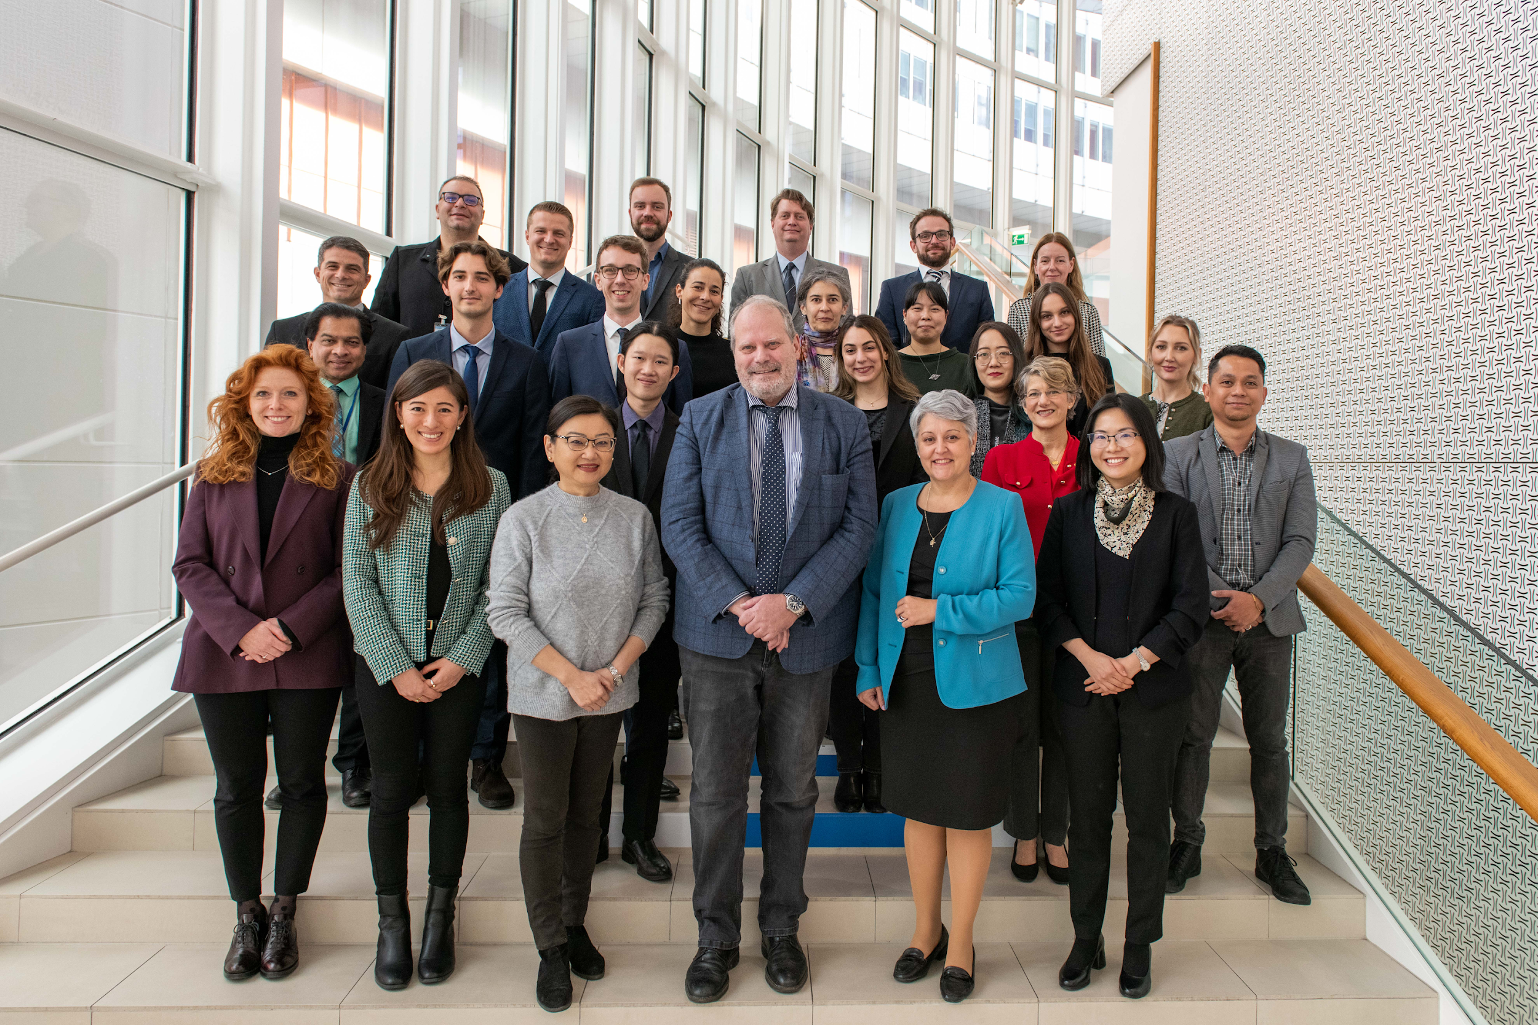
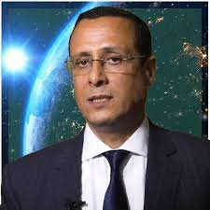
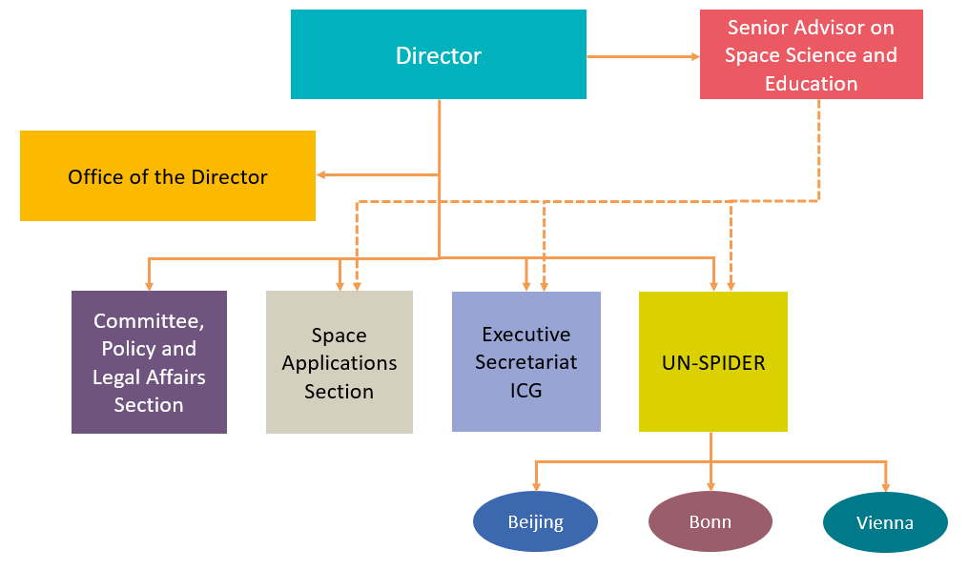
The Office
Aarti Holla-Maini
Driss El Hadani

Slide 3
Committee on the Peaceful Uses of Outer Space
UN General Assembly
COPUOS
(June)
102 Member States
40+ Permanent Observers
CEOS is a Permanent Observer
UNISPACE III -> UN-SPIDER and Charter Space and Major Disasters
Scientific and Technical Subcommittee
(Feb)
Legal Subcommittee
(~April)

Slide 4
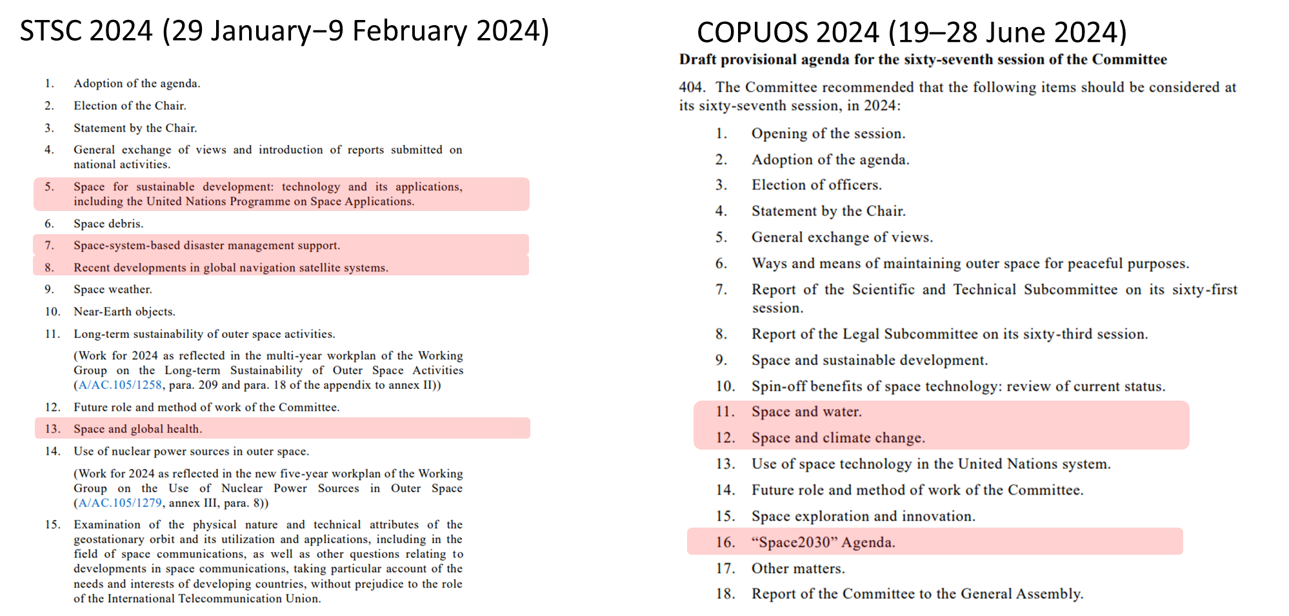
Committee on the Peaceful Uses of Outer Space

Slide 5
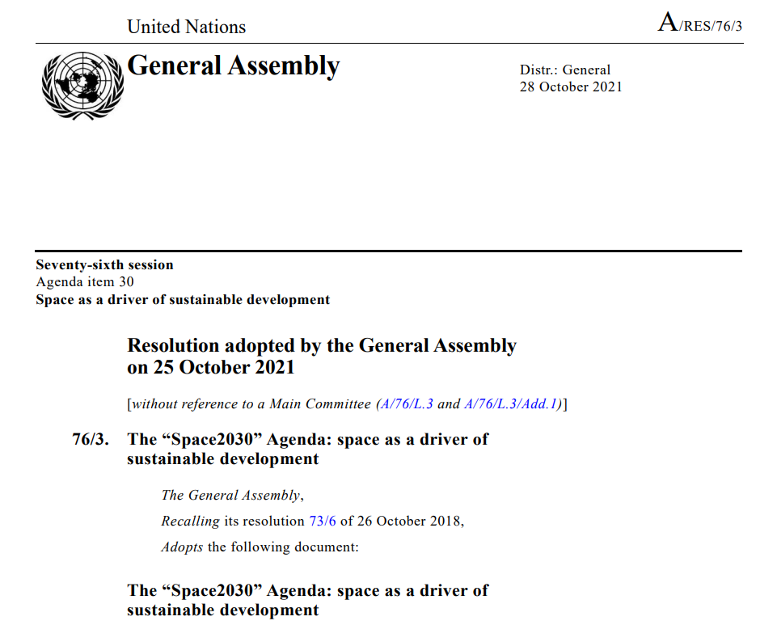
“Space2030” Agenda
The Committee on the Peaceful Uses of Outer Space should include an item on its agenda for each session allowing for an exchange among States members of the Committee and its permanent observers on their experiences in implementing the “Space2030” Agenda.
In 2025, the Committee should carry out a midterm review of progress made in implementing the “Space2030” Agenda.
In 2030, the Committee should carry out a final review of the implementation of the “Space2030” Agenda and report to the General Assembly on the results

Slide 6
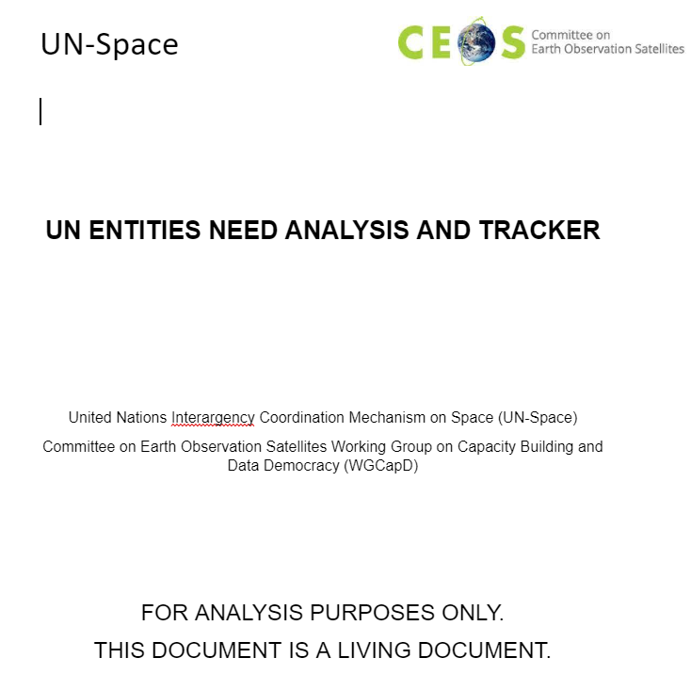
United Nations Interagency Coordination Mechanism on Space (UN-SPACE)
WGCapD Training for UN Entities through UN-Space
October 2023
WGCapD-12 + UN-Space
March 2023

Slide 7
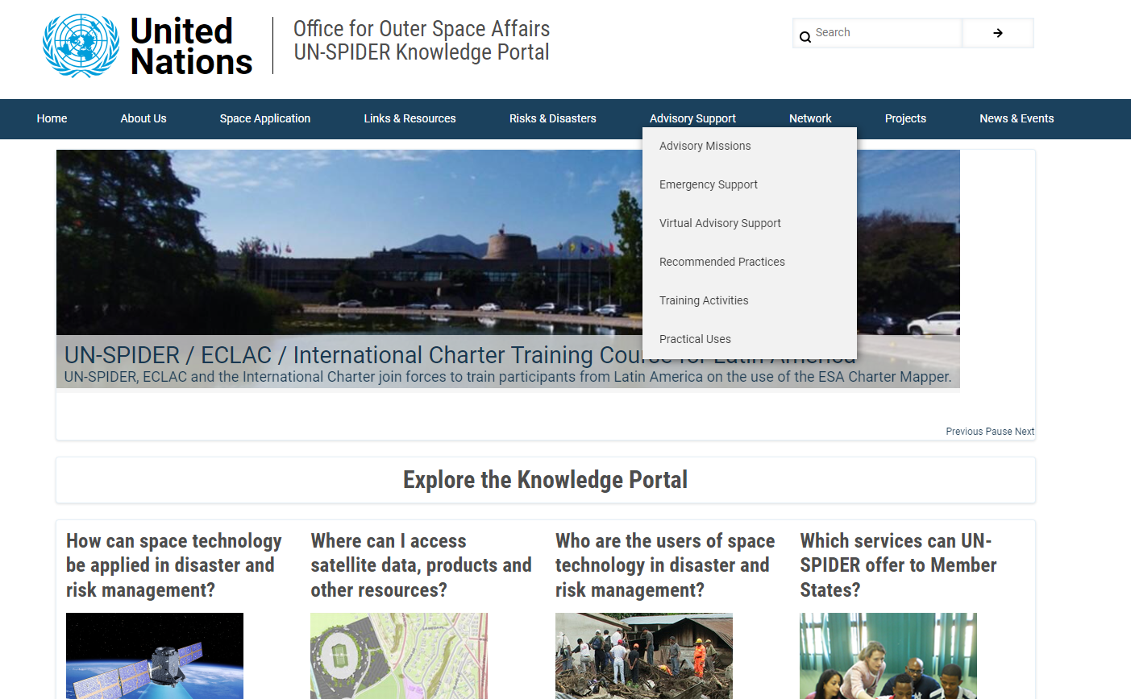
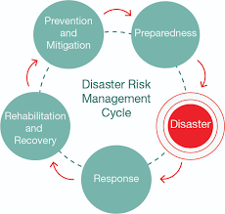
Space-based Information Platform for Disaster Management and Emergency Response (UN-SPIDER)

Slide 8
CAPACITY-BUILDING

Slide 9
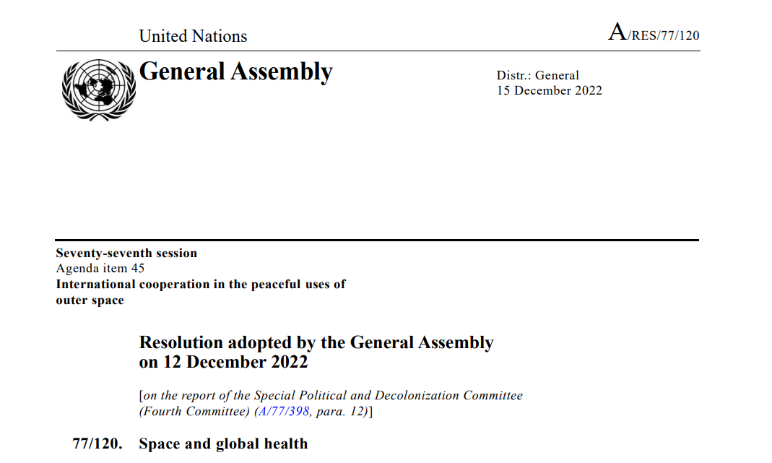
CAPACITY-BUILDING

Slide 10
REQUESTS
Continue Supporting the Office
UN-SPIDER
Capacity-Building / Awareness Raising Efforts
Secondments
Continue Supporting the United Nations
UN-SPACE

Slide 11
THANK YOU

