Slide 1
New Space Task Team
White Paper Overview and Recommendations
Ivan Petiteville, ESA
Agenda Item 12.1
37th CEOS Plenary
15 - 16 November 2023
Chiang Rai, Thailand
Hosted by GISTDA

Slide 2
New Space and CEOS …
Collaboration between New Space & Public Space sectors:
at national or regional level, Governments are integrating new arrangements with Space 2.0 firms into their satellite EO programme planning
What could be the expected mutual benefits and added-value of a public / new space collaboration ?
Are there collective actions at CEOS level, that can foster this collaboration at national or regional level ? CEOS must keep up and consider implications for its thematic observation strategies
Duality & complementarity between CEOS and New Space: one of the strategic priorities introduced by ESA as 2022-2023 CEOS SIT Chair

Slide 3
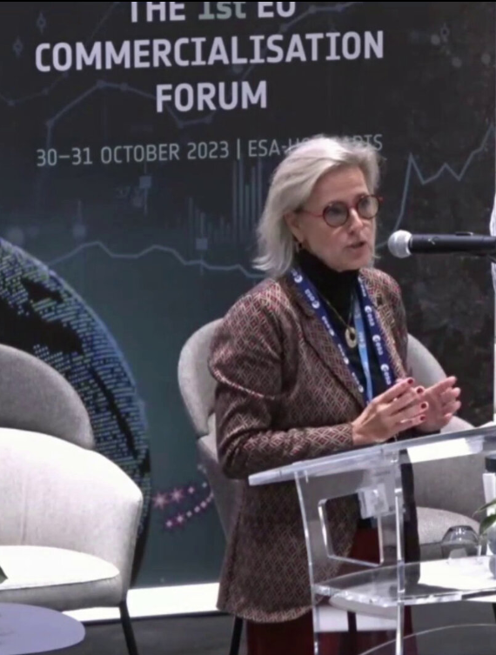
ESA and New Space: examples
At COP26, +100 countries signed up to the Global Methane Pledge to limit emissions by 30% in 2030 compared with 2020 levels
🡪 GHGSat joined ESA’s Third Party Mission Programme (May 2022)
2. ICEYE commercial constellation of 27 small X-band SAR satellites (31 by end-2023)
Monitoring floods and mining activities, marine vessel detection and iceberg monitoring. 3 hours anywhere on Earth.
🡪 ICEYE SAR imagery is provided to all Copernicus services, mainly the Emergency, Security, Land and Marine services, as Copernicus Contributing Mission (Nov. 2021)
3. ESA’s first Earth Observation Commercialisation Forum (ESA HQ, Paris, 30–31 October 2023)
Notes:
All current ICEYE imaging modes are offered through this programme. Users get access to the very high-resolution Spot imaging mode covering areas of 25 km², the high-resolution Strip and the recently launched Scan imaging mode covering areas of 10,000 km², respectively. It is possible to obtain archive data or request new image acquisitions.\
ICEYE builds and operates a commercial constellation of small synthetic aperture radar satellites. So far, 14 satellites have been launched and ICEYE and plans to expand its constellation up to 18 satellites by mid-2022, with the objective of reaching an average access time of three hours anywhere on the globe. The mission is used in many sectors, from monitoring floods and mining activities, to marine vessel detection and iceberg monitoring.
The ICEYE satellite constellation is a Copernicus Contributing Mission, complementing existing synthetic aperture radar missions in the Copernicus programme.
Read full story: ICEYE commercial satellite
at COP26, more than 100 countries have just signed up to the Global Methane Pledge, which aims to limit emissions by 30% compared with 2020 levels.
With both public and commercial satellite data playing key roles in assessing progress on climate action, ESA and GHGSat are supporting the United Nations Environment Programme’s new International Methane Emissions Observatory, also announced at COP26.

Slide 4
New Space in CEOS: Milestones
New Space sessions at all SIT, SIT TW and CEOS Plenary in 2022-2023.
Sharing of experience of CEOS Agencies (CNES, CSA, EC, ESA, GISTDA, NASA, NOAA, UKSA, USGS) and presentation of activities e.g. CEOS-ARD, WGCV,….
A temporary Task Team with representatives from +20 CEOS Agencies and from CEOS WGs, produced a list of early key findings (2022 CEOS Plenary).
‘New Space’ Task Team (NSTT) created at 2022 Plenary
Objective: to explore opportunities between public and private commercial services that bring mutual benefit to all parties, including the identification of concrete initiatives.
Terms of Reference for a CEOS ‘New Space’ Task Team endorsed @2022 Plenary
Delivery of a White Paper with findings and recommendations @ 2023 Plenary for endorsement

Slide 5
NSTT’s Objectives and Deliverable
Sharing experience between CEOS Space Agencies, through dedicated sessions at each CEOS meeting attended by CEOS Principals (SIT, SIT Technical Workshop, and CEOS Plenary).
Assess areas and issues that are common among CEOS agencies and that may impact public EO programmes in future.
Recommend actions within the CEOS framework that aim to enhance the outcomes of CEOS entities (WGs, VCs, AHTs) working with New Space companies.
Issue a White Paper summarising Findings & Recommendations, based on both the information collected during the experience sharing sessions and reporting of specific relevant activities undertaken by CEOS entities.

Slide 6
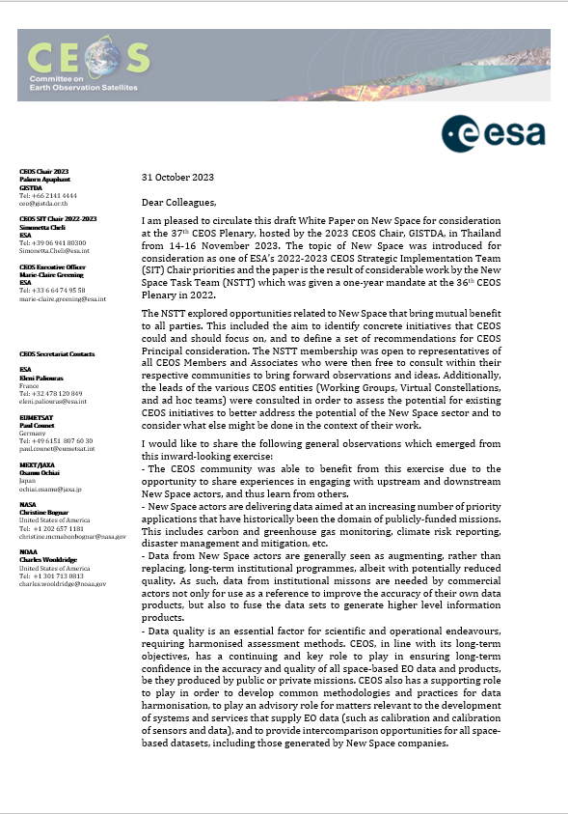
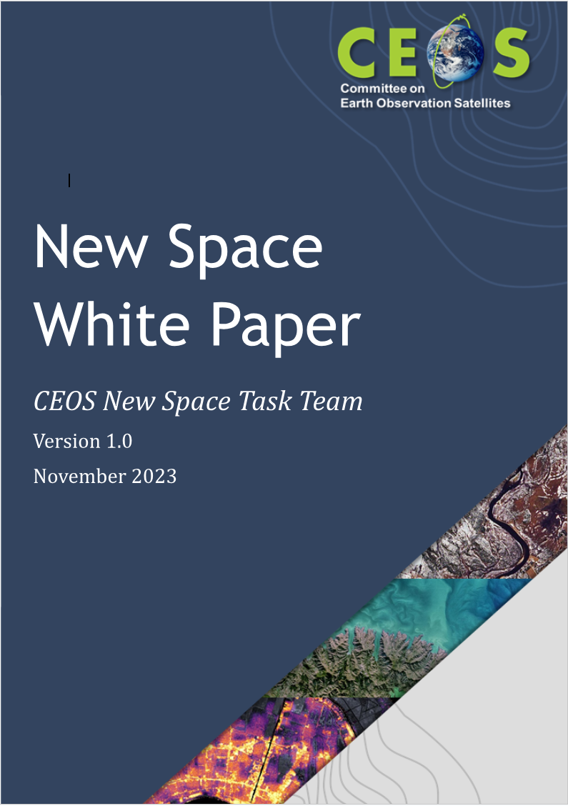
NSTT’s White Paper
NSTT White Paper authorship & process :
Open to representatives of all CEOS Members and Associates who were then free to consult within their respective communities to bring forward observations and ideas.
Leads of the various CEOS entities (Working Groups, Virtual Constellations, and ad hoc teams) were consulted in order to assess the potential for existing CEOS initiatives to better address the potential of the New Space sector and to consider what else might be done in the context of their work.
76-pages document: a huge work by NSTT , coordinated by SIT Chair…
Many thanks to all CEOS Agencies and CEOS groups !!!!

Slide 7
White Paper: Content (1/2)
1. Introduction & Objectives
2. Definition and Scope of New Space relevant to CEOS
3. Interaction between Governmental/Public and Private actors in New Space for EO
4. CEOS Agencies’ Experiences in their Interactions with EO New Space
CNES, CONAE, CSA, CSIRO, DLR, EC, ESA, EUMETSAT, GA, GISTDA, ISRO, JAXA, NASA, NOAA, NSO, UKSA, USGS
5. Opportunities for New Space
5.1. Thematic Area Observation Gap Opportunities
AFOLU, SDG, Precipitation, GHG, Climate, Disasters, Agriculture, Capacity Development, Land Surface Imaging, Ocean Surface Wind Vector, Sea-surface Temperature, Ocean Surface Topography,..
5.2. Opportunities for New Space to support science
incl. Radio Occultation, Hyperspectral Imaging, SAR, Thermal IR, Very Hi-Res Commercial Optical Imagery,.

Slide 8
White Paper: Content (2/2)
6. Current CEOS Activities Supporting New Space
incl. CEOS Cal/Val, CEOS ARD, CEOS Interoperability Framework, Open Data Cube, CEOS Engagement with Standards Organisations, CEOS MIM, Combined and harmonised data streams.
7. Conclusion and Recommendations
Appendix A - Recommendations to CEOS Plenary
Appendix B - Recommended Deliverables for inclusion in the CEOS Work Plan
Appendix C - Task Team Membership
Appendix D - Further details on Cal/Val References
References

Slide 9
CEOS Agencies’ Experiences in their Interactions with EO New Space
Although the experience with “New Space” in EO is heterogeneous and depends on national policies, strategies and capabilities, all the participating Agencies, directly or indirectly, support private investments in the space sector (e.g. for SME)
Many dedicated programmes are flourishing at national and international level
Motivations range from stimulating space economy and the competitiveness of national industry to the provision of novel products and services complementing the traditional “big” satellite missions.
PPP and anchor tenancy are the most common arrangements methods.
The use of commercial data are also being explored for scientific and operational applications, thus creating synergies between industry, academia and government

Slide 10
Observation Gaps and Opportunities for New Space
Thematic Areas Observation Gaps - Opportunities
Agriculture Forests and Other Land Use | Documenting smaller scale AFOLU variables and land management, augmenting rather than replacing the observations of long-term programmes, increasing the revisit time.
SDG | Very High spatial and temporal resolution, with short latency tasking over specific location
Precipitation | 1) Timely precipitation products in near-real time for operational weather and hydrological services, ensuring consistency over time scales from few hours to decades. 2) Expanding the measurement network of GHG, provided that transparency on algorithms and datasets are guaranteed (IPR).
Climate | 1) Low-cost, affordable and sustainable frequent sampling and redundancy are potentially transformative for climate work, but dataset homogeneity shall be guaranteed, and the potential value depends upon the data use. 2) IPR and data costs may hinder the benefits of "New Space" implying commonality of contractual language
Disaster | 1) Urgent tasking, acquisition and short latency from the data request, high revisit and high resolution for the different stages of disaster 2) Great interest for emergency response in spite of the intrinsically limited image quality 3) Identify provisions to access free and open data policy while preserving the commercial interests of industry
Agriculture | 1) New Space data are already used e.g. in precision agriculture and crop classification, requiring consistent radiometric calibration 2) 10 m resolution TIR (+ VNIR) and 10-30 m radiometers with reliable and long- term access to archives 3) Hyperspectral data potentially add value to agricultural application 4) CEOS Agencies cooperate with industry and provide to develop user cases in exchange of data. Unclear the sustainability of this process.
Capacity Development | Albeit not traditionally engaged with the private sector in their activities, WDCapD advocate free and open use of data archives held by the private sector. Historical archives are of interest, which have negligible commercial value.
Land Surface Imaging | 1) Defined acquisition requirements for Essential Agriculture Variables: moderate resolution and tasking time can be contributed by Commercial/New Space 2) Fill the gaps in LST for Climate data record 3) Analysis Ready Data is of great interest in this sector, with trends in Machine learning and Artificial Intelligence
Ocean Surface Wind Vector | 1)For studies on mesoscale the target is 10 km with a frequency of, ideally, 6 h so addressing the need of scatterometer constellation 2) Ocean Current Retrival, would, in future require Doppler scatterometers 3) Ocean Wind information would also require accurate information for wind speed greater than 30 m/s
Sea Surface Temperature | New Space could push the boundaries for higher spatial IR and temporal resolution for observations dynamic in sub-mesoscale coastal ocean region (0.1-10 km) [Niche application]

Slide 11
Activities Supporting New Space in CEOS
Current Activities Supporting New Space in CEOS
Calibration and Validation References | 1) CEOS WGCV provides reference for Cal/Val and allow comparison of results that New Space can use to anchor its own satellites’ observations to assess fitness of purpose for these new data sources so reducing time to market and the return of investments 2) Achieve a good understanding of observation characteristics for interoperability and increase opportunity for global applications (agriculture, water use, climate applications etc). Harmonisation in Cal/Val is fundamental for augmenting the trust in accuracy and characterisation 3) Establishing reference for geometry and image quality Cal/Val via Reference Ground Control Point Database
Intercomparison of CEOS and New Space Data Base | CEOS WGCV has ongoing activities aimed at establishing intercomparison algorithms or approaches to Cal/Val, with obvious benefits for New Space
SI-Traceable Satellite SITSat Coordination | WGCV is coordinating SI-Traceable Satellite missions for the traceability of the measurement standards and measuring instruments to the International System of Units (SI) considering unbroken chain of calibrations or comparisons linking them to relevant primary standards of the SI units of measurements. A dedicated WG has been proposed for mission coordination, new technologies and spectral domain in view of integrated system approach.
Cal/Val Maturity Matrix | NASA launched the CSDA Project and ESA the EDAP to assess the quality of data from new vendors and constituted a common framework to verify claimed mission performances (ESA-NASA EO Mission Quality Assessment Framework). This is an interactive process between assessors and vendors. New Space gains knowledge of their data quality and have a feedback for improvements, increasing synergies between New Space and CEOS missions
CEOS Analysis Ready Data (CEOS-ARD) | CEOS-ARD and LSI-VC have engaged with a few new Space Providers and continues establishing dialogue for the sector, developing connections in the frame of VH-RODA, JACIE and LPS meetings. Having datasets processed to a minimum set of requirement and organised in a form allowing immediate analysis is of great benefit for New Space.
CEOS Interoperability Framework | The 2022 CEOS Plenary recorded a decision for a CEOS Interoperability Framework to be developed as a multi-Working Group and multi-Virtual Constellation activity, to provide guidance for the development of interoperable service and data. This may include and be beneficial for “New Space”
Open Data Cube | The Open Data Cube (ODC), created and facilitated by CEOS, is an open-source software architecture that can be equally used to manage CEOS datasets and New Space datasets. To date, there have not been any efforts to integrate and test CEOS data with New Space data in an ODC framework, but it can offer obvious advantages to CEOS and NS firms
CEOS Engagement with Standard Organisations | If CEOS considers the definition of standards to be one of its roles in supporting the New Space sector, additional coordination is necessary. In fact, New space has been active in the Spatio-Temporal Access Catalogue specification (i.e. a common language to describe geospatial information, so it can more easily be worked with, indexed, and discovered). CEOS needs to be reactive on this.

Slide 12
White Paper: Main Findings
Sharing of experience in engaging with New Space actors is beneficial to CEOS community.
New Space actors’ data aimed at an increasing number of priority applications that have historically been the domain of publicly-funded missions e.g.
Carbon and greenhouse gas monitoring, Climate risk reporting, Disaster risk management, etc.
New Space actors’ data generally seen as augmenting, rather than replacing, long-term institutional programmes, albeit with potentially reduced quality.
Data from institutional missions are used by commercial actors as a reference to improve the accuracy of their own data products, and also to fuse multiple data sets to generate higher level information products.
Data quality is an essential factor for scientific and operational endeavours:
Need for harmonised assessment methods.
CEOS Agencies are key to ensure long-term confidence in accuracy and quality of all space-based EO data and products, produced by public or private missions.
CEOS has a long experience in the development of common methodologies and practices for data harmonisation.
CEOS can supply EO data (such as calibration and validation of sensors and data), and provide intercomparison opportunities for all space-based datasets, including those generated by New Space companies.

Slide 13
White paper: Recommendations
R1) To increase the scientific and operational potential of long-term institutional programs, CEOS Agencies should act collectively to identify and support potential complementary capabilities enabled by New Space and other commercial actors.
R2) CEOS Agencies should continue to share information on relevant events and activities related to the new space, incl. results of business data assessment where possible.
CEOS agencies should also explore ways to work together on cooperative agreements with New Space players, possibly incl. common lines for resolving end-user licensing agreements and IPR issues.
R3) Cooperation and collaboration opportunities should be sought to facilitate interoperability between private and public sector data
Future CEOS SIT Chairs are encouraged to routinely provide opportunity for CEOS Agencies to report on developments in the standards domain, from both public or private sources.

Slide 14
White paper: Deliverables to include in CEOS Work Plan (1/2)
D1) To ensure users can benefit from increased complementarity and interoperability of CEOS Agency and New Space datasets, the CEOS-ARD initiative should identify and implement mechanisms to deepen engagement with the New Space sector, consistent with CEOS Governing Documents.
Examples include establishing a mechanism to consult the New Space sector during the development and review of CEOS-ARD Product Family Specifications (PFS), encouraging commercial sector participation in the ISO-OGC ARD Standards Working Group, and encouraging and assisting New Space entities to undertake self-assessments of their datasets against CEOS-ARD PFSs.
D2) CEOS Members and Associates should continue unified engagement with New Space actors on key topics such as ARD, Cal/Val and data quality via CEOS representation at key meetings including VH-RODA, JACIE, IGARSS, Living Planet Symposium, and ARD2x.

Slide 15
White paper: Deliverables to include in CEOS Work Plan (2/2)
D3) A revision of CEOS-ARD Industry Engagement Strategy should include consideration of aspects of specific relevance to the New Space sector, and the CEOS-ARD Oversight Group should consider the merits of organising a dedicated New Space workshop.
D4) The CEOS Interoperability Roadmap will ensure that legacy and new public and commercial datasets can be used more interoperably to generate advanced decision-support products and new research applications. As such, adequate resources should be made available to complete its development and maturation
D5) The CEOS Systems Engineering Office should demonstrate the integration of New Space data into the CEOS Analytics Lab and evaluate its interoperability with common CEOS datasets.

Slide 16
Conclusions
White Paper v1.0 to be endorsed by Plenary
It is not recommended to extend the term of the New Space Task Team.

Slide 17
Background information

Slide 18
Opportunities of New Space to support Science
GNSS - Radio Occultation
GNSS - Reflectometry
Hyperspectral Imaging Spectroscopy
Synthetic Aperture Radar
Thermal Infrared Remote Sensing
VHR Commercial Optical Imagery (< 2 m)
Hyperspectral Imaging

Slide 19
Conclusions 1/2
Institutional long-term programmes are the reference for New Space industry
New Space should be seen as augmenting long-term institutional programmes, albeit with reduced quality, rather than replacing them. Data quality is an essential factor for scientific and operational endeavours and needs harmonised assessment methods
Many New Space EO companies have started to re-structure their businesses with governments and public customers in mind, with data policies regulated by End-User License Agreement
B2G is prevalent in EO, B2B is increasing in certain areas (e.g. insurance). B2C is not existent
New Space applications are on the rise for some EO disciplines such as carbon monitoring, climate risk reporting etc.
New Space firms are still evolving and face the challenge to enlarge the user base beyond the public/government one to ensure an affordable and sustainable business case
The business continuity of New Space firm cannot be given for granted a priori
In general, today it is premature to assess the maturity of the commercial space market for EO and the definition of its priorities, which are still with public/governmental entities

Slide 20
Conclusions 2/2
Nonetheless, the overall volume of investments is such that public and private cooperation it is expected to continue, generating a natural selection of the commercial firms
In line with CEOS objectives, CEOS should have a supporting role to play within this nascent industrial community, e.g. (not exhaustive) :
Developing common methodologies and practices for data harmonisation, Cal/Val and expert advisory role for matters relevant to the development of system and services that supply EO data
Addressing methods to assess the data quality of constellations
Providing intercomparison opportunities for current CEOS and New Space Datasets
It is important to consider the IPR and the free and open availability of long-term archives, to ensure transparency and a smooth process for the scientific use of data

Slide 21
Recommended Actions
1 | CEOS Members and Associates should strive to continue to share information on relevant events and activities related to New Space, including commercial data evaluation results when possible, and for CEOS Agencies investigate ways to work together on cooperation agreements with New Space actors.
2 | CEOS Members and Associates should support the development of a Radiometric Cal/Val matchup Database and a Ground Control Point (GCP) Database, to ensure long-term confidence in the accuracy and quality of EO data and products produced by either public or private missions. Reporting on uses of those databases should be encouraged. CEOS Members and Associates are also encouraged to continue to support the development, maintenance and operation of Cal/Val sites and networks, which are essential to all EO sectors.
3 | To ensure users can benefit from increased complementarity and interoperability of CEOS Agency and New Space datasets, the CEOS-ARD initiative should identify and implement mechanisms to deepen engagement with the New Space sector, consistent with the CEOS Governing Documents. NOTE: Examples include: establishing a mechanism to consult the New Space sector during the development and review of CEOS-ARD Product Family Specifications (PFS); encouraging commercial sector participation in the ISO-AGC ARD Standards Working Group; encouraging and assisting New Space entities to undertake self-assessments of their datasets against CEOS-ARD PFSs.
4 | CEOS Members and Associates should continue unified engagement with New Space actors on key topics such as ARD, Cal/Val and data quality via CEOS representation at key meetings including VH-RODA, JACIE, IGARSS, LPS and ARD2x.
5 | A revision of CEOS-ARD Industry Engagement Strategy should include consideration of aspects of specific relevance to the New Space sector and the CEOS-ARD Oversight Group should the considers the merits of organising a dedicated New Space workshop.
6 | CEOS Members and Associates should support the ongoing development and maturation of the CEOS Interoperability Roadmap by making available additional technical and personnel resources to the CEOS Working Groups and Virtual Constellations that will be asked to specify needed interoperability criteria. These activities and contributions will ensure that legacy and new public and private datasets can be used more interoperably to generate advanced decision-support products and new research applications.
7 | The CEOS Systems Engineering Office should demonstrate the integration of New Space data into the Open Data Cube (ODC) framework and evaluate its interoperability with common CEOS datasets.
8 | Future CEOS SIT Chairs are encouraged to routinely provide the opportunity for CEOS Members and Associates to report on developments in the standards domain, be they from public or private sources, at future SIT Technical Workshops.

