Slide 1
CEOS Analysis Ready Data (CEOS-ARD)
Steve Labahn & Peter Strobl (LSI-VC Co-Leads) on behalf of
Ferran Gascon (ESA, CEOS-ARD Oversight Group Lead)
37th CEOS Plenary
16 November 2023

Slide 2
CEOS-ARD Oversight Group
Forum for all matters related to CEOS-ARD
Coordination across CEOS
Includes representatives from CEOS Virtual Constellations and Working Groups
Technical expertise to recommend, develop and maintain Product Family Specifications for other domains: Atmosphere, Ocean, Precipitation

Slide 3
CEOS Analysis Ready Data (CEOS-ARD) are satellite data that have been processed to a minimum set of requirements and organized into a form that allows:
immediate analysis with a minimum of additional user effort
interoperability both through time and with other datasets
http://ceos.org/ard

Slide 4
Motivations
Easing the use of satellite EO data to reach new, non-expert users and increase data uptake
Provision of analysis-ready geophysical measurements
Reduce pre-processing burden for users
Facilitate analysis in the cloud
Reduce egress and processing
Provide a first step for interoperability
Open and transparent
Common starting point; consistency
Promote clear documentation of processing steps
Capitalise on space agency expertise and experience
Best available science and high quality processes

Slide 5
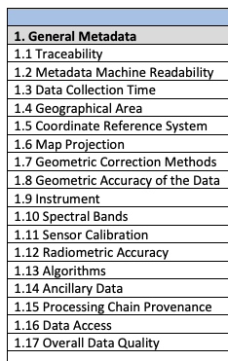
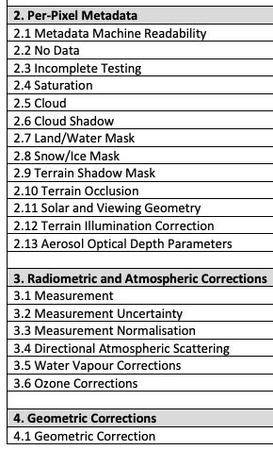
CEOS-ARD Product Family Specifications
Product Family Specifications (PFS)
Specifications for each geophysical measurement
Detail ‘Threshold’ and ‘Target’ requirements for a variety of parameters

Slide 6
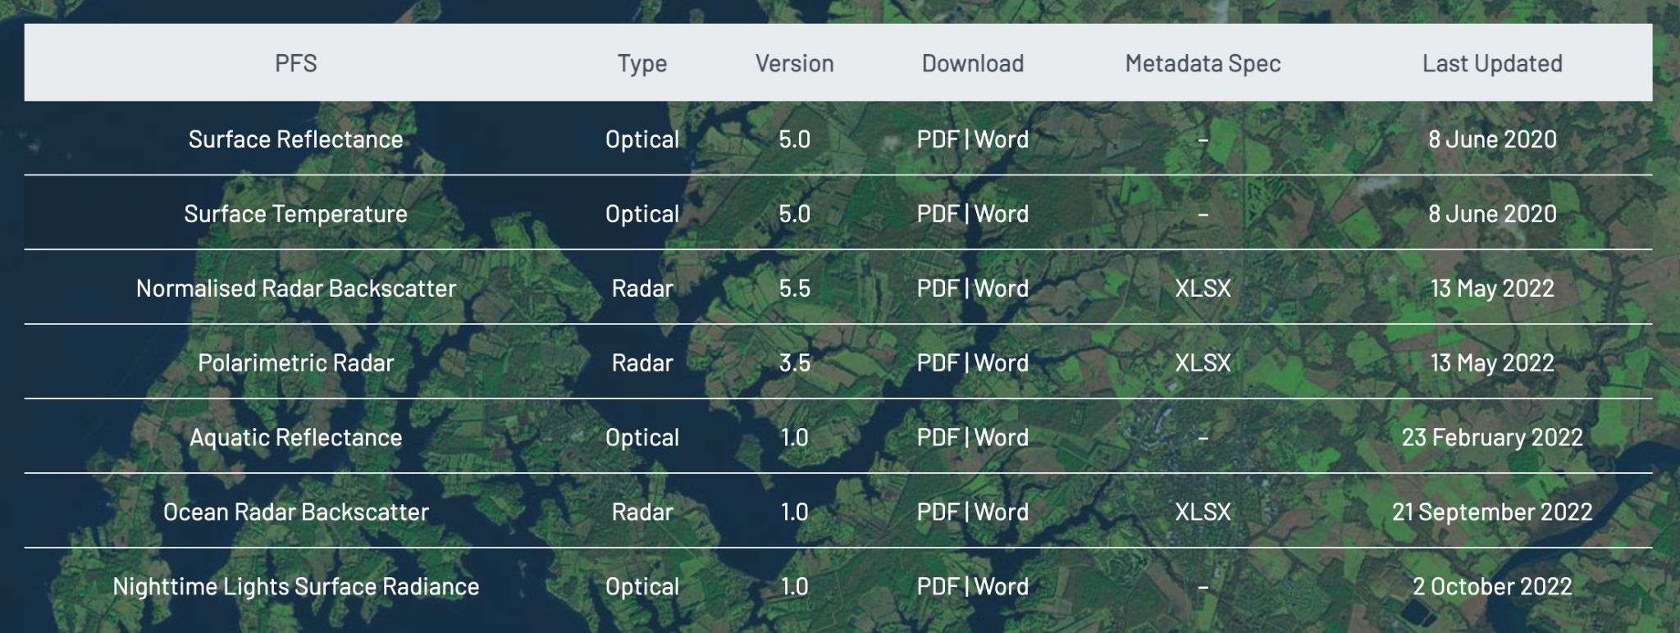
Current + In-development CEOS-ARD Specifications
Land
Inland and Coastal Waters
Oceans
Optical
Surface Reflectance
Surface Temperature
Nighttime Lights Surface Radiance
LiDAR Terrain and Canopy Top Height
Radar
Normalised Radar Backscatter
Polarimetric Radar
Geocoded Single-Look Complex (GSLC)
Interferometric Radar (INSAR)
Aquatic Reflectance
Ocean Radar Backscatter
http://ceos.org/ard/index.html#specs

Slide 7
CEOS-ARD for Synthetic Aperture Radar
Endorsed:
Normalised Radar Backscatter (NRB v5.5)
Polarimetric Radar (POL v3.5)
Ocean Radar Backscatter (ORB v1.0)
Endorsed @ LSI-VC-14 in Oct 2023:
Geocoded SLC (GSLC)
Next in line:
Interferometric Radar (INSAR)
Community uptake:
Approved NRB compliant:
DE-Africa/Sinergise (Sentinel-1)
JAXA (ALOS-2 PALSAR-2)
CSIRO (NovaSAR-1) [NEW]
Ongoing NRB self-assessments or in development
ESA (all SAR), DLR (S1), NASA (OPERA), CONAE (SAOCOM), ISRO (RISAT-1A), KARI (KOMPSAT-5), …
ALOS-2 PALSAR-2 Polarimetric Decomposition
©JAXA
Proc. by F. Charbonneau

Slide 8
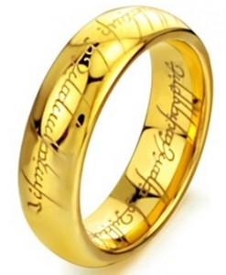
CARD4SAR – One PFS to Rule Them All
Single PFS for all CEOS-ARD SAR products:
NRB, POL, ORB, GLSC
Benefits:
Ensure consistent parameter names and specifications across all SAR PFSs
Simplify PFS revisions and change tracking
Simplifying interface with ongoing external standarisation frameworks (OGC/ISO, STAC)
Elegance:
CARD4SAR PFS facilitates the generation of one, several or all of the CARD SAR products – a true combined SAR ARD product
Reduces duplication of per-pixel metadata
CEOS-ARD for SAR

Slide 9
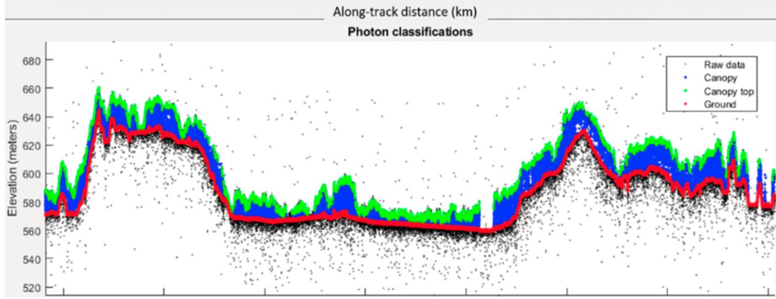
CEOS-ARD for (Spaceborne) Lidar
PFS: Lidar Terrain & Canopy Height
Footprint (1D single-source) product
Gridded (2D multi-source) product – under discussion
Prime focus on spaceborne Lidar
Accommodating full waveform and photon counting systems
Current ARD-Lidar Team Members
Lidar Mission Teams:
GEDI, MOLI, ICESat-2
Data Providers:
NASA LP-DAAC; NSIDC; USGS (TBC)
Science community
Schedule (easy does it...)
First PFS draft: Q1/2024
Lidar Terrain & Canopy Top Height PFS draft (based on new CEOS-ARD PFS template)
Terrain & canopy top height from ICESat-2
(Neuenschwander et al, 2019)

Slide 10
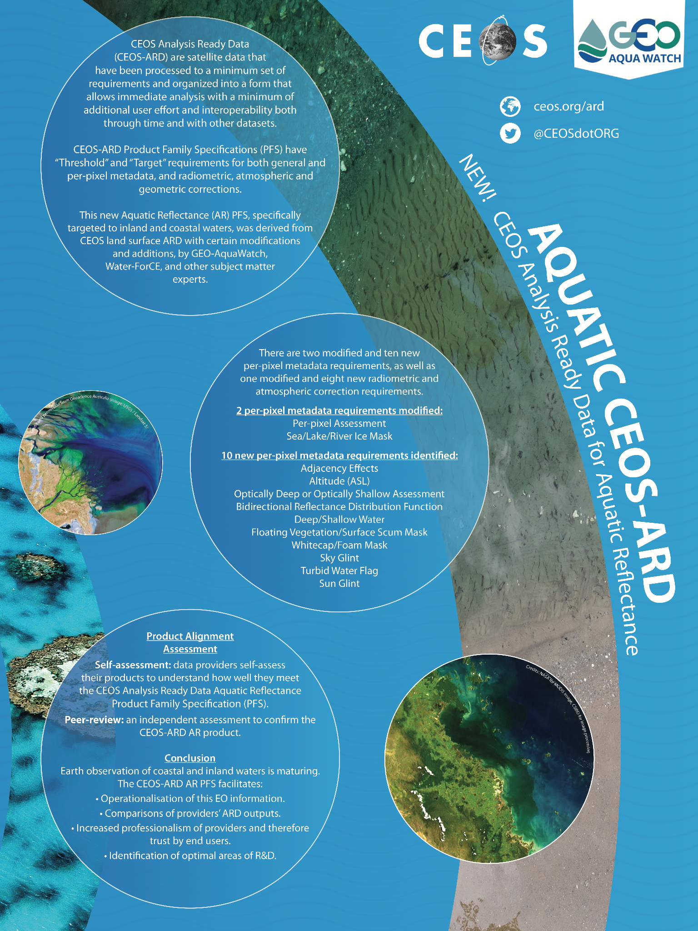
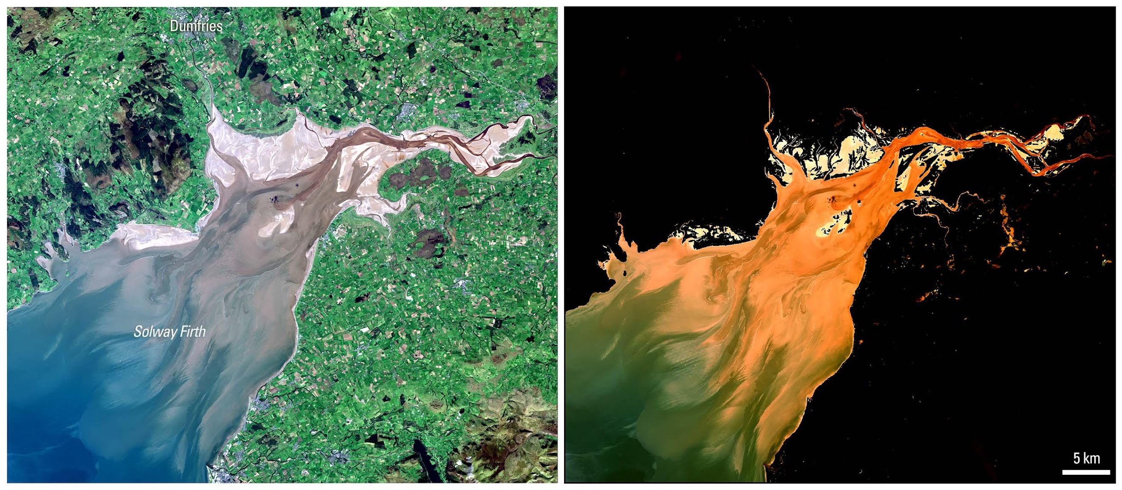
Aquatic Reflectance (AR) PFS Expansion to Oceans
Existing Aquatic Reflectance (AR) PFS applies to data collected by multispectral and hyperspectral sensors operating in the VIS/NIR/SWIR wavelengths over coastal and inland water bodies
Developed in collaboration with GEO-Aquawatch, Water-ForCE and subject matter experts around the world
November 2022: CEOS-ARD Oversight Group, including others from the ocean observing community, reaffirmed that a single consolidated AR PFS covering inland, coastal and oceanic waters is the preferred approach and should be developed in collaboration between CEOS OCR-VC, GEO Aquawatch, and International Ocean Colour Coordinating Group (IOCCG)
Ensure what is baselined for the land domain, does not break
Early 2024 expect presentation of recommendations to the CEOS-ARD Oversight Group to update the AR PFS to include oceanic waters
More details here
Source: USGS Provisional Aquatic Reflectance

Slide 11
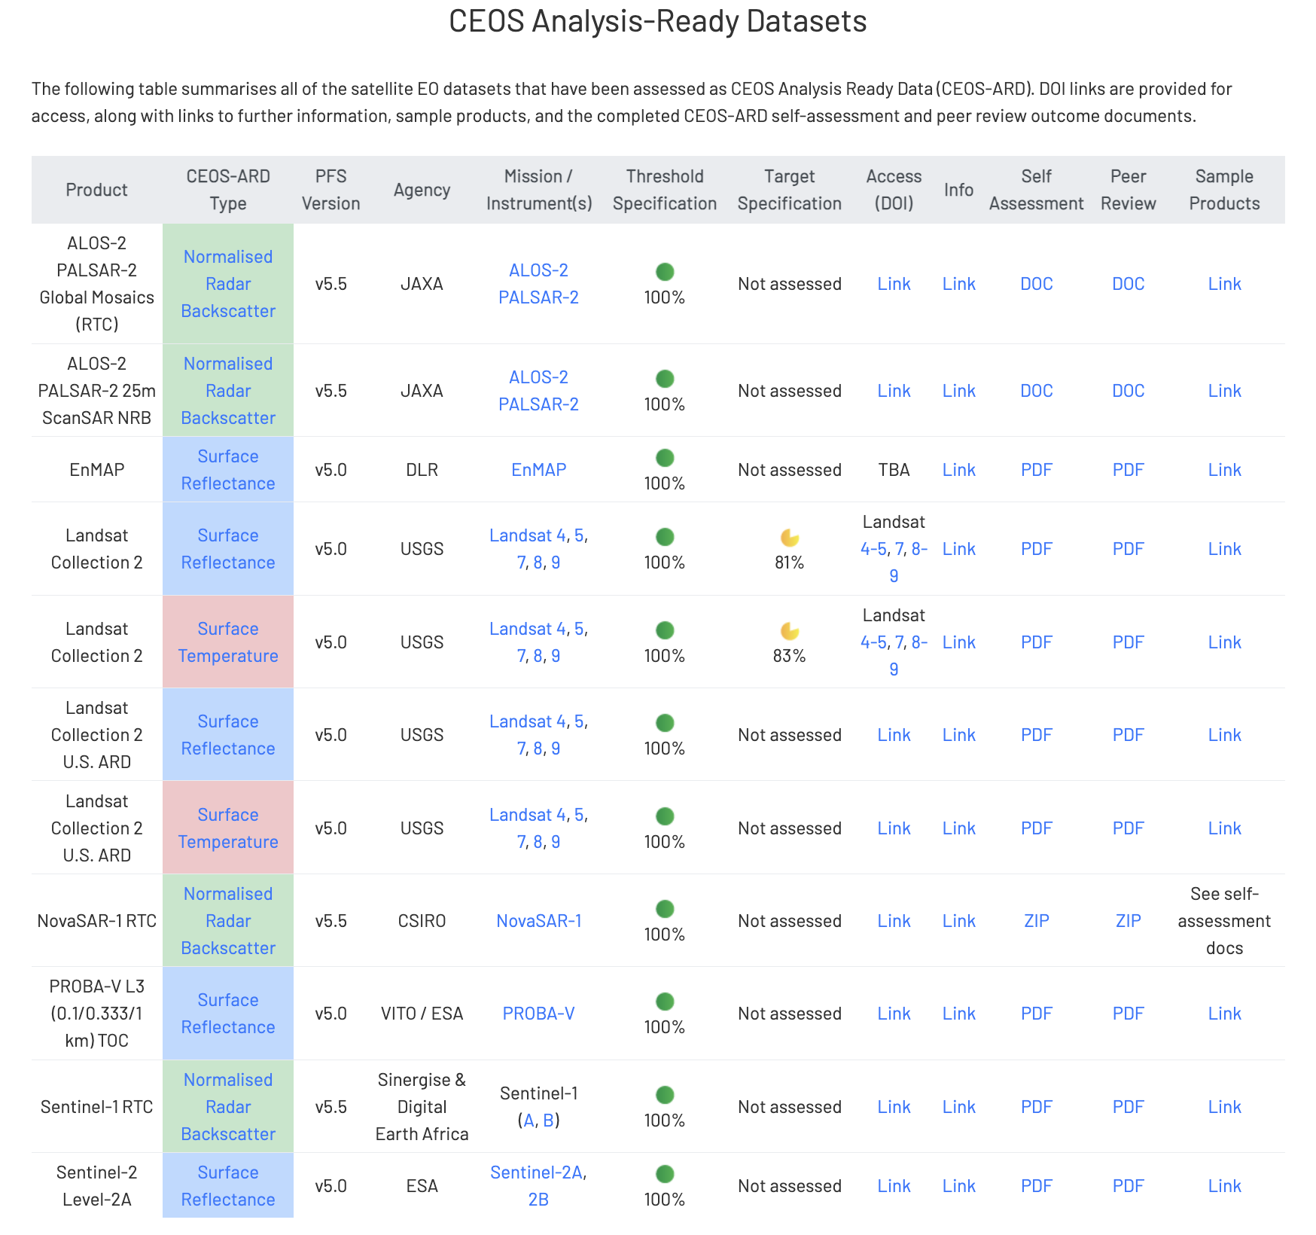
Current CEOS-ARD Products
Updates since 36th CEOS Plenary
Tables at ceos.org/ard
New!
New!
New!
New!

Slide 12
Status of ESA CEOS-ARD Products
Mission | Product | PFS | Status | Availability Date
Sentinel-2 | L2A | SR | ✅ | January 2022
PROBA-V | Collection 2 | SR | ✅ | March 2023
Sentinel-2 | L2H | SR | Under Development | 2023 (pilot product), TBD (operational product)
Sentinel-2 | L2F | SR | Under Development | 2023 (pilot product), TBD (operational product)
Sentinel-2 | L2A | AR | Under Development | TBD
Sentinel-1 | NRB / ORB | NRB / ORB | Under Development | TBD
Sentinel-3 | SYN | SR | Under Development | TBD
ERS SAR | TBC | NRB | Under Development | TBD
ERS ATSR | TBC | LST | Under Development | 2024
Envisat ASAR | TBC | NRB | Under Development | TBD
Envisat MERIS | TBC | SR | Under Development | 2024
CHIME | L2A | SR | Under Development | 2029
CHIME | L2H/L2F | SR | Under Development | 2029 (pilot product), TBD (operational product)
LSTM | L2A | ST, SR | Under Development | 2029
LSTM | L2H/L2F | ST, SR | Under Development | TBD
ROSE-L | TBD | NRB…TBC | Under Development | TBD

Slide 13
Under Development
KOMPSAT-3/3A Surface Reflectance
KOMPSAT-5 Normalised Radar Backscatter
SPOT 1-7 Surface Reflectance
RISAT-1A (EOS-04) NRB SAR
Resourcesat-2/2A
NovaSAR
SAOCOM
Landsat Surface Reflectance and Surface Temperature
Gaofen-1/6 Surface Reflectance
AVHRR LST Surface Temperature
DESIS L2A Surface Reflectance
EnMAP Aquatic Reflectance
Sentinel-1
OPERA project

Slide 14
What Next?
Sea Surface Temperature?
Precipitation?
Ocean Colour?
Atmospheric Composition Datasets?
Active discussion by CEOS Virtual Constellations and CEOS-ARD Oversight Group. Demonstration and user demand is key.

Slide 15
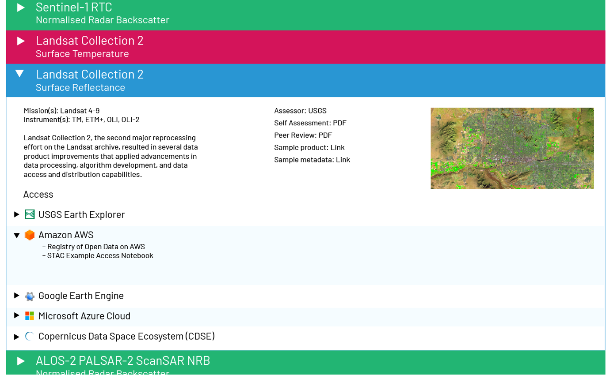
CEOS-ARD Discovery and Access
Getting all of this CEOS-ARD into the cloud, and making it accessible and interoperable across all major cloud platforms should be a priority for CEOS Agencies.
CEOS WGISS has been advancing the concept of an ‘Interoperability Framework’
CEOS-ARD is the first step on the “interoperability spectrum”, and a number of additional interoperability factors also need to be addressed. Considerations include:
data formats, including cloud-optimised formats
discoverability and accessibility standards
consistent terminology
references and DEMs
consistent front-end data discovery and APIs for cross-cloud data access
consistent metadata; Spatio-Temporal Asset Catalog (STAC)
data versioning and collections
authoritative data sources, etc.
Under development concept for ceos.org/ard refresh with improved CEOS-ARD data access links

Slide 16
OGC/ISO ARD SWG Engagement
Significant activity and discussion in the broader EO community around ‘Analysis Ready Data’
Term ‘ARD’ is inherently subjective
CEOS, with its long heritage, experience, and expertise has a key role to play in defining ARD for the community (Incl. ‘New Space’)
Feedback from industry (VH-RODA, JACIE, LPS, ARD2x) that formal standards are needed for ‘ARD’
Government and commercial sectors will likely not reference documents and commit funds unless they have gone through an open standard process (formal peer review, etc.)
Standards built on the foundation of CEOS-ARD would be helpful
Increase reach of the concepts of CEOS-ARD
Expansion beyond satellite EO data to geospatial data more generally
OGC/ISO ARD SWG progress has been slow, but now moving towards drafting text now
CEOS-ARD Oversight Group, LSI-VC, CEOS SEO actively engaging to ensure consistency with CEOS-ARD
Patrick Quinn (NASA) nominated as a co-chair
CEOS pushing for broad community engagement (space agencies, commercial sector, etc.) to ensure resulting standard is relevant and used!
Pushing for robust first principles framework that ensures strong foundation that is extensibile

Slide 17
How to get involved in CEOS-ARD?
Uptake and engagement beyond CEOS is critical
Any data provider can submit a self-assessment against the PFS
PFS updates – all feedback goes into the process
Involvement in the CEOS Virtual Constellations
Development of new Product Family Specifications
Technical inputs and discussions
Contact: matthew@symbioscomms.com
ARD standards discussion
Based on the foundation of CEOS-ARD
Opportunity to input to that process
Contact: matthew@symbioscomms.com

Slide 18
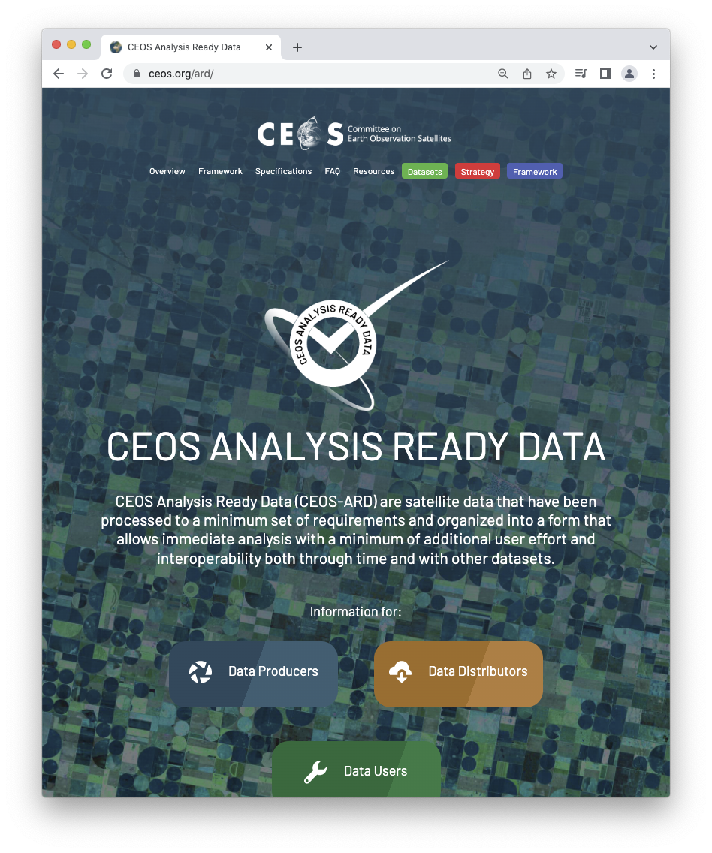
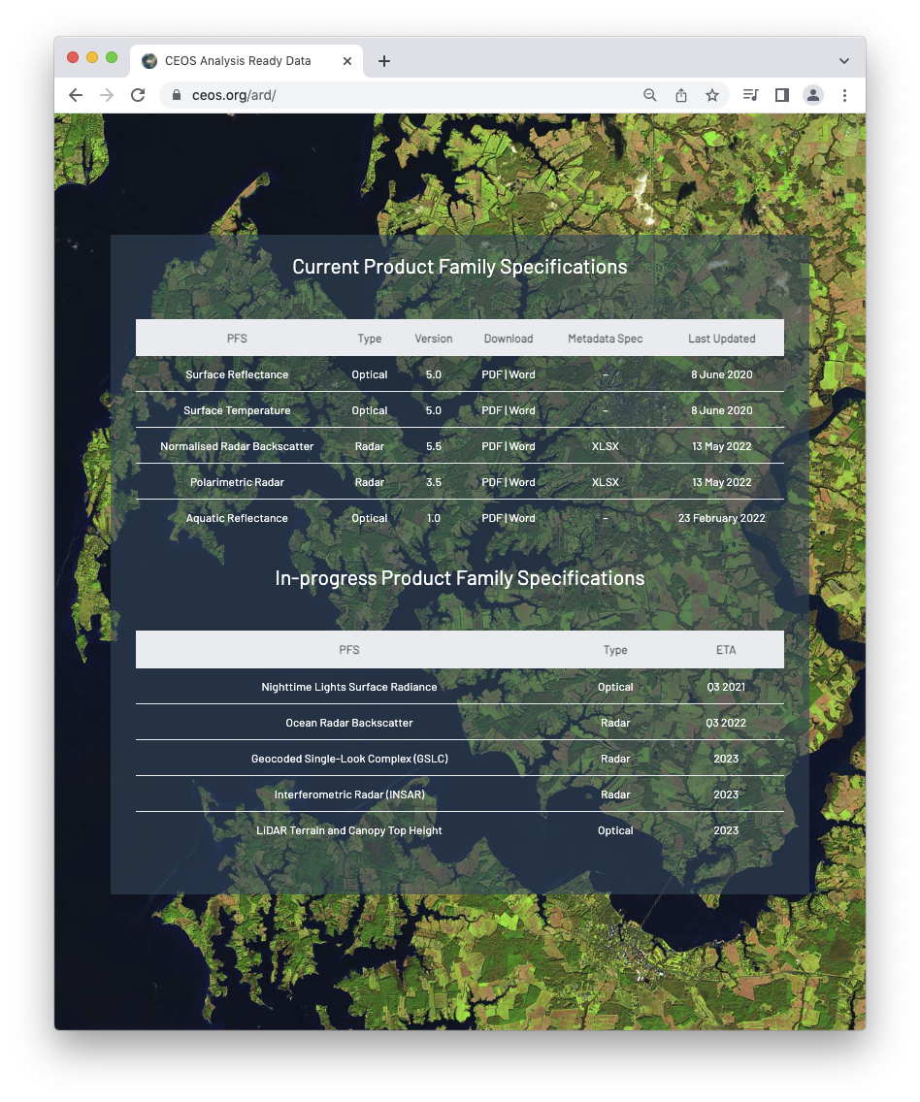
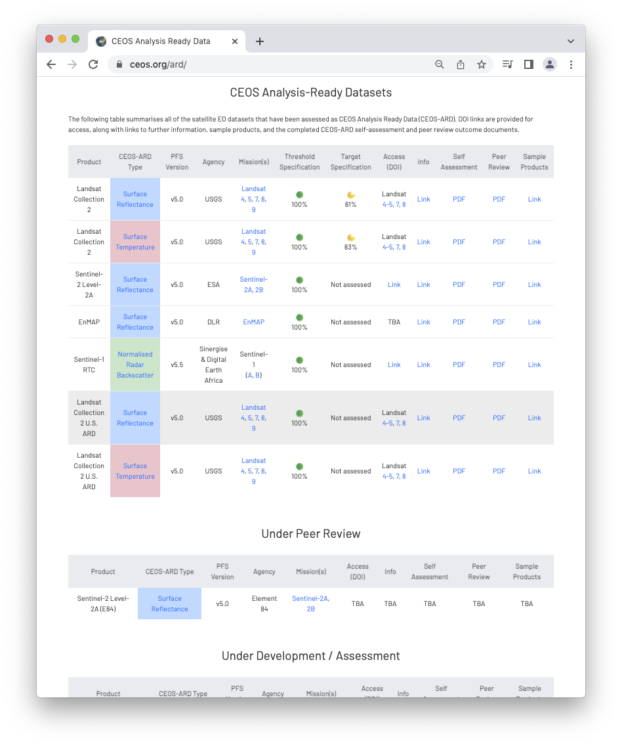
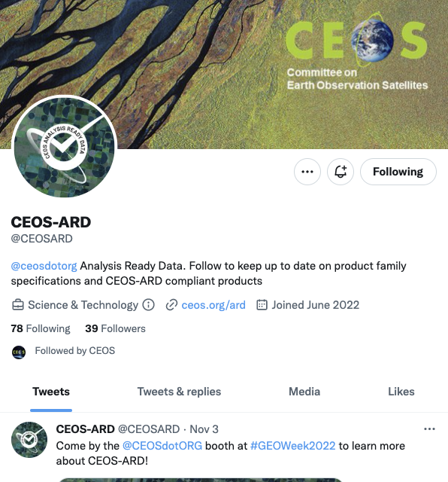
More information
ceos.org/ard
CEOS-ARD Newsletter Sign-up
Past issues: https://ceos.org/ceos-ard-newsletter/
https://twitter.com/CEOSARD
Contacts:
Ferran.Gascon@esa.int
matthew@symbioscomms.com
ard-contact@lists.ceos.org

Slide 19
Thank you!

Slide 20
CEOS-ARD Oversight Group Members
Ferran Gascon (Lead) SIT Chair Team
Matthew Steventon Secretariat
Andreia Siqueira LSI-VC
Steve Labahn LSI-VC
Peter Strobl LSI-VC
Maycira Costa OCR-VC
Mark Higgins OST-VC
Ed Armstrong SST-VC
Chris Kidd P-VC
Barry Lefer AC-VC
Medhavy Thankappan WGCV
Philippe Goryl WGCV
Makoto Natsuisaka WGISS
Jorge Del Rio Vera WGCapD
Mailing list: ard-oversight-group@lists.ceos.org

