Slide 1
CEOS Missions Instruments & Measurements (MIM) Database
Ivan Petiteville, ESA
Agenda Item 11.2
CEOS Plenary 2023
16th - 17th November 2023, Chiang Rai

Slide 2
Context
CEOS MIM Database is the cornerstone of all CEOS coordination and planning
Origins were the CEOS EO Handbook (1992) and WMO database (mid 90s) initiated by Don Hinsman
Annual survey process to remain current
ESA contributes the database and Handbook as a standing significant contribution to CEOS
CEOS Work Plan Service

Slide 3
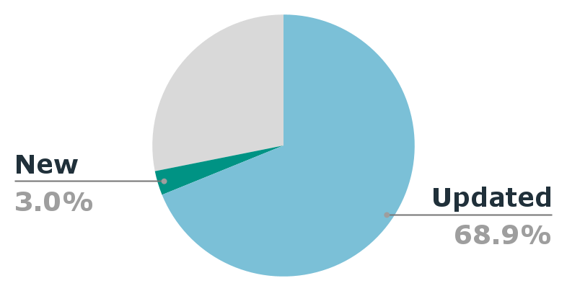
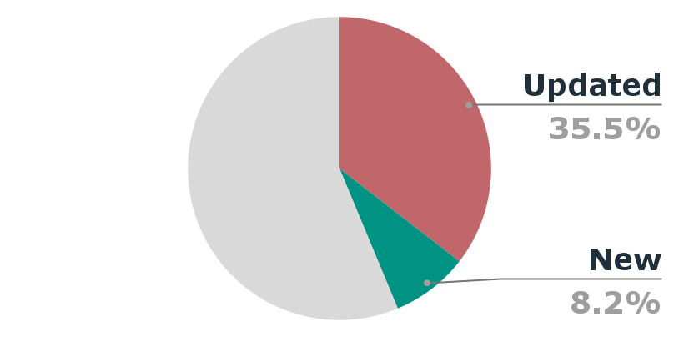
2023 Survey
41 agencies surveyed
32 responses (78%) - 26 provided updates
Missing nine agencies: AEM (Mexico), AGEOS (Gabon), NASRDA (Nigeria), NIER (Republic of Korea), NRSCC / CAST, CNSA / CRESDA (China), NSAU (Ukraine), SANSA (South Africa), Tubitak (Turkey), UAE SA (UAE)
11
42
new mission records
new instrument records
330
new/updated instrument measurement records
252 mission records updated
181 instrument records updated
51
new/updated instrument waveband records
Thank you to all the Agency POCs - we know it can be a tough exercise, especially for the larger agencies!

Slide 4
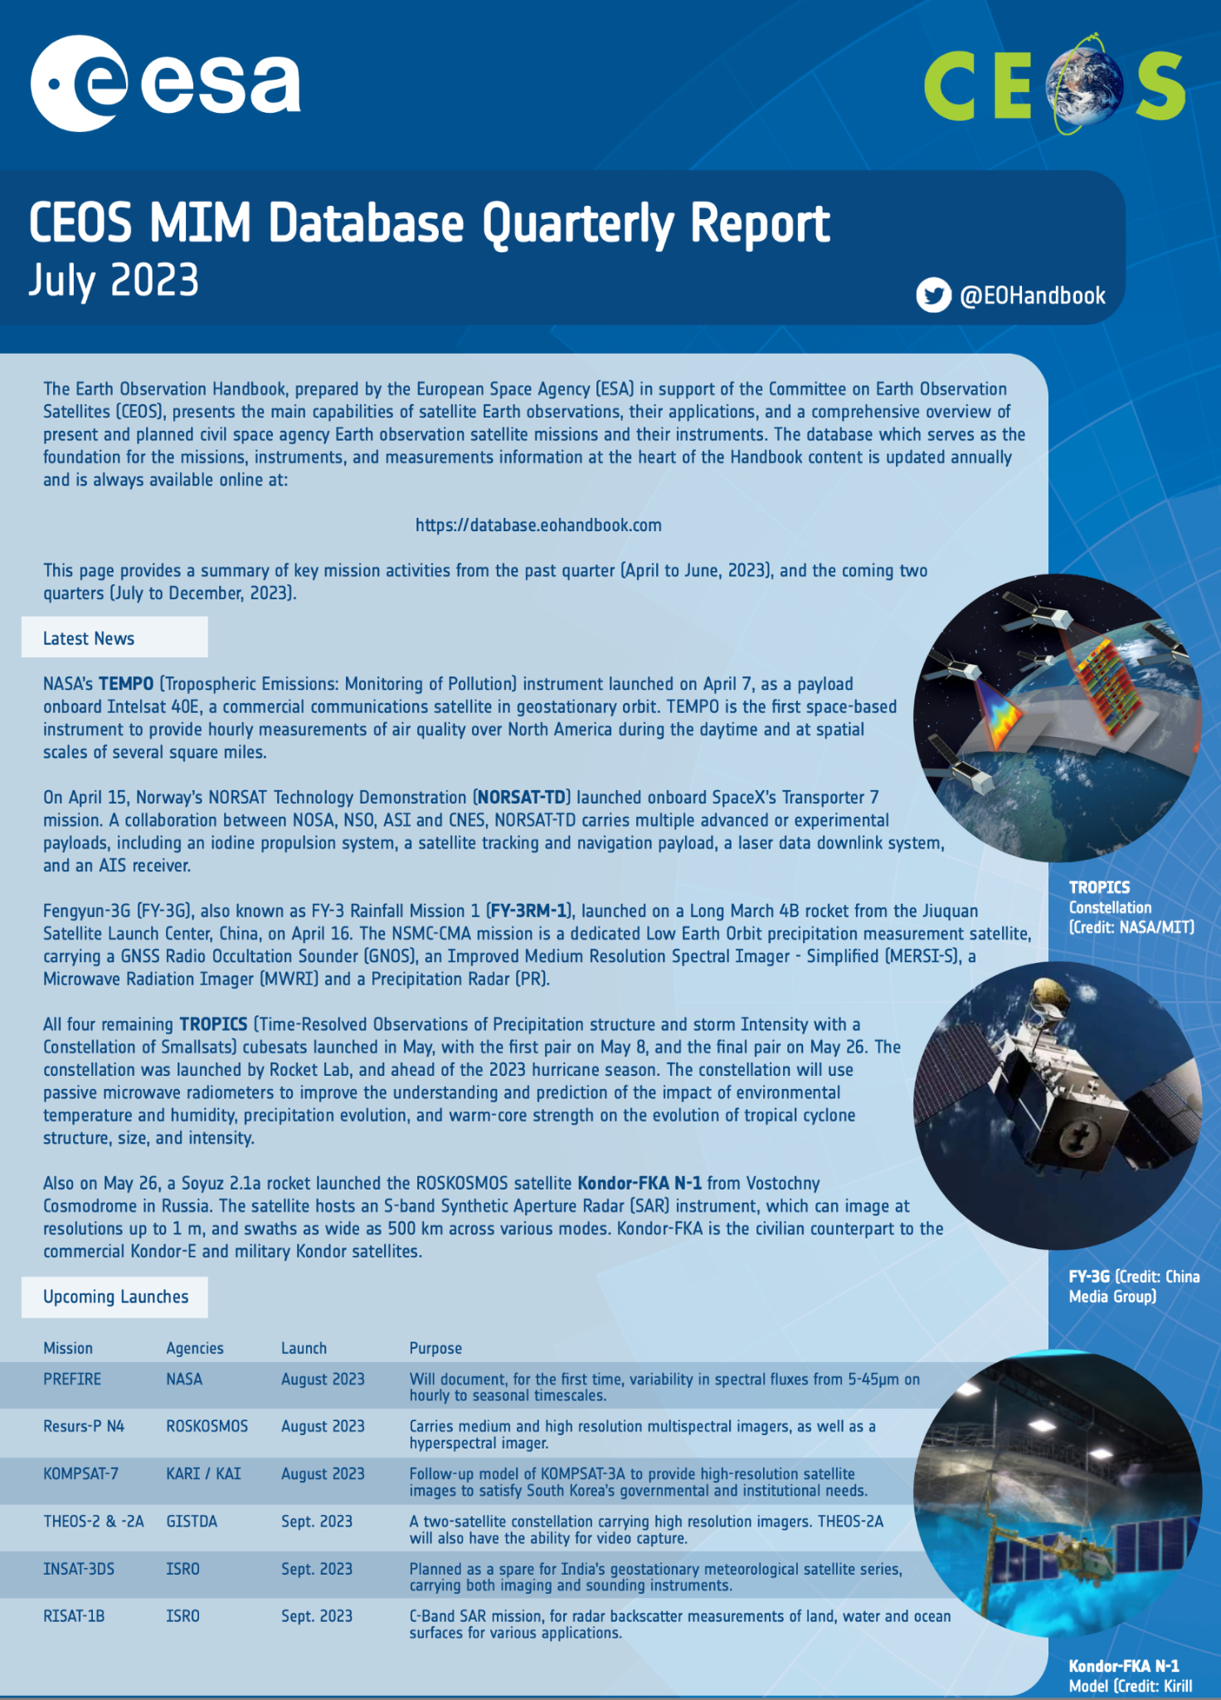
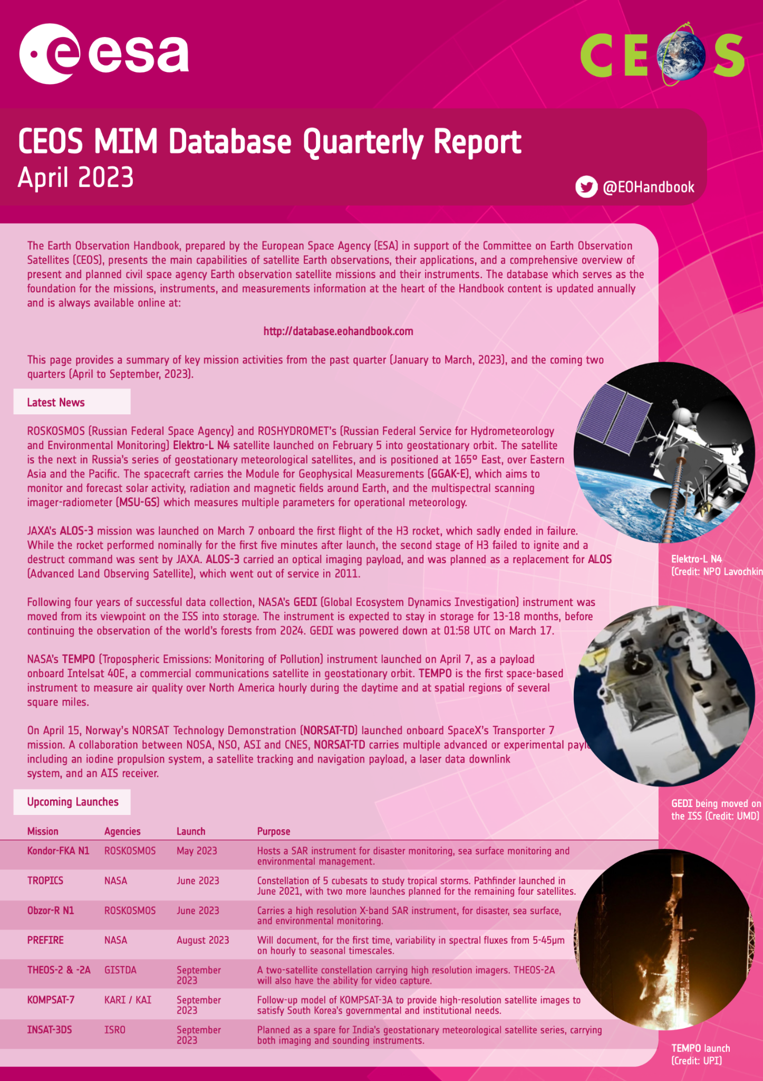
Recent developments
Quarterly updates
Cooperation with WMO to ensure compatibility and complementarity of info and interfaces
Links to eoportal.org (ESA)
NORAD ID and UCS database linkages/checks
CEOS database toolkit for admin & power users
Inclusion of some non-CEOS missions for certain applications (like GHG Portal)
Not visible for general use
Used for many CEOS & agency applications and analyses

Slide 5
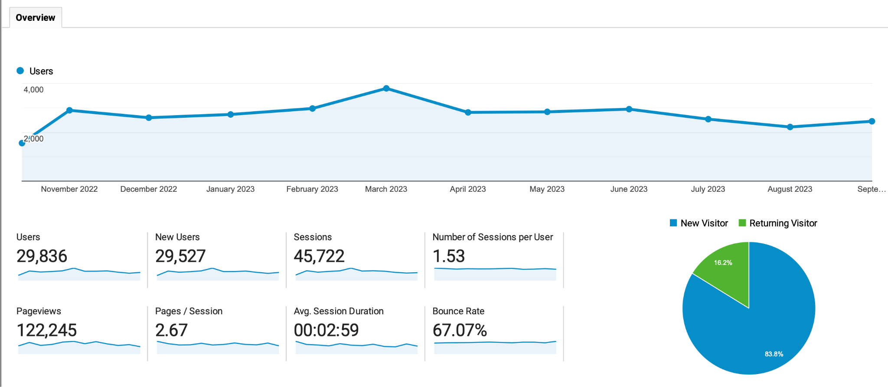
User growth
Up over 100% YoY

Slide 6
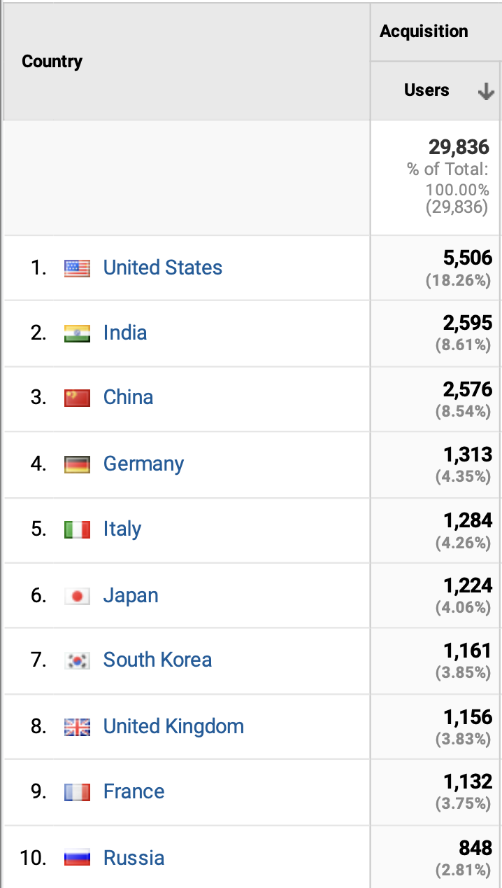
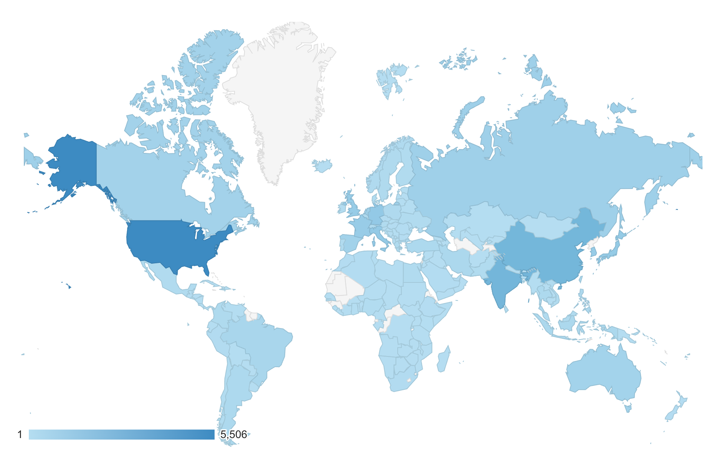
Global users Oct 22 - Sep 23

Slide 7
Future plans
Continued linkages to available web resources (eoPortal, OSCAR and more) to stay relevant
Ability to include commercial missions for specific applications as needed
Visual interface somewhat overdue a refresh (~2024)
Further development of toolkit for admin and applications
CEOS Teams pages an option (akin to GHG Portal)
Continued leverage of SEO interests and support
Further linkages for users keen on accessing actual data
Consultation process in 2024 - but feedback welcome at any time!

