Slide 1
Systems Engineering Office Report
David Borges
CEOS SEO, NASA
Agenda Item 11.1
CEOS Plenary 2023, GISTDA
16 November 2023

Slide 2
CEOS Communications Strategy
David Borges, SEO, NASA
Libby Rose, CEOS Comms Team
CEOS Community

Slide 3
Action SIT-38-07
SEO to bring an updated CEOS Communications Strategy to CEOS Plenary 2023 for consideration
The final document is available here
Document outline:
1. Executive Summary
2. Introduction & Objectives
2.1. CEOS Mission
2.2. Communications Objectives
3. Situation Analysis
4. Stakeholders
4.1. Internal CEOS
4.2. External CEOS
5. Campaigns
5.1. 40th Anniversary of CEOS
5.2. EO for Biodiversity
5.3. Greenhouse Gas Observations from Space
6. Content Types & Processes
6.1. CEOS Blog
6.2. CEOS Newsletter
6.3. CEOS Quarterly Revisit
6.4. Social Media
6.5. Video
7. Measuring Impact
7.1. Goals for Publication
7.2. Measuring Success
7.3. Reporting
8. Implementation & Execution
8.1. Core Comms Team
8.2. CEOS Community Liaisons
8.3. CEOS Agency Communications Staff
8.4. Contacts & Connections
9. Conclusion

Slide 4
Stakeholders
Internal CEOS Communications
External CEOS Communications
CEOS Principals
Working Teams
Ensure cross-cutting work is shared broadly
Decision Makers
Including local/regional, governments UN Agencies
EO Experts
Academics, technicians and commercial EO industry
Candidate CEOS Members/Associates
Organisations who meet the criteria to join CEOS
EO Allies
E.g. biodiversity experts, urban planners

Slide 5
Campaigns
40th Anniversary of CEOS Jan - Dec 2024
Reflect on past 40 years, and look to the future
EO for Biodiversity Plenary 2023 - Plenary 2024
Support CSA Chair Priority
Promote EETT White Paper & EO for Ecosystems
Greenhouse Gas Observations from Space 2024-2025
Support JAXA SIT Chair Priority
Promote related deliverables and activities

Slide 6
Implementation & Execution
Core SEO Comms Team
Responsible for publishing all content – Libby Rose
CEOS Community Liaisons
Volunteers from across CEOS Community, including CEOS Executive Officer
So far: Katy Matthews (NOAA), Chris Barnes (USGS), Flora Kerblat (CSIRO), Lucie Viciano (CSA), Marie-Claire Greening (ESA, CEO)
More nominations welcome
CEOS Agency Communications Staff
To help cross-promote relevant content
CEOS Entities
It is expected that CEOS Working Groups, Virtual Constellations, and other teams contribute one piece of communications each year

Slide 7
Measuring Impact
Goals for publication:
2 blog articles each month (total of 24 annually)
Annual series of articles focusing on one Chair or SIT Chair priority
1-2 videos published each year, focusing on topics of interest to Chair, SIT Chair or otherwise
Publication of Quarterly Revist, 4 times per year
Monitor analytics:
Views per blog post
Social media followers
Average engagements on social media posts
Submit 1-2 page report to SEO annually prior to SIT meetings, reporting on the progress towards the above goals
SEO can submit the report to SIT for information if desired

Slide 8
Why should CEOS value Comms?
GLOC 2023 Key Takeaways
“What” and “How” are common space press themes – but communicating “Why” is critical to politicians, citizens and end-users.
There is a gap in knowledge and awareness across different sectors of how satellite data can help address climate change mitigation and adaptation.
“We must learn how to communicate Earth observations role more effectively.” –Steven George, ESA, SpaceWatch.Global

Slide 9
SDG Coordination Group
Continuity & Future Work
David Borges, SEO, NASA
Marc Paganini, SIT Chair Team, ESA
Flora Kerblat, CSIRO

Slide 10
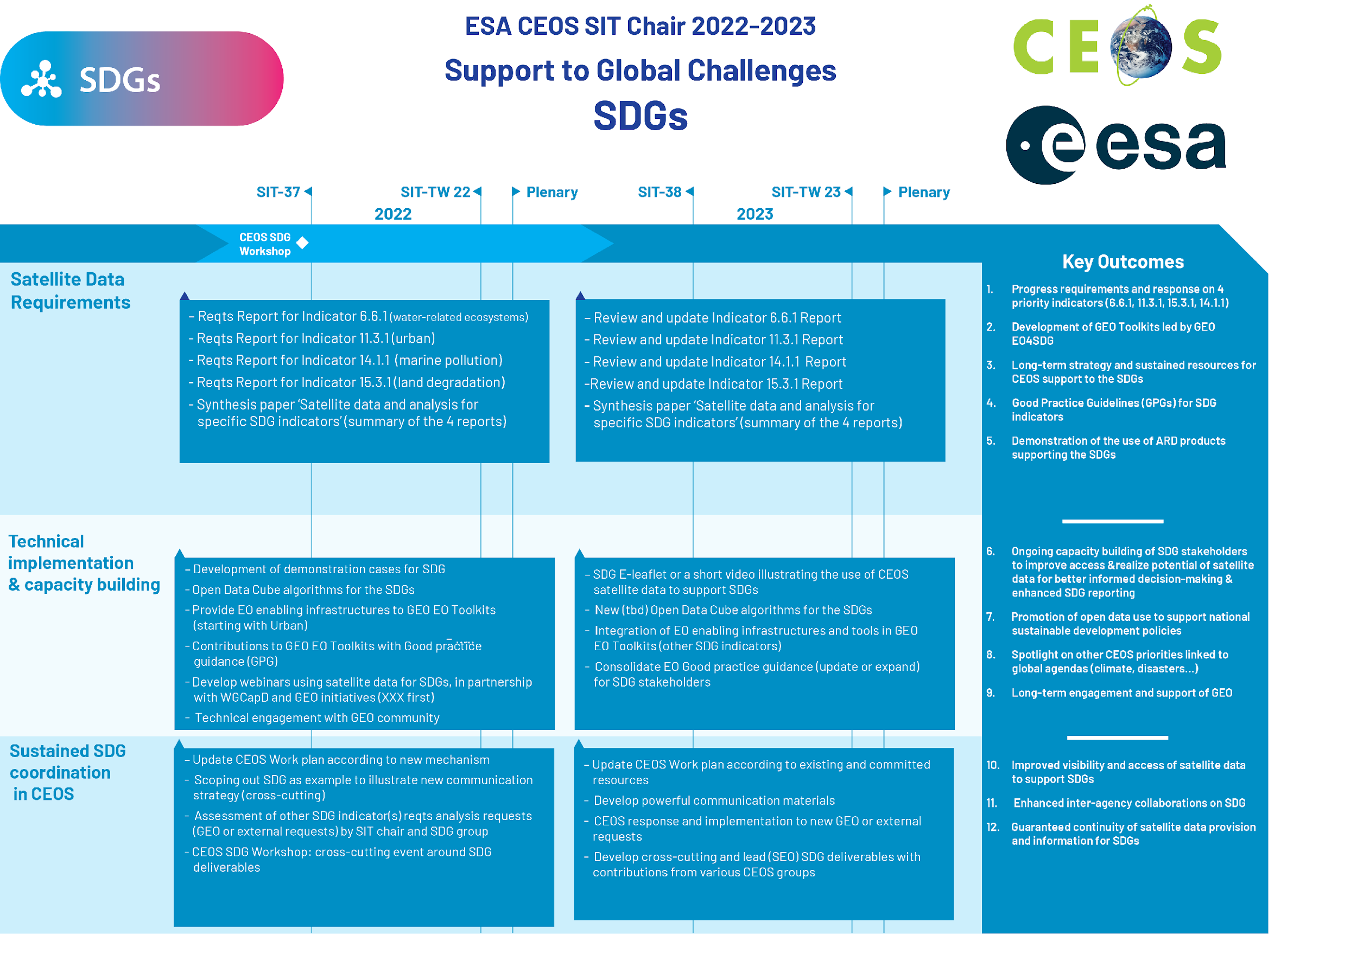
ESA CEOS SIT Chair 2022-2023
ESA CEOS SIT chair priorities on SDGs
for the 2022-2023 time frame
3 main lines of SDG priorities
Analysis of the relevance of satellite data for SDG indicators, starting with SDG 6.6.1 (water), 11.3.1 (urban), 14.1.1 (marine pollution) and 15.3.1 (on land degradation)
EO demonstrators and Capacity Building (in partnership with GEO activities and CEOS WGCapD)
Sustainable CEOS coordination and involvement on SDGs

Slide 11
SDG Coordination Group: Members
Name | Organization
Marc Paganini | ESA
Marie-Claire Greening | ESA / CEOS CEO
David Borges | NASA / CEOS SEO
Brian Killough | NASA / CEOS SEO
Flora Kerblat | CSIRO
Neil Sims | CSIRO
Alex Held | CSIRO
Paul DiGiacomo | NOAA
Martyn Clark | GEOSEC
Julie Chamberlain | NASA / EO4SDG
Libby Rose | CEOS Communications Team / Symbios
Lead Agencies: ESA, NASA, CSIRO, NOAA
SME Content support: CNES, SANSA, JAXA, DLR, etc.
Technical contributions rely on experts across CEOS and external bodies (GEO communities, UN Agencies, etc.) including many other CEOS Agencies
Slide ‹#›

Slide 12
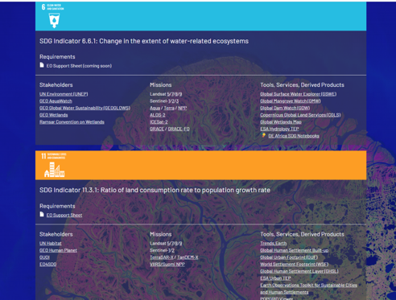
SDG Coordination Group in 2023
The group has been meeting monthly and organised 3 face-to-face side-meetings (SEO-led): Notes
ceos.org/sdg
A few accomplishments this year…
Completed most planned 2023 deliverables
Contributed SDG perspectives to New Space Task Team
Assessed GEO-CEOS coordination in a changing context
Coordinated CEOS capability with WGCapD to support UN Space Training event in Brindisi Italy, 17 Oct
Re-engaged with the UN-GGIM IAEG-SDGs WG Geospatial Information (WGGI) and offered its contribution to “Rescuing SDGs” proposed paper
Received GEO 2023 SDG Award!
Slide ‹#›

Slide 13
2023 GEO SDG Award
Winner
Recognizing the productivity, innovation, novelty and exemplary efforts in the use of Earth observations to support sustainable development.
CEOS SDG Coordination Group

Slide 14
2023 SDG Deliverables
Number | Objective/Deliverable Title | Projected Completion | Responsible CEOS Entities
SDG-23-01 | EO Support sheet for SDG Indicator 6.6.1 (Water) 2023 Review | 2023 Q4 | ESA
SDG-23-02 | EO Support sheet for SDG Indicator 11.3.1 (Urbanization) 2023 Review | 2023 Q4 | EO4SDG, GEO SEC
SDG-23-03 | EO Support sheet for SDG Indicator 14.1.1 (Marine Pollution) 2023 Review | 2023 Q4 | COAST AHT
SDG-23-04 | EO Support sheet for SDG Indicator 15.3.1 (Land degradation) 2023 Review | 2024 | CSIRO
SDG-23-05 | Land Degradation Neutrality (LDN) Task | 2023 Q4 | SEO, CSIRO
SDG-23-06 | Open Data Cube Applications for SDGs | 2023 Q4 | SEO
SDG-23-07 | Communications packages to demonstrate broad contributions to SDGs for a variety of CEOS groups and initiatives | 2023 Q4 | SEO / Communications Team
Responsible
Marc Paganini
Julie Chamberlain, Martyn Clark
Paul DiGiacomo
Neil Sims
Brian Killough, Neil Sims
Brian Killough
Libby Rose, Flora Kerblat

Slide 15
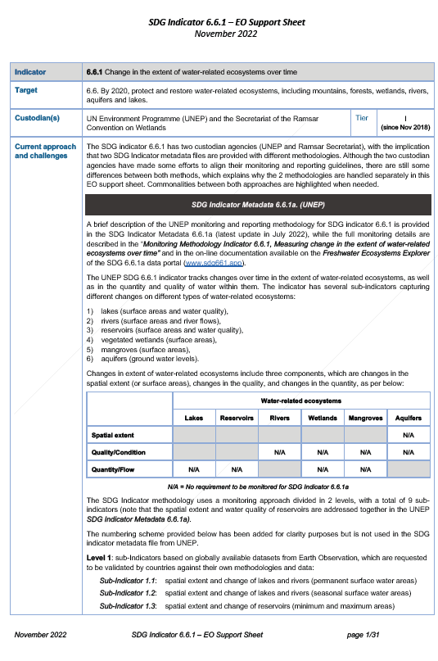
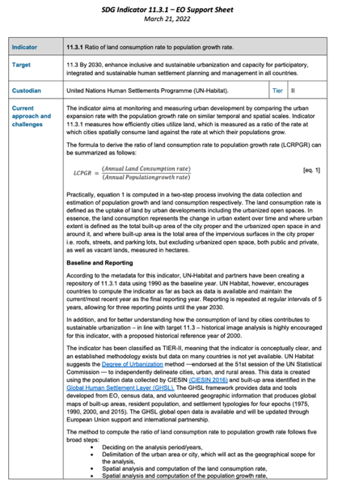
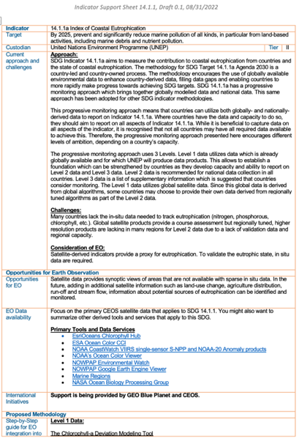
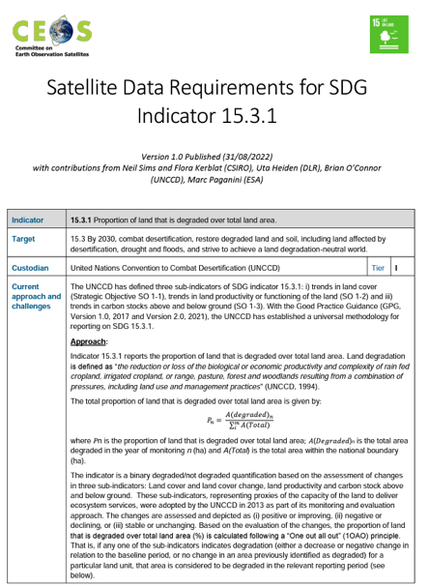
EO Support Sheets
ceos.org/sdg
SDG-23-01
Water
SDG-23-02 Urbanization
SDG-23-03
Coastal Eutrophication
SDG-23-04
Land Degradation
The Earth Observation (EO) Support sheets are a valuable resource for the user community and Custodian Agencies: CEOS plans to keep them updates by undertaking an annual review to ensure that details including current approaches and challenges, data requirements, access and tools, and publication references remain up-to-date and useful.

Slide 16
2024 CEOS SDG Outlook
Planned Activities and Deliverables:
SIT Chair transition [ESA 🡪 JAXA]
Indicator Support Sheets (4) Annual Revisions / Impact
UNCCD / GEO LDN (Pacific focus) Continued Support
OGC SDG Standards Working Group (SWG)
WGCapD: SDG capacity building support
Communications material / outreach
Biodiversity activity (Ecosystem Extent Task Team)
UN-GGIM IAEG-SDGs WG Geospatial Information (WGGI)
Rescuing the SDGs: The Role Geospatial Information
Joint deliverables with ongoing WG/VC/etc activities
Influencing future policy framework now: Beyond 2030
Slide ‹#›

Slide 17
GEO PIAG / DE Pacific Update

Slide 18
CEOS Engagement in the Pacific
GEO Pacific Islands Advisory Group (PIAG)
Advisory body on Pacific activities, created in 2020 following Canberra Ministerial
Co-led by Australia (CSIRO/GA), France (New Caledonia), China, SPC
Co-organized the Oceania Geospatial Symposium (OGC), New Caledonia
Facilitated CEOS Plenary 2022 Special Session to connect Pacific end-users
Digital Earth Pacific (DE Pacific)
Led by SPC (Pacific Community); Needs Assessment Report (2021) informed planning phase
Official launch in November 2023
CEOS SEO serving on new Advisory Committee
Slide ‹#›

Slide 19
Pacific Satellite Data Stocktake
Survey designed by SPC and SPREP, supported by PIAG
Distributed to Pacific EO data regional users
40+ responses received
PIAG-SPC-CEOS (through SEO) engagement has begun:
Draft report shared with CEOS (SEO, CSIRO/GA)
SEO to work with PIAG to refine satellite requirements –
planned report to CEOS in 2024
Satellite datasets
Applications
Time periods most commonly used?
Main issues with open and free datasets currently available
Current limitations for their use
Slide ‹#›

Slide 20
SEO Activities

Slide 21
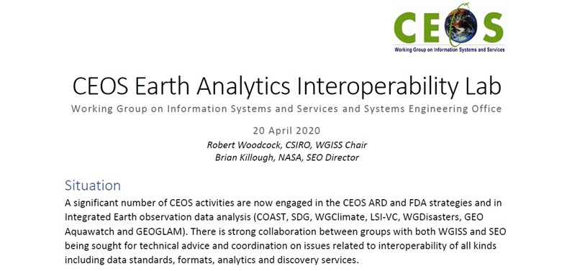
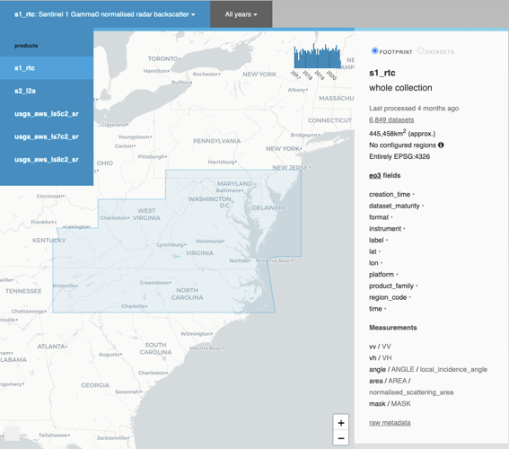
Earth Analytics Interoperability Lab (EAIL)
Initiated in April 2020 as a CEOS WGISS / SEO initiative, EAIL was a data and analytics platform that used AWS Cloud and Open Data Cube. Its advantages included Jupyter Hub, Dask scaling, customized ARD pipelines and GPU processing.

Slide 22
ceos.org/cal

Slide 23
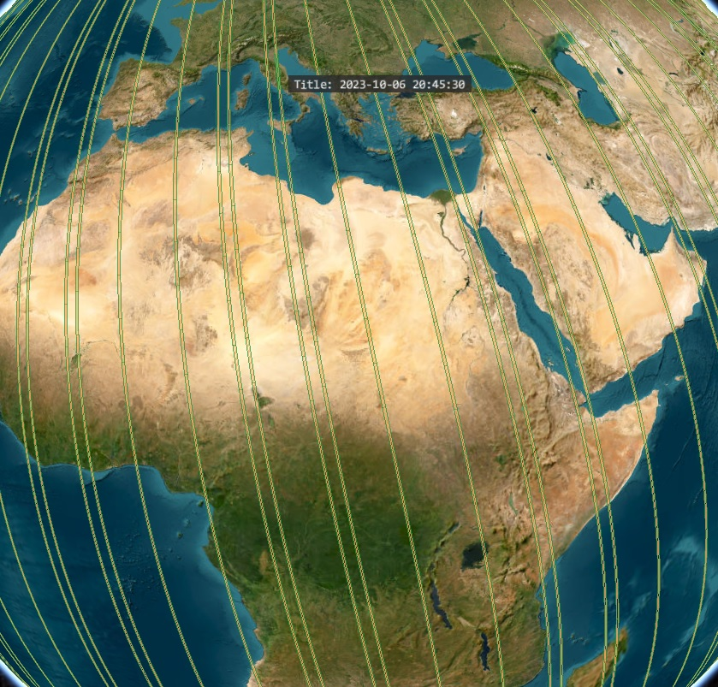
SEO Activities
GEO Infrastructure Development Task Team (GIDTT)
Space-based data, Data Cubes, Cloud providers
ODC Community Engagement
Digital Earth Africa
Digital Earth Pacific
COVE
New commercial missions
STAC data access

Slide 24
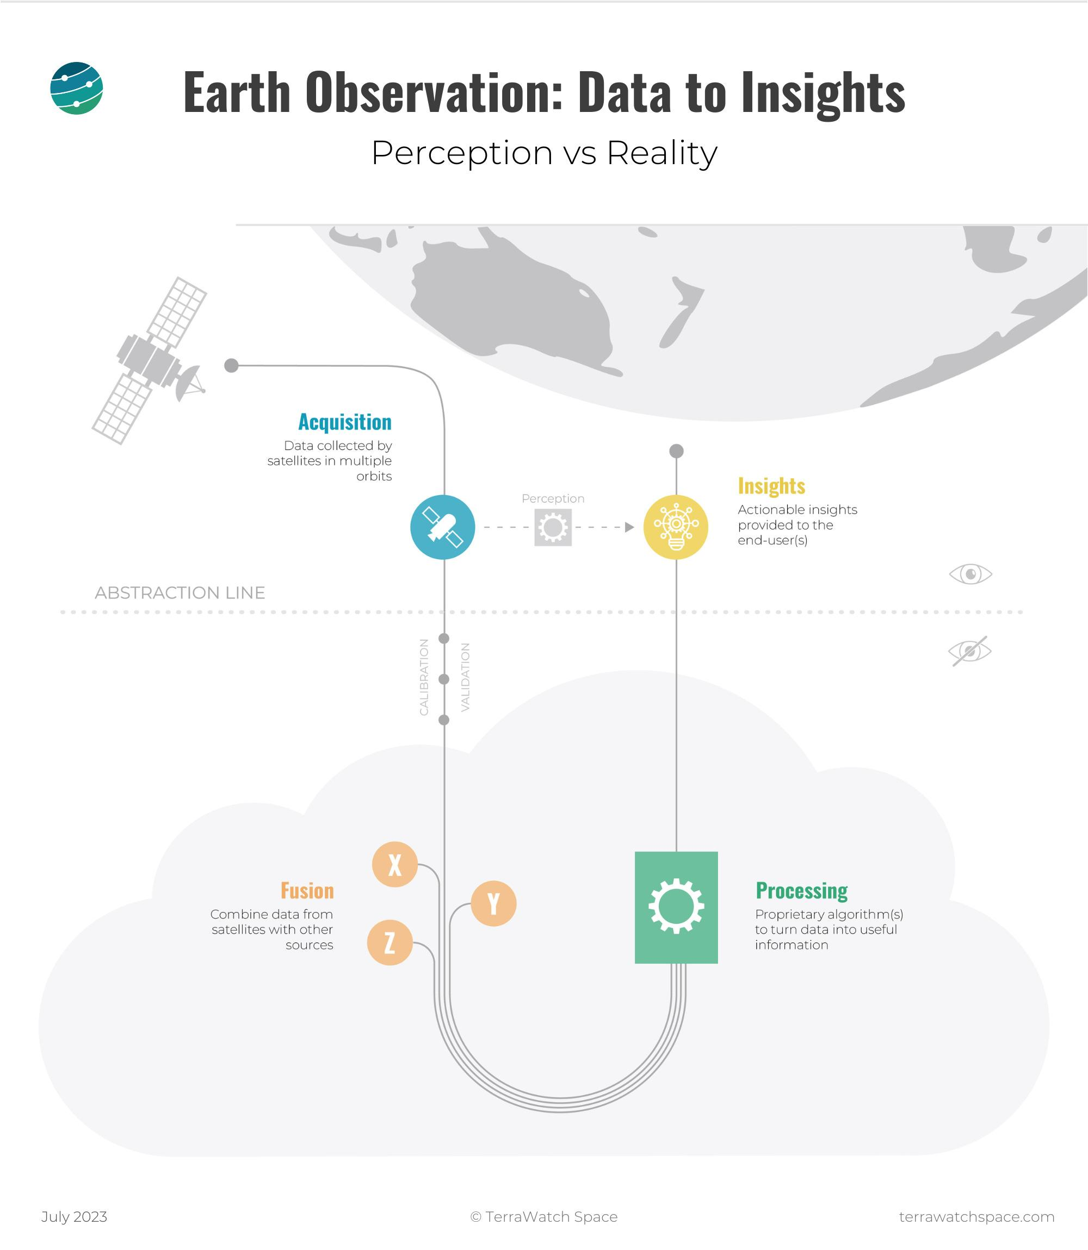
SEO Activities
CEOS ARD
Standards / Community Engagement
Nighttime Lights Occlusion Analysis
AI/ML
WGISS Tech Exploration White Paper
Generative Pre-trained Transformer (GPT) for CEOS
New Space Task Team
Commercial data integration
Interoperability with CEOS datasets

