Slide 1
CEOS Executive Officer report
Marie-Claire Greening
CEOS Executive Officer
Agenda Item 1.2
2023 CEOS Plenary, Chiang Rai, Thailand
14th – 16th November 2023

Slide 2
CEOS Mission & Objectives
Primary Objectives:
To optimise the benefits of space-based Earth observation
To serve as the focal point for international coordination of space-based Earth observation activities
To encourage complementarity and compatibility

Slide 3
CEOS Long-term Priorities
Ensure that climate observation requirements identified by the Global Climate Observing System (GCOS) – and implications of the Paris Climate Agreement – are addressed.
Ensure, in the context of the Sendai Framework for Disaster Risk Reduction 2015-2030, that CEOS Agency data are made available in support of disaster risk reduction and that CEOS continues engagement with UN agencies and authorities.
Ensure that space-based Earth observations support the success of the next decade of the Group on Earth Observations (GEO), and that CEOS engagement in GEO governance and leadership is enhanced.
Proactively engage in global discussions on the critical challenges that face society, in support of the UN 2030 Agenda for Sustainable Development.

Slide 4
CEOS Organisation
CEO
CEOS Chair
SIT Chair
CEOS Secretariat
Troika
SIT Vice-Chair
Working Groups
Past Chair
ARD Oversight Group
WGCapD
WGClimate
Future Chair
Ocean Coordination Group
WGDisasters
GHG Task Team
New Space Task Team
SEO
WGCV
WGISS
SDG Coordination Group
Subgroups
Data Discovery & Access Team
ACSG
Virtual Constellations
Interest Groups
IVOS
Technology Exploration
AC-VC
P-VC
LPV
COAST AHT
Data Preservation & Stewardship
OCR-VC
SST-VC
MSSG
SAR
Data Interoperability & Use
Ecosystem Extent Task Team
OST-VC
LSI-VC
TMSG
OSVW-VC

Slide 5
CEO Responsibilities
Serves the entire CEOS organisation and acts with neutrality
Internal Stakeholders
Focal point on governance, resourcing and processes
Custodian of CEOS Governing Documents, including CEOS Work Plan
Ensures information flow across all CEOS entities and advises CEOS leadership
Handles membership and works with the SEO on comms and outreach
Contact point for all enquiries, responsible for CEOS membership, listservs, website and events calendar … and general housekeeping!
External Stakeholders
Point of Contact for all external stakeholders, both existing and new
CEOS interface to the Group on Earth Observations (GEO); supports coordination meetings sits on the GEO Programme Board and Executive Committee
External interface to all CEOS contacts and represents CEOS at relevant partner and stakeholder meetings

Slide 6
Governance & Work Planning
Four key governing documents primarily guide the work of CEOS:
CEOS Terms of Reference defines the mission and scope of CEOS activities
CEOS Strategic Guidance document articulates the overarching long-term (7-10 years) purpose and goals of CEOS
CEOS Governance and Processes document provides
guidelines on the structure, operations, and processes
CEOS employs to achieve its goals
4. CEOS Work Plan (3-year rolling) sets forth near-term
actions to achieve the goals outlined in the CEOS
Strategic Guidance document. Detailed work defined
as deliverables: outlined in the WP, reconciled and
tracked in CEOS deliverable tracking tool
Jan
Dec
Feb
SIT
Nov
Mar
Plenary
Oct
Apr
Sep
May
SIT TW
Aug
Jun
Jul

Slide 7
2023-25 Work Plan deliverables
Chapter | Closed | Overdue | Due by end 2023 | Due in 2024 | Due in 2025 & beyond
Climate Monitoring, Research, and Services |  | 4 | 1 | 2 | 1
Carbon Observations in Support of Climate Science and Policy | 5 | 3 | 4 | 4
Observations in Support of the Global Stocktake of the UNFCCC |  | 2 | 6
Observations for Agriculture | 1 |  |  | 2
Observations for Disasters |  | 1 | 2 | 5 | 1
Data Quality |  | 2 | 4 | 4 | 3
Capacity Building and Data Democracy | 1 | 8 | 7 | 4
Data Discovery, Access, Preservation, Usability and Exploitation: approaches, systems, tools and technologies | 2 | 1 | 1 | 3
Advancement of the CEOS Virtual Constellations | 4 | 4 | 8 | 5 | 9
Support to Other Key Stakeholder Initiatives | 3 |  | 13 | 2
Totals | 16 | 25 | 46 | 31 | 14

Slide 8
2023 Key Meetings
 | Jan | Feb | Mar | Apr | May | Jun | Jul | Aug | Sep | Oct | Nov | Dec
CEOS Leadership | SEC¹ | UNCOPUOS³ STSC-60 SEC | SIT²-38 SEC | SEC | SEC | SEC | SEC |  | SEC | IAC⁴-74 SIT TW⁵ SEC | CEOS-37 SEC | SEC
Working Groups |  | WGClimate⁸-18 | WGCapD⁶-12 | WGDisasters⁷-19 WGISS¹⁰-55 |  | WGCV⁹-52 |  |  | WGDisasters-20 | WGClimate-19 WGISS-56
Virtual Constellations |  |  | LSI-VC¹²-13 |  |  |  |  |  |  | LSI-VC-14 AC-VC¹¹-19
ad hoc Teams |  |  |  |  |  |  |  |  |  | COAST¹⁴
GEO |  | CEOS-GEO coordination PB¹⁵-25 | ExCom¹⁶-60 |  |  | GEO symposium PB-26 | EXCom-61 |  | PB-27 |  | GEO-19 EXCom-62
Other External |  |  |  |  | UNCOPUOS³-66 | CGMS-51 | IGARSS¹⁸ |  |  |  | COP¹⁹-28
¹ CEOS Secretariat
² CEOS Strategic Implementation Team
³ UN Committee on the Peaceful Uses of Outer Space
⁴ International Aeronautical Congress
⁵ SIT Technical Workshop
⁶ CEOS Working Group on Capacity Building and Data Democracy
⁷ CEOS Working Group on Disasters
⁸ Joint CEOS/CGMS Working Group on Climate
⁹ CEOS Working Group on Calibration and Validation
¹⁰ CEOS Working Group on Information Systems and Services
¹¹ CEOS Atmospheric Composition Virtual Constellation
¹² CEOS Land Surface Imaging Virtual Constellation
¹³ CEOS Ocean Surface Topography Virtual Constellation
¹⁴ CEOS Coastal Observations, Applications, Services and Tools ad hoc Team
¹⁵ GEO Programme Board
¹⁶ GEO Executive Committee
¹⁷ Coordination Group for Meteorological Satellites
¹⁸ International Geoscience and Remote Sensing Symposium
¹⁹ UNFCCC Conference of the Parties

Slide 9
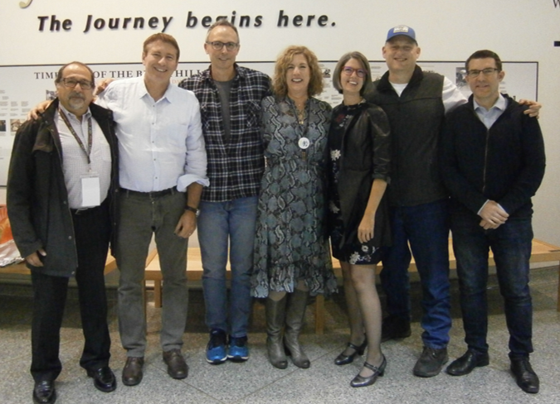
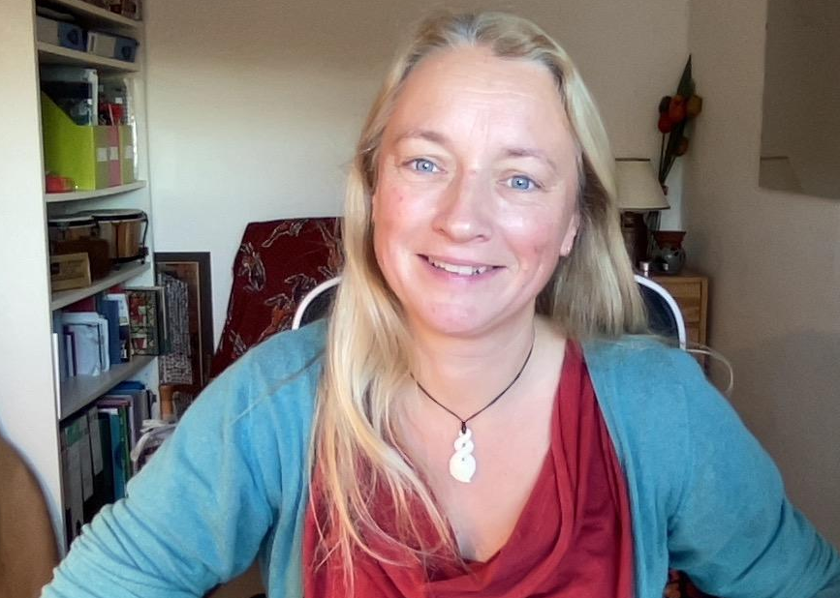
The CEOS Executive Officer
2006-2020
2021-2023

Slide 10
Thank you!
Marie-Claire Greening
CEOS Executive Officer
Agenda Item 1.2
2023 CEOS Plenary, Chiang Rai, Thailand
14th – 16th November 2023

