Slide 1
Space Technologies for Addressing Climate Change
- Application of Satellite Earth Observation Data to Monitor
Sources and Sink of Greenhouse Gases -
Osamu Ochiai
Manager, Senior Engineer, Satellite Application and Observation Center
Japan Aerospace Exploration Agency

Slide 2
Vantage Point from Space and Changes on Earth

Slide 3
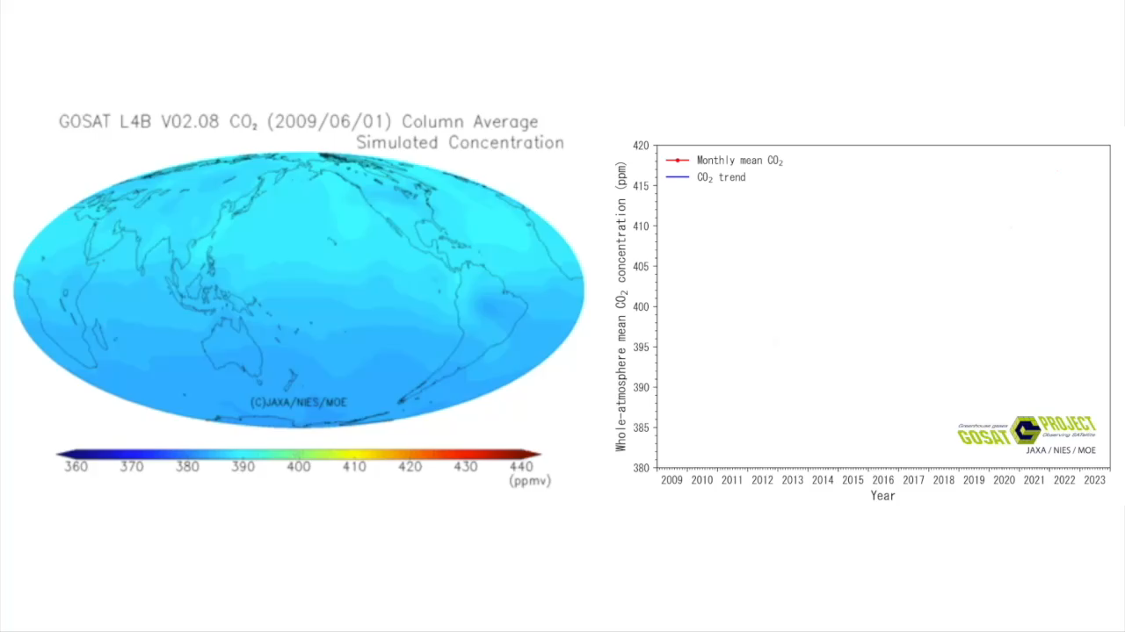
Global CO₂ Concentration since 2009
416.9 ppm
September 2023

Slide 4
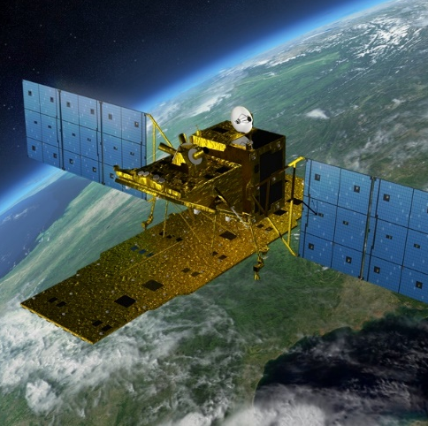
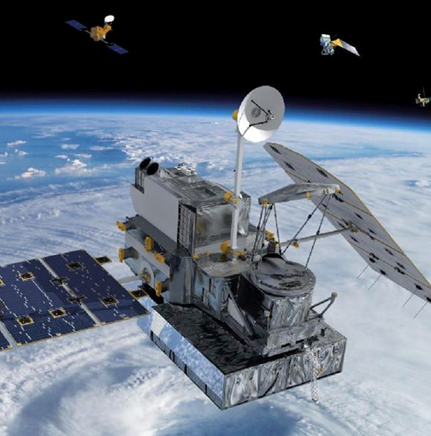
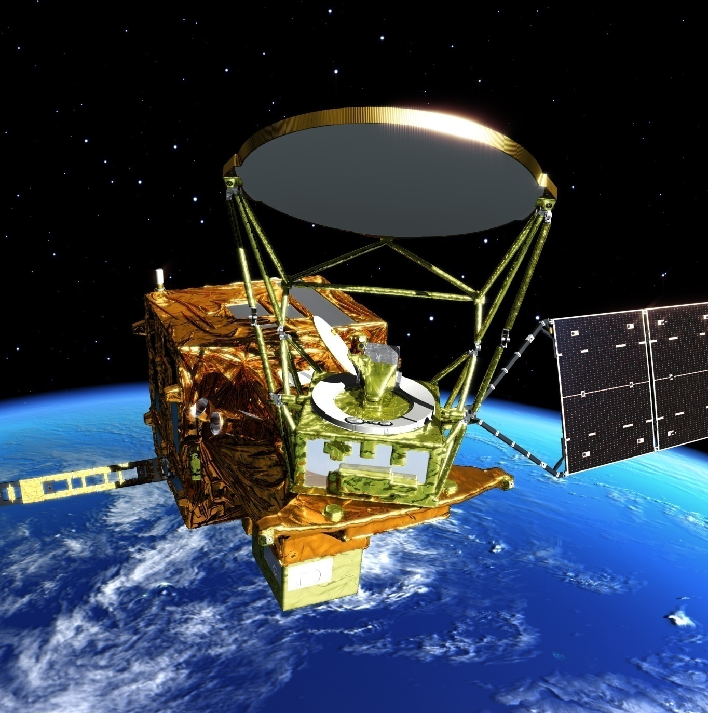


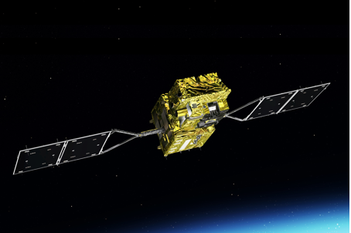
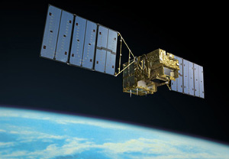
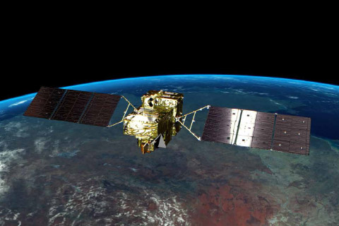

Earth Observation Missions Addressing Global Challenges
ALOS-2 (Radar)
since 2014
GPM-Core
since 2014
GCOM-W
since 2012
Disaster/
Land
(c) NASA
Precipitation
Water Cycle
(NASA-JAXA joint mission)
GCOM-C
since 2017
GOSAT
since 2009
GOSAT-2
since 2018
SDGs
Cloud/
Aerosols/
Vegetation
Greenhouse gases
Greenhouse gases

Slide 5
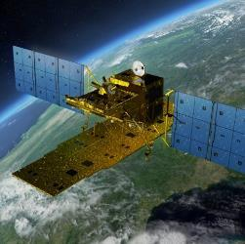
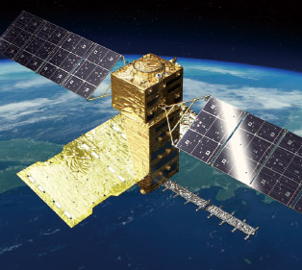

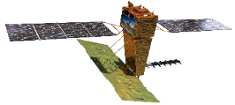
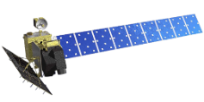
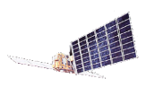
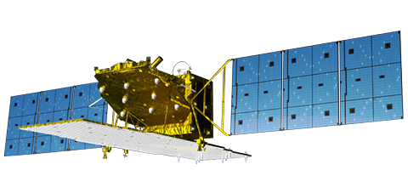
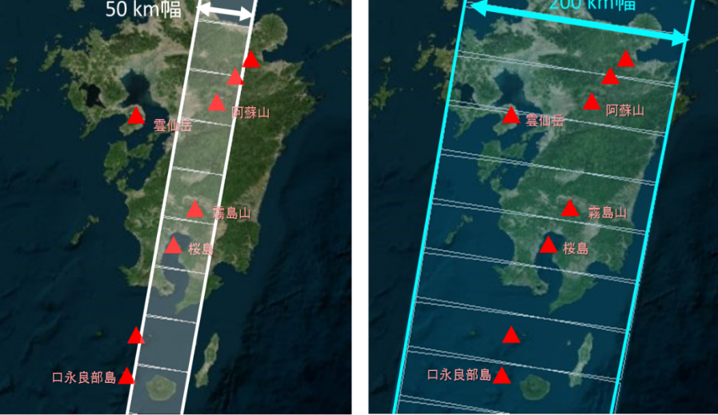

Land Surface Observation from Space
High-resolution
Resolution
(2) Wider observation
3m
▼
ALOS-2
(2014-)
▼
ALOS-4
(JFY2023-)
Maximum L-band SAR resolution
(1) Higher resolution
10m
ALOS ▼
(2006-2011)
ALOS-4
(JFY2023)
ALOS-2
(Since 2014 - )
16m
JERS-1 ▼
(1992-1998)
Advantages of L-band Synthetic Aperture Radar (SAR)
Acquire images regardless of day and night
- no requirement of sunlight
Observe less affected by cloud cover and rain
Reach the ground, partially penetrating through vegetation - obtain information about the current vegetation and ground surface
50km
70km
75km
200km
Swath
Coverage of 1 repeat cycle (14 days)
Wide-swath
ALOS-4/PALSAR-3 (200 km)
3m resolution
50 km swath width
3m resolution
200 km swath width

Slide 6
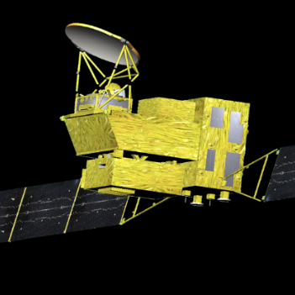
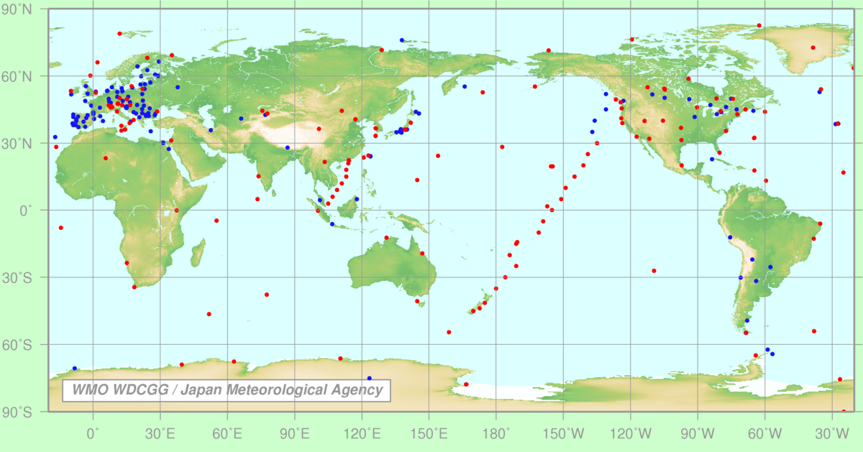
Greenhouse Gases Observation from Space
GOSAT
GOSAT-2
GOSAT-GW
2009
2018
JFY2024
CO₂, CH₄
CO₂, CH₄, CO
CO₂, CH₄, NO₂
GOSAT was the world’s first satellite dedicated to measuring Greenhouse Gases (GHG).
GOSAT-2, the successor to GOSAT, was built with improved accuracy and expanded observation capabilities.
GOSAT-GW is equipped with both GHG and water cycle observation sensors.
GOSAT and GOSAT-2 are currently on operation and their observation data provided for climate change research.
In-situ observation
GOSAT observation
Increased observation points with a single sensor

Slide 7
Space Technology Contributing to Paris Agreement

Slide 8
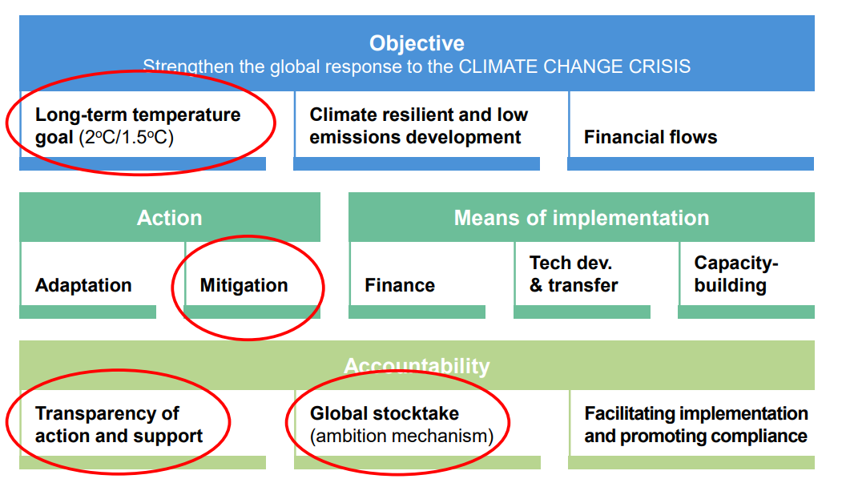
EO for contribution to the Paris Agreement

Slide 9
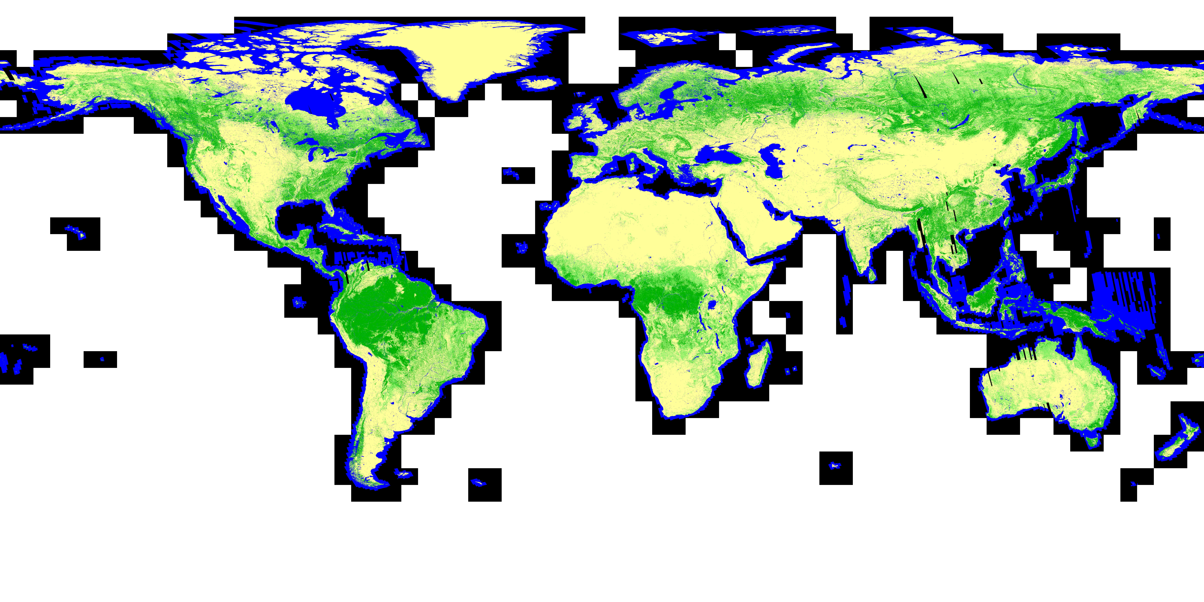
Global Forest Non-forest Map (2020)

Slide 10
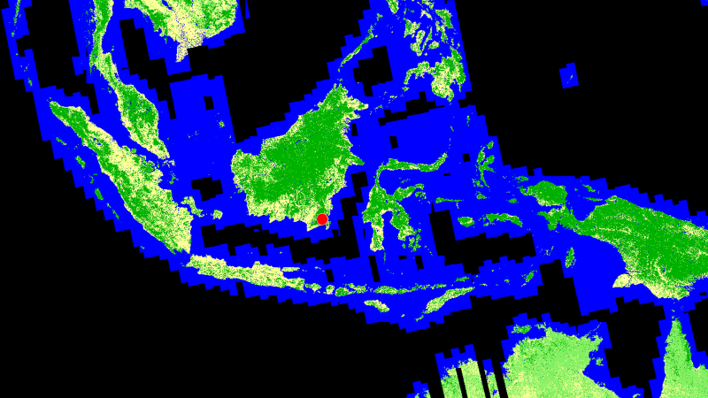
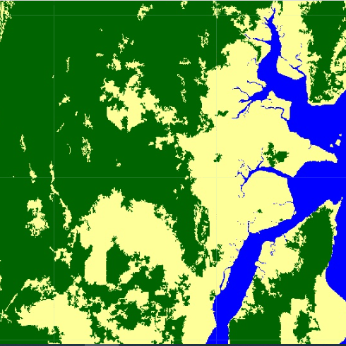
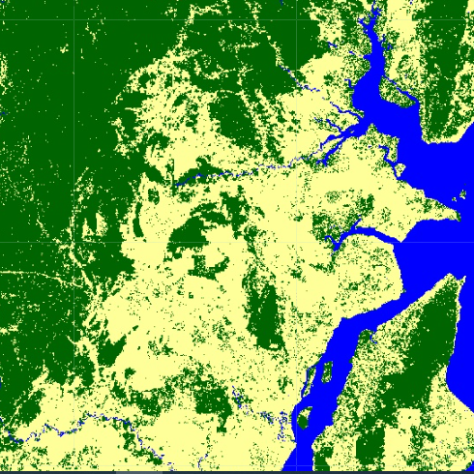
Forest Change in Southern Kalimantan, Indonesia for 10 years
Forest Non-Forest Map 2010
Forest Non-Forest Map 2020

Slide 11
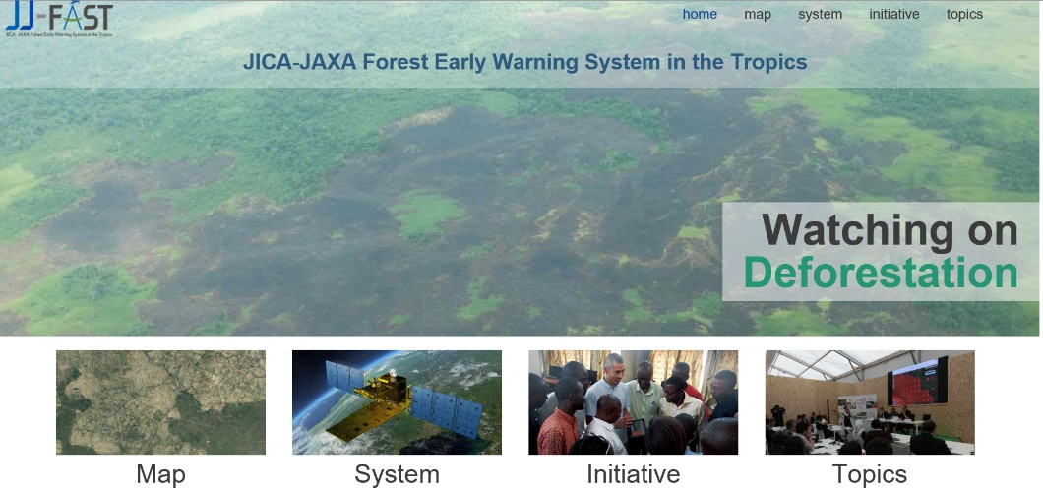
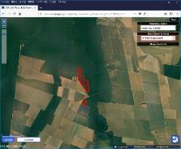
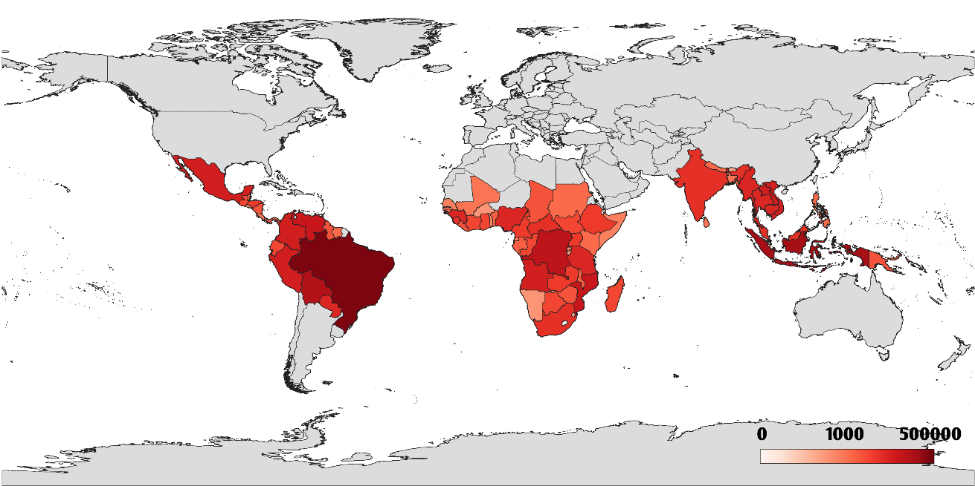
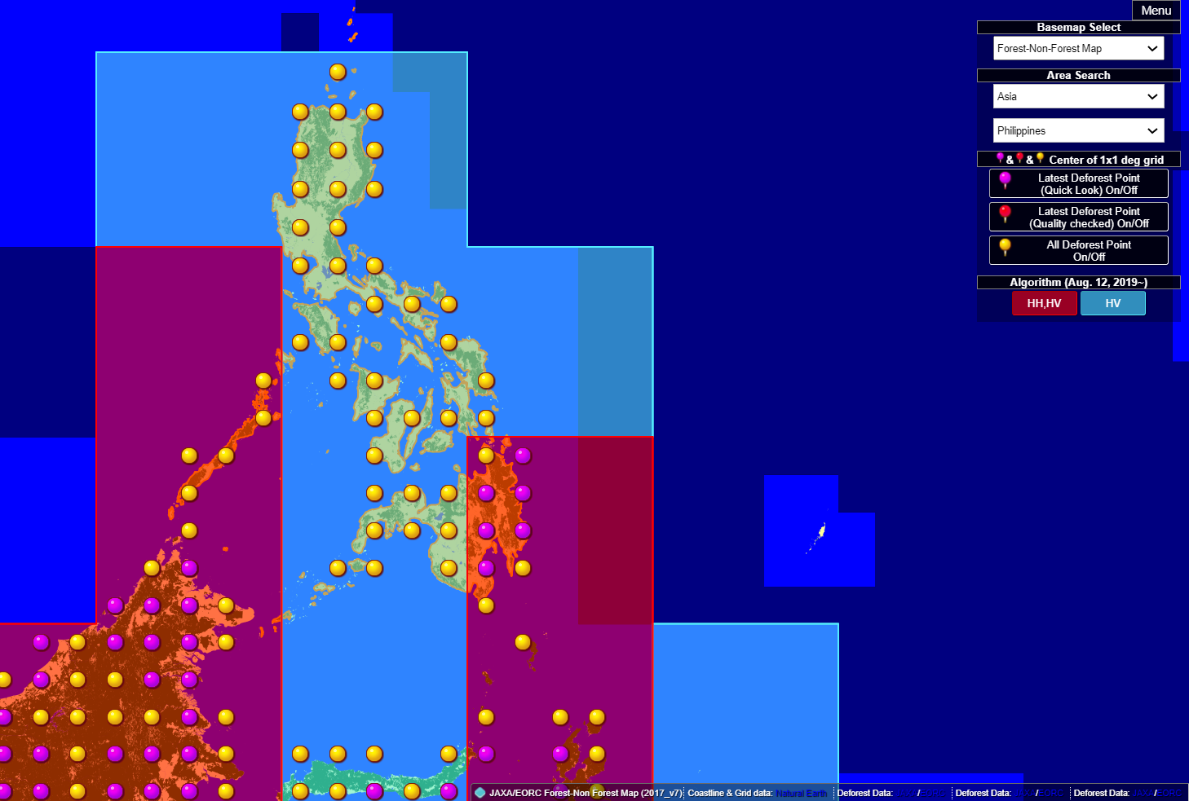
Save Tropical Forest
Monitoring Forest Changes for More Than 25 Years
Broad Ground Surface Observation by Radar Capable of Penetrating Clouds
Contributing to the sustainable forest management using satellite data of forest changes
JICA-JAXA Forest Early Warning System in the Tropics (JJ-FAST)
JJ-FAST has been operated as a deforestation monitoring tool under the JICA-JAXA collaboration project since November 2016
JJ-FAST covers 78 tropical countries and disseminates deforestation areas detected by ALOS-2 for every 1.5 months
Deforestation polygon
Number of detections up to the end of February 2021（1,521,092 sites. The country with the highest number of sites was Brazil with 523,853 sites）
Red indicates the latest Deforest Point
Yellow indicates all Deforest Point

Slide 12
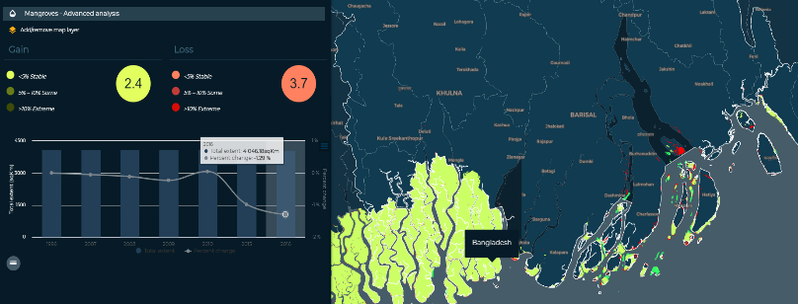

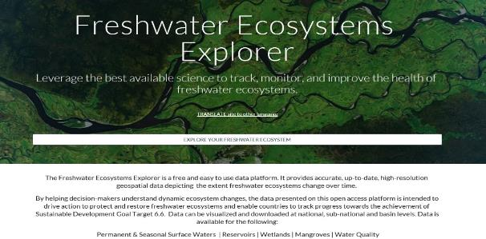
Global Mangrove Map（GMW*)
In the fall of 2019, United Nations Environment Programme (UNEP) designated the global mangrove map (GMW) as official data for SDG 6.6.1**.
In April 2020, data and the methodology are released at UNEP SDG website.
Loss
Gain
No change
2016
●Total extent：4046.18 ㎢
●Percent change: -1.29%(Gain2.4%, Loss3.7%）
Ex）Bangladesh
* GMW: Global Mangrove Watch
**SDG 6.6.1: Changes in the extent of water-related ecosystems over time
Released at UNEP SDG 6.6.1 website（https://www.sdg661.app/home）

Slide 13

Long-term Monitoring Mangrove Forests

Slide 14

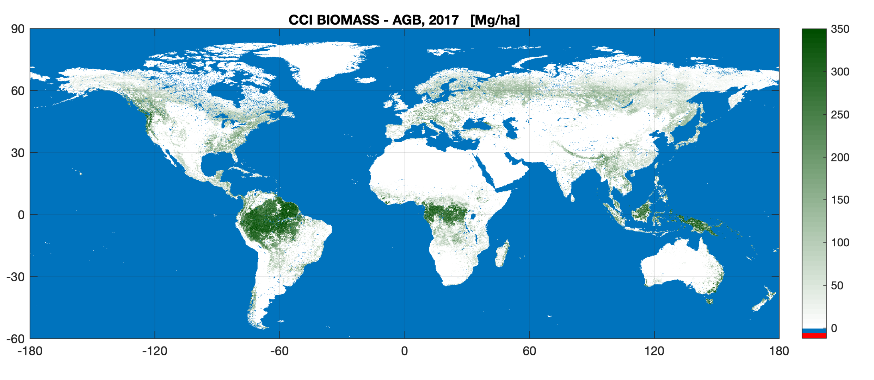
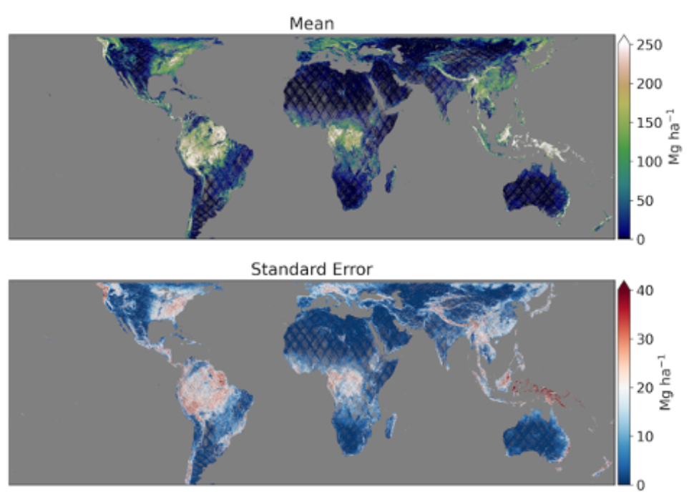
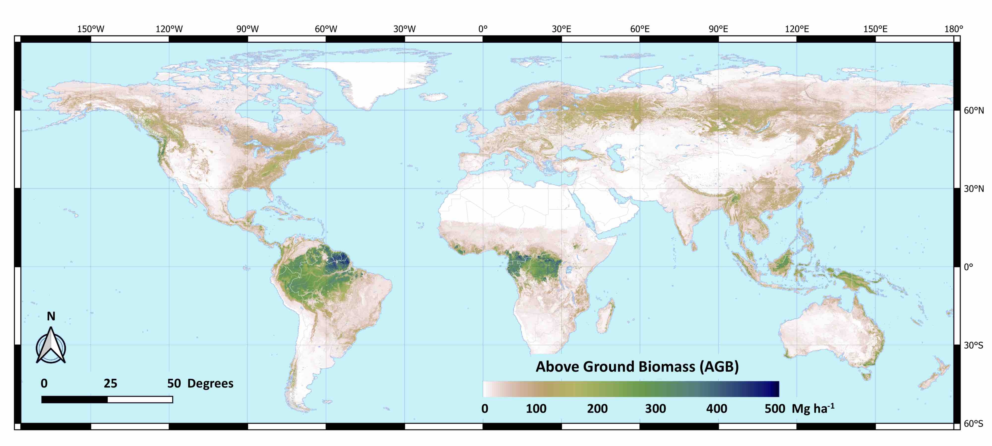

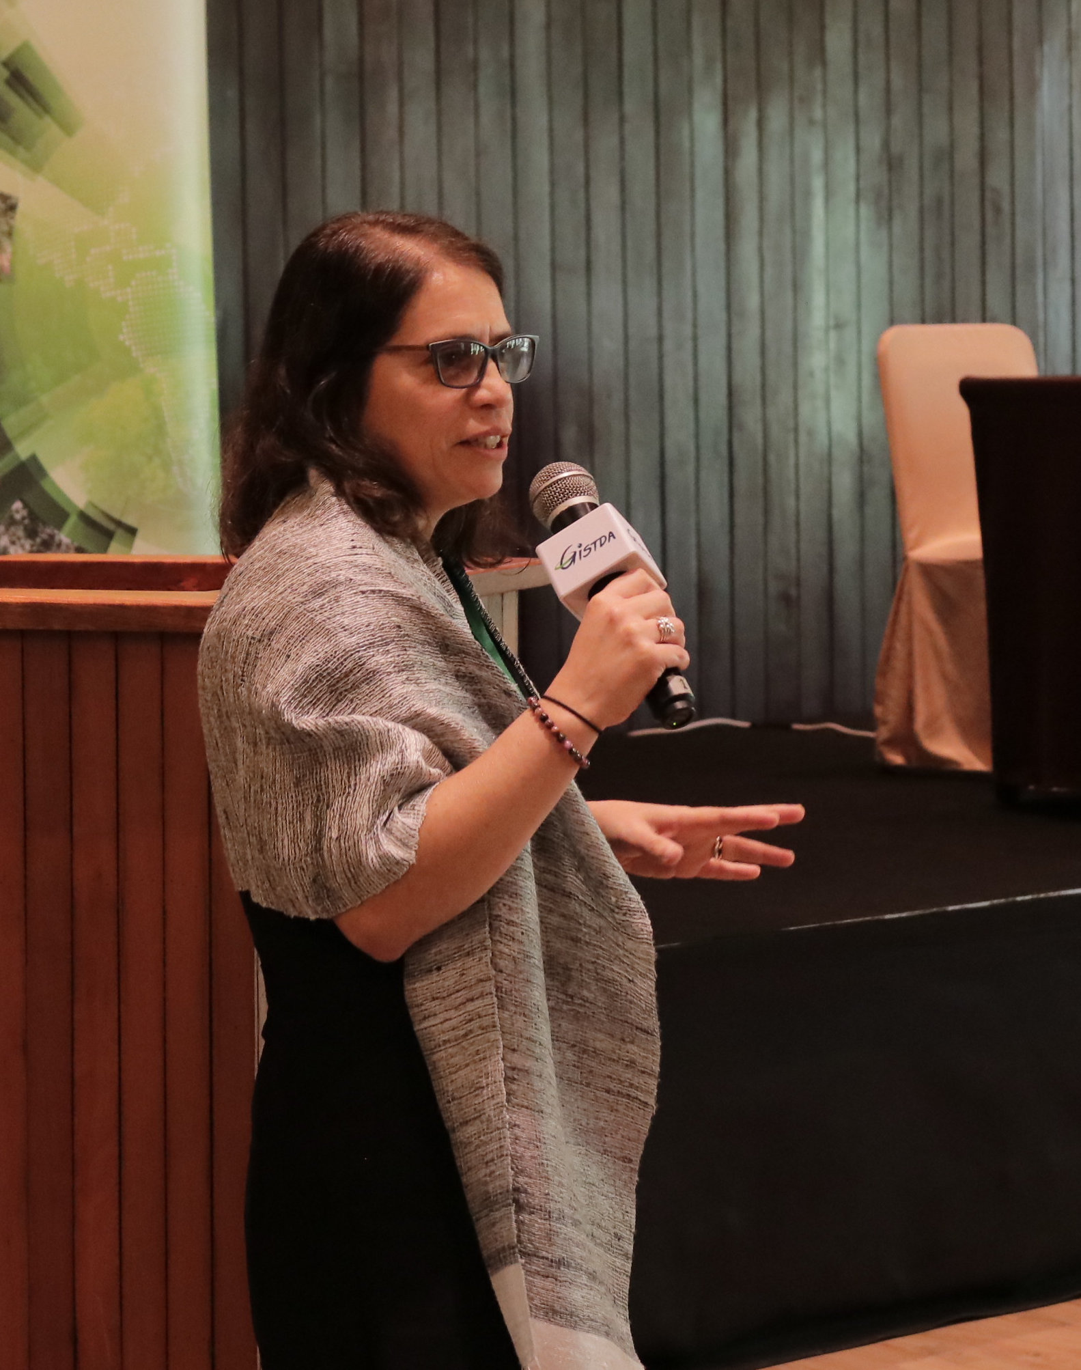

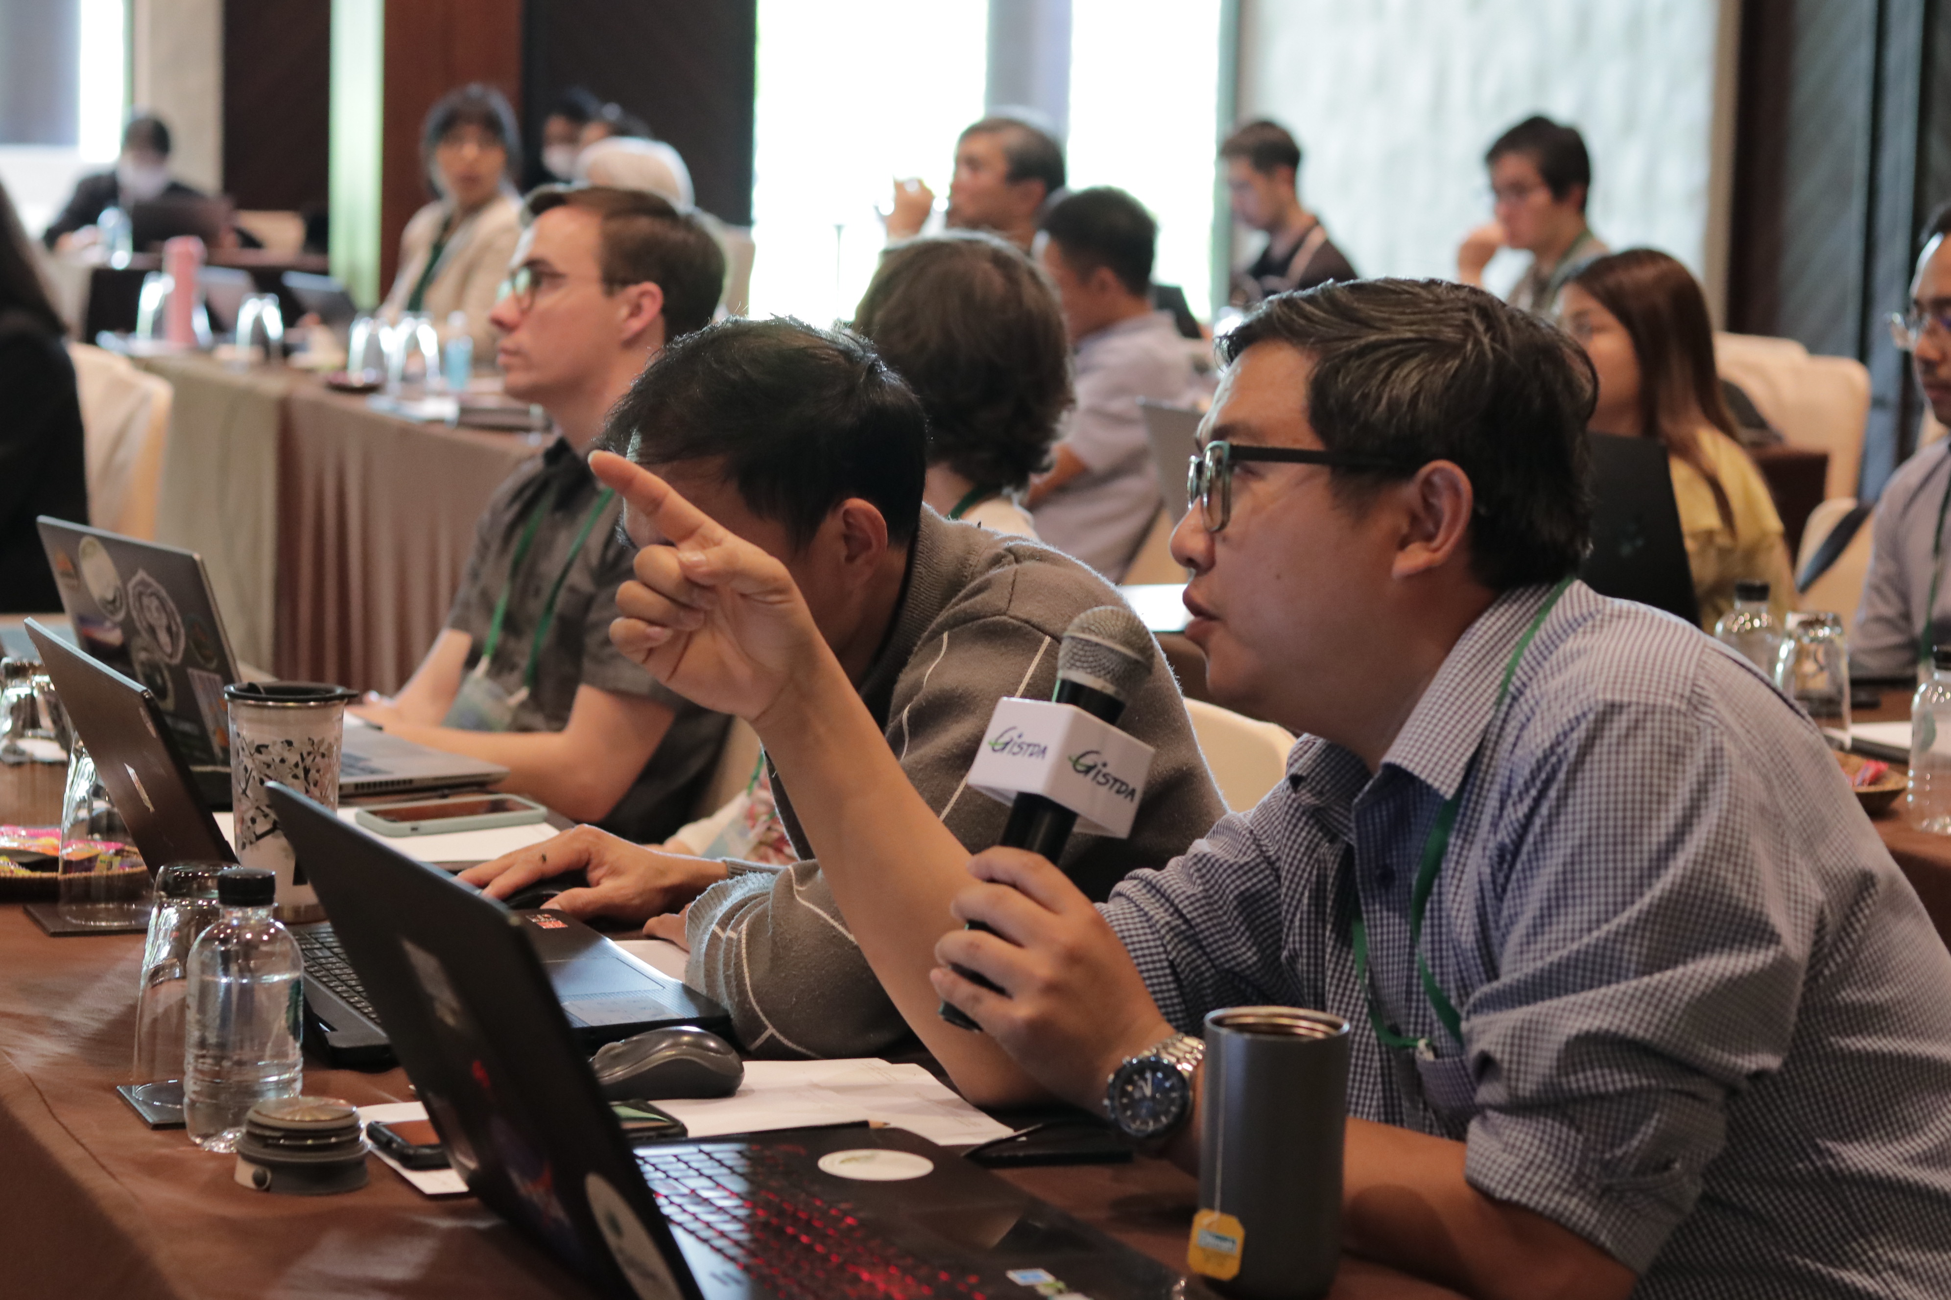
Biomass Datasets in Cooperation with Asian Countries
JAXA Biomass Mapping Initiative
Global Biomass Maps
Satellite-based SAR recognized for estimating aboveground forest biomass (2019 IPCC guideline refinement).
→Global biomass maps developed:
ESA CCI Biomass, NASA/JPL Biomass, NASA GEDI Biomass.
Challenges for Asian forest biomass mapping:
  Uneven reference data distribution.
  Errors from ground slope.
Goals:
JAXA aims the project through collaboration with Asian countries;
  To develop accurate satellite-based biomass maps.
  To use maps to support national policies and carbon credit.
  Funding was approved by Japanese government.
ESA CCI Biomass
NASA GEDI Biomass Map
Mutually Engage
NASA JPL Biomass Map
Capacity Building
Potential Partners:
GISTDA (Thailand), MoE DIGS (Department of Geospatial Information Service) (Cambodia), ICIMOD (Nepal)

Slide 15
Partnerships for Effective & Practical Measures
Addressing to Climate Change

Slide 16

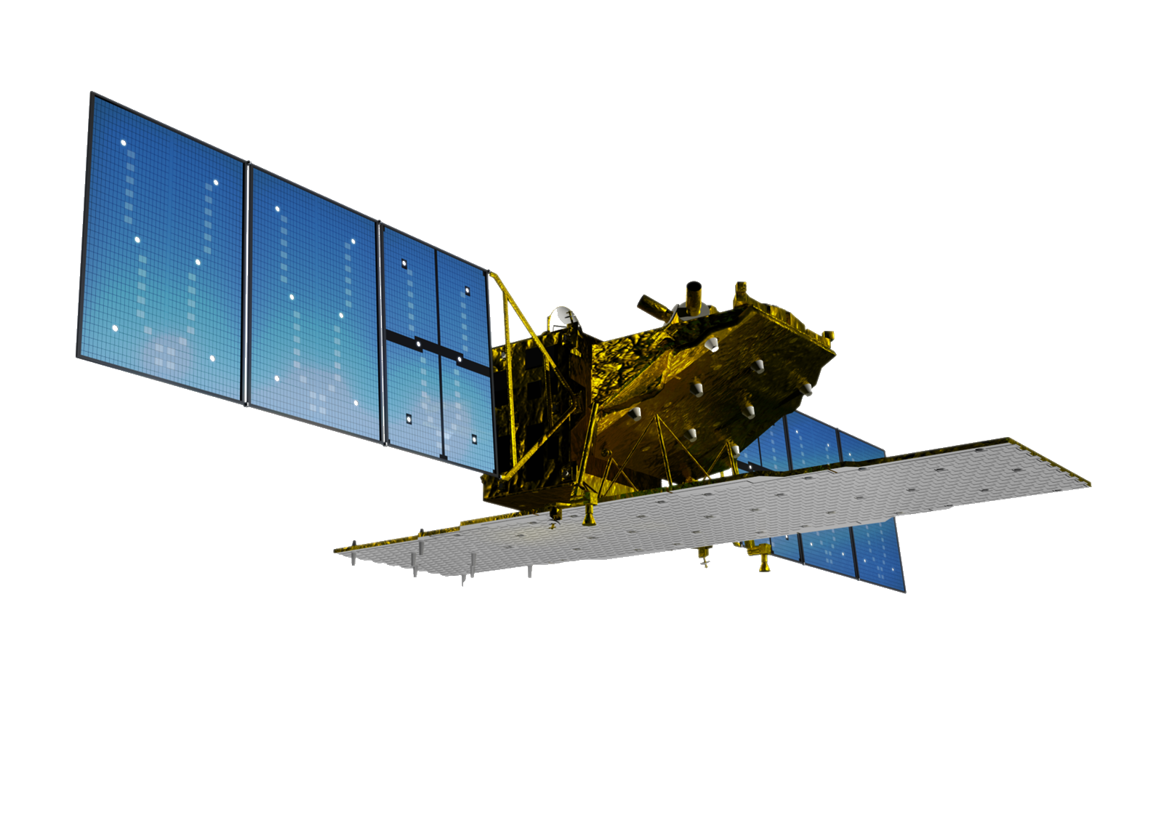


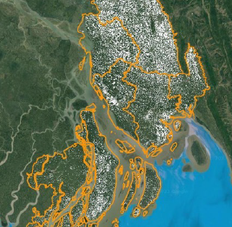
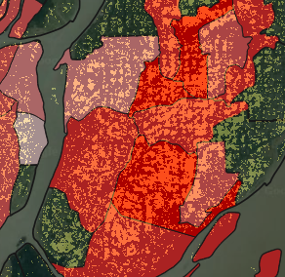
Precision and Efficiency in Agricultural Statistics for Enhanced Productivity
Innovation through high-value added services utilizing satellite observation, ground-based agricultural machinery sensing, and AI Technology
Precision and efficiency in agricultural statistics through timely provision of cultivated area, growth status, and yield
Contribution to environmental impact reduction and productivity enhancement through integrated services, including weather information, on digital platforms for agricultural support (sustainable agriculture)
×

Slide 17

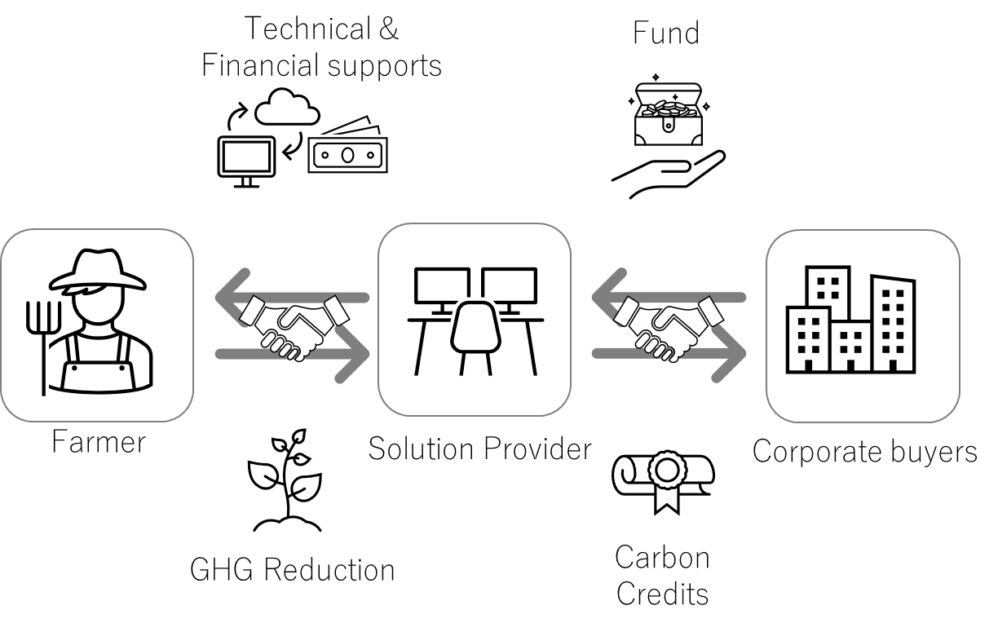

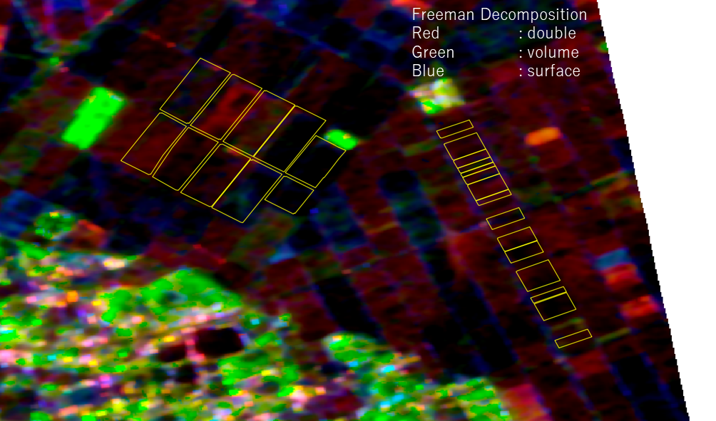
Enhancing Agricultural Productivity and Increasing Income through Carbon Credit Service
Innovation through the utilization of sensing from satellite observations and ground-based observation networks, coupled with AI technology
Timely and continuous information provision on paddy field water levels and methane emission reduction associated with water level management.
Contributing to increased income for farmers through the carbon credit service by both public and private on methane emission reduction, as well as productivity enhancement through optimal water level management.
Satellite Data
Carbon Credit Service provided by Japanese Startup Company
Radar backscatter in the presence of water
Radar backscatter in the absence of water
Estimating water existence in paddy fields from satellite data.

Slide 18
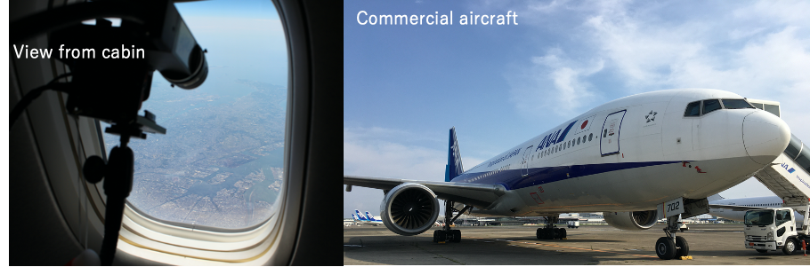
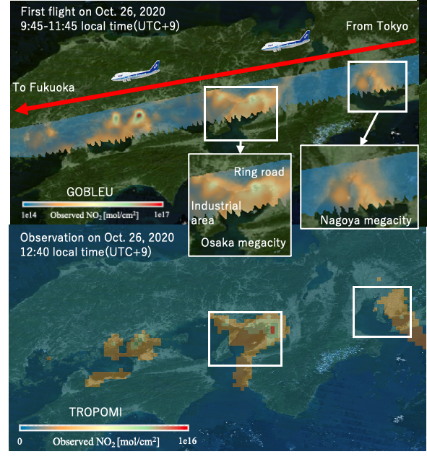
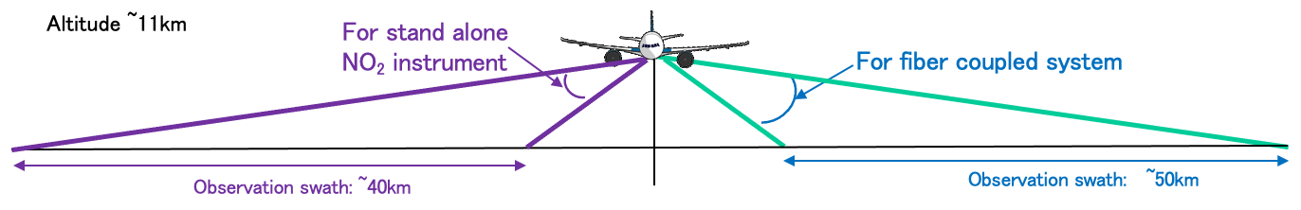
Real-time Observations over Large Cities by Passenger Airline
Greenhouse gas Observations of Biospheric &
Local Emissions from the Upper sky (GOBLEU) Project
An initiative partnered with ANA, a Japanese private airline company, for detailed urban greenhouse gas monitoring to support climate change mitigation efforts aligned with the Paris Agreement.
A sensor like the GOSAT is installed in aircraft cabins for high-resolution, real-time observation of large cities in identifying human-caused emission sources.
The initiative combines these precise aircraft measurements with satellite data to pinpoint and analyze emission sources in urban areas.

Slide 19


เพื่ออนาคตที่ยั่งยืนและรุ่งโรจน์
For Sustainable and Prosperous Future
ขอบคุณครับ
Thank you!

