Slide 1
Biodiversity Side Meeting
Ecosystem Extent Task Team ToR and Activity Proposal
Gary Geller, NASA
Marie-Josée Bourassa, CSA
Marc Paganini, ESA
Room 2, 09:30 – 11:00
2022 CEOS Plenary, Biarritz, France
Nov. 29 – Dec. 1

Slide 2
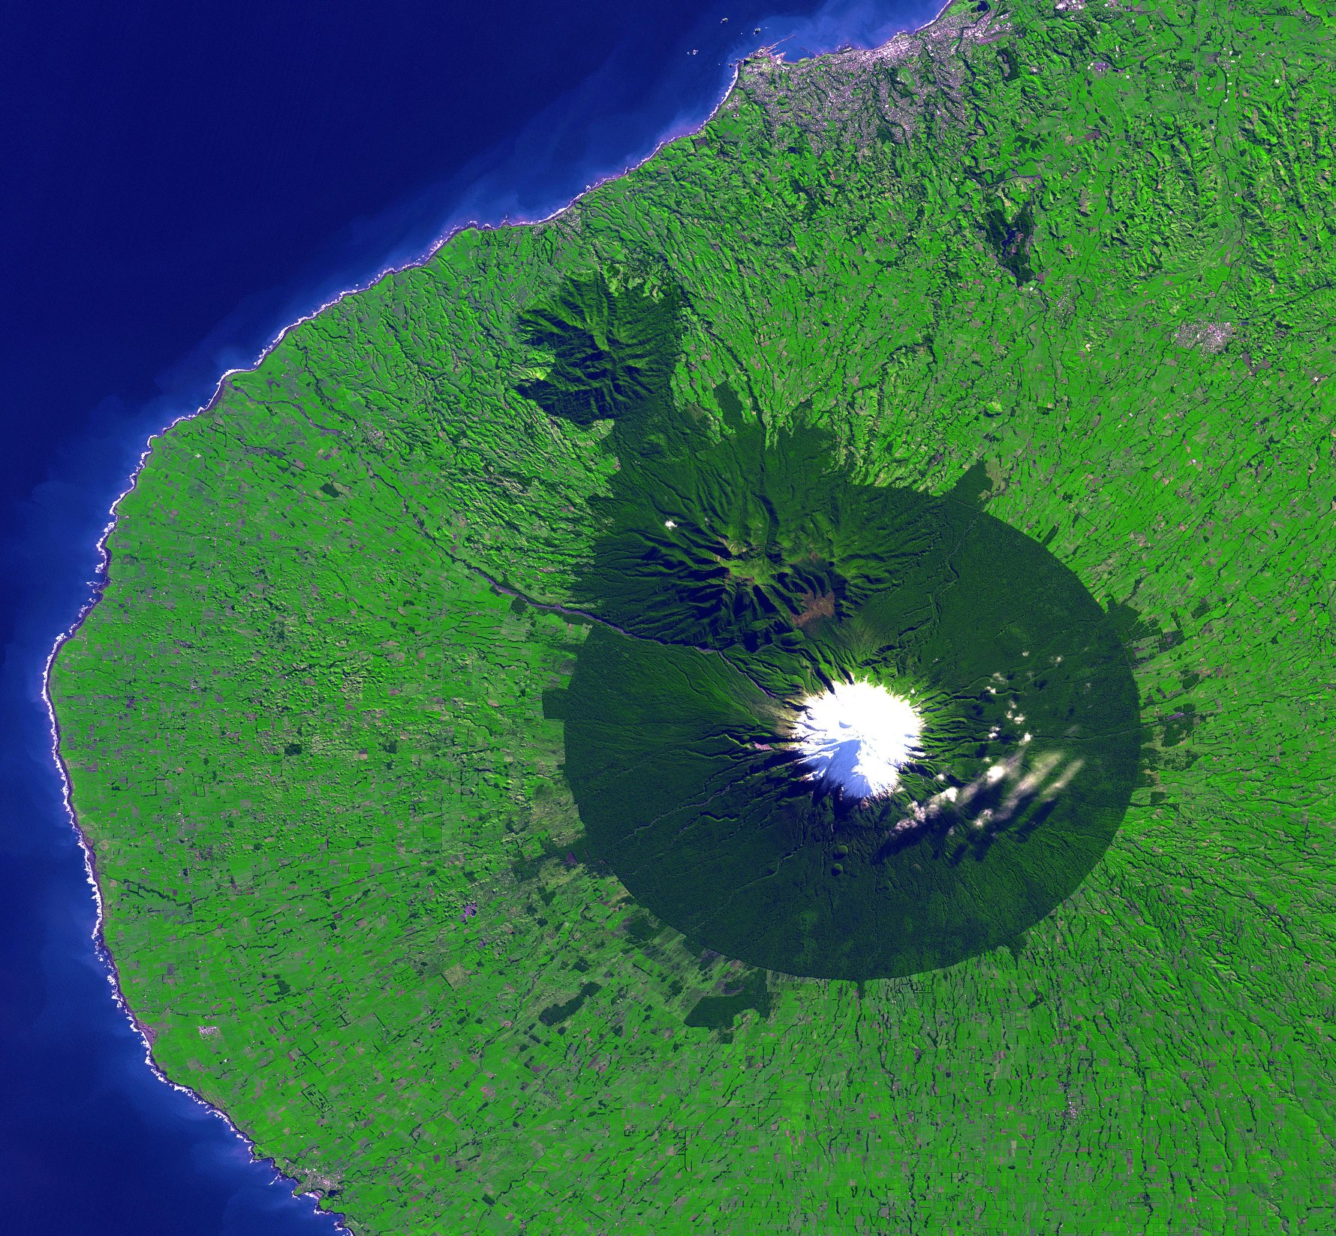
Side Meeting Topics
Purpose
Prepare for Plenary (ToR submitted for endorsement)
Introduce the Ecosystem Extent Task Team concept
Hear your thoughts and suggestions
Content
History and context
Overview of ecosystem extent
Task Team draft activity proposal
Discussion throughout

Slide 3
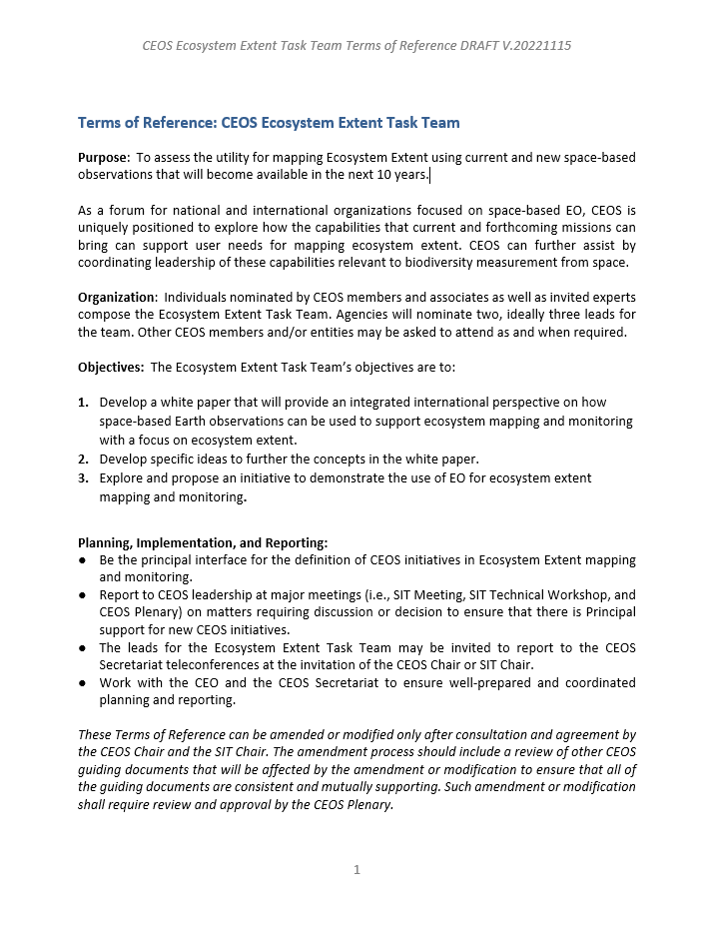
Task Team Terms of Reference

Slide 4
History
~2012: Biodiversity Activity initiated
~2020: Informal discussions on increasing engagement
Triggered by biodiversity crisis
Goal: Long term engagement
2021 (SIT-36): One slide overview
2021 (35th Plenary): “Discussion Group” initiated
2022 (SIT-37): Limited level of engagement
2022 (SIT-TW):
Ecosystem Extent focus proposed
Resulted in Action SIT-TW-2022-07 (develop ToR proposal for Plenary)
Notes:
Biodiversity Discussion Group was to begin increased CEOS engagement with biodiversity

Slide 5
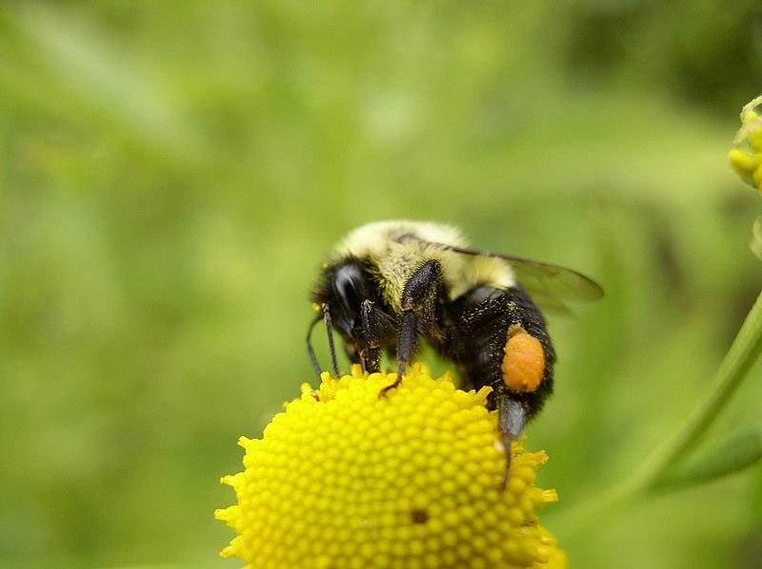
Now…
Forming Ecosystem Extent Task Team
Mechanism to enhance CEOS engagement with biodiversity
Long term goal remains
Need for Ecosystem Extent is ubiquitous
EO has a central role
Progress via a combination of
Advancing technology
Current missions
Forthcoming missions
Wikimedia-Beatriz Moisset

Slide 6
Task Team Purpose
(From the Terms of Reference)
To assess the utility for mapping Ecosystem Extent using current and new space-based observations that will become available in the next 10 years
Notes:
From draft TOR

Slide 7
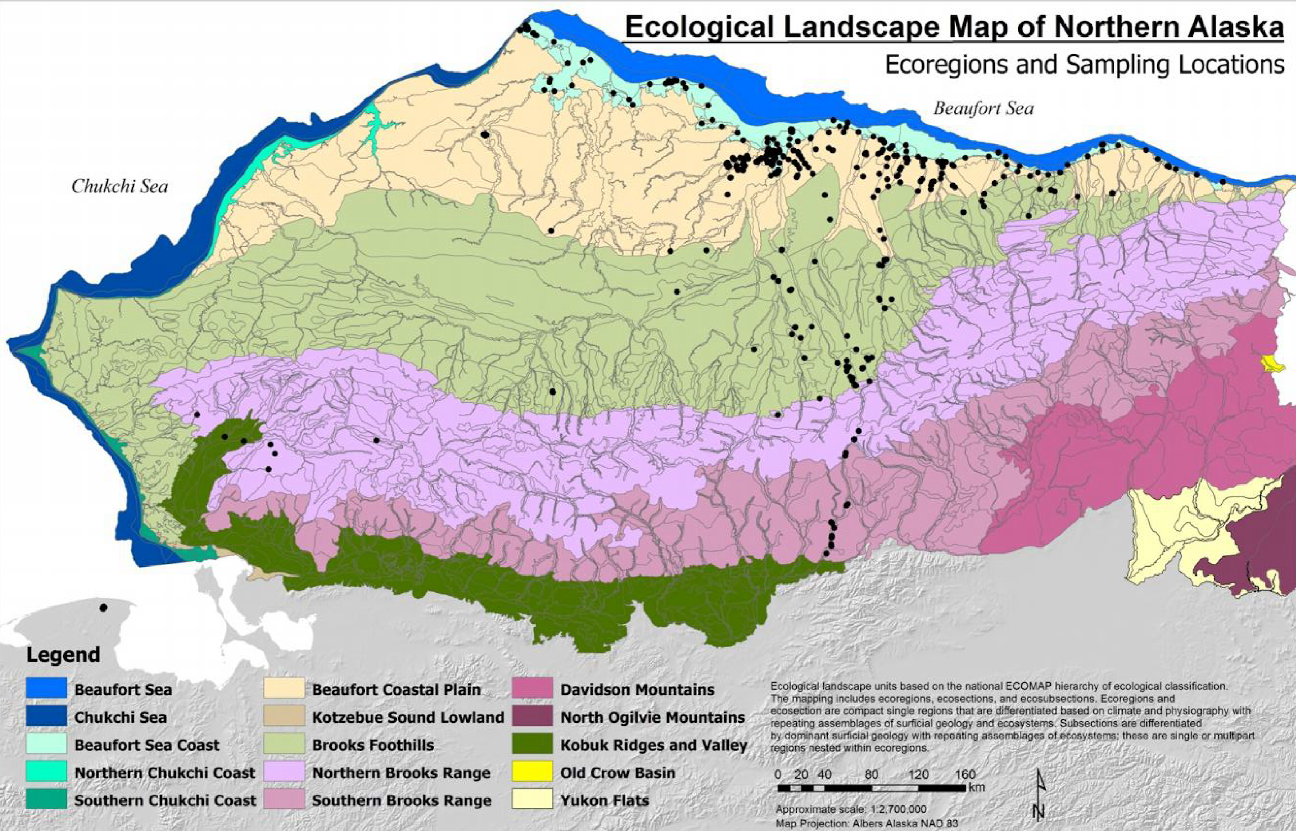
What is Ecosystem Extent?
A dataset that outlines one or more ecosystems of interest
Discrimination based on ecosystem characteristics
ORNL DAAC from Jorgenson and Grunblatt, 2013
Notes:
Rather coarse scale—15 ecosystems (ecoregions)

Slide 8
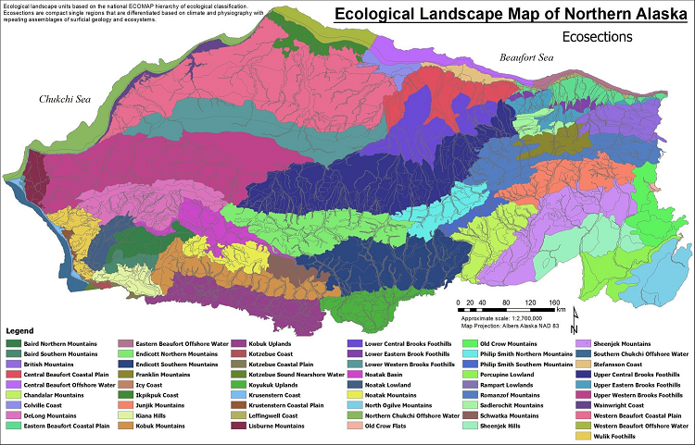
What is Ecosystem Extent?
Hierarchical
ORNL DAAC from Jorgenson and Grunblatt, 2013
Notes:
Finer scale. Its hierarchical. 55 ecosystems
Often created using RS data—each pixel assigned to a specific class

Slide 9
Defining Ecosystems
Physical environment
Physical structure
Composition
Functions & processes
Characteristics used to classify an ecosystem*
US National Park Service
Notes:
NOTES:
“Characteristics” = “features”
For nice discussion on the conceptual basis of classification, see:
https://www.fao.org/3/X0596E/x0596e01f.htm There, features are discriminated using “classifiers”. The discussion includes the FAO Land Cover Classification System, though it seems to not include ecosystem functions/processes
Composition: Species…or level of biodiversity
Environment: climate, slope, aspect, elevation
Structure: height, vertical biomass distribution
Functions & processes: GPP, ET, nutrient retention…
FAO Land Cover Classification System
USGS Global Ecosystem Land Units
IUCN Ecosystem Typology V2.0

Slide 10
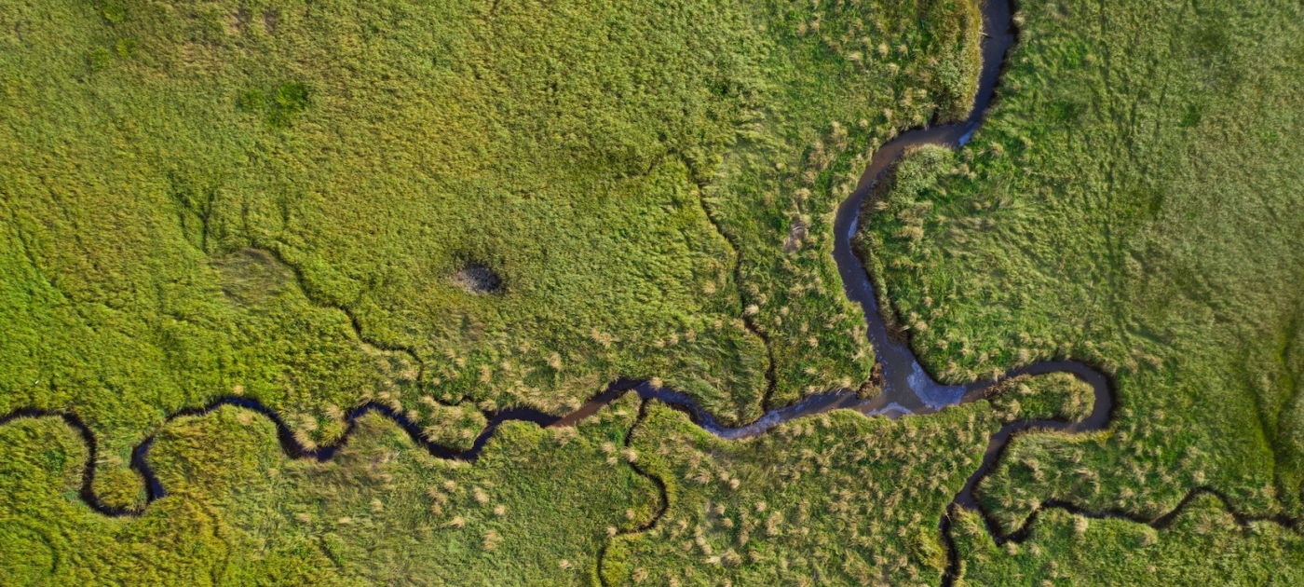
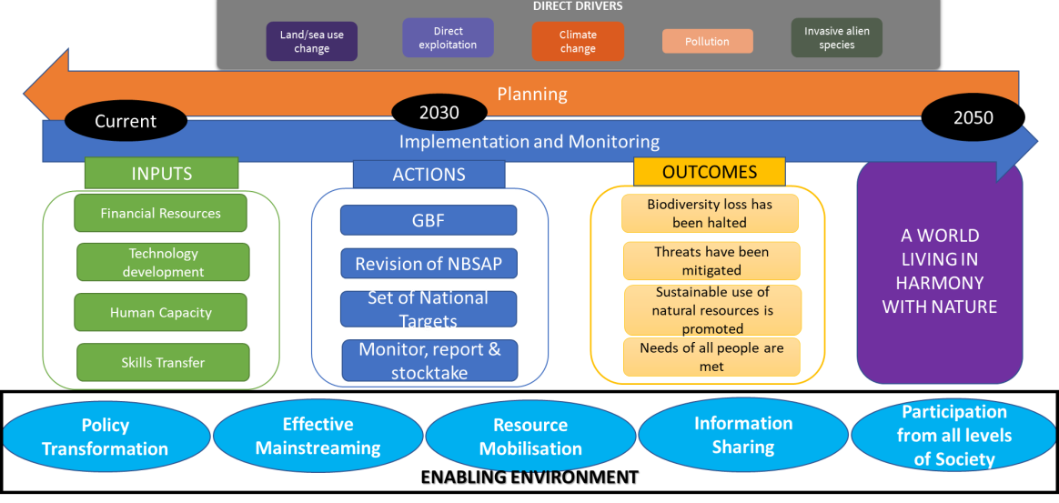
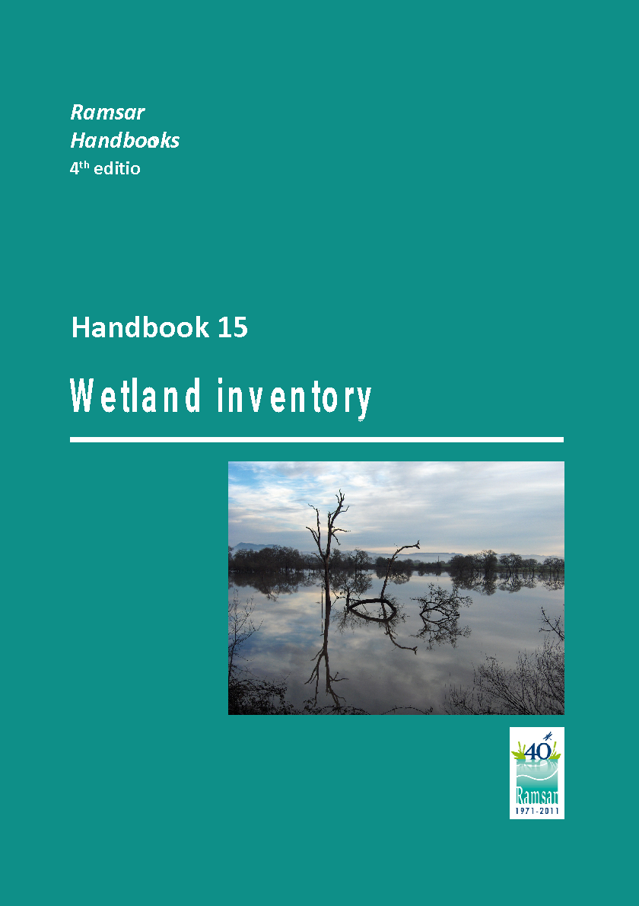
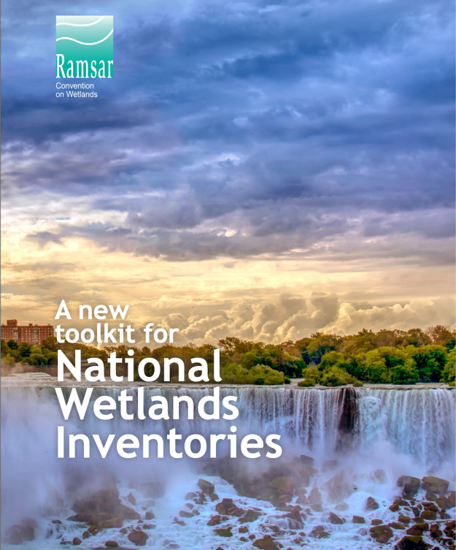
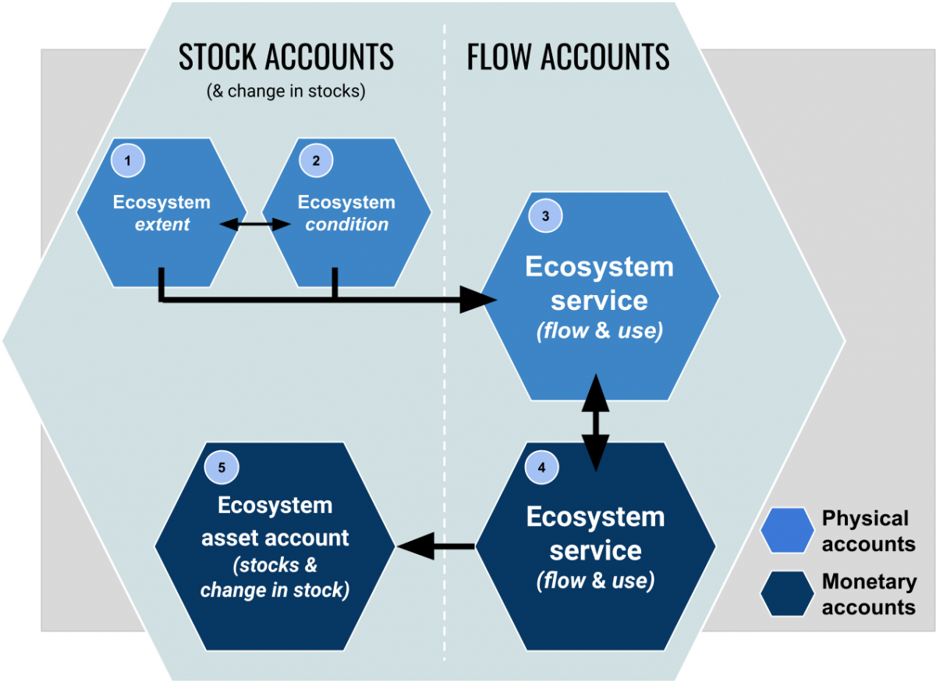
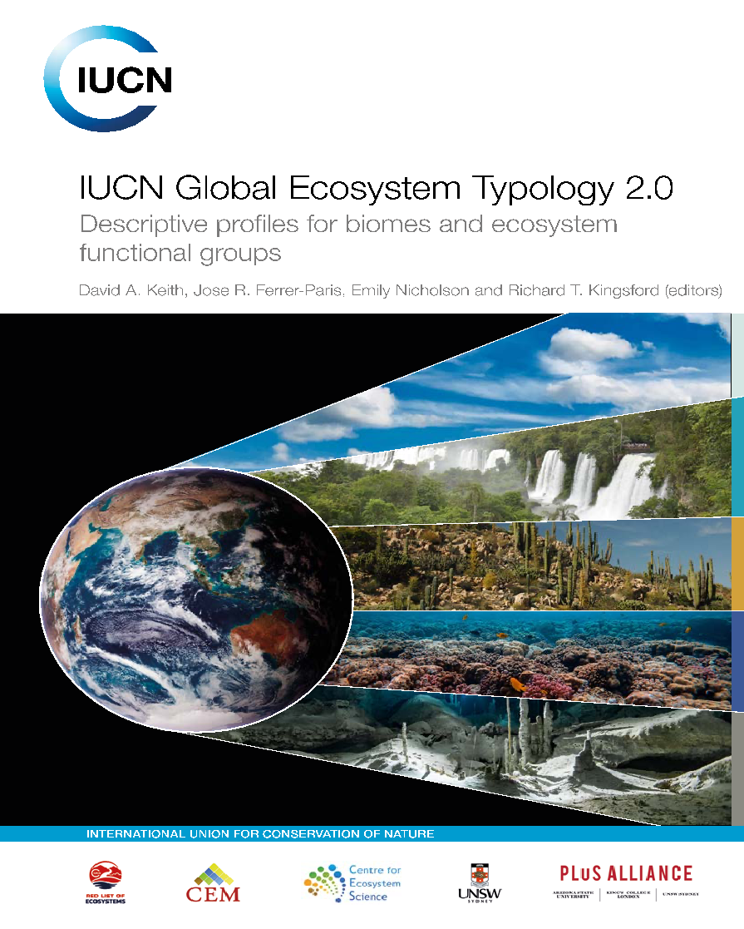
Why Is Ecosystem Extent So Important ?
Convention on Biological Diversity (CBD)
Sustainable Development Goals (SDGs)
Ramsar Convention on Wetlands
Post 2020 Global Biodiversity Framework (GBF)
SDG Target 6.6
Protect and restore water-related ecosystems, including mountains, forests, wetlands, rivers, aquifers and lakes
Ramsar Strategic Plan (2016 – 2024)
Target 8: National wetland inventories are initiated, completed or updated and disseminated and used for promoting the conservation and effective management of all wetlands.
SDG Target 14.2
Sustainably manage and protect marine and coastal ecosystems to avoid significant adverse impacts.
GBF Monitoring Framework
Headline indicator A.0.1 Extent of selected natural ecosystems (forest, savannahs and grasslands, wetlands, mangroves, saltmarshes, coral reef, seagrass, macroalgae and intertidal habitats)
SDG Target 15.1
Ensure the conservation, restoration and sustainable use of terrestrial and inland freshwater ecosystems and their services.
SEEA Ecosystem Accounting
New international standard on Ecosystem Accounting which regulate the production on statistical accounts on ecosystem extent, condition and services.
Measurement framework underpinning the development of monitoring frameworks of other international agreements, such as the CBD post-2020 GBF, the Ramsar Convention on Wetlands, and the 2030 Agenda on Sustainable Development.

Slide 11
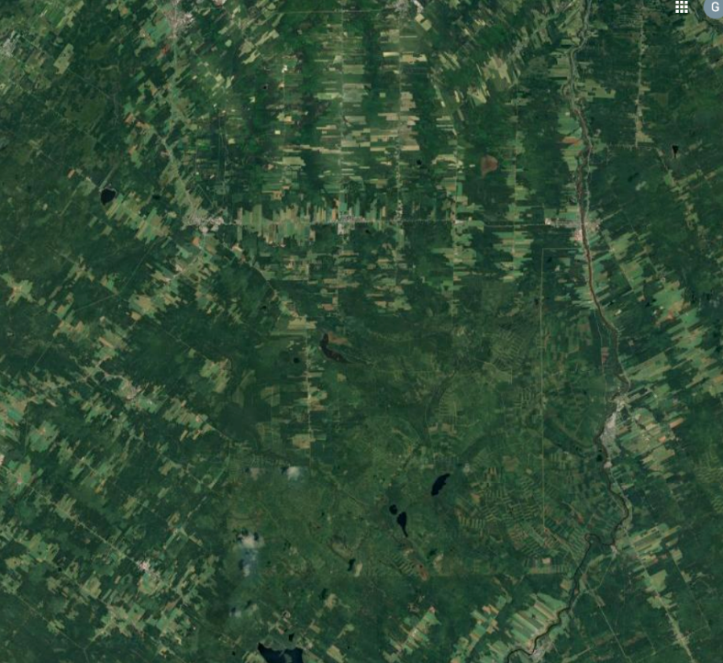
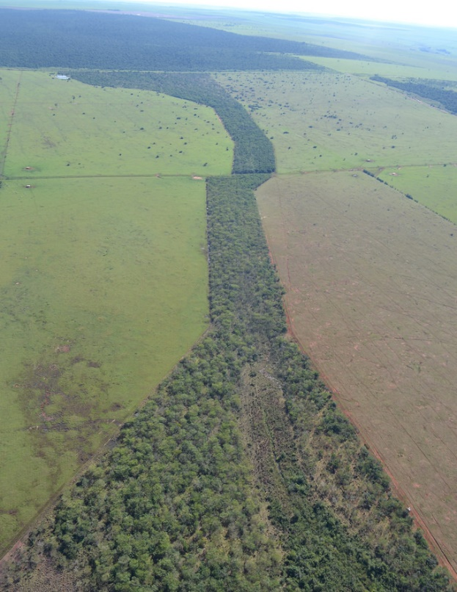
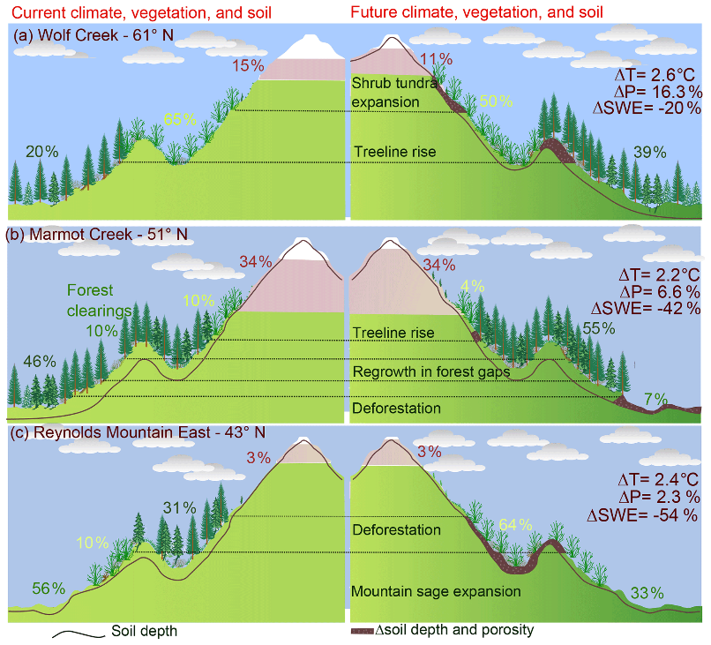
Supports Many Derived Products
googlemaps
Total ecosystem area
Fragmentation
Condition
Corridors/connectivity
Location
Habitat (EC directive)
Environmental accounting (UN SEEA)
Kabir Rasouli et al 2019
Ipe-institutodepesquisasecologicas

Slide 12
Role of EO
Mapping ecosystem extent at scale is impractical from ground
Ecosystems have characteristics that can be measured from space and integrated with in situ information
Classical ecology: Structure, Composition, Function
Structure: 3d physical structure (radar, lidar)
Composition: Specific species or level of biodiversity (multi & hyperspectral)
Function: Ecosystem function and canopy “functional traits” (multi & hyperspectral)
Photosynthesis (e.g., GPP)
Water or nutrient content
Chlorophyll
Lignins
Every “trait” (characteristic) has a function
Notes:
Function is a new and developing field

Slide 13
Role of EO in Context
EO sensor data is only one piece
Training data: verified sites characterizing each ecosystem
Used to train the models and assess accuracy
Creation is largely a manual process
In situ data* (e.g., level of biodiversity)
Models: correlate EO data with site & do the classification
Fusing data from different sensors
Similar types: Landsat and Sentinel-2: more data & tighter time series
Different types: Radar, multispectral, hyperspectral
These measure complementary ecosystem characteristics
Takeaway: Multiple data sources are needed
Notes:
Function is a new and developing field
*Direct use of in situ data not currently widespread

Slide 14
Role of CEOS
CEOS Strategic Guidance document

Slide 15
Role of CEOS
CEOS Strategic Guidance document

Slide 16
Role of CEOS
CEOS Strategic Guidance document
But it’s also a huge opportunity
EO is underutilized for biodiversity applications
New missions will greatly extend biodiversity capabilities
Users are waiting for our data and products
Notes:
New missions has ties into Newspace

Slide 17
Proposal Basic Elements
Finish assembling the Task Team
Develop two related streams (2-year activity)
White paper
Explore opportunities created by advancing technologies and forthcoming missions
Expected user focus: Convention on Biological Diversity, UN System of Economic - Environmental Accounting
Demonstrator
Convey how EO can fill important gaps
Enable future work

Slide 18
White Paper Content (v. preliminary)
What is ecosystem extent and why is it important?
Who uses it and what for?
How is it currently mapped?
What are the shortcomings?
What is EO’s role?
How do different sensor types map to ecosystem characteristics?
How can forthcoming missions address the shortcomings?
What types of in situ data are needed (and are they available)?
What role can advancing technology play in improving products?
What should be CEOS’s role?
What improvements are possible if shortcomings are eliminated?
Can they enable broadscale IUCN Ecosystem Typology products?
What are the challenges and dependencies to utilizing advances?
What would success look like?

Slide 19
Demonstrator
Purpose
Demonstrate how advances in EO and technology can improve ecosystem extent mapping and monitoring to interested parties such as CBD and SEEA
Wide range of possibilities
Scope and details will be determined by the Task Team
Want to excite potential users
Leverage existing initiatives as much as possible
Enable future work
Dependent on TT level of expertise and of support

Slide 20
Demonstrator: Example Ideas
To feed the discussion….
Focus on specific sites and collect all existing observations
Selection criteria: data availability, ecosystem knowledge, local partnership
Develop a data cube incorporating the full range of sensor types available
Enable new products by co-location of data and tools
Assess potential to create ecosystem maps
Partner with a national government
Identify EO data gaps and key areas where EO data can be nationally contextualized to strengthen national target tracking
Consider how open source data and science can be leveraged

Slide 21
Proposed Task Team
PARTNER REPRESENTATION
GEO - Laurent Durieux
GEO BON - POC pending
UN Convention on Biological Biodiversity (CBD) - POC pending
UN System of Environmental Economic Accounting - POC pending
PROPOSED TASK TEAM CO-LEADS
CSA - Marie-Josée Bourassa
NASA - Gary Geller
Co-lead #3
TASK TEAM MEMBERS (In Process)
CSA - Marie-Josée Bourassa, Nicholas Coops, Michael Gill, Jason Duffe
CNES - Sandra Luque
CSIRO - Shaun Levick
ESA - Marc Paganini
JAXA - Osamu Ochiai
NASA - Gary Geller, Christine Bognar, Woody Turner, Pamela Collins
UN Environment Programme (UNEP) - pending
New Members - The Task Team will be further populated as the proposal is socialized with CEOS and partners

Slide 22
Notional Timeline
Jan-Mar (+) 2023: Enhance TT membership
White Paper:
Jan.-Sept. 2023:
Assemble outline, assign activities and develop initial draft
Sept.-Nov. 2023:
Complete Stream 1 and finalize the White Paper for presentation at the 2023 Plenary
Make recommendations for future CEOS activities under the CEOS Work Plan
Demonstrator
2023: Explore ideas in parallel with White Paper
2023-2024:
Develop concept for demonstrator and begin implementation, in conjunction with stakeholders
Sept 2024: Present initial demonstrator at SIT Technical Workshop
Nov 2024: Present outcome of the two-year Task Team effort at CEOS Plenary

Slide 23
Summary
EO is underutilized for biodiversity applications
Ecosystem Extent is a key product needed by a wide range of organizations
Advancing technology and both current and forthcoming missions have the potential to greatly improve existing products
Proposed Task Team will explore ways to take advantage of these opportunities and demonstrate how
Terms of Reference provide a top-level framing of the proposed team

Slide 24
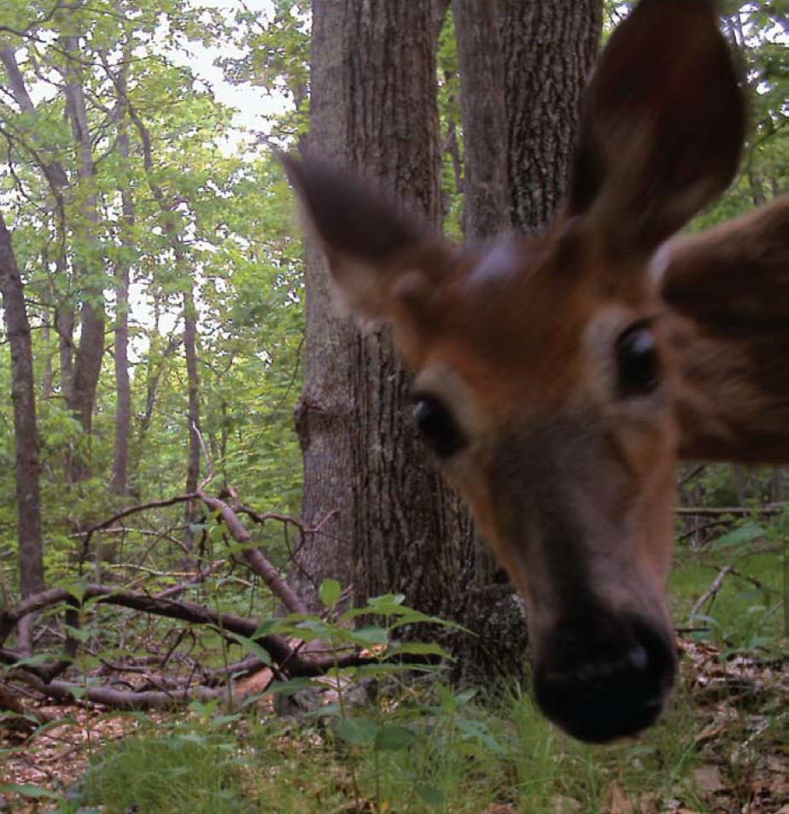
Thank you
US FWS

Slide 25
Backup

Slide 26
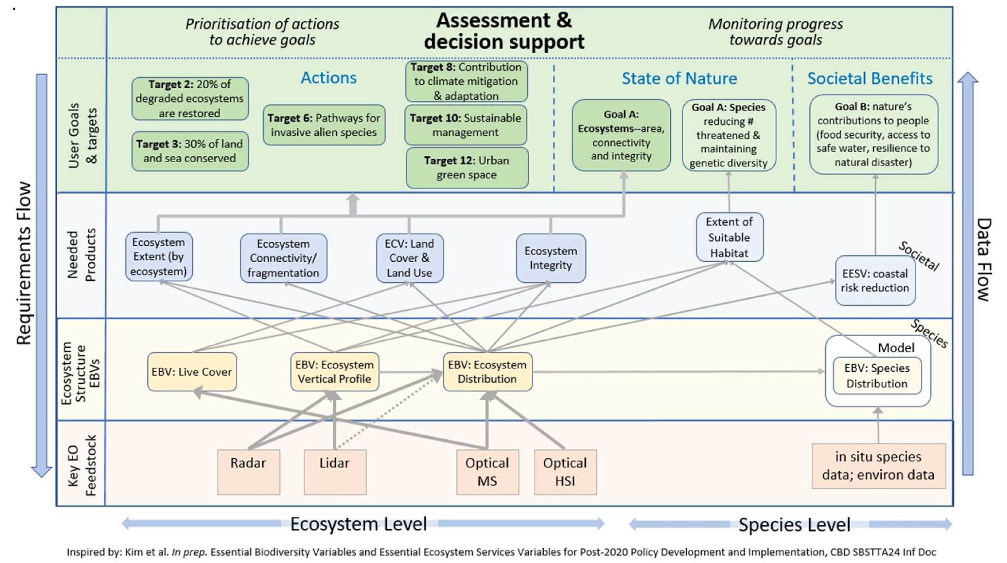
Connecting User Needs to Observations
From SIT-37
Notes:
This figure shows how Agency data flows into Essential Biodiversity Variables and products needed by Conventions and other entities for managing biodiversity.
(Updated version from SIT-37)

