Slide 1
GISTDA 2023 CEOS Chair Priorities
Pakorn Apaphant, GISTDA
Agenda Item #2.16
2022 CEOS Plenary
Biarritz, France
Nov. 29 – Dec. 1

Slide 2
“
”
Earth Observation for
Better Environment,
Economy, and Humanity
GISTDA CEOS Chair Priorities 2023

Slide 3
CEOS Chair Priorities 2023
1
Supporting CEOS Preparations and Inputs to the Global Stocktake of the UNFCCC Paris Agreement
2
Supporting Exploration of New Geometries for Space Agencies and CEOS with New Space

Slide 4
Expected support and Contribution from CEOS
1
Support the implementation of the AFOLU and GHG Roadmap
2
Further update to the CEOS Global Stocktake Portal.
3
Ocean Carbon Workshop
4
Carbon Observation from Space
5
Support WGs/ Task Teams/ VCs activities to support GST
6
Support the collaboration between CEOS and GEO, WMO, and etc.

Slide 5
GISTDA activities to support GST

Slide 6
Priority #1 Supporting CEOS Preparations and Inputs to
the Global Stocktake of the UNFCCC Paris Agreement
Workshop
GISTDA - SilvaCarbon 2023 CEOS Workshop on Uptaking Global AFOLU Datasets
CEOS Agencies Dataset
Continued expansion of the offering of CEOS Agency datasets available to support the GST and countries’ assessments of their Nationally Determined Contributions (NDCs)
GHG & AFOLU Roadmap
Support the Implementation of both
the GHG Roadmap and AFOLU Roadmap.

Slide 7
GISTDA - SilvaCarbon 2023 CEOS Workshop on Uptaking Global AFOLU Datasets
23 February - 3 March 2023
Field Trip & Field Data Collection
Khao Yai National Park
Khung Kraben Bay Mangrove Forest, Chanthaburi
Participants ~ 50 people
SilvaCarbon countries
Thailand
CEOS agencies attendees and Presenters
Please visit the link for workshop agenda and objective: GISTDA - SlivaCarbon 2023 CEOS Workshop Paper

Slide 8
Expected Support and Contribution from CEOS
1
The experience sharing among CEOS Space Agencies
2
Support the New space activities from CEOS entities (Working Groups, Virtual Constellations, and Ad Hoc Teams)

Slide 9
Priority #2: Supporting Exploration of New Geometries for Space Agencies and CEOS with New Space
New Space Task Team
Work with CEOS New Space Task team led by SIT Chair to develop New Space Economy document as a means for knowledge sharing with CEOS Agencies.
Collaboration Opportunities
Workshops/Meetings as inputs to the border CEOS discussion on New Space opportunities. (TBC)
Facilitate a discussion during CEOS 2023 timeframe

Slide 10
GISTDA in CEOS

Slide 11
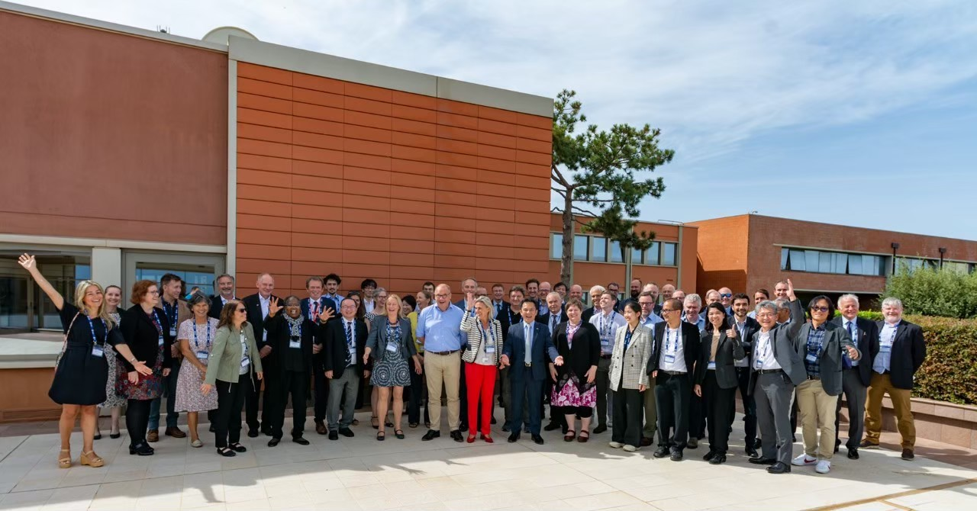
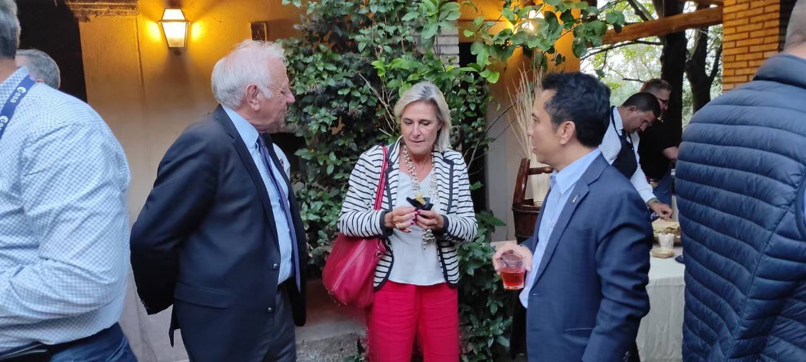
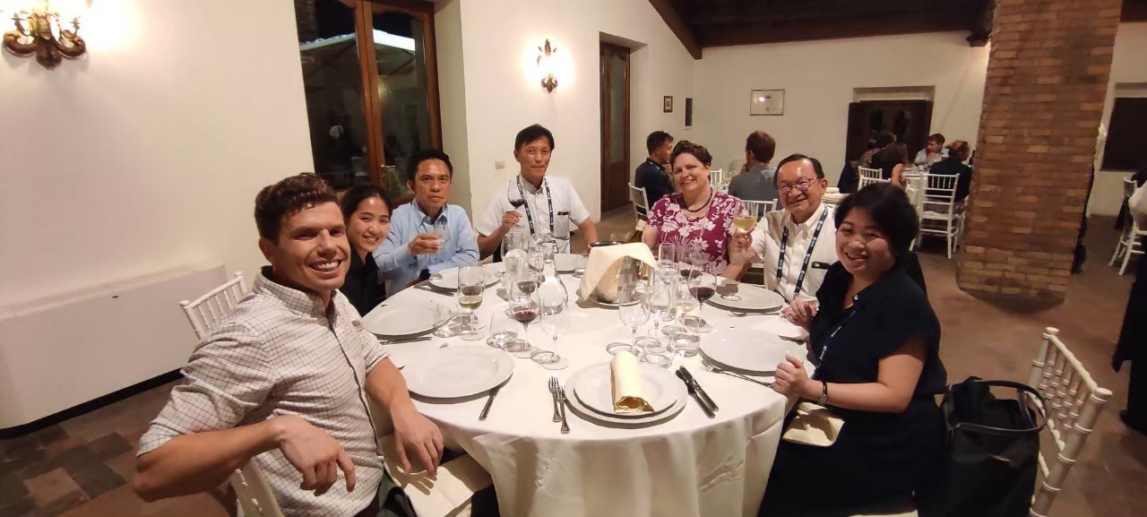
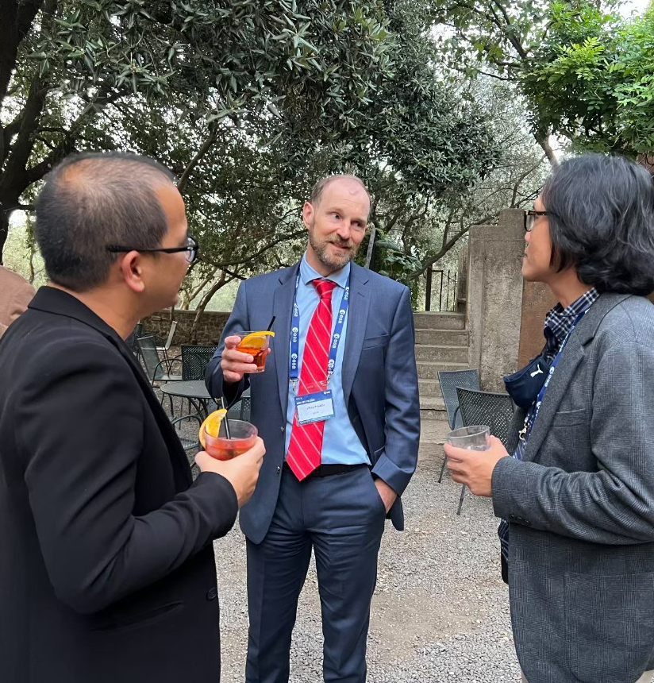
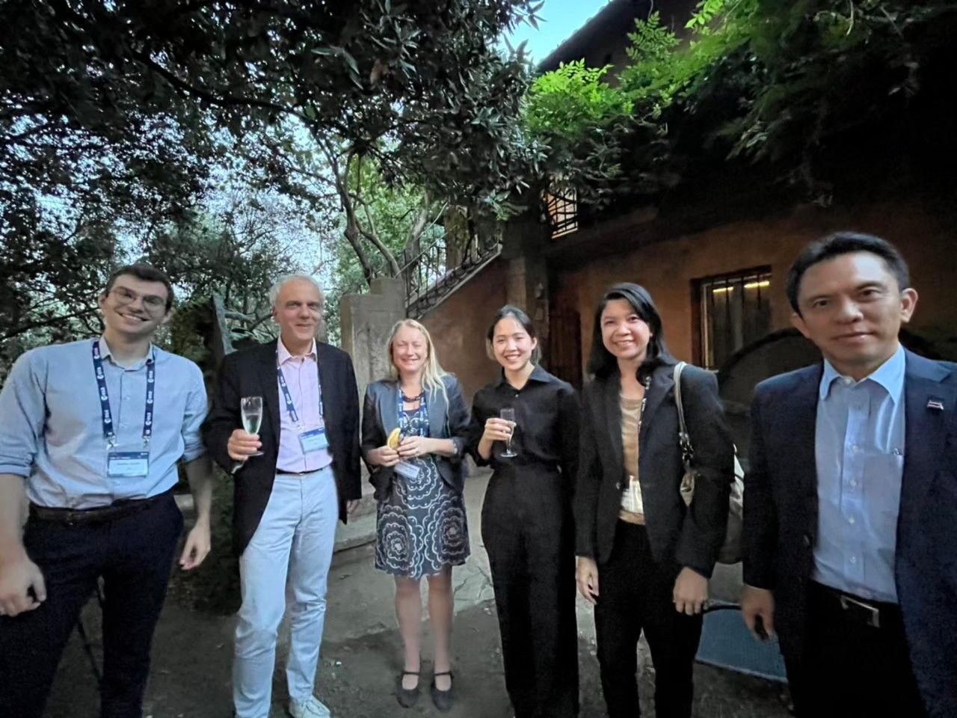
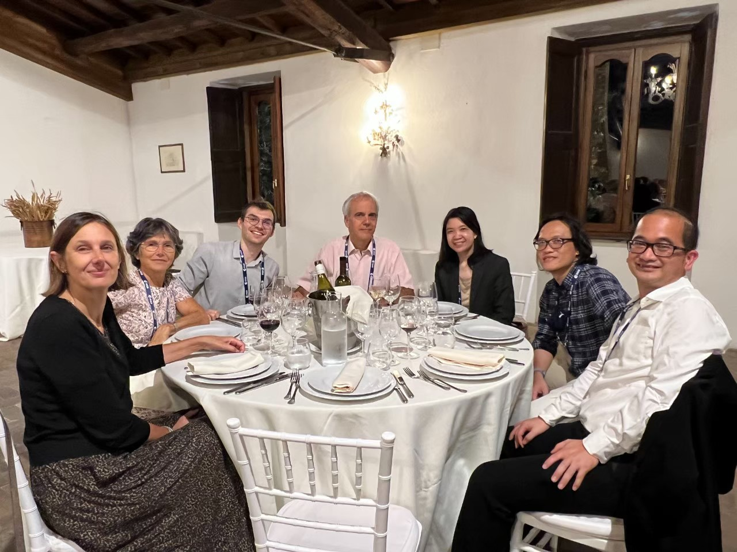

Slide 12
The CEOS Plenary 2023
Date: 13-16 November 2023
Structure: 13 Nov - Side Meeting
14 - 15 Nov - CEOS Plenary 2023
16 Nov - Excursion
Location: Chiang Rai, Thailand

