Slide 1
CEOS Missions, Instruments and Measurements (MIM) Database
Annual Report
Ivan Petiteville
ESA, SIT Chair Team
Agenda Item 2.14
2022 CEOS Plenary
Biarritz, France
Nov. 29 – Dec. 1

Slide 2
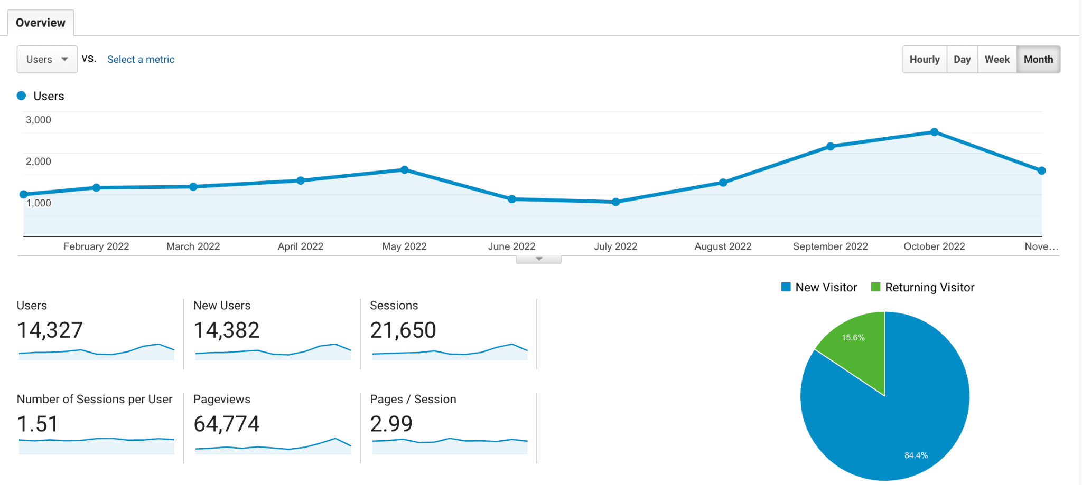
Summary
The CEOS MIM (Missions, Instruments, Measurements) remains a key ‘connective tissue’ across the CEOS community – CEOS Work Plan ‘Core Service # 7’
2022 update survey completed with 36 new missions and 47 new instruments
Web audience CEOS DB 1000+ users/month, plus 500/month EO Handbook, adding CEOS Internal, Twitter, and YouTube content - traffic +8% year on year
The publication of quarterly reports continues
CEOS Database Monthly Traffic YTD 2022 (database.eohandbook.com)

Slide 3
2022 Survey
Annual effort of at least 15 weeks FTE for contacts from 30+ CEOS Agencies - thanks for your support!
33 agencies responded to the survey this year, with 24 providing updates
Ongoing challenge to secure quality inputs from CAST, CRESDA, NRSCC, NSMC-CMA
CGMS Plenary, OSCAR/Satellite, and launch activity reports help augment information
Response not received from ROSCOSMOS this year. Launch records were updated based on online sources
36 new mission records, and 324 mission records updated
47 new instrument records, 177 inst. records updated
103 new instrument-measurement mappings added

Slide 4
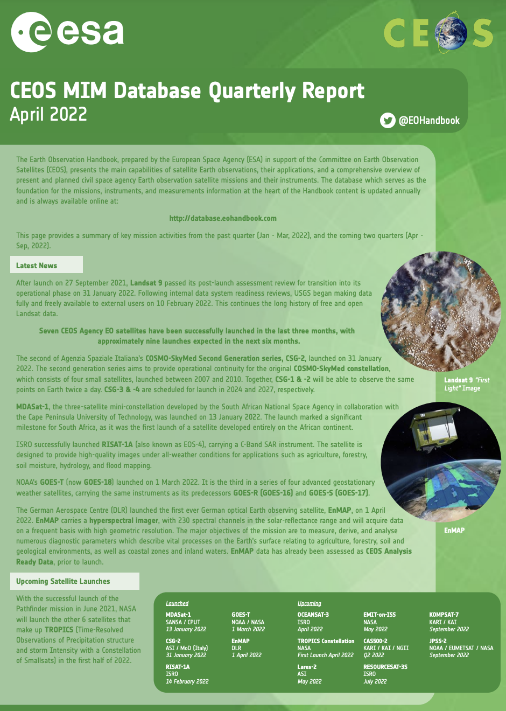
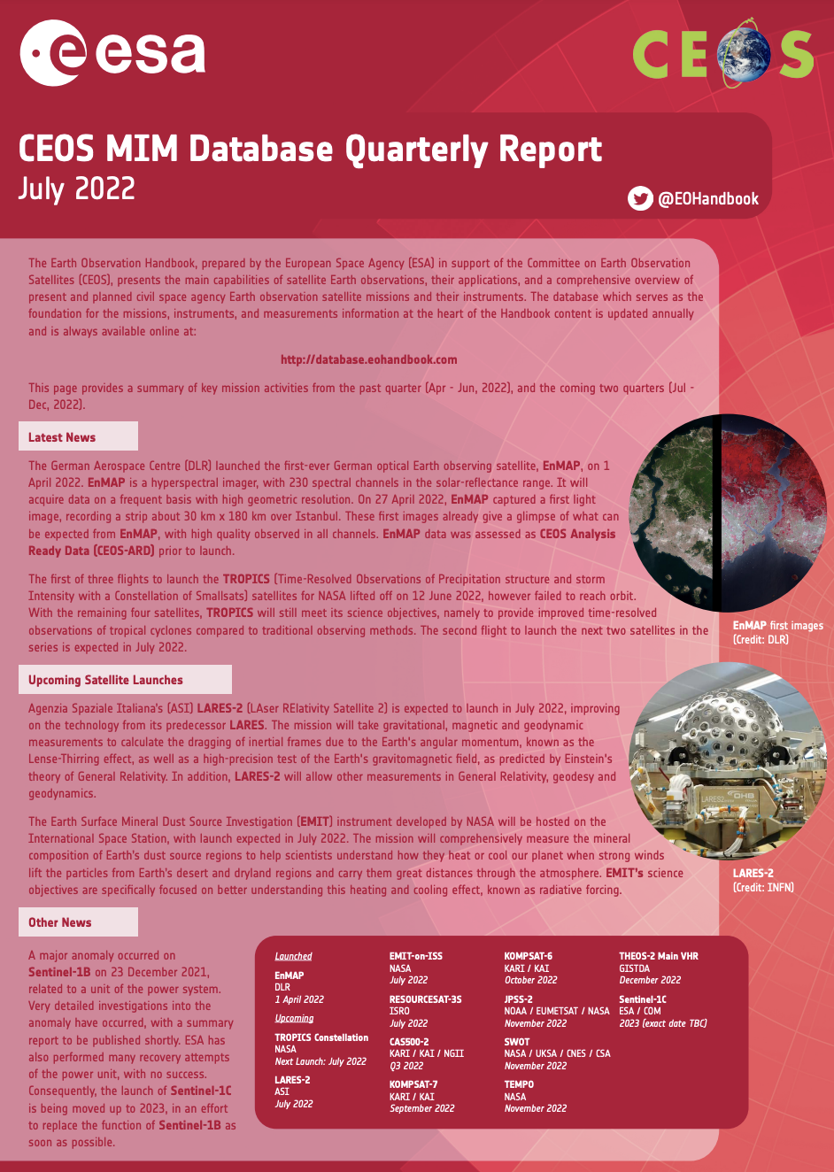
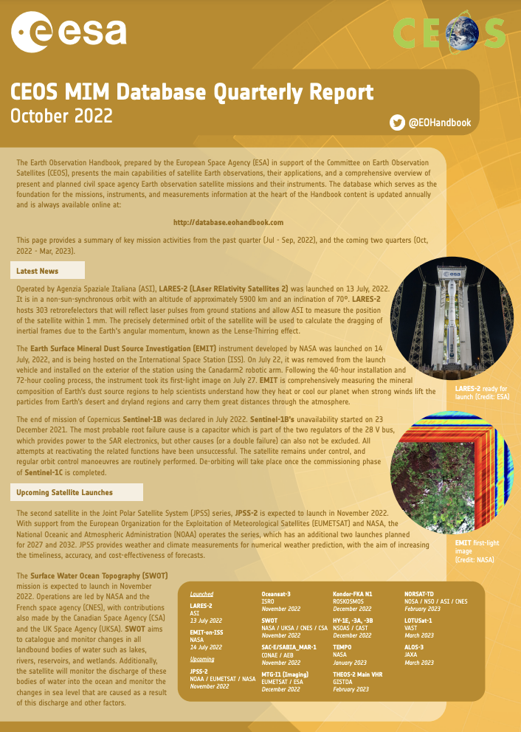
2022 Publications
Quarterly reports
Key Tables
ceos.org/mim-reports-archive

Slide 5
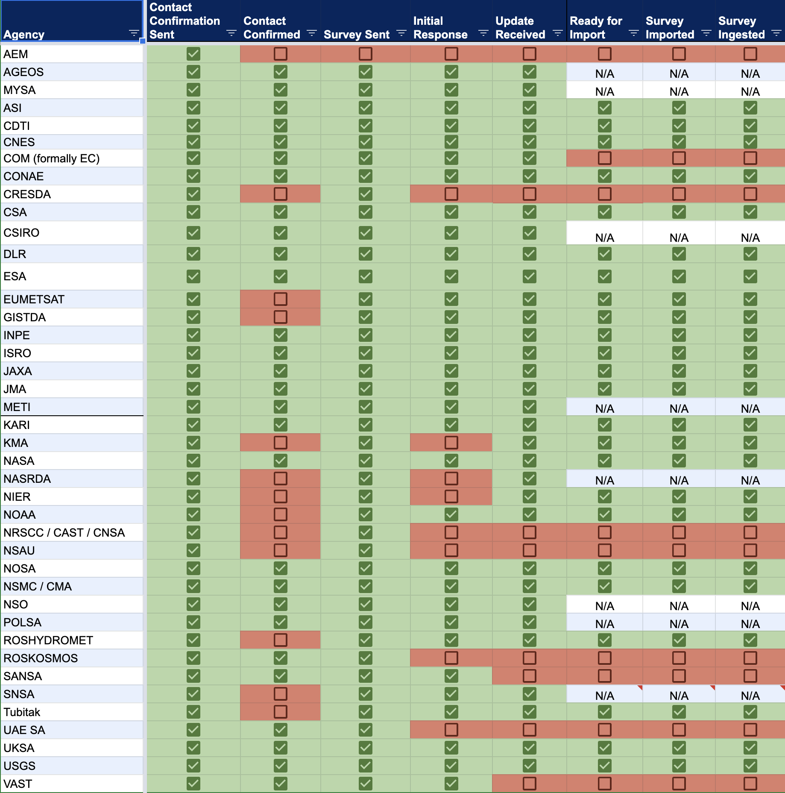
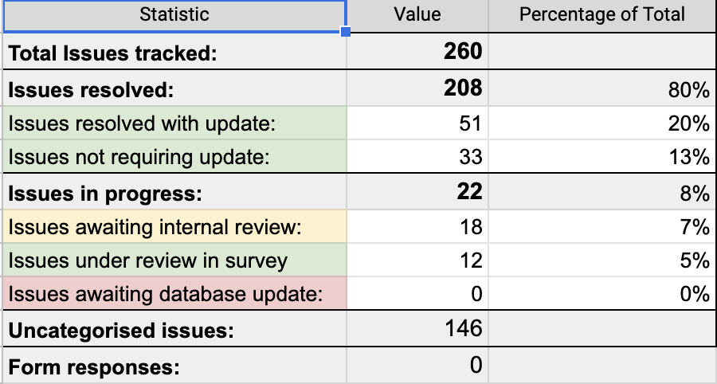
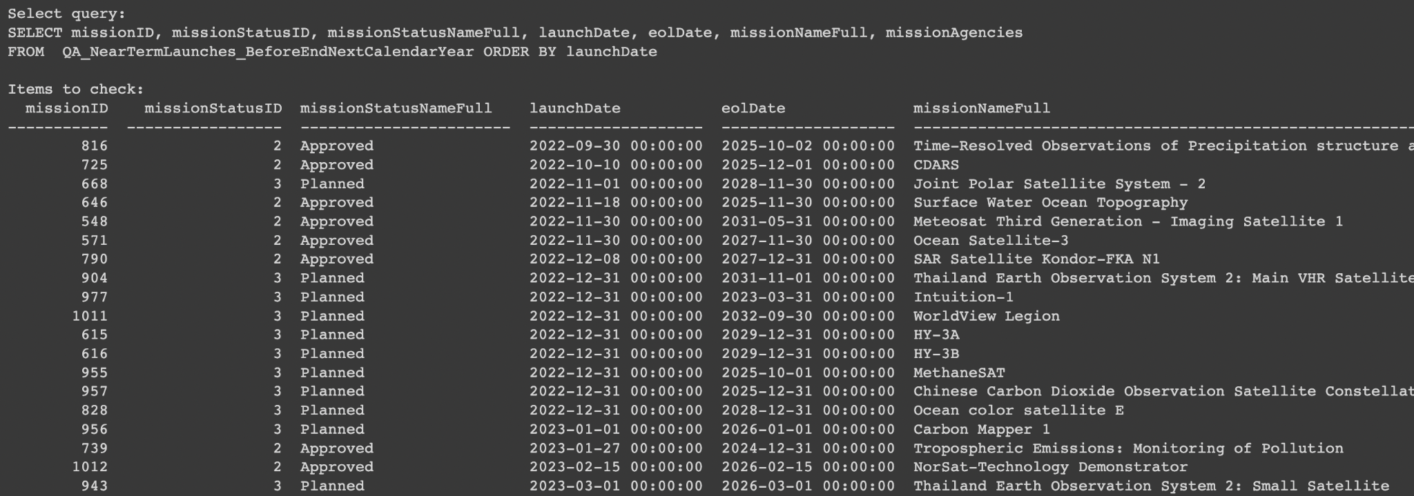
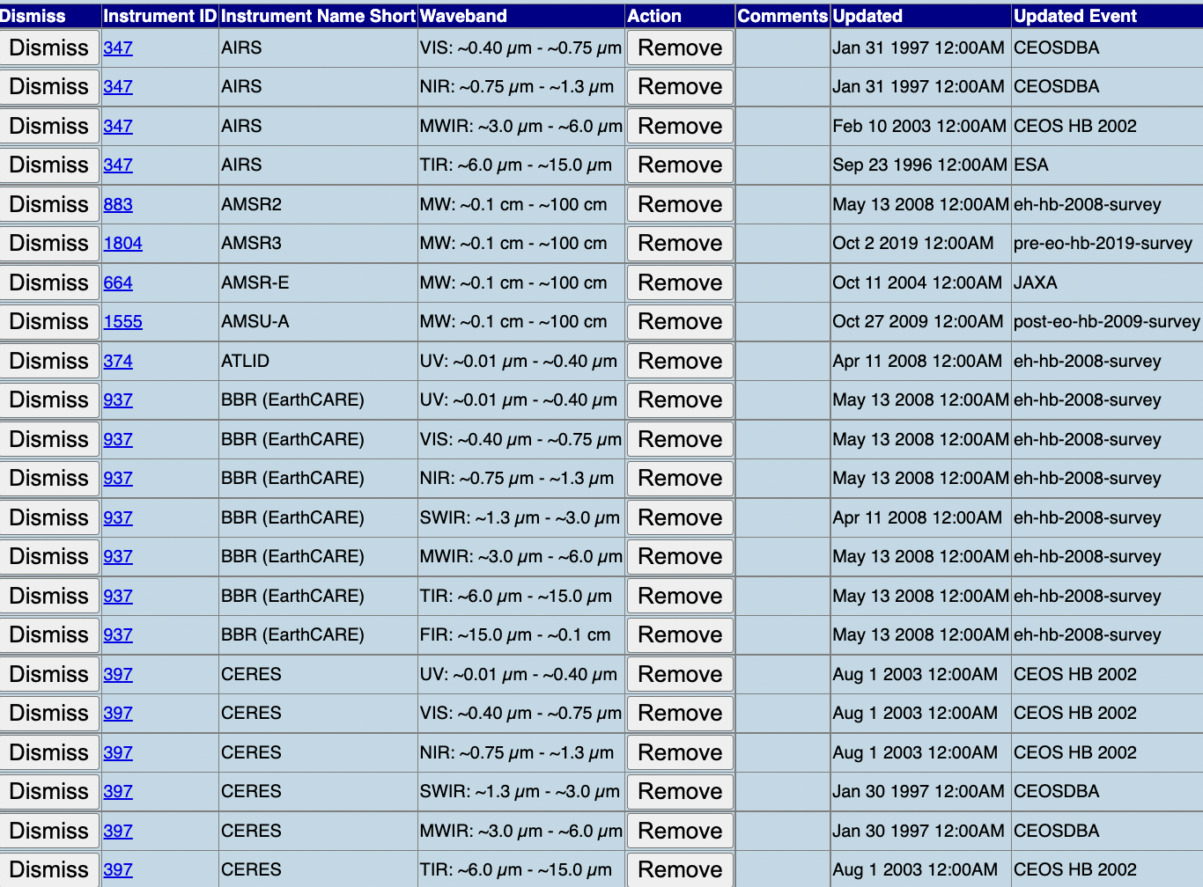
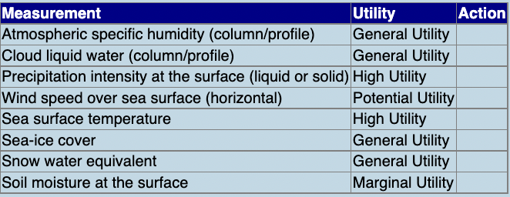
Summary of current MIM info
41 Agencies Followed
100’s of Issues Tracked
* ADD STATS *

Slide 6
QA Process
Logic checks:
Zero measurements associated with instrument
Instruments not expired, mission not operational
Linked mission dates (hosted payloads)
Mission commissioning, launch more than 3 months ago
Mission date NULL, Status not NA/Cancelled
Mission in series, not in missions
Mission launch date passed, status still future
Mission Operational, instrument status not operational
Mission past EOL date, status not EOL NA/Cancelled
Near Term Launches - before end next calendar year
Mission Still Operational (Nominal) but launch was more than five years ago.
Date override strings

Slide 7
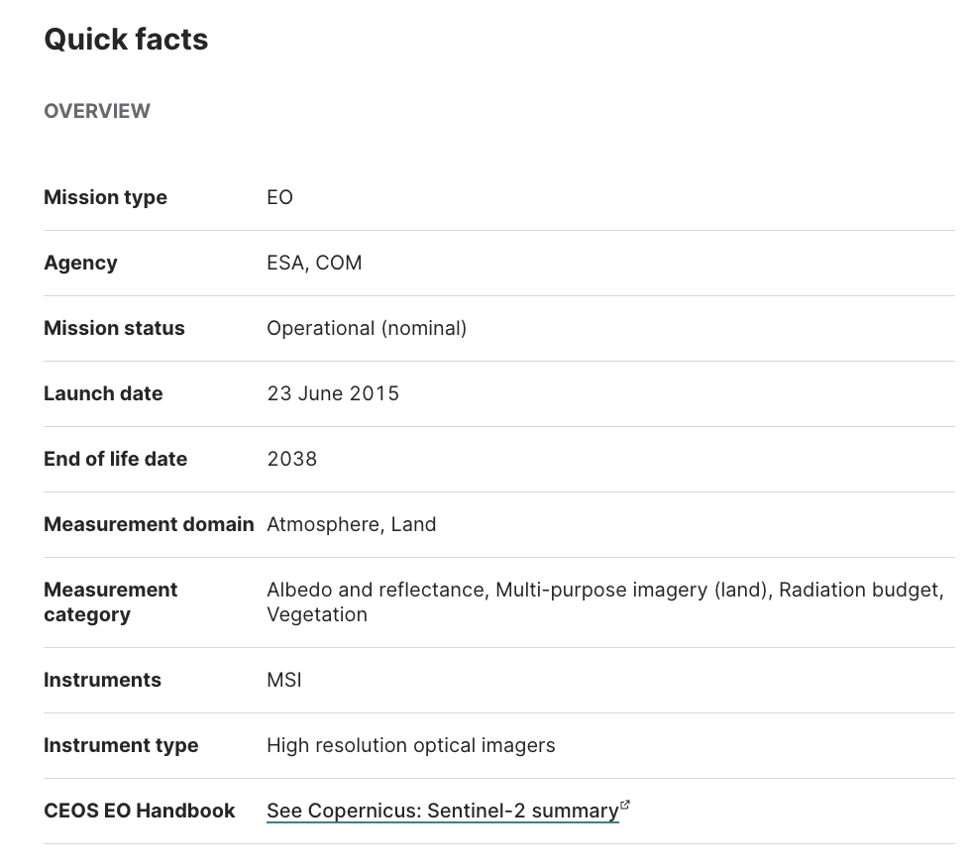
Link to EO Portal
Improved link between the CEOS database and the EO Portal from Aug 2022
168% growth in CEOS DB traffic: increasing awareness of CEOS agency activities
Expanding commercial mission content in support (records not visible online) - working towards eventual comprehensive record
ESA EO Portal: eoportal.org

Slide 8
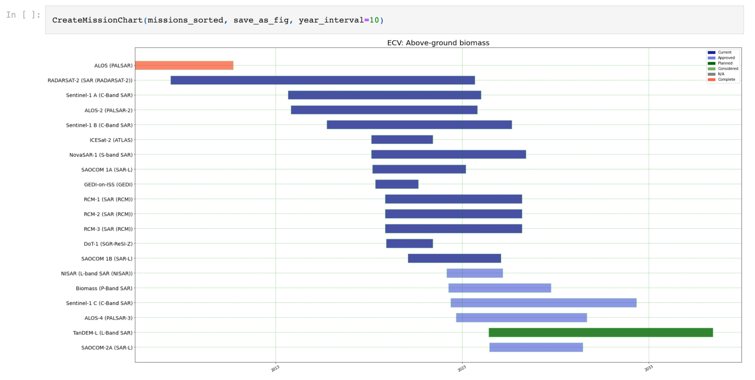
VC-18-07: Gap Analysis Tools
Collaboration between CEOS DB and SEO teams
Initial set of analysis tools released
Open to building more and adding users
Unlocking CEOS DB information
github.com/gamedaygeorge/ceos-db-toolkit

Slide 9
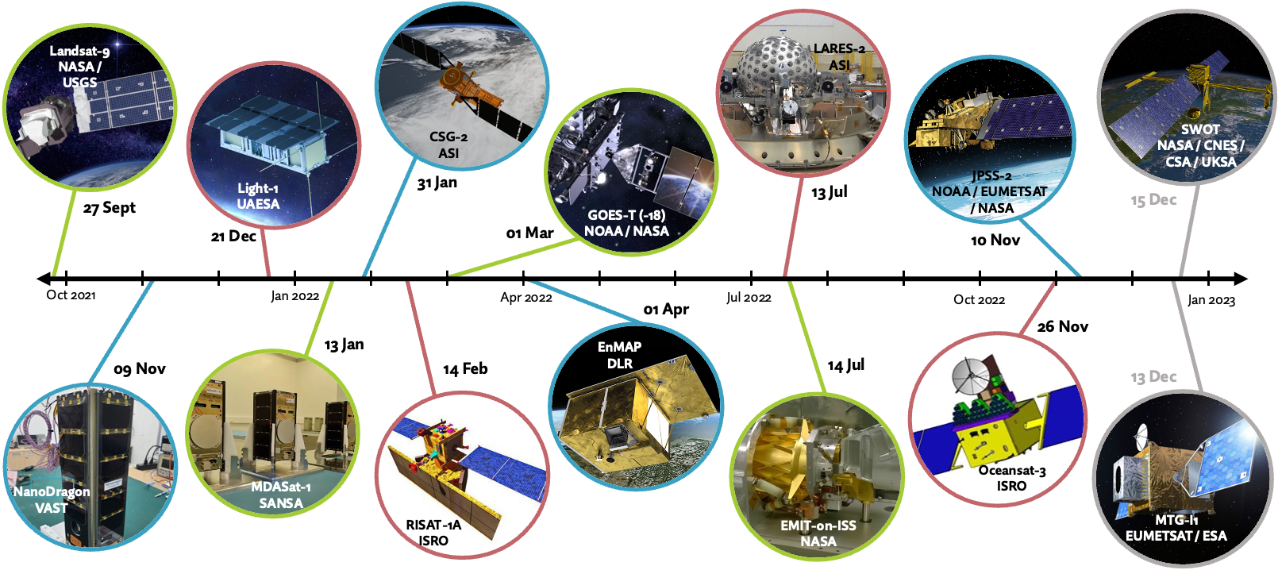
Missions launched this year

