Slide 1
CEOS Systems Engineering Office (SEO) Report
Brian Killough NASA, CEOS-SEO
Agenda Item 2.13
2022 CEOS Plenary
Biarritz, France
Nov 29-Dec 1, 2022

Slide 2
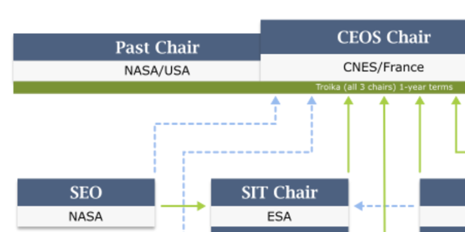
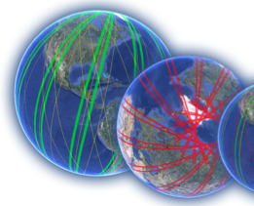
SEO Reminder ... What We Do
The CEOS Systems Engineering Office (SEO) was established in April 2007 (sponsored by NASA HQ) to support the CEOS organization and facilitate global space agency initiatives. 15+ years of support to CEOS!
The SEO technical functions include: developing systems engineering tools and solutions, conducting requirements and gap assessments, data acquisition planning, and special projects (e.g., Open Data Cube)
The SEO management functions include: improving communications through web-based tools, managing CEOS social media, meeting logistics, and developing education and outreach products.
Slide 2

Slide 3
Cloud Computing Prototypes
The SEO has been testing several cloud computing frameworks to understand CEOS data access and technology capabilities. These cloud frameworks use YOUR data!
Google – we use the Google Cloud (paid), Colab (free notebook platform, but limited) and Earth Engine (free satellite datasets).
Amazon – we use the AWS Cloud (paid), SageMaker (free notebook platform, but limited), and the AWS Open Data Catalog (free satellite datasets).
Sentinel Hub – we are working with Sinergise to test ODC integration with the Sentinel Hub via CreoDIAS (European cloud provider).
Microsoft – we use the Microsoft Azure Cloud (paid), Azure Labs (free notebook platform, but limited) and the Planetary Computer Data Catalog (free satellite datasets).
Slide 3

Slide 4
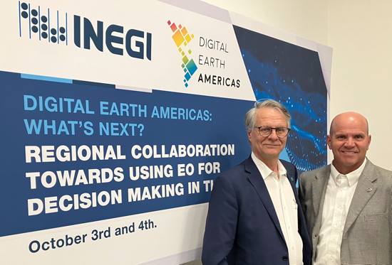
Regional Data Cubes
Digital Earth Africa – The SEO led the deployment and testing of the African Regional Data Cube in 2018. The success of this prototype led to a fully funded DE-Africa. Leadership has now completely transitioned to Africa (SANSA). The SEO still represents CEOS on the Technical Advisory Committee (TAC).
Digital Earth Pacific – The SEO has worked with the Pacific Community (SPC) to guide the initial prototype and conduct user needs meetings. SPC is now working on securing funding. The SEO represents CEOS on the Interim Steering Group (ISG).
Digital Earth Americas – The SEO is working with CSIRO (Chile) and INEGI (Mexico) to explore opportunities toward a future DE-Americas. We conducted several workshops in the region to explore user needs. A future Caribbean initiative funded by Mexico is likely the next opportunity. There are also ideas for pilots in Costa Rica and Suriname (via GPSDD) and Brazil (INPE). A meeting with AmeriGEO was held at the GEO Plenary in Ghana to share progress and plans.
Slide 4

Slide 5
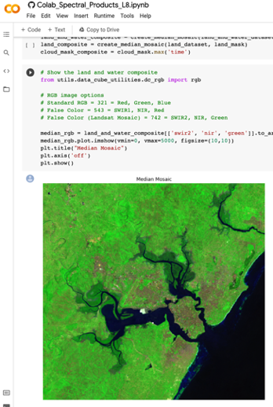
Open Data Cube Sandbox
The Open Data Cube (ODC) Sandbox has 19 applications in GitHub. This open source tool is a great example of “open science” and has gained significant popularity as an educational and research tool.
The SEO worked with Digital Earth Africa to develop their ODC applications and tools. They recently released 100+ application notebooks focused on satellite datasets, real-world examples and SDGs.
The SEO participated in several WGCapD webinars to promote open science and use of CEOS satellite data via Jupyter notebooks.
openearthalliance.org/sandbox
Slide 5

Slide 6
More Accomplishments in 2022 ...
Analysis Ready Data (ARD) ... led the developed of the Nighttime Lights ARD specification. Released in October 2022.
SDG Coordination Team ... led the implementation and completed all planned deliverables. Completed ODC notebooks focused on SDG 6.6.1 (water).
Earth Analytics Interoperability Lab (EAIL) ... Worked with CSIRO to support several prototype tests and training. COAST, WGCV (DEMIX), WGDisasters (Flood Monitoring), and Rice Monitoring projects all strongly requested continued support of the EAIL.
COVE Tool (ceos-cove.org) ... 3000+ annual users, enhanced API, new missions/instruments
WGCapD ... maintained Training Calendar and EOTEC DevNet Floods Tracker tool
WGISS ... maintained Open Source Software Inventory and Future Data Architectures Inventory
Slide 6

Slide 7
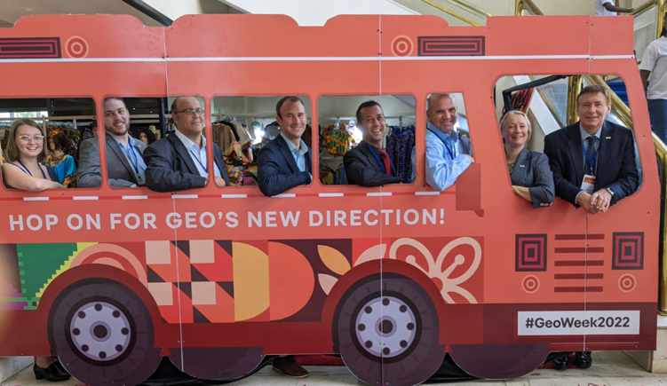
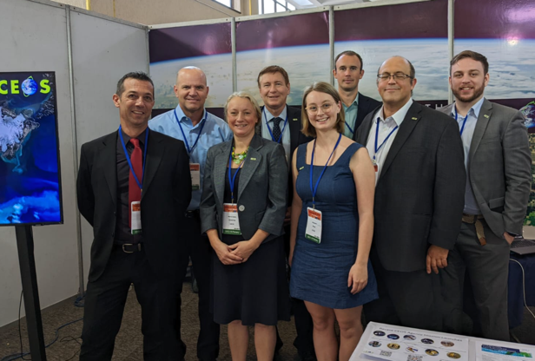
CEOS Communications
Thanks to the Symbios team (Libby, Riza and Matt) for an engaging CEOS communications approach and lots of new content!
Have you visited the CEOS website recently? You will find new monthly articles (VCs, SDGs, MIM, ARD), a new video on CEOS and SDGs, and a new CEOS Newsletter (via JAXA) page. We get 30,000+ web “requests” per day and many of them are “blocked”. Our website is quite active!
Have you visited CEOS social media channels? Twitter (@CEOSdotORG, 4500+ followers, #FunFactFriday, and a new @CEOSARD page), Facebook (@socialceos, 1900+ followers)
CEOS hosted an exhibition booth at the GEO Plenary in Ghana. Here are some “lessons learned” ... people love “swag” and it attracts them to the booth, one flyer or business card with QR codes would be ideal. Training and Data Access were the most popular topics.
Slide 7

Slide 8
Plans for 2023
Continue leadership of the Sustainable Development Goals (SDG) Coordination Group.
Continue to support regional data cube development (Digital Earths) for Africa, the Americas, and the Pacific Islands. The SEO is part of the steering/advisory group for each initiative.
Continue to advance Open Data Cube (ODC) initiatives within CEOS (e.g., EAIL), advance the sandbox tool for educational impact, and advance user applications using Jupyter notebooks.
Continue testing analysis-ready datasets (e.g., JAXA’s ALOS PALSAR-2, NASA’s Black Marble Nighttime Lights) and begin preparations for new missions (e.g., Sentinel-1C, NISAR).
Continue to participate in global meetings (GEO) and conferences (IGARSS).
Continue critical support of CEOS infrastructure ... website and social media content, website and database maintenance and security, meeting logistics, mailing list management.
Let us know how the SEO can better serve CEOS!

Slide 9
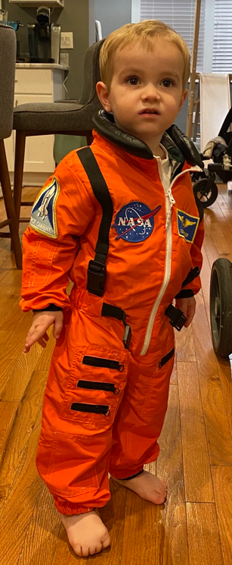
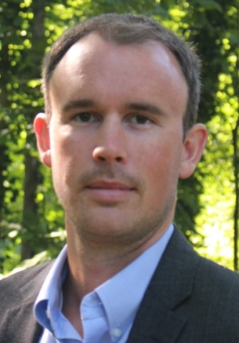
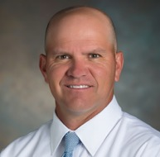
Future SEO Leadership
Brian Killough is retiring on December 16, 2022 after 35+ years with NASA and 15+ years with the CEOS-SEO.
David Borges will lead the CEOS-SEO after Dec 16. You have an excellent and capable leader to carry the CEOS-SEO forward!
I am proud of what we accomplished together!
Slide 9

Slide 10
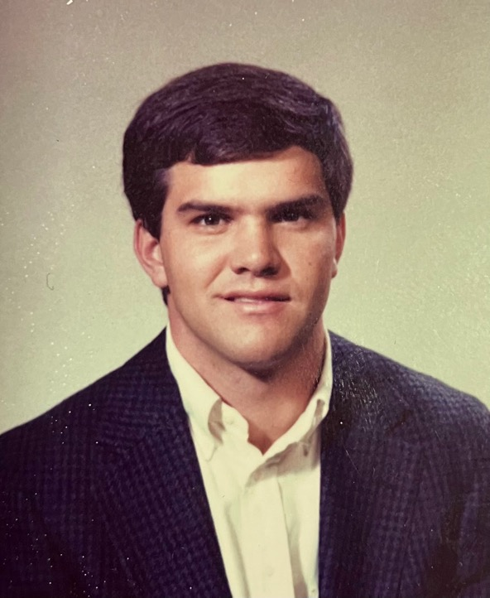
The End
Out with the old …
In with the new …
Slide 10

