Slide 1
2022 CEOS Chair Priorities
Paths to Sustainability:
From Strategy to Practical
Measures
Selma Cherchali
CNES, 2022 CEOS Chair
Agenda Item 2.12
2022 CEOS Plenary
Biarritz, France
Nov. 29 – Dec. 1

Slide 2
Paths to Sustainability: From Strategy to Practical Measures
Ensuring Long-term Sustainability of CEOS Strategies
Explore Establishment of Services from CEOS Demonstrators
Sustained Operation and Application of CEOS Demonstrators
CEOS Support to the UNFCCC Global Stocktake
Implementation of the CEOS Strategy to Support the Global Stocktake of the UNFCCC Paris Agreement through the support of the CEOS Biomass Protocol uptake & GEO-TREES
Support to CEOS Cal-Val Initiatives
CEOS Protocol for Cross-calibration of Thermal Infrared Measurements
Joint Multi-thematic Cal-Val Sites to Develop CEOS Agency Synergies and Support Future Applications

Slide 3
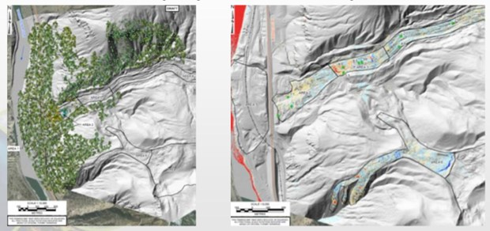
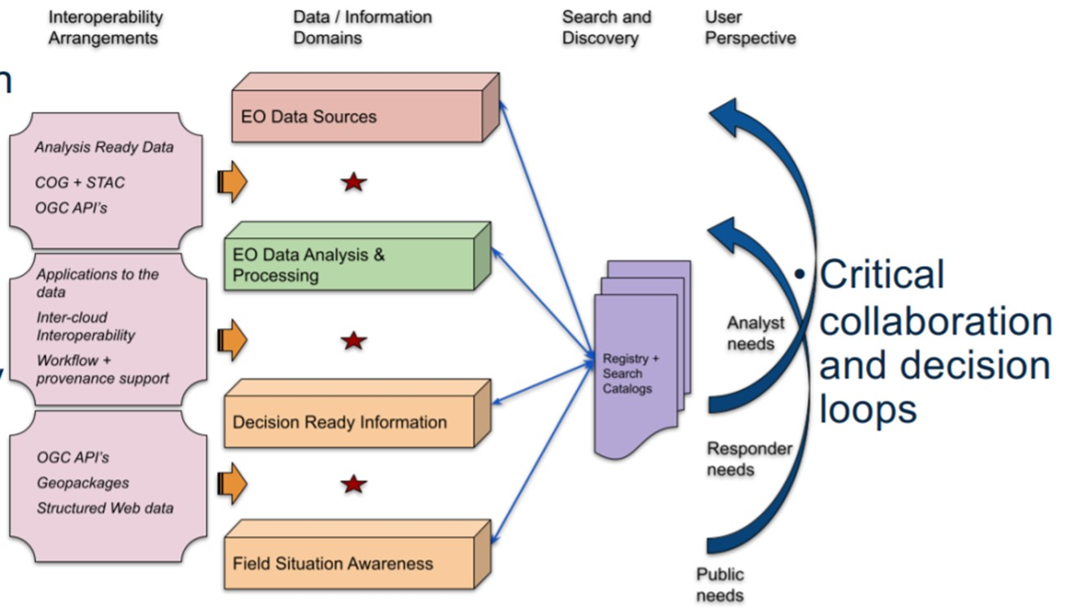
Priority #1: Ensuring Long-term Sustainability of CEOS Strategies Disaster Risk Reduction and Response, & Capacity Building
Identify demonstrators / R&D stage activities across CEOS suitable to transition to operational services.
Continue to develop model partnerships through Demonstrators, specifically Recovery Observatory (RO)
Develop synergies between CEOS projects and identify support mechanisms with key external stakeholders. Engagement with GEO is key in that manner.

Slide 4
Accomplished: Ensuring Long-term Sustainability of CEOS Strategies Disaster Risk Reduction and Response, & Capacity Building
WGDisasters Recovery Observatory (RO)
Cited in the UN Space Agenda 2030
4 Demonstrators activated by PDNA tripartite agreement partners (UE, WB, UNDP)
RO sustainability sub-group started at the WGDisasters meeting #17 in March.
Links established with WGCAPD
WGCAPD/WG Disasters joint action : Capacity Building for Decision Makers on Recovery Observatories
WGDisasters activities sustainability
Sub-team created within the WG’s Demonstrators to address sustainability issues
To ensure long term sustainability:
Keep on working on the development of strong and visible links with GEO and WG GEO DRR:
RO integrated as a case study in the GEO EO risk toolkit
GEO4DRM
Linkages to be done with GEO post 2025 incubators
Continuous efforts have to be provided for strong policy linkages: e.g., Sendai framework, International Charter "Space and Major Disasters“, Copernicus EMS.

Slide 5
Accomplished : Priority #2 : CEOS Support to the UNFCCC Global Stocktake Ensure Strong and Unified CEOS Support to the UNFCCC Global Stocktake
Support Global Stocktake data requirements:
CNES with UKSA and DLR will ensure planned missions, such as MicroCARB & MERLIN, to provide practical support to Global Stocktake data requirements:
CNES/UKSA/EUMETSAT partnership
MicroCARB data will be key for CO2M CAL-VAL
GHG Roadmap
Biomass Protocol – CNES is enhancing ongoing activities by :
supporting and hosting the GEO-TREES secretariat office
funding two biomass protocol implementation sites

Slide 6
Accomplished : Engage with countries for adaptation and mitigation support: Space for Climate Observatory (SCO)
Engage with countries for adaptation and mitigation support
Provided use cases through Space for Climate Observatory (SCO) within the WGD
Involvement of many CEOS agencies in SCO Charter signed in June 2022
The Space for Climate Observatory is part of the wider EO global community as a GEO participating organization. Its Charter gathers over 33 partners including 22 space agencies.
CNES level in-depth analysis of possible ties with different CEOS WGs and promote this sustainable framework.
Outcome: One application was presented at WGD level : FloodDam (CNES, JPL, ADS, CERFACS, Predict Services)

Slide 7
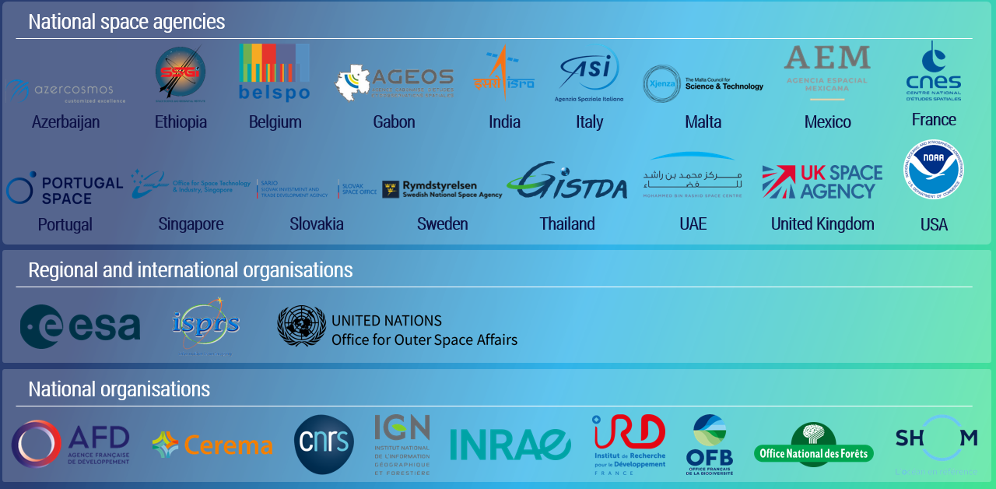
SCO’s international Charter

Slide 8
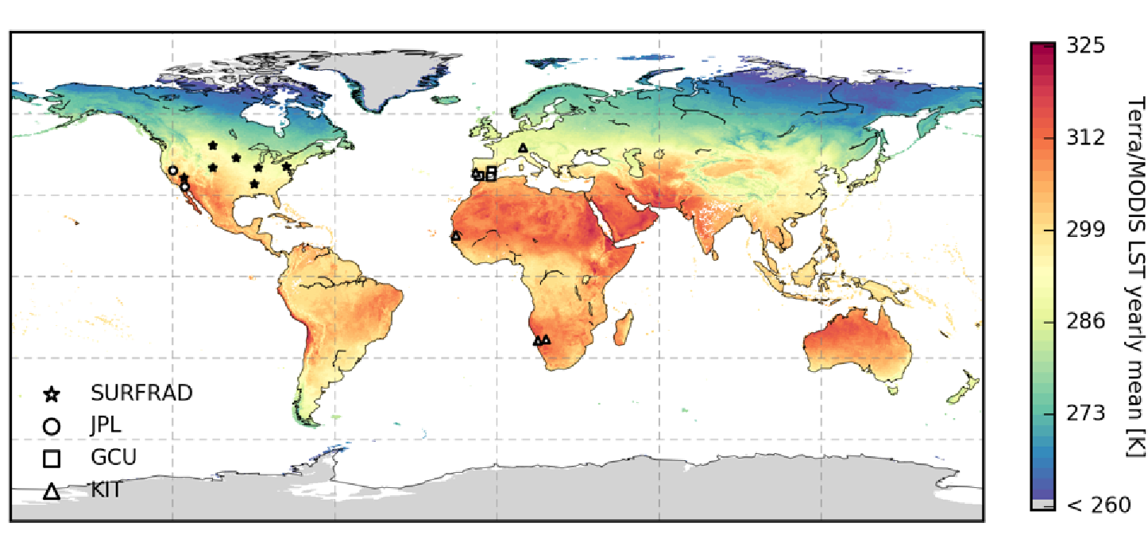
Priority #3: Support to CEOS Cal-Val Initiatives Increased CEOS Agency Cal-Val Collaboration
CEOS protocol to support the cross-calibration of thermal infrared measurements from future CEOS Agency missions:
WGCV supporting – CEOS Work Plan 2022-2024 task established
Definition of a common network of in situ calibration sites to harmonize calibration methods for thermal infrared instruments : the activity is co-led by IVOS, for Level 1 calibration, and LPV, for the protocols for the ground-based measurements.
Connections Trishna (CNES/ISRO) made with ESA (LSTM), NASA/JPL (SBG), CSIRO (Aquawatch), etc.
Goal: maximize the benefit of these missions for users
Location of ground observational networks currently used to validate standard LST products derived from US and European spaceborne instruments.

Slide 9
Accomplished: Thermal Infrared Cal/Val
Dedicated Working Group implemented and leaded by ESA and CNES, following the RadCalNet example.
First dedicated meeting in September 2022 (ESA, CNES, INRAE, KIT, Leicester Univ., NASA, NPL, STFC-UKRI, USGS, Valencia Univ.,…) :
Objective of the automated network: to provide ToA (Top of Atmosphere) TIR spectra for ToA calibration/validation
ESA and CNES will assess the possibility for funding a study that would firmly define the ToA objective and requirement for the TIR Network and also the characteristics that sites will need to fulfil in terms of environment and instrumentation.
The study should also identify potential candidate sites that correspond to the requirements, or that could be brought to that level.
CNES increased representation in WGCV and is seeking to reinforce its CEOS participation for TIR activities.

Slide 10
Accomplished : CEO continuity
The CEO position is key for CEOS stability
The CEO position is the backbone of CEOS in terms of leadership and governing stability. Nonetheless, efforts should be continuous to identify mechanism to ensure the continuity of the CEOS Executive Officer function in the next years.
CNES CEOS Chair coordinated with CEOS sec agencies the discussion on CEO sustainability and continuity

Slide 11
Acted “Sustainability” → CAP D activities perspectives
CNES action to support its priorities as CEOS chair will continue beyond its presidency term, in particular :
Joint WGCapD-WGDisasters reach-out activity towards decision makers on the added value of EO for Recovery Monitoring (with UNOOSA, ASI and CONAE) : workshops in Africa and South-East Asia
Copernicus Training of African Trainers 2-years Program (starting now) in Portuguese, French and Spanish, funded by the European Commission, involving 12 European partners incl. Portugal Space, ASI,… and reaching out towards 17 African countries

Slide 12
Welcome
GISTDA !

Slide 13
Un très grand
Merci !

Slide 14
