Slide 1
ASI Current and Future Earth Observation missions: an overview
ASI, Italian Space Agency
ASI Earth Observation Division
ASI Earth Observation Division - This document contains proprietary information of ASI, and may not be reproduced, copied, disclosed or utilized in any way, in whole or in part, without the prior written consent of ASI

Slide 2
Earth science and applications
Ensure that Earth Observation missions offers the best possible benefits for science and society. Involve EO community in all program phases
ASI Earth Observation at glance:
Our 8 major objectives
Pull users towards applications and services
Facilitate access to data, information and processing capabilities.
Pioneer new services
Stimulate downstream industrial and economic growth
ASI Earth Observation Division - This document contains proprietary information of ASI, and may not be reproduced, copied, disclosed or utilized in any way, in whole or in part, without the prior written consent of ASI

Slide 3
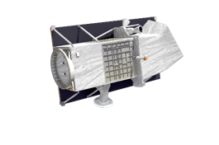
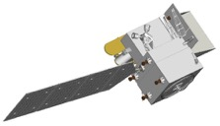
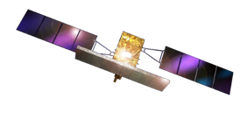
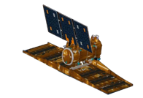
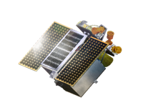
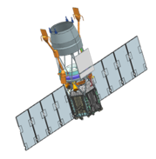
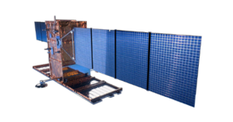
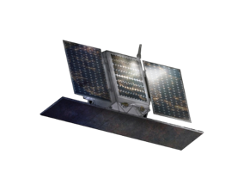
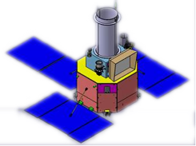
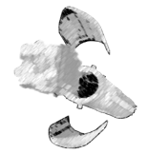
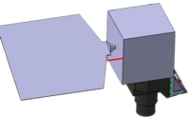
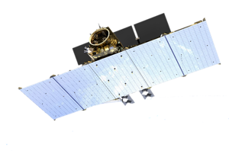
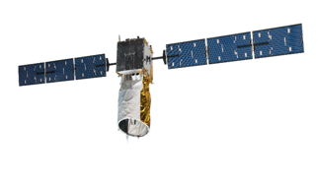
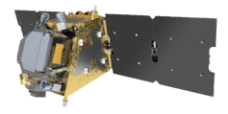
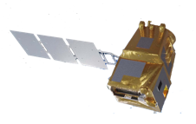
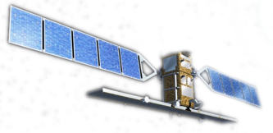
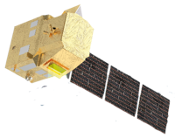
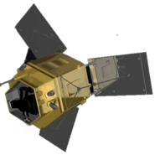
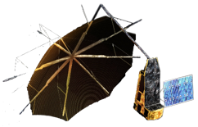
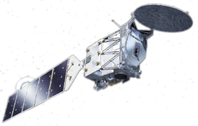
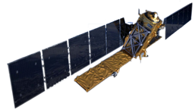
PRISMA
SBG -TIR
SAOCOM
PLATiNO-3 VHR
CSK
CSG
SHALOM
NATIONAL/BiLATERAL
MAIA
L-Band M&B
PLATiNO-1 M&B
PSG
PLATiNO-4
GEOSAR
CALIGOLA
Lidar
NIR SWIR MWIR LWIR
X C L
ESA / EC
AEOLUS
Sentinel-1
Rose-L
FLEX
LSTM
AEOLUS FO
CHIME
Forum
Harmony
EarthCare
BIOMASS

Slide 4
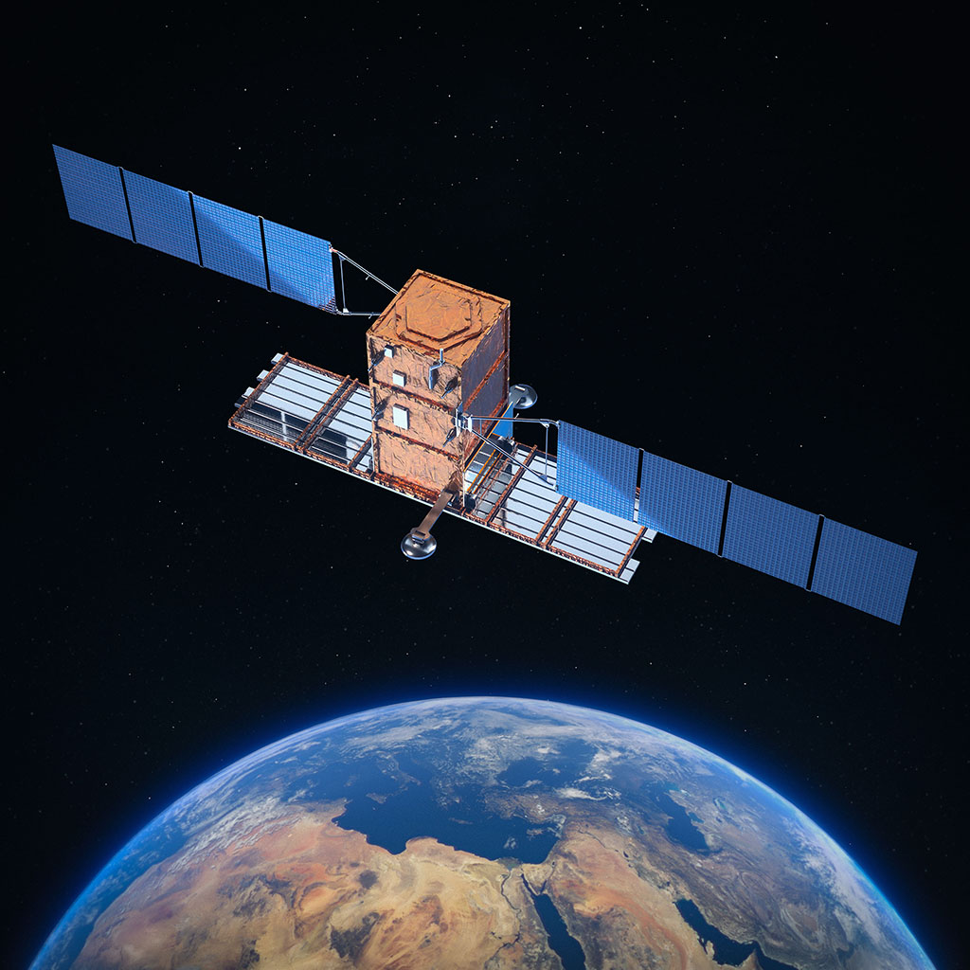
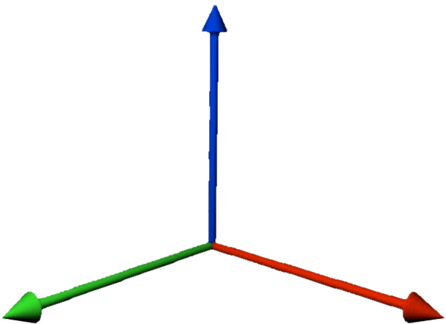
THE MICROWAVES: SAR in L, (C) and X Band
Focus on:
COSMO-SkyMed: First, Second and Next Evolutions
GEOSAR, a GEOSYNCRONOUS SAR MISSION
PLATiNO-1: MONO/BI STATIC X-BAND SAR MISSION
SAR Different Bands & Modes
Devel. and evol. of Size & Orbits
Devel. and evol. in Time
ASI – Earth Observation Division - Do not reproduce and distribute without permission

Slide 5
COSMO-SkyMed - The First and the Second Generation
COSMO-SkyMed Second Generation (CSG) will:
Ensure operational continuity to the currently operating constellation
Achieve a step ahead in terms of functionality, performances and system services for the Earth Observation users
The 4 CSG Satellites will have an operational lifetime of at least 7 years. Evolutive approach already in place with FM3 & FM4
8 Jun.2007 CSK-1
9 Dec.2007 CSK-2
25 Oct.2008 CSK-3
5 Nov.2010 CSK-4
CSG-1 (PFM)
COSMO-SkyMed is the Italian end-to-end System for Earth Observation, funded by:
CSG-2 (FM2)
CSG-3 (FM3)*
CSG-4 (FM4)*
2007
2008
2009
2010
2011
2012
2013
2014
2015
2016
2017
2018
2019
2020
2021
2022
2023
2024
2025
2026
2027
ASI Earth Observation Division - This document contains proprietary information of ASI, and may not be reproduced, copied, disclosed or utilized in any way, in whole or in part, without the prior written consent of ASI

Slide 6
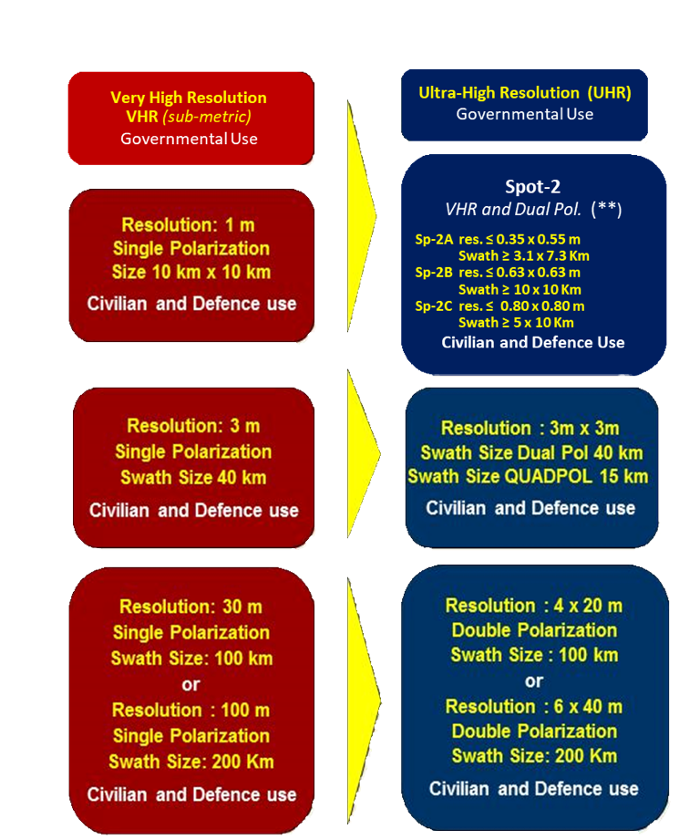
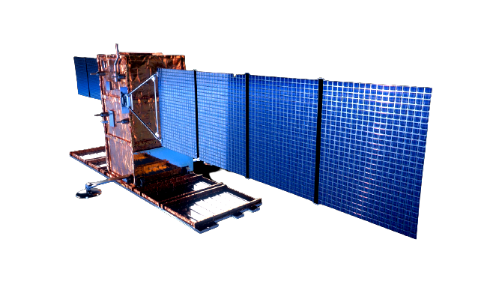
Future COSMO-SkyMed: Beyond the Second Generation
CSK
CSG
The FUTURE
New architectures: a system of systems
GEO and LEO elements
Multi-Sensor capabilities (X and L band SAR)
Multi modes: mono and bi-static SAR
VHR optical capabilities
Enhanced performances
Systematic approach and new on-demand services
SPOTLIGHT
STRIPMAP
SCANSAR

Slide 7
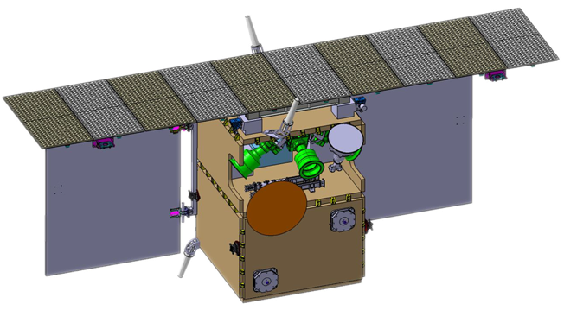
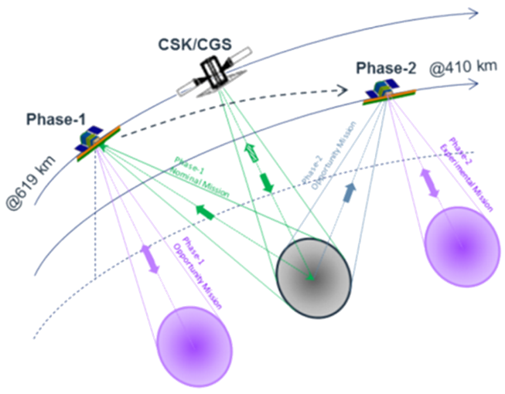
PLATiNO-1 – SAR Mission
Mission Phases are:
Commissioning (LEOP and Commissioning) 3 months;
Phase-1 (@619 km, formation flying with CSK/CSG) 1 year;
Re-orbit phase (orbit transfer with HET) 6 months;
Phase-2 (@410 km, monostatic acquisition) 1.5 years;
De-orbiting phase 6 months.
During Phase-1 PLT-1 will mainly work as a receiver acquiring from Earth the signal generated by CSK/CSG
Bistatic performances (Phase-1)
Altitude | 619 km
Swath | 40 km
Stripmap Resolution | 3 m
Spotlight Resolution | 1 m
Continuous stripmap | Up to 1000 km
Monostatic performances (Phase -2)
Altitude | 410 km
Swath | 15 km
Stripmap Resolution | 3 m
Spotlight Resolution | 1 m
Continuous stripmap | Up to 800km
PLT-1 shall be sized to provide the capacity to acquire, downlink and archive images totaling 20000 km2 daily.
ASI Earth Observation Division - This document contains proprietary information of ASI, and may not be reproduced, copied, disclosed or utilized in any way, in whole or in part, without the prior written consent of ASI

Slide 8
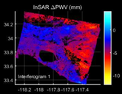
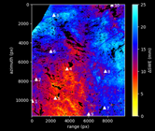
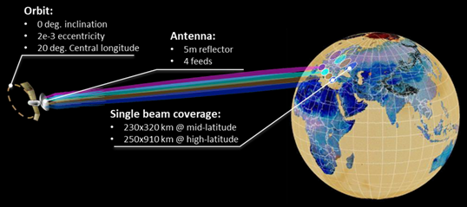
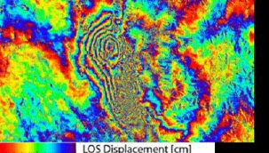
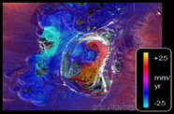
GEOSAR: The GEOSYNCRONOUS SAR Mission
Geosynchronous satellites are suitable for the applications that require constant coverage of a specific spot on the Earth surface.
Such platform can be equipped with a Synthetic Aperture Radar that requires relative motion with respect to the observation target.
X-band SAR, GSD up to 8 m
ATMOSPHERE
CLIMATE CHANGE
EMERGENCY
LAND

Slide 9
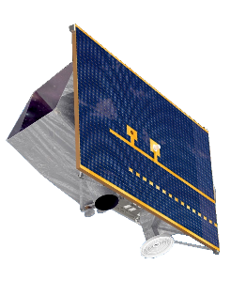
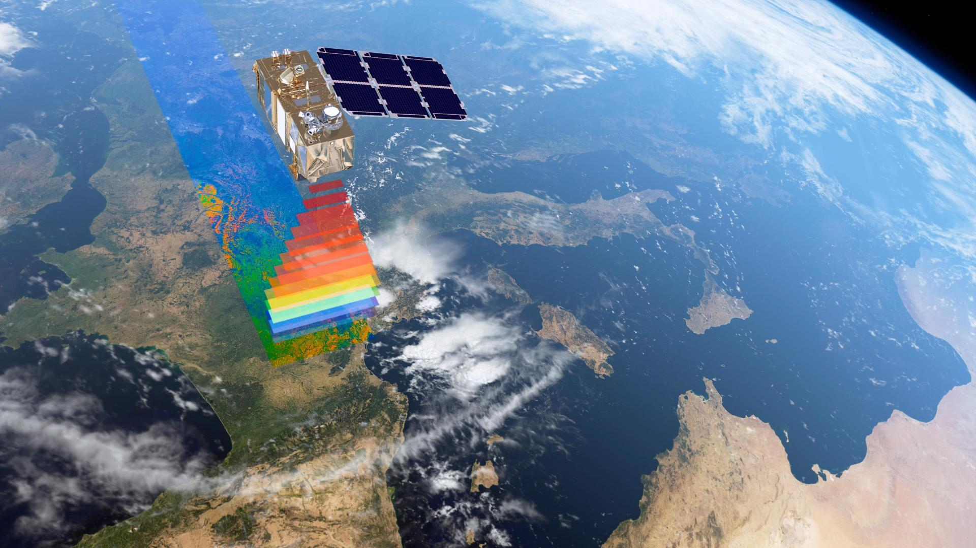
THE REFLECTIVE/EMISSIVE BANDS: VIS-NIR-SWIR-TIR
Focus on:
Multispectral imagery in the thermal IR.
Hyperspectral imagery in the visible and shortwave infrared;
ASI – Earth Observation Division - Do not reproduce and distribute without permission

Slide 10
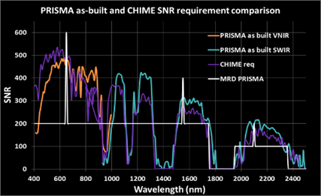
PRISMA - Hyperspectral
Fully funded by the Italian Space Agency (ASI): in-orbit Earth Observation system that simultaneous combines data of a hyperspectral sensor and a panchromatic camera from the same scene.
240 total bands in VNIR (#66, 400–1010 nm) & SWIR (#174, 920–2505 nm) at a spatial resolution of 30 m on a swath of 30 km
Mean spectral resolution of 10 nm in a spectral range of 400-2500 nm
Pan (Panchromatic) imagery is provided at a spatial resolution of 5 m
Simultaneous acquisition of images in the VNIR, SWIR and PAN on the same scene!

Slide 11
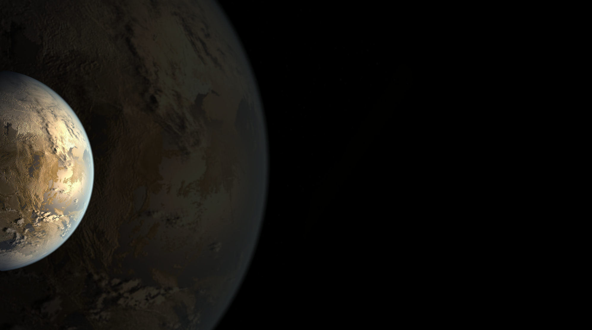
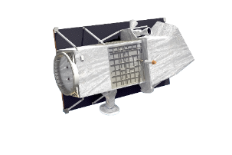
PRISMA 2nd Generation constellation
PRISMA Second Generation is the future Hyperspectral Italian Constellation, to be launched in 2025.
Entirely Funded by the Italian Space Agency
Hyperspectral data continuity currently available by the PRISMA system.
2 COMPONENTS:
- A big high-performance satellite
- A small sat confirming PRISMA performances
SPECS of #1 constellation component (High performance satellite)
SWATH and SNR: on demand techniques of SWATH enlargement and SNR enhancement on a single pass using the platform agility.
Low revisit time (72 h with a maximum off-nadir angle of ± 30°)
Acquisition modes: STRIPMAP and SPOTLIGHT.
STRIPMAP image: VNIR/SWIR GSD ≤ 30 m and PAN GSD ≤5 m, swath ≥30 km and indefinite length with a Daily STRIPMAP Imaging Capacity (acquire, downlink and archive) more than 2.000.000 km2.
SPOTLIGHT image (on-demand): VNIR/SWIR GSD ≤10 m and PAN GSD ≤2,5 m, swath ≥30 km and length up to 210 km with a Daily SPOTLIGHT Imaging Capacity (acquire, downlink and archive) more than 200.000 km2.
ASI Earth Observation Division - This document contains proprietary information of ASI, and may not be reproduced, copied, disclosed or utilized in any way, in whole or in part, without the prior written consent of ASI

Slide 12
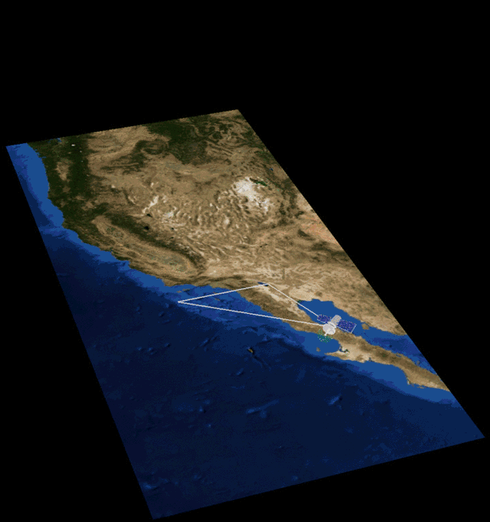
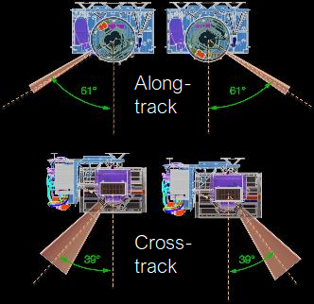
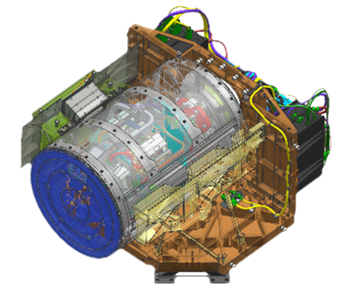
PLATiNO-2 – MAIA Mission
Data collected by the MAIA instrument, orbiting the Earth at 740 kilometers overhead tells a group of tiny sulfate particles apart from a group of equally tiny dust particles. MAIA will be able to distinguish types of particulate matter (PM) based on how the particles reflect or absorb sunlight.
MAIA contains a specialized digital camera that peers at how the Sun’s light reflects off of the Earth and its atmosphere.
The MAIA camera is mounted on a motorized gimbal that can rotate 60 degrees forward and backward as MAIA passes over a target on the Earth. This technique is called “step and stare.”
ASI Earth Observation Division - This document contains proprietary information of ASI, and may not be reproduced, copied, disclosed or utilized in any way, in whole or in part, without the prior written consent of ASI

Slide 13
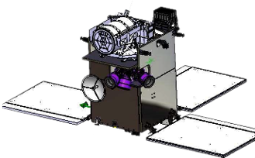
MAIA: Multi-Angle Imager for Aerosols Mission
Cooperation between NASA/JPL and ASI
MAIA represents a great opportunity applying EO observation for real world benefit, linking exposure to different PM types (mixtures of particles having different sizes, shapes, and compositions) with human health.
MAIA measurements represent a main goal in ASI Earth Science Program.
Data collected by the MAIA instrument, orbiting the Earth at 740 kilometers overhead tells a group of tiny sulfate particles apart from a group of equally tiny dust particles. MAIA will be able to distinguish types of particulate matter (PM) based on how the particles reflect or absorb sunlight.

Slide 14
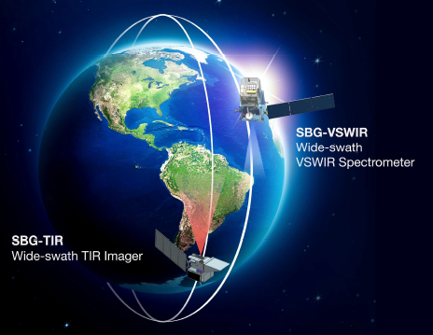
SBG-TIR-Multispectral Mission
TIR instrument
VNIR camera
Thermal IR Bands | 8.28 μm / 8.63 μm / 9.07 μm / 11.33 μm / 12.05 μm
mid-IR bands | 3.98 μm / 4.80 μm
short-wave IR | 1.60 μm
NETD | 0.2 °K @ 300 °K
GSD | 60m
Swath width | 935 km
Coverage | Global
Visible Bands center | 655 nm
NIR Bands center | 835 nm
SNR | 100
GSD | <35 m
Swath width | 935 km
Coverage | Global

Slide 15
THANK YOU FOR YOUR ATTENTION!
laura.candela@asi.it
ASI Earth Observation Division - This document contains proprietary information of ASI, and may not be reproduced, copied, disclosed or utilized in any way, in whole or in part, without the prior written consent of ASI

