Slide 1
2022 CEOS Plenary
NL EO instrument/mission developments
J.Carpay, NSO
Agenda Item #
2022 CEOS Plenary
Biarritz, France
Nov. 29 – Dec. 1

Slide 2
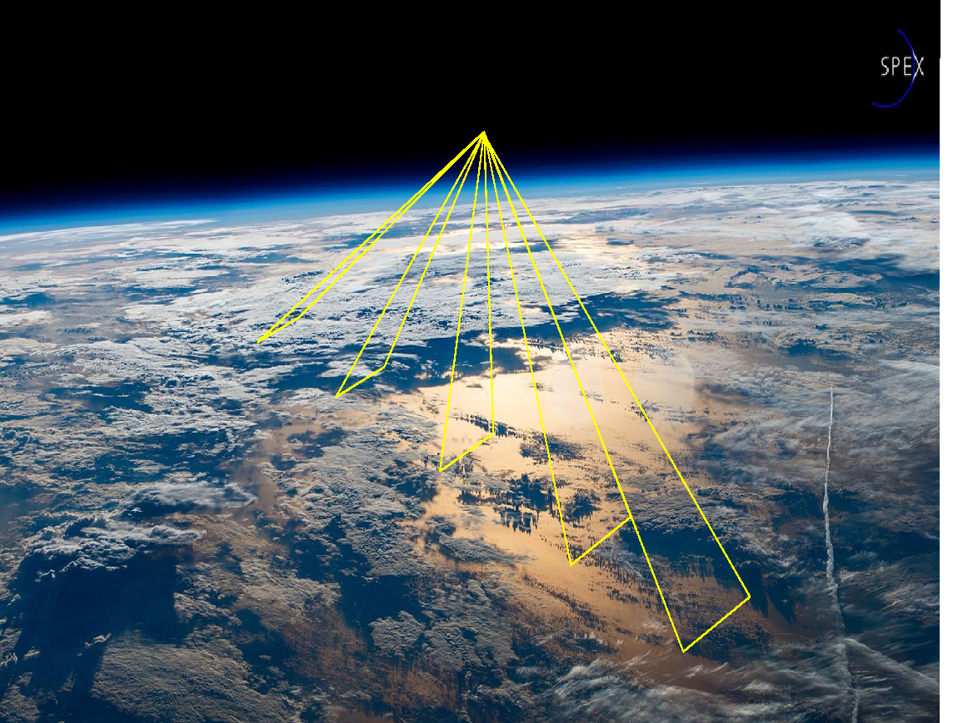
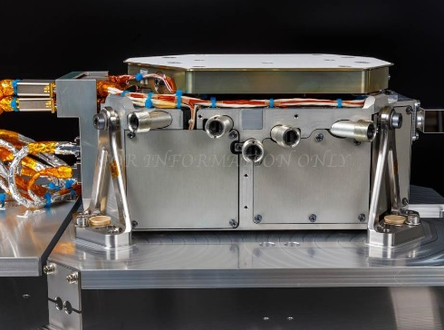
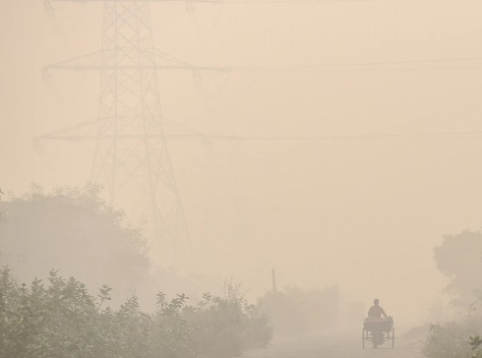
SPEXone Spectropolarimeter
Scientific Goals:
To understand and quantify the climate effect of aerosols and clouds
Light path correction for high-res spectroscopy for trace gas (e.g. CO₂)
Technical Specification:
Hyperspectral radiance and polarization at 5 viewing angles
Spectral range 385-770nm
Spatial resolution 5 km, swath 100 km
Robust design, no moving parts
Small (10 kg, 40x30x15 cm³)
Expected Result:
Improved quantification of radiative forcing 🡪 improved climate models
Improved accuracies of AOD
new products as absorption, composition, size, CCN (GCOS ECVs)
Improved quantification of aerosol emissions
PACE synergy with HARP-2 and OCI
Instrument made in partnership between SRON and Airbus NL with support of TNO and funded by NSO, first instance in cooperation with NASA
Hasekamp et al., Journal of Quant. Spectroscopy and Radiative Transfer, 2019; Persad et al. Nature 2022
Notes:
https://www.nature.com/articles/d41586-022-03763-9
https://www.sciencedirect.com/science/article/pii/S0022407318308653
Aerosols cool climate, directly by scattering sunlight and indirectly by forming clouds
Also affect precipitation and extreme weather events
Quantitative effect uncertain

Slide 3
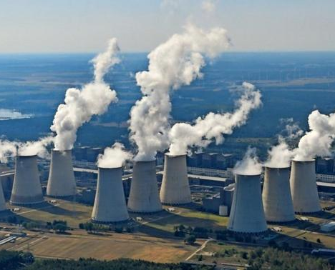
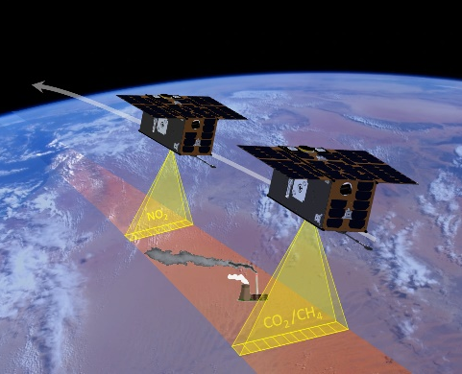
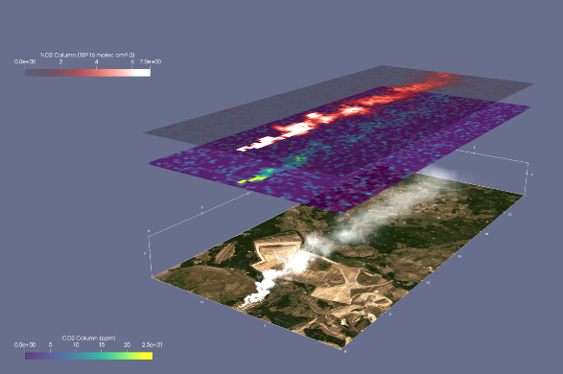
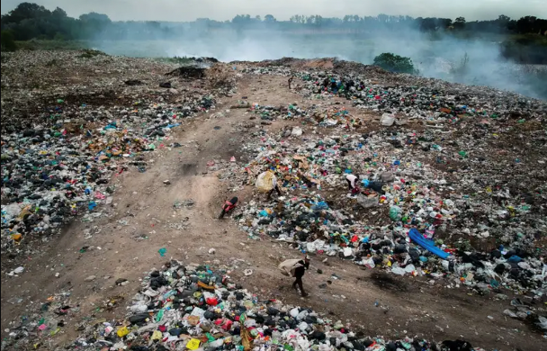
Tango (Twin Anthropogenic Greenhouse Gas Observers)
Scientific Goal:
Monitoring anthropogenic greenhouse gas emissions from point sources
Contribution to global stock take 2028 (Paris Agreement, Methane Pledge)
Technical Specification:
Two agile cubeSats: TANGO-Carbon and TANGO-Nitro
Collocated CO₂/CH₄ and NO₂ measurements with a 30x30 km² FoV, resolution of 300x300 m²
Build on long NL heritage (from SCIAMACHY to TROPOMI)
Expected Results:
CO₂ and CH₄ emission estimates of localized point sources
Complement CO2M on the regional scale with high resolution and local emission estimates.
Also precursor to operational constellation
Mission to be developed in partnership by SRON, KNMI, TNO and ISIS, funded through ESA
Notes:
NO2 required for plume detection (same as for CO2M)

Slide 4
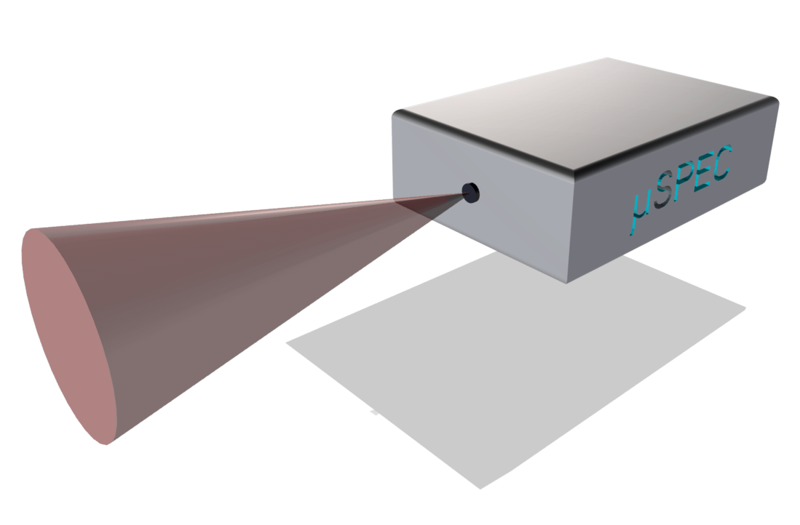
MINIATURIZED ONBOARD DEVICE FOR INFLIGHT CALIBRATION
Instrument developed by cosine BV with Lionix and TNO, funded by NSO

Slide 5
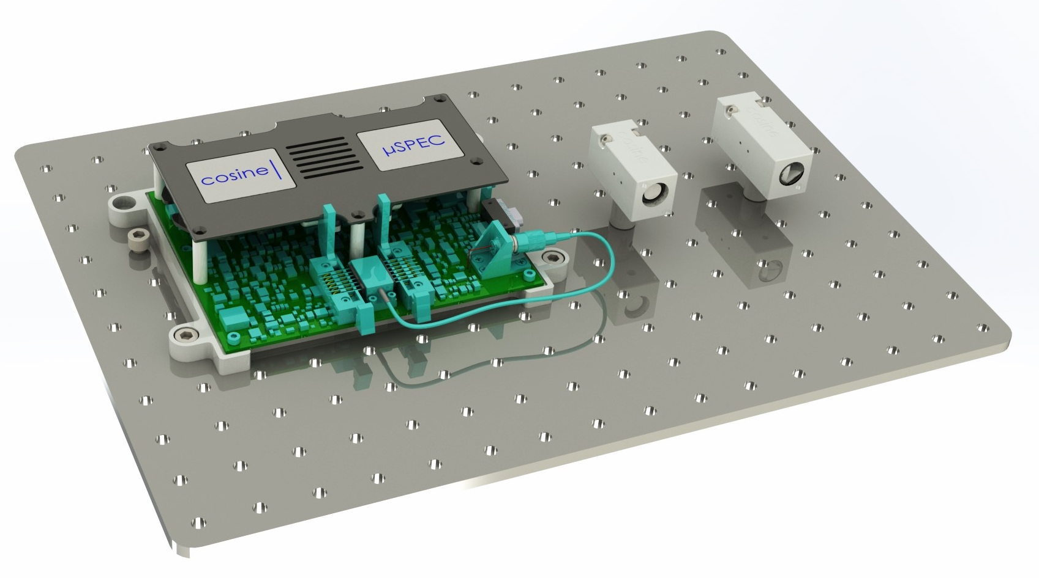
CALIBRATOR SPECS AND ONGOING BREADBOARD ACTIVITY

Slide 6
Other NL activities;
User Needs inventarisation
surprising results (new data is often not the answer)
Air Quality, Emission Monitoring, Water Quality, Water Quantity, Agriculture/food security, object change monitoring,
More focussed on “what do you need?” than “do you want this?”
Study to investigate obstacles to EO use in government
Fund “knowledge networks” to innovate, integrate up- and downstream, w/universities, industry, end users (low TRL)
Innovation studies (SBIR) w/ end users (use exisiting data)
Early instrument development
Notes:
Study not by upstream parties but by knowledgeable independents
Working hard to involve end users, still void to be bridged

