Slide 1
2022 CEOS Plenary
European Commission Report
Mauro Facchini
European Commission
Agenda Item 2.11
2022 CEOS Plenary
Biarritz, France
Nov. 29 – Dec. 1

Slide 2
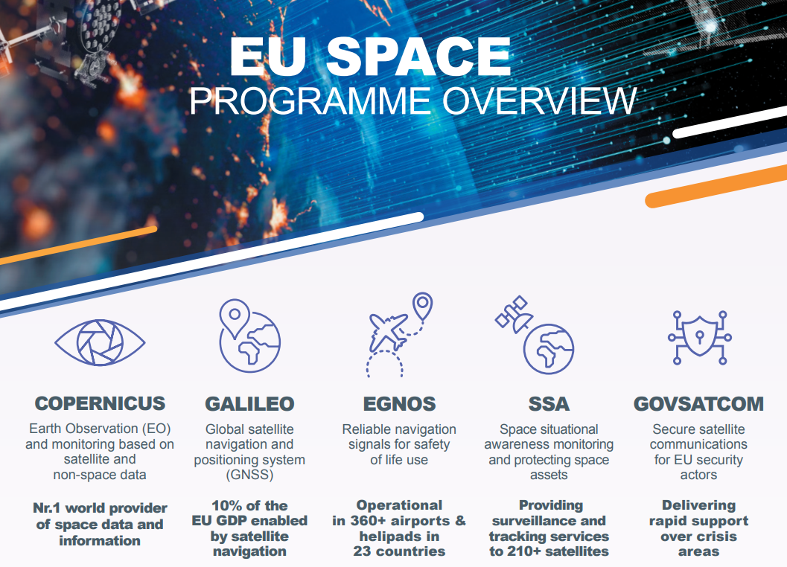
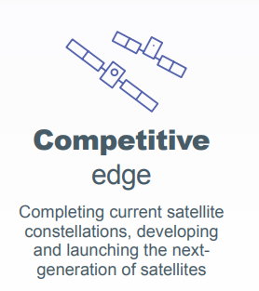
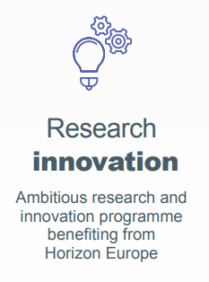
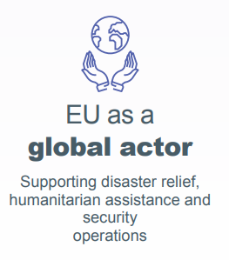
The EU Space Programme
2022 CEOS Plenary Biarritz, France Nov. 29 – Dec. 1
Slide ‹#›
Notes:
Note taking

Slide 3
From Copernicus 1.0 to Copernicus 2.0
COPERNICUS 2.0
Continuation
COPERNICUS 1.0
2022 CEOS Plenary Biarritz, France Nov. 29 – Dec. 1
Slide ‹#›

Slide 4
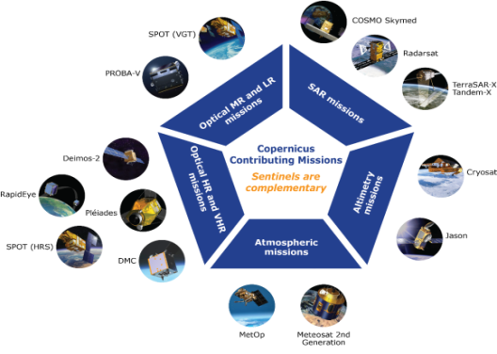
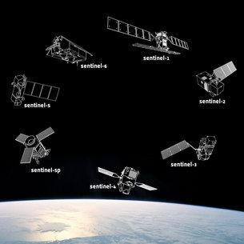
COPERNICUS ARCHITECTURE
FULL, FREE AND OPEN
6 services use Earth Observation data to deliver…
Contributing missions
Sentinels
…added-value products
2022 CEOS Plenary Biarritz, France Nov. 29 – Dec. 1
Slide ‹#›
Notes:
Copernicus was born as a tool for environment monitoring and as the EU’s contribution to global environment and climate change efforts (including international commitments such as COP21)

Slide 5
Next Launches
Sentinel | Launch Term
SENTINEL 1C | 1 May 2023 – 30 June 2023
SENTINEL 1D | 1 July 2024 - 30 June 2025
SENTINEL 2C | 1 January 2024 - 31 December 2024
SENTINEL 3C | 1 December 2024 - 30 November 2025
SENTINEL CO2M-A | 1 December 2025 - 30 November 2026
SENTINEL CO2M-B | 1 December 2025 - 30 November 2026
2022 CEOS Plenary Biarritz, France Nov. 29 – Dec. 1
Slide ‹#›
Notes:
Copernicus was born as a tool for environment monitoring and as the EU’s contribution to global environment and climate change efforts (including international commitments such as COP21)

Slide 6
From Copernicus 1.0 to Copernicus 2.0
COPERNICUS 2.0
Continuation
Evolution
COPERNICUS 1.0
2022 CEOS Plenary Biarritz, France Nov. 29 – Dec. 1
Slide ‹#›

Slide 7
Four dimensions of Copernicus
Continuation of data +
Agile observation (New Space)
Enhance performance
Reduce dependencies
Amplify observation potential
Hybrid constellations
Service uplifting
Integrate faster with digital, AI, HPC
Be instrumental to Green Deal objectives
Increase support to resilience needs (Governmental Service)
More support to EU and National policies
1- Data
Acquisition
2- Services
4- User uptake
3- Access &
distribution
Boosting EU infrastructures
Develop Integrated Data Management
Streamline data platforms
Develop Data analytics with Destination Earth
Re-energise Copernicus downstream
Anticipate user needs
Use space data to transform different ecosystems
Develop innovative tools for greater uptake
2022 CEOS Plenary Biarritz, France Nov. 29 – Dec. 1
Slide ‹#›
Notes:
Copernicus was born as a tool for environment monitoring and as the EU’s contribution to global environment and climate change efforts (including international commitments such as COP21)

Slide 8
Hybrid constellation
Copernicus Sentinels - REFERENCE
COPERNICUS
HYBRID
CONSTELLATION
New Space – AGILE
Expansions - GREEN

Slide 9
THANK YOU
Copernicus EU
Copernicus EU
Copernicus EU
www.copernicus.eu

