Slide 1
2022 CEOS Plenary Canadian Space Agency Report
Éric Laliberté, Canadian Space Agency
Agenda Item #2.11
2022 CEOS Plenary
Biarritz, France
Nov. 29 – Dec. 1

Slide 2
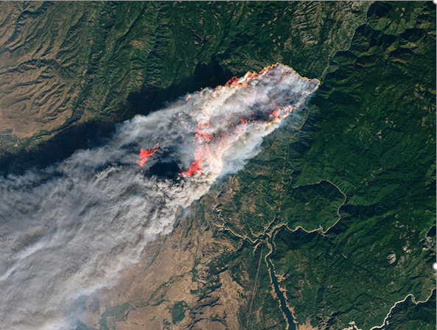
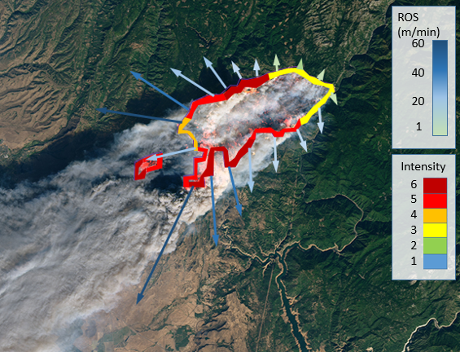
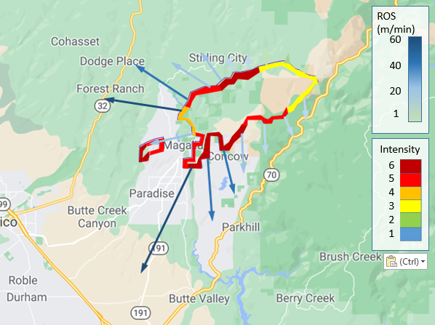
WildFireSat
Monitoring the radiated power from active wildfires in Canada from space, daily and in near-real-time (i.e. approximately 30 minutes).
Also
providing more precise information on smoke and air quality conditions.
further enabling us to more accurately measure the carbon emitted by wildfires, an important requirement of international agreements on carbon reporting.

Slide 3
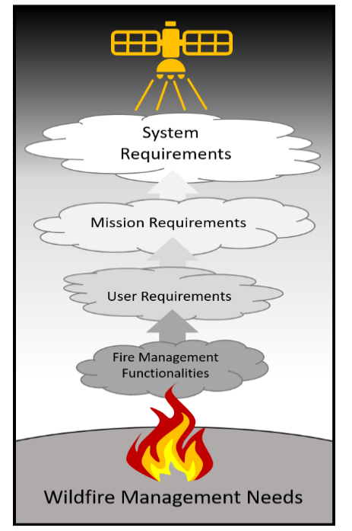
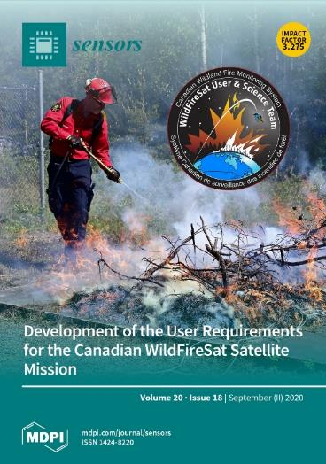
WildFireSat
Key Features:
VIS/NIR (200 m);
MWIR/LWIR (400 m);
Daily peak burn overpass;
FRP optimised;
Detection capacity at 15 x 15 m fire;
*open canopy (Johnston et al, 2018)
30 min data latency.
Fire Monitoring Capability:
Near-real-time data delivery;
Early detection (remote access fires);
Active perimeter mapping and progression;
Perimeter mapping of ROS (m min⁻¹) when combined with VIIRS (Johnston, 2016);
Perimeter mapping of FI (kW m⁻¹), (Johnston et al, 2017);
Mapping of Fuel Consumption (kg m⁻²);
Near-real-time measurements of carbon emissions and smoke plume dynamics.
(Johnston et al, 2020)

Slide 4
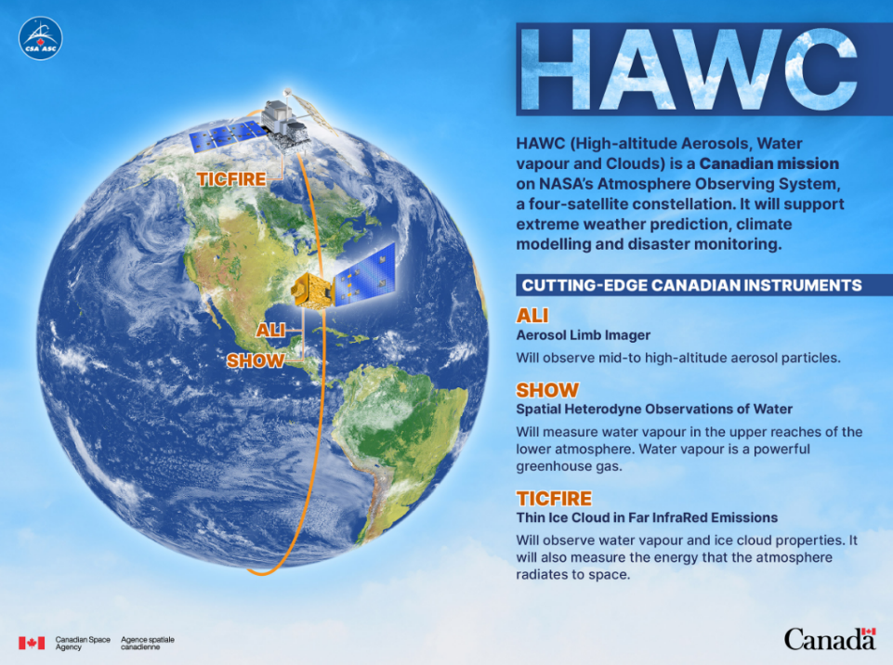
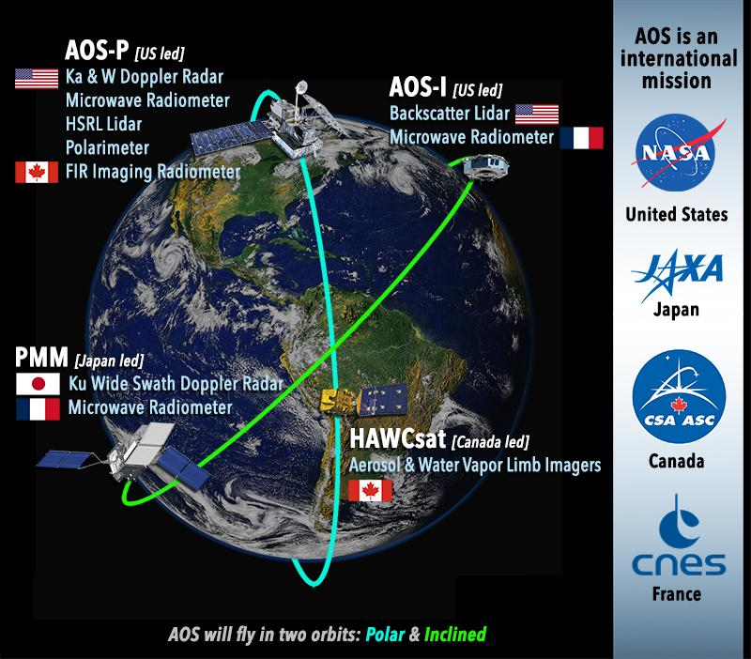

Slide 5
Radarsat Data Continuity – The Plan
Investigate a suitable replacement for our national C band SAR capability
Explore the possibility of investments in the new space economy and commercial imagery (C, X, and L bands)
Collaborate with space agencies to barter imagery and coordinate AOIs (C, X, L bands)
Invest in applications development and ensure they are operationalised
Provide free & open imagery
Make heritage imagery readily available (ex.: R1 and R2)
Advance and promote technology through research and development
Bartering with space agencies
Ensure
continuity
Free & Open
Resilient
Commercial
Imagery
Adaptable
National
Capabilities
Fiscally
responsible

Slide 6
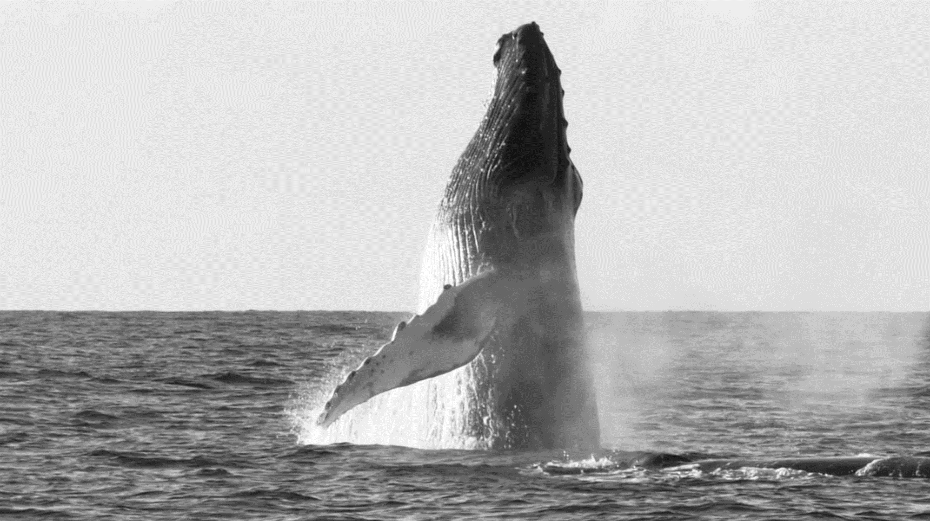
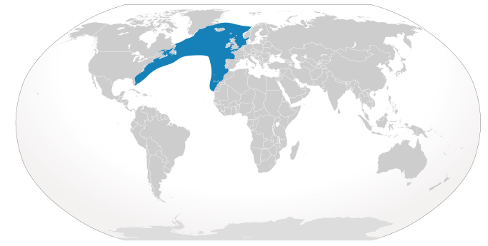
smartWhales baleineIdée
The North Atlantic Right Whale (NARW) was listed as endangered under the Species at Risk Act (SARA) in 2005.
Objective: Develop Space-Based Solutions for the Monitoring and Protection of the North Atlantic Right Whale.
Collaboration: Partnership between the Canadian Space Agency, the Department of Fisheries and Oceans and Transport Canada.
2 Streams: Habitat modelling / Detection (AI-based)
3 Federal departments
5 Multi-sectoral consortia
11 Science organizations
Source: www.iucnredlist.org
8 Foreign organizations
80 Highly qualified personnel
50% New organizations involved
Source: https://www.asc-csa.gc.ca/eng/search/video/watch.asp?v=1_s6vj9s6q&search=whales

