Slide 1
2022 CEOS Plenary
Report from German Space Agency (DLR)
Klaus Schmidt, DLR
Agenda Item 2.11
2022 CEOS Plenary
Biarritz, France
Nov. 29 – Dec. 1

Slide 2
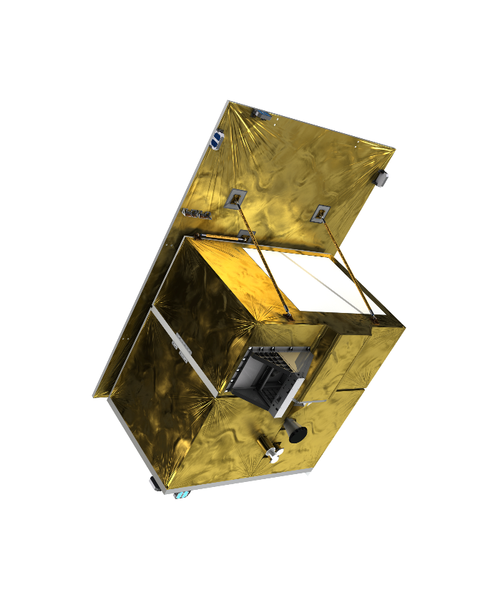
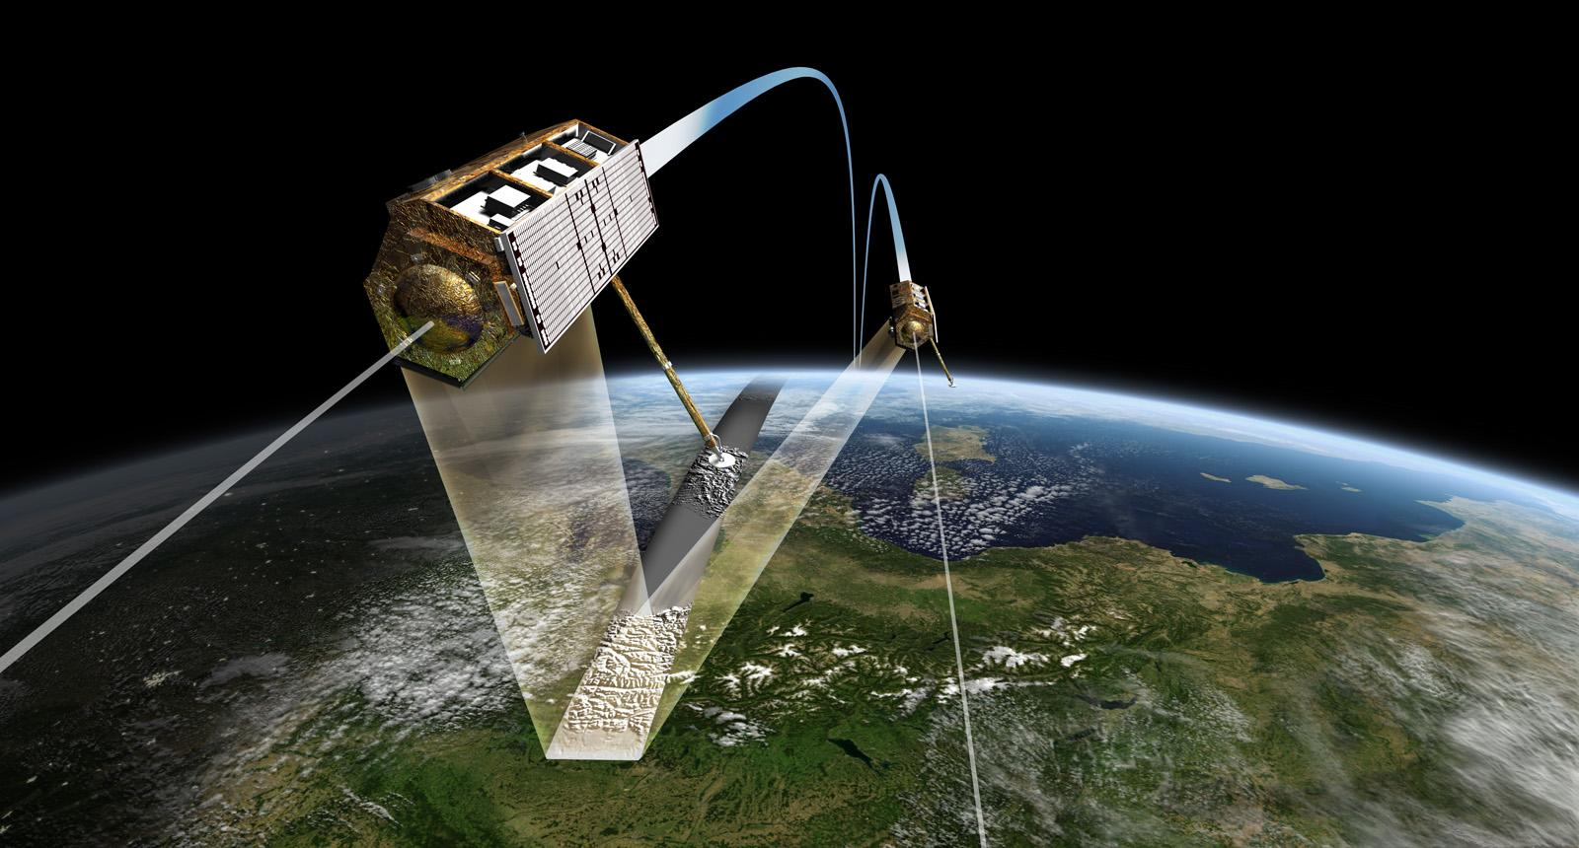
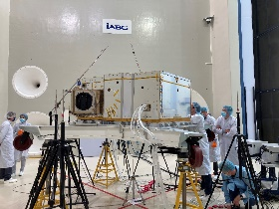
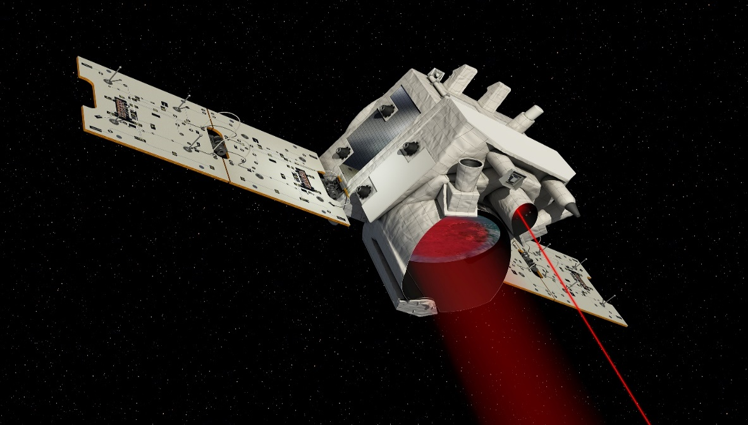
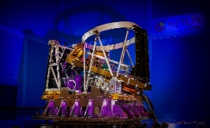
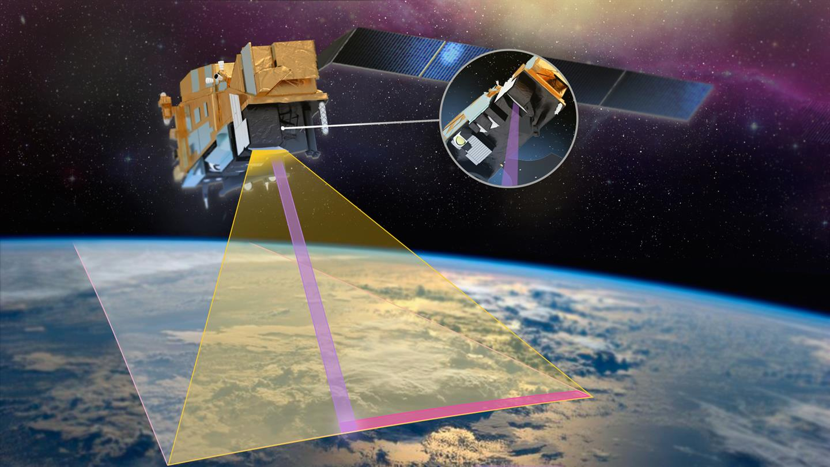
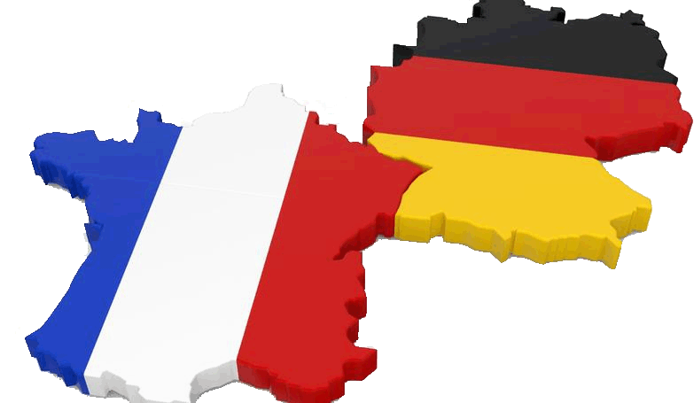
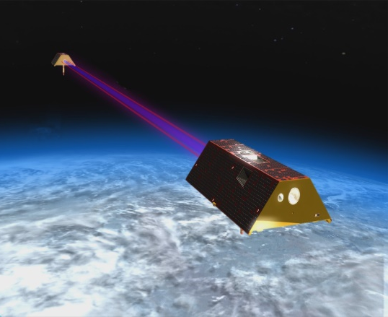
Earth‘s surface
Environment, Resources
Mission X-Band-Radar
- TerraSAR-X (2007)
- TanDEM-X (2010)
New Radar-Mission
- X-Band Continuity
- Focus on multistatic
Current status
- Phase 0 Preparation
Mission Hyperspectral
EnMap (2022)
Objectives
- Technology lead, F&E
- Establish applications
- Continuity in Copernicus
Current status
- Phase E
Climate
Weather
Mission LIDAR
Merlin (2028)
Objectives
Measurement of global CH4-concentration
Current status
Phase C/D
Mission Multispektral
METimage (2025) + 2 recurrent units
Objectives
- Establish German technology in MetOP-Program
- Strengthen German industry in optics
Current status
Phase C/D
Gravity, Hydrology
Mission Laserlink/Platform
GRACE FO (2018)
Objectives GRACE-I
Continuity to GRACE FO
Collaboration with NASA
Current status
Phase B Preparation

Slide 3
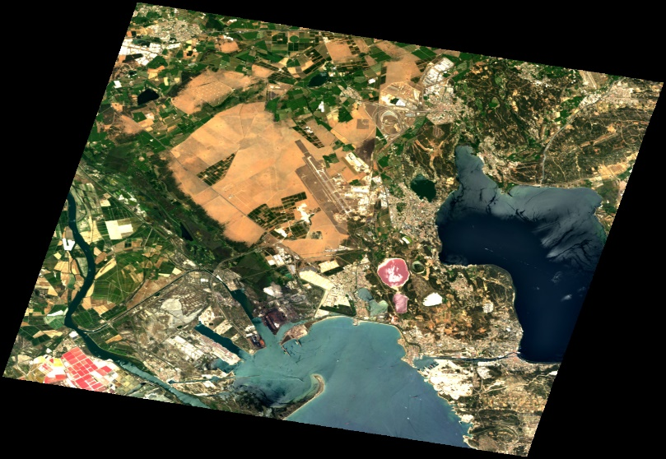
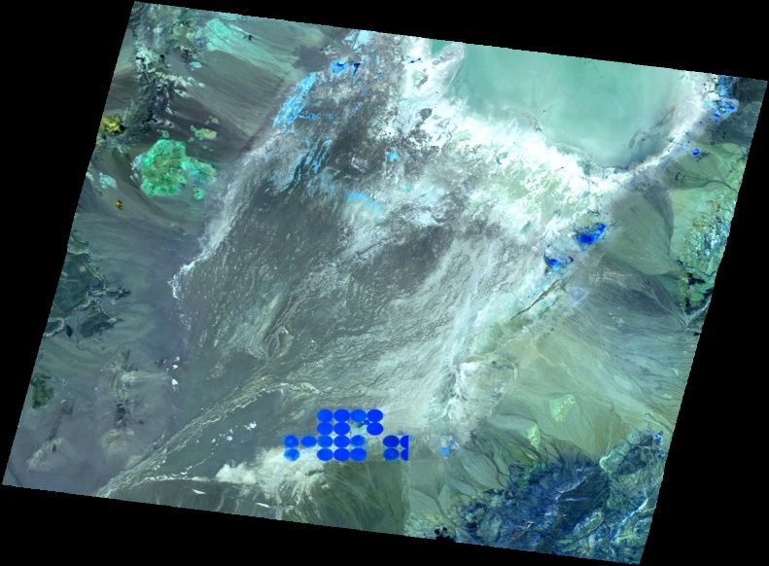
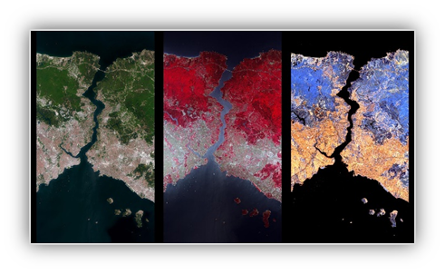
EnMAP - Environmental Mapping and Analysis Program
Lauched April 1, 2022
Current EnMAP Status: Phase E
Data available: https://planning.enmap.org/
-> free and open data policy
Two Announcement of Opportunities open:
AO #00001: General AO Process
AO #00002: Special AO Process: Long-Term Ecosystem Monitoring
https://www.enmap.org/
La Crau, France; 2022/07/02; true color; credit: comissioning phase data 2022 DLR
Istanbul, Bosporus, Turkey; 2022/04/27; first light; credit: comissioning phase data 2022 DLR
Nevada, USA; 2022/07/01; false color; credit: comissioning phase data 2022 DLR

