Slide 1
United Nations Office for Outer Space Affairs
Jorge Del Río Vera
Agenda Item #2.11
CEOS Plenary 2022, CNES Biarritz
30th Nov – 1st December 2022

Slide 2
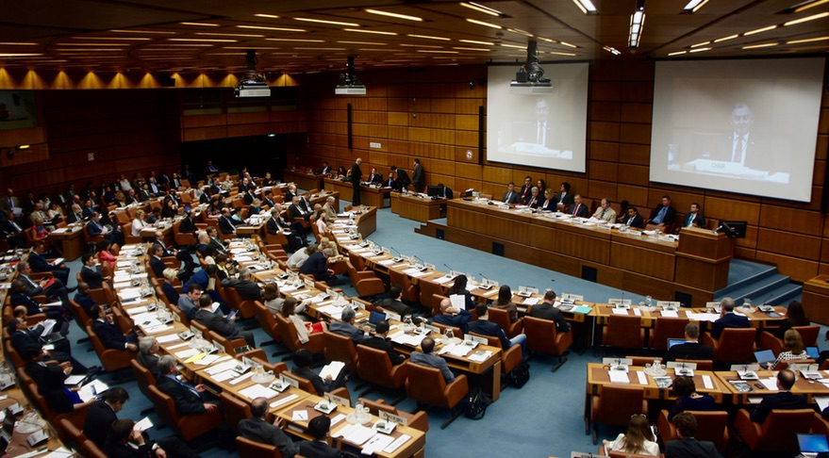
COPUOS

Slide 3
ICG
International Committee on GNSS: strives to encourage and facilitate compatibility, interoperability and transparency between all the satellite navigation systems, to promote and protect the use of their open service applications and thereby benefit the global community. Our vision is to ensure the best satellite based positioning, navigation and timing for peaceful uses for everybody, anywhere, any time
Discussions on ITRF (International Terrestrial Reference Frame)
International Committee on Global Navigation Satellite Systems (ICG) (unoosa.org)

Slide 4
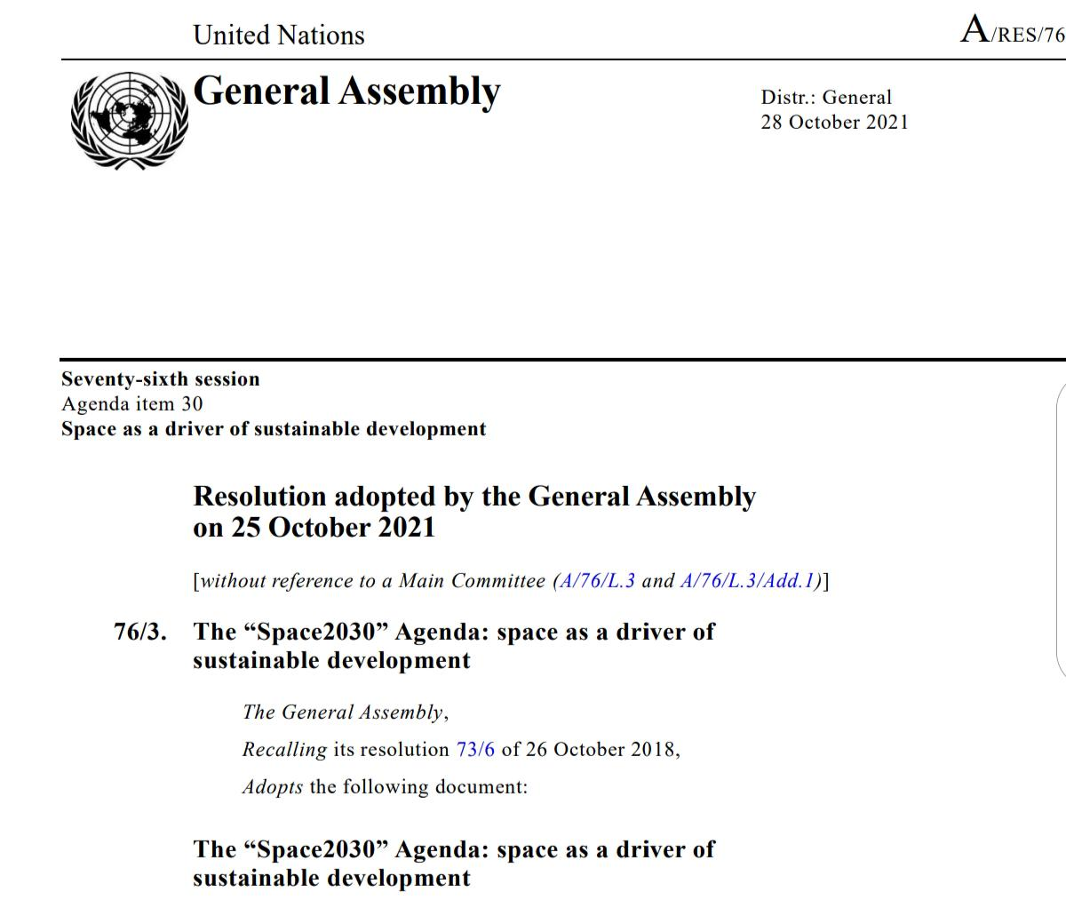
Space2030 Agenda
https://www.unoosa.org/oosa/oosadoc/data/resolutions/2021/general_assembly_76th_session/ares763.html

Slide 5
UN-SPACE
The United Nations and its specialised agencies conduct a coordinated programme of activities utilising these technologies. UN-Space, an inter-agency mechanism for such coordination, convenes annual sessions of the Inter-Agency Meeting on Outer Space Activities to discuss current and future activities, emergent technologies of interest and other related matters among UN system entities. For broader stakeholders' consultations, UN-Space organizes informal sessions open to Member States, private sector, non-governmental institutions and academia.

Slide 6
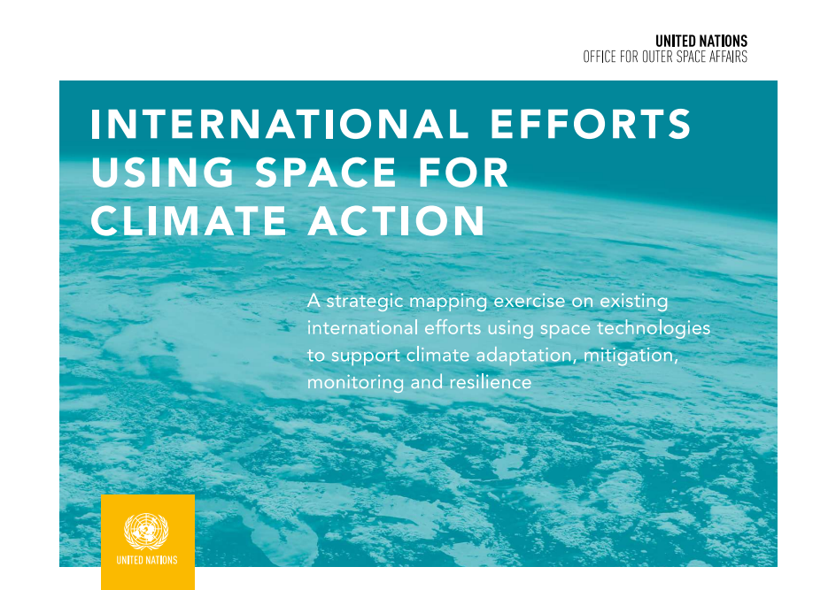
SPACE FOR CLIMATE ACTION
UNOOSA and the United Kingdom jointly worked on a strategic mapping exercise on international efforts to support climate action.
Through this report, parties strive to
Address provide useful information for decision-makers
Build synergies
Facilitate coherence
Contribute to avoiding duplication of existing efforts
The focus of collaborative efforts:
A review of existing climate action using space technologies at the international and regional levels, in the UN system, for non-UN groups, partnerships, organizations and other relevant entities.
Generously sponsored by the government of the United Kingdom.
Notes:
Zoya → VLAB (Technical)
Lucianne Lu Veeck → Capacity-Building (Education and Training Programme)

Slide 7
SPACE FOR CLIMATE ACTION
As part of the mandate to support Climate Action, UNOOSA is developing website focusing on Space for climate action.
Objectives:
To raise awareness and to promote the use of space technologies and applications to meet climate objectives.
To serve as a resource for organizations, industry, academia, policymakers, experts.
The development is generously sponsored by the government of Austria.
Notes:
The quote from Adrian was taken from his participation in the flood tracker demo, edited for clarity, we can ask him to confirm

Slide 8
UN-SPIDER – Strategy 2030
The United Nations General Assembly established UN-SPIDER in Dec. 2006 through its Resolution 61-110 (UN-SPIDER Knowledge Portal)
Gateway | Bridge | Technical Advisory Support
Activity 1. Gateway to space-based information | Activity 4. Outreach activities | Activity 7. Integrated and complementary use of satellite technologies
Activity 2. Online Learning Environment | Activity 5. Platform for fostering alliances | Activity 8. Emerging technologies
Activity 3. Geo-intelligence Technology Centre | Activity 6. UN-SPIDER networks | Activity 9. Humanitarian action and development cooperation
 |  | Activity 10. Gender mainstreaming and youth engagement

Slide 9
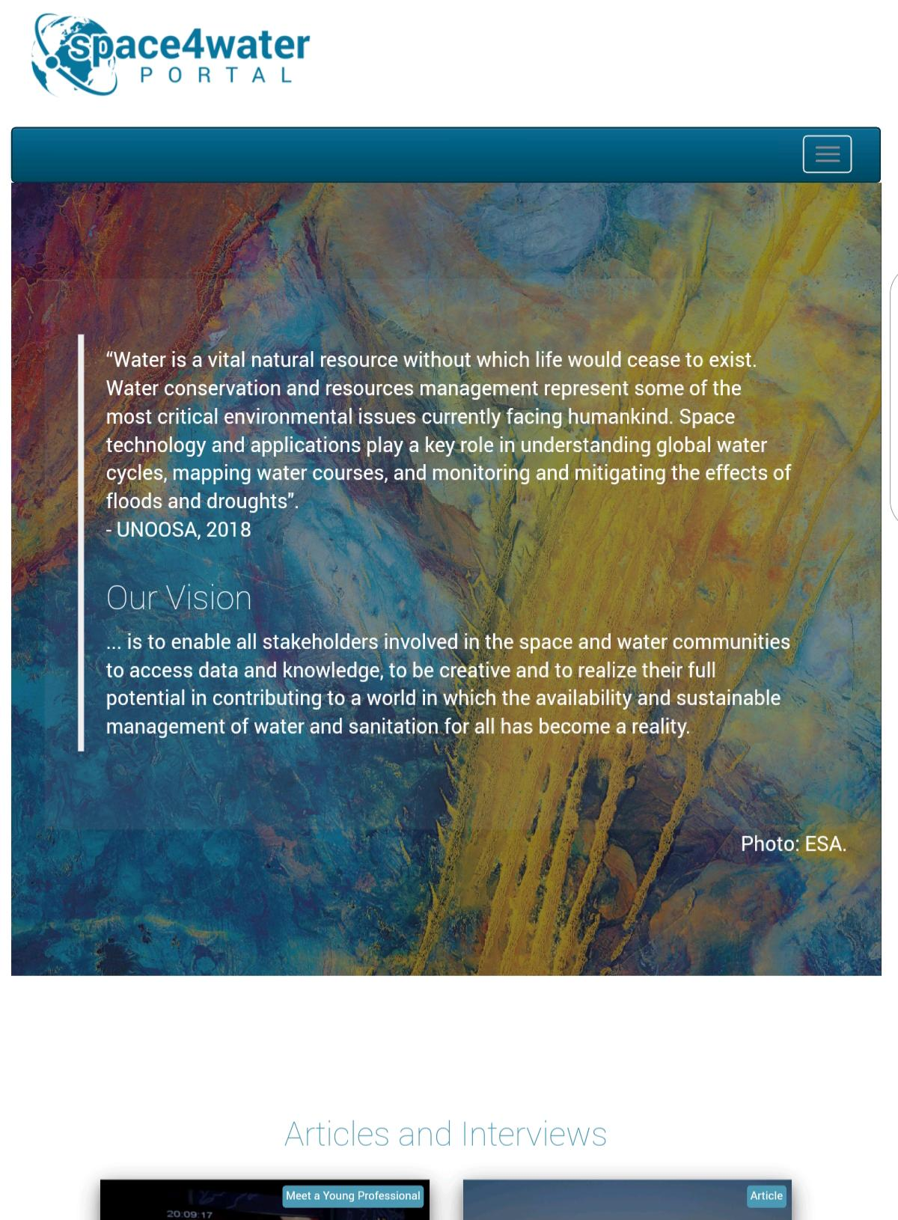
SPACE4WATER
The Space4Water Project launched in January 2018 is an interdisciplinary multi-stakeholder project fostering the knowledge exchange between actors in the space and the water related sectors. The project is inclusive for youth, women and stakeholders on the local, national, regional and international level. This inclusive approach allowed for information and exchange between a wide range of stakeholders (87 as of today) from government, intergovernmental organisations, academia, the private sector and industry and civil society active in the water(-related) sectors. It could hence be considered as a prototype for cooperation beyond the sectors and contexts. The Space4Water Project is well aligned with the objectives of the Water Action Decade in improving knowledge generation and dissemination, facilitating access to knowledge and the exchange of good practices; generating new information relevant to water-related Sustainable Development Goals (SDGs); pursuing advocacy, networking and promoting partnerships and action by different actors; and, strengthening communication actions at various levels for the implementation of the water-related Goals.
Space4Water Portal

Slide 10
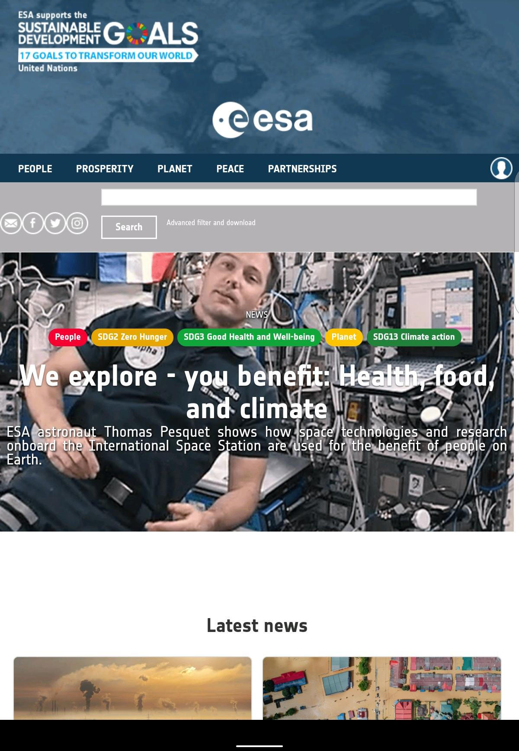
Space solutions compendium
ESA is spearheading efforts on raising awareness on the link between space and SGDs
https://sdg.esa.int/
UNOOSA and ESA signed an MoU to exchange data on SDGs and build a global repository on Space and SDGs

Slide 11
UNOOSA
Jorge Del Río Vera
Agenda Item #2.11
CEOS Plenary 2022, CNES Biarritz
30th Nov – 1st December 2022

