Slide 1
USGS Update
36th CEOS Plenary
29 Nov – 1 Dec 2022
Timothy Stryker
Chief, Outreach and Collaboration Branch
CEOS Principal
USGS National Land Imaging Program

Slide 2
USGS CEOS Contributions
Tim Stryker – CEOS Principal
Steve Labahn – CEOS Contact
Land Surface Imaging Virtual Constellation (LSI-VC)
Steve Labahn – LSI-VC Co-Lead
Tim Stryker / Chris Barnes / Sylvia Wilson – LSI-VC Members
CEOS & UNFCCC Global Stocktake
Working Group on Calibration & Validation (WGCV)
Cody Anderson – WGCV Vice-Chair
Chris Crawford – LPV Member
Dean Gesch – TMSG Member
Working Group on Information Systems & Services (WGISS)
Tom Sohre – WGISS Vice-Chair
CEOS/CGMS Working Group on Climate (WGClimate)
Chris Crawford – WGClimate Member
Working Group on Capacity Building & Data Democracy (WGCapD)
Chris Barnes – WGCapD Member

Slide 3
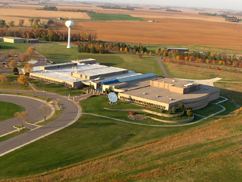
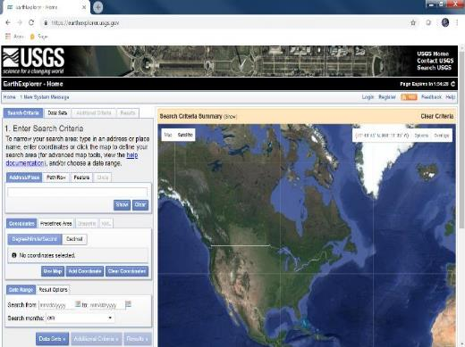
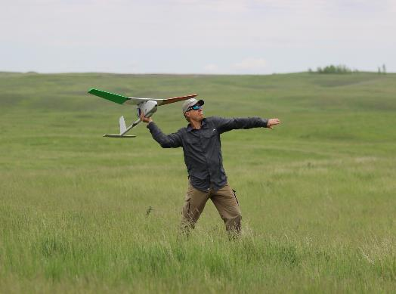
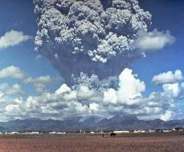
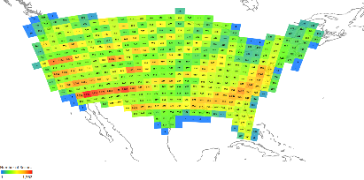
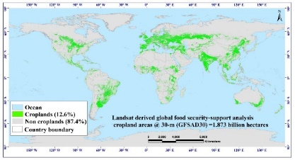
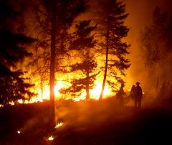
USGS Land Remote Sensing Activities
Delivers a national and global capability to ensure broad public and scientific availability of observations of the Earth’s land surface
The USGS National Land Imaging Program funds:
Landsat development and operations
Applied science and applications
Remote sensing R&D
National Civil Applications activities
National Land Remote Sensing Education & Outreach Grant
Earth Resources Observation and Science Center
Landsats 7, 8, 9, and Next
Earth Explorer –
https://earthexplorer.usgs.gov/
Hazards Data Distribution System -
https://hddsexplorer.usgs.gov/
National Civil Applications
Center
Uncrewed Aircraft Systems (UAS)
Essential Climate Variables
Global Products
‹#›

Slide 4
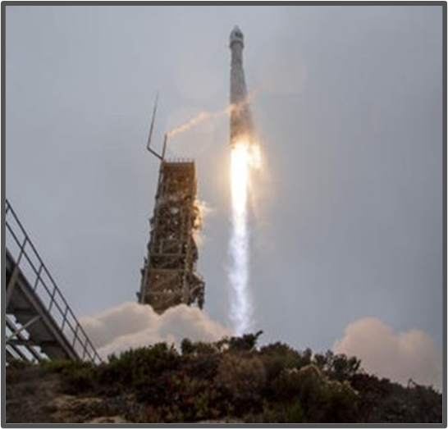
Landsat Operations Status
Landsat 9 (2021 - )
Collecting more than 700 new scenes per day; full mission transitioned to USGS in August
Earth Resources Observation
and Science Center (EROS)
Landsat Archive Operations
10 million unique Landsat scenes available in the 50-year archive, with well over 100 million downloads since Landsat data become freely available in 2008.
Reprocessed CEOS-ARD-compliant “Collection 2” available on the Amazon Cloud.
Landsat 8 (2013 - )
Collecting more than 700 new scenes per day; night and off-nadir imaging of volcano and fire imaging.
Landsat 7 (1999 - 2022)
Recently lowered into storage orbit; awaiting NASA satellite rendezvous and refueling

Slide 5
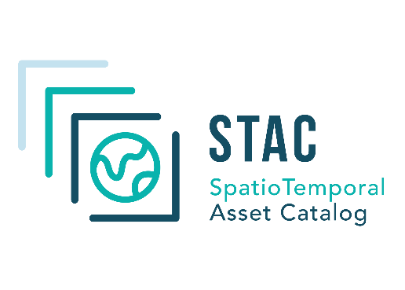
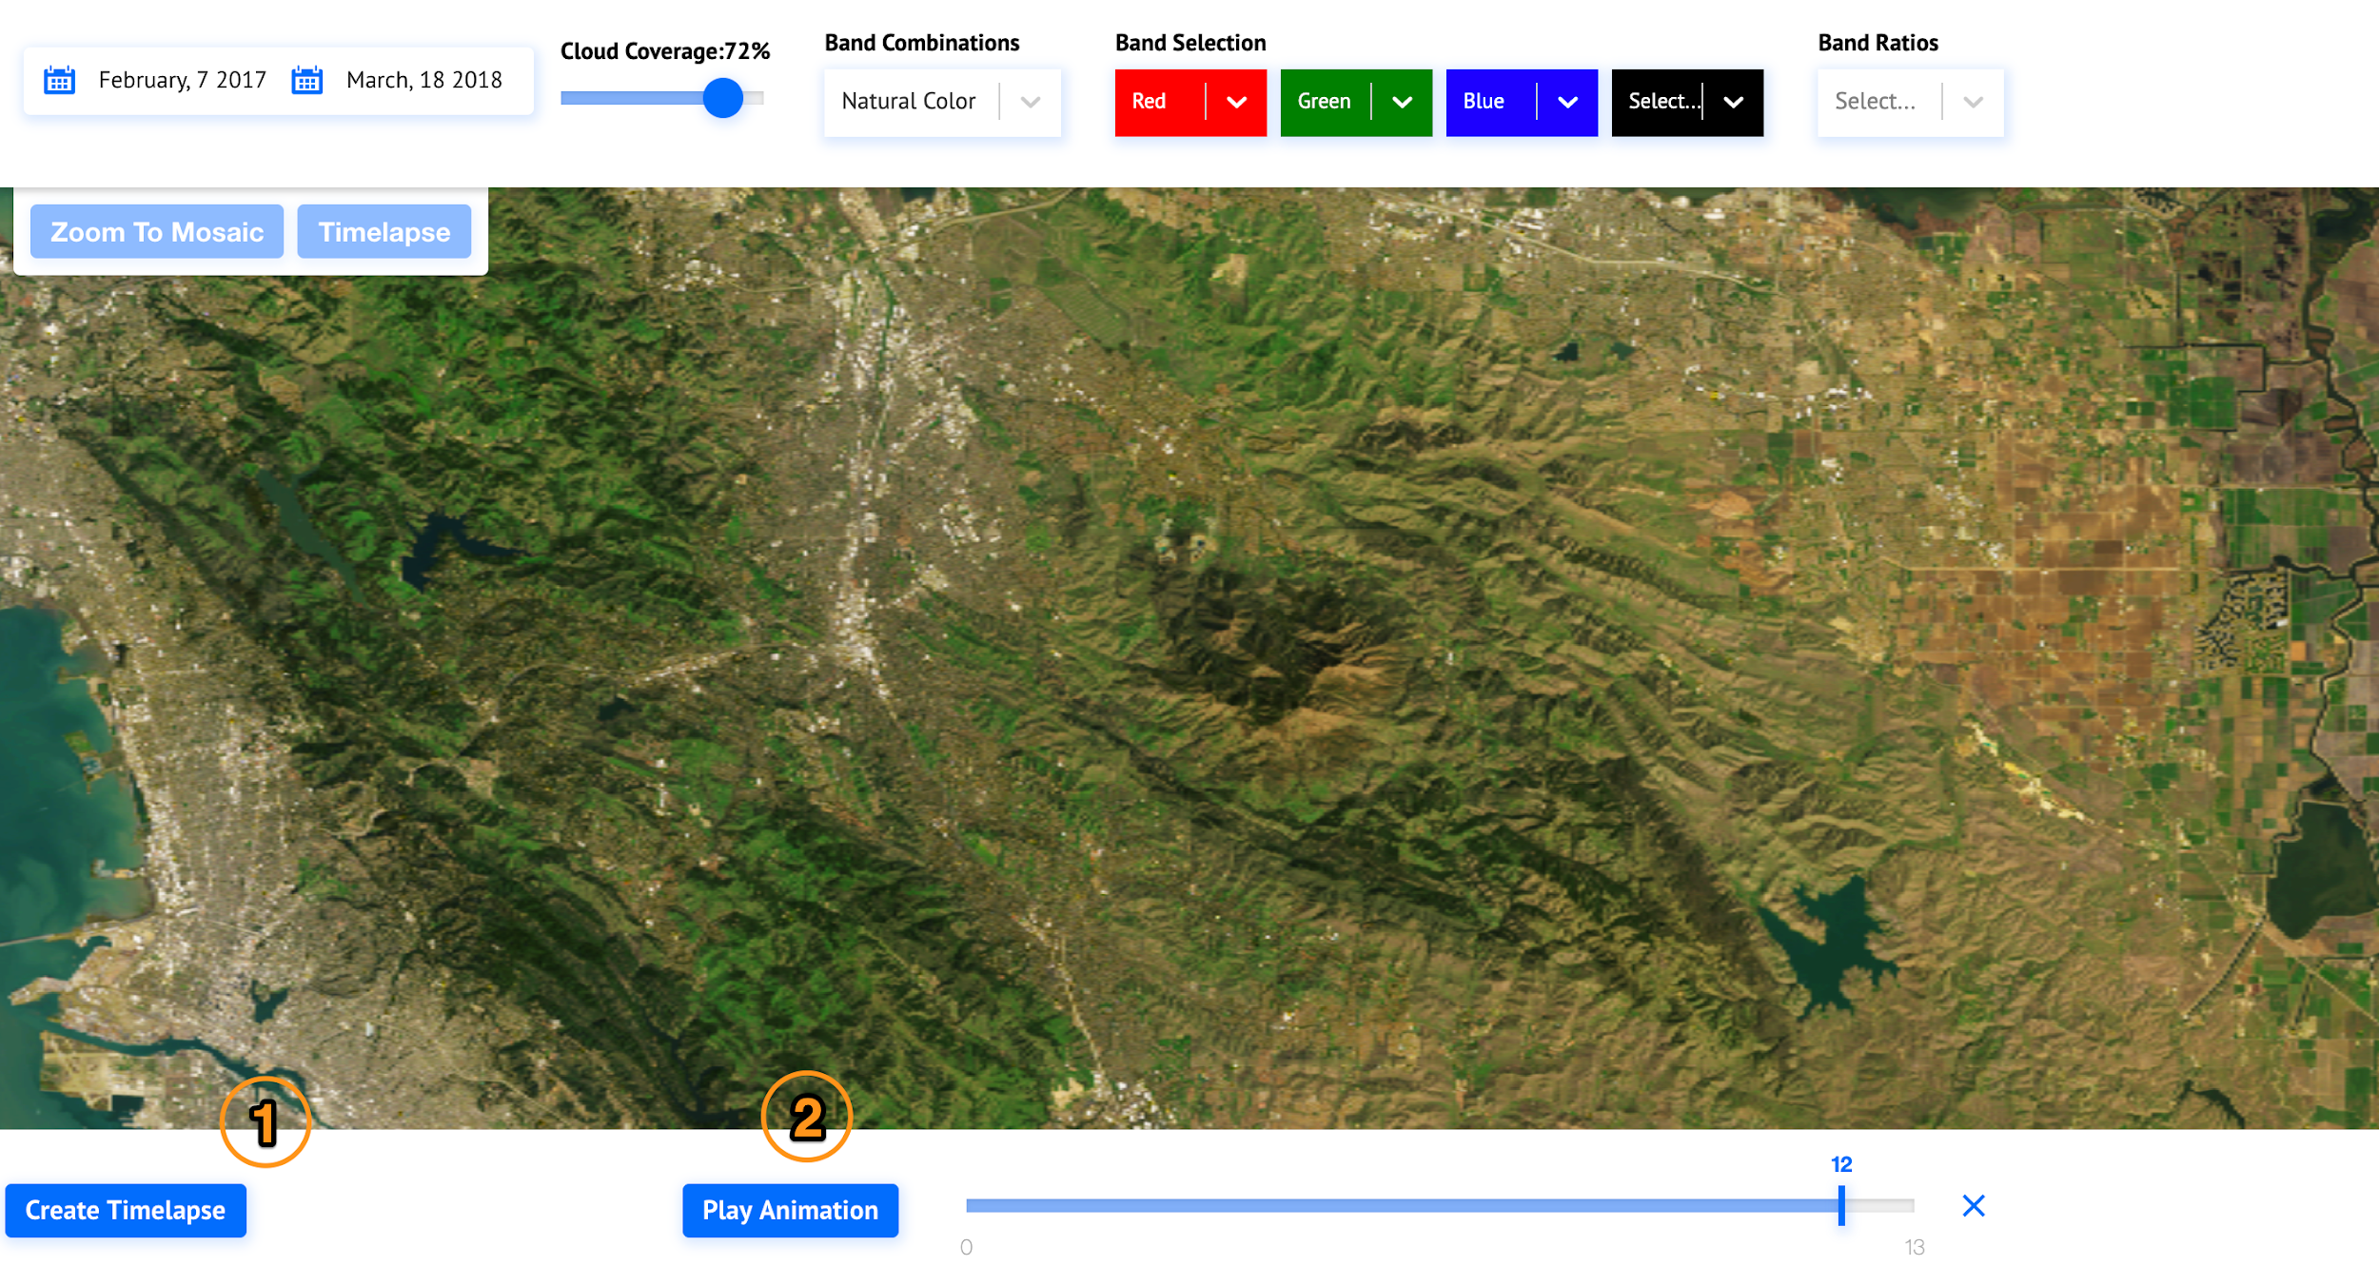
Landsat Collection 2 Released in the Commercial Cloud – 2021
Improved radiometry, geometry, metadata and access
New tools for search and discovery
Direct access to U.S. Analysis Ready Data tiles
More than 4 billion landsat data accesses this year
Cloud Optimized
Geotiff
More Landsat data accesses have been made directly from the Commercial Cloud in the last year than in the entire preceding 49-year history of the Landsat program!

Slide 6
Landsat 9 Transition to Operations Timeline
Landsat 9 Imagery Data First Released on 10 Feb 22
Final Orbit
December 1
Formal Transition
August 11, 2022
Mission Transition & Handover
Mission Launch
September 27, 2021
First Light
October 31
L9 Under-flight of L8
November 11-15

Slide 7
Landsat Next Program Activities
NASA and USGS have determined the Landsat Next mission concept
NASA and USGS held Key Decision-Point A meeting on 29 November to proceed with the mission
Constellation of three observatories in a repeating ground track Sun-synchronous orbit to achieve an aggregate six-day revisit over the Earth’s land surfaces
Instrument suite will provide for the instruments(s) to support the mission concept and provide the complete spectral coverage of the required Landsat Next Visible to Short-Wave Infrared (VSWIR) and Thermal Infrared (TIR) spectral bands
Community Forum for the Landsat Next Instrument Suite: 8 December 2022
Target Launch Readiness Date: 2030

Slide 8
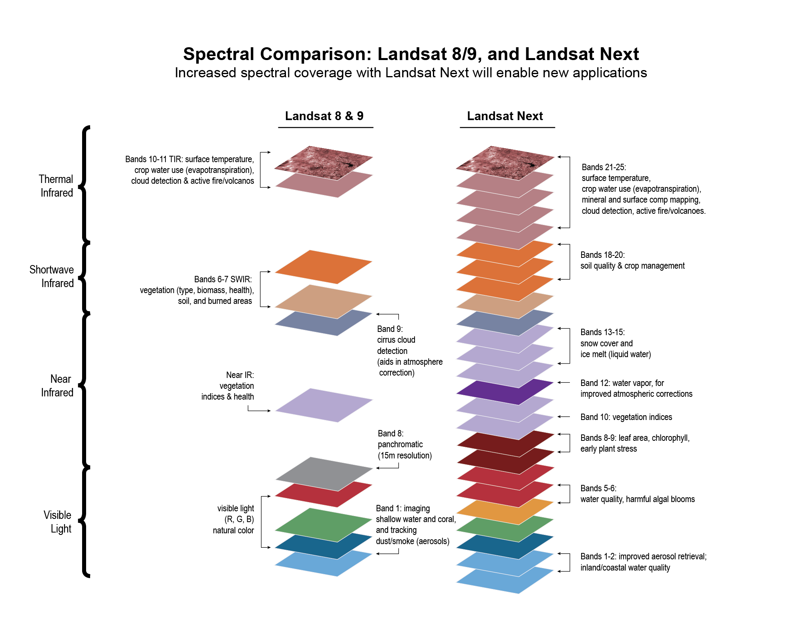
Landsat Next Requirements Meet Emerging Needs
Multi-spectral 🡪 Super-spectral
User need surveys provided a clear set of priorities for Landsat Next requirements to meet emerging needs at breakthrough effectiveness:
Improved Revisit Frequency. Dynamic phenomena (crop health & productivity, water quality, snow/ice state, wildfire) which require ~weekly clear views.
Higher Spatial Resolution. Experience with Sentinel-2 has underscored importance of 10-meter data for monitoring small agricultural fields, forest disturbance, urbanization, and other applications.
Additional spectral bands to support emerging applications in water quality, snow hydrology, soil mapping, and other areas.
Maintaining radiometric quality established by Landsat 8/9
Landsat Next will provide more than twice as many spectral bands than Landsat 8/9, with resolution improved by a factor of 2, and with improved repeat coverage

Slide 9
Heading into the Next 50 Years
Future challenges
Growing user needs
Related systems engineering to deliver new data products
Data interoperability among EO systems
USGS objectives for the coming decade
Provision of foundational data and products
Enhance EO capabilities through external partnerships
Advance analysis-ready data and formats to support interoperability
Leverage multi-source and multi-modal science and applications, and growing artificial intelligence/machine learning capabilities
Support end users in accessing and exploiting data in the cloud

