Slide 1
2022 CEOS Plenary
ESA Report
Simonetta Cheli, ESA
Agenda Item 2.11
2022 CEOS Plenary
Biarritz, France
Nov. 29 – Dec. 1

Slide 2
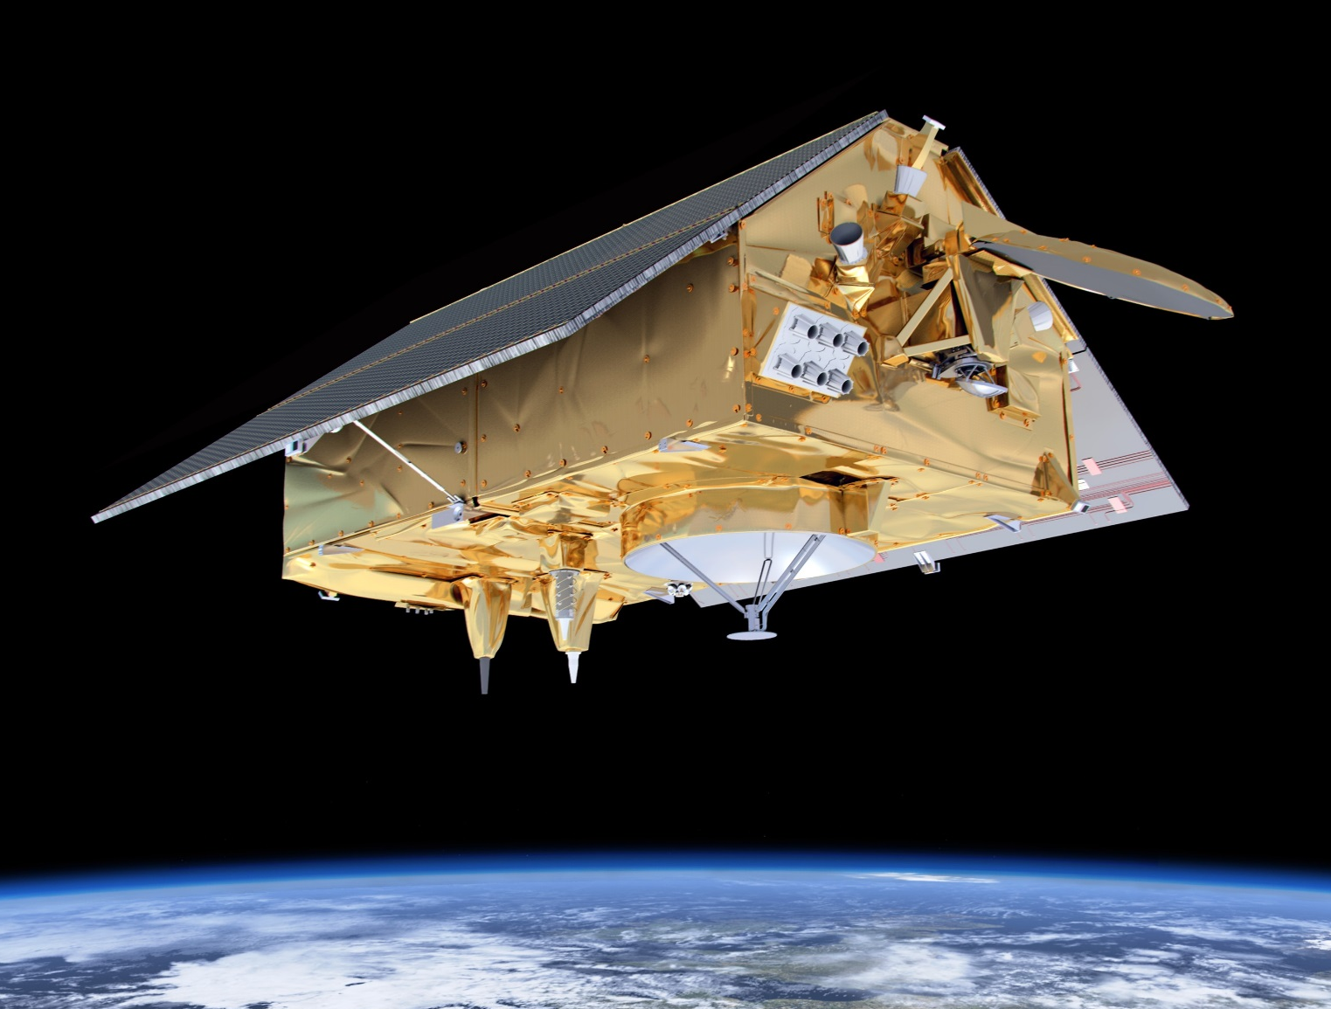
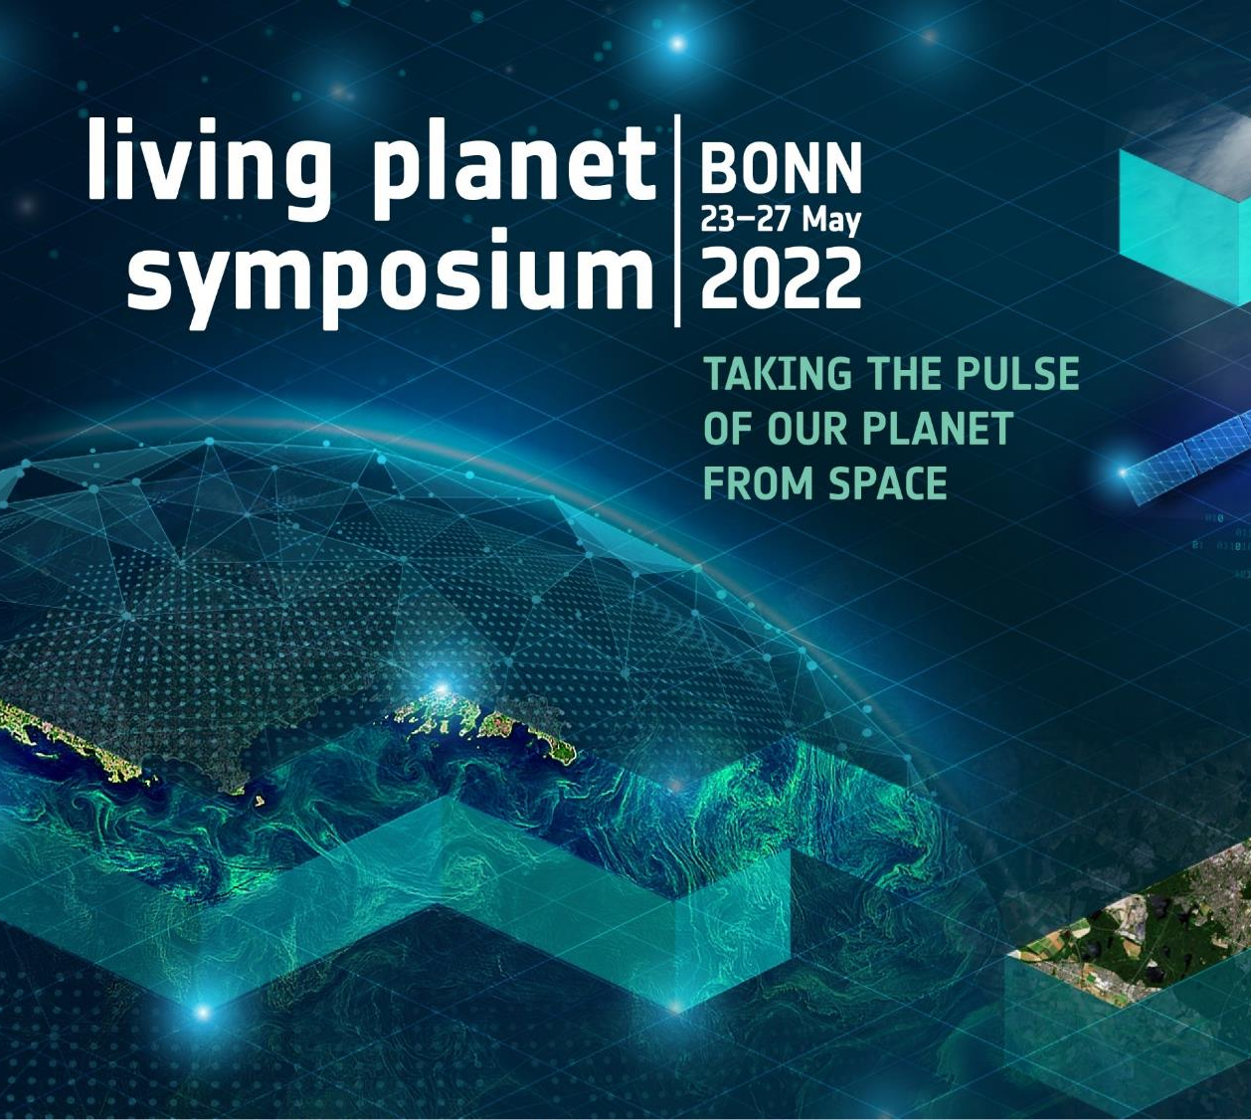
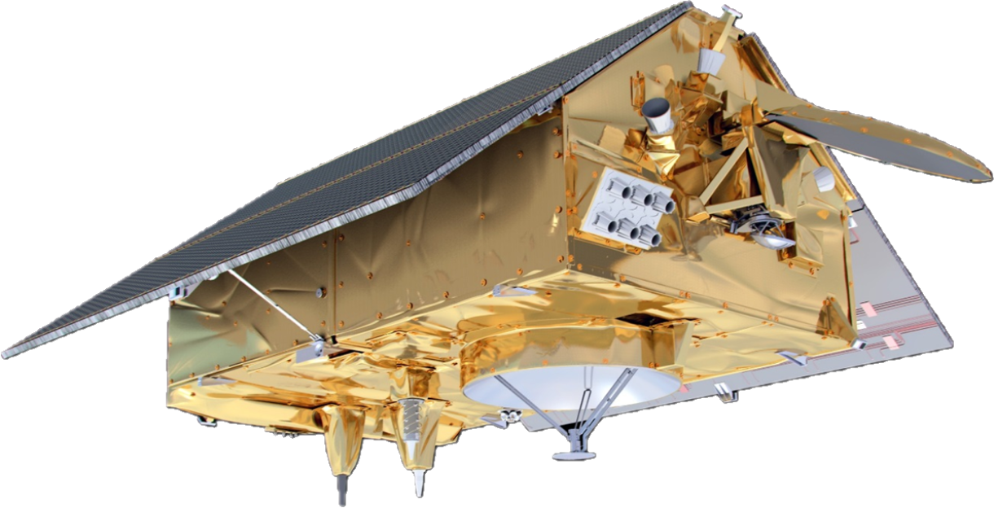
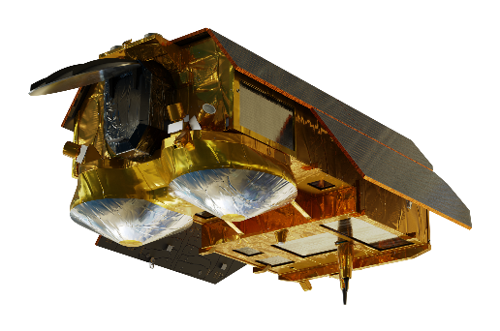
Highlights
Signature with NASA Administrator of MOU on Earth Sciences
Exchange of letters with NASA on Cristal & S-6 cooperation
Successful LPS22
Agreement with EC DG-INTPA
Extension Trilateral Covid dashboard cooperation
Notes:
Signature with NASA Administrator of MOU on Earth Sciences
Exchange of letters on Cristal and Sentinel 6 cooperation and in kind provision by NASA
Agreement with EC DG-INTPA on CofaLAC
Extension of Trilateral Covid cooperation dashboard with NASA / JAXA
Successful LPS22 in May, Bonn
LPS22 took place in person at the World Conference Center in Bonn, Germany form 23 to 27 May 2022.
There were 5000+ Registered visitors from 60+ Countries (authors), 240+ scientific sessions with more than 1370+ oral presentations and 2250+ posters, and high-level plenary sessions covering more than 10 innovative themes.
The Community Building and Networking activities have been particularly appreciated, roviding 80+ Agora discussion sessions, OpenEarth Forum sessions and EO digital platform-related training activities and a wide offer of 30+ networking events for the participants.
More than 45 companies sponsored the event and exhibited their product and services in the dedicated exhibition area, with a large ESA booth built around the various Agency partners; European Commission, DLR, EUMETSAT, EUSPA, ECMWF.

Slide 3
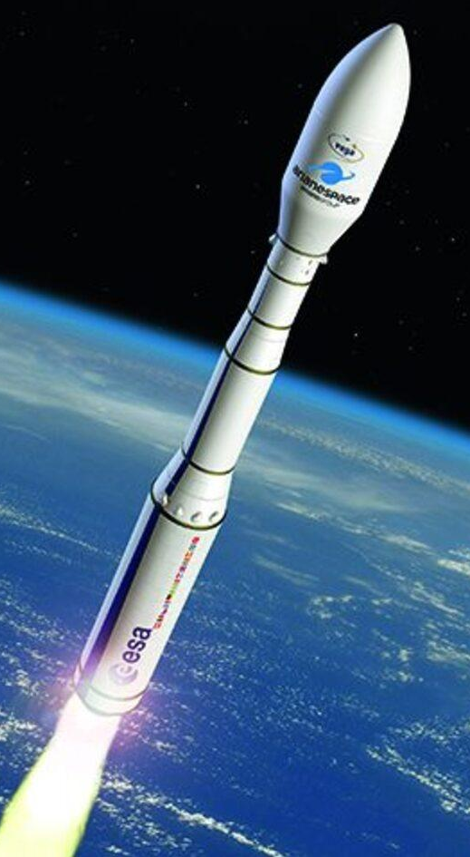
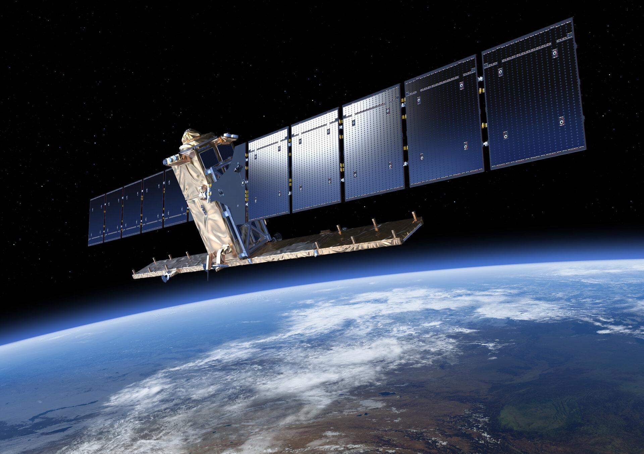
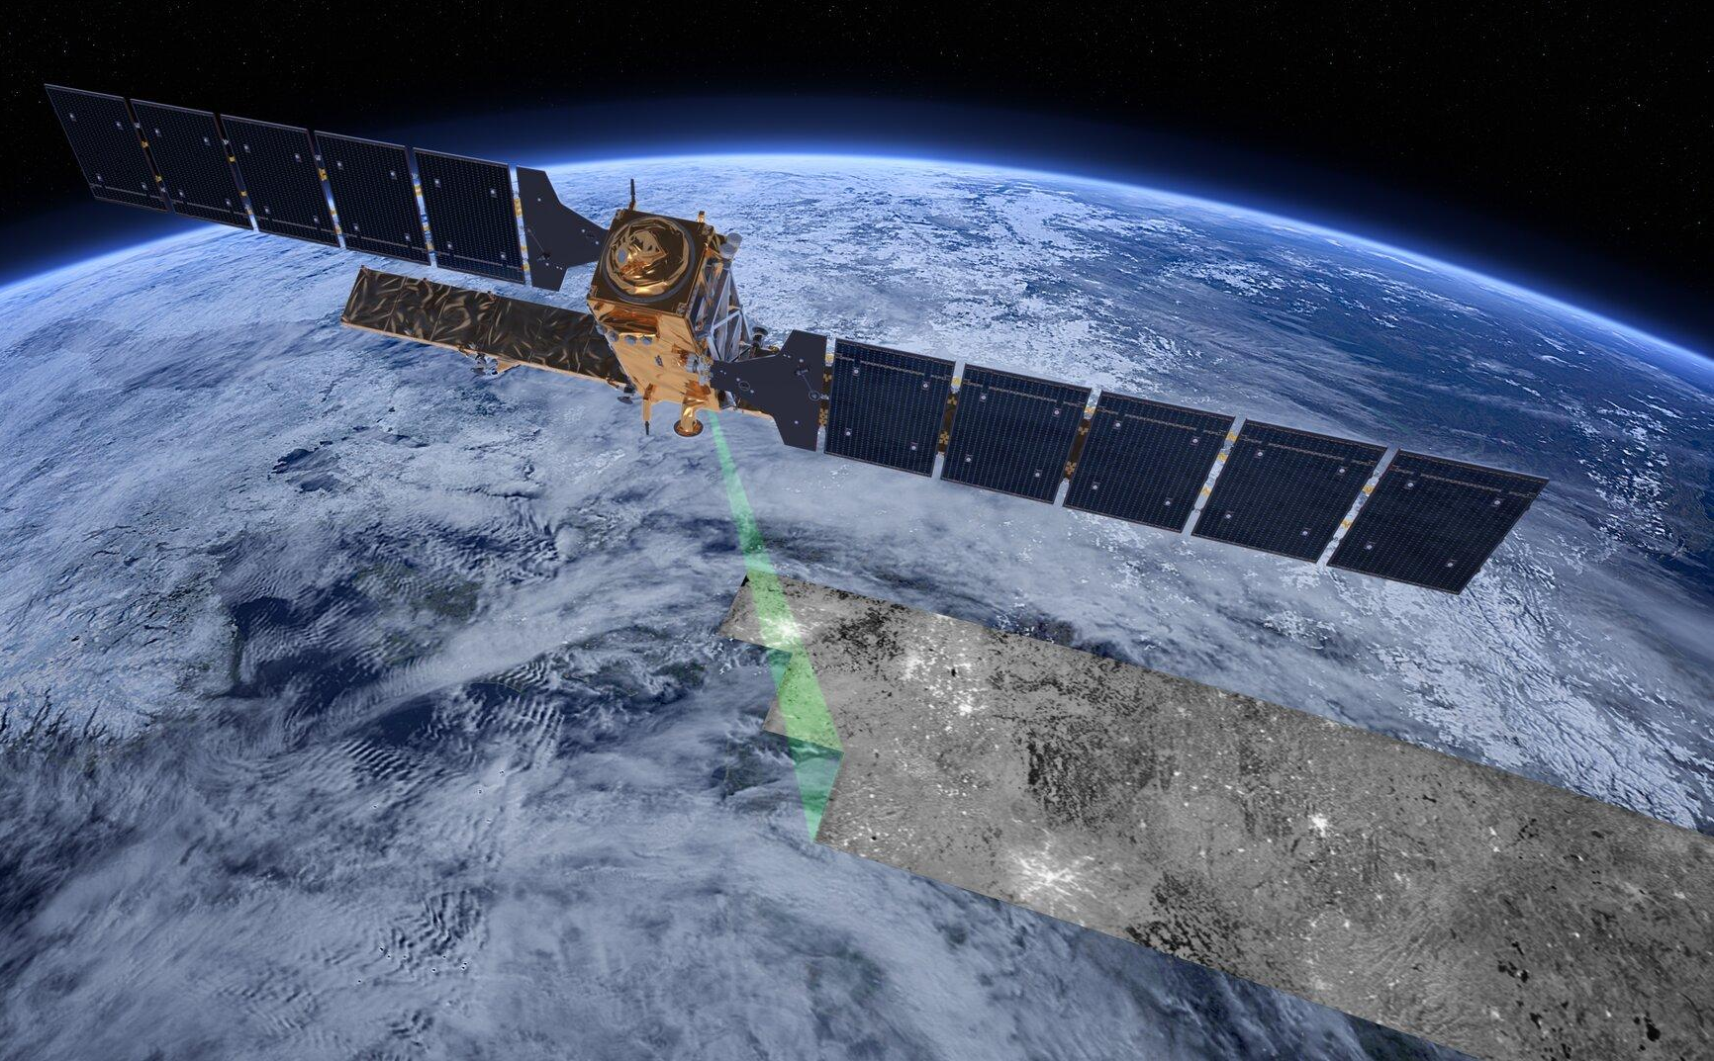
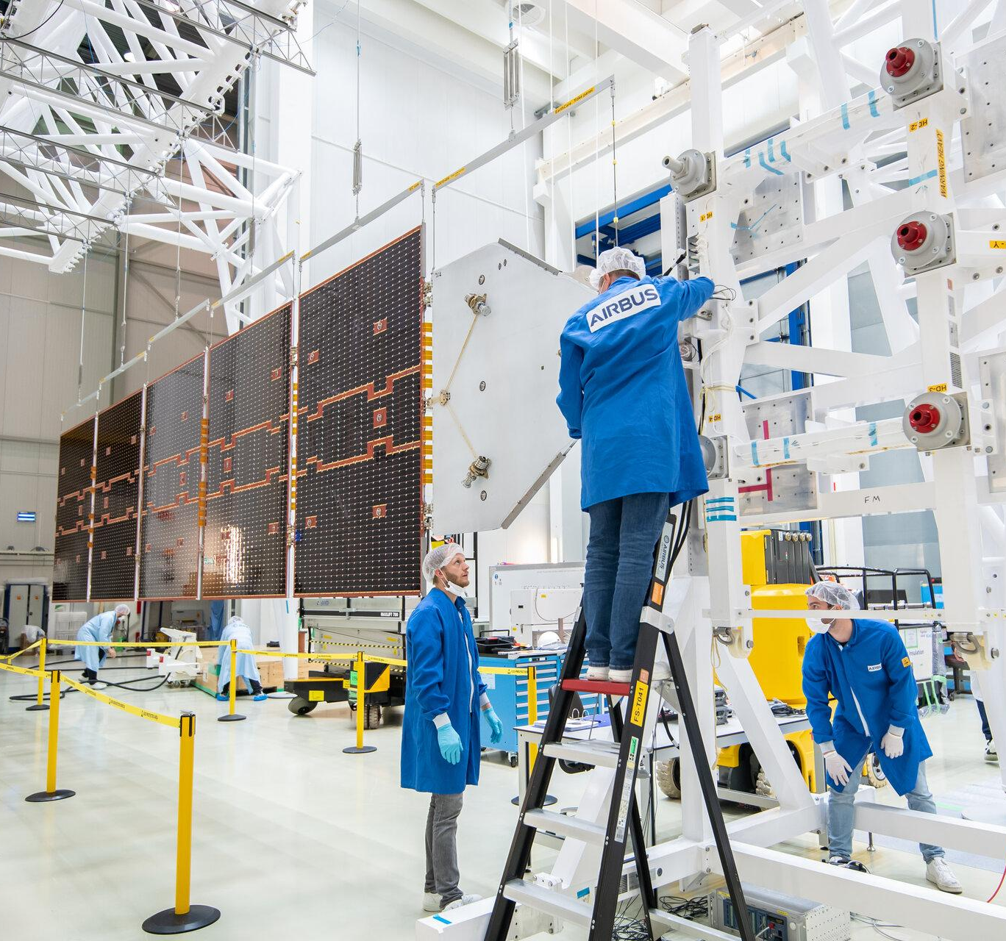
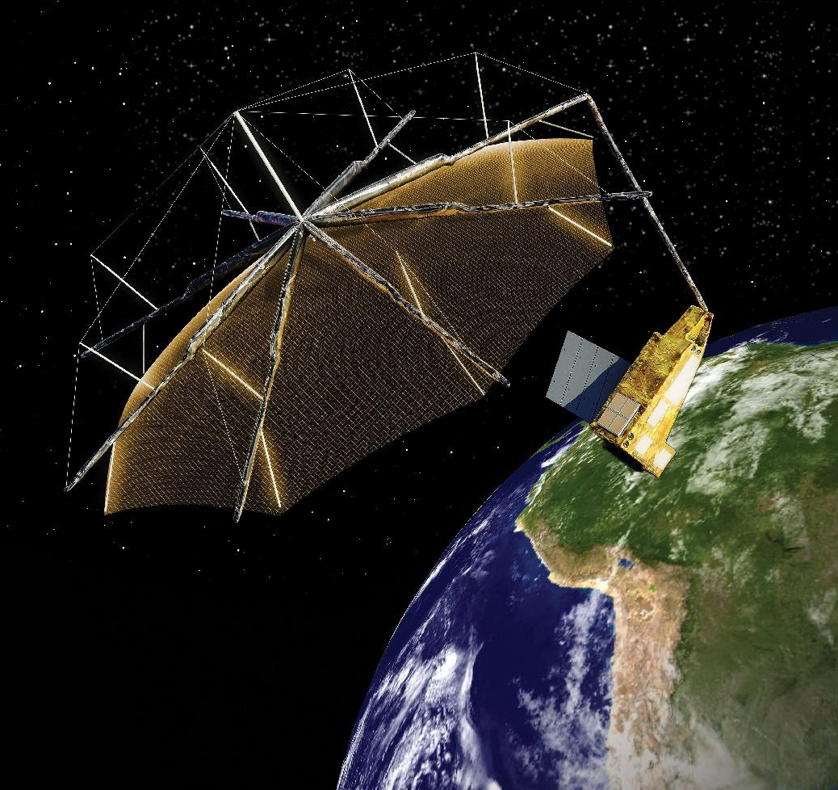
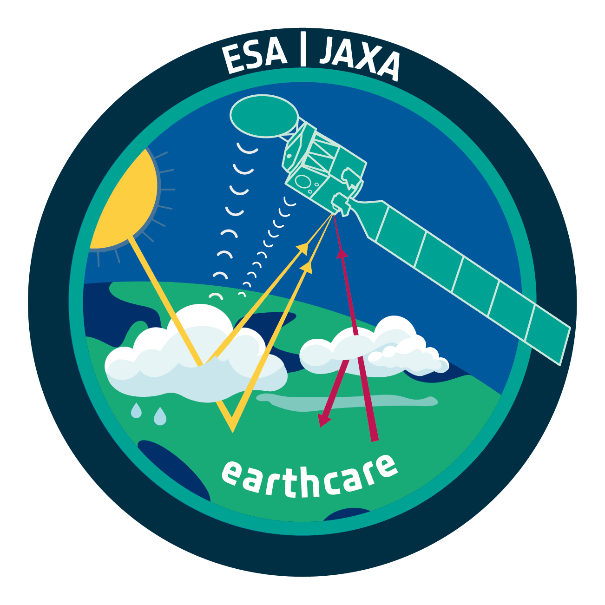
Programmatic Updates
Sentinel-1B – End of mission
Sentinel-1C – Launch May/June 2023
Vega-C Successfully launched July ‘22
Aeolus celebrated 4 years achievements with anniversary conference
EarthCARE to be launched on Vega-C Planned Q2 2024
Biomass to be launched on Vega July 2024
Notes:
Successful launch Vega-C in July 2022
Loss of Sentinel-1B
The most probable failure scenario was identified as a leakage of a ceramic capacitor which is part of the main and redundant regulators of the 28V power regulated bus. It was then decided, in July, to declare the end of the Sentinel-1B mission
Acceleration of launch Sentinel-1C.
Launch Sentinel-1C, foreseen in May/June 2023
Aeolus 4 year achievement celebrated with anniversary conference in March-April
EarthCARE development progressing well
Currently being tested at ESTEC test facility.
To be launched on Vega-C in Q2 2024
Biomass to be launched July 2024

Slide 4
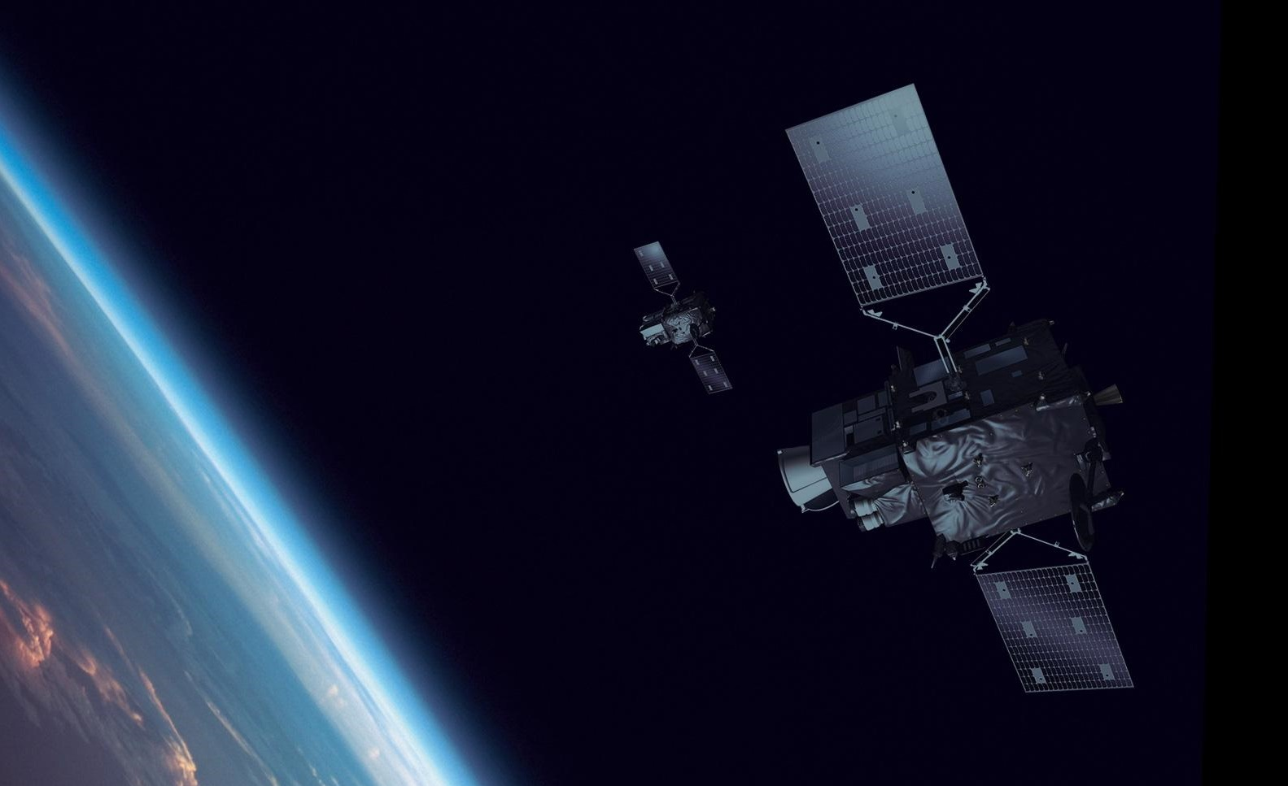
MTG-I1 Launch 13th December from Kourou
together with
'Securing the Future of Global Weather Forecasting'
Notes:
The MTG System
Meteosat Third Generation (MTG) will guarantee an enhanced continuity of data for weather forecasting from geostationary orbit for the next two decades, into the 2040s.
The full MTG system is based on a series of two types of satellites: four MTG-Imagers and, for the first time over Europe, two MTG Sounding satellites.
Answering to the needs of an operational community with respect to nowcasting, global and regional numerical weather prediction, climate, and atmospheric chemistry monitoring, the MTG satellites are one of the most technologically advanced family of geostationary weather satellites.
A three-axis stabilised satellite platform will be replacing the spinning satellite design of previous Meteosats, keeping the MTG satellites orientation fixed with respect to the Earth, with the payloads looking continuously at the Earth’s disc. (for comparison, the previous generation spinning satellites spent less than 5% looking towards the Earth)
As of today, there are three MSG satellites in orbit and two MetOp and soon we will be able to welcome the New Generation of Weather Satellites into the ESA family of Earth Observation Satellites.
The launch of MTG will be the highlight launch of 2022 for ESA (and EUMETSAT) and will continue the more than 40-years-long data series from Meteosat satellites.

Slide 5
CM22 Outcome for Earth Observation
EO TOTAL: 2.7B€ on 3.03B€
Close to 90% of proposed envelope
Guaranteeing continuity of current activities and programmes and allowing start of new projects
ESA MS Demonstrating
Overwhelming support to climate and environmental actions
Strategic relevance of EO sector for climate and environment
Climate as top concern for European Citizens (Harris survey)
FutureEO
Undersubscribed, but highest contribution ever on yearly basis, 400 M€/year
Copernicus
Oversubscription shows continued support by MS
Customised EO
Climate Space (Oversubscribed)
Digital Twin Earth (Near full subscription)
TRUTHS (Continuity of Activities)
InCubed-2 (Well subscribed)
Aeolus-2: Oversubscribed

